Slide 1
Evaluating plasma sheet properties with in-situ observations and machine learning – Recent advancements and limitations
Savvas Raptis
APL/JHU, Laurel, MD, USA
savvas.raptis@jhuapl.edu / https://savvasraptis.github.io

Slide 2
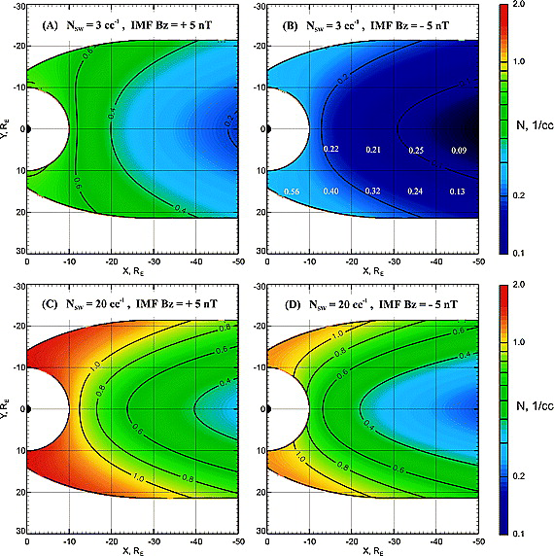
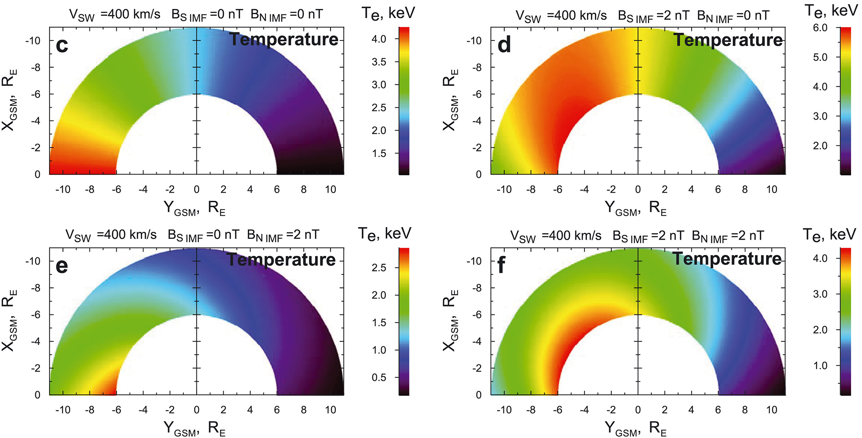
Baseline empirical models for Ti and Te
Modelled with Geotail
Modelled with THEMIS
Dubyagin+ 2016
Why work on this?
Understand plasma sheet properties and how different populations get heated
Important quantity for global modeling to initialize distribution of particles in the inner magnetosphere
Tsyganenko & Mukai 2003

Slide 3
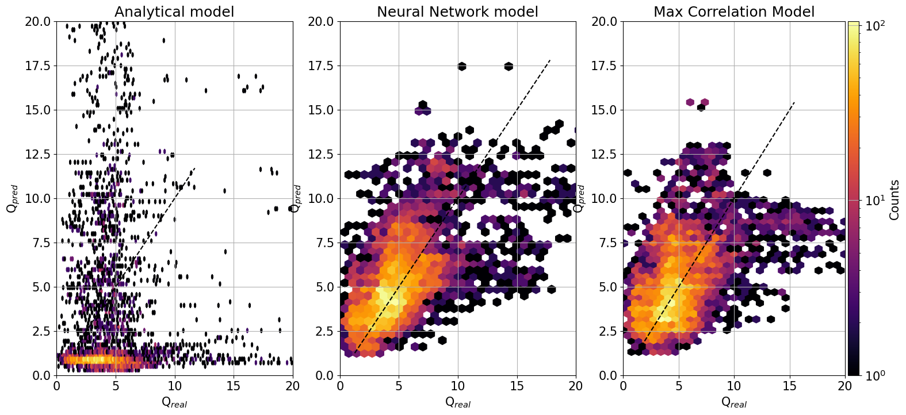
Results shown 2 days ago in ML session
Trying to model Ti/Te in the plasmasheet (input Solar wind, Output MMS)
 | NN | Linear
R2 | 0.32 | 0.12
MAE | 1.8 | 2.1
RMSE | 2.5 | 2.9
r (cor) | 0.6 | 0.45
TLDR: Analytical model bad, neural network good? Yes kinda.
Note: To be fair to the analytical models, they are not trained on similar radial distances or datasets

Slide 4
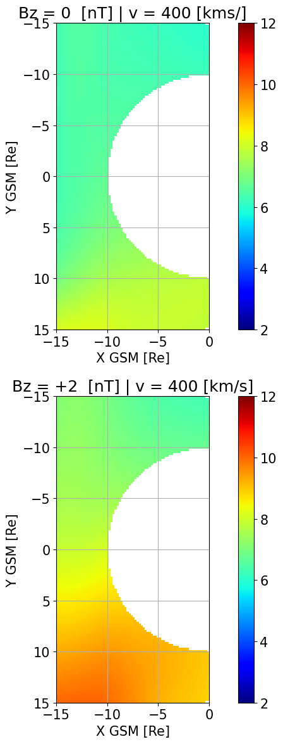
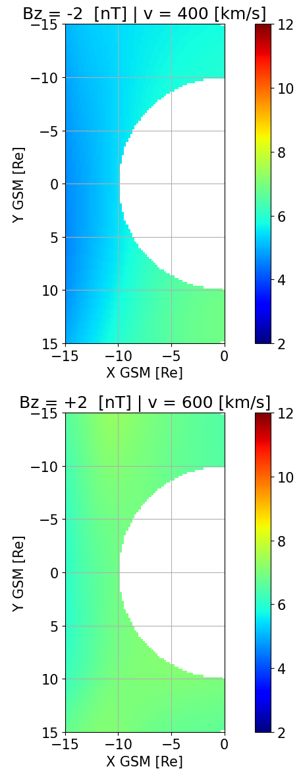
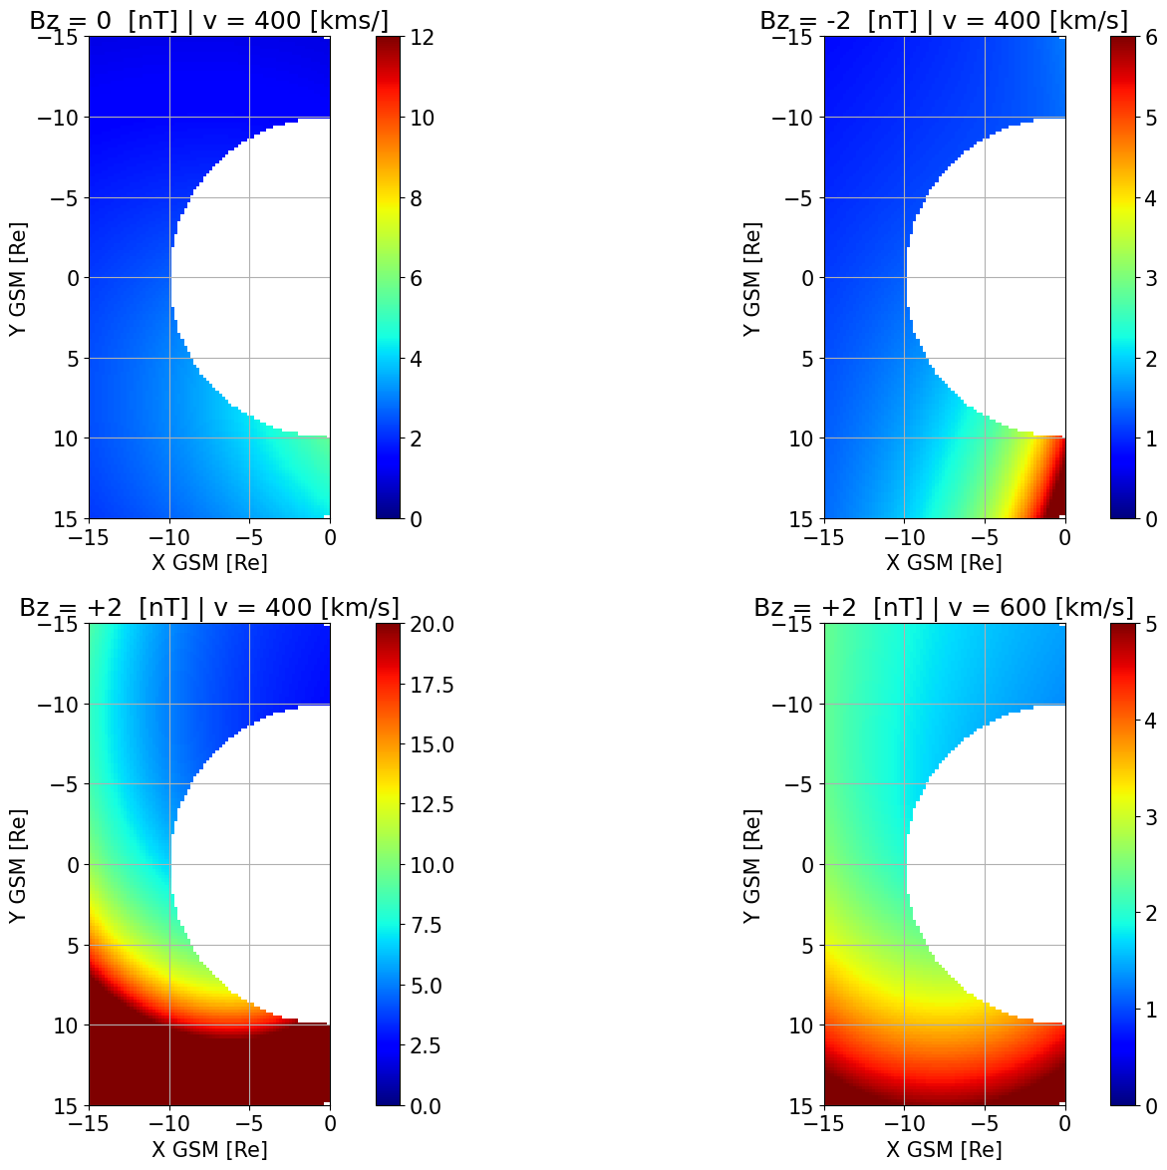
Modeling Temperature Ratios | 2D Maps
Reproducing: Wang et al., 2009 with dusk Ti/Te much higher than dawn
✅ No extreme values
✅ Asymmetries are shown
✅ Coherent physical picture
Neural Networks modeling
Empirical modeling (TM03/DSGR16)

Slide 5
Data Preprocessing
Data Sparsity & Extreme Events
Statistical Metrics & Pitfalls
Modeling Challenges for Storms
But….there are many issues ☺
My initial plan was to talk about all of them…
Notes:
20 minutes mark

Slide 6
Data Preprocessing (Ti/Te)
Better moments can yield ~30% difference (Q~4 rather than 5.5)
Data Sparsity & Extreme Events (General)
Number of unique events and distribution of driving conditions is more insightful than statistical metrics.
Statistical Metrics & Pitfalls (Ti/Te)
Constant-value models (baseline) can outperform complex models.
Use (adjusted) R² instead of correlation for model evaluation.
Binning data can artificially increasing metrics.
Always compare to baseline models (linear / persistence model)
Modeling Challenges for Storms (Ti/Te)
Storms are difficult to model due to sparse observations and limited information

Slide 7
Data Preprocessing (Ti/Te)
Better moments can yield ~30% difference (Q~4 rather than 5.5)
Data Sparsity & Extreme Events (General)
Number of unique events and distribution of driving conditions is more insightful than statistical metrics.
Statistical Metrics & Pitfalls (Ti/Te)
Constant-value models (baseline) can outperform complex models.
Use (adjusted) R² instead of correlation for model evaluation.
Binning data can artificially increasing metrics.
Always compare to baseline models (linear / persistence model)
Modeling Challenges for Storms (Ti/Te)
Storms are difficult to model due to sparse observations and limited information
Notes:
20 minutes mark

Slide 8
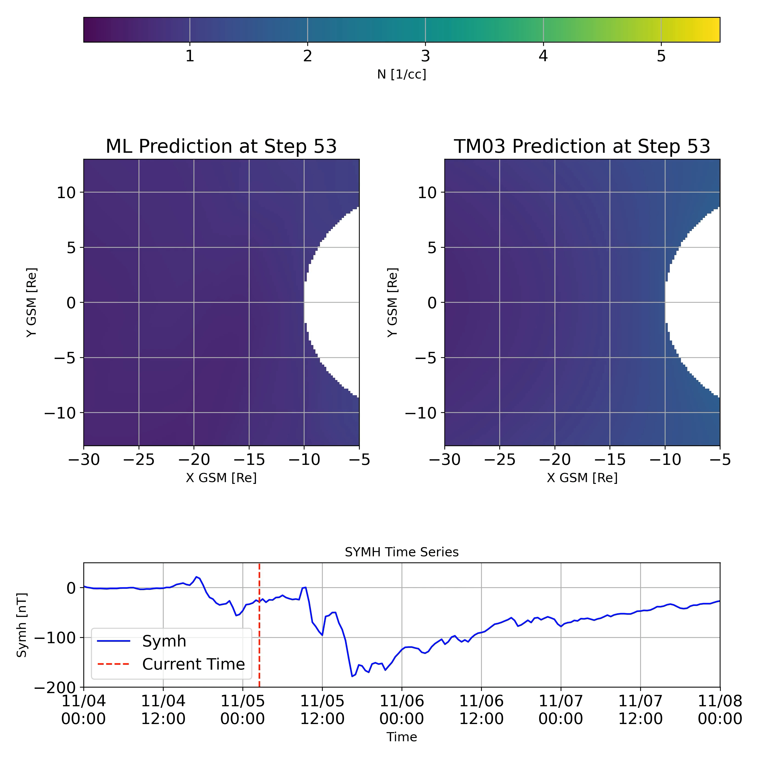
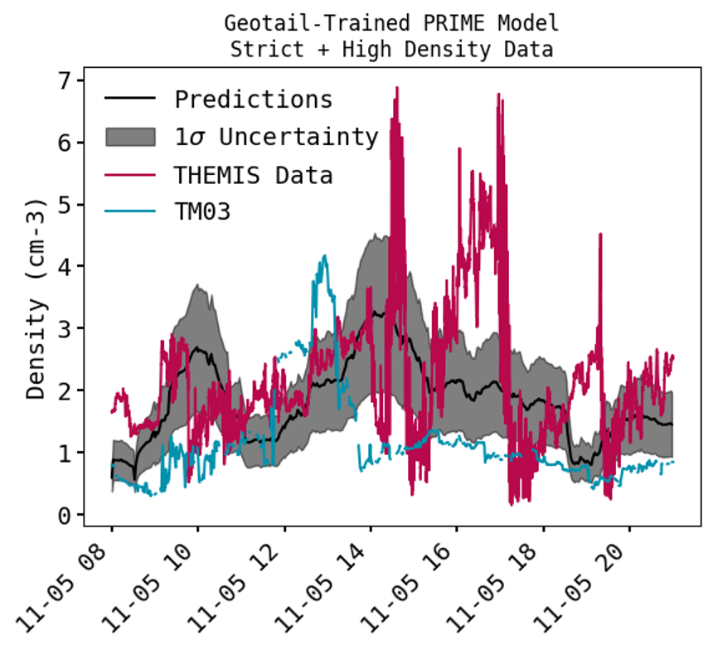
Can we really predict extreme events with data? Density
MAE (>40% improvement)
PRIME-PS: 0.7 [1/cc]
TM03: 1.22 [1/cc]

Slide 9
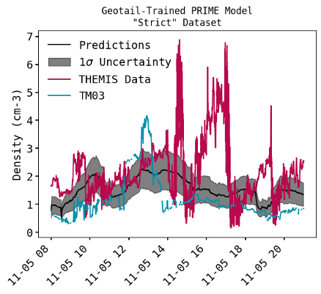
The importance of “Rare Events”
MAE (>40% improvement)
ML model: 0.7 [1/cc]
TM03: 1.22 [1/cc]
Note: values <1 cm⁻³, are transitions to the lobe/BL (will filter them out).

Slide 10
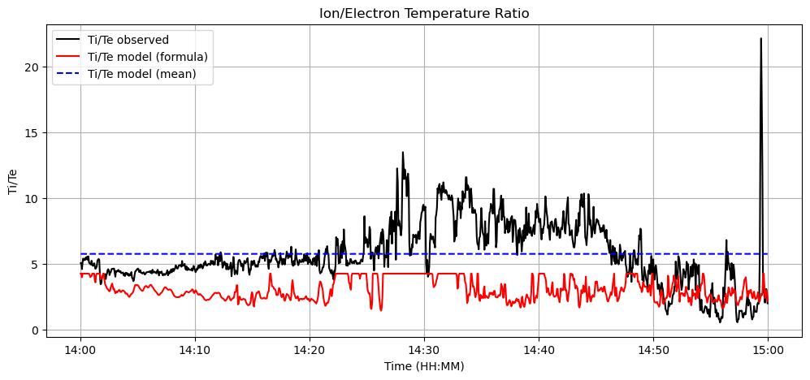
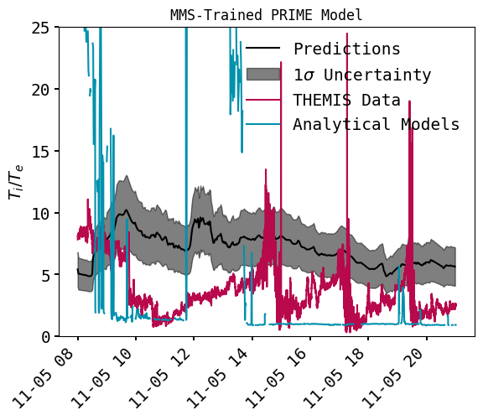
How is Ti/Te doing there?
Mean Model: MAE = 1.67
Formula Model (a polynomial fit from another period): MAE = 3.21
Formula vs Mean: MAE = -92.64%
Old model shown, new is actually better, there is still hope
Key Message: Modeling (in-situ or from SW) struggle during extreme events like storms

Slide 11
Ending on a relatively positive note
What We Achieved: Better Performance (“shrug”)
By incorporating time history and more diverse input, our ML models improved plasma sheet density predictions by up to +40% for quiet times and for a case study storm.
What We Learned: The Limits of Data-Driven models
Data-driven ML models are powerful but can be matched by simpler baseline models if the input data is not sufficient to describe the system
The "Rare Event" Problem: Adding more "rare" events can help, but isn't a silver bullet. We need a better data strategy.
Path Forward
Adopt rigorous validation and transparent assessment as a core practice. e.g., a model with R² of 0.054 had a r of 0.7.
Build Better methodologies: Develop hybrid simulation-observation methods to create representative datasets that include more extreme events.

Slide 12


Advertisement: LMAG25 (13 – 17 OCT 2025 JHU/APL)
When: 13–17 October 2025
Where: JHU/APL, Laurel, MD (primarily in-person)
Remote access: Zoom participation available
Format: ~20 minute talks plus short Q&A. Emphasis on interaction and collaborative problem-solving
Topics: See the LMAG2025 site for science themes; topic suggestions and ideas welcome
Audience: Heliophysics and geospace researchers, data scientists and computer scientists experts
No registration fee
RSVP today!

