Slide 1


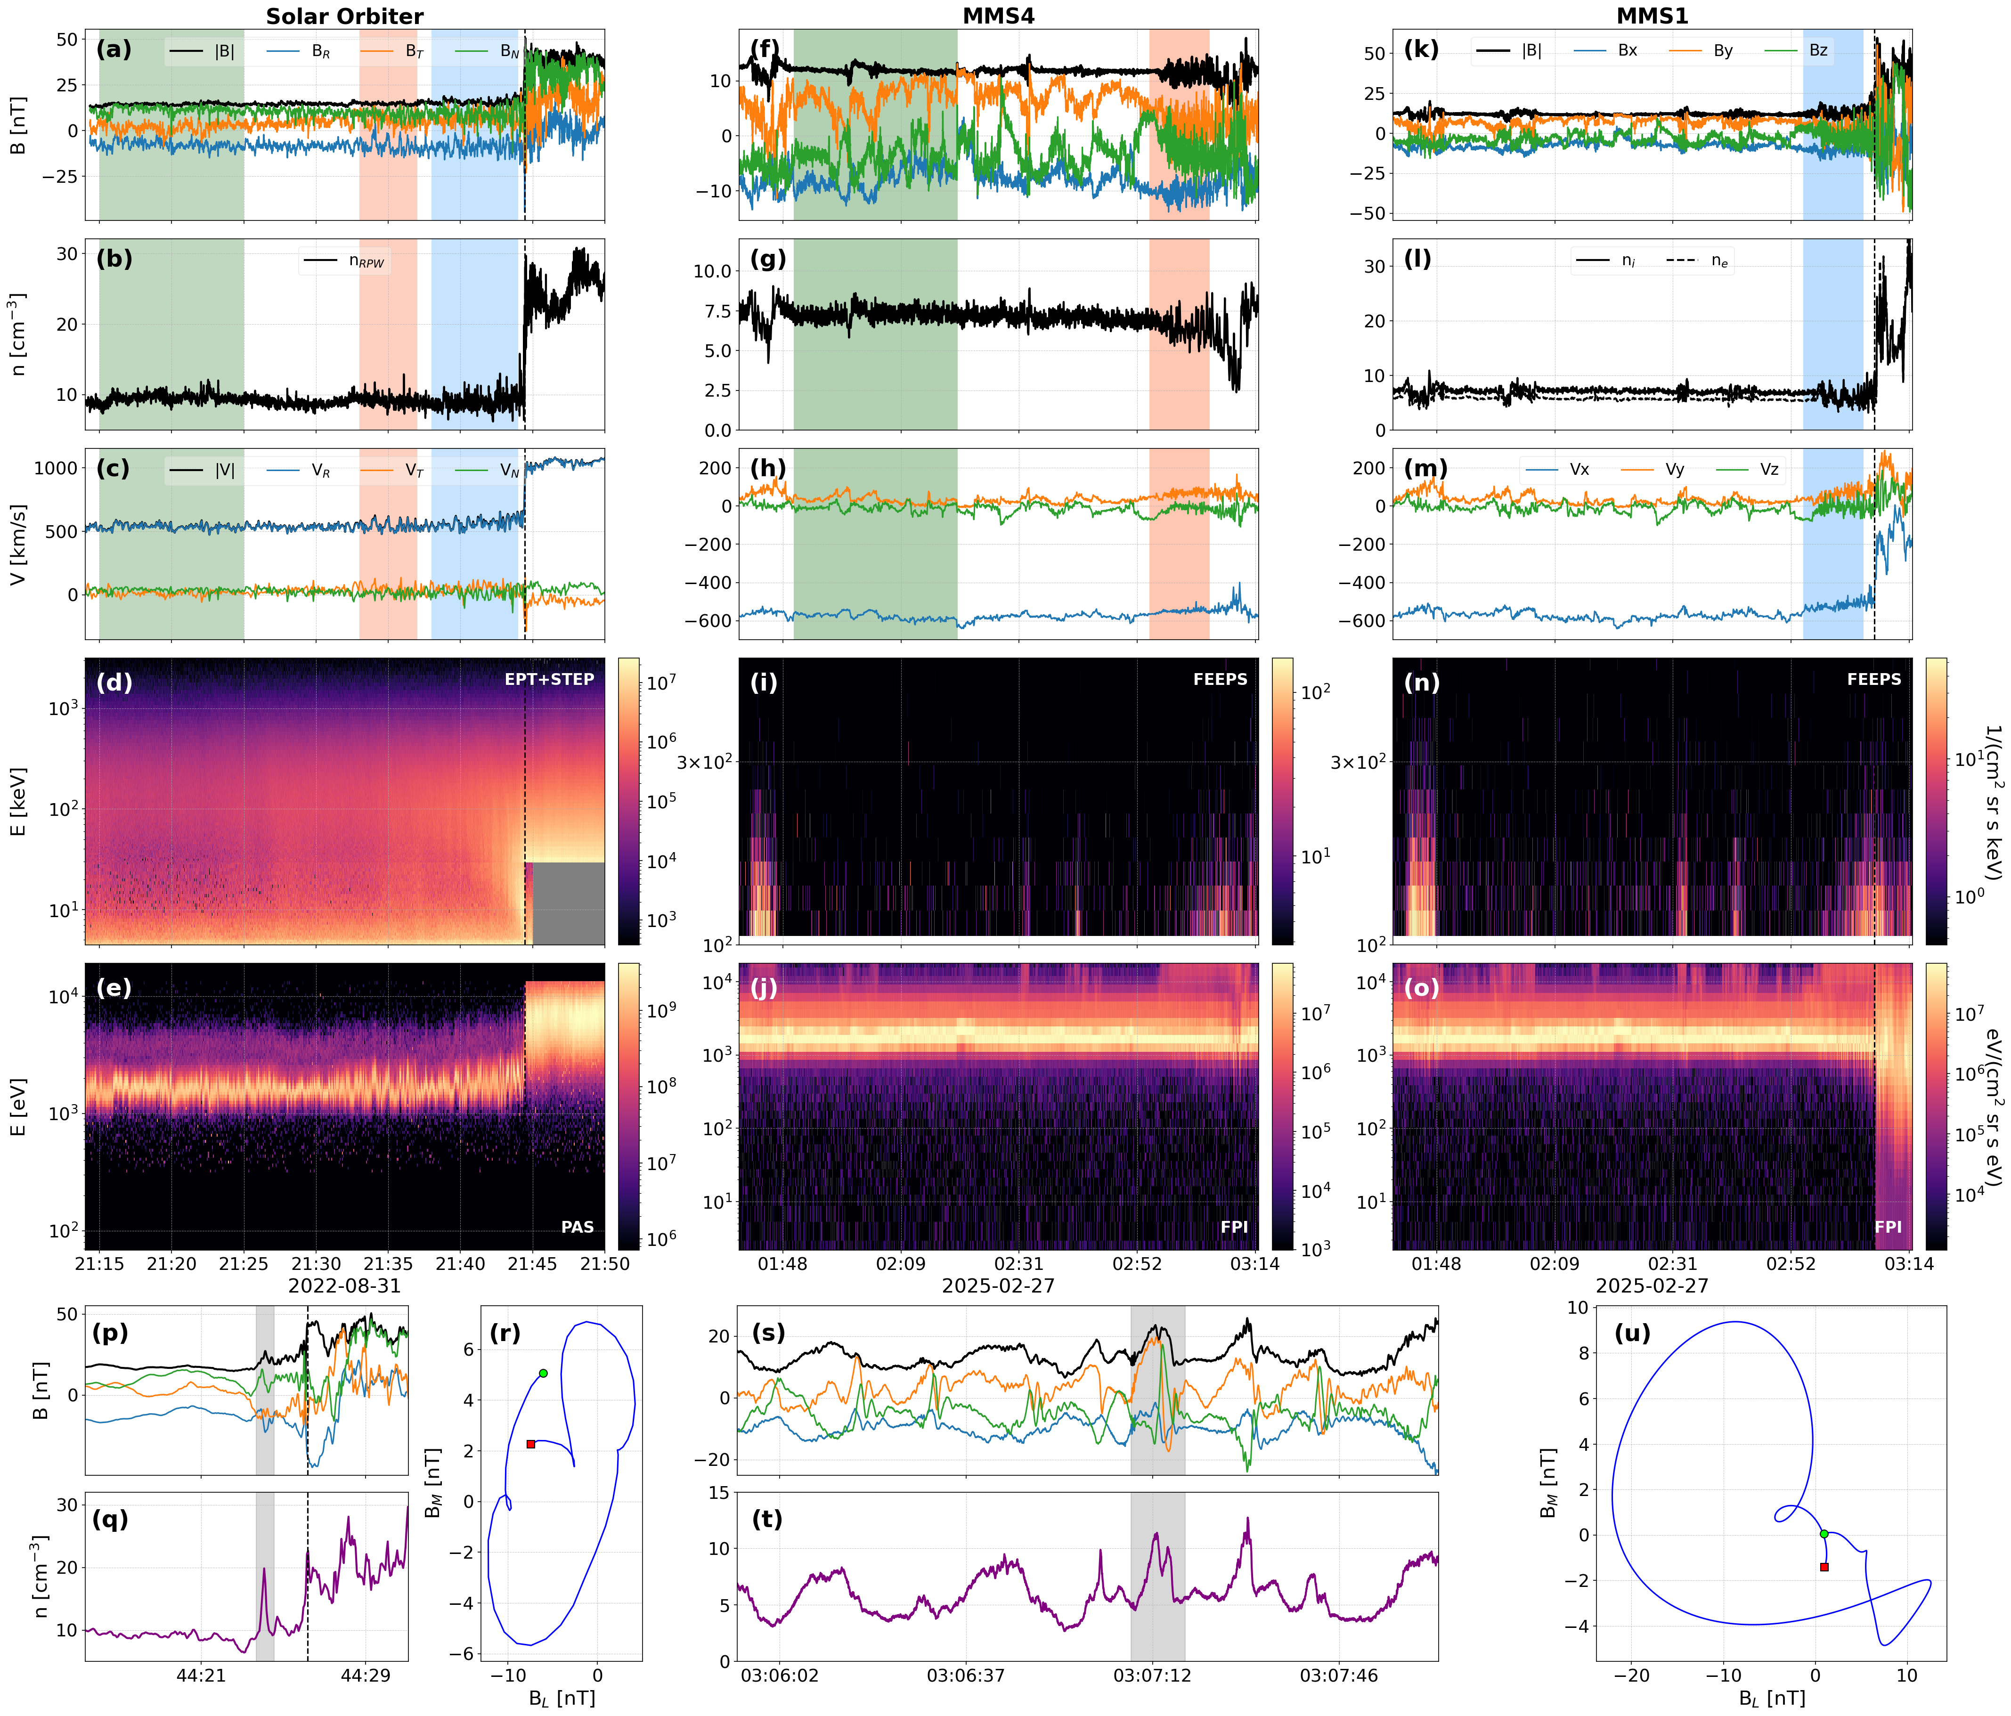



Background & Main Idea
Compressive Structures in the Foreshock of Collisionless Shocks
Geometric Challenge
Collisionless Shocks: Powerful particle accelerators found universally. In our solar system, they manifest as planetary bow shocks or Interplanetary (IP) shocks driven by CMEs.
Quasi-Parallel Regime: Occurs when the angle between magnetic field and shock’s normal vector is less than 45$°$. This creates a foreshock filled with ULF waves.
Process: Near the shock, these waves become non-linear and steepen, evolving into foreshock compressive structures (FCS).
While well-observed at planetary bow shocks, this process has not been systematically studied at IP shocks. We compare two shocks of similar Mach numbers to evaluate their foreshock structures (1) Earth’s Bow Shock with MMS and (2) an IP Shock using Solar Orbiter.
Earth's Bow Shock: A curved, quasi-stationary obstacle. Reflected ions are magnetically connected for long durations, allowing ample time for observations to be taken showing waves to grow and steepen into complex structures.
IP Shocks: Planar and propagating structures moving rapidly (∼800 km/s) through the solar wind. The interaction time for wave growth is limited by the shock's motion, potentially restricting the foreshock development and limiting our observation capabilities.
S. Raptis¹, D. Trotta², D. L., Turner¹, X. Blanco-Cano³, H. Hietala⁴, T. Karlsson⁵, I. C. Jebaraj⁶, I. Y. Vasko⁷, A. Osmane⁸, K. Takahashi¹, D. Lario⁹, L. B. Wilson III⁹, R. F. Wimmer-Schweingruber¹⁰
¹The Johns Hopkins University Applied Physics Laboratory, Laurel, MD, USA, ²European Space Agency (ESA), European Space Astronomy Centre (ESAC), Camino Bajo del Castillo s/n, 28692 Villanueva de la Cañada, Madrid, Spain, ³Departamento de Ciencias Espaciales, Instituto de Geofísica, Universidad Nacional Autónoma de México, Mexico City, Mexico, ⁴Department of Physics and Astronomy, Queen Mary University of London, London E1 4NS, UK, ⁵Division of Space and Plasma Physics - KTH Royal Institute of Technology, Stockholm, Sweden, ⁶Department of Physics and Astronomy, University of Turku, 20500 Turku, Finland, ⁷William B. Hanson Center for Space Sciences, University of Texas at Dallas, Richardson, TX, USA, ⁸ Department of Physics, University of Helsinki, Helsinki, Finland, ⁹NASA Goddard Space Flight Center, Greenbelt, MD, USA, ¹⁰Institute of Experimental and Applied Physics, Kiel University, Leibnizstrasse 11, D-24118 Kiel, Germany
Foreshock compressive structures fully evolve at IP shocks and planetary bow shocks by ~25-50 di
Figure 1 Timeseries of collisionless shock and foreshock observations by Solar Orbiter (RTN) and MMS (GSE). Panels display magnetic field, plasma density, bulk ion velocity, and ion fluxes (suprathermal and low-energy). Shaded areas denote different plasma environments. Bottom panels detail foreshock structures and minimum variance analysis hodograms. Vertical dashed lines mark shock crossings.
Foreshock 1D Spatial Distribution
Figure 3 Magnetic field and suprathermal particle properties plotted against distance ($d_{i}$) along the shock normal for (a) Solar Orbiter (IP shock) and (b) MMS (bow shock). Upper panels display magnetic magnitude |B| and normalized suprathermal density; lower panels show magnetic variability σ(B). Red shaded regions highlight compressive structures observed at ∼25−50 $d_{i}$upstream.
Figure 2 Magnetic field Power Spectral Densities (PSDs) comparing Solar Orbiter IP shock (a) and MMS Earth bow shock (b) environments. Spectra contrast close foreshock, far foreshock, and background solar wind (See Figure 1) against theoretical turbulent slopes. Vertical lines indicate local ion cyclotron $f_{ci}$) and expected ULF wave frequencies; panel (b) additionally marks an ion scale whistler peak.
Discussion Points
A potential threshold: By integrating ion fluxes >10 keV across multiple instruments (Figure 1, 3), we identify a consistent threshold: at both shocks, steepened foreshock compressive structures fully form when the suprathermal ion density reaches ∼ 1% of the background solar wind density.
Observational biases: The perceived difference in foreshock compressive structure occurrence is largely observational. Solar missions traverse the shock rapidly, providing only a brief "spatial cut" that misleadingly suggests structures are rare or absent. In contrast, planetary observations provide long "time histories”, near the planetary bow shock, which misleadingly suggests an overabundance and extended range of structures.
Implications: These findings show that quasi-parallel shock physics is universal across Heliospheric environments. To fully decouple these spatial and temporal ambiguities, future mission proposals and concepts such as Plasma Observatory (POª) and MAKOS^{b} are essential to assess dynamics that current capabilities are unable to resolve.
Spectral Signatures of Evolution
Spectral Signatures: As ULF waves steepen nonlinearly, they act as localized transient shock fronts, generating high-frequency dispersive whistler waves at their leading edge. In magnetic Power Spectral Density (PSD) plots, these waves manifest as a distinct secondary peak above the ion cyclotron frequency. The presence of this "whistler peak" indicates that foreshock structures have reached full nonlinear evolution; its absence suggests the observed wavefield is not fully developed or lacks such developed structures.
Work “almost” submitted to Astrophysical Journal Letters, feedback very welcomed!
Acknowledgment: MMS Early Career Award 80NSSC25K7353 and the Magnetospheric Multiscale (MMS) mission of NASA's Science Directorate Heliophysics Division via subcontract to the Southwest Research Institute (NNG04EB99C).
References: ªRetinò et al., https://doi.org/10.1007/s10686-021-09797-7 | ^{b}Goodrich et al., https://doi.org/10.3389/fspas.2023.1199711
Contact info: 📧 savvasraptis@pm.me / savvas.raptis@jhuapl.edu | 🔗 savvasraptis.github.io

