Slide 1


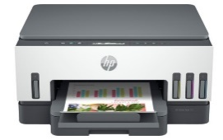

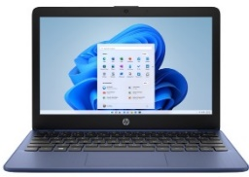
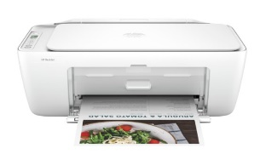



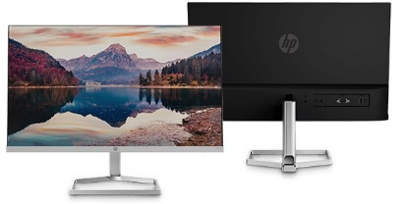



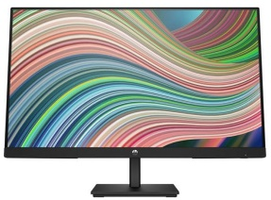

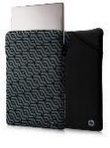



HP Home Notebooks
Retail File November2024 Page 1/8. Promo prices are valid until 30/11 or Until Stock Last.
6UU46A HP PRINTER ALL IN ONE INKJET COLOR SMART TANK HOME - OFFICE 720 A4, PRINT, SCAN, COPY, 23PPM (B), 22PPM (C), 4800x1200 DPI, DC:5K, DUPLEX, 250P TRAY, USB, BT, WIFI, 1YW, GET 3YW EXT. FREE, CASHBACK 50€ UNTIL 31/04/25 324 €
The HP 15.6" Laptop PC empowers you to do more with the reliable power of an Intel® Processor, plus ample storage, and powerful graphics in a sleek, thoughtfully designed device. Created for wherever the day takes you and built with ocean-bound and post-consumer recycled plastics[2], it’s easy to show some love for the planet.
Between home, school, and work your mobile life demands a PC that just doesn’t quit. With up to 13 hours of battery life, the HP Stream 11.6’’ does everything your smartphone can’t.
7P364EA HP NOTEBOOK 15-FD0012NV, INTEL I3-1315U 3.3-4.5GHz /10MB, 6 CORES, 8GB, 512GB PCIe SSD, INTEL IRIS XE GRAPHICS, 15.6'' FHD, WIN 11 HOME, 2YW, MOONLIGHT BLUE, 867 €
72V30EA HP NOTEBOOK STREAM 11-AK0002NV, INTEL CELERON N4120 1.1-2.6GHz/4MB, 4 CORES, 4GB, 64GB EMMC, UHD GRAPHICS,11.6' HD, WIN 11 HOME, 2YW, ROYAL BLUE, 339 €
588Q0B HP PRINTER ALL IN ONE INKJET COLOR DESKJET HOME 2820e HP+ A4, PRINT, SCAN COPY, 7PPM (B), 5PPM (C), DC:1K, 60P INPUT TRAY, AIR PRINT, USB, WIFI, 1YW - ONLY RETAILERS 51 €
474U1E9 HP MONITOR 23.8'' M24FD HOME, IPS LED, FHD 1920 X 1080, 5MS, 300 NITS, AMD FREESYNC, ANTIGLARE, TILT, DISPLAY PORT, USB TYPE-C, 2 X USB TYPE-A, HDMI, VGA, 2YW, BLACK/SILVER 244 €
2D803AA HP SPEAKER 350 BLUETOOTH, CONNECT FAR AND WIDE USING BLUETOOTH 5 WITH 2X SPEED AND 4X THE RANGE, COMPATIBLE WITH TABLETS, SMARTPHONES, PCS, AND OTHER DEVICES WITH BLUETOOTH AND 3.5 MM AUDIO DEVICES, BLUE, 19 €
HP MOUSE WIRELESS Z3700
2D799AA HP SPEAKER 360 BLUETOOTH, WHEREVER YOUR MUSIC TAKES YOU WITH THE PERFECTLY PORTABLE BLUETOOTH SPEAKER, WATER-RESISTANT AND DUST-RESISTANT RATING, BLACK 19 €
7UH88AA LUMIERE BLUE 18 €
171D8AA WHITE, 19 €
758A9AA SILVER, 21 €
758A8AA BLACK, 21 €
2D9K0E9 HP MONITOR 23.8'', M24f HOME, E, IPS, FHD 1920 X 1080, 5MS, 300 NITS, TILT, VGA, HDMI, 2YW, SILVER / BLACK ,
190 €
V0L82AA RED, 18 €
X7Q43AA GOLD, 18 €
4VY82AA WHITE/PINK, 21 €
2F1X3AA HP 14 CASE GOLD / BLACK, 16 €
2F2L0AA HP 15.6 CASE BLACK/ GREY, 19 €
6D8H0E9 HP MONITOR 24'', V24ie G5 HOME, E, IPS LED, FHD 1920 X 1080, 5MS, 250 NITS, ANTIGLARE, TILT, DISPLAY PORT, HDMI, VGA, 2YW, BLACK 138 €
2F2K6AA HP 15.6 CASE GOLD/ BLACK, 18 €
2F1W8AA HP 15.6 CASE, MAUVE/ BLACK, 18 €
6M5S4AA
HP CARRY CASE CREATOR 13.3 SLING, DARK NAVY, 27 €
2Z8P3AA
HP PRELUDE BACKPACK 15.6, GREY, 20 €
500S6AA
HP CASE BACKPACK 17,3, BLACK, 30 €
Prices, promotions, specifications, availability and terms of offers may change without notice. Despite our best efforts,
a small number of items may contain pricing, typography, or photography errors. Correct prices and promotions are validated at the time your order is placed. Recycling fees are not included in the Dealer & Retail File. Delivery and installation charges are not included. Products' warranty is the warranty given by the manufacturer. VAT is included
Call now on:
Mail on:

Slide 2

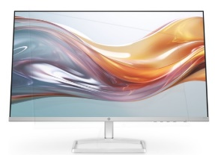
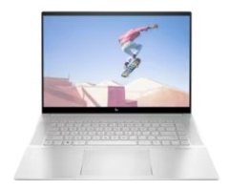
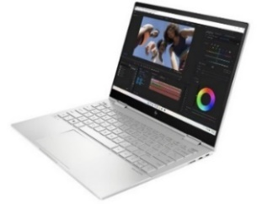




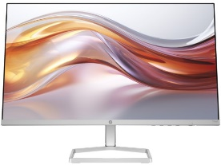

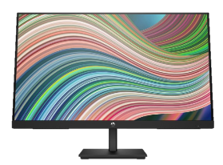

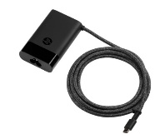
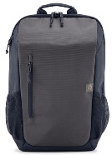
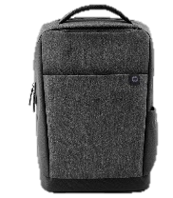


HP Envy Home
Notebooks
Experience seamless connectivity with the HP Envy 16". Combine the creative power of your devices with HP Palette. Enjoy the ultimate color accuracy on a 16" display. Plus, with the Intel® Processor and powerful graphics, it can handle what you throw at it. Look and sound your best on video calls with a 5MP camera with Auto Frame and AI Noise Reduction.
Retail File November 2024 Page 2/8. Promo prices are valid until 30/11 or Until Stock Last.
94F46E9 HP MONITOR 27'', S5 527SW HOME, D, IPS, FHD 1920 X 1080, 100Hz, 16:9, 5MS, 300 NITS, ANTIGLARE, TILT, 2X HDMI, VGA, 2YW, WHITE 183 €
Seamlessly create with the compact HP Envy x360 13“. With the color-calibrated display, you get the ultimate color accuracy. Stay productive with a long battery life and the Intel CPUs and graphics. Combine the power of devices with HP Palette. Look your best on the 5MP GlamCam with Appearance Filter, Backlight Adjustment & Auto Frame.
7E859EA HP NOTEBOOK ENVY 16-H0003NV, INTEL i5-12500H, 2.5-4.5GHz/18MB, 12 CORES, 16GB, 512GB PCle SSD, INTEL ARC A370M 4GB, 16'' WQXGA, WIN 11 HOME, 2YW, NATURAL SILVER 1,264 €
94C21E9 HP MONITOR 23.8'', 524SW S5 HOME, E, IPS, FHD 1920 X 1080, 100Hz, 16:9, 5MS, 300 NITS, ANTIGLARE, TILT, HDMI, VGA, 2YW, WHITE 159 €
7N3N9EA HP NOTEBOOK ENVY X360 CONVERTIBLE
13-BF0007NV, INTEL i5-1230U 3.3-4.4GHz/12MB,
10 CORES, 8GB, 512GB PCIe SSD, INTEL IRIS XE GRAPHICS, 13.3'' 2.8K 2880 x1800 TOUCH, WIN 11 HOME, 2YW, SILVER, 1,189 €
6K5K6EA HP NOTEBOOK ENVY 16-H0000NV, INTEL i7-12700H 3.5-4.7GHz/24MB, 14 CORES, 16GB, 512GB PCle SSD, INTEL ARC A370M 4GB, 16'' WQXGA, WIN 11 HOME, 2YW, NATURAL SILVER 1,413 €
94C17E9 HP MONITOR 23.8'', S5 524SF HOME, E, IPS, FHD 1920x1080 100Hz, 16:9, 5MS, 300 NITS, ANTIGLARE, TILT, HDMI, VGA, 2YW, BLACK/SILVER 159 €
803Y4EA HP NOTEBOOK ENVY 16-H1003NV, INTEL i7-13700H 3.7-5.0GHz/24MB, 14 CORES, 16GB, 512GB PCle SSD, INTEL ARC A370M 4GB, 16'' WQXGA, WIN 11 HOME, 2YW, NATURAL SILVER,
2,007 €
6D8H0E9 HP MONITOR 24'', V24ie G5 HOME, E, IPS LED, FHD 1920 X 1080, 5MS, 250 NITS, ANTIGLARE, TILT, DISPLAY PORT, HDMI, VGA, 2YW, BLACK, 138 €
HP MOUSE ENVY RECHARGEABLE 500, WIRELLESS
2LX92AA RUBBER GRIPS AND ALUMINIUM FINISH, 30 €
671R2AA HP AC ADAPTER USB-C 65W, COMPATIBLE WITH PROBOOK, ELITEBOOK, PAVILION, ENVY, SPECTRE, ZBOOK WORKSTATION 28 €
6B8U6AA HP CARRY CASE 15.6’’ TRAVEL BACKPACK , ORGED IRON 23 €
2Z8A3AA HP CARRY CASE BACKPACK TRAVEL 15.6'', WATER RESISTANT, GREY 35 €
5LX63AA HP HUB ENVY USB-C, HOST PORT (USB 3.0 - TYPE C ALT-MODE W/PD 3.0) WITH CABLE, USB 3.0, USB 2.0, HDMI 2.0, TYPE C POWER PASS THROUGH PORT, CAN CHARGE THE NOTEBOOK, 50 €
Prices, promotions, specifications, availability and terms of offers may change without notice. Despite our best efforts,
a small number of items may contain pricing, typography, or photography errors. Correct prices and promotions are validated at the time your order is placed. Recycling fees are not included in the Dealer & Retail File. Delivery and installation charges are not included. Products' warranty is the warranty given by the manufacturer. VAT is included
Call now on:
Mail on:

Slide 3

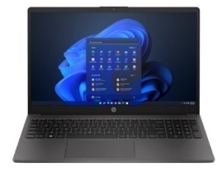
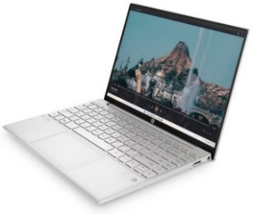
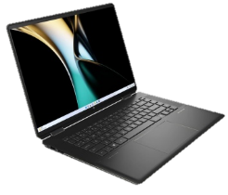
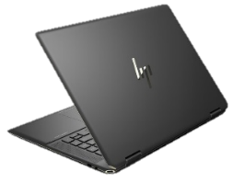
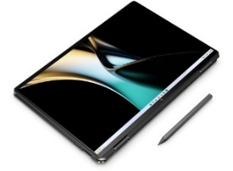
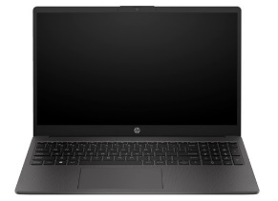

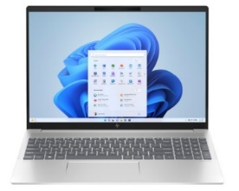
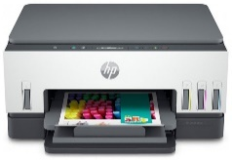


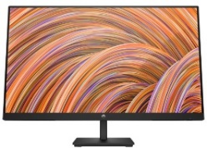

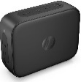
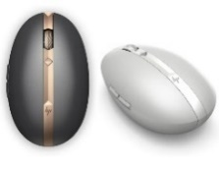
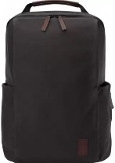
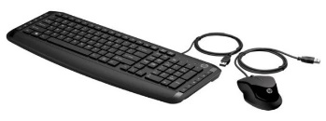


HP Pavilion & Spectre
Home Notebooks
The HP 250 G10 Laptop provides essential business-ready features in a thin and light design that’s easy to take everywhere you go. The 15.6-inch diagonal display with 85 percent screen-to-body ratio, powerful Intel® processor, fast memory, and storage is powered for productivity, while the included ports connect your peripherals—all at a price you can value.
Nothing will hold you back with the HP Pavilion Aero. Incredibly lightweight and packs a punch to the most demanding tasks at hand. This laptop has a 16:10 micro-edge display that lets you see more for a better entertainment experience and do more for your productivity. Get up to speed with the powerful performance of an AMD processor.
Retail File November 2024 Page 3/8. Promo prices are valid until 30/11 or Until Stock Last.
9G1E8ET HP NOTEBOOK 250 G10, INTEL i5-1334U 3.3-4.6GHz/12MB, 10 CORES, 16GB (1x16GB), 512GB PCIe NVMe SSD, INTEL IRIS XE GRAPHICS, USB-C, 15.6'' FHD, WIN 11 PRO, 1YW, DARK ASH SILVER 797 €
6K5F8EA HP NOTEBOOK PAVILION AERO 13-BE1000NV, AMD RYZEN 7 5825U 2.0-4.5GHz/4MB, 8 CORES, 16GB, 1TB PCIe SSD, AMD RADEON GRAPHICS, 13, 3' WQXGA, WIN 11 HOME, 2YW, SILVER, 1,303 €
HP Spectre x360 14’’ 2-in-1 Laptop. Stunning craftmanship meets powerful performance with the HP Spectre x360. The 360° design rotates for the perfect position, while the dynamic camera features let you look your best live. This powerful machine evolves your laptop experience with the Intel® Evo™ certified Platform, and Intel Unison™ for freedom to work across operating systems.
7N3P2EA HP NOTEBOOK SPECTRE X360 CONVERTIBLE 14-EF2003NV, INTEL i5-1335U 3.4-4.6GHz/12MB, 10 CORES, 8GB, 512GB PCIe SSD, INTEL IRIS XE, 13.5'' WUXGA+ IPS TOUCH, W/PEN, WIN 11 HOME, 3YW, NIGHTFALL BLACK,
1,486 €
The HP 255 G10 Laptop provides essential business-ready features in a thin and light design that’s easy to take everywhere you go. The 15.6-inch diagonal display with 85 percent screen-to-body ratio, robust AMD Ryzen™ processor, fast memory, and storage is powered for productivity, while the included ports connect your peripherals—all at a price you can value.
Step it up with the HP Pavilion Plus 16" Laptop PC, with a powerful Intel® Core™ Processor, mesmerizing screen enhancements, and seamless collaboration tools that give you the edge to surpass all expectations. Login fast via the 5MP camera with Windows Hello, while specialty video controls keep you looking good and connected with everyone.
9Y713AT HP NOTEBOOK 255 G10, RYZEN 3-7330U 2.3-4.3GHZ/8MB, 4 CORES, 8GB (1x8GB), 512GB PCIe NVMe SSD, AMD RADEON GRAPHICS, 15.6'' FHD IPS, DOS, 1YW, DARK ASH SILVER 422 €
9M3H1AT HP NOTEBOOK 255 G9, RYZEN 5-5625U 2.3-4.3GHZ/16MB, 6 CORES, 16GB (2x8GB), 512GB PCIe NVMe SSD, AMD RADEON GRAPHICS, USB-C, 15.6'' FHD IPS, DOS, 1YW, DARK ASH SILVER 625 €
B17ZSEA HP NOTEBOOK PAVILION PLUS 16-AB1007NN, INTEL ULTRA 7-155H 3.8-4.8GHz/24MB, 16 CORES, 32GB, 1TB PCIe NVMe M.2 SSD, INTEL ARC GRAPHICS, 16'' WQXGA (2560x1600), WIN 11 PRO, 3YW, NATURAL SILVER, 1,648 €
6UU48A HP PRINTER ALL IN ONE INKJET COLOR SMART TANK HOME - OFFICE 670 A4, PRINT, SCAN, COPY, 22PPM (B), 21PPM (C), 4800x1200 DPI, DC:3K, DUPLEX, 150P TRAY, USB, BT, WIFI, 1YW, GET 3YW EXT. FREE, CASHBACK 50€ UNTIL 31/04/25 231 €
1C1Y5AA HP USB-C HUB MINI PORT TRAVEL, USB 2.0, USB 3.0, RJ-45, VGA, HDMI - COMPATIBLE WITH CONSUMER NOTEBOOKS WITH AVAILABLE TYPE-C PORT, 2YW, 53 €
HP MOUSE 240 WIRELESS
65P64E9 HP MONITOR 27'', V27i G5 HOME, IPS LED, FHD 1920x1080, 16:9, 75Hz, 5MS, 250 NITS, ANTIGLARE, TILT, AMD FREESYNC, DISPLAY PORT, VGA, HDMI, 2YW, BLACK 171 €
43N04AA PIKE SILVER 17 €
793F9AA LUNAR WHITE 16 €
6UW42AA HP SURE KEY CABLE LOCK FOR NOTEBOOK, PCS, THIN CLIENTS, WORKSTATION, 23 €
HP MOUSE 700 SPECTRE RECHARGEABLE, BLUETOOTH WIRELLESS, PAIR WITH 4 DEVISES, WITH 1.200 DPI, THE LASER SENSOR PROVIDES SUPERB ACCURACY AND PRECISION — ON ALMOST EVERY SURFACE
3NZ70AA DARK ASH SILVER, 48 €
3NZ71AA PIKE SILVER, 48 €
HP SPECTRE FOLIO BACKPACK 15,6’’
Go wherever your music takes you with the perfectly portable HP 350 Bluetooth 5 speaker. Listen to music or take a call, hands-free, using the built-in mic with noise reduction.
8GF06AA
HP CARRY CASE UP TO 15.6’’
BACKPACK, DARK BROWN, 99 €
2D802AA BLACK 19 €
9DF28AA HP KEYBOARD AND MOUSE PAVILION 200, USB WIRED, GREEK, BLACK, 23 €
2D802AA BLACK 19 €
Prices, promotions, specifications, availability and terms of offers may change without notice. Despite our best efforts,
a small number of items may contain pricing, typography, or photography errors. Correct prices and promotions are validated at the time your order is placed. Recycling fees are not included in the Dealer & Retail File. Delivery and installation charges are not included. Products' warranty is the warranty given by the manufacturer. VAT is included
Call now on:
Mail on:

Slide 4

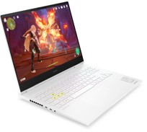
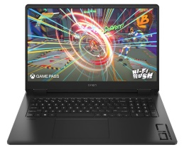

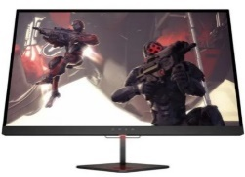



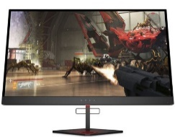

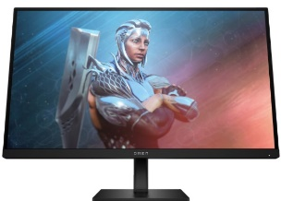
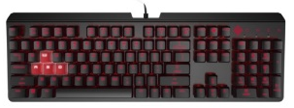



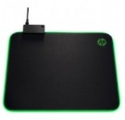

HP Gaming Notebooks
The OMEN 16” gaming laptops are engineered to redefine your gaming experience, offering a blend of power, precision, and immersive design. With cutting-edge hardware, high refresh rates, and top-tier graphics, the Omen Gaming laptops 16'' are the ultimate companions for gamers who demand exceptional performance.
With the new OMEN 17, we didn't waste time loading it with features you'd never use. Instead, with an impressive 17" IPS display with 100% sRGB, new AI-enhanced AMD Ryzen™ 8000 CPUs and NVIDIA® RTX™ 40 Series GPUs, as well as a 1-zone RGB numeric keyboard, it's everything you need for great gaming and nothing you don't.
Retail File November 2024 Page 4/8.
Promo prices are valid until 30/11
or Until Stock Last.
8B2P2EA HP NOTEBOOK OMEN TRANSCEND GAMING 16-U0000NV, INTEL i7-13700HX 3.7-5.0GHz / 30MB, 16 CORES, 16GB, 1TB PCIe SSD, NVIDIA GEFORCE RTX 4070 8GB,16'' WUXGA IPS, WIN 11 HOME, 2YW, CERAMIC WHITE 2,463 €
A44MBEA HP NOTEBOOK OMEN GAMING 17-db0006nv, AMD RYZEN 7-8845HS 3.8-5.1GHz/16MB, 8 CORES, 16GB, 512GB PCIe NVMe SSD, NVIDIA GEFORCE RTX 4050 6GB, 17.3'' FHD 144Hz, WIN 11 HOME, 2YW, SHADOW BLACK 1,745 €
8BC53AA HP MOUSE OMEN GAMING VECTOR USB, 6 BUTTONS, OMEN RADAR 3 SENSOR, CO-DEVELOPED WITH PIXART, OPTICAL SENSOR FOR PRECISE MOVEMENT ON MOST SURFACES, 6 PROGRAMMABLE BUTTONS, CUSTOM LIGHTING THROUGH OMEN COMMAND CENTER, BLACK €28
Z7Y57AA HP MONITOR 24.5'', 25 OMEN GAMING HOME, F, TN LED, FHD 1920 X 1080, 1MS, 400 NITS, FREESYNC 144Hz, ANTIGLARE, TILT, AUDIO OUTPUT, 3X USB, 2X HDMI, DISPLAY PORT, 1YW, BLACK 286 €
HP OMEN REACTOR GAMING MOUSE USB – 6 BUTTONS. Light beam detection enables a 0.2ms click response time, 3 times faster than a traditional mechanical mouse switch. Respond quicker in-game and enjoy extended durability with a 50 million click lifetime.
6FN07AA HP MONITOR 27'', X27 OMEN GAMING HOME HDR, C, TN LED, QHD 2560 X 1440, 1MS, 400 NITS, AMD RADEON FREESYNC 240HZ HDR TECHNOLOGY, HEIGHT ADJUSTABLE, PIVOT, SWIVEL, TILT, 2X USB, HDMI, DISPLAY PORT 1.2, 1YW, BLACK 717 €
2VP02AA BLACK, 42 € 7ZF19AA WHITE, 50 €
6YW76AA HP KEYBOARD OMEN GAMING BY HP ENCODER, COMMAND A FLAWLESS SYMPHONY OF KEYSTROKES, CHERRY MX RED MECHANICAL SWITCHES DELIVER THE AGILITY YOU NEED TO MANEUVER AHEAD OF THE COMPETITION, RED €85
780F9E9 HP MONITOR 27'', 27 OMEN GAMING HOME, E, IPS, FHD 1920 X 1080, 165HZ, 1MS, 400 NITS, AMD FREESYNC PREMIUM, ANTIGLARE, HEIGHT ADJUSTABLE, TILT, 2x HDMI, DISPLAY PORT, 2YW, BLACK 231 €
4PH30AA HP MOUSE PAVILION GAMING 300 USB, 5000 DPI OPTICAL SENCOR, 8 BUTTONS, TOTAL WITH 2 THUMB BUTTONS ON EACH SIDE, MAKING IT IDEAL WHETHER YOU’RE LEFT OR RIGHT HANDED, BLACK/GREEN 21 €
9LY71AA HP MOUSE PAVILION GAMING 300 USB, 5000 DPI OPTICAL SENCOR, 8 BUTTONS, TOTAL WITH 2 THUMB BUTTONS ON EACH SIDE, MAKING IT IDEAL WHETHER YOU’RE LEFT OR RIGHT HANDED, BLACK/GREEN €45
5JS07AA HP MOUSE 200 PAVILION GAMING, USB,YOUR NEXT GAMING SESSION IS ABOUT TO GET A LOT MORE CONTROLLED, COMFORTABLE, AND COLORFUL, IS OPTIMIZED FOR PRECISE CONTROL AND FEATURES AN ERGONOMIC DESIGN BLACK RGB LIGHTING 23 €
5JH72AA HP MOUSEPAD PAVILION USB, 27 €
6MF36AA HP HEADSET OMEN MIND-FRAME PRIME HEADSET, MICROPHONE, BUILT IN VIRTUAL SURROUND SOUND AUDIO CHIP POWERED BY C-MEDIA XEAR, OMEN'S ACTIVE EAR CUP COOLING TECHNOLOGY, COMPATIBLE WITH PCs WITH USB-A 1YW, WHITE,108 114 €
Prices, promotions, specifications, availability and terms of offers may change without notice. Despite our best efforts,
a small number of items may contain pricing, typography, or photography errors. Correct prices and promotions are validated at the time your order is placed. Recycling fees are not included in the Dealer & Retail File. Delivery and installation charges are not included. Products' warranty is the warranty given by the manufacturer. VAT is included
Call now on:
Mail on:

Slide 5

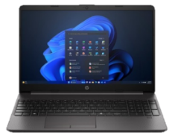
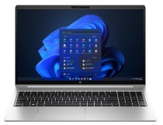
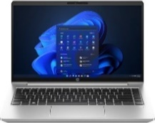

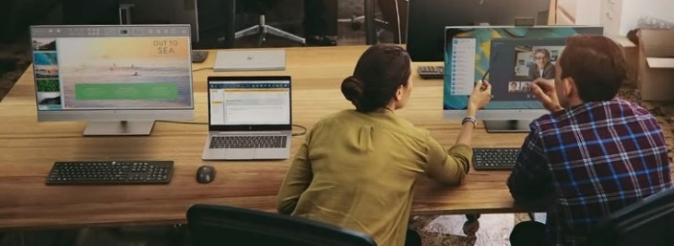
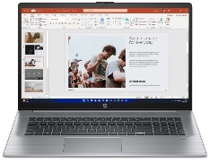


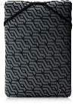

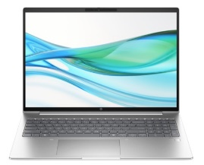
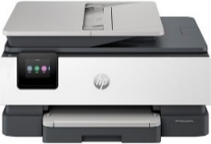
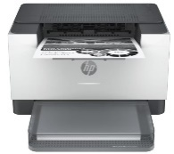
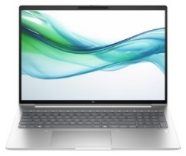


HP 250 & ProBook 400 Series Business Notebooks
The HP ProBook 450/455 15-inch laptop provides growing businesses with the commercial-grade performance, multi-layered endpoint security, and durability in an easily upgradeable design. Powered by the latest Intel® processor and long battery life, this feature-rich PC is well-equipped for long-term productivity and helps enable hybrid work.
The HP 250 G9 Laptop provides essential business-ready features in a thin and light design that’s easy to take everywhere you go. The 15.6-inch diagonal display with big screen-to-body ratio, powerful Intel® processor, fast memory, and storage is powered for productivity, while the included ports connect your peripherals—all at a price you can value.
Retail File November 2024 Page 5/8. Promo prices are valid until 30/11 or Until Stock Last.
9G256ET HP NOTEBOOK PROBOOK 455 G10, AMD RYZEN 5 7530U 2.3–4.5GHZ/16MB, 6 CORES, 16GB, 512GB PCIe NVMe SSD, AMD RADEON GRAPHICS, 15.6'' FHD IPS, USB-C, LAN, WIN 11 PRO, 3YW, SILVER, 846 €
A38H3ET HP NOTEBOOK 250 G9, INTEL CELERON N4500 1.1-2.8GHz/4MB, 2 CORES, 8GB (1x8GB), 256GB PCIe NVMe SSD, INTEL UHD GRAPHICS, USB-C, LAN, 15.6'' FHD, WIN 11 HOME, 1YW, DARK ASH
SILVER 375 €
The HP ProBook 440 14-inch laptop provides growing businesses with the commercial-grade performance, multi-layered endpoint security, and durability in an easily upgradeable design. Powered by the latest Intel processor and long battery life, this feature-rich PC is well-equipped for long-term productivity and helps enable hybrid work.
9G252ET HP NOTEBOOK PROBOOK 440 G10, INTEL i7-1355U 3.7-5.0GHZ /12MB, 10 CORES, 16GB, 512GB PCIe NVMe SSD, INTEL IRIS XE GRAPHICS, 14'' FHD IPS, TYPE-C, LAN, WIN 11 PRO, 3YW, SILVER 1,282 €
9Y7W6ET HP NOTEBOOK PROBOOK 445 G11, AMD RYZEN 5 7535U 2.9–4.6GHZ/16MB, 6 CORES, 16GB, 512GB PCIe NVMe SSD, AMD RADEON GRAPHICS, 14'' WUXGA IPS, USB-C, LAN, WIN 11 PRO, 3YW, SILVER 939 €
9M3J6AT HP NOTEBOOK 250 G9, INTEL i3-1215U 3.3-4.4GHz/10MB, 6 CORES, 8GB (1x8GB), 512GB PCIe NVMe SSD, INTEL UHD GRAPHICS, USB-C, LAN, 15.6'' FHD, WIN 11 PRO, 1YW, DARK ASH SILVER 579 €
9G2J6ET HP NOTEBOOK PROBOOK 445 G10, AMD RYZEN 7 7730U 2.3–4.5GHZ/16MB, 6 CORES, 16GB, 1TB PCIe NVMe SSD, AMD RADEON GRAPHICS, 14'' FHD IPS, USB-C, LAN, WIN 11 PRO, 3YW, SILVER 1,157 €
9G253ET HP NOTEBOOK PROBOOK 440 G10, INTEL i5-1335U 3.4-4.6 GHZ/12MB, 10 CORES, 16GB, 512GB PCIe NVMe SSD, INTEL IRIS XE GRAPHICS, 14'' FHD IPS, TYPE-C, LAN, WIN 11 PRO, 3YW, SILVER 977 €
The HP 470 delivers desktop performance and laptop mobility with essential features for today’s workforce. The 17-inch diagonal display with an anti-glare option, delivers an expansive viewing experience.
9B9P1EA HP NOTEBOOK PROBOOK 470 G10, INTEL i7-1355U 3.7-5.0GHz/12MB, 10 CORES, 16GB, 512GB PCIe NVMe SSD, INTEL IRIS XE GRAPHICS, 17.3'' FHD IPS, TYPE-C, WIN 11 PRO, 3YW, SILVER 1,221 €
HP LIGHTWEIGHT
15.6’’
HP PRELUDE PRO 17.3’’
HP REVERSIBLE
PROTECTIVE 14’’
The HP ProBook 460 16-inch laptop provides growing businesses with commercial-grade performance, multi-layered endpoint security, and durability in an easily upgradeable design. Powered by the latest Intel® processor and long battery life, this feature-rich PC is well-equipped for long-term productivity and helps enable hybrid work.
The HP 255 G10 Laptop provides essential business-ready features in a thin and light design that’s easy to take everywhere you go. The 15.6-inch diagonal display with 85 percent screen-to-body ratio, robust AMD Ryzen™ processor, fast memory, and storage is powered for productivity, while the included ports connect your peripherals—all at a price you can value.
1G6D5AA HP CARRY CASE TOPOAD 15.6”, 25 €
3E2P1AA HP CARRY CASE TOPLOAD 17.3'', 25 €
2F2L4AA
HP 14 CASE, GRAY / BLACK, 18 €
8A672EA HP NOTEBOOK 255 G10, RYZEN 7-7730U 2.0-4.5GHZ/16MB, 8 CORES, 16GB (1x16GB), 1TB PCIe NVMe SSD, AMD RADEON GRAPHICS, USB-C, 15.6'' FHD IPS, WIN 11 PRO, 1YW, DARK ASH SILVER 977 €
9Y7S4ET HP NOTEBOOK PROBOOK 460 G11, INTEL ULTRA 7-155U AI VPRO 1.2-4.8GHZ/12MB, 12 CORES, 16GB (1x16GB), 512GB PCIe NVMe SSD, INTEL GRAPHICS, 16'' WUXGA IPS, TYPE-C, LAN, WIN 11 PRO, 3YW, SILVER 1,315 €
405U3B HP PRINTER ALL IN ONE INKJET COLOR OFFICEJET PRO BUSINESS 8122e A4, PRINT, SCAN COPY, 20PPM (B) & 10PPM (C) , 1200x1200 DPI, DC:20K, DUPLEX, ADF 35P, LAN, USB, WIFI, 1YW, WHITE+BASALT, CASHBACK 30€ UNTIL 31/04/25 153 €
The HP ProBook 465 16-inch laptop provides growing businesses with commercial-grade performance, multi-layered endpoint security, and durability in an easily upgradeable design. Powered by the latest AMD processor and long battery life, this feature-rich PC is well-equipped for
long-term productivity and helps enable hybrid work.
9G1V1ET HP NOTEBOOK PROBOOK 460 G11, INTEL ULTRA 5-125U AI VPRO 1.3-4.3GHZ/12MB, 12 CORES, 16GB (1x16GB), 512GB PCIe NVMe SSD, INTEL GRAPHICS, 16'' WUXGA IPS, TYPE-C, LAN, WIN 11 PRO, 3YW, SILVER 1,174 €
6GW62F HP PRINTER LASER MONOCHROME BUSINESS M209DW A4, PRINT, 29PPM, 600 X 600 DPI, 64MB, DC:20K, 1-5 USERS, DUPLEX, AIR PRINT, USB, LAN, WIFI, BLUETOOTH, 1YW, WHITE + BASALT,
144 €
9Y7X3ET HP NOTEBOOK PROBOOK 465 G11, AMD RYZEN 7 7735U 2.7–4.8GHZ/16MB, 8 CORES, 16GB, 1TB PCIe NVMe SSD, AMD RADEON GRAPHICS, 16'' WUXGA IPS, USB-C, LAN, WIN 11 PRO, 3YW, SILVER 1,174 €
3L1F0AA HP KEYBOARD AND MOUSE 230, WIRELESS, EXPERIENCE A KEYBOARD AND MOUSE COMBO THAT’S COMFORTABLE, SLEEK AND QUIET, WHITE, 27 €
https://partner.hp.com/
Prices, promotions, specifications, availability and terms of offers may change without notice. Despite our best efforts,
a small number of items may contain pricing, typography, or photography errors. Correct prices and promotions are validated at the time your order is placed. Recycling fees are not included in the Dealer & Retail File. Delivery and installation charges are not included. Products' warranty is the warranty given by the manufacturer. VAT is included
Call now on:
Mail on:

Slide 6

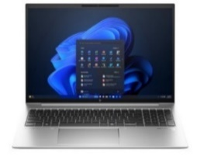
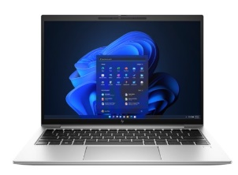
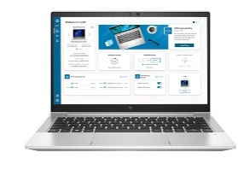


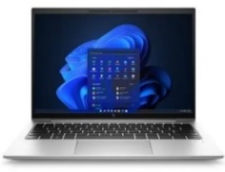
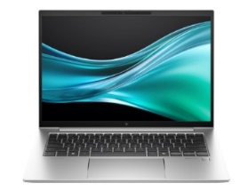
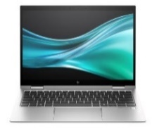








HP Elite Business Notebooks
Take some friction out of working remotely with the HP EliteBook 835. Built to seamlessly fit into enterprise IT, it also comes with features that delight its users. This enterprise business laptop brings new conferencing capabilities powered by HP Presence, productivity, and security that is easily managed in hybrid work environments.
The HP EliteBook 860 effectively meets the demands of multi-tasking teams across the globe.
Retail File November 2024 Page 6/8. Promo prices are valid until 30/11 or Until Stock Last.
970R0ET HP NOTEBOOK ELITEBOOK 860 G11, INTEL ULTRA 7-155H AI VPRO 3.8-4.8GHz/24MB, 16 CORES, 32GB, 1TB PCIe NVMe SSD, INTEL ARC GRAPHICS, 16'' WUXGA IPS, WIN 11 PRO, 3YW, SILVER 1,923 €
Cashback is valid until 31/10/2024 for more info click here
6F6Y2EA HP NOTEBOOK ELITEBOOK 835 G9, AMD RYZEN 5 6600U 2.9-4.5GHZ/3MB, 6 CORES, 8GB, 256GB PCIe NVMe SSD, AMD 660M GRAPHICS, 13.3'' WUXGA IPS, TYPE-C (2), WIN 11 PRO, 3YW, SILVER 967 €
The HP EliteBook 630 and 640 is a cost-effective, powerful, and secure PC that allows easy standardization, while giving end-users the tools needed work from almost anywhere. Designed around the fundamental needs of enterprise businesses, this PC features the collaboration, power, and security your business needs to stay on top.
Take some friction out of working remotely with the HP EliteBook 835. Built to seamlessly fit into enterprise IT, it also comes with features that delight its users. This enterprise business laptop brings new conferencing capabilities powered by HP Presence, productivity, and security that is easily managed in hybrid work environments.
9G258ET HP NOTEBOOK ELITEBOOK 630 G10, INTEL i7-1355U 3.7-5.0GHz/12MB, 10 CORES, 16GB, 512GB PCIe NVMe SSD, INTEL UHD GRAPHICS, 13.3'' FHD IPS, LAN, TYPE-C, WIN 11 PRO, 3YW, SILVER, CASHBACK 60€ UNTIL 31/01/25, 1,126 €
5P727EA HP NOTEBOOK ELITEBOOK 835 G9, AMD RYZEN 7 6800U 2.7-4.7GHZ/16MB, 8 CORES, 16GB, 512GB PCIe NVMe SSD, AMD RADEON 680M GRAPHICS, 13.3'' WUXGA IPS, TYPE-C, WIN 11 PRO PREINSTALLED WITH WIN 10 PRO, 3YW, SILVER , 1,409 €
401G8EA HP NOTEBOOK ELITEBOOK 835 G8, AMD RYZEN 5 PRO 5650U 2.3–4.2GHZ/3MB, 6 CORES, 8GB, 256GB SSD, UHD GRAPHICS, CAM, 13.3'' FHD IPS, WIN 10 PRO, 3YW, SILVER, 893 €
5TW10AA HP DOCKING STATION USB-C G5, UNIVERSAL, USB TYPE-C, 3X USB 3.0, 2X DISPLAY PORT, HDMI, RJ-45, 1 X HEADPHONE AND MIC, 157 €
The HP EliteBook 840 effectively meets the demands of multi-tasking teams across the globe.
6SP25AA HP TRAVEL BLUETOOTH MOUSE 5 BUTTONS, 27 €
6F6Y2EA HP NOTEBOOK ELITEBOOK 835 G9, AMD RYZEN 5 6600U 2.9-4.5GHZ/3MB, 6 CORES, 8GB, 256GB PCIe NVMe SSD, AMD 660M GRAPHICS, 13.3'' WUXGA IPS, TYPE-C, WIN 11 PRO, 3YW, SILVER, 967 €
970S0ET HP NOTEBOOK ELITEBOOK 840 G11, INTEL ULTRA 7-155H AI VPRO 3.8-4.8GHz/24MB, 16 CORES, 32GB, 512GB PCIe NVMe SSD, INTEL ARC GRAPHICS, 14'' WUXGA IPS, WIN 11 PRO, 3YW, SILVER 1,798 €
Remove barriers to hybrid work with the HP EliteBook 830. This enterprise business laptop brings new conferencing capabilities powered by HP Presence, productivity, and security that is easily managed in hybrid work environments.
5P727EA HP NOTEBOOK ELITEBOOK 835 G9, AMD RYZEN 7 6800U 2.7 - 4.7GHZ / 16MB, 8 CORES, 16GB, 512GB PCIe NVMe SSD, GRAPHICS, CAM, 13.3'' WUXGA IPS, WIN 10 PRO, 3YW, SILVER, 3YW, 1,409 €
5P794EA HP NOTEBOOK ELITEBOOK 830 G9, INTEL i5-1235U 3.3-4.4GHZ /12MB, 10 CORES, 8GB, 256GB PCIe NVMe SSD, INTEL IRIS XE GRAPHICS, CAM, 13.3'' WUXGA IPS, TYPE-C, WIN 11 PRO, 3YW, SILVER, 1,116 €
1F3Y2A HP PRINTER ALL IN ONE INKJET COLOR SMART TANK HOME - OFFICE 580 A4, PRINT, SCAN, COPY, 22PPM (B), 16PPM (C), 4800 x 1200 DPI, 100P TRAY, DC: 3K, 4 BOTTLES INK, BT, WIFI, 1YW, GET 3YW EXT. FREE, CASHBACK 50€ UNTIL 31/04/25, 199 €
HP EXTERNAL DVD - RW
F6V97AA HP DVD WRITER EXTERNAL DRIVE USB, BLACK 37 €
5P6Q5EA HP NOTEBOOK ELITEBOOK 830 G9, INTEL i5-1235U 3.3-4.4GHZ /12MB, 10 CORES, 8GB, 256GB SSD, IRIS XE GRAPHICS, CAM, 13.3'' WUXGA IPS, TYPE-C, LTE-ADVANCED, WIN 11 PRO, 3YW, SILVER, 1,041 €
CZ992A HP PRINTER ALL IN ONE INKJET COLOR OFFICEJET MOBILE 250 A4, PRINT, SCAN, COPY, 20 PPM (B), 19 PPM (C), 4800x1200 DPI, 700MHZ, 256MB, DC:500, 2 INKS, USB, WIFI, 1YW, BLACK, CASHBACK 20€ UNTIL 31/04/25, 345 €
HP MOUSE DUAL MODE With this dual mode wireless mouse, you can easily connect to two separate PCs via Bluetooth or 2.4 GHz wireless.
6CR71AA
HP MOUSE WIRELESS, BLACK 24 €
6CR72AA HP MOUSE WIRELESS, SILVER, 23 €
8J9E6AA HP HP MONITOR 27'', S7 PRO 727PU BUSINESS, F, IPS BLACK, QHD 2560x1440 120Hz, 16:9, 5MS, 400 NITS, HEIGHT ADJUSTABLE, PIVOT, SWIVEL, TILT, AMD FREESYNC PREMIUM, HDMI, DISPLAY PORT IN/OUT, THUNDERBOLT, LAN, 3YW, BLACK/SILVER 613 €
HP ENVY URBAN 15.6’’
7XG57AA ENVY URBAN TOPLOAD 15.6’’, BLACK, 48 €
Prices, promotions, specifications, availability and terms of offers may change without notice. Despite our best efforts,
a small number of items may contain pricing, typography, or photography errors. Correct prices and promotions are validated at the time your order is placed. Recycling fees are not included in the Dealer & Retail File. Delivery and installation charges are not included. Products' warranty is the warranty given by the manufacturer. VAT is included
Call now on:
Mail on:

Slide 7
















HP Elite Business Notebooks
Remove barriers to hybrid work with the HP EliteBook 840. This enterprise business laptop brings new conferencing capabilities powered by HP Presence, productivity, and security that is easily managed in hybrid work environments.
Retail File November 2024 Page 7/8. Promo prices are valid until 30/11 or Until Stock Last.
6T2B5EA HP NOTEBOOK ELITEBOOK 840 G10, INTEL i5-1335U 3.4-4.6GHZ/12MB, 10 CORES, 16GB, 512GB PCIe NVMe SSD, INTEL IRIS XE GRAPHICS, 14'' WUXGA IPS, WIN 11 PRO, 3YW, SILVER 1,251 €
404M5B HP PRINTER ALL IN ONE INKJET COLOR OFFICEJET PRO BUSINESS 9132e A4, PRINT, SCAN, COPY, FAX, 25PPM (B) 20PPM (C), DC:30K, DUPLEX, ADF 35P, 2X TRAYS 500 SHEET, AIR PRINT, USB, WIFI, LAN, 1YW, BASALT, CASHBACK 40€ UNTIL 31/04/25, 305 €
Cashback is valid until 31/11/2024 for more info click here
Change the dynamics of the room with the meticulously crafted, ultra-light HP Elite Dragonfly featuring HP Wolf Security for Business. This beautifully designed, laptop provides a stunning collaboration experience powered by HP Presence with AI-driven crystal-clear audio and an HD display. Drive productivity with a powerful Intel® Core™ processor, a Wi-Fi 6 connection, and contextual intelligence.
5P6R5EA HP NOTEBOOK ELITEBOOK 840 G9, INTEL i5-1235U, 2.6-4.4GHZ/12MB, 10 CORES, 8GB, 256GB SSD, INTEL IRIS XE GRAPHICS, 14'' WUXGA + IPS, TYPE-C, WIN 11 PRO, 3YW, SILVER, 1,126 €
5Z6D5EA HP NOTEBOOK ELITEBOOK 840 G9, INTEL i5-1235U 3.3-4.4GHZ /12MB, 10 CORES, 16GB, 256GB PCIe NVMe SSD, INTEL IRIS XE GRAPHICS, 14'' WUXGA IPS, CAMERA, WIN 10 PRO, 3YW, SILVER, 1,189 €
4RA84F HP PRINTER ALL IN ONE LASER COLOR PRO BUSINESS 4302FDN A4, PRINT, SCAN, COPY, FAX, 35PPM (B&C), 600 X 600 DPI, 512MB, DC:50K, DUPLEX, ADF 50 PAGES, USERS 3-10, USB, LAN, 1YW, GET 3YW EXT. FREE, CASHBACK 50€ UNTIL 31/01/25, 614 €
6T1B8EA HP NOTEBOOK ELITEBOOK DRAGONFLY G3, INTEL i5-1235U 3.3-4.4GHz / 12MB, 10 CORES, 16GB, 512 GB SSD, INTEL IRIS XE GRAPHICS, 13.5’’ WUXGA+ IPS TOUCH, LTE ADVANCED PRO, WIN 11 PRO, 3YW, DRAGONFLY BUE, 1,721 €
Overcome obstacles to hybrid work with the HP EliteBook 845. The latest AMD processor and features that enhance online meetings let you listen, be heard, and look your best. Work confidently knowing your PC has a suite of enterprise-ready security and manageability.
7L7V9ET HP NOTEBOOK ELITEBOOK DRAGONFLY G4, INTEL i7-1355U 3.4-5.0GHZ/12MB, 10 CORES, 16GB, 1TB PCIe NVMe TLC SSD, INTEL IRIS XE GRAPHICS, 13.5'' 3K2K OLED, WIN 11 PRO, 3YW, SLATE BLUE, CASHBACK 100€ UNTIL 31/01/25 , 2,091 €
64W41AA HP MONITOR 27'', P27H G5 BUSINESS WITH DUAL SPEAKERS, D, IPS, FHD 1920 X 1080, 5MS, 250 NITS, ANTIGLARE, HEIGHT ADJUSTABLE, VGA, DISPLAY PORT, HDMI, 3YW, BLACK 195 €
96Y17ET HP NOTEBOOK ELITEBOOK 845 G10, AMD RYZEN 7 PRO 7840U 3.3-5.1GHz/16MB, 8 CORES, 16GB, 512GB PCIe NVMe SSD, AMD RADEON GRAPHICS, 14'' WUXGA IPS, WIN 11 PRO, 3YW, SILVER, CASHBACK 70€ UNTIL 31/01/25 1,409 €
4J0A2AA HP DOCK THUNDERBOLT 120W G4 , 2X USB 3.2, USB-C, 1 X HDMI, LAN, 2X DISPLAY PORT, 223 €
Technology needs to power your business now more than ever. HP offers a broad portfolio of business notebooks with enterprise-class security, premium design, and cutting-edge collaboration features.
Hybrid workers can stay connected, productive, and secure just like they were when working inside the office.
HP KEYBOARD AND MOUSE COMBO
18H24AA HP KEYBOARD AND MOUSE 230, WIRELESS, SLEEK AND QUIET, CHICLET KEYBOARD DESIGN LETS YOU ENJOY COMFORTABLE, MORE ACCURATE TYPING WITH LESS NOISE, BLACK 26 €
428H5AA HP HEADSET G2, STEREO USB, HOLD ON CALLS, ADJUST HEAD STRAP, VOICE- CANCELLING, COMFOTRABLE DESIGN, EASY ADJUSTMENT, VEGAN LEATHER EARCUPS, USB-A PORT, 2YW, 22 €
4Z513AA HP CARRY CASE PRELUDE 15.6'' BACKPACK, 27 €
1E7D6A6 HP CARRY CASE PRELUDE BACKPACK G2 15.6'', GREY 26 €
HP MOUSE WIRELESS
1JR31AA HP MOUSE WIRELESS BLACK 27 €

Slide 8

















HP ZBook Workstations
Business Notebooks
Pro-level performance combines with true mobility in this amazingly sleek and powerful laptop. Stay productive wherever you're working with integrated or discrete graphics and processor, AI-enhanced webcam and audio, and a stunning display—everything you need to collaborate and manage projects anywhere.
Unleash your creativity. From keyboard to screen, every aspect of ZBook Studio is designed for high-performance workflows. Create or view in real time, collaborate remotely and play from anywhere. With all this power concentrated in such a small machine, a device has finally been created for everything you need.
Retail File November 2024 Page 8/8.
Promo prices are valid until 30/11 or Until Stock Last.
98M90ET HP NOTEBOOK ZBOOK WORKSTATION FIREFLY 14 G11, INTEL CORE ULTRA 7-165H AI 3.8-5.0GHz/24MB, 16 CORES, 32GB, 1TB PCIe NVMe SSD, NVIDIA RTX A500 4GB, 14'' WUXGA IPS, VPRO, IR CAM, FINGERPRINT, WIN 11 PRO, 3YW 2,209 €
Wolf Pro Security Edition Upgrade to professional ZBook performance and security at an unbelievably affordable price. Power up your productivity on this durable yet premium device — delivering enhanced collaboration features and pro-grade components to run pro software apps for CAD, 3D concepting, modeling, rendering and more.
HP ZBook Power 15.6’’ G10 Mobile Workstation PC
62U35EA HP NOTEBOOK ZBOOK WORKSTATION STUDIO 16 G9, INTEL i7-12700H 3.5 -4.7GHz/24MB, 8 CORES, 16GB, 512 GB PCIe SSD, NVIDIA RTX A1000 4GB, 16'' WUXGA IPS, BACKLIT KEY, WIFI, BT, FP, CAM, WIN 11 PRO, 3YW, 2,379 €
862J4ET HP NOTEBOOK ZBOOK WORKSTATION POWER 15 G10, INTEL i9-13900H 4.1-5.40GHz/24MB, 14 CORES, 32GB, 1TB PCIe NVMe TLC SSD, NVIDIA RTX 3000 ADA 8GB, 15.6'' FHD IPS, VPRO, WIN 11 PRO HIGH END, 1YW 3,371 €
98M82ET HP NOTEBOOK ZBOOK WORKSTATION FIREFLY 16 G11, INTEL ULTRA 7-155H AI 3.8-4.8GHz/24MB, 16 CORES, 32GB, 512GB PCIe NVMe SSD, NVIDIA RTX A500 4GB, 16'' WUXGA IPS, IR CAM, FINGERPRINT SENSOR, WIN 11 PRO, 3YW 1,871 €
Upgrade to professional ZBook performance and security at an unbelievably affordable price. Power up your productivity on this durable yet premium device—delivering enhanced collaboration features and pro-grade components to run pro software apps for CAD, 3D concepting, modeling, rendering and more.
6N6E9AA HP MONITOR 23.8'', E24 G5 BUSINESS, D, IPS, FHD 1920 X 1080, 5MS, 250 NITS, ANTIGLARE, EYE EASE, HEIGHT ADJUSTABLE, PIVOT, SWIVEL, TILT, 4 X USB TYPE-A , USB TYPE-B, HDMI, DISPLAY PORT, 3YW, BLACK/SILVER 201 €
HP works closely with ISVs (independent software vendors) such as Autodesk to ensure that users can use their products with confidence. Tested to work and ISV certified.
HP ZBook Power 16’’ G11 Mobile Workstation PC
537P6B HP PRINTER ALL IN ONE INKJET COLOR OFFICEJET PRO BUSINESS 9730e A3, PRINT, SCAN, COPY, 22PPM(B) 18PPM(C), 1200DPI, 512MB, DC:30K, DUPLEX PRINT& SCAN, ADF 35P, 2X TRAYS, USB, WIFI, LAN, 1YW, WHITE, CASHBACK 40€ UNTIL 31/04/25 309 €
A3YS6ET HP NOTEBOOK ZBOOK WORKSTATION POWER 16 G11, INTEL ULTRA 7-155H 3.8-4.8GHz/24MB, 16 CORES, 32GB (1x 32GB), 1TB PCIe NVMe TLC SSD, NVIDIA RTX 1000 ADA 6GB, 16'' WUXGA, WIN 11 PRO, 3YW 2,181 €
1A9C9AA HP MONITOR 25'' Z25xs G3 BUSINESS DREAMCOLOR, G, IPS, QHD 2560 X 1440, 14MS, 266 NITS, ADJUSTABLE, PIVOT, SWIVEL, TILT, 3X USB, HDMI, DIPLAY PORT, USB TYPE-C, 3YW, 592 €
3QA55A HP PRINTER ALL IN ONE LASER COLOR ENTERPRISE M480F A4, PRINT, COPY, SCAN, FAX, 27PPM, 600 x 600 DPI, 800MHZ, 3-10 USERS, DC:55K, DUPLEX, ADF, USB, LAN, 1YW, GET 3YW EXT. FREE 854 €
A3YT4ET HP NOTEBOOK ZBOOK WORKSTATION POWER 16 G11, INTEL ULTRA 9-185H 3.8-5.1GHz/24MB, 16 CORES, 32GB (1x 32GB), 1TB PCIe NVMe TLC SSD, NVIDIA RTX 2000 ADA 8GB, 16'' WUXGA, WIN 11 PRO HIGH END, 3YW 2,637 €
1PV65A HP PRINTER ALL IN ONE LASER MONOCHROME ENTERPRISE M528F A4, PRINT, SCAN, COPY, FAX, 43PPM, 1200 DPI, 1.25GB, DC:150K, DUPLEX , ADF 100 SHEETS, 2X TRAYS, No OF USERS: 5-15, USB, LAN, 1YW - GET 3YW FREE EXT, 1,779 €
5HB09A HP PLOTTER DESIGNJET T630 24'' A1, PRINT, 30 SEC/PAGE ON A1, 76 A1 PRINTS PER HOUR, 2400 X 1200 DPI, 1GB, ROLL, STAND, CUTTER, 4 INKS,USB, WIFI, LAN, 1YW, 1,330 €
50U19AA HP MONITOR 31.5”, Z32k BUSINESS, G3, IPS, 4K UHD 3840 x 2160 , 5MS, 400 NITS, 60Hz, HEIGHT ADGUST, TILT,SWIVEL, PIVOT, HDMI, DISPLAY PORT, USB-C 100W POWER DELIVERY, LAN, 3YW, BLACK 936 €
5HB11A HP PLOTTER DESIGNJET T630 36'' A0, PRINT, 30 SEC/PAGE, 76 A1 PRINTS PER HOUR, 2400 X 1200 DPI, STAND, SHEET FEED, ROLL FEED, ADF, MEDIA BIN, AUTOMATIC CUTTER, 4 INKS, USB, WIFI, WIFI, WIFI DIRECT, LAN, 1YW, 2,069 €
6UW42AA HP SURE KEY CABLE LOCK FOR NOTEBOOK, PCS, THIN CLIENTS, WORKSTATION, 23 €
Prices, promotions, specifications, availability and terms of offers may change without notice. Despite our best efforts,
a small number of items may contain pricing, typography, or photography errors. Correct prices and promotions are validated at the time your order is placed. Recycling fees are not included in the Dealer & Retail File. Delivery and installation charges are not included. Products' warranty is the warranty given by the manufacturer. VAT is included
Call now on:
Mail on:

