Slide 1
Marketing Analytics Project
Unified Ads Data Analysis
Google, Facebook, TikTok

Slide 2
Problem Statement
Ad data is fragmented across platforms, making comparison difficult.

Slide 3
Data Sources
Google Ads CSV
Facebook Ads CSV
TikTok Ads CSV

Slide 4
Architecture
CSV → Database → Unified Table → Dashboard

Slide 5
Data Model
Unified fact table with standardized metrics

Slide 6
Key Metrics
CTR, CPC, CPA, CVR, CPM, Funnel Efficiency

Slide 7
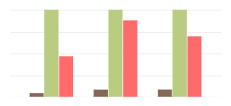
Dashboard 1
Platform comparison of KPIs (cvr{brown}, cpa{green}, cpc{pink}), for Tiktok, Google and Facebook respectively.

Slide 8
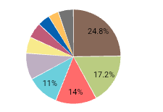
Dashboard 2
Campaign performance by clicks

Slide 9
Insights
CPA is relatively uniform, but TikTok has the highest.
The highest CPC is Google's.
Creator partnership has the highest spend.
Influencer_Collab with 24.8% clicks.

Slide 10
Challenges
Missing revenue for Facebook & TikTok; therefore total revenue and revenue metric like ROAS(Return on Ads Spend) was not calculated.

Slide 11
Recommendations
Reallocate budget to high-performing channels.
Choose high or low spend adgroups for a corresponding budget.
Google ads might be best for optimum spend and conversion.

