Slide 1
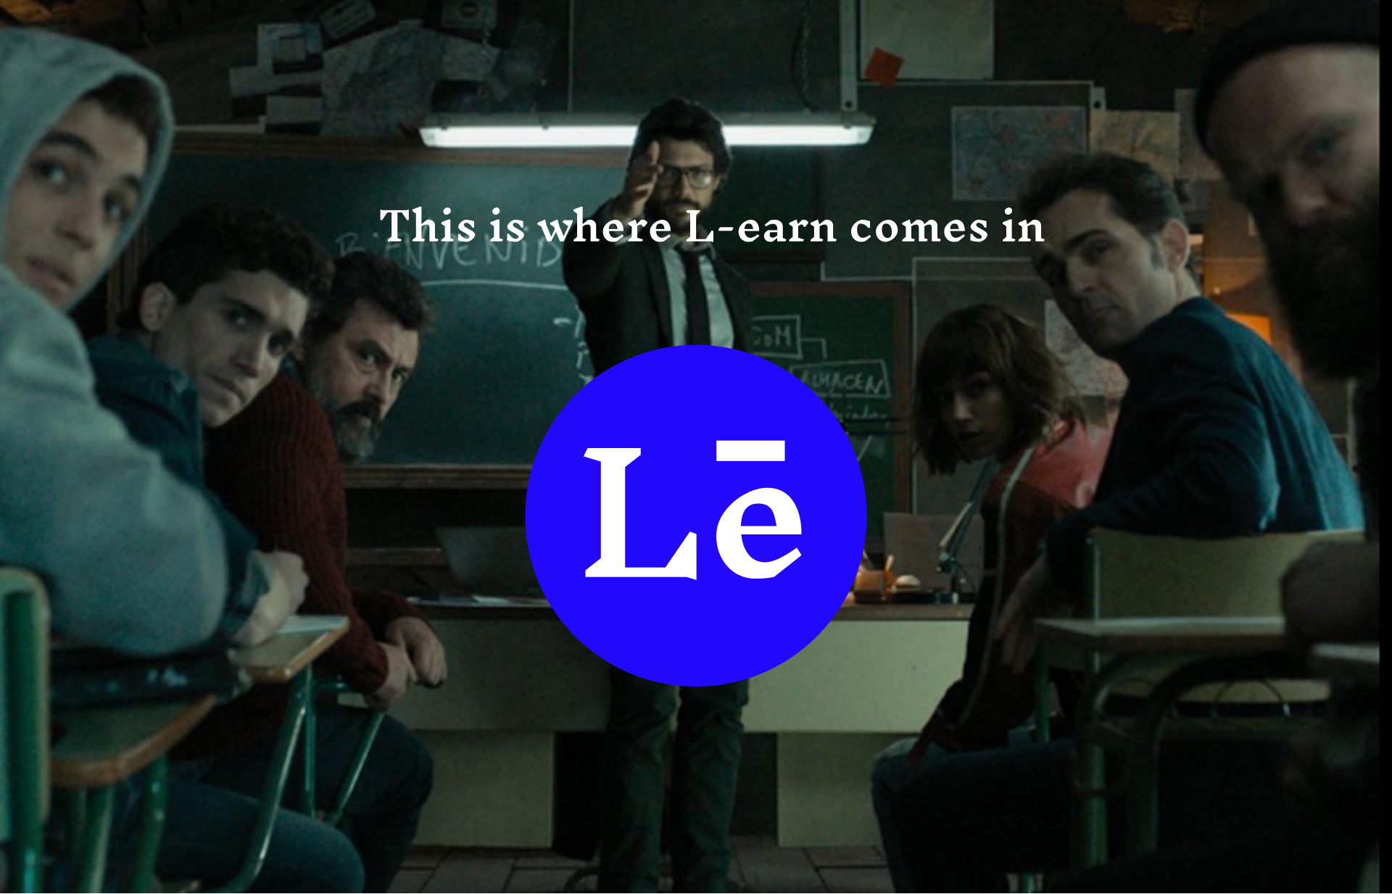

Slide 2
L-EARN OPPORTUNITIES: TRACTION & CREDIBILITY
ACHIEVEMNET SO FAR
LEGAL & BUSINESS STANDING
• Explosive Subscriber Growth 300 Student subscribers with average traffic. • Fully Live & Functional. • 4 Exclusive Jobs Listed
Fully Registered Business We are officially incorporated and recognized by the Registrar of Companies, granting us operating leverage and trust with corporate partners.
JUMPING ONTO A HUNGRY SYSTEM
The youth unemployment gap represents a massive, underserved, and 'hungry' ecosystem. Our rapid adoption proves that job seekers and providers are desperate for a streamlined, trustworthy matching solution. The market was waiting for us.

Slide 3
TECHNOLOGY, MONETIZATION & RESEARCH
HOW OUR TECHNOLOGY WORKS
REVENUE & MONETIZATION
Smart Categorization: Our platform automatically tags and filters gigs, internships, and jobs for relevant skill matching. Automated Communication: Integrated inbox, automated email digests, and real-time dashboard updates keep the system alive.
• B2B Job Postings: Fees for corporate features. • Premium Subscriptions: Advanced access for users. • Partner Integrations: Value adds like assessments.
MARKET RESEARCH
• Students are willing and hungry to work on microgigs to earn a considerable amount while learning.
• Professional are usually highly in need of labour of helping them in short roles. • Engagement Rates: Our beta shows an 80% open rate indicating immense demand.

