Slide 1
Intro to Machine learning
Part 2
Juan Alejandro Ramon Ortega
Erika Saiz
Dániel Dávid

Slide 2
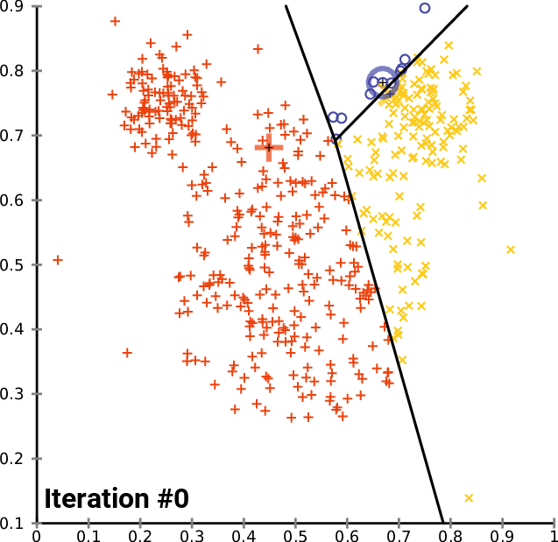
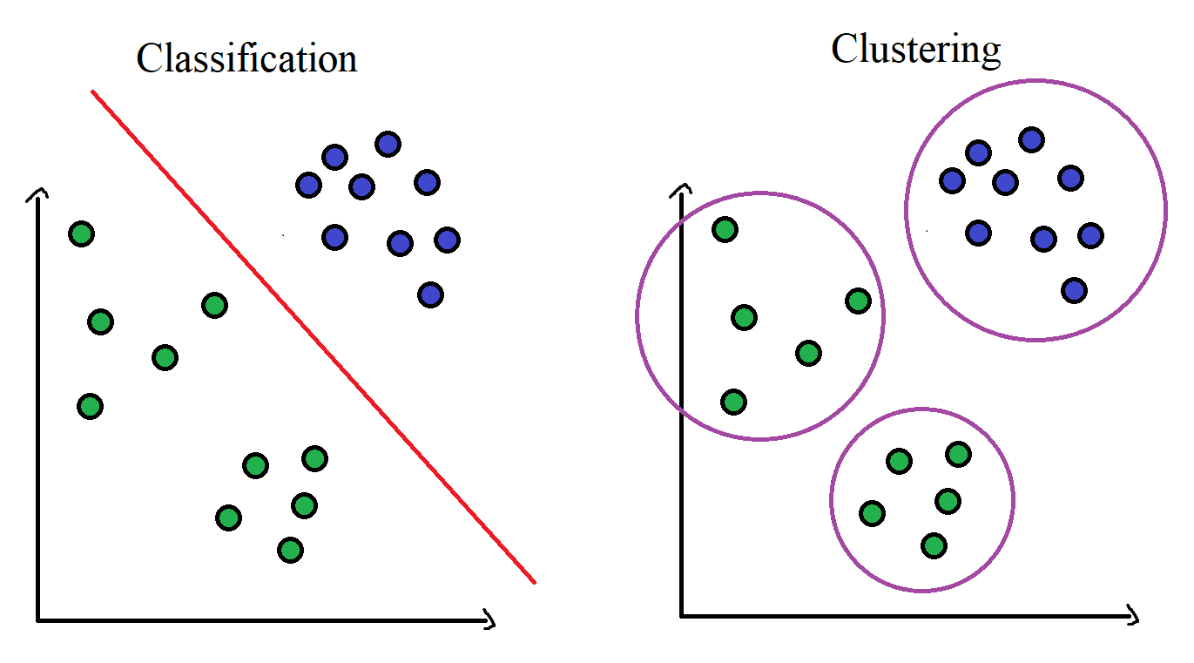
K-Means questions
True labels?
Cluster vs class?

Slide 3
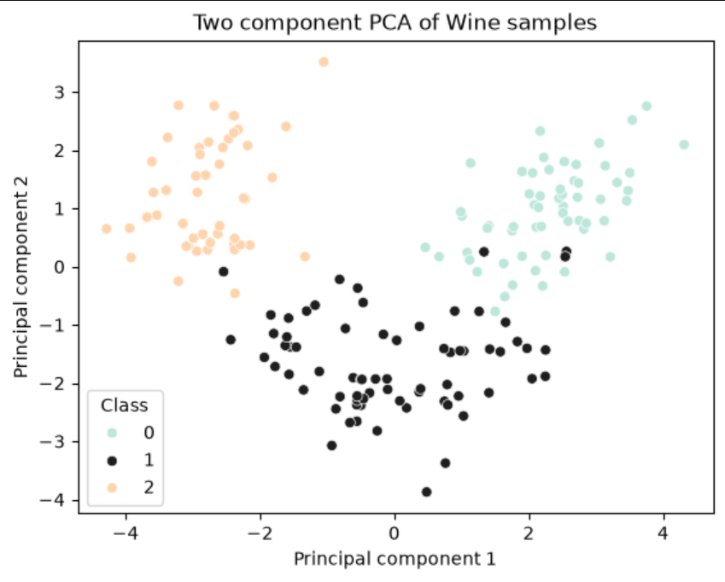
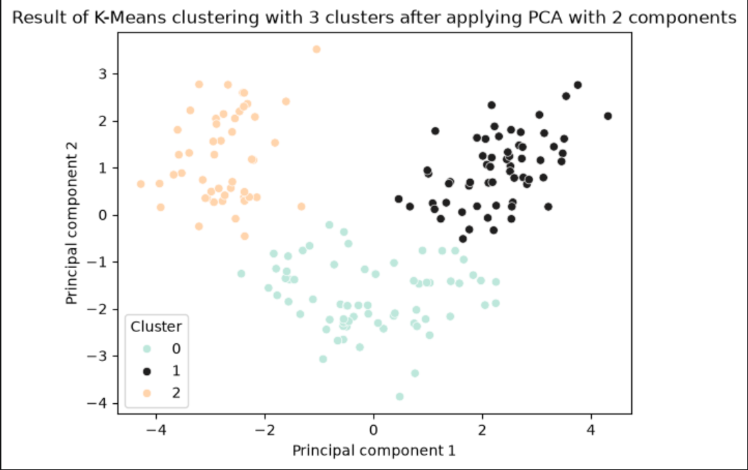
K-means initial results
Not too compact
Correspond well

Slide 4

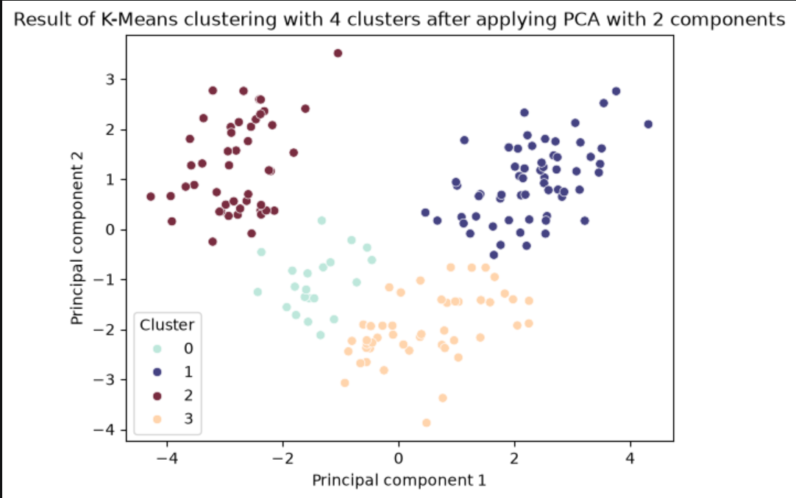
Number of clusters
WSS (2 - 8): 628 -> 259 -> 201 -> 169 -> 123 -> 104 -> 91
Strongest agreement: k = 3
True labels?

Slide 5
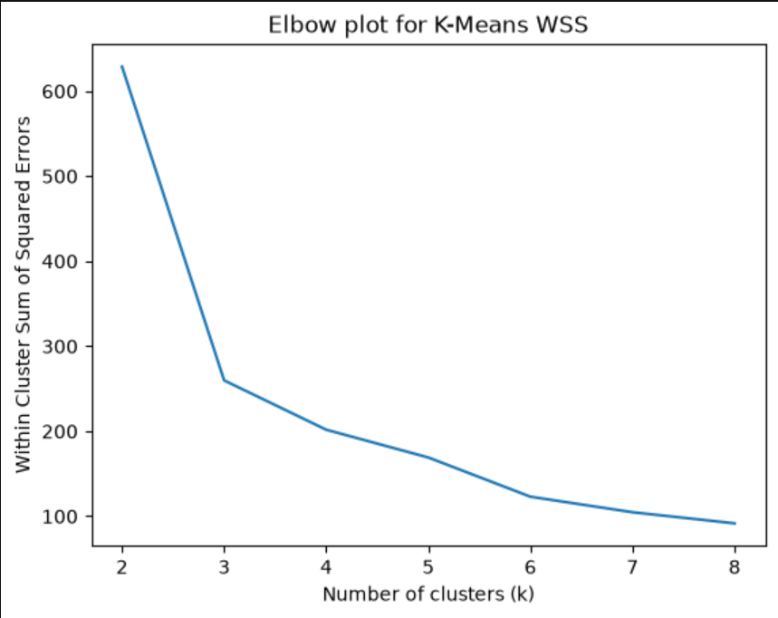
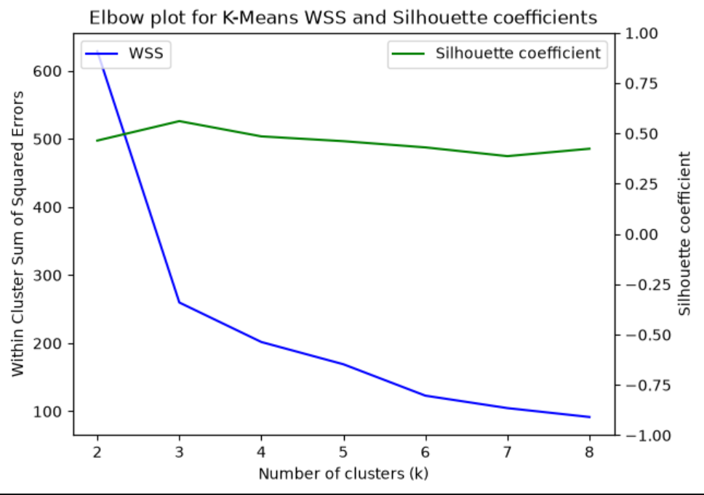
Elbow method
Winner: k = 3

Slide 6
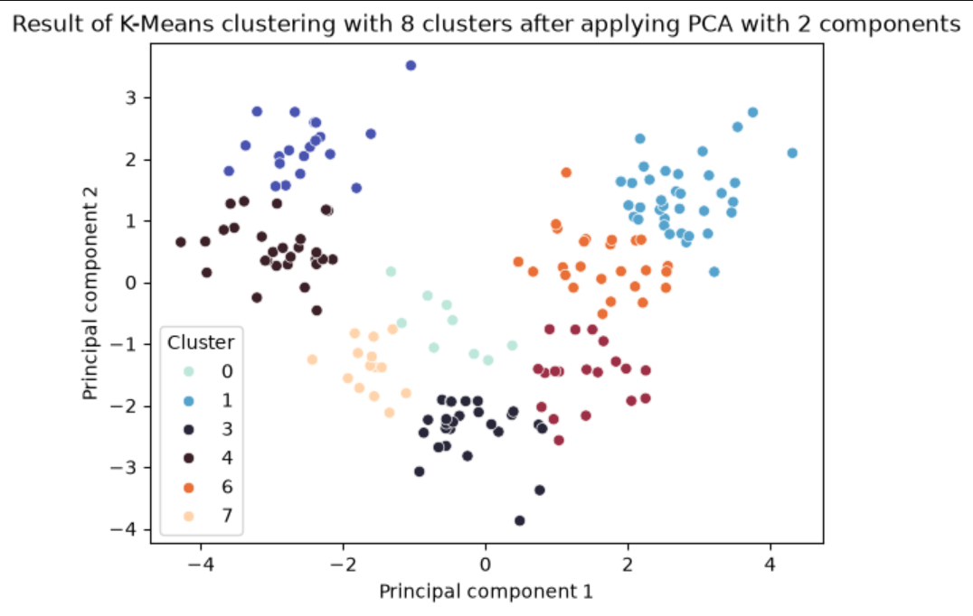
Per cluster silhouette
K = 3
  0.45, 0.62, 0.65
K = 4
  0.32, 0.49, 0.53, 0.59
K = 5
  0.29, 0.45, 0.45, 0.49, 0.59
K = 8
  0.28, 0.35, 0.40 …
Example:

Slide 7
THANK YOU

