Slide 1
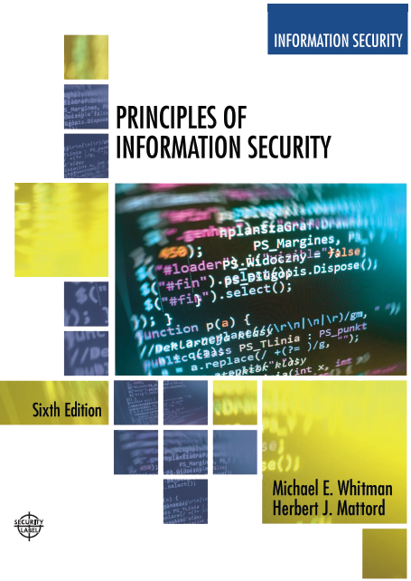

Principles of Information Security
Sixth Edition
Chapter1
Introduction to Information Security
Copyright © 2018 Cengage. May not be copied, scanned, or duplicated, in whole or in part, except for use as permitted in a license distributed with a certain product or service or otherwise on a password-protected website for classroom use.

Slide 2
Learning Objectives
Upon completion of this material, you should be able to:
Define information security
Recount the history of computer security and explain how it evolved into information security
Define key terms and critical concepts of information security
Explain the role of security in the systems development life cycle
Describe the information security roles of professionals within an organization
Notes:
Upon completion of this material, you should be able to:
Define information security
Recount the history of computer security and how it evolved into information security
Define key terms and critical concepts of information security
List the phases of the security systems development life cycle
Describe the information security roles of professionals within an organization

Slide 3
Introduction
“Enterprise information security is a critical business capability that needs to be aligned with corporate expectations and culture that provides the leadership and insight to identify risks and implement effective controls.”—Martin Fisher, IT Security Manager, North side Hospital, Atlanta, Georgia ‏
Security professionals must review the origins of this field to understand its impact on our understanding of information security today
Notes:
What Is Information Security?
Information security in today’s enterprise is a “well-informed sense of assurance that the information risks and controls are in balance.” – Jim Anderson, Inovant (2002)‏
Before we can begin analyzing the details of information security, it is necessary to review the origins of this field and its impact on our understanding of information security today.

Slide 4
The History of Information Security
Computer security began immediately after the first mainframes were developed
Groups developing code-breaking computations during World War II created the first modern computers.
Multiple levels of security were implemented.
Physical controls limiting access to sensitive military locations to authorized personnel
Rudimentary in defending against physical theft, espionage, and sabotage
Notes:
The History Of Information Security
Computer security began immediately after the first mainframes were developed
Groups developing code-breaking computations during World War II created the first modern computers
Multiple levels of security were implemented
Physical controls to limit access to sensitive military locations to authorized personnel
Rudimentary in defending against physical theft, espionage, and sabotage

Slide 5
Table 1-1 Key Dates in Information Security (1 of 2)
Date | Document
1968 | Maurice Wilkes discusses password security in Time - Sharing Computer Systems.
1970 | Willis H. Ware author the report Security Controls for Computer Systems: Report of Defense Science Board Task Force on Computer Security—RAND R.609 which was not declassified until 1979. I became known as the seminal work identifying the need for computer Security.
1973 | Schell, Downey, and Popek examine the need for additional security in military systems in Preliminary Notes on the Design of Secure Military Computer Systems.
1975 | The Federal Information Processing Standards (FIPS) examines DES (Digital Encryption Standard) In the Federal Register.
1978 | Bisbey and Hollingsworth publish their study “Protection Analysis: Final Report,” which discussed the Protection Analysis project created by ARPA to better understand the vulnerabilities of operating system security and examine the possibility of automated vulnerability detection techniques in existing system software.

Slide 6
Table 1-1 Key Dates in Information Security (2 of 2)
Date | Document
1979 | Dennis Ritchie publishes “On the Security of UNIX” and “Protection of Data File Contents,” which discussed secure user IDs, secure group IDs, and the problems inherent in the systems.
1982 | The US. Department of Defense Computer Security Evaluation Center publishes the first version of the Trusted Computer Security (TCSEC) documents, which came to be known as the Rainbow Series.
1982 | Grampp and Morris write “The UNIX System: UNIX Operating System Security.” In this report the authors examined four “important handles to computer security”: physical control of primes and computer facilities, management commitment to security objectives, education of employees, and administrative procedures aimed at increased security.
1984 | Reeds and Weinberger publish “File Security and the UNIX System Crypt Command.” Their premise was: “No technique can be secure against wiretapping or is equivalent on the computer. Therefore no technique can be secure against the system administrator or other privileged users... the naive user have no chance.”
1992 | Researchers for the Internet Engineering Task force, working at the Naval Research Laboratory, develop the Simple Internet Protocol Plus (SIPP) Security protocols, creating what is now known as IPSEC security.

Slide 7
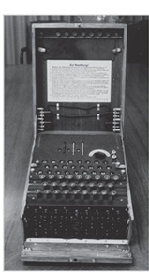
Figure 1-1 The Enigma (1 of 2)
Source. Bletchley Park Trust. Used with permission.
Notes:
This picture shows a high-visibility artifact associated with the early days of information security – focusing on the confidentiality of information. This artifact is also part of the study of cryptography from Chapter 8.

Slide 8
Figure 1-1 The Enigma (2 of 2)
Earlier versions of the German code machine Enigma were first broken by the Poles in the 1930s. The British and Americans managed to break later, more complex versions during World War II. The increasingly complex versions of the Enigma, especially the submarine or Unterseeboot version of the Enigma, caused considerable anguish to Allied forces before finally being cracked. The information gained from decrypted transmissions was used to anticipate the actions of German armed forces. 'Some ask why, if we were reading the Enigma, we did not win the war earlier. One might ask, instead, when, if ever, we would have won the war if we hadn't read it'

Slide 9
The 1960s
Advanced Research Projects Agency (ARPA) began to examine the feasibility of redundant networked communications.
Larry Roberts developed the ARPANET from its inception.
Notes:
The 1960s
During the 1960s, the Department of Defense’s Advanced Research Procurement Agency (ARPA) began examining the feasibility of a redundant networked communications system designed to support the military’s need to exchange information.
Larry Roberts, known as the founder of the Internet, developed the project from its inception.

Slide 10
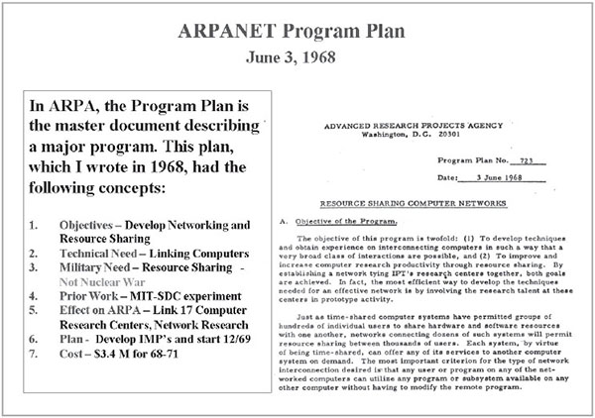
Figure 1-2 Development of the ARPANET
Source. Courtesy of Dr. Lawrence Roberts. Used with permission.
Notes:
This picture shows a high-visibility artifact associated with the early days of information security – focusing on the confidentiality of information. This artifact is also part of the study of cryptography from Chapter 8.

Slide 11
The 1970s and 80s (1 of 2)
ARPANET grew in popularity, as did its potential for misuse.
Fundamental problems with ARPANET security were identified.
No safety procedures for dial-up connections to ARPANET
Nonexistent user identification and authorization to system
Notes:
The 1970s and 80s
ARPANET grew in popularity as did its potential for misuse
Fundamental problems with ARPANET security were identified
No safety procedures for dial-up connections to ARPANET
Nonexistent user identification and authorization to system
Late 1970s: microprocessor expanded computing capabilities and security threats

Slide 12
The 1970s and 80s (2 of 2)
Information security began with RAND Report R-609 (paper that started the study of computer security and identified the role of management and policy issues in it)‏.
The scope of computer security grew from physical security to include:
Securing the data
Limiting random and unauthorized access to data
Involving personnel from multiple levels of the organization in information security
Notes:
The 1970s and 80s (cont’d.)
Information security began with Rand Report R-609 (paper that started the study of computer security and identified role of management and policy issues in it)‏
Scope of computer security grew from physical security to include:
Securing the data
Limiting random and unauthorized access to data
Involving personnel from multiple levels of the organization in information security

Slide 13
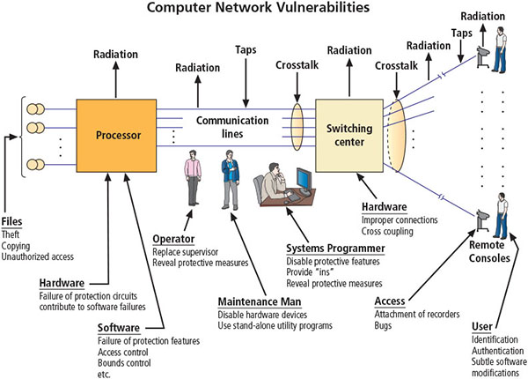
Figure 1-4 Illustration of computer network vulnerabilities from RAND Report R-609
Source. RAND Report R-609-1. Used with permission.

Slide 14
MULTICS (1 of 2)
Early focus of computer security research centered on a system called Multiplexed Information and Computing Service (MULTICS)‏.
First operating system was created with security integrated into core functions.
Mainframe, time-sharing operating system was developed in the mid-1960s by General Electric (GE), Bell Labs, and Massachusetts Institute of Technology (MIT)‏.
Notes:
MULTICS
Early focus of computer security research centered on a system called Multiplexed Information and Computing Service (MULTICS)‏
First operating system created with security integrated into core functions
Mainframe, time-sharing OS developed in mid-1960s by General Electric (GE), Bell Labs, and Massachusetts Institute of Technology (MIT)‏
Several MULTICS key players created UNIX
Primary purpose of UNIX was text processing
Late 1970s: microprocessor expanded computing capabilities and security threats

Slide 15
MULTICS (2 of 2)
Several MULTICS key players created UNIX.
Primary purpose of UNIX was text processing.
Late 1970s: The microprocessor expanded computing capabilities and security threats.

Slide 16
The 1990s
Networks of computers became more common, as did the need to connect them to each other.
Internet became the first global network of networks.
Initially, network connections were based on de facto standards.
In early Internet deployments, security was treated as a low priority.
In 1993, DEFCON conference was established for those interested in information security.
Notes:
The 1990s
Networks of computers became more common; so did the need to connect them to each other
Internet became first global network of networks
Initially based on de facto standards
In early Internet deployments, security was treated as a low priority
In 1993, DEFCON conference established for those interested in information security

Slide 17
2000 to Present
The Internet brings millions of unsecured computer networks into continuous communication with each other.
The ability to secure a computer’s data was influenced by the security of every computer to which it is connected.
Growing threat of cyber attacks has increased the awareness of need for improved security.
Nation-states engaging in information warfare
Notes:
2000 to Present
The Internet brings millions of unsecured computer networks into continuous communication with each other
Ability to secure a computer’s data influenced by the security of every computer to which it is connected
Growing threat of cyber attacks has increased the awareness of need for improved security
Nation-states engaging in information warfare

Slide 18
What Is Security? (1 of 2)
“(1) A state of being secure and free from danger or harm; (2) the actions taken to make someone or something secure.”
A successful organization should have multiple layers of security in place to protect:
Operations (Processes - work)
Physical infrastructure
People
Functions (how I structure my business)
Communications
Data, Information, Intelligence, Knowledge
Components
(What should I Protect?)
Notes:
What Is Security?
“A state of being secure and free from danger or harm; the actions taken to make someone or something secure”
A successful organization should have multiple layers of security in place to protect:
Operations
Physical Infrastructure
People
Functions
Communications
Information

Slide 19
What Is Security? (2 of 2)
The protection of information and its critical elements, including systems and hardware that use, store, and transmit that (data) information
Includes information security management, data security, and network security
C.I.A. triad
Is a standard based on confidentiality, integrity, and availability, now viewed as inadequate.
Expanded model consists of a list of critical characteristics of information.
Notes:
What Is Security? (cont’d.)
The protection of information and its critical elements, including systems and hardware that use, store, and transmit that information
Includes information security management, data security, and network security
C.I.A. triangle
Is standard based on confidentiality, integrity, and availability, now viewed as inadequate
Expanded model consists of a list of critical characteristics of information

Slide 20
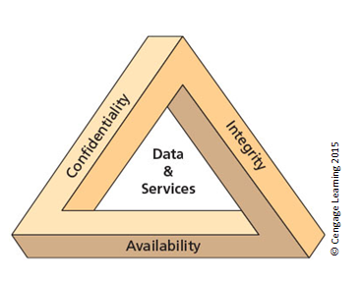
Figure 1-5 The C.I.A. triad (2 of 2)

Slide 21
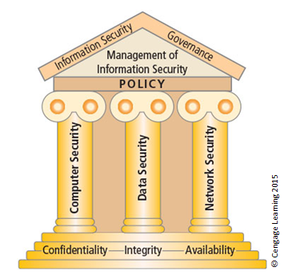
Figure 1-5 Components of information security (1 of 2)
Government ICT House of Values*
Lower Cost
Increased Productivity
ICT Value
Citizen Convenience
Security
Interoperability
Reduced Duplication
Economies of Scale
Digital Inclusion
Objectives
ICT Planning (GWEA) → ICT Acquisition → ICT Operations
Means/Services
* From e-Government Policy, SITA Regulations & SITA Act (amended)
21

Slide 22
Key Information Security Concepts (1 of 3)
Access
Asset
Attack
Control, safeguard, or countermeasure
Exploit
Exposure
Loss
Protection profile or security posture
Know what the Concepts are.
Notes:
Key Terms
Access - a subject or object’s ability to use, manipulate, modify, or affect another subject or object.
Asset - the organizational resource that is being protected.
Attack - an intentional or unintentional act that can damage or otherwise compromise information and the systems that support it.
Control, Safeguard, or Countermeasure - Security mechanisms, policies, or procedures that can successfully counter attacks, reduce risk, resolve vulnerabilities, and otherwise improve security within an organization.
Exploit – a technique used to compromise a system.
Exposure - a condition or state of being exposed.
Loss: A single instance of an information asset suffering damage or destruction, unintended or unauthorized modification or disclosure, or denial of use.
Protection Profile or Security Posture-entire set of controls and safeguards that the organization implements to protect the asset.
Risk - the probability of an unwanted occurrence.
Subjects and Objects – a computer can be either an agent entity used to conduct an attack, or the target entity.
Threat - a category of objects, people, or other entities that represents a danger to an asset.
Threat Agent – the specific instance or a component of a threat.
Vulnerability - weaknesses or faults in a system or protection mechanism that expose information to attack or damage.

Slide 23
Key Information Security Concepts (2 of 3)
Risk
Subjects and objects of attack
Threat
Threat agent
Threat event
Threat source
Vulnerability
Know what the Concepts are.

Slide 24
Key Information Security Concepts (3 of 3)
A computer can be the subject of an attack and/or the object of an attack.
When it is the subject of an attack, the computer is used as an active tool to conduct attack.
When it is the object of an attack, the computer is the entity being attacked.
Notes:
Key Information Security Concepts
When considering the security of information systems components, it is important to understand the concept of the computer as the subject of an attack as opposed to the computer as the object of an attack.
When a computer is the subject of an attack, it is used as an active tool to conduct the attack. When a computer is the object of an attack, it is the entity being attacked.

Slide 25
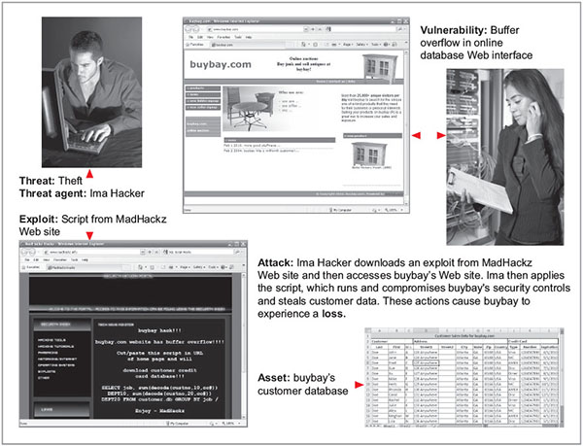
Figure 1-7 Key concepts in information security
Source. (top left to bottom right): © iStockphoto/tadija, Internet Explorer, © iStockphoto/darrenwise , Internet Explorer, Microsoft Excel.

Slide 26
Critical Characteristics of Information
The value of information comes from the characteristics it possesses:
Availability
Accuracy
Authenticity
Confidentiality
Integrity
Utility
Possession
NB!!!
Notes:
Critical Characteristics of Information
The value of information comes from the characteristics it possesses.
Availability – Enables users who need to access information to do so without interference or obstruction and in the required format. The information is said to be available to an authorized user when and where needed and in the correct format.
Accuracy – Free from mistake or error and having the value that the end user expects. If information contains a value different from the user’s expectations due to the intentional or unintentional modification of its content, it is no longer accurate.
Authenticity –The quality or state of being genuine or original, rather than a reproduction or fabrication. Information is authentic when it is the information that was originally created, placed, stored, or transferred.
Confidentiality – The quality or state of preventing disclosure or exposure to unauthorized individuals or systems.
Integrity – The quality or state of being whole, complete, and uncorrupted. The integrity of information is threatened when the information is exposed to corruption, damage, destruction, or other disruption of its authentic state.
Utility – The quality or state of having value for some purpose or end. Information has value when it serves a particular purpose. This means that if information is available, but not in a format meaningful to the end user, it is not useful.
Possession – The quality or state of having ownership or control of some object or item. Information is said to be in possession if one obtains it, independent of format or other characteristic. While a breach of confidentiality always results in a breach of possession, a breach of possession does not always result in a breach of confidentiality.

Slide 27
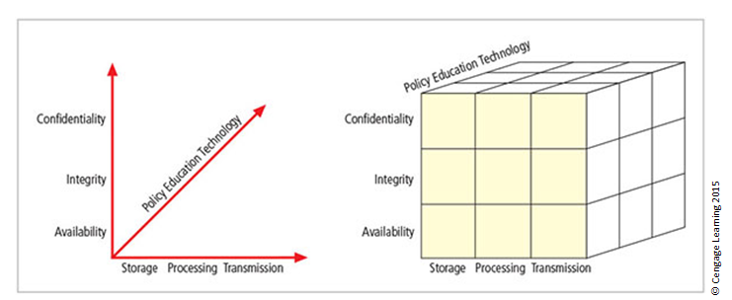
Figure 1-9 The McCumber Cube
Notes:
This graphic informs the fundamental approach of the chapter and can be used to illustrate the intersection of information states (x-axis), key objectives of C.I.A. (y-axis), and the three primary means to implement (policy, education, and technology).

Slide 28
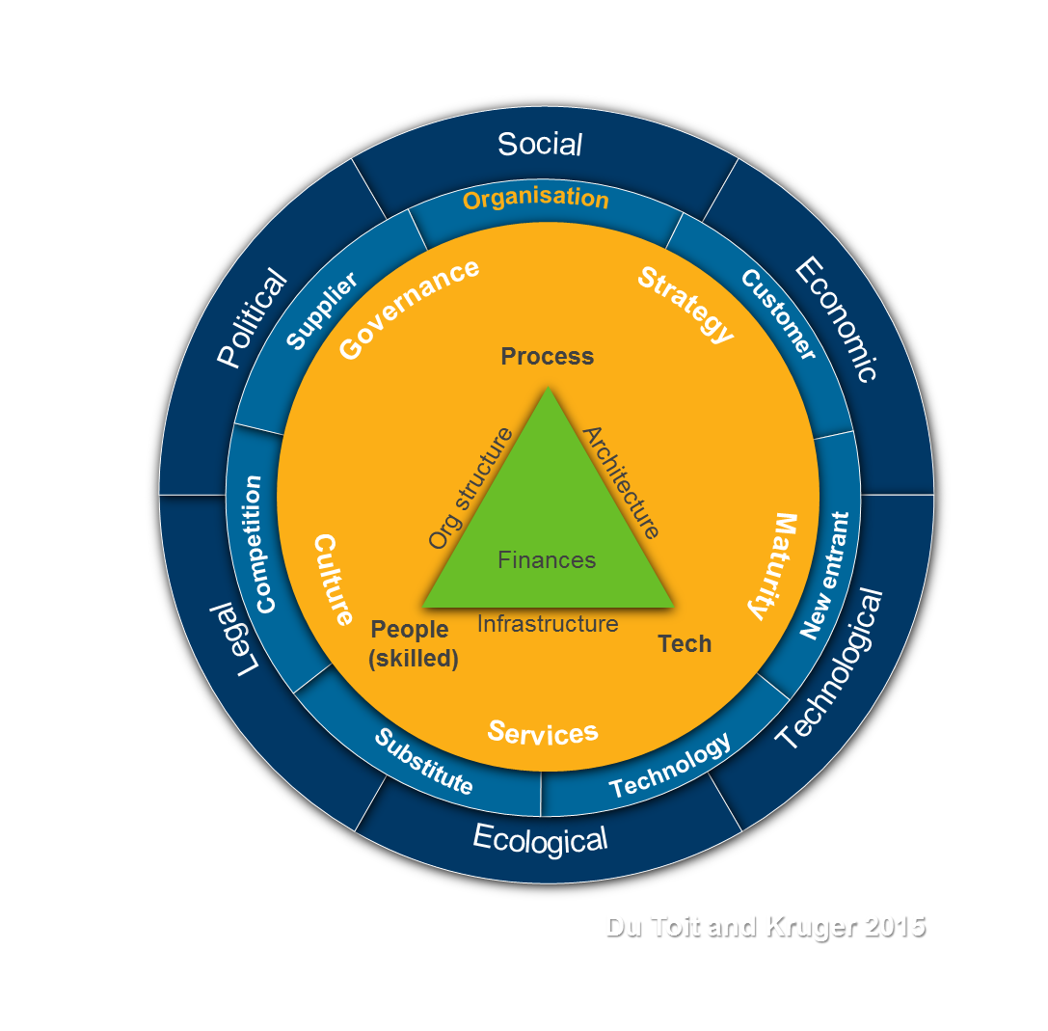
Components of an Information System
Information system (IS) is the entire set of people, processes / procedures, and technology that enable business to use information.
Software
Hardware
Data
People
Procedures
Networks
Notes:
Components of an Information System
Information system (IS) is entire set of people, procedures, and technology that enable business to use information.
Software
Hardware
Data
People
Procedures
Networks

Slide 29
Components of an Information System
New entrant
Technology
Legal
Political
Social
Economic
Ecological
Technological
Customer
Organisation
Supplier
Competition
Substitute
Strategy
Governance
Maturity
Services
Input
Culture
Output
Process
Value Chain
Org structure
Architecture
Segment 3
Finances
People (skilled)
Infrastructure
Tech
Du Toit and Kruger 2015

Slide 30
Balancing Information Security and Access
Impossible to obtain perfect information security—it is a process, not a goal.
Security should be considered a balance between protection and availability.
To achieve balance, the level of security must allow reasonable access, yet protect against threats.
Notes:
Security and Access Balancing
When considering information security, it is important to realize that it is impossible to obtain perfect security. Security is not an absolute; it is a process not a goal.
Security should be considered a balance between protection and availability.
To achieve balance, the level of security must allow reasonable access yet protect against threats.

Slide 31

Approaches to Information Security Implementation: Bottom-Up Approach
Grassroots effort: Systems administrators attempt to improve security of their systems.
Key advantage: technical expertise of individual administrators
Seldom works, as it lacks a number of critical features:
Participant support (Culture)
Organizational staying power (Structure)
Notes:
Bottom-up Approach to Security Implementation
Security can begin as a grass-roots effort when systems administrators attempt to improve the security of their systems. This is referred to as the bottom-up approach.
The key advantage of the bottom-up approach is the technical expertise of the individual administrators.
Unfortunately, this approach seldom works, as it lacks a number of critical features, such as participant support and organizational staying power.

Slide 32
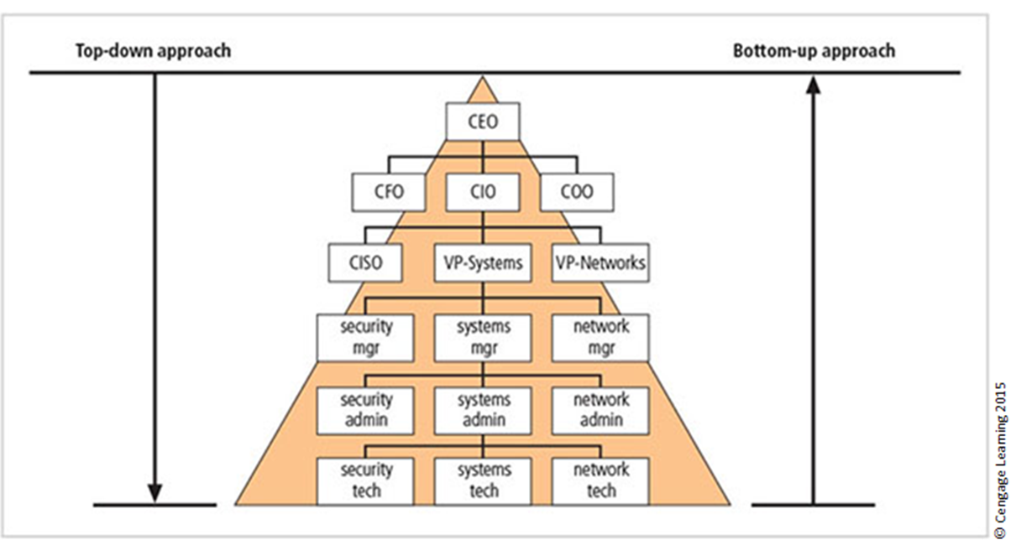

Approaches to Information Security Implementation: Top-Down Approach
Initiated by upper management
Issue policy, procedures, and processes
Dictate goals and expected outcomes of project (Strategy)
Determine accountability for each required action (Governance)
The most successful type of top-down approach also involves a formal development strategy referred to as systems development life cycle.
Notes:
Top-down Approach to Security Implementation
An alternative approach, which has a higher probability of success, is called the top-down approach. The project is initiated by upper management who issue policy, procedures, and processes; dictate the goals and expected outcomes of the project; and determine who is accountable for each of the required actions.
The top-down approach has strong upper-management support, a dedicated champion, dedicated funding, clear planning, and the opportunity to influence organizational culture.
The most successful top-down approach also involves a formal development strategy referred to as a systems development life cycle.

Slide 33
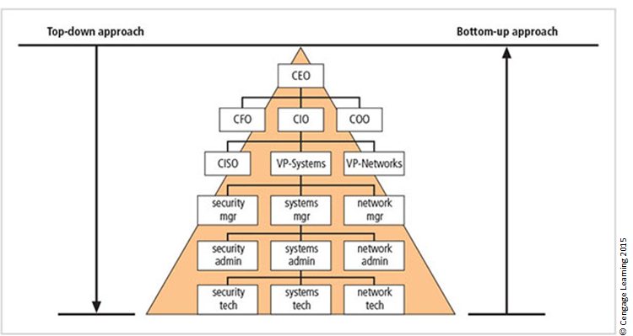
Figure 1-12 Approaches to information security implementation
Notes:
The key concept here is the direction of the left and right side arrows to show where planning is sourced and from which direction the pressure for success is driven.

Slide 34
Security in the Systems Development Life Cycle
Systems development life cycle (SDLC): a methodology for the design and implementation of an information system
Methodology: a formal approach to solving a problem based on a structured sequence of procedures
Using a methodology:
Ensures a rigorous process with a clearly defined goal (Strategy)
Increases probability of success
Notes:
The Systems Development Life Cycle
Systems Development Life Cycle (SDLC): methodology for design and implementation of an information system
Methodology: formal approach to solving a problem based on a structured sequence of procedures
Using a methodology:
Ensures a rigorous process with a clearly defined goal
Increases probability of success
Traditional SDLC consists of six general phases

Slide 35
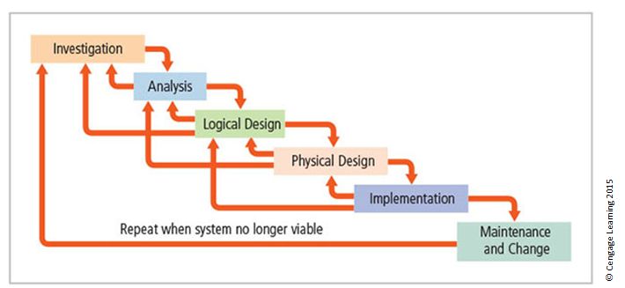
Figure 1-13 SDLC waterfall methodology
Notes:
Very much a traditional SDLC diagram.

Slide 36
Investigation
What problem is the system being developed to solve?
Objectives, constraints, and scope of project are specified.
Preliminary cost-benefit analysis is developed.
At the end of all phases, a process is undertaken to assess economic, technical, and behavioral feasibilities and ensure implementation is worth the time and effort.
Notes:
Investigation
What problem is the system being developed to solve?
Objectives, constraints, and scope of project are specified
Preliminary cost-benefit analysis is developed
At the end of all phases, a process is undertaken to assess economic, technical, and behavioral feasibilities and ensure implementation is worth time and effort

Slide 37
Analysis
Consists of assessments of:
The organization
Current systems
Capability to support proposed systems
Analysts determine what the new system is expected to do and how it will interact with existing systems.
Analysis ends with documentation of findings and an update of feasibility.
Notes:
Analysis
The analysis phase begins with the information learned during the investigation phase.
This phase consists primarily of assessments of the organization, the status of current systems, and the capability to support the proposed systems.
Analysts begin to determine what the new system is expected to do and how it will interact with existing systems.
This phase ends with the documentation of the findings and a feasibility analysis update.

Slide 38
Logical Design
The first and driving factor is the business need.
Applications are selected to provide needed services.
Data support and structures capable of providing the needed inputs are identified.
Specific technologies are delineated to implement the physical solution.
Analysts generate estimates of costs and benefits to allow comparison of available options.
Feasibility analysis is performed at the end.
Notes:
Logical Design
First and driving factor is business need
Applications are selected to provide needed services
Data support and structures capable of providing the needed inputs are identified
Specific technologies are delineated to implement the physical solution
Analysts generate estimates of costs and benefits to allow comparison of available options
Feasibility analysis performed at the end

Slide 39
Physical Design
Specific technologies are selected to support the alternatives identified and evaluated in the logical design.
Selected components are evaluated on make-or-buy decision.
Feasibility analysis is performed.
Entire solution is presented to organization’s management for approval.
Notes:
Physical Design
Specific technologies selected to support the alternatives identified and evaluated in the logical design
Selected components evaluated on make-or-buy decision
Feasibility analysis performed
Entire solution presented to organization’s management for approval

Slide 40
Implementation
Needed software is created.
Components are ordered, received, and tested.
Users are trained and supporting documentation created.
Feasibility analysis is prepared.
Sponsors are presented with the system for a performance review and acceptance test.
Notes:
Implementation
Needed software created
Components ordered, received, and tested
Users trained and supporting documentation created
Feasibility analysis prepared
Sponsors presented with system for performance review and acceptance test

Slide 41
Maintenance and Change
Longest and most expensive phase
Consists of the tasks necessary to support and modify the system for the remainder of its useful life
Life cycle continues until the team determines the process should begin again from the investigation phase
When current system can no longer support the organization’s mission, a new project is implemented
Notes:
Maintenance and Change
The maintenance and change phase is the longest and most expensive phase of the process.
This phase consists of the tasks necessary to support and modify the system for the remainder of its useful life cycle.
Even though formal development may conclude during this phase, the life cycle of the project continues until it is determined that the process should begin again from the investigation phase. When the current system can no longer support the changed mission of the organization, the project is terminated and a new project is implemented.

Slide 42
Software Assurance (1 of 3)
Many organizations recognize the need to include planning for security objectives in the SDLC used to create systems.
Established procedures to create software that is more capable of being deployed in a secure fashion
This approach is known as software assurance (SA).
A national effort is under way to create a common body of knowledge focused on secure software development.
Notes:
Many organizations recognize need to include planning for security objectives in the SDLC used to create systems
Established procedures to create software more capable of being deployed in a secure fashion
This approach known as software assurance (SA)
Software Assurance Initiative resulted in publication of Secure Software Assurance (SwA) Common Body of Knowledge (CBK)

Slide 43
Software Assurance (2 of 3)
U.S. Department of Defense and Department of Homeland Security supported the Software Assurance Initiative, which resulted in the publication of Secure Software Assurance (SwA) Common Body of Knowledge (CBK).
SwA CBK serves as a strongly recommended guide to developing more secure applications.
SwA CBK, which is a work in progress, contains the following sections:
Nature of Dangers
Fundamental Concepts and Principles
Ethics, Law, and Governance
Notes:
SwA CBK is a work in progress, contains following sections:
Nature of Dangers
Fundamental Concepts and Principles
Ethics, Law, and Governance
Secure Software Requirements
Secure Software Design
Secure Software Construction
Secure Software Verification, Validation, and Evaluation
Secure Software Tools and Methods
Secure Software Processes
Secure Software Project Management
Acquisition of Secure Software
Secure Software Sustainment

Slide 44
Software Assurance (3 of 3)
Secure Software Requirements
Secure Software Design
Secure Software Construction
Secure Software Verification, Validation, and Evaluation
Secure Software Tools and Methods
Secure Software Processes
Secure Software Project Management
Acquisition of Secure Software
Secure Software Sustainment

Slide 45
Software Design Principles (1 of 2)
Good software development results in secure products that meet all design specifications.
Some commonplace security principles
Keep design simple and small
Access decisions by permission not exclusion
Every access to every object checked for authority
Design depends on possession of keys/passwords
Protection mechanisms require two keys to unlock
Programs/users utilize only necessary privileges

Slide 46
Software Design Principles (2 of 2)
Some commonplace security principles
Minimize mechanisms common to multiple users
Human interface must be easy to use so users routinely/automatically use protection mechanisms.

Slide 47
The NIST Approach to Securing the SDLC
NIST Special Publication 800-64, rev. 2, maintains that early integration of security in the SDLC enables agencies to maximize return on investment through:
Early identification and mitigation of security vulnerabilities and misconfigurations
Awareness of potential engineering challenges
Identification of shared security services and reuse of security strategies and tools
Facilitation of informed executive decision making
Notes:
The NIST Approach to Securing the SDLC
NIST Special Publication 800-64 rev. 2 maintains that early integration of security in the SDLC enables agencies to maximize return on investment through:
Early identification and mitigation of security vulnerabilities and misconfigurations
Awareness of potential engineering challenges
Identification of shared security services and reuse of security strategies and tools
Facilitation of informed executive decision making

Slide 48
The NIST Approach: Initiation
Security at this point is looked at in terms of business risks, with information security office providing input.
Key security activities include:
Delineation of business requirements in terms of confidentiality, integrity, and availability
Determination of information categorization and identification of known special handling requirements to transmit, store, or create information
Determination of any privacy requirements
Notes:
Initiation
Security at this point looked at in terms of business risks, with information security office providing input
Key security activities include:
Delineation of business requirements in terms of confidentiality, integrity, and availability
Determination of information categorization and identification of known special handling requirements to transmit, store, or create information
Determination of any privacy requirements

Slide 49
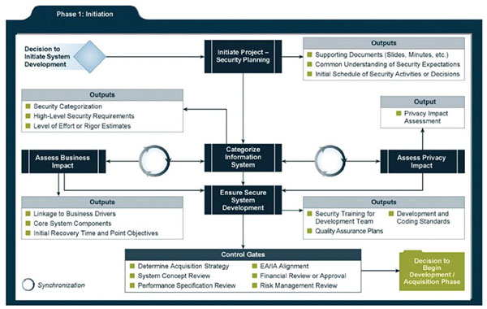
Figure 1-14 Relating security considerations in the Initiation phase
Source: NIST SP 800-64 Rev. 2: Security Considerations in the System Development Life Cycle.

Slide 50
The NIST Approach: Development/Acquisition
Key security activities include:
Conducting risk assessment and using results to supplement baseline security controls
Analyzing security requirements
Performing functional and security testing
Preparing initial documents for system certification and accreditation
Designing security architecture
Notes:
Development/Acquisition
Key security activities include:
Conduct risk assessment and use results to supplement baseline security controls
Analyze security requirements
Perform functional and security testing
Prepare initial documents for system certification and accreditation
Design security architecture

Slide 51
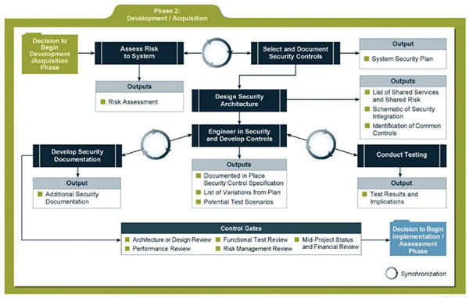
Figure 1-15 Relating security considerations in the Development/Acquisition phase
Source: NIST SP 800-64 Rev. 2: Security Considerations in the System Development Life Cycle.

Slide 52
The NIST Approach: Implementation/Assessment
System is installed and evaluated in operational environment.
Key security activities include:
Integrating information system into its environment
Planning and conducting system certification activities in synchronization with testing of security controls
Completing system accreditation activities
Notes:
Implementation/Assessment
System installed and evaluated in operational environment
Key security activities include:
Integrate information system into its environment
Plan and conduct system certification activities in synchronization with testing of security controls
Complete system accreditation activities

Slide 53
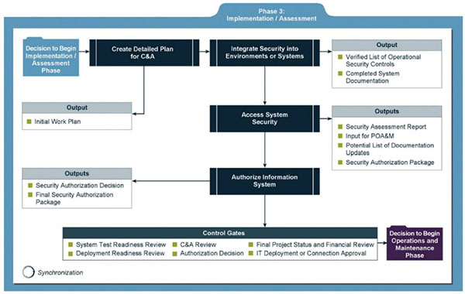
Figure 1-16 Relating security considerations in the Implementation/Assessment phase
Source: NIST SP 800-64 Rev. 2: Security Considerations in the System Development Life Cycle.

Slide 54
The NIST Approach: Operations and Maintenance
Systems are in place and operating, enhancements and/or modifications to the system are developed and tested, and hardware and/or software are added or replaced.
Key security activities include:
Conducting operational readiness review
Managing configuration of system
Instituting process and procedure for assured operations and continuous monitoring of information system’s security controls
Performing reauthorization as required
Notes:
Operations and Maintenance:
Systems are in place and operating, enhancements and/or modifications to the system are developed and tested, and hardware and/or software added or replaced
Key security activities include:
Conduct operational readiness review
Manage configuration of system
Institute process and procedure for assured operations and continuous monitoring of information system’s security controls
Perform reauthorization as required

Slide 55
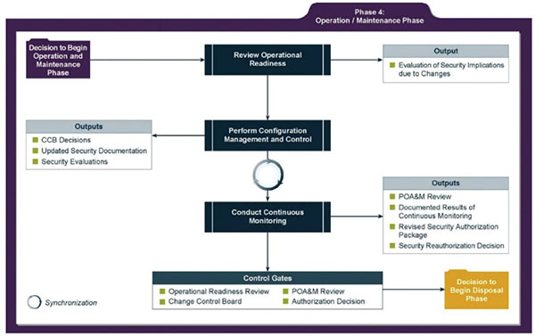
Figure 1-17 Relating security considerations in the Operation/Maintenance phase
Source: NIST SP 800-64 Rev. 2: Security Considerations in the System Development Life Cycle.

Slide 56
The NIST Approach: Disposal
Provides for disposal of system and closeout of any contracts in place
Key security activities include:
Building and executing disposal/transition plan
Archival of critical information
Sanitization of media
Disposal of hardware and software
Notes:
Disposal:
Provides for disposal of system and closeout of any contracts in place
Key security activities include:
Building and executing disposal/transition plan
Archival of critical information
Sanitization of media
Disposal of hardware and software

Slide 57
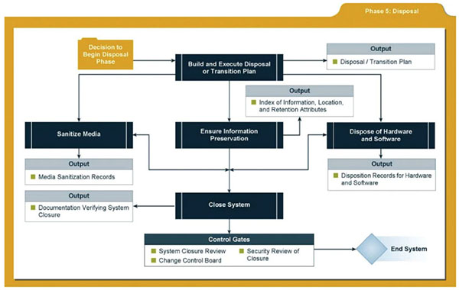
Figure 1-18 Relating security considerations in the Disposal phase
Source: NIST SP 800-64 Rev. 2: Security Considerations in the System Development Life Cycle.

Slide 58
Figure 1-19 Microsoft’s SDL (1 of 3)
Training:
Core security training
Requirements:
Establish security requirements
Create quality gates/bug bars
Perform security and privacy risk assessments
Design:
Establish design requirements
Perform attack surface analysts/ reduction
Use threat modeling

Slide 59
Figure 1-19 Microsoft’s SDL (2 of 3)
Implementation:
Use approved tools
Deprecate unsafe functions
Perform static analysis
Veri cation:
Perform dynamic analysis
Perform fuzz testing
Conduct attack surface review

Slide 60
Figure 1-19 Microsoft’s SDL (3 of 3)
Release:
Create an incident response plan
Conduct nal security review
Certify release and archive
Response:
Execute incident response plan
Source © Microsoft Learning 2015

Slide 61


Security Professionals and the Organization
Wide range of professionals are required to support a diverse information security program.
Senior management is the key component.
Additional administrative support and technical expertise are required to implement details of the IS program.
Notes:
Security Professionals and the Organization
It takes a wide range of professionals to support a diverse information security program.
To develop and execute specific security policies and procedures, additional administrative support and technical expertise is required.

Slide 62
Senior Management
Chief information officer (CIO)‏
Senior technology officer
Primarily responsible for advising the senior executives on strategic planning
Chief information security officer (CISO)‏
Has primary responsibility for assessment, management, and implementation of IS in the organization
Usually reports directly to the CIO
Notes:
Senior Management
Chief Information Officer – The senior technology officer, although other titles such as Vice President of Information, VP of Information Technology, and VP of Systems may be used. The CIO is primarily responsible for advising the Chief Executive Officer, President, or company owner on the strategic planning that affects the management of information in the organization.
Chief Information Security Officer – The individual primarily responsible for the assessment, management, and implementation of securing the information in the organization. The CISO may also be referred to as the Manager for Security, the Security Administrator, or a similar title.

Slide 63
Information Security Project Team
A small functional team of people who are experienced in one or multiple facets of required technical and nontechnical areas:
Champion
Team leader
Security policy developers
Risk assessment specialists
Security professionals
Systems administrators
End users
Notes:
Security Project Team
A number of individuals who are experienced in one or multiple requirements of both the technical and nontechnical areas.
The champion: A senior executive who promotes the project and ensures its support, both financially and administratively, at the highest levels of the organization.
The team leader: A project manager, who may be a departmental line manager or staff unit manager, who understands project management, personnel management, and information security technical requirements.
Security policy developers: Individuals who understand the organizational culture, policies, and requirements for developing and implementing successful policies.
Risk assessment specialists: People who understand financial risk assessment techniques, the value of organizational assets, and the security methods to be used.
Security professionals: Dedicated, trained, and well-educated specialists in all aspects of information security from both technical and nontechnical standpoints.
Systems administrators: People with the primary responsibility for administering the systems that house the information used by the organization.
End users: Those whom the new system will most directly impact. Ideally, a selection of users from various departments, levels, and degrees of technical knowledge assist the team in focusing on the application of realistic controls applied in ways that do not disrupt the essential business activities they seek to safeguard.

Slide 64
Data Responsibilities
Data owners: senior management responsible for the security and use of a particular set of information
Data custodians: responsible for the information and systems that process, transmit, and store it
Data users: individuals with an information security role
Notes:
Data Responsibilities
Data owners: Members of senior management who are responsible for the security and use of a particular set of information. The data owners usually determine the level of data classification (discussed later), as well as the changes to that classification required by organizational change. The data owners work with subordinate managers to oversee the day-to-day administration of the data.
● Data custodians: Working directly with data owners, data custodians are responsible for the information and the systems that process, transmit, and store it. Depending on the size of the organization, this may be a dedicated position, such as the CISO, or it may be an additional responsibility of a systems administrator or other technology manager. The duties of a data custodian often include overseeing data storage and backups, implementing the specific procedures and policies laid out in the security policies and plans, and reporting to the data owner.
● Data users: Everyone in the organization is responsible for the security of data, so data users are included here as individuals with an information security role.

Slide 65
Communities of Interest
Group of individuals united by similar interests/values within an organization
Information security management and professionals
Information technology management and professionals
Organizational management and professionals
Notes:
Communities of Interest
Each organization develops and maintains its own unique culture and values. Within that corporate culture, there are communities of interest. These include:
Information Security Management and Professionals
Information Technology Management and Professionals
Organizational Management and Professionals

Slide 66
Information Security: Is It an Art or a Science?
Implementation of information security is often described as a combination of art and science.
“Security artisan” idea: based on the way individuals perceive system technologists and their abilities.
Notes:
Information Security: Is It an Art or a Science?
With the level of complexity in today’s information systems, the implementation of information security has often been described as a combination of art and science.
The concept of the security artisan is based on the way individuals perceived systems technologists since computers became commonplace.

Slide 67
Security as Art
No hard and fast rules nor many universally accepted complete solutions
No manual for implementing security through entire system
Notes:
Security as Art
There are no hard and fast rules regulating the installation of various security mechanisms.
Nor are there many universally accepted complete solutions.
While there are many manuals to support individual systems, once these systems are interconnected, there is no magic user’s manual for the security of the entire system.
This is especially true with the complex levels of interaction between users, policy, and technology controls.

Slide 68
Security as Science
Dealing with technology designed for rigorous performance levels.
Specific conditions cause virtually all actions in computer systems.
Almost every fault, security hole, and systems malfunction is a result of interaction of specific hardware and software.
If developers had sufficient time, they could resolve and eliminate faults.
Notes:
Security as Science
We are dealing with technology developed by computer scientists and engineers—technology designed to perform at rigorous levels of performance.
Even with the complexity of the technology, most scientists would agree that specific scientific conditions cause virtually all actions that occur in computer systems.
Almost every fault, security hole, and systems malfunction is a result of the interaction of specific hardware and software.
If the developers had sufficient time, they could resolve and eliminate these faults.

Slide 69
Security as a Social Science
Social science examines the behavior of individuals interacting with systems.
Security begins and ends with the people that interact with the system, intentionally or otherwise.
Security administrators can greatly reduce the levels of risk caused by end users and create more acceptable and supportable security profiles.
Notes:
Security as a Social Science
There is a third view: security as a social science.
Social science examines the behavior of individuals as they interact with systems, whether societal systems or in our case information systems.
Security begins and ends with the people inside the organization and the people that interact with the system planned or otherwise.
End users that need the very information the security personnel are trying to protect may be the weakest link in the security chain.
By understanding some of the behavioral aspects of organizational science and change management, security administrators can greatly reduce the levels of risk caused by end users and create more acceptable and supportable security profiles.

Slide 70
Summary (1 of 2)
Computer security began immediately after the first mainframes were developed.
Successful organizations have multiple layers of security in place: physical, personal, operations, communications, network, and information.
Security should be considered a balance between protection and availability.

Slide 71
Summary (2 of 2)
Information security must be managed similar to any major system implemented in an organization using a methodology like the SDLC.
Implementation of information security is often described as a combination of art and science.

