Slide 1



IPL Analysis Dashboard
Name: Mehfooj Alam
Date: 6th May 2024
Develop a IPL Dashboard for season 2008 to 2022 to have a detailed insight on below problem statement.

Slide 2
Project Overview
Objective
Scope
Approach
Analyze the performance and trends in the Indian Premier League (IPL), one of the world's most popular cricket tournaments.
Examine player statistics, team rankings, and other key metrics to uncover insights that can help teams, players, and fans better understand the league.
Utilize data visualization techniques to present the analysis in an engaging and informative dashboard.

Slide 3
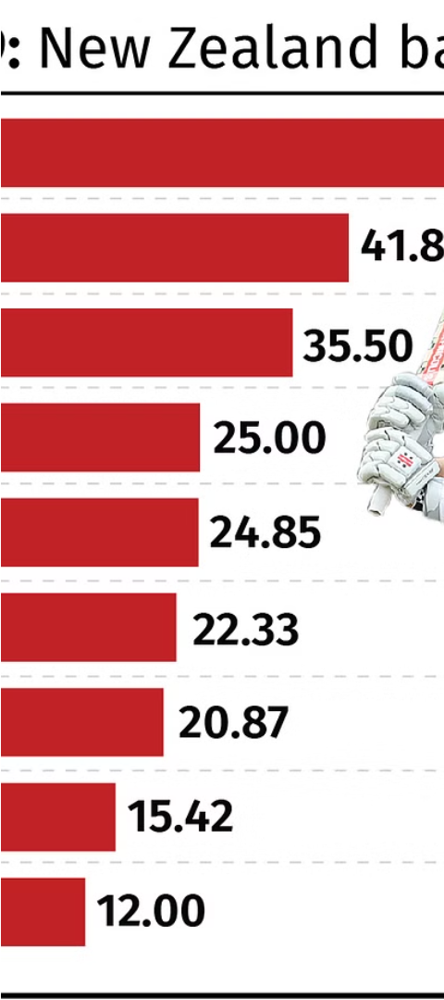
Objectives
1
Identify top performing players
2
Analyze team performance
Analyze individual player stats such as runs scored, wickets taken, and batting/bowling averages.
Evaluate team standings, win/loss records, and other key team-level metrics.
3
Uncover trends and patterns
Detect any significant changes or trends in player and team performance over time.

Slide 4
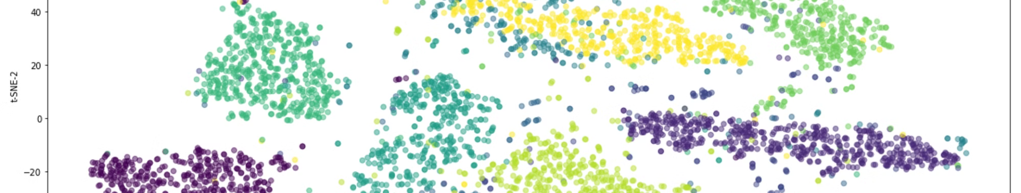
Dataset Description
IPL Match Data
Player Profiles
Team Records
Comprehensive information on every IPL match played since the league's inception, including scores, player stats, and more.
Detailed biographies and performance histories for all players who have participated in the IPL.
Historical data on team standings, win/loss records, and other key team-level metrics.

Slide 5
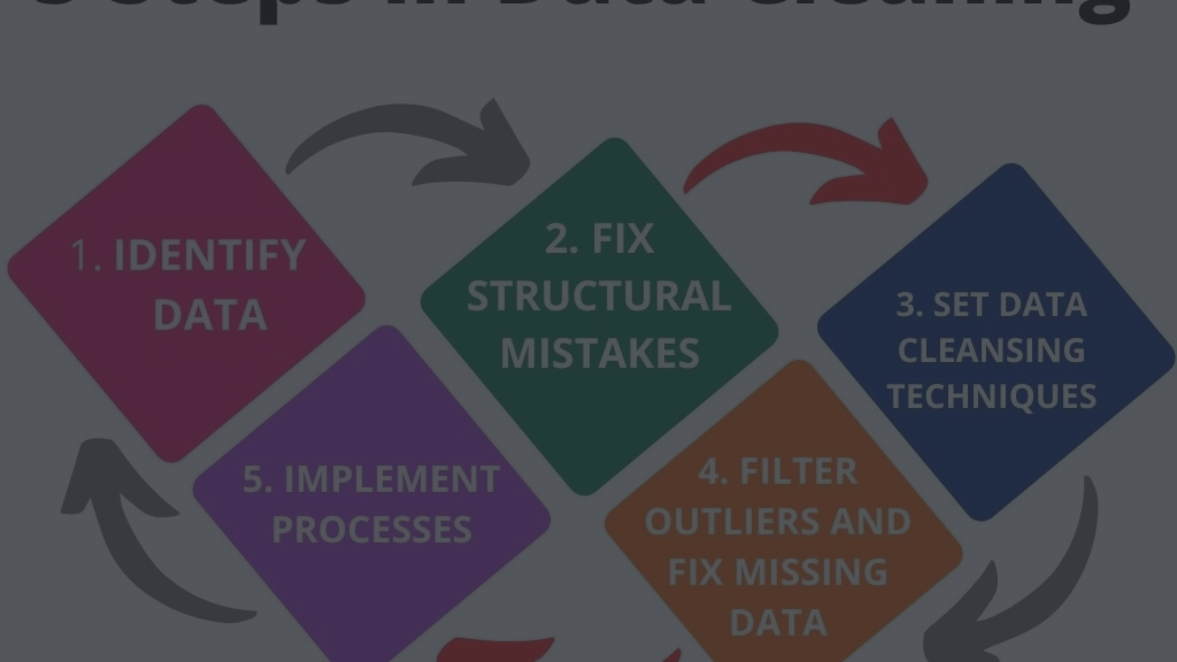
Preprocessing
Aggregation
Data Cleaning
Summarize the data at different levels (player, team, season) to enable more comprehensive analysis.
Identify and address any missing values, inconsistencies, or outliers in the raw data.
1
2
3
Plotting and Dashboard
present the row data into a visual form to make it easy to understand and take data driven decisoin .

Slide 6




Graphs and Visuals
Bar Charts
Line Graphs
Scatter Plots
Heatmaps
Visualize and compare player/team performance metrics.
Identify trends and patterns in performance over time.
Explore relationships between different player/team attributes.
Provide a visual summary of data, highlighting areas of high and low values.

Slide 7




Analysis Approach used :
Cleaning the Dataset using python and SQL
Conduct initial investigations to understand the dataset and identify key areas of interest.
Python for additional data cleaning and charts and visuals .
Used matplotlib python library for creating visuals
Using Power Query Editor and Power BI to build final Dashboard .
Generate summary statistics and visualizations to describe the current state of the league.

Slide 8
Key Insights
Top Batsmen
Bowling Dominance
Team Dynamics
Virat Kohli, KL Rahul, and Shikhar Dhawan have consistently been the league's top run-scorers in recent seasons.
Jasprit Bumrah, Kagiso Rabada, and Rashid Khan have emerged as the IPL's most formidable bowlers, regularly topping the wickets taken leaderboard.
Mumbai Indians and Chennai Super Kings have been the league's most successful teams, winning 5 and 4 titles respectively.

