Slide 1
Progressive Web Apps (PWA)
METATEAM MYANMAR

Slide 2
TABLE OF CONTENTS
01
02
03
04
What is PWA?
Advantage
Disadvantage
05
Setup PWA
Supported Framework

Slide 3
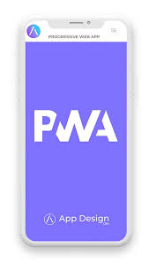
01
What is PWA?

Slide 4

What is PWA?
It is a type of web application that utilizes modern web technologies to provide an app-like experience to users. PWAs are designed to work across different platforms and devices, providing a consistent experience similar to native mobile applications.it are written in JavaScript, CSS, and HTML.

Slide 5
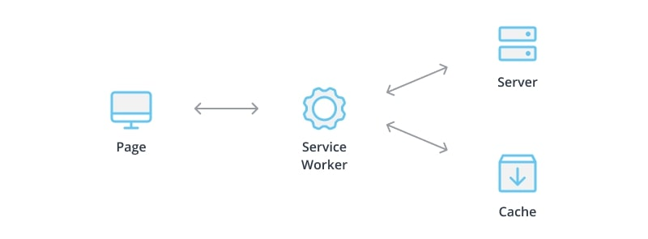
How it’s work?

Slide 6

02
Advantage

Slide 7
Advantage of PWA
Offline functionalty
Faster performance
App-like experience
Lower development
Lower device storage
Responsive design
Installable and linkable
Push notifications
Follow the link in the map to modify its data and then paste the new one here. For more info, click here

Slide 8
How to work offline?
online
offline

Slide 9
03
Disadvantage

Slide 10
DISADVANTAGE of PWA
Limited access to device capabilities
Persistent reliance on internet connectivity
Limited integration to device app stores

Slide 11
04
Set Up PWA

Slide 12
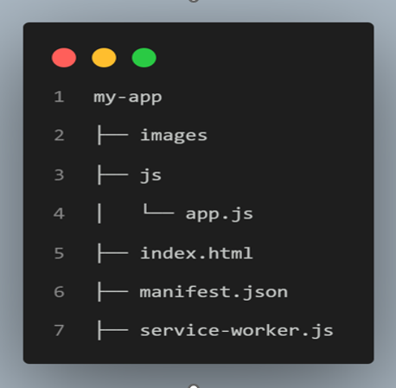
Folder Structure

Slide 13
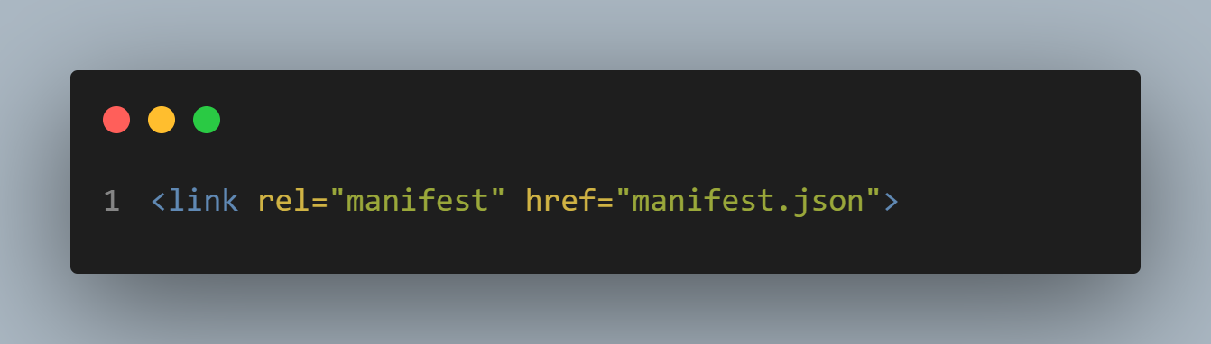
Create a Basic HTML Structure
Start by creating a basic HTML structure for your PWA. You'll need an HTML file (index.html) that includes the necessary metadata and links (Manifest JSON) file

Slide 14
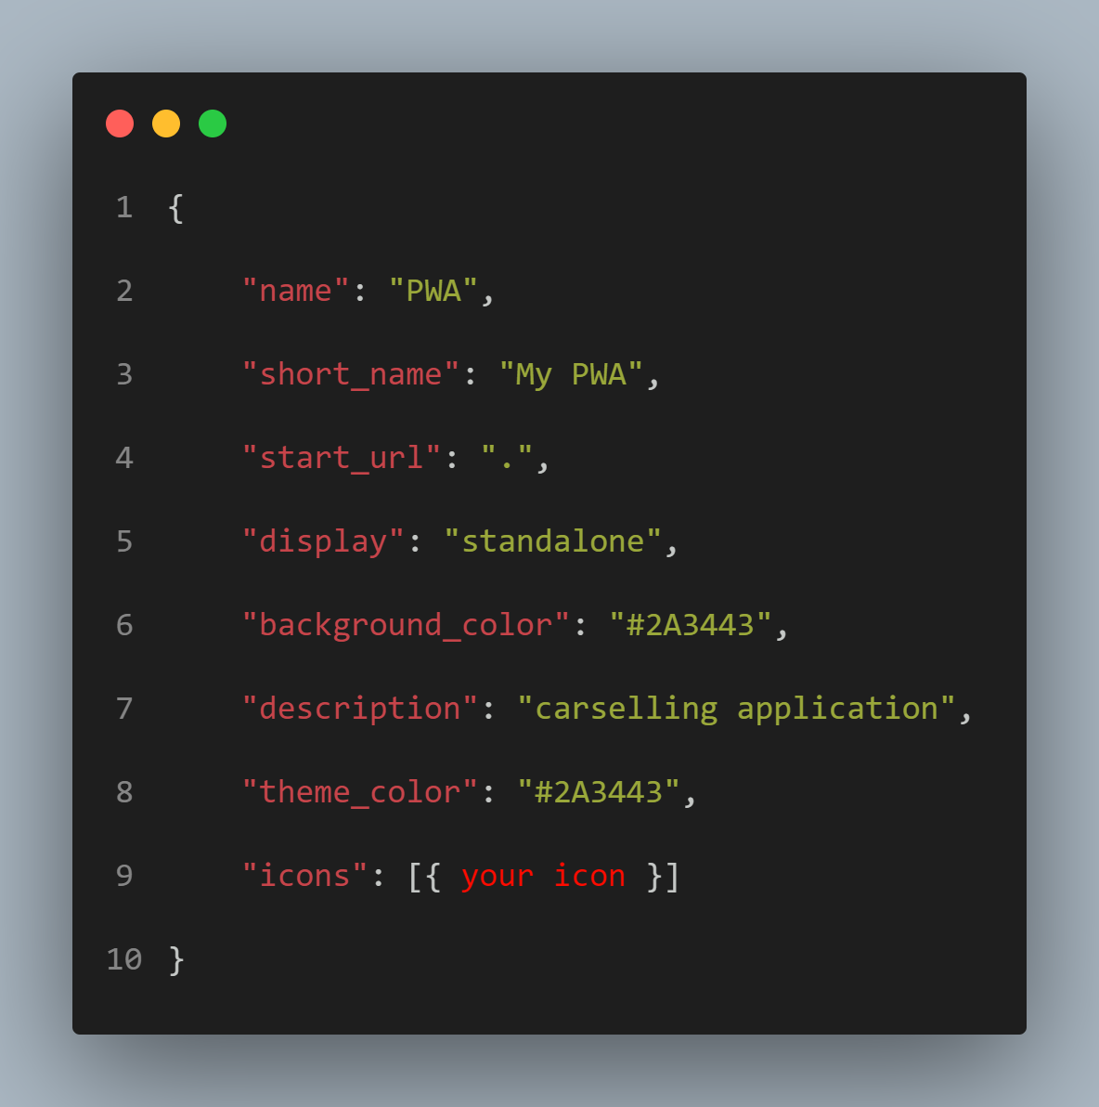
Create a Manifest File
The manifest file contains metadata about your PWA, such as the app's name, icons, and display preferences. This file is essential for installing the PWA on users' devices

Slide 15
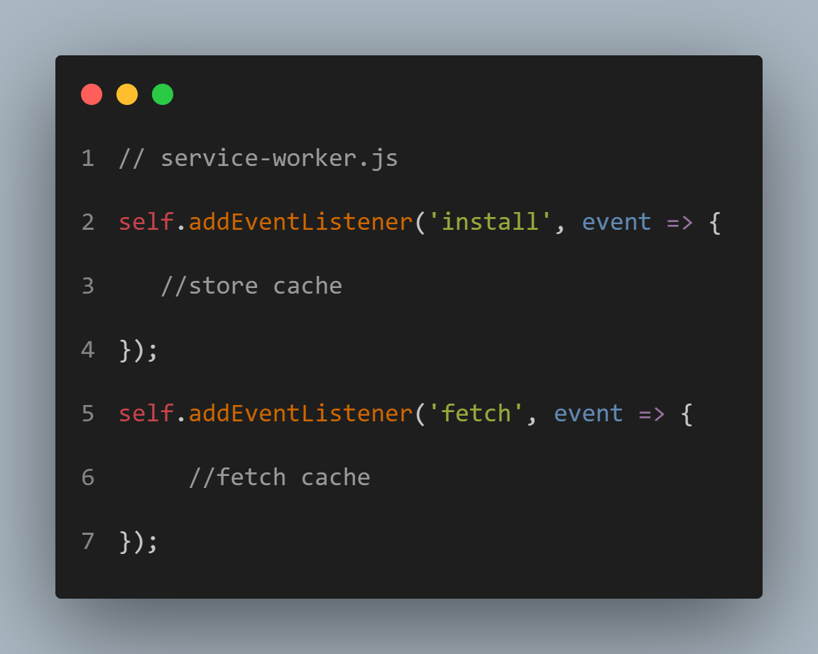
Implement Service Worker:
A service worker is a script that runs in the background and enables your PWA to work offline.

Slide 16
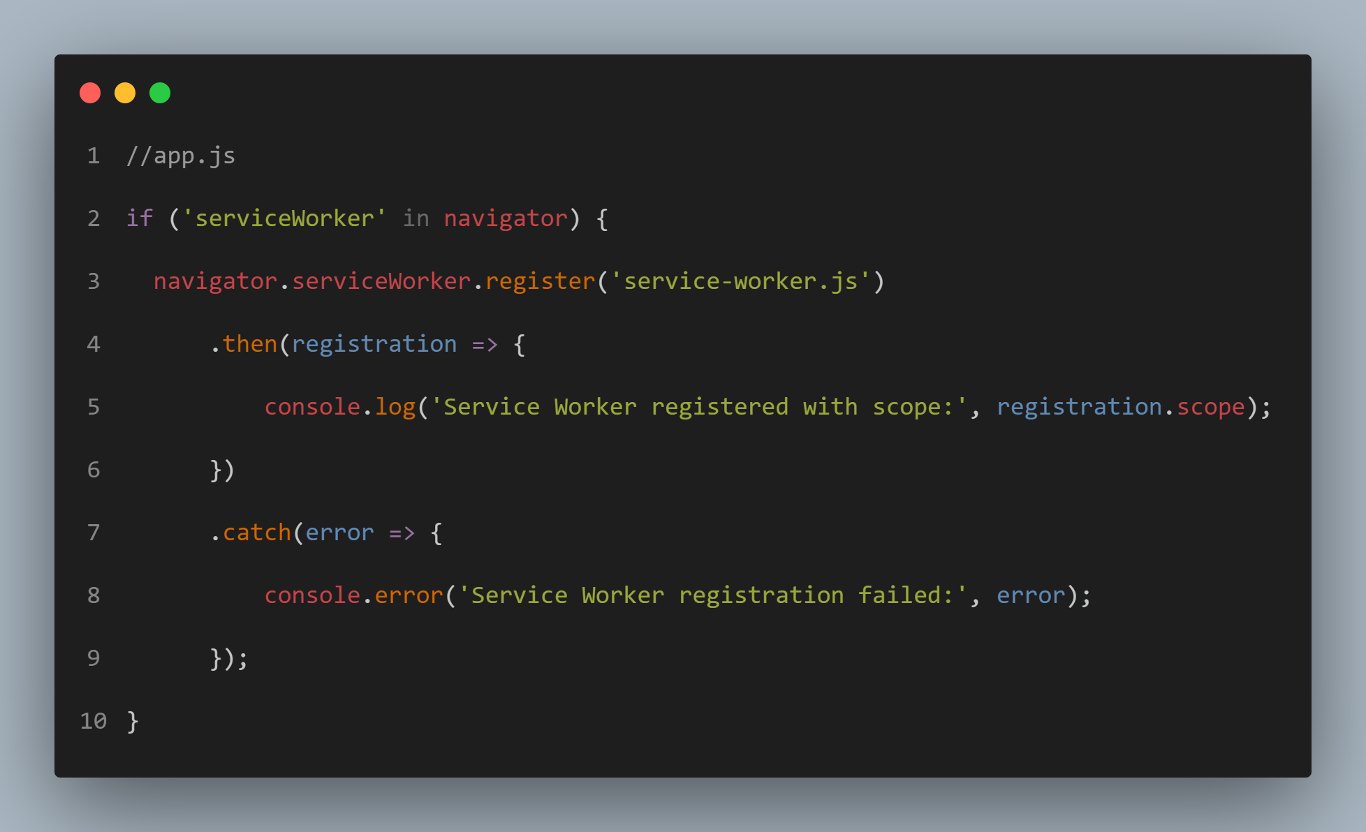
Register the Service Worker
In your JavaScript file (app.js), register the service worker to enable its functionality.

Slide 17
05
Support Framework

Slide 18
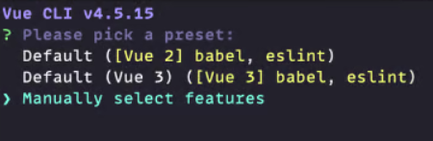
Setup Vue with PWA
1 . Install Vue cli
2 . Create Vue project
3 . Select Manual Select Features

Slide 19
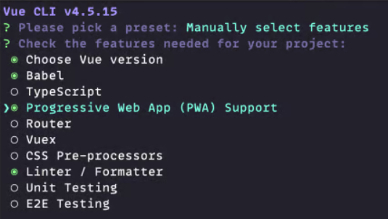
Setup Vue with PWA
4 . Select Progressive Web App (PWA) Support
5 . Testing PWA

Slide 20
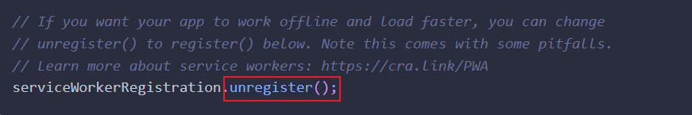
Setup React with PWA
1 . Create react app with PWA
2 . Change unregister to register in src/index.js file
3 . Testing PWA

Slide 21
THANKS!
DO YOU HAVE ANY QUESTIONS?
Please keep this slide for attribution

