Slide 1
Vue Packages
METATEAM MYANMAR

Slide 2
TABLE OF CONTENTS
01
02
03
04
Create package
Public package
Testing
Package
05
Private package
Update package version

Slide 3

01
Create Package

Slide 4
Step by Step
1. Install Vue CLI
2. Create project
3. Create component
https://vuejs.org/guide/essentials/component-basics

Slide 5
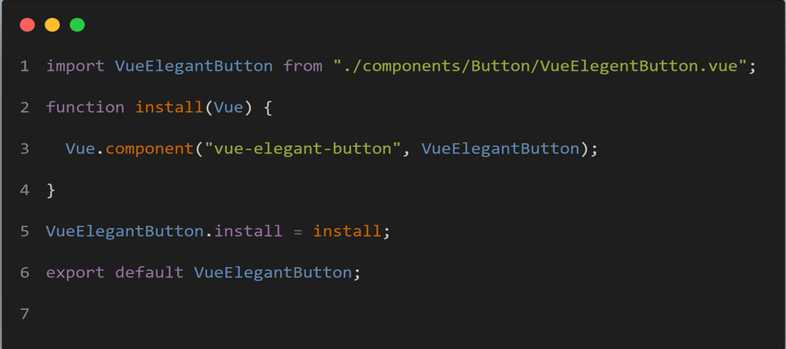
4. Create js file (eg. Install.js) Note => Implement your component instead of VueElegantButton

Slide 6
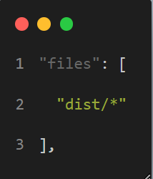
4. Add this code inside script of packae.json file
5. Add files attribute determines which files you want to publish at your npm package

Slide 7
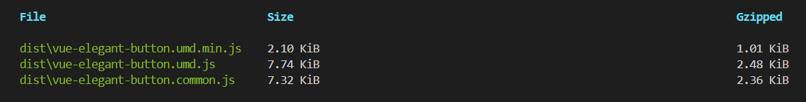
6. Run script in terminal
7. This command is produce below output files

Slide 8
6. Run script in terminal
7. This command is produce below output files

Slide 9
6. Run script in terminal
7. This command is produce below output files

Slide 10
6. Run script in terminal
7. This command is produce below output files

Slide 11

Multiple Component

Slide 12
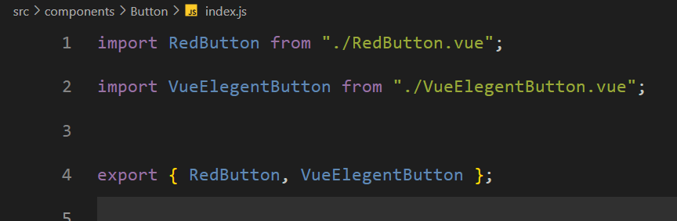
Step by Step
Create js file in components/(component folder)

Slide 13
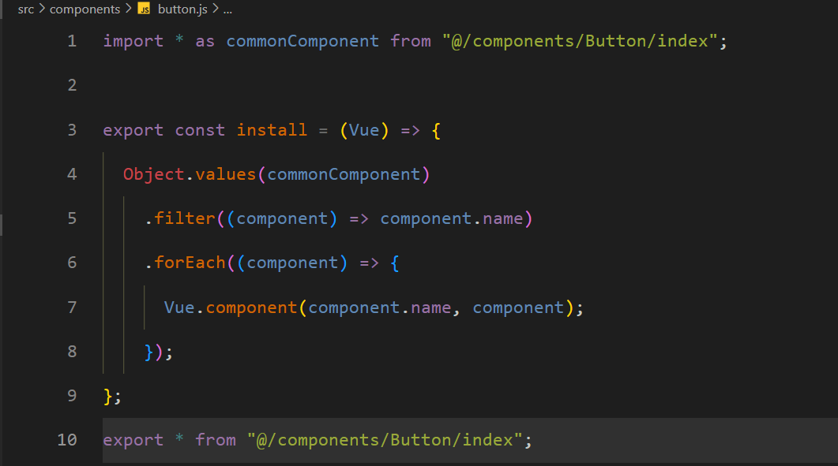
2. Add js file in mian components

Slide 14
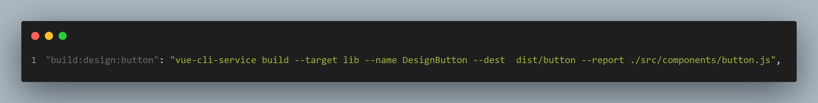
2. Add this code inside script of packae.json file
name DesignButton => This sets the name of the output library to "DesignButton". When other projects import this library, they would refer to it by this name.
dest dist/button: => This specifies the destination directory for the output files. In this case, the built library will be placed in the dist/button directory.
report: => This flag enables the generation of a bundle analysis report. It provides insights into the composition and size of the generated bundle.
- ./src/components/button.js => This is the entry point for the button component. It tells the Vue CLI where to start bundling the code for this component.

Slide 15

02
Testing Package

Slide 16
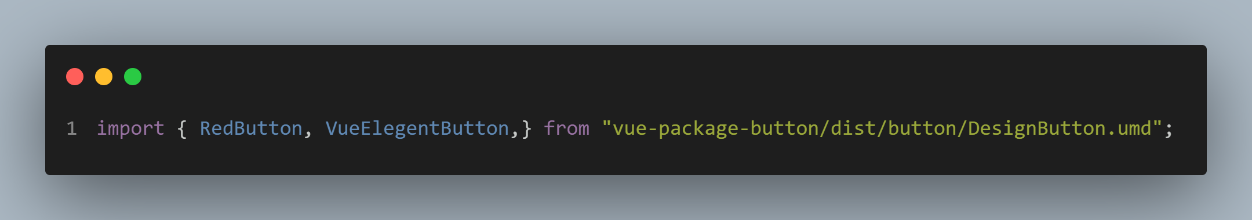
1. Run script in your package directory terminal
2. Run script in your package testing directory terminal
3. Implement this component code in your testing project. If your package don’t
have error, your component should work well.

Slide 17
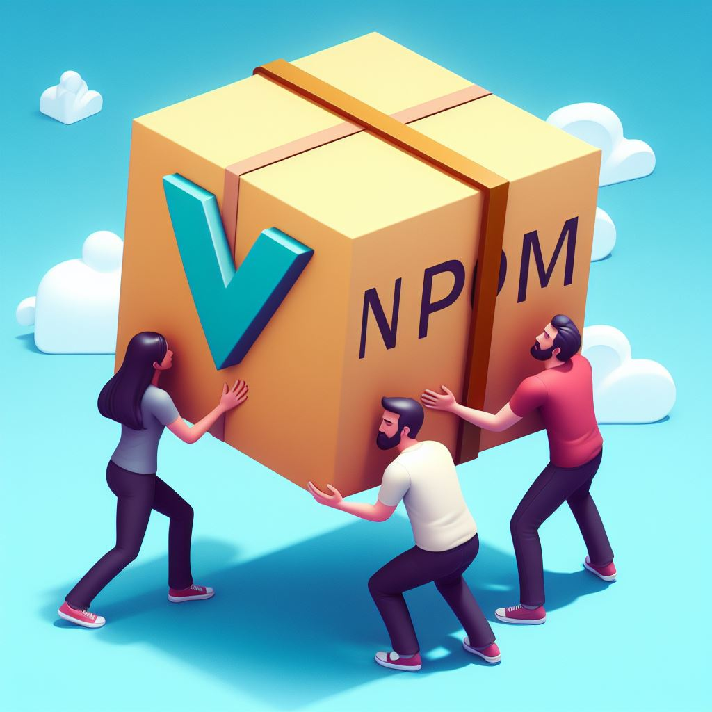
03
Public Npm

Slide 18
1. If you don’t have npm account , you need to login
2. If an existing package has the same name,
3. Publish your scoped package

Slide 19

04
Github Package

Slide 20
Advantage of PWA
Offline functionalty
Faster performance
App-like experience
Lower development
Lower device storage
Responsive design
Installable and linkable
Push notifications
Follow the link in the map to modify its data and then paste the new one here. For more info, click here

Slide 21
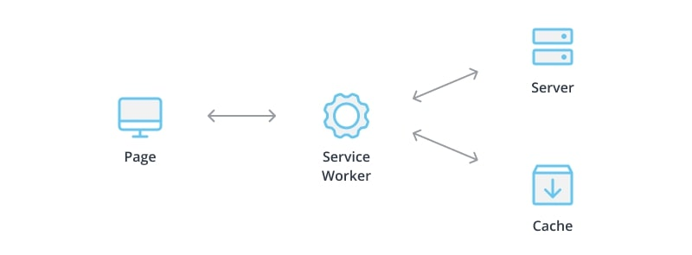
How to work offline?
online
offline

Slide 22
DISADVANTAGE of PWA
Limited access to device capabilities
Persistent reliance on internet connectivity
Limited integration to device app stores

Slide 23

04
Set Up PWA

Slide 24
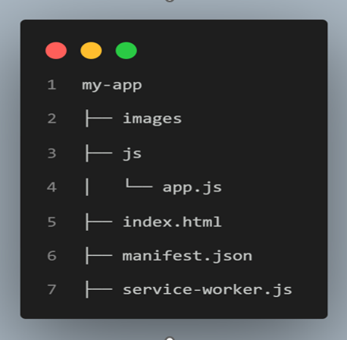
Folder Structure

Slide 25
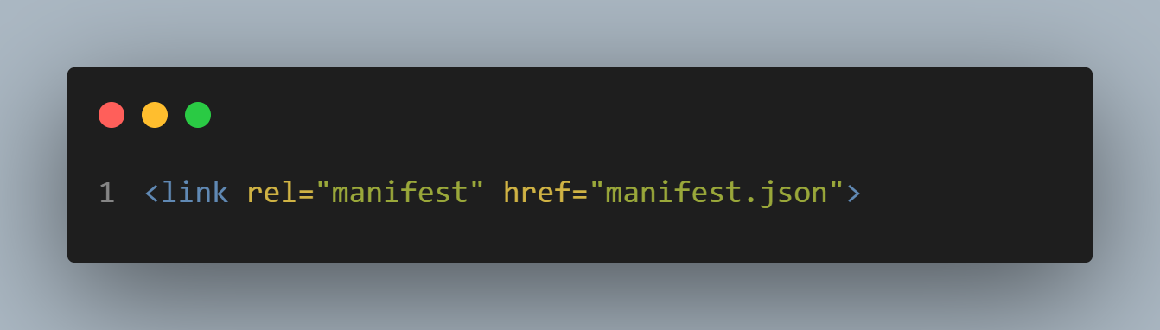
Create a Basic HTML Structure
Start by creating a basic HTML structure for your PWA. You'll need an HTML file (index.html) that includes the necessary metadata and links (Manifest JSON) file

Slide 26
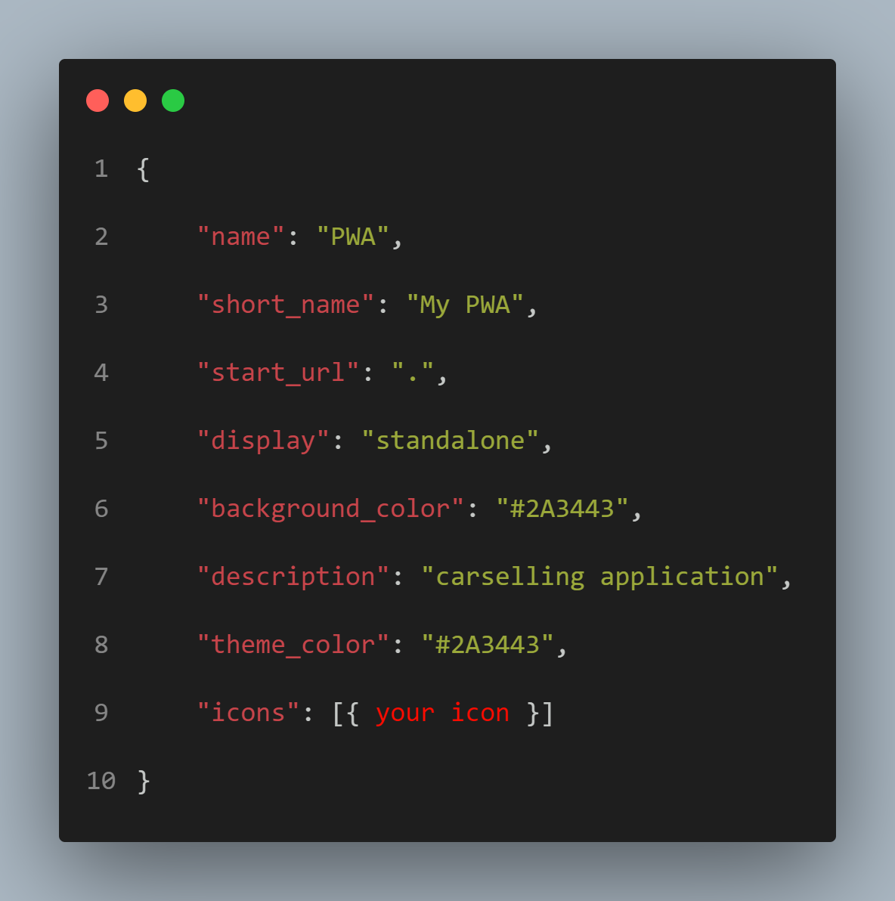
Create a Manifest File
The manifest file contains metadata about your PWA, such as the app's name, icons, and display preferences. This file is essential for installing the PWA on users' devices

Slide 27
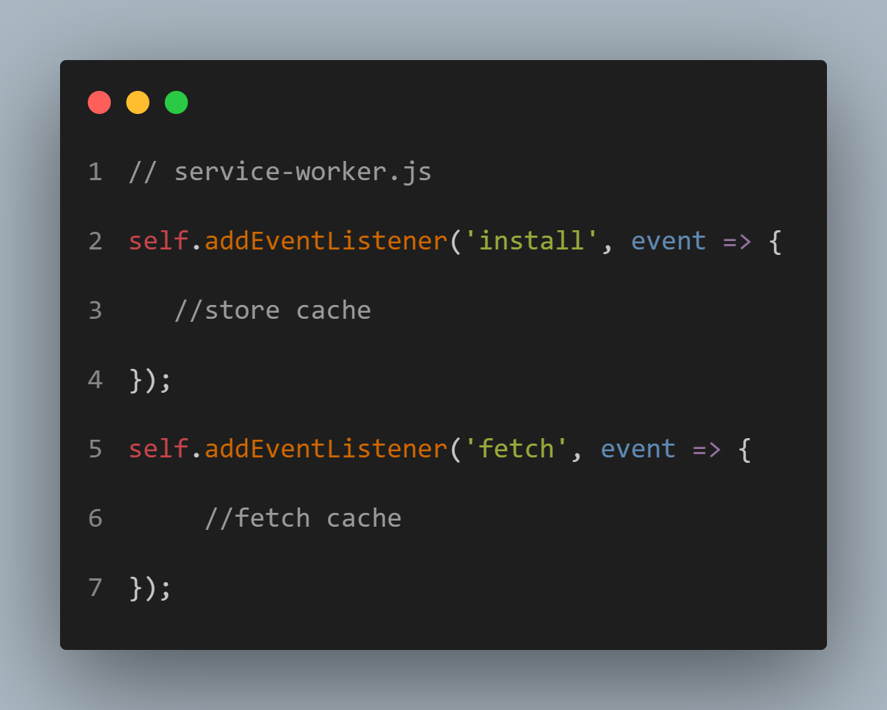
Implement Service Worker:
A service worker is a script that runs in the background and enables your PWA to work offline.

Slide 28
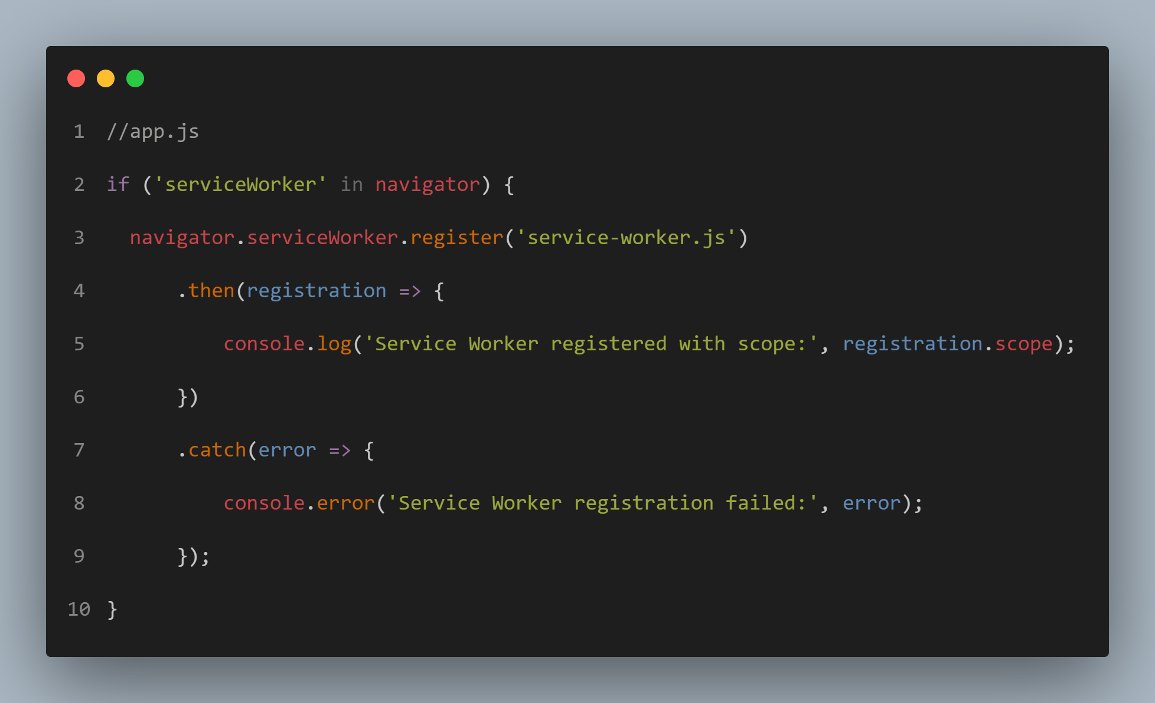
Register the Service Worker
In your JavaScript file (app.js), register the service worker to enable its functionality.

Slide 29
05
Support Framework

Slide 30
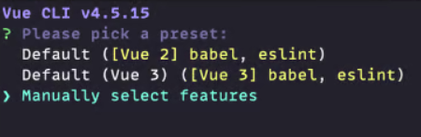
Setup Vue with PWA
1 . Install Vue cli
2 . Create Vue project
3 . Select Manual Select Features

Slide 31
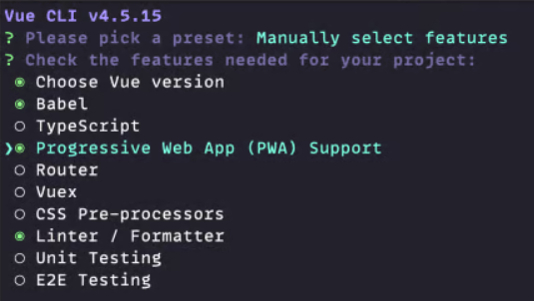
Setup Vue with PWA
4 . Select Progressive Web App (PWA) Support
5 . Testing PWA

Slide 32
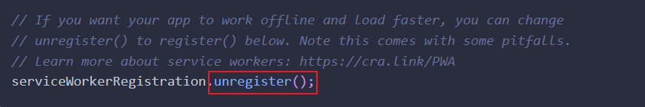
Setup React with PWA
1 . Create react app with PWA
2 . Change unregister to register in src/index.js file
3 . Testing PWA

Slide 33
THANKS!
DO YOU HAVE ANY QUESTIONS?
Please keep this slide for attribution

