Slide 1
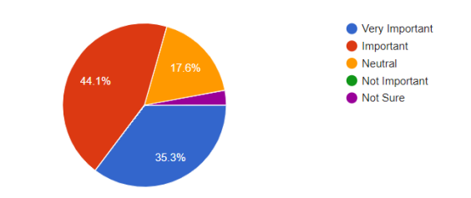
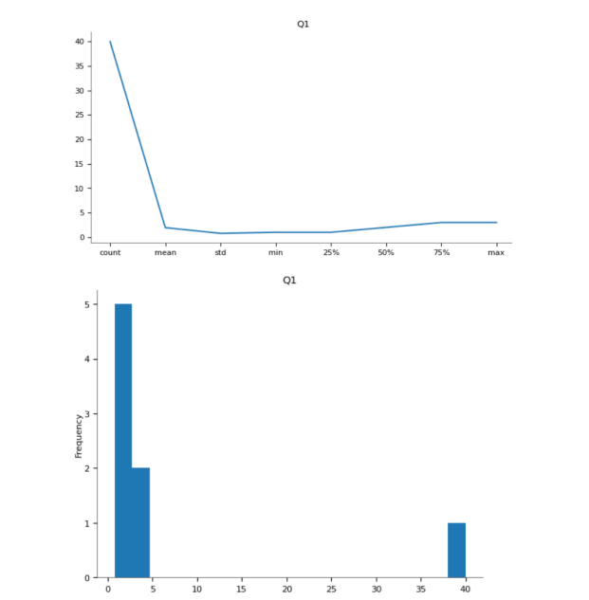
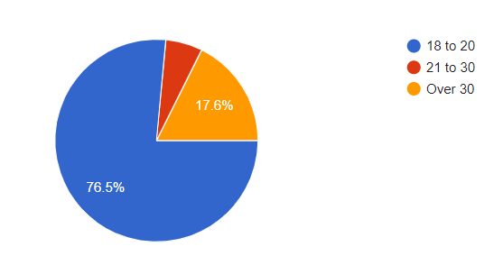
The Investment of Smart Environment
Monitoring System by Internet of Things
SAW WIN NWE
Introduction
The growth of IoT technology presents unprecedented opportunities for smart environment systems, transforming industries such as urban planning and healthcare. Understanding investment potential and obstacles is critical for stakeholders, investors, and scholars.
Methods
Quantitative research comprises gathering and evaluating numerical data to make statistical inferences and achieve evidence-based conclusions. To conduct a quantitative study on investing in a smart environment monitoring system using the Internet of Things (IoT), consider using descriptive statistics (mean, median, standard deviation), inferential statistics (correlation, regression), and hypothesis testing. Additionally, use appropriate statistical tools for analysis.
Results
Example of question 1 results:
This question aims to gauge participants' views on the significance of investing in IoT-powered smart environment monitoring systems. Positive responses would validate the hypothesis, suggesting recognition of potential cost savings and efficiency enhancements offered by these systems.
Discussion & Conclusions
The research aims to give a thorough grasp of both possibilities and difficulties by examining the transformational potential of IoT investments in smart environment monitoring systems. Through an analysis of technological elements, market patterns, and funding approaches, it provides insights obtained from qualitative research techniques such as literature reviews and case studies in various sectors.
The research aims to give a through grasp of both possibilities and difficulties by examining the transformational potential of IoT investment in smart environment monitoring systems. Through an analysis of technological elements, market patterns, and funding approaches, it provides insights obtained from qualitative research techniques such as literature reviews and case studies in various sectors. Triangulating data and taking ethical issues into account improve the validity of results, assisting scholars, investors, and legislators in marking well-informed decisions in this ever-changing environment.
Purpose
This study seeks to investigate the investment landscape for IoT-enabled smart environment solutions, focusing on technology underpinnings, market trends, risks, and benefits. We aim to identify barriers to effective deployment through case studies, stakeholder views, and regulatory research. Furthermore, we look at the importance of public-private partnerships, scalability, and socioeconomic consequences of IoT-powered smart settings.
Full width images, or images more than 2/3 column width should width of the column and can appear above or below the image.
Qualitative Research
Qualitative research involves exploring meanings, experiences, and perspectives through non-numerical data analysis. For a qualitative study on IoT investment in smart environment monitoring systems, methodologies may include in-depth interviews for rich narratives and semi-structured interviews for flexibility, as well as focus group discussions to capture collective insights and interactions.
References
A., V. J., 2015. Internet of Things (IoT) based Smart Environment integrating various Business Applications. Tiruchirappalli, Tamilnadu, India: International Journal of Computer Applications (0975 – 8887) ..
Participants
Contact details
GUSTO UNIVERISTY
HND- 43
sawwinnwe612@gmail.com
https://drive.google.com/file/d/1_4KpBXdNy0vhZxf82YwC2bxS6qHX_Ama/view?usp=drive_link

