Slide 1
ROADSTAR / DISPATCHOS
01
CUSTOM TMS · SOUTHERN ONTARIO
One operating system
for every RoadStar move.
01
Loads → eligible units
02
Approval → driver action
03
Live route → geofence
Quote more freight. Dispatch with confidence. Prove every kilometre, decision, and detention minute.
04
Evidence → revenue
roadstardispatch.xyz
Notes:
RoadStar DispatchOS is a custom operating system for city dispatch, built around RoadStar’s workflow rather than around a generic third-party TMS. The story follows a load from intake to assignment, execution, evidence and measurable financial impact.

Slide 2
ROADSTAR / DISPATCHOS
02
THE COST OF FRAGMENTATION
Five disconnected tools turn dispatch into manual orchestration.
5
1–3
$15K–$50K+
systems per dispatcher
missed jobs per day
monthly revenue at risk
Load boards, ELD, TMS, rates and back office
Check calls and reconciliation steal quoting time
Missed quotes plus unbilled detention
The hidden bug
A driver can lose legal HOS while waiting at a dock—at the same moment the carrier begins earning detention.
RoadStar has to connect compliance, customer service and billing in one decision—not three after-the-fact reports.
Source: Hackathon Project Brief, pp. 1–6. Opportunity figures are brief estimates, not guaranteed results.
Notes:
The brief estimates that a dispatcher switches among roughly five systems and can miss one to three jobs daily. It also values the combined leakage at approximately $15,000 to $50,000 or more per month. RoadStar attacks the workflow failure behind those figures rather than merely adding another dashboard.

Slide 3
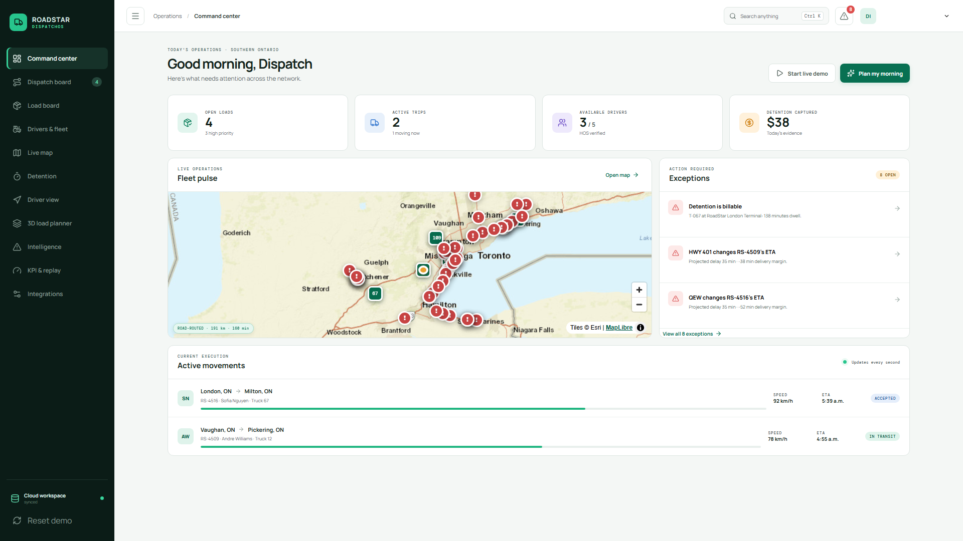
ROADSTAR / DISPATCHOS
03
THE CLOSED OPERATIONAL LOOP
One shared workspace moves a load from intake to auditable revenue.
RoadStar-owned workflow
1
Load board + document-assisted intake
2
Eligibility, HOS and capacity checks
3
Approval-first assignments and decision log
4
Driver acceptance, telemetry and geofences
5
Detention evidence and KPI replay
REALTIME
ROLE-SAFE
EXPLAINABLE
REVISION-CHECKED
Notes:
The command centre is not a read-only dashboard. It joins load intake, asset eligibility, human approval, driver action, live execution and financial evidence. Supabase provides the current managed Postgres and Realtime runtime, while RoadStar owns the schema, constraints and workflow logic.

Slide 4
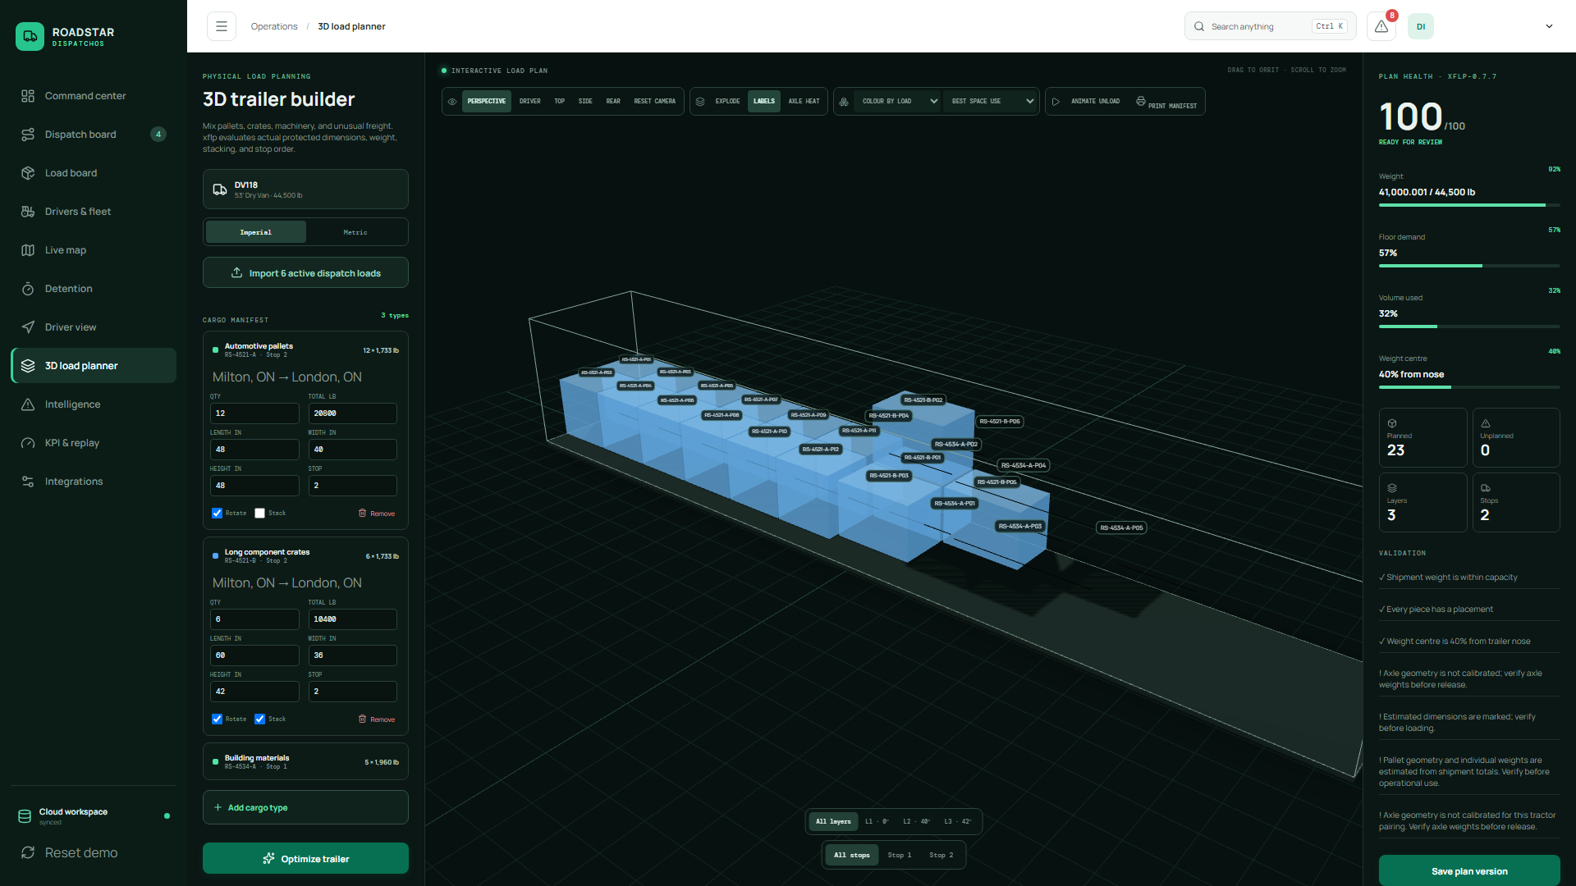
ROADSTAR / DISPATCHOS
04
PHYSICAL PLANNING BEFORE DISPATCH
Every mixed load becomes a safe, explainable 3D plan before wheels move.
MIXED CARGO
TRUE LAYERS
AXLE / FLOOR GUARDS
UNLOAD SEQUENCE
Notes:
The 3D planner accepts pallets, crates, machinery and irregular dimensions, then evaluates protected geometry, stackability, floor bearing and unload order. The xflp sidecar handles specialized packing while RoadStar keeps a deterministic browser fallback. Axle geometry is deliberately labelled for verification rather than presented as certified advice.

Slide 5
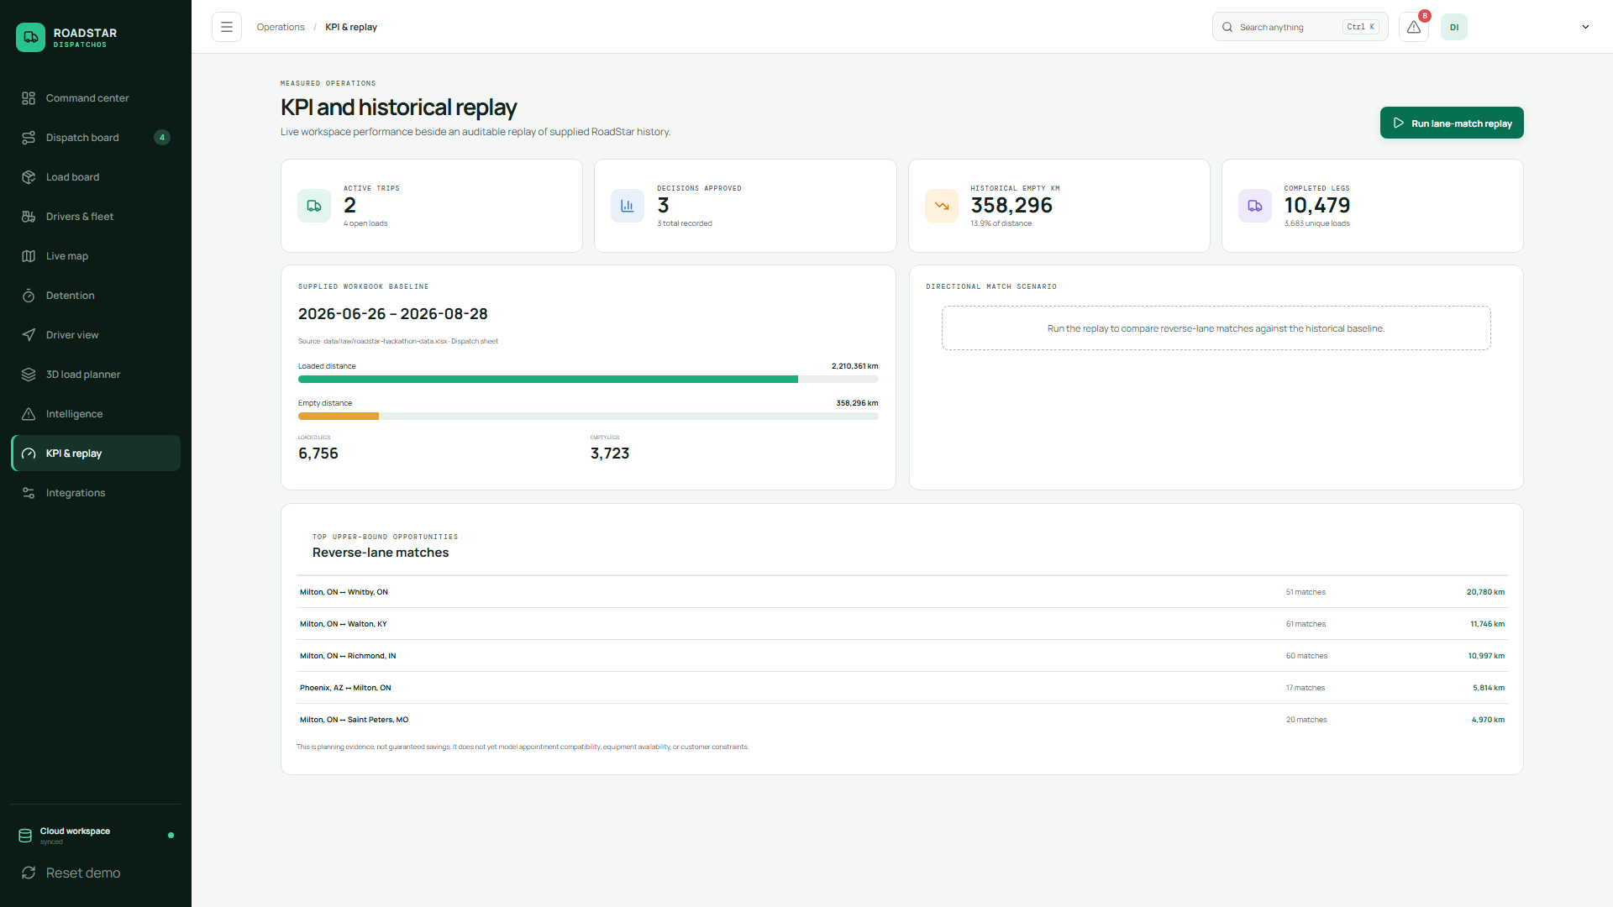
ROADSTAR / DISPATCHOS
05
MEASURED OPERATIONS
Historical replay turns empty kilometres into a ranked opportunity list.
10,479
completed legs
358,296 km
historical empty distance
13.9%
of recorded distance
Honest by design
Replay labels opportunities—not guaranteed savings.
Baseline shown: supplied RoadStar workbook, 2026-06-26 to 2026-08-28.
Notes:
The historical view reconciles the supplied RoadStar workbook into completed legs, loaded kilometres, empty kilometres and reverse-lane candidates. The 10,479 legs and 358,296 empty kilometres shown are evidence from the supplied baseline. The system avoids claiming the directional match scenario as guaranteed savings.

Slide 6
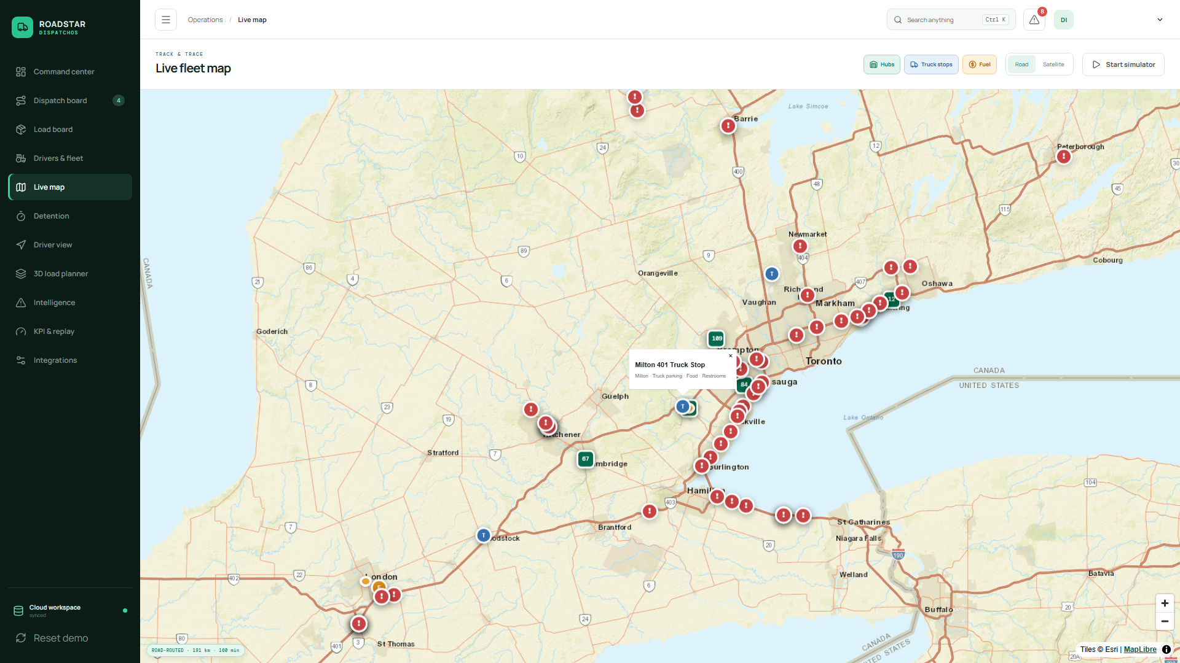
ROADSTAR / DISPATCHOS
06
WHY THIS CORRIDOR · WHY NOW
Southern Ontario’s dense freight grid rewards one shared operating picture.
Live road geometry
OSRM distance, duration and road-following coordinates
Context at a glance
Ontario 511 incidents, satellite mode, hubs, fuel and truck stops
Track & trace depth
Breadcrumbs, speed, odometer and active route progress
Actionable edge cases
Closures, shrinking HOS margin and dock dwell become decisions
London ↔ Milton ↔ GTA
Notes:
The brief defines a Southern Ontario operating area anchored by London and Milton and bounded by Barrie, Peterborough, Pickering and Niagara Falls. RoadStar now renders that corridor with real hosted OSRM road geometry. The provider is an adapter: a self-hosted OSRM graph can replace the demo endpoint without changing the browser contract.

Slide 7
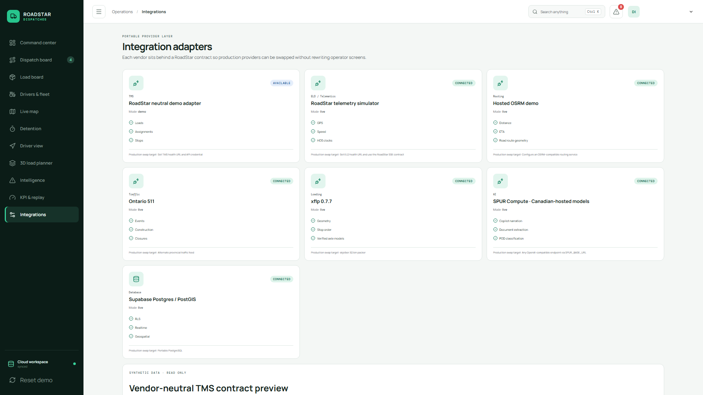
ROADSTAR / DISPATCHOS
07
DEPLOYABLE FOUNDATION
The custom TMS core is live—and its integrations are designed to be replaceable.
LIVE
163
17
5
HTTPS production deployment
unit + integration checks
browser journeys
authenticated QA roles/accounts
ROADSTAR-OWNED OPERATIONAL MODEL
loads
cargo_items
loading_plans
trailers
Stable adapter contracts
ELD / telemetry
TMS load exchange + outbox
Routing + Ontario 511
AI document intake
drivers
recommendations
decision_records
detention_events
No third-party TMS dependency: RoadStar owns the workflow, rules, schema and decision history. Managed infrastructure and data providers remain swappable.
Notes:
This slide recreates the supplied database schema snippet as editable entities: loads and cargo flow into plans and trailers, while drivers, recommendations, decisions and detention retain operational evidence. Production is live, the quality gate passes 163 unit/integration checks and 17 browser journeys, and authenticated QA covers dispatcher, driver, viewer and cross-organization boundaries. Real ELD and TMS vendors still require their API documentation and sandbox credentials.

Slide 8
ROADSTAR / DISPATCHOS
08
THE NEXT MOVE
Prove the value in one controlled RoadStar pilot.
30 days · one dispatch desk · one operating corridor
01
02
03
Connect one real feed
Run real morning dispatch
Measure three outcomes
Select an ELD or TMS sandbox and map it through the existing adapter contract.
Use RoadStar for intake, eligibility, approvals, driver action and exception handling.
Quote response time, empty kilometres and captured detention revenue.
RoadStar DispatchOS Team
A custom operating system—not another disconnected subscription.
roadstardispatch.xyz
Notes:
The ask is a controlled pilot rather than a wholesale systems replacement. Start with one real integration, operate the closed loop with one dispatch desk, and evaluate measurable workflow and financial outcomes. The current demo remains honest about simulated ELD/TMS data while proving the system’s integration seam.

