Slide 1
An Android Cluster System Capable of Dynamic Node Reconfiguration
Yuki Sawada Yusuke Arai Kanemitsu Ootsu
Takashi Yokota Takeshi Ohkawa
Utsunomiya University, Japan

Slide 2
Outline
Background and research objective
Android Cluster System
Static reconfiguration mechanism
Dynamic reconfiguration mechanism
Performance evaluation
Conclusion and future work

Slide 3
Outline
Background and research objective
Android Cluster System
Static reconfiguration mechanism
Dynamic reconfiguration mechanism
Performance evaluation
Conclusion and future work

Slide 4
Background(1/2)
Computation performance and capacity of mobile devices have been improved.
Such mobile devices spread rapidly, they have attracted attention as a new platform for parallel and distributed applications.
We are developing a cluster computer system, called “Android Cluster System” using mobile devices running Android OS.
Notes:
30sec
we are developing a
cluster computer system, called Android cluster,
using mobile computer devices running Android OS.

Slide 5
Background(2/2)
However, node computers(mobile devices) within the cluster might move physically.
A node might move out of the area capable of wireless communication…etc
Two problems
1. It is difficult to know which nodes are available for
parallel computation beforehand.
2. When a node leaves from parallel computation during
execution, application programs must abort and it must be
executed again from the beginning.
Notes:
45sec

Slide 6
Research objective
Even when the number of nodes changes, we want to continue the execution of parallel applications to avoid re-execution.
In order to handle the changes in the number of nodes
we implement static and dynamic reconfiguration mechanism on our cluster system.
Static reconfiguration mechanism
To know automatically which nodes are available for parallel computation.
Dynamic reconfiguration mechanism
To continue the parallel computation using the remaining
nodes, when a node leaves from the cluster.
Notes:
45sec
ここまで 120sec 2分

Slide 7
Outline
Background and research objective
Android Cluster System
Static reconfiguration mechanism
Dynamic reconfiguration mechanism
Performance evaluation
Conclusion and future work

Slide 8

Android Cluster System
EX)
Android Cluster System
configured of 3 nodes
Wi-Fi
Host
Node
Most common wireless communication method
Remote
Node A
Parallel and distributed
applications
Remote
Node B
MPI
(Open MPI)
CPU-native
Most common framework for parallel and distributed.
For high-performance, we use Android NDK.
(developed using C/C++)
Notes:
1分 計3分
Wi-Fi
・many devices have Wi-Fi facility
・communication
performance is higher than other wireless method

Slide 9
Outline
Background and research objective
Android Cluster System
Static reconfiguration mechanism
Dynamic reconfiguration mechanism
Performance evaluation
Conclusion

Slide 10
Static reconfiguration mechanism(1/2)
EX)
Android Cluster System
consisting of three nodes
“Machine file” holds the IP address and the number of processor cores available for parallel execution.
When the number of nodes changes, Each node updates Machine file automatically.
Host
Node
Remote
Node A
MPI
applications
Remote
Node B
EX) Machine file
192.168.0.1 cpu=4
192.168.0.2 cpu=4
192.168.0.3 cpu=4
‘host information’
Notes:
口頭
・When launching an MPI application, this file is used to determine which node computers are available
for parallel execution.

Slide 11
Static reconfiguration mechanism(2/2)
If detecting withdrawal of a node…
delete its host information
from the machine file.
If detecting a new incoming node…
record its host information to
the machine file.
To detect the withdrawal of the node…
To detect the new incoming node…
Each node within the cluster exchanges message periodically.
(at 1 minute interval)
A new node sends the request message by broadcast to all nodes within the cluster.
Notes:
To detect the withdrawal of the node

Slide 12
Outline
Background and research objective
Android Cluster System
Static reconfiguration mechanism
Dynamic reconfiguration mechanism
Performance evaluation
Conclusion and future work
Notes:
Dynamic reconfiguration mechanism 2分くらい? 計7分

Slide 13
Dynamic reconfiguration mechanism(1/3)
To continue the parallel computation using the remaining nodes, when a node leaves from the cluster.
We use checkpointing / restart technology.
We use DMTCP
DMTCP (Distributed MultiThreaded Checkpointing)
DMTCP saves the states of all parallel processes for future restarting.
Checkpoint data is created per process.
Checkpoint data is used for restarting MPI application.
Notes:
DMTCP
use Checkpointing / Restart technology.

Slide 14
Dynamic reconfiguration mechanism(2/3)
DMTCP can make a process migrate to other node by transferring checkpoint data.
Parallel processes can migrate to other remaining node from the withdrawal node by DMTCP.
Collects and manages checkpoint
data of remote nodes
Host
Node
A
B
Remote Node B withdraws
send
send
Remote
Node A
Remote
Node B
: checkpoint data
Notes:
DMTCP
use Checkpointing / Restart technology.

Slide 15
Dynamic reconfiguration mechanism(3/3)
At restarting…
Sends checkpoint data of MPI processes on withdrawal node
Host
Node
B
Remote
Node A
Takes over the
MPI process that executed on Remote Node B
: checkpoint data
Notes:
DMTCP
use Checkpointing / Restart technology.

Slide 16
Outline
Background and research objective
Android Cluster System
Static reconfiguration mechanism
Dynamic reconfiguration mechanism
Performance evaluation
Conclusion and future work
Notes:
Performance Evaluation 4分30秒 計11分30

Slide 17
Parallel execution performance
Device | TF201 (ASUSTek Computer Inc.)
Android version | 4.0.3
CPU | NVIDIA Tegra3 Mobile processor :4 core Operating frequency:1.3GHz
Memory | 1GByte
Wi-Fi | IEEE 802.11/n Bandwidth: 18Mbps (measured by netperf)
N-queen program
( N = 17 )
Provides the scalable performance to the number of nodes
※ 4 processes run on each node

Slide 18
Checkpointing overhead(1/2)
Since porting of DMTCP onto Android OS has not been completed, we measure the checkpointing overhead by using 4 PC units equipped with Linux OS (CentOS 6.6).
We estimate the checkpointing overhead by using wireless communication.
We compare three execution times.
1.No checkpointing
2.Checkpointing with ethernet
3.Checkpointing with Wi-Fi (estimated)

Slide 19
Checkpointing overhead(2/2)
When checkpointing interval is long, the checkpointing overhead is low.
Use of wireless communication results in longer execution time.
N-queen: traffic is light
IS: traffic is heavy
 | TF201 | PC (Cent OS 6.6)
CPU | 4 core 1.3GHz | 4core 2.67GHz
Bandwidth | 18Mbps | 94Mbps
Checkpointing overhead is high for application with heavy communication traffic.
Notes:
口頭:
DMCTP はまだandroid上で動かせていないことをいう
execution time has increased by checkpointing
The traffic of the communication between processes is high in IS program, while the traffic is
low in N-queen program.

Slide 20
Conclusion and future work
We are developing Android Cluster System that can handle the changes in the number of nodes.
Android Cluster System implements static and dynamic reconfiguration mechanism
Preliminary performance shows…
It is possible to reduce checkpointing overhead by enlarging checkpointing interval.
In order to reduce execution time further, we are planning to implement load balancing function in DMTCP.
Notes:
45秒 計12分15秒 余裕は45秒→ う～ん、微妙

Slide 21
An Android Cluster System Capable of Dynamic Node Reconfiguration
Yuki Sawada Yusuke Arai Kanemitsu Ootsu
Takashi Yokota Takeshi Ohkawa
Utsunomiya University, Japan

Slide 22
checkpointing overhead
Bandwidth of Wi–Fi continue improving.
Bandwidth of 802.11ac is 10 times higher that of 802.11n.
Transmission time decrease in the future.
The length of the transmission time is relaxed.
Notes:
45秒 計12分15秒 余裕は45秒→ う～ん、微妙

Slide 23
Wi-fi
802.11 2Mbps
802.11b 11Mbps
802.11g/a 54Mbps
802.11n 65~600Mbps :周波数域2.4GHz帯
802.11ac 290~6900Mbps (nの11.5倍)
周波数域
5.15 - 5.35GHz: 屋内の利用に限り免許不要 5.47 - 5.725GHz: 屋内外に限らず免許不要
帯域幅拡大

Slide 24
Data
Checkpointing count(times)
Interval | IS | N-queen
15 | 7 | 17
30 | 4 | 8
60 | 1 | 4
Notes:
無線による送信時間をもとにcheckpoint(wireless)を計測

Slide 25
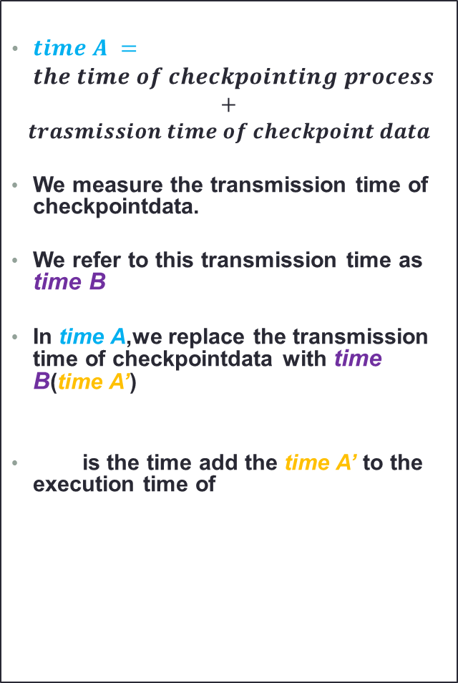
Estimation of overhead
$time A =the time of checkpointing process$
$$+$$
$$trasmission time of checkpoint data$$
We measure the transmission time of checkpointdata.
We refer to this transmission time as time B
In time A,we replace the transmission time of checkpointdata with time B(time A’)
is the time add the time A’ to the execution time of
Notes:
無線による送信時間をもとにcheckpoint(wireless)を計測

Slide 26
Data
 | IS | N-queen
Count of communication | 308330368 | 18139
Datasize (per 1 communication) | 4116byte | 24byte
Notes:
無線による送信時間をもとにcheckpoint(wireless)を計測

