Slide 1

Kasratan Games
بٍ قَلَمٍ شَجَرَةٍ
Bee, monkey, darts, basketball, pizza and more!
Start ▶

Slide 2

How to play: Busy Bee
1. Read the question at the top.
2. Fly to the right flower.
3. Fill the honey jar!

Slide 3




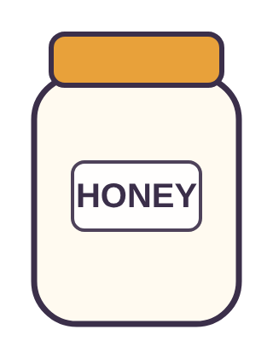
Find
بٍ
بِي
بِ
بٍ

Slide 4
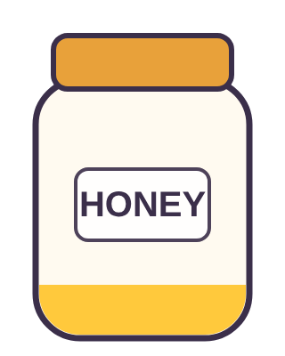
How do we write it?
تِ + نۡ
تِ
تٍ
تِي

Slide 5
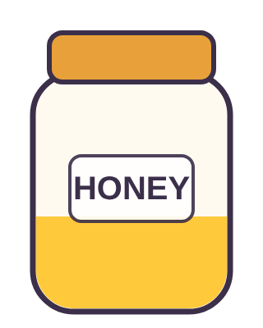
Find
وَرۡدَةٍ
وَرۡدَةً
وَرۡدَةِ
وَرۡدَةٍ

Slide 6
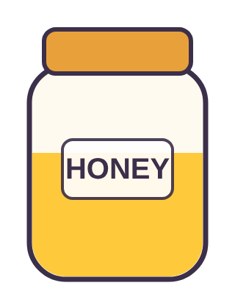
Which word has tanween?
نَهۡرٍ
شَرِبَ
جَلَسَ

Slide 7

Find
يٍ
يِي
يٍ
يِ

Slide 8

Yummy honey!

Slide 9
Find
بٍ
بِي
بِ
بٍ
Try again!

Slide 10
How do we write it?
تِ + نۡ
تِ
تٍ
تِي
Try again!

Slide 11
Find
وَرۡدَةٍ
وَرۡدَةً
وَرۡدَةِ
وَرۡدَةٍ
Try again!

Slide 12
Which word has tanween?
نَهۡرٍ
شَرِبَ
جَلَسَ
Try again!

Slide 13
Find
يٍ
يِي
يٍ
يِ
Try again!

Slide 14

How to play: Monkey Climb
1. Read the question at the top.
2. Tap the right card.
3. Help the monkey reach the bananas!

Slide 15

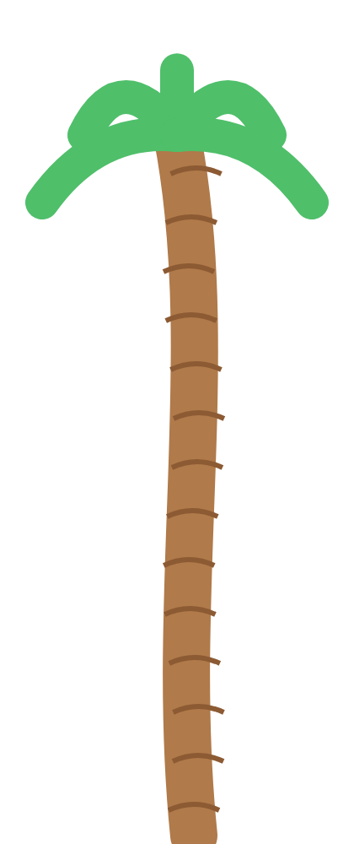
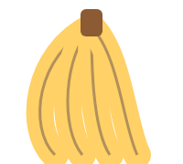
How do we write it?
نِ + نۡ
نٍ
نِي
نِ

Slide 16
Find
نَهۡرٍ
نَهۡرِ
نَهۡرٌ
نَهۡرٍ

Slide 17
Which word has tanween?
سَمِعَ
نَامَ
شَجَرَةٍ

Slide 18
Find
حٍ
حِ
حِي
حٍ

Slide 19
Find
خٍ
خٍ
خِ
خِي

Slide 20
Bananas! Yum!

Slide 21
How do we write it?
نِ + نۡ
نٍ
نِي
نِ
Try again!

Slide 22
Find
نَهۡرٍ
نَهۡرِ
نَهۡرٌ
نَهۡرٍ
Try again!

Slide 23
Which word has tanween?
سَمِعَ
نَامَ
شَجَرَةٍ
Try again!

Slide 24
Find
حٍ
حِ
حِي
حٍ
Try again!

Slide 25
Find
خٍ
خٍ
خِ
خِي
Try again!

Slide 26

How to play: Darts
1. Read the question at the top.
2. Throw at the right board.
3. Bullseye! You get a star.

Slide 27

Find
مَكۡتَبَةٍ
مَكۡتَبَةٍ
مَكۡتَبَةٌ
مَكۡتَبَةِ

Slide 28
Which word has tanween?
كَتَبَ
مَطَرٍ
يَلۡعَبُ
Bullseye!

Slide 29
Find
دٍ
دِي
دِ
دٍ
Bullseye!

Slide 30
Find
ذٍ
ذٍ
ذِ
ذِي
Bullseye!

Slide 31
How do we write it?
رِ + نۡ
رِ
رِي
رٍ
Bullseye!

Slide 32

Champion!

Slide 33
Find
مَكۡتَبَةٍ
مَكۡتَبَةٍ
مَكۡتَبَةٌ
مَكۡتَبَةِ
Missed! Try again!

Slide 34
Which word has tanween?
كَتَبَ
مَطَرٍ
يَلۡعَبُ
Missed! Try again!

Slide 35
Find
دٍ
دِي
دِ
دٍ
Missed! Try again!

Slide 36
Find
ذٍ
ذٍ
ذِ
ذِي
Missed! Try again!

Slide 37
How do we write it?
رِ + نۡ
رِ
رِي
رٍ
Missed! Try again!

Slide 38

How to play: Basketball
1. Read the question at the top.
2. Shoot the right ball.
3. Swish! You get a star.

Slide 39


Which word has tanween?
جَبَلٍ
يَلۡعَبُ
جَلَسَ

Slide 40
Find
رٍ
Swish!
رِ
رٍ
رِي

Slide 41
Find
زٍ
Swish!
زِي
زِ
زٍ

Slide 42
How do we write it?
سِ + نۡ
Swish!
سٍ
سِ
سِي

Slide 43
Find
شَجَرٍ
Swish!
شَجَرٍ
شَجَرِ
شَجَرٌ

Slide 44
What a player!

Slide 45
Which word has tanween?
Try again!
جَبَلٍ
يَلۡعَبُ
جَلَسَ

Slide 46
Find
رٍ
Try again!
رِ
رٍ
رِي

Slide 47
Find
زٍ
Try again!
زِي
زِ
زٍ

Slide 48
How do we write it?
سِ + نۡ
Try again!
سٍ
سِ
سِي

Slide 49
Find
شَجَرٍ
Try again!
شَجَرٍ
شَجَرِ
شَجَرٌ

Slide 50

How to play: Grow a Flower
1. Read the question at the top.
2. Tap the right card.
3. Water the flower until it blooms!

Slide 51
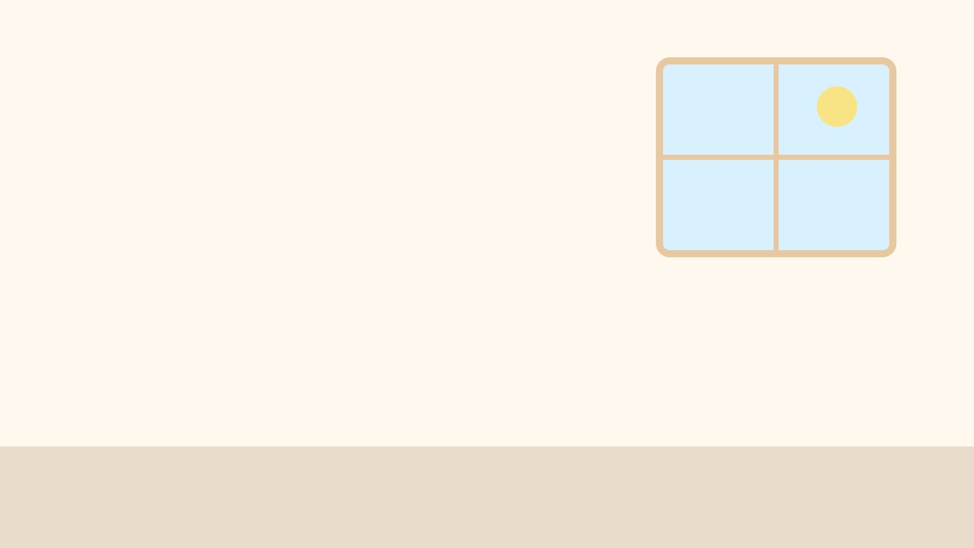

Find
سٍ
سِ
سِي
سٍ

Slide 52

Find
شٍ
شِي
شٍ
شِ

Slide 53

How do we write it?
صِ + نۡ
صِ
صٍ
صِي

Slide 54

Find
بَلَدٍ
بَلَدٍ
بَلَدِ
بَلَدٌ

Slide 55
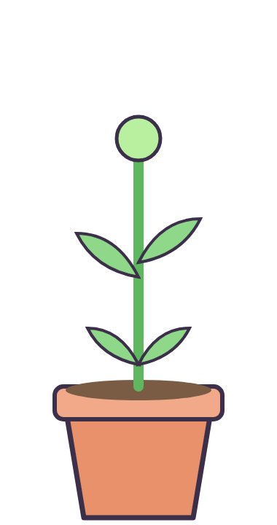
Which word has tanween?
طَعَامٍ
يَلۡعَبُ
سَمِعَ

Slide 56
Beautiful!

Slide 57
Find
سٍ
سِ
سِي
سٍ
Try again!

Slide 58
Find
شٍ
شِي
شٍ
شِ
Try again!

Slide 59
How do we write it?
صِ + نۡ
صِ
صٍ
صِي
Try again!

Slide 60
Find
بَلَدٍ
بَلَدٍ
بَلَدِ
بَلَدٌ
Try again!

Slide 61
Which word has tanween?
طَعَامٍ
يَلۡعَبُ
سَمِعَ
Try again!

Slide 62
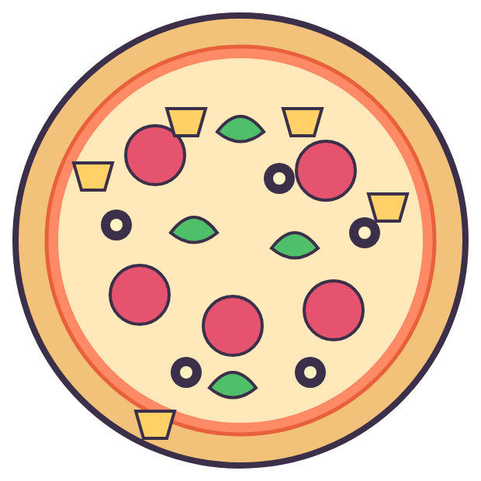
How to play: Pizza Party
1. Read the question at the top.
2. Tap the right card.
3. Every right answer adds a topping!

Slide 63


Find
ضٍ
ضِ
ضِي
ضٍ

Slide 64

How do we write it?
طِ + نۡ
طٍ
طِ
طِي

Slide 65

Find
نَجۡمٍ
نَجۡمِ
نَجۡمٌ
نَجۡمٍ

Slide 66

Which word has tanween?
شَرِبَ
الۡقَمَرُ
قَلَمٍ

Slide 67
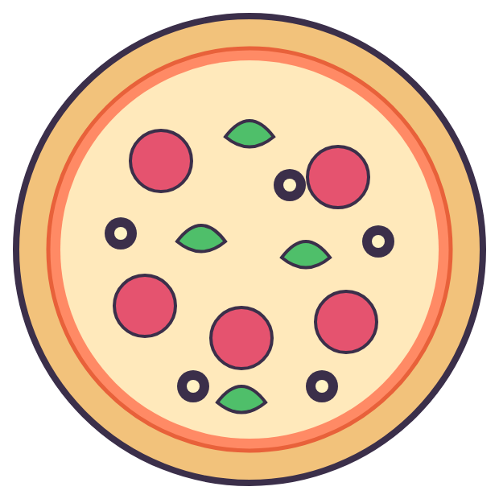
Find
غٍ
غِي
غٍ
غِ

Slide 68
Pizza is ready!

Slide 69
Find
ضٍ
ضِ
ضِي
ضٍ
Try again!

Slide 70
How do we write it?
طِ + نۡ
طٍ
طِ
طِي
Try again!

Slide 71
Find
نَجۡمٍ
نَجۡمِ
نَجۡمٌ
نَجۡمٍ
Try again!

Slide 72
Which word has tanween?
شَرِبَ
الۡقَمَرُ
قَلَمٍ
Try again!

Slide 73
Find
غٍ
غِي
غٍ
غِ
Try again!

Slide 74

How to play: Turtle Trip
1. Read the question at the top.
2. Tap the right card.
3. Help the turtle walk home!

Slide 75


How do we write it?
عِ + نۡ
عِي
عٍ
عِ

Slide 76
Find
نُورٍ
نُورٍ
نُورِ
نُورٌ

Slide 77
Which word has tanween?
ذَهَبَ
قَالَ
مَدۡرَسَةٍ

Slide 78
Find
قٍ
قٍ
قِي
قِ

Slide 79
Find
كٍ
كٍ
كِي
كِ

Slide 80
Home sweet home!

Slide 81
How do we write it?
عِ + نۡ
عِي
عٍ
عِ
Try again!

Slide 82
Find
نُورٍ
نُورٍ
نُورِ
نُورٌ
Try again!

Slide 83
Which word has tanween?
ذَهَبَ
قَالَ
مَدۡرَسَةٍ
Try again!

Slide 84
Find
قٍ
قٍ
قِي
قِ
Try again!

Slide 85
Find
كٍ
كٍ
كِي
كِ
Try again!

Slide 86
Find
وَلَدٍ
وَلَدٍ
وَلَدِ
وَلَدًا

Slide 87
Which word has tanween?
كَتَبَ
طَعَامٍ
فَتَحَ

Slide 88
Find
لٍ
لِي
لِ
لٍ

Slide 89
Find
مٍ
مٍ
مِ
مِي

Slide 90
How do we write it?
هِ + نۡ
هِي
هِ
هٍ

Slide 91
Yummy honey!

Slide 92
Find
وَلَدٍ
وَلَدٍ
وَلَدِ
وَلَدًا
Try again!

Slide 93
Which word has tanween?
كَتَبَ
طَعَامٍ
فَتَحَ
Try again!

Slide 94
Find
لٍ
لِي
لِ
لٍ
Try again!

Slide 95
Find
مٍ
مٍ
مِ
مِي
Try again!

Slide 96
How do we write it?
هِ + نۡ
هِي
هِ
هٍ
Try again!

Slide 97
Which word has tanween?
يَكۡتُبُ
قَمَرٍ
نَامَ

Slide 98
Find
هٍ
هِي
هٍ
هِ

Slide 99
Find
وٍ
وٍ
وِ
وِي

Slide 100
How do we write it?
بِ + نۡ
بِ
بٍ
بِي

Slide 101
Find
قَلۡبٍ
قَلۡبٌ
قَلۡبٍ
قَلۡبِ

Slide 102
Bananas! Yum!

Slide 103
Which word has tanween?
يَكۡتُبُ
قَمَرٍ
نَامَ
Try again!

Slide 104
Find
هٍ
هِي
هٍ
هِ
Try again!

Slide 105
Find
وٍ
وٍ
وِ
وِي
Try again!

Slide 106
How do we write it?
بِ + نۡ
بِ
بٍ
بِي
Try again!

Slide 107
Find
قَلۡبٍ
قَلۡبٌ
قَلۡبٍ
قَلۡبِ
Try again!

Slide 108
Find
بٍ
بِي
بٍ
بِ

Slide 109
Find
تٍ
تٍ
تِ
تِي
Bullseye!

Slide 110
How do we write it?
ثِ + نۡ
ثٍ
ثِي
ثِ
Bullseye!

Slide 111
Find
مَدۡرَسَةٍ
مَدۡرَسَةٍ
مَدۡرَسَةً
مَدۡرَسَةِ
Bullseye!

Slide 112
Which word has tanween?
قَلَمٍ
فَتَحَ
الۡقَمَرُ
Bullseye!

Slide 113
Champion!

Slide 114
Find
بٍ
بِي
بٍ
بِ
Missed! Try again!

Slide 115
Find
تٍ
تٍ
تِ
تِي
Missed! Try again!

Slide 116
How do we write it?
ثِ + نۡ
ثٍ
ثِي
ثِ
Missed! Try again!

Slide 117
Find
مَدۡرَسَةٍ
مَدۡرَسَةٍ
مَدۡرَسَةً
مَدۡرَسَةِ
Missed! Try again!

Slide 118
Which word has tanween?
قَلَمٍ
فَتَحَ
الۡقَمَرُ
Missed! Try again!

Slide 119
Find
نٍ
نِي
نٍ
نِ

Slide 120
How do we write it?
يِ + نۡ
Swish!
يٍ
يِي
يِ

Slide 121
Find
جَمَلٍ
Swish!
جَمَلٍ
جَمَلِ
جَمَلًا

Slide 122
Which word has tanween?
Swish!
رَجُلٍ
يَكۡتُبُ
يَلۡعَبُ

Slide 123
Find
خٍ
Swish!
خِي
خٍ
خِ

Slide 124
What a player!

Slide 125
Find
نٍ
Try again!
نِي
نٍ
نِ

Slide 126
How do we write it?
يِ + نۡ
Try again!
يٍ
يِي
يِ

Slide 127
Find
جَمَلٍ
Try again!
جَمَلٍ
جَمَلِ
جَمَلًا

Slide 128
Which word has tanween?
Try again!
رَجُلٍ
يَكۡتُبُ
يَلۡعَبُ

Slide 129
Find
خٍ
Try again!
خِي
خٍ
خِ

Slide 130
How do we write it?
حِ + نۡ
حِ
حٍ
حِي

Slide 131
Find
كِتَابٍ
كِتَابٍ
كِتَابِ
كِتَابٌ

Slide 132
Which word has tanween?
ذَهَبَ
يَلۡعَبُ
مَدۡرَسَةٍ

Slide 133
Find
ذٍ
ذِي
ذِ
ذٍ

Slide 134
Find
رٍ
رِي
رٍ
رِ

Slide 135
Beautiful!

Slide 136
How do we write it?
حِ + نۡ
حِ
حٍ
حِي
Try again!

Slide 137
Find
كِتَابٍ
كِتَابٍ
كِتَابِ
كِتَابٌ
Try again!

Slide 138
Which word has tanween?
ذَهَبَ
يَلۡعَبُ
مَدۡرَسَةٍ
Try again!

Slide 139
Find
ذٍ
ذِي
ذِ
ذٍ
Try again!

Slide 140
Find
رٍ
رِي
رٍ
رِ
Try again!

Slide 141
Find
مَكۡتَبَةٍ
مَكۡتَبَةٌ
مَكۡتَبَةِ
مَكۡتَبَةٍ

Slide 142
Which word has tanween?
سَمِعَ
جَلَسَ
بَلَدٍ

Slide 143
Find
زٍ
زِي
زِ
زٍ

Slide 144
Find
سٍ
سٍ
سِي
سِ

Slide 145
How do we write it?
شِ + نۡ
شِ
شِي
شٍ

Slide 146
Pizza is ready!

Slide 147
Find
مَكۡتَبَةٍ
مَكۡتَبَةٌ
مَكۡتَبَةِ
مَكۡتَبَةٍ
Try again!

Slide 148
Which word has tanween?
سَمِعَ
جَلَسَ
بَلَدٍ
Try again!

Slide 149
Find
زٍ
زِي
زِ
زٍ
Try again!

Slide 150
Find
سٍ
سٍ
سِي
سِ
Try again!

Slide 151
How do we write it?
شِ + نۡ
شِ
شِي
شٍ
Try again!

Slide 152
Which word has tanween?
شَجَرٍ
نَامَ
كَتَبَ

Slide 153
Find
شٍ
شِي
شِ
شٍ

Slide 154
Find
صٍ
صِي
صِ
صٍ

Slide 155
How do we write it?
ضِ + نۡ
ضٍ
ضِ
ضِي

Slide 156
Find
مَكۡتَبَةٍ
مَكۡتَبَةٍ
مَكۡتَبَةِ
مَكۡتَبَةٌ

Slide 157
Home sweet home!

Slide 158
Which word has tanween?
شَجَرٍ
نَامَ
كَتَبَ
Try again!

Slide 159
Find
شٍ
شِي
شِ
شٍ
Try again!

Slide 160
Find
صٍ
صِي
صِ
صٍ
Try again!

Slide 161
How do we write it?
ضِ + نۡ
ضٍ
ضِ
ضِي
Try again!

Slide 162
Find
مَكۡتَبَةٍ
مَكۡتَبَةٍ
مَكۡتَبَةِ
مَكۡتَبَةٌ
Try again!

Slide 163
Find
ضٍ
ضِي
ضٍ
ضِ

Slide 164
Find
طٍ
طٍ
طِي
طِ

Slide 165
How do we write it?
ظِ + نۡ
ظٍ
ظِ
ظِي

Slide 166
Find
كَلۡبٍ
كَلۡبِ
كَلۡبٍ
كَلۡبٌ

Slide 167
Which word has tanween?
فَتَحَ
الۡبَابُ
جَبَلٍ

Slide 168
Yummy honey!

Slide 169
Find
ضٍ
ضِي
ضٍ
ضِ
Try again!

Slide 170
Find
طٍ
طٍ
طِي
طِ
Try again!

Slide 171
How do we write it?
ظِ + نۡ
ظٍ
ظِ
ظِي
Try again!

Slide 172
Find
كَلۡبٍ
كَلۡبِ
كَلۡبٍ
كَلۡبٌ
Try again!

Slide 173
Which word has tanween?
فَتَحَ
الۡبَابُ
جَبَلٍ
Try again!

Slide 174
Find
عٍ
عٍ
عِي
عِ

Slide 175
How do we write it?
غِ + نۡ
غِ
غٍ
غِي

Slide 176
Find
قَمَرٍ
قَمَرِ
قَمَرٍ
قَمَرٌ

Slide 177
Which word has tanween?
يَلۡعَبُ
مَطَرٍ
الۡقَمَرُ

Slide 178
Find
كٍ
كِ
كٍ
كِي

Slide 179
Bananas! Yum!

Slide 180
Find
عٍ
عٍ
عِي
عِ
Try again!

Slide 181
How do we write it?
غِ + نۡ
غِ
غٍ
غِي
Try again!

Slide 182
Find
قَمَرٍ
قَمَرِ
قَمَرٍ
قَمَرٌ
Try again!

Slide 183
Which word has tanween?
يَلۡعَبُ
مَطَرٍ
الۡقَمَرُ
Try again!

Slide 184
Find
كٍ
كِ
كٍ
كِي
Try again!

Slide 185

How to play: Block Tower (class game)
1. Two teams: Red and Blue.
2. Read the word, then tap your team.
3. First tower of 5 blocks wins!

Slide 186
Block Tower! Read the word, then tap your team.
رَجُلٍ
Red ✓
Blue ✓
Red: 0
Blue: 0

Slide 187
Block Tower! Read the word, then tap your team.
سَحَابٍ
Red ✓
Blue ✓
Red: 0
Blue: 1

Slide 188
Block Tower! Read the word, then tap your team.
بَحۡرٍ
Red ✓
Blue ✓
Red: 0
Blue: 2

Slide 189
Block Tower! Read the word, then tap your team.
مَاءٍ
Red ✓
Blue ✓
Red: 0
Blue: 3

Slide 190
Block Tower! Read the word, then tap your team.
قَمَرٍ
Red ✓
Blue ✓
Red: 0
Blue: 4

Slide 191
Blue team wins!
Red: 0
Blue: 5

Slide 192
Block Tower! Read the word, then tap your team.
سَحَابٍ
Red ✓
Blue ✓
Red: 1
Blue: 0

Slide 193
Block Tower! Read the word, then tap your team.
بَحۡرٍ
Red ✓
Blue ✓
Red: 1
Blue: 1

Slide 194
Block Tower! Read the word, then tap your team.
مَاءٍ
Red ✓
Blue ✓
Red: 1
Blue: 2

Slide 195
Block Tower! Read the word, then tap your team.
قَمَرٍ
Red ✓
Blue ✓
Red: 1
Blue: 3

Slide 196
Block Tower! Read the word, then tap your team.
نَهۡرٍ
Red ✓
Blue ✓
Red: 1
Blue: 4

Slide 197
Blue team wins!
Red: 1
Blue: 5

Slide 198
Block Tower! Read the word, then tap your team.
بَحۡرٍ
Red ✓
Blue ✓
Red: 2
Blue: 0

Slide 199
Block Tower! Read the word, then tap your team.
مَاءٍ
Red ✓
Blue ✓
Red: 2
Blue: 1

Slide 200
Block Tower! Read the word, then tap your team.
قَمَرٍ
Red ✓
Blue ✓
Red: 2
Blue: 2

Slide 201
Block Tower! Read the word, then tap your team.
نَهۡرٍ
Red ✓
Blue ✓
Red: 2
Blue: 3

Slide 202
Block Tower! Read the word, then tap your team.
سَمَكٍ
Red ✓
Blue ✓
Red: 2
Blue: 4

Slide 203
Blue team wins!
Red: 2
Blue: 5

Slide 204
Block Tower! Read the word, then tap your team.
مَاءٍ
Red ✓
Blue ✓
Red: 3
Blue: 0

Slide 205
Block Tower! Read the word, then tap your team.
قَمَرٍ
Red ✓
Blue ✓
Red: 3
Blue: 1

Slide 206
Block Tower! Read the word, then tap your team.
نَهۡرٍ
Red ✓
Blue ✓
Red: 3
Blue: 2

Slide 207
Block Tower! Read the word, then tap your team.
سَمَكٍ
Red ✓
Blue ✓
Red: 3
Blue: 3

Slide 208
Block Tower! Read the word, then tap your team.
جَبَلٍ
Red ✓
Blue ✓
Red: 3
Blue: 4

Slide 209
Blue team wins!
Red: 3
Blue: 5

Slide 210
Block Tower! Read the word, then tap your team.
قَمَرٍ
Red ✓
Blue ✓
Red: 4
Blue: 0

Slide 211
Block Tower! Read the word, then tap your team.
نَهۡرٍ
Red ✓
Blue ✓
Red: 4
Blue: 1

Slide 212
Block Tower! Read the word, then tap your team.
سَمَكٍ
Red ✓
Blue ✓
Red: 4
Blue: 2

Slide 213
Block Tower! Read the word, then tap your team.
جَبَلٍ
Red ✓
Blue ✓
Red: 4
Blue: 3

Slide 214
Block Tower! Read the word, then tap your team.
كَلۡبٍ
Red ✓
Blue ✓
Red: 4
Blue: 4

Slide 215
Blue team wins!
Red: 4
Blue: 5

Slide 216
Red team wins!
Red: 5
Blue: 0

Slide 217
Red team wins!
Red: 5
Blue: 1

Slide 218
Red team wins!
Red: 5
Blue: 2

Slide 219
Red team wins!
Red: 5
Blue: 3

Slide 220
Red team wins!
Red: 5
Blue: 4

Slide 221
How do we write it?
قِ + نۡ
قِي
قٍ
قِ

Slide 222
Find
وَرۡدَةٍ
وَرۡدَةِ
وَرۡدَةٌ
وَرۡدَةٍ
Bullseye!

Slide 223
Which word has tanween?
مَاءٍ
قَالَ
فَتَحَ
Bullseye!

Slide 224
Find
مٍ
مٍ
مِ
مِي
Bullseye!

Slide 225
Find
هٍ
هِي
هِ
هٍ
Bullseye!

Slide 226
Champion!

Slide 227
How do we write it?
قِ + نۡ
قِي
قٍ
قِ
Missed! Try again!

Slide 228
Find
وَرۡدَةٍ
وَرۡدَةِ
وَرۡدَةٌ
وَرۡدَةٍ
Missed! Try again!

Slide 229
Which word has tanween?
مَاءٍ
قَالَ
فَتَحَ
Missed! Try again!

Slide 230
Find
مٍ
مٍ
مِ
مِي
Missed! Try again!

Slide 231
Find
هٍ
هِي
هِ
هٍ
Missed! Try again!

Slide 232
Find
مَطَرٍ
مَطَرٌ
مَطَرٍ
مَطَرِ

Slide 233
Which word has tanween?
Swish!
شَرِبَ
مَاءٍ
ذَهَبَ

Slide 234
Find
وٍ
Swish!
وِي
وٍ
وِ

Slide 235
Find
بٍ
Swish!
بٍ
بِ
بِي

Slide 236
How do we write it?
تِ + نۡ
Swish!
تٍ
تِ
تِي

Slide 237
What a player!

Slide 238
Find
مَطَرٍ
Try again!
مَطَرٌ
مَطَرٍ
مَطَرِ

Slide 239
Which word has tanween?
Try again!
شَرِبَ
مَاءٍ
ذَهَبَ

Slide 240
Find
وٍ
Try again!
وِي
وٍ
وِ

Slide 241
Find
بٍ
Try again!
بٍ
بِ
بِي

Slide 242
How do we write it?
تِ + نۡ
Try again!
تٍ
تِ
تِي

Slide 243
Which word has tanween?
يَكۡتُبُ
نَامَ
رَجُلٍ

Slide 244
Find
تٍ
تِ
تِي
تٍ

Slide 245
Find
ثٍ
ثِي
ثٍ
ثِ

Slide 246
How do we write it?
نِ + نۡ
نِي
نِ
نٍ

Slide 247
Find
حِصَانٍ
حِصَانٌ
حِصَانٍ
حِصَانِ

Slide 248
Beautiful!

Slide 249
Which word has tanween?
يَكۡتُبُ
نَامَ
رَجُلٍ
Try again!

Slide 250
Find
تٍ
تِ
تِي
تٍ
Try again!

Slide 251
Find
ثٍ
ثِي
ثٍ
ثِ
Try again!

Slide 252
How do we write it?
نِ + نۡ
نِي
نِ
نٍ
Try again!

Slide 253
Find
حِصَانٍ
حِصَانٌ
حِصَانٍ
حِصَانِ
Try again!

Slide 254
Find
نٍ
نِي
نِ
نٍ

Slide 255
Find
يٍ
يٍ
يِي
يِ

Slide 256
How do we write it?
جِ + نۡ
جِ
جِي
جٍ

Slide 257
Find
بَيۡتٍ
بَيۡتٍ
بَيۡتٌ
بَيۡتِ

Slide 258
Which word has tanween?
سَمِعَ
قَمَرٍ
قَالَ

Slide 259
Pizza is ready!

Slide 260
Find
نٍ
نِي
نِ
نٍ
Try again!

Slide 261
Find
يٍ
يٍ
يِي
يِ
Try again!

Slide 262
How do we write it?
جِ + نۡ
جِ
جِي
جٍ
Try again!

Slide 263
Find
بَيۡتٍ
بَيۡتٍ
بَيۡتٌ
بَيۡتِ
Try again!

Slide 264
Which word has tanween?
سَمِعَ
قَمَرٍ
قَالَ
Try again!

Slide 265
Find
حٍ
حِي
حٍ
حِ

Slide 266
How do we write it?
خِ + نۡ
خِ
خٍ
خِي

Slide 267
Find
رَجُلٍ
رَجُلٍ
رَجُلٌ
رَجُلِ

Slide 268
Which word has tanween?
يَكۡتُبُ
وَلَدٍ
نَامَ

Slide 269
Find
رٍ
رِ
رٍ
رِي

Slide 270
Home sweet home!

Slide 271
Find
حٍ
حِي
حٍ
حِ
Try again!

Slide 272
How do we write it?
خِ + نۡ
خِ
خٍ
خِي
Try again!

Slide 273
Find
رَجُلٍ
رَجُلٍ
رَجُلٌ
رَجُلِ
Try again!

Slide 274
Which word has tanween?
يَكۡتُبُ
وَلَدٍ
نَامَ
Try again!

Slide 275
Find
رٍ
رِ
رٍ
رِي
Try again!

Slide 276
How do we write it?
ذِ + نۡ
ذِي
ذِ
ذٍ

Slide 277
Find
شَجَرَةٍ
شَجَرَةِ
شَجَرَةٍ
شَجَرَةً

Slide 278
Which word has tanween?
كِتَابٍ
الۡبَابُ
ذَهَبَ

Slide 279
Find
سٍ
سِي
سِ
سٍ

Slide 280
Find
شٍ
شٍ
شِ
شِي

Slide 281
Yummy honey!

Slide 282
How do we write it?
ذِ + نۡ
ذِي
ذِ
ذٍ
Try again!

Slide 283
Find
شَجَرَةٍ
شَجَرَةِ
شَجَرَةٍ
شَجَرَةً
Try again!

Slide 284
Which word has tanween?
كِتَابٍ
الۡبَابُ
ذَهَبَ
Try again!

Slide 285
Find
سٍ
سِي
سِ
سٍ
Try again!

Slide 286
Find
شٍ
شٍ
شِ
شِي
Try again!

Slide 287
Find
بَلَدٍ
بَلَدٌ
بَلَدِ
بَلَدٍ

Slide 288
Which word has tanween?
بَحۡرٍ
شَرِبَ
ذَهَبَ

Slide 289
Find
صٍ
صِ
صٍ
صِي

Slide 290
Find
ضٍ
ضٍ
ضِي
ضِ

Slide 291
How do we write it?
طِ + نۡ
طِ
طٍ
طِي

Slide 292
Bananas! Yum!

Slide 293
Find
بَلَدٍ
بَلَدٌ
بَلَدِ
بَلَدٍ
Try again!

Slide 294
Which word has tanween?
بَحۡرٍ
شَرِبَ
ذَهَبَ
Try again!

Slide 295
Find
صٍ
صِ
صٍ
صِي
Try again!

Slide 296
Find
ضٍ
ضٍ
ضِي
ضِ
Try again!

Slide 297
How do we write it?
طِ + نۡ
طِ
طٍ
طِي
Try again!

Slide 298
Which word has tanween?
نَامَ
الۡبَابُ
رَجُلٍ

Slide 299
Find
طٍ
طِي
طٍ
طِ
Bullseye!

Slide 300
Find
ظٍ
ظِ
ظِي
ظٍ
Bullseye!

Slide 301
How do we write it?
عِ + نۡ
عِ
عِي
عٍ
Bullseye!

Slide 302
Find
نَهۡرٍ
نَهۡرٌ
نَهۡرٍ
نَهۡرِ
Bullseye!

Slide 303
Champion!

Slide 304
Which word has tanween?
نَامَ
الۡبَابُ
رَجُلٍ
Missed! Try again!

Slide 305
Find
طٍ
طِي
طٍ
طِ
Missed! Try again!

Slide 306
Find
ظٍ
ظِ
ظِي
ظٍ
Missed! Try again!

Slide 307
How do we write it?
عِ + نۡ
عِ
عِي
عٍ
Missed! Try again!

Slide 308
Find
نَهۡرٍ
نَهۡرٌ
نَهۡرٍ
نَهۡرِ
Missed! Try again!

Slide 309
Find
عٍ
عٍ
عِي
عِ

Slide 310
Find
غٍ
Swish!
غِي
غِ
غٍ

Slide 311
How do we write it?
فِ + نۡ
Swish!
فِي
فٍ
فِ

Slide 312
Find
قَمَرٍ
Swish!
قَمَرِ
قَمَرٍ
قَمَرٌ

Slide 313
Which word has tanween?
Swish!
سَحَابٍ
يَكۡتُبُ
شَرِبَ

Slide 314
What a player!

Slide 315
Find
عٍ
Try again!
عٍ
عِي
عِ

Slide 316
Find
غٍ
Try again!
غِي
غِ
غٍ

Slide 317
How do we write it?
فِ + نۡ
Try again!
فِي
فٍ
فِ

Slide 318
Find
قَمَرٍ
Try again!
قَمَرِ
قَمَرٍ
قَمَرٌ

Slide 319
Which word has tanween?
Try again!
سَحَابٍ
يَكۡتُبُ
شَرِبَ

Slide 320
Find
قٍ
قِي
قِ
قٍ

Slide 321
How do we write it?
كِ + نۡ
كِي
كٍ
كِ

Slide 322
Find
مَكۡتَبَةٍ
مَكۡتَبَةِ
مَكۡتَبَةٍ
مَكۡتَبَةٌ

Slide 323
Which word has tanween?
يَكۡتُبُ
فَتَحَ
بَابٍ

Slide 324
Find
هٍ
هِي
هِ
هٍ

Slide 325
Beautiful!

Slide 326
Find
قٍ
قِي
قِ
قٍ
Try again!

Slide 327
How do we write it?
كِ + نۡ
كِي
كٍ
كِ
Try again!

Slide 328
Find
مَكۡتَبَةٍ
مَكۡتَبَةِ
مَكۡتَبَةٍ
مَكۡتَبَةٌ
Try again!

Slide 329
Which word has tanween?
يَكۡتُبُ
فَتَحَ
بَابٍ
Try again!

Slide 330
Find
هٍ
هِي
هِ
هٍ
Try again!

Slide 331
How do we write it?
مِ + نۡ
مِي
مٍ
مِ

Slide 332
Find
بَيۡتٍ
بَيۡتِ
بَيۡتٍ
بَيۡتًا

Slide 333
Which word has tanween?
نَامَ
حِصَانٍ
الۡبَابُ

Slide 334
Find
بٍ
بٍ
بِ
بِي

Slide 335
Find
تٍ
تِي
تٍ
تِ

Slide 336
Pizza is ready!

Slide 337
How do we write it?
مِ + نۡ
مِي
مٍ
مِ
Try again!

Slide 338
Find
بَيۡتٍ
بَيۡتِ
بَيۡتٍ
بَيۡتًا
Try again!

Slide 339
Which word has tanween?
نَامَ
حِصَانٍ
الۡبَابُ
Try again!

Slide 340
Find
بٍ
بٍ
بِ
بِي
Try again!

Slide 341
Find
تٍ
تِي
تٍ
تِ
Try again!

Slide 342
Find
وَرۡدَةٍ
وَرۡدَةٌ
وَرۡدَةِ
وَرۡدَةٍ

Slide 343
Which word has tanween?
قَالَ
يَكۡتُبُ
بَلَدٍ

Slide 344
Find
ثٍ
ثِ
ثِي
ثٍ

Slide 345
Find
نٍ
نِ
نِي
نٍ

Slide 346
How do we write it?
يِ + نۡ
يِ
يٍ
يِي

Slide 347
Home sweet home!

Slide 348
Find
وَرۡدَةٍ
وَرۡدَةٌ
وَرۡدَةِ
وَرۡدَةٍ
Try again!

Slide 349
Which word has tanween?
قَالَ
يَكۡتُبُ
بَلَدٍ
Try again!

Slide 350
Find
ثٍ
ثِ
ثِي
ثٍ
Try again!

Slide 351
Find
نٍ
نِ
نِي
نٍ
Try again!

Slide 352
How do we write it?
يِ + نۡ
يِ
يٍ
يِي
Try again!

Slide 353
Which word has tanween?
شَرِبَ
بَابٍ
الۡقَمَرُ

Slide 354
Find
يٍ
يٍ
يِي
يِ

Slide 355
Find
جٍ
جِ
جِي
جٍ

Slide 356
How do we write it?
حِ + نۡ
حِي
حٍ
حِ

Slide 357
Find
حِصَانٍ
حِصَانِ
حِصَانٍ
حِصَانًا

Slide 358
Yummy honey!

Slide 359
Which word has tanween?
شَرِبَ
بَابٍ
الۡقَمَرُ
Try again!

Slide 360
Find
يٍ
يٍ
يِي
يِ
Try again!

Slide 361
Find
جٍ
جِ
جِي
جٍ
Try again!

Slide 362
How do we write it?
حِ + نۡ
حِي
حٍ
حِ
Try again!

Slide 363
Find
حِصَانٍ
حِصَانِ
حِصَانٍ
حِصَانًا
Try again!

Slide 364
Find
حٍ
حِ
حٍ
حِي

Slide 365
Find
خٍ
خِ
خِي
خٍ

Slide 366
How do we write it?
دِ + نۡ
دِي
دٍ
دِ

Slide 367
Find
مَاءٍ
مَاءٍ
مَاءِ
مَاءٌ

Slide 368
Which word has tanween?
جَلَسَ
كَلۡبٍ
كَتَبَ

Slide 369
Bananas! Yum!

Slide 370
Find
حٍ
حِ
حٍ
حِي
Try again!

Slide 371
Find
خٍ
خِ
خِي
خٍ
Try again!

Slide 372
How do we write it?
دِ + نۡ
دِي
دٍ
دِ
Try again!

Slide 373
Find
مَاءٍ
مَاءٍ
مَاءِ
مَاءٌ
Try again!

Slide 374
Which word has tanween?
جَلَسَ
كَلۡبٍ
كَتَبَ
Try again!

Slide 375
Block Tower! Read the word, then tap your team.
عِنَبٍ
Red ✓
Blue ✓
Red: 0
Blue: 0

Slide 376
Block Tower! Read the word, then tap your team.
جَمَلٍ
Red ✓
Blue ✓
Red: 0
Blue: 1

Slide 377
Block Tower! Read the word, then tap your team.
نُورٍ
Red ✓
Blue ✓
Red: 0
Blue: 2

Slide 378
Block Tower! Read the word, then tap your team.
بَلَدٍ
Red ✓
Blue ✓
Red: 0
Blue: 3

Slide 379
Block Tower! Read the word, then tap your team.
مَدۡرَسَةٍ
Red ✓
Blue ✓
Red: 0
Blue: 4

Slide 380
Blue team wins!
Red: 0
Blue: 5

Slide 381
Block Tower! Read the word, then tap your team.
جَمَلٍ
Red ✓
Blue ✓
Red: 1
Blue: 0

Slide 382
Block Tower! Read the word, then tap your team.
نُورٍ
Red ✓
Blue ✓
Red: 1
Blue: 1

Slide 383
Block Tower! Read the word, then tap your team.
بَلَدٍ
Red ✓
Blue ✓
Red: 1
Blue: 2

Slide 384
Block Tower! Read the word, then tap your team.
مَدۡرَسَةٍ
Red ✓
Blue ✓
Red: 1
Blue: 3

Slide 385
Block Tower! Read the word, then tap your team.
مَاءٍ
Red ✓
Blue ✓
Red: 1
Blue: 4

Slide 386
Blue team wins!
Red: 1
Blue: 5

Slide 387
Block Tower! Read the word, then tap your team.
نُورٍ
Red ✓
Blue ✓
Red: 2
Blue: 0

Slide 388
Block Tower! Read the word, then tap your team.
بَلَدٍ
Red ✓
Blue ✓
Red: 2
Blue: 1

Slide 389
Block Tower! Read the word, then tap your team.
مَدۡرَسَةٍ
Red ✓
Blue ✓
Red: 2
Blue: 2

Slide 390
Block Tower! Read the word, then tap your team.
مَاءٍ
Red ✓
Blue ✓
Red: 2
Blue: 3

Slide 391
Block Tower! Read the word, then tap your team.
نَجۡمٍ
Red ✓
Blue ✓
Red: 2
Blue: 4

Slide 392
Blue team wins!
Red: 2
Blue: 5

Slide 393
Block Tower! Read the word, then tap your team.
بَلَدٍ
Red ✓
Blue ✓
Red: 3
Blue: 0

Slide 394
Block Tower! Read the word, then tap your team.
مَدۡرَسَةٍ
Red ✓
Blue ✓
Red: 3
Blue: 1

Slide 395
Block Tower! Read the word, then tap your team.
مَاءٍ
Red ✓
Blue ✓
Red: 3
Blue: 2

Slide 396
Block Tower! Read the word, then tap your team.
نَجۡمٍ
Red ✓
Blue ✓
Red: 3
Blue: 3

Slide 397
Block Tower! Read the word, then tap your team.
حِصَانٍ
Red ✓
Blue ✓
Red: 3
Blue: 4

Slide 398
Blue team wins!
Red: 3
Blue: 5

Slide 399
Block Tower! Read the word, then tap your team.
مَدۡرَسَةٍ
Red ✓
Blue ✓
Red: 4
Blue: 0

Slide 400
Block Tower! Read the word, then tap your team.
مَاءٍ
Red ✓
Blue ✓
Red: 4
Blue: 1

Slide 401
Block Tower! Read the word, then tap your team.
نَجۡمٍ
Red ✓
Blue ✓
Red: 4
Blue: 2

Slide 402
Block Tower! Read the word, then tap your team.
حِصَانٍ
Red ✓
Blue ✓
Red: 4
Blue: 3

Slide 403
Block Tower! Read the word, then tap your team.
قَلَمٍ
Red ✓
Blue ✓
Red: 4
Blue: 4

Slide 404
Blue team wins!
Red: 4
Blue: 5

Slide 405
Red team wins!
Red: 5
Blue: 0

Slide 406
Red team wins!
Red: 5
Blue: 1

Slide 407
Red team wins!
Red: 5
Blue: 2

Slide 408
Red team wins!
Red: 5
Blue: 3

Slide 409
Red team wins!
Red: 5
Blue: 4

Slide 410
Well done!
↺ Play again

