Slide 1

Tanween Review Games
بًا بٍ بٌ
Fathatan, kasratan and dammatan together
Start ▶

Slide 2

How to play: Busy Bee
1. Read the question at the top.
2. Fly to the right flower.
3. Fill the honey jar!

Slide 3




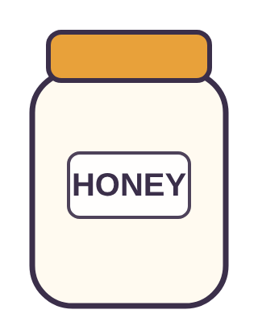
Find
بًا
بًا
بٌ
بٍ

Slide 4
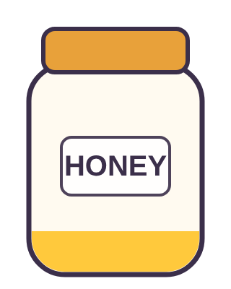
What is it called?
تٌ
ضَمَّتَانِ
كَسۡرَتَانِ
فَتۡحَتَانِ

Slide 5

How do we write it?
ثُ + نۡ
ثٌ
ثٍ
ثًا

Slide 6

Find
جَبَلًا
جَبَلٍ
جَبَلًا
جَبَلٌ

Slide 7

Find
يًا
يٌ
يًا
يٍ

Slide 8

Yummy honey!

Slide 9
Find
بًا
بًا
بٌ
بٍ
Try again!

Slide 10
What is it called?
تٌ
ضَمَّتَانِ
كَسۡرَتَانِ
فَتۡحَتَانِ
Try again!

Slide 11
How do we write it?
ثُ + نۡ
ثٌ
ثٍ
ثًا
Try again!

Slide 12
Find
جَبَلًا
جَبَلٍ
جَبَلًا
جَبَلٌ
Try again!

Slide 13
Find
يًا
يٌ
يًا
يٍ
Try again!

Slide 14

How to play: Monkey Climb
1. Read the question at the top.
2. Tap the right card.
3. Help the monkey reach the bananas!

Slide 15

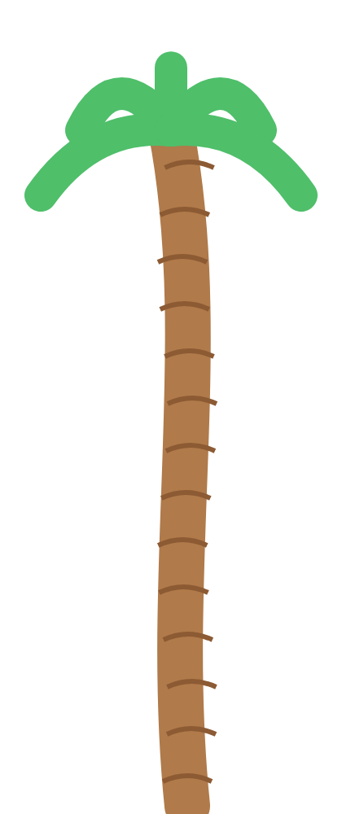
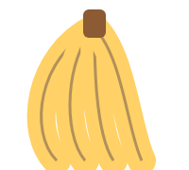
How do we write it?
نُ + نۡ
نًا
نٌ
نٍ

Slide 16
Find
شَجَرٍ
شَجَرًا
شَجَرٍ
شَجَرٌ

Slide 17
Find
جٍ
جٌ
جًا
جٍ

Slide 18
Find
حٍ
حٍ
حِي
حِ

Slide 19
Find
خًا
خٌ
خًا
خٍ

Slide 20
Bananas! Yum!

Slide 21
How do we write it?
نُ + نۡ
نًا
نٌ
نٍ
Try again!

Slide 22
Find
شَجَرٍ
شَجَرًا
شَجَرٍ
شَجَرٌ
Try again!

Slide 23
Find
جٍ
جٌ
جًا
جٍ
Try again!

Slide 24
Find
حٍ
حٍ
حِي
حِ
Try again!

Slide 25
Find
خًا
خٌ
خًا
خٍ
Try again!

Slide 26

How to play: Darts
1. Read the question at the top.
2. Throw at the right board.
3. Bullseye! You get a star.

Slide 27

Find
حٌ
حًا
حٍ
حٌ

Slide 28
Find
خًا
خًا
خَا
خَ
Bullseye!

Slide 29
Find
دٍ
دًا
دٌ
دٍ
Bullseye!

Slide 30
What is it called?
ذًا
كَسۡرَتَانِ
ضَمَّتَانِ
فَتۡحَتَانِ
Bullseye!

Slide 31
How do we write it?
رُ + نۡ
رٍ
رٌ
رًا
Bullseye!

Slide 32

Champion!

Slide 33
Find
حٌ
حًا
حٍ
حٌ
Missed! Try again!

Slide 34
Find
خًا
خًا
خَا
خَ
Missed! Try again!

Slide 35
Find
دٍ
دًا
دٌ
دٍ
Missed! Try again!

Slide 36
What is it called?
ذًا
كَسۡرَتَانِ
ضَمَّتَانِ
فَتۡحَتَانِ
Missed! Try again!

Slide 37
How do we write it?
رُ + نۡ
رٍ
رٌ
رًا
Missed! Try again!

Slide 38

How to play: Basketball
1. Read the question at the top.
2. Shoot the right ball.
3. Swish! You get a star.

Slide 39
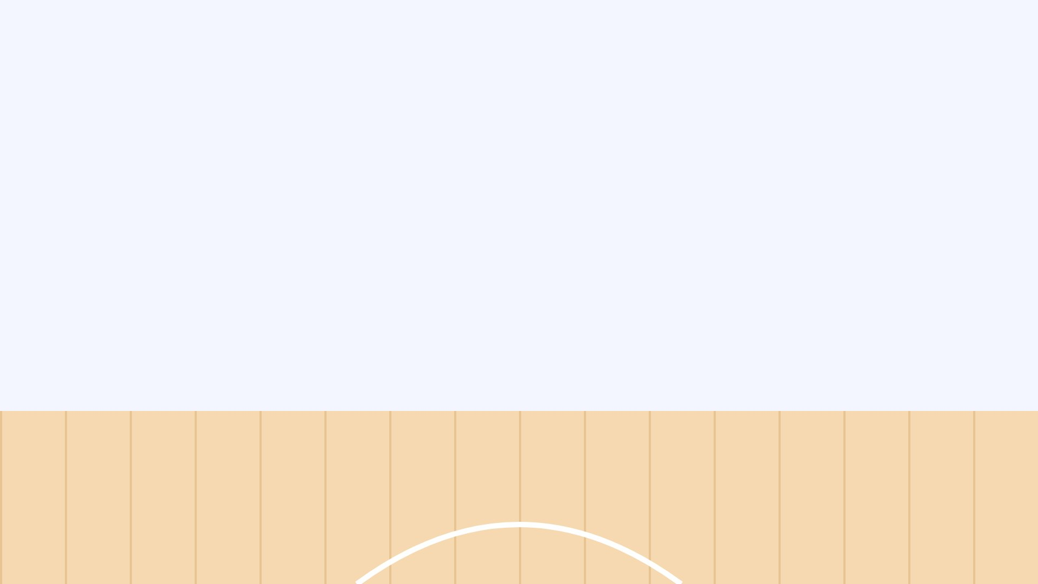

Find
ذٍ
ذًا
ذٍ
ذٌ

Slide 40
What is it called?
رٌ
Swish!
كَسۡرَتَانِ
ضَمَّتَانِ
فَتۡحَتَانِ

Slide 41
How do we write it?
زِ + نۡ
Swish!
زًا
زٍ
زٌ

Slide 42
Find
مَكۡتَبَةٌ
Swish!
مَكۡتَبَةً
مَكۡتَبَةٌ
مَكۡتَبَةٍ

Slide 43
Find
شٍ
Swish!
شٌ
شٍ
شًا

Slide 44
What a player!

Slide 45
Find
ذٍ
Try again!
ذًا
ذٍ
ذٌ

Slide 46
What is it called?
رٌ
Try again!
كَسۡرَتَانِ
ضَمَّتَانِ
فَتۡحَتَانِ

Slide 47
How do we write it?
زِ + نۡ
Try again!
زًا
زٍ
زٌ

Slide 48
Find
مَكۡتَبَةٌ
Try again!
مَكۡتَبَةً
مَكۡتَبَةٌ
مَكۡتَبَةٍ

Slide 49
Find
شٍ
Try again!
شٌ
شٍ
شًا

Slide 50

How to play: Grow a Flower
1. Read the question at the top.
2. Tap the right card.
3. Water the flower until it blooms!

Slide 51
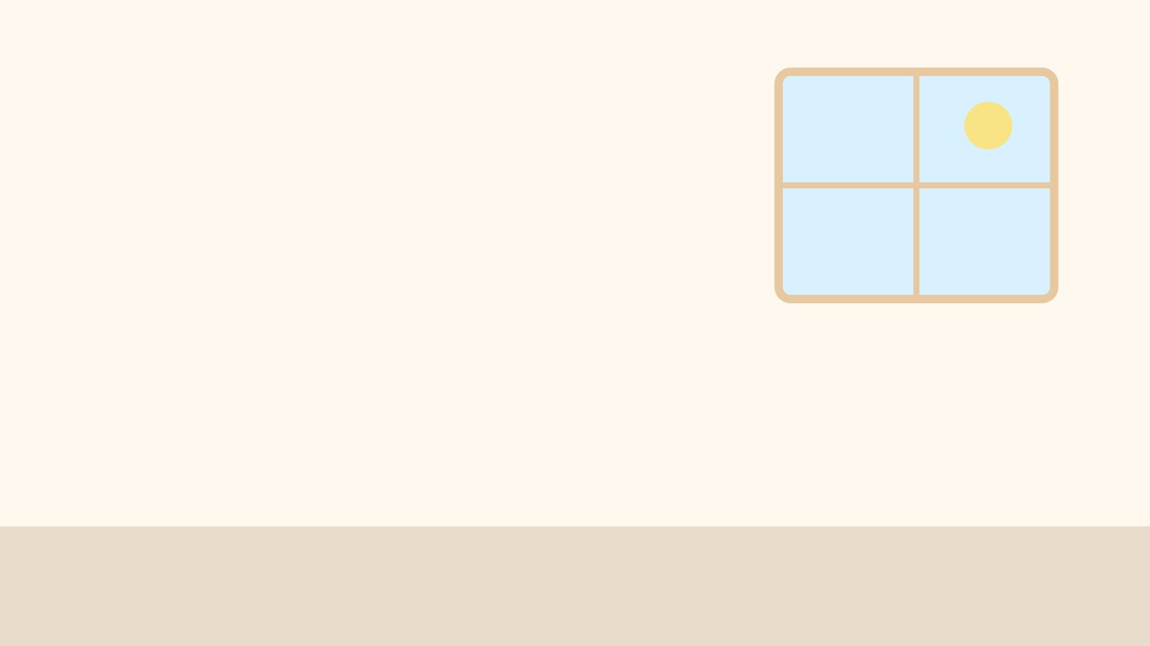

How do we write it?
سِ + نۡ
سٍ
سٌ
سًا

Slide 52

Find
شَجَرٌ
شَجَرًا
شَجَرٍ
شَجَرٌ

Slide 53

Find
صٌ
صًا
صٍ
صٌ

Slide 54

Find
ضٌ
ضُو
ضٌ
ضُ

Slide 55

Find
طًا
طٌ
طًا
طٍ

Slide 56
Beautiful!

Slide 57
How do we write it?
سِ + نۡ
سٍ
سٌ
سًا
Try again!

Slide 58
Find
شَجَرٌ
شَجَرًا
شَجَرٍ
شَجَرٌ
Try again!

Slide 59
Find
صٌ
صًا
صٍ
صٌ
Try again!

Slide 60
Find
ضٌ
ضُو
ضٌ
ضُ
Try again!

Slide 61
Find
طًا
طٌ
طًا
طٍ
Try again!

Slide 62
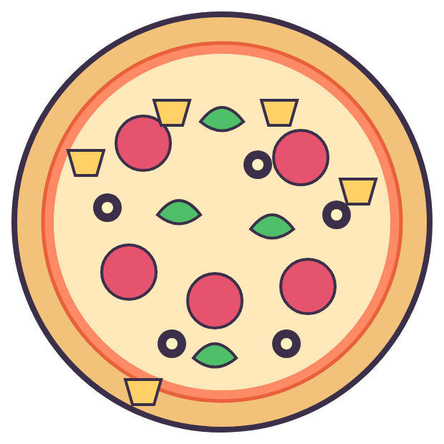
How to play: Pizza Party
1. Read the question at the top.
2. Tap the right card.
3. Every right answer adds a topping!

Slide 63


Find
ضًا
ضٌ
ضًا
ضٍ

Slide 64

Find
طٍ
طِي
طٍ
طِ

Slide 65

Find
ظًا
ظًا
ظٍ
ظٌ

Slide 66

What is it called?
عًا
ضَمَّتَانِ
فَتۡحَتَانِ
كَسۡرَتَانِ

Slide 67

How do we write it?
غُ + نۡ
غًا
غٌ
غٍ

Slide 68
Pizza is ready!

Slide 69
Find
ضًا
ضٌ
ضًا
ضٍ
Try again!

Slide 70
Find
طٍ
طِي
طٍ
طِ
Try again!

Slide 71
Find
ظًا
ظًا
ظٍ
ظٌ
Try again!

Slide 72
What is it called?
عًا
ضَمَّتَانِ
فَتۡحَتَانِ
كَسۡرَتَانِ
Try again!

Slide 73
How do we write it?
غُ + نۡ
غًا
غٌ
غٍ
Try again!

Slide 74

How to play: Turtle Trip
1. Read the question at the top.
2. Tap the right card.
3. Help the turtle walk home!

Slide 75


Find
عًا
عًا
عٍ
عٌ

Slide 76
What is it called?
غًا
ضَمَّتَانِ
فَتۡحَتَانِ
كَسۡرَتَانِ

Slide 77
How do we write it?
فُ + نۡ
فٌ
فٍ
فًا

Slide 78
Find
سَمَاءً
سَمَاءٌ
سَمَاءٍ
سَمَاءً

Slide 79
Find
كٍ
كًا
كٌ
كٍ

Slide 80
Home sweet home!

Slide 81
Find
عًا
عًا
عٍ
عٌ
Try again!

Slide 82
What is it called?
غًا
ضَمَّتَانِ
فَتۡحَتَانِ
كَسۡرَتَانِ
Try again!

Slide 83
How do we write it?
فُ + نۡ
فٌ
فٍ
فًا
Try again!

Slide 84
Find
سَمَاءً
سَمَاءٌ
سَمَاءٍ
سَمَاءً
Try again!

Slide 85
Find
كٍ
كًا
كٌ
كٍ
Try again!

Slide 86
How do we write it?
قُ + نۡ
قٌ
قًا
قٍ

Slide 87
Find
قَمَرًا
قَمَرٍ
قَمَرٌ
قَمَرًا

Slide 88
Find
لًا
لٌ
لًا
لٍ

Slide 89
Find
مًا
مَ
مًا
مَا

Slide 90
Find
هٍ
هٍ
هٌ
هًا

Slide 91
Yummy honey!

Slide 92
How do we write it?
قُ + نۡ
قٌ
قًا
قٍ
Try again!

Slide 93
Find
قَمَرًا
قَمَرٍ
قَمَرٌ
قَمَرًا
Try again!

Slide 94
Find
لًا
لٌ
لًا
لٍ
Try again!

Slide 95
Find
مًا
مَ
مًا
مَا
Try again!

Slide 96
Find
هٍ
هٍ
هٌ
هًا
Try again!

Slide 97
Find
مًا
مٌ
مٍ
مًا

Slide 98
Find
هٌ
هُ
هُو
هٌ

Slide 99
Find
وًا
وٌ
وٍ
وًا

Slide 100
What is it called?
بًا
فَتۡحَتَانِ
ضَمَّتَانِ
كَسۡرَتَانِ

Slide 101
How do we write it?
تَ + نۡ
تٌ
تًا
تٍ

Slide 102
Bananas! Yum!

Slide 103
Find
مًا
مٌ
مٍ
مًا
Try again!

Slide 104
Find
هٌ
هُ
هُو
هٌ
Try again!

Slide 105
Find
وًا
وٌ
وٍ
وًا
Try again!

Slide 106
What is it called?
بًا
فَتۡحَتَانِ
ضَمَّتَانِ
كَسۡرَتَانِ
Try again!

Slide 107
How do we write it?
تَ + نۡ
تٌ
تًا
تٍ
Try again!

Slide 108
Find
بًا
بٍ
بٌ
بًا

Slide 109
What is it called?
تٌ
فَتۡحَتَانِ
كَسۡرَتَانِ
ضَمَّتَانِ
Bullseye!

Slide 110
How do we write it?
ثُ + نۡ
ثٍ
ثًا
ثٌ
Bullseye!

Slide 111
Find
عِنَبٍ
عِنَبًا
عِنَبٌ
عِنَبٍ
Bullseye!

Slide 112
Find
يٌ
يًا
يٌ
يٍ
Bullseye!

Slide 113
Champion!

Slide 114
Find
بًا
بٍ
بٌ
بًا
Missed! Try again!

Slide 115
What is it called?
تٌ
فَتۡحَتَانِ
كَسۡرَتَانِ
ضَمَّتَانِ
Missed! Try again!

Slide 116
How do we write it?
ثُ + نۡ
ثٍ
ثًا
ثٌ
Missed! Try again!

Slide 117
Find
عِنَبٍ
عِنَبًا
عِنَبٌ
عِنَبٍ
Missed! Try again!

Slide 118
Find
يٌ
يًا
يٌ
يٍ
Missed! Try again!

Slide 119
How do we write it?
نَ + نۡ
نٌ
نٍ
نًا

Slide 120
Find
قَمَرٍ
Swish!
قَمَرٌ
قَمَرٍ
قَمَرًا

Slide 121
Find
جًا
Swish!
جٌ
جٍ
جًا

Slide 122
Find
حًا
Swish!
حَ
حًا
حَا

Slide 123
Find
خٌ
Swish!
خًا
خٌ
خٍ

Slide 124
What a player!

Slide 125
How do we write it?
نَ + نۡ
Try again!
نٌ
نٍ
نًا

Slide 126
Find
قَمَرٍ
Try again!
قَمَرٌ
قَمَرٍ
قَمَرًا

Slide 127
Find
جًا
Try again!
جٌ
جٍ
جًا

Slide 128
Find
حًا
Try again!
حَ
حًا
حَا

Slide 129
Find
خٌ
Try again!
خًا
خٌ
خٍ

Slide 130
Find
حٍ
حٍ
حًا
حٌ

Slide 131
Find
خٌ
خٌ
خُ
خُو

Slide 132
Find
دًا
دٍ
دًا
دٌ

Slide 133
What is it called?
ذًا
كَسۡرَتَانِ
فَتۡحَتَانِ
ضَمَّتَانِ

Slide 134
How do we write it?
رِ + نۡ
رًا
رٌ
رٍ

Slide 135
Beautiful!

Slide 136
Find
حٍ
حٍ
حًا
حٌ
Try again!

Slide 137
Find
خٌ
خٌ
خُ
خُو
Try again!

Slide 138
Find
دًا
دٍ
دًا
دٌ
Try again!

Slide 139
What is it called?
ذًا
كَسۡرَتَانِ
فَتۡحَتَانِ
ضَمَّتَانِ
Try again!

Slide 140
How do we write it?
رِ + نۡ
رًا
رٌ
رٍ
Try again!

Slide 141
Find
ذٍ
ذًا
ذٌ
ذٍ

Slide 142
What is it called?
رٌ
فَتۡحَتَانِ
كَسۡرَتَانِ
ضَمَّتَانِ

Slide 143
How do we write it?
زَ + نۡ
زًا
زٍ
زٌ

Slide 144
Find
شَجَرَةٍ
شَجَرَةً
شَجَرَةٌ
شَجَرَةٍ

Slide 145
Find
شٌ
شًا
شٍ
شٌ

Slide 146
Pizza is ready!

Slide 147
Find
ذٍ
ذًا
ذٌ
ذٍ
Try again!

Slide 148
What is it called?
رٌ
فَتۡحَتَانِ
كَسۡرَتَانِ
ضَمَّتَانِ
Try again!

Slide 149
How do we write it?
زَ + نۡ
زًا
زٍ
زٌ
Try again!

Slide 150
Find
شَجَرَةٍ
شَجَرَةً
شَجَرَةٌ
شَجَرَةٍ
Try again!

Slide 151
Find
شٌ
شًا
شٍ
شٌ
Try again!

Slide 152
How do we write it?
سَ + نۡ
سٌ
سًا
سٍ

Slide 153
Find
نَهۡرًا
نَهۡرٌ
نَهۡرًا
نَهۡرٍ

Slide 154
Find
صٌ
صًا
صٌ
صٍ

Slide 155
Find
ضٍ
ضٍ
ضِ
ضِي

Slide 156
Find
طٍ
طٌ
طًا
طٍ

Slide 157
Home sweet home!

Slide 158
How do we write it?
سَ + نۡ
سٌ
سًا
سٍ
Try again!

Slide 159
Find
نَهۡرًا
نَهۡرٌ
نَهۡرًا
نَهۡرٍ
Try again!

Slide 160
Find
صٌ
صًا
صٌ
صٍ
Try again!

Slide 161
Find
ضٍ
ضٍ
ضِ
ضِي
Try again!

Slide 162
Find
طٍ
طٌ
طًا
طٍ
Try again!

Slide 163
Find
ضٌ
ضًا
ضٍ
ضٌ

Slide 164
Find
طٌ
طُو
طٌ
طُ

Slide 165
Find
ظٌ
ظٌ
ظًا
ظٍ

Slide 166
What is it called?
عٌ
فَتۡحَتَانِ
ضَمَّتَانِ
كَسۡرَتَانِ

Slide 167
How do we write it?
غِ + نۡ
غٌ
غًا
غٍ

Slide 168
Yummy honey!

Slide 169
Find
ضٌ
ضًا
ضٍ
ضٌ
Try again!

Slide 170
Find
طٌ
طُو
طٌ
طُ
Try again!

Slide 171
Find
ظٌ
ظٌ
ظًا
ظٍ
Try again!

Slide 172
What is it called?
عٌ
فَتۡحَتَانِ
ضَمَّتَانِ
كَسۡرَتَانِ
Try again!

Slide 173
How do we write it?
غِ + نۡ
غٌ
غًا
غٍ
Try again!

Slide 174
Find
عٌ
عٍ
عٌ
عًا

Slide 175
What is it called?
غٌ
فَتۡحَتَانِ
ضَمَّتَانِ
كَسۡرَتَانِ

Slide 176
How do we write it?
فِ + نۡ
فًا
فٌ
فٍ

Slide 177
Find
سَحَابٍ
سَحَابًا
سَحَابٍ
سَحَابٌ

Slide 178
Find
كٌ
كٌ
كًا
كٍ

Slide 179
Bananas! Yum!

Slide 180
Find
عٌ
عٍ
عٌ
عًا
Try again!

Slide 181
What is it called?
غٌ
فَتۡحَتَانِ
ضَمَّتَانِ
كَسۡرَتَانِ
Try again!

Slide 182
How do we write it?
فِ + نۡ
فًا
فٌ
فٍ
Try again!

Slide 183
Find
سَحَابٍ
سَحَابًا
سَحَابٍ
سَحَابٌ
Try again!

Slide 184
Find
كٌ
كٌ
كًا
كٍ
Try again!

Slide 185

How to play: Block Tower (class game)
1. Two teams: Red and Blue.
2. Read the word, then tap your team.
3. First tower of 5 blocks wins!

Slide 186
Block Tower! Read the word, then tap your team.
مَطَرٍ
Red ✓
Blue ✓
Red: 0
Blue: 0

Slide 187
Block Tower! Read the word, then tap your team.
نَهۡرٍ
Red ✓
Blue ✓
Red: 0
Blue: 1

Slide 188
Block Tower! Read the word, then tap your team.
شَجَرَةٌ
Red ✓
Blue ✓
Red: 0
Blue: 2

Slide 189
Block Tower! Read the word, then tap your team.
طَعَامٌ
Red ✓
Blue ✓
Red: 0
Blue: 3

Slide 190
Block Tower! Read the word, then tap your team.
جَبَلٌ
Red ✓
Blue ✓
Red: 0
Blue: 4

Slide 191
Blue team wins!
Red: 0
Blue: 5

Slide 192
Block Tower! Read the word, then tap your team.
نَهۡرٍ
Red ✓
Blue ✓
Red: 1
Blue: 0

Slide 193
Block Tower! Read the word, then tap your team.
شَجَرَةٌ
Red ✓
Blue ✓
Red: 1
Blue: 1

Slide 194
Block Tower! Read the word, then tap your team.
طَعَامٌ
Red ✓
Blue ✓
Red: 1
Blue: 2

Slide 195
Block Tower! Read the word, then tap your team.
جَبَلٌ
Red ✓
Blue ✓
Red: 1
Blue: 3

Slide 196
Block Tower! Read the word, then tap your team.
مَدۡرَسَةٌ
Red ✓
Blue ✓
Red: 1
Blue: 4

Slide 197
Blue team wins!
Red: 1
Blue: 5

Slide 198
Block Tower! Read the word, then tap your team.
شَجَرَةٌ
Red ✓
Blue ✓
Red: 2
Blue: 0

Slide 199
Block Tower! Read the word, then tap your team.
طَعَامٌ
Red ✓
Blue ✓
Red: 2
Blue: 1

Slide 200
Block Tower! Read the word, then tap your team.
جَبَلٌ
Red ✓
Blue ✓
Red: 2
Blue: 2

Slide 201
Block Tower! Read the word, then tap your team.
مَدۡرَسَةٌ
Red ✓
Blue ✓
Red: 2
Blue: 3

Slide 202
Block Tower! Read the word, then tap your team.
مَكۡتَبَةً
Red ✓
Blue ✓
Red: 2
Blue: 4

Slide 203
Blue team wins!
Red: 2
Blue: 5

Slide 204
Block Tower! Read the word, then tap your team.
طَعَامٌ
Red ✓
Blue ✓
Red: 3
Blue: 0

Slide 205
Block Tower! Read the word, then tap your team.
جَبَلٌ
Red ✓
Blue ✓
Red: 3
Blue: 1

Slide 206
Block Tower! Read the word, then tap your team.
مَدۡرَسَةٌ
Red ✓
Blue ✓
Red: 3
Blue: 2

Slide 207
Block Tower! Read the word, then tap your team.
مَكۡتَبَةً
Red ✓
Blue ✓
Red: 3
Blue: 3

Slide 208
Block Tower! Read the word, then tap your team.
نُورٍ
Red ✓
Blue ✓
Red: 3
Blue: 4

Slide 209
Blue team wins!
Red: 3
Blue: 5

Slide 210
Block Tower! Read the word, then tap your team.
جَبَلٌ
Red ✓
Blue ✓
Red: 4
Blue: 0

Slide 211
Block Tower! Read the word, then tap your team.
مَدۡرَسَةٌ
Red ✓
Blue ✓
Red: 4
Blue: 1

Slide 212
Block Tower! Read the word, then tap your team.
مَكۡتَبَةً
Red ✓
Blue ✓
Red: 4
Blue: 2

Slide 213
Block Tower! Read the word, then tap your team.
نُورٍ
Red ✓
Blue ✓
Red: 4
Blue: 3

Slide 214
Block Tower! Read the word, then tap your team.
عِنَبٍ
Red ✓
Blue ✓
Red: 4
Blue: 4

Slide 215
Blue team wins!
Red: 4
Blue: 5

Slide 216
Red team wins!
Red: 5
Blue: 0

Slide 217
Red team wins!
Red: 5
Blue: 1

Slide 218
Red team wins!
Red: 5
Blue: 2

Slide 219
Red team wins!
Red: 5
Blue: 3

Slide 220
Red team wins!
Red: 5
Blue: 4

Slide 221
How do we write it?
قِ + نۡ
قٌ
قٍ
قًا

Slide 222
Find
شَجَرًا
شَجَرًا
شَجَرٍ
شَجَرٌ
Bullseye!

Slide 223
Find
لٌ
لًا
لٌ
لٍ
Bullseye!

Slide 224
Find
مًا
مَ
مًا
مَا
Bullseye!

Slide 225
Find
هٌ
هٍ
هًا
هٌ
Bullseye!

Slide 226
Champion!

Slide 227
How do we write it?
قِ + نۡ
قٌ
قٍ
قًا
Missed! Try again!

Slide 228
Find
شَجَرًا
شَجَرًا
شَجَرٍ
شَجَرٌ
Missed! Try again!

Slide 229
Find
لٌ
لًا
لٌ
لٍ
Missed! Try again!

Slide 230
Find
مًا
مَ
مًا
مَا
Missed! Try again!

Slide 231
Find
هٌ
هٍ
هًا
هٌ
Missed! Try again!

Slide 232
Find
مٍ
مٌ
مٍ
مًا

Slide 233
Find
هٍ
Swish!
هِ
هٍ
هِي

Slide 234
Find
وٌ
Swish!
وٍ
وٌ
وًا

Slide 235
What is it called?
بٍ
Swish!
كَسۡرَتَانِ
فَتۡحَتَانِ
ضَمَّتَانِ

Slide 236
How do we write it?
تَ + نۡ
Swish!
تٌ
تًا
تٍ

Slide 237
What a player!

Slide 238
Find
مٍ
Try again!
مٌ
مٍ
مًا

Slide 239
Find
هٍ
Try again!
هِ
هٍ
هِي

Slide 240
Find
وٌ
Try again!
وٍ
وٌ
وًا

Slide 241
What is it called?
بٍ
Try again!
كَسۡرَتَانِ
فَتۡحَتَانِ
ضَمَّتَانِ

Slide 242
How do we write it?
تَ + نۡ
Try again!
تٌ
تًا
تٍ

Slide 243
Find
بٍ
بٌ
بًا
بٍ

Slide 244
What is it called?
تٌ
فَتۡحَتَانِ
ضَمَّتَانِ
كَسۡرَتَانِ

Slide 245
How do we write it?
ثَ + نۡ
ثٍ
ثٌ
ثًا

Slide 246
Find
نُورٍ
نُورٍ
نُورًا
نُورٌ

Slide 247
Find
يٍ
يٌ
يٍ
يًا

Slide 248
Beautiful!

Slide 249
Find
بٍ
بٌ
بًا
بٍ
Try again!

Slide 250
What is it called?
تٌ
فَتۡحَتَانِ
ضَمَّتَانِ
كَسۡرَتَانِ
Try again!

Slide 251
How do we write it?
ثَ + نۡ
ثٍ
ثٌ
ثًا
Try again!

Slide 252
Find
نُورٍ
نُورٍ
نُورًا
نُورٌ
Try again!

Slide 253
Find
يٍ
يٌ
يٍ
يًا
Try again!

Slide 254
How do we write it?
نِ + نۡ
نٌ
نٍ
نًا

Slide 255
Find
بَيۡتًا
بَيۡتًا
بَيۡتٍ
بَيۡتٌ

Slide 256
Find
جٌ
جٍ
جٌ
جًا

Slide 257
Find
حٍ
حِ
حٍ
حِي

Slide 258
Find
خٍ
خًا
خٌ
خٍ

Slide 259
Pizza is ready!

Slide 260
How do we write it?
نِ + نۡ
نٌ
نٍ
نًا
Try again!

Slide 261
Find
بَيۡتًا
بَيۡتًا
بَيۡتٍ
بَيۡتٌ
Try again!

Slide 262
Find
جٌ
جٍ
جٌ
جًا
Try again!

Slide 263
Find
حٍ
حِ
حٍ
حِي
Try again!

Slide 264
Find
خٍ
خًا
خٌ
خٍ
Try again!

Slide 265
Find
حًا
حٍ
حٌ
حًا

Slide 266
Find
خًا
خًا
خَا
خَ

Slide 267
Find
دًا
دًا
دٍ
دٌ

Slide 268
What is it called?
ذٍ
ضَمَّتَانِ
فَتۡحَتَانِ
كَسۡرَتَانِ

Slide 269
How do we write it?
رُ + نۡ
رٌ
رٍ
رًا

Slide 270
Home sweet home!

Slide 271
Find
حًا
حٍ
حٌ
حًا
Try again!

Slide 272
Find
خًا
خًا
خَا
خَ
Try again!

Slide 273
Find
دًا
دًا
دٍ
دٌ
Try again!

Slide 274
What is it called?
ذٍ
ضَمَّتَانِ
فَتۡحَتَانِ
كَسۡرَتَانِ
Try again!

Slide 275
How do we write it?
رُ + نۡ
رٌ
رٍ
رًا
Try again!

Slide 276
Find
ذٍ
ذًا
ذٍ
ذٌ

Slide 277
What is it called?
رٌ
فَتۡحَتَانِ
ضَمَّتَانِ
كَسۡرَتَانِ

Slide 278
How do we write it?
زُ + نۡ
زٍ
زٌ
زًا

Slide 279
Find
بَلَدٍ
بَلَدٌ
بَلَدٍ
بَلَدًا

Slide 280
Find
شٌ
شًا
شٍ
شٌ

Slide 281
Yummy honey!

Slide 282
Find
ذٍ
ذًا
ذٍ
ذٌ
Try again!

Slide 283
What is it called?
رٌ
فَتۡحَتَانِ
ضَمَّتَانِ
كَسۡرَتَانِ
Try again!

Slide 284
How do we write it?
زُ + نۡ
زٍ
زٌ
زًا
Try again!

Slide 285
Find
بَلَدٍ
بَلَدٌ
بَلَدٍ
بَلَدًا
Try again!

Slide 286
Find
شٌ
شًا
شٍ
شٌ
Try again!

Slide 287
How do we write it?
سِ + نۡ
سًا
سٌ
سٍ

Slide 288
Find
عِنَبٍ
عِنَبٌ
عِنَبٍ
عِنَبًا

Slide 289
Find
صٍ
صٍ
صًا
صٌ

Slide 290
Find
ضٍ
ضٍ
ضِي
ضِ

Slide 291
Find
طٍ
طٌ
طٍ
طًا

Slide 292
Bananas! Yum!

Slide 293
How do we write it?
سِ + نۡ
سًا
سٌ
سٍ
Try again!

Slide 294
Find
عِنَبٍ
عِنَبٌ
عِنَبٍ
عِنَبًا
Try again!

Slide 295
Find
صٍ
صٍ
صًا
صٌ
Try again!

Slide 296
Find
ضٍ
ضٍ
ضِي
ضِ
Try again!

Slide 297
Find
طٍ
طٌ
طٍ
طًا
Try again!

Slide 298
Find
ضٍ
ضٌ
ضٍ
ضًا

Slide 299
Find
طًا
طَا
طَ
طًا
Bullseye!

Slide 300
Find
ظٍ
ظٌ
ظًا
ظٍ
Bullseye!

Slide 301
What is it called?
عٌ
فَتۡحَتَانِ
ضَمَّتَانِ
كَسۡرَتَانِ
Bullseye!

Slide 302
How do we write it?
غِ + نۡ
غًا
غٌ
غٍ
Bullseye!

Slide 303
Champion!

Slide 304
Find
ضٍ
ضٌ
ضٍ
ضًا
Missed! Try again!

Slide 305
Find
طًا
طَا
طَ
طًا
Missed! Try again!

Slide 306
Find
ظٍ
ظٌ
ظًا
ظٍ
Missed! Try again!

Slide 307
What is it called?
عٌ
فَتۡحَتَانِ
ضَمَّتَانِ
كَسۡرَتَانِ
Missed! Try again!

Slide 308
How do we write it?
غِ + نۡ
غًا
غٌ
غٍ
Missed! Try again!

Slide 309
Find
عٍ
عٍ
عٌ
عًا

Slide 310
What is it called?
غًا
Swish!
فَتۡحَتَانِ
ضَمَّتَانِ
كَسۡرَتَانِ

Slide 311
How do we write it?
فِ + نۡ
Swish!
فٌ
فٍ
فًا

Slide 312
Find
سَمَاءً
Swish!
سَمَاءً
سَمَاءٍ
سَمَاءٌ

Slide 313
Find
كٌ
Swish!
كٌ
كًا
كٍ

Slide 314
What a player!

Slide 315
Find
عٍ
Try again!
عٍ
عٌ
عًا

Slide 316
What is it called?
غًا
Try again!
فَتۡحَتَانِ
ضَمَّتَانِ
كَسۡرَتَانِ

Slide 317
How do we write it?
فِ + نۡ
Try again!
فٌ
فٍ
فًا

Slide 318
Find
سَمَاءً
Try again!
سَمَاءً
سَمَاءٍ
سَمَاءٌ

Slide 319
Find
كٌ
Try again!
كٌ
كًا
كٍ

Slide 320
How do we write it?
قِ + نۡ
قًا
قٌ
قٍ

Slide 321
Find
عِنَبًا
عِنَبًا
عِنَبٍ
عِنَبٌ

Slide 322
Find
لًا
لًا
لٌ
لٍ

Slide 323
Find
مًا
مَ
مَا
مًا

Slide 324
Find
هٍ
هٍ
هٌ
هًا

Slide 325
Beautiful!

Slide 326
How do we write it?
قِ + نۡ
قًا
قٌ
قٍ
Try again!

Slide 327
Find
عِنَبًا
عِنَبًا
عِنَبٍ
عِنَبٌ
Try again!

Slide 328
Find
لًا
لًا
لٌ
لٍ
Try again!

Slide 329
Find
مًا
مَ
مَا
مًا
Try again!

Slide 330
Find
هٍ
هٍ
هٌ
هًا
Try again!

Slide 331
Find
مٌ
مًا
مٍ
مٌ

Slide 332
Find
هٌ
هُو
هٌ
هُ

Slide 333
Find
وٍ
وًا
وٌ
وٍ

Slide 334
What is it called?
بٌ
ضَمَّتَانِ
كَسۡرَتَانِ
فَتۡحَتَانِ

Slide 335
How do we write it?
تَ + نۡ
تًا
تٌ
تٍ

Slide 336
Pizza is ready!

Slide 337
Find
مٌ
مًا
مٍ
مٌ
Try again!

Slide 338
Find
هٌ
هُو
هٌ
هُ
Try again!

Slide 339
Find
وٍ
وًا
وٌ
وٍ
Try again!

Slide 340
What is it called?
بٌ
ضَمَّتَانِ
كَسۡرَتَانِ
فَتۡحَتَانِ
Try again!

Slide 341
How do we write it?
تَ + نۡ
تًا
تٌ
تٍ
Try again!

Slide 342
Find
بًا
بٌ
بٍ
بًا

Slide 343
What is it called?
تٍ
فَتۡحَتَانِ
كَسۡرَتَانِ
ضَمَّتَانِ

Slide 344
How do we write it?
ثِ + نۡ
ثٍ
ثًا
ثٌ

Slide 345
Find
شَجَرَةٍ
شَجَرَةٍ
شَجَرَةٌ
شَجَرَةً

Slide 346
Find
يٌ
يٌ
يًا
يٍ

Slide 347
Home sweet home!

Slide 348
Find
بًا
بٌ
بٍ
بًا
Try again!

Slide 349
What is it called?
تٍ
فَتۡحَتَانِ
كَسۡرَتَانِ
ضَمَّتَانِ
Try again!

Slide 350
How do we write it?
ثِ + نۡ
ثٍ
ثًا
ثٌ
Try again!

Slide 351
Find
شَجَرَةٍ
شَجَرَةٍ
شَجَرَةٌ
شَجَرَةً
Try again!

Slide 352
Find
يٌ
يٌ
يًا
يٍ
Try again!

Slide 353
How do we write it?
نَ + نۡ
نًا
نٌ
نٍ

Slide 354
Find
طَعَامٌ
طَعَامًا
طَعَامٍ
طَعَامٌ

Slide 355
Find
جٌ
جٍ
جٌ
جًا

Slide 356
Find
حًا
حَ
حَا
حًا

Slide 357
Find
خٌ
خًا
خٌ
خٍ

Slide 358
Yummy honey!

Slide 359
How do we write it?
نَ + نۡ
نًا
نٌ
نٍ
Try again!

Slide 360
Find
طَعَامٌ
طَعَامًا
طَعَامٍ
طَعَامٌ
Try again!

Slide 361
Find
جٌ
جٍ
جٌ
جًا
Try again!

Slide 362
Find
حًا
حَ
حَا
حًا
Try again!

Slide 363
Find
خٌ
خًا
خٌ
خٍ
Try again!

Slide 364
Find
حًا
حٍ
حٌ
حًا

Slide 365
Find
خٍ
خٍ
خِ
خِي

Slide 366
Find
دًا
دًا
دٌ
دٍ

Slide 367
What is it called?
ذٌ
كَسۡرَتَانِ
فَتۡحَتَانِ
ضَمَّتَانِ

Slide 368
How do we write it?
رَ + نۡ
رٌ
رٍ
رًا

Slide 369
Bananas! Yum!

Slide 370
Find
حًا
حٍ
حٌ
حًا
Try again!

Slide 371
Find
خٍ
خٍ
خِ
خِي
Try again!

Slide 372
Find
دًا
دًا
دٌ
دٍ
Try again!

Slide 373
What is it called?
ذٌ
كَسۡرَتَانِ
فَتۡحَتَانِ
ضَمَّتَانِ
Try again!

Slide 374
How do we write it?
رَ + نۡ
رٌ
رٍ
رًا
Try again!

Slide 375
Block Tower! Read the word, then tap your team.
مَطَرٍ
Red ✓
Blue ✓
Red: 0
Blue: 0

Slide 376
Block Tower! Read the word, then tap your team.
قَمَرٍ
Red ✓
Blue ✓
Red: 0
Blue: 1

Slide 377
Block Tower! Read the word, then tap your team.
قَلَمٍ
Red ✓
Blue ✓
Red: 0
Blue: 2

Slide 378
Block Tower! Read the word, then tap your team.
نُورًا
Red ✓
Blue ✓
Red: 0
Blue: 3

Slide 379
Block Tower! Read the word, then tap your team.
بَحۡرٍ
Red ✓
Blue ✓
Red: 0
Blue: 4

Slide 380
Blue team wins!
Red: 0
Blue: 5

Slide 381
Block Tower! Read the word, then tap your team.
قَمَرٍ
Red ✓
Blue ✓
Red: 1
Blue: 0

Slide 382
Block Tower! Read the word, then tap your team.
قَلَمٍ
Red ✓
Blue ✓
Red: 1
Blue: 1

Slide 383
Block Tower! Read the word, then tap your team.
نُورًا
Red ✓
Blue ✓
Red: 1
Blue: 2

Slide 384
Block Tower! Read the word, then tap your team.
بَحۡرٍ
Red ✓
Blue ✓
Red: 1
Blue: 3

Slide 385
Block Tower! Read the word, then tap your team.
نَهۡرٌ
Red ✓
Blue ✓
Red: 1
Blue: 4

Slide 386
Blue team wins!
Red: 1
Blue: 5

Slide 387
Block Tower! Read the word, then tap your team.
قَلَمٍ
Red ✓
Blue ✓
Red: 2
Blue: 0

Slide 388
Block Tower! Read the word, then tap your team.
نُورًا
Red ✓
Blue ✓
Red: 2
Blue: 1

Slide 389
Block Tower! Read the word, then tap your team.
بَحۡرٍ
Red ✓
Blue ✓
Red: 2
Blue: 2

Slide 390
Block Tower! Read the word, then tap your team.
نَهۡرٌ
Red ✓
Blue ✓
Red: 2
Blue: 3

Slide 391
Block Tower! Read the word, then tap your team.
شَجَرًا
Red ✓
Blue ✓
Red: 2
Blue: 4

Slide 392
Blue team wins!
Red: 2
Blue: 5

Slide 393
Block Tower! Read the word, then tap your team.
نُورًا
Red ✓
Blue ✓
Red: 3
Blue: 0

Slide 394
Block Tower! Read the word, then tap your team.
بَحۡرٍ
Red ✓
Blue ✓
Red: 3
Blue: 1

Slide 395
Block Tower! Read the word, then tap your team.
نَهۡرٌ
Red ✓
Blue ✓
Red: 3
Blue: 2

Slide 396
Block Tower! Read the word, then tap your team.
شَجَرًا
Red ✓
Blue ✓
Red: 3
Blue: 3

Slide 397
Block Tower! Read the word, then tap your team.
بَيۡتٌ
Red ✓
Blue ✓
Red: 3
Blue: 4

Slide 398
Blue team wins!
Red: 3
Blue: 5

Slide 399
Block Tower! Read the word, then tap your team.
بَحۡرٍ
Red ✓
Blue ✓
Red: 4
Blue: 0

Slide 400
Block Tower! Read the word, then tap your team.
نَهۡرٌ
Red ✓
Blue ✓
Red: 4
Blue: 1

Slide 401
Block Tower! Read the word, then tap your team.
شَجَرًا
Red ✓
Blue ✓
Red: 4
Blue: 2

Slide 402
Block Tower! Read the word, then tap your team.
بَيۡتٌ
Red ✓
Blue ✓
Red: 4
Blue: 3

Slide 403
Block Tower! Read the word, then tap your team.
سَمَاءٍ
Red ✓
Blue ✓
Red: 4
Blue: 4

Slide 404
Blue team wins!
Red: 4
Blue: 5

Slide 405
Red team wins!
Red: 5
Blue: 0

Slide 406
Red team wins!
Red: 5
Blue: 1

Slide 407
Red team wins!
Red: 5
Blue: 2

Slide 408
Red team wins!
Red: 5
Blue: 3

Slide 409
Red team wins!
Red: 5
Blue: 4

Slide 410
Well done!
↺ Play again

