Slide 1

Muqattaat Games
الٓمٓ كٓهيعٓصٓ يسٓ
Read the letter names: 0, 2 or 6 counts
Start ▶

Slide 2
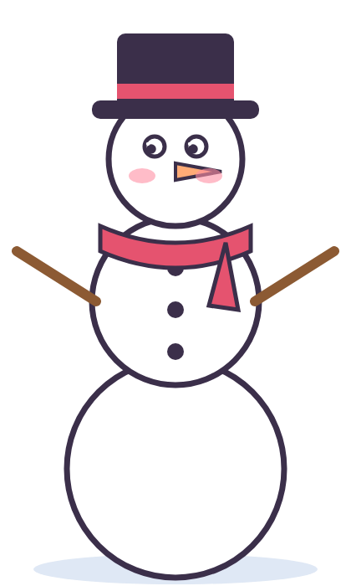
How to play: Build a Snowman
1. Read the question at the top.
2. Tap the right card.
3. Every right answer adds a piece!

Slide 3
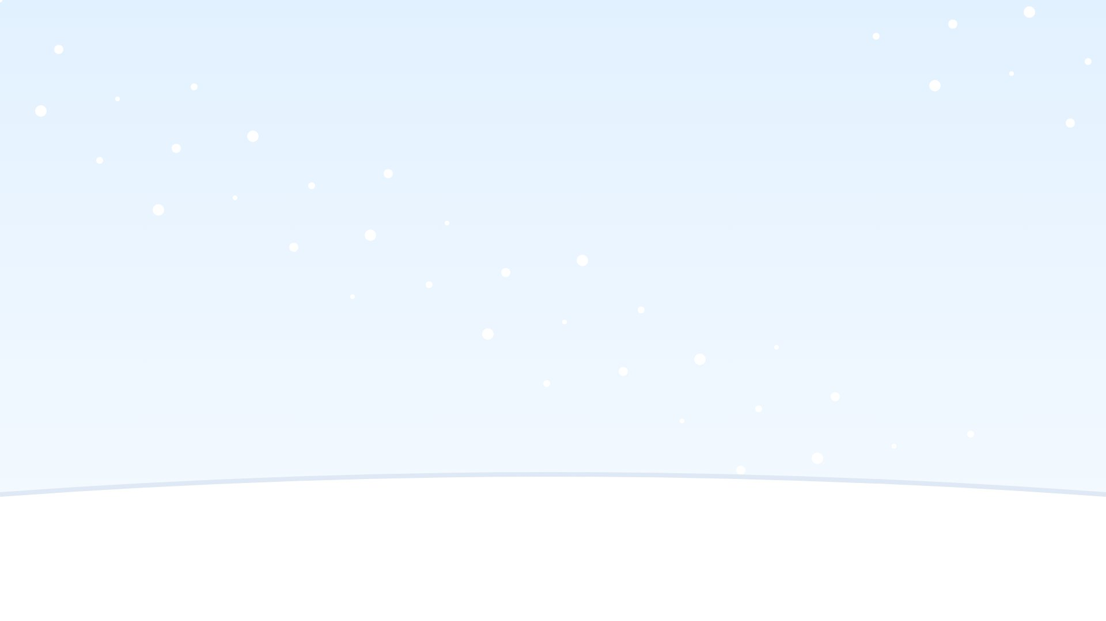
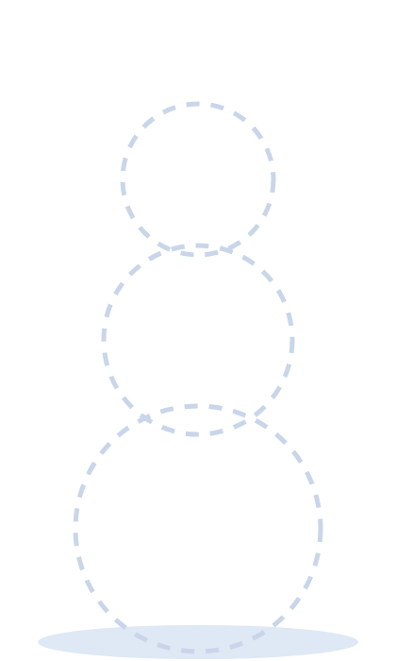
How do we read it?
الٓمٓ
أَلِفۡ لَآمۡ مِّيمۡ
أَلَمۡ

Slide 4
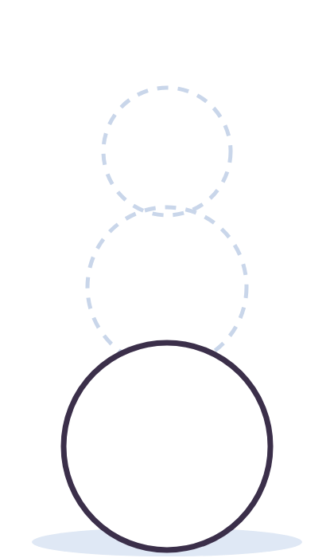
What is its name?
ق
كَافۡ
قَافۡ
نُونۡ

Slide 5
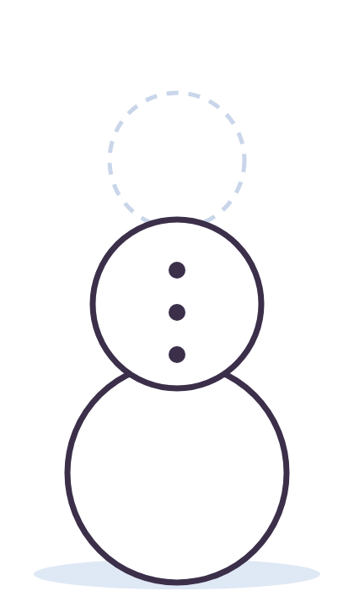
How many counts do we stretch it?
ر
0
2
6

Slide 6
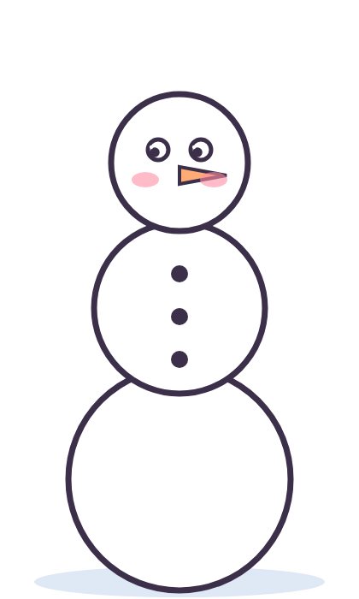
Find the letter we stretch 6 counts
ه
م
ي

Slide 7
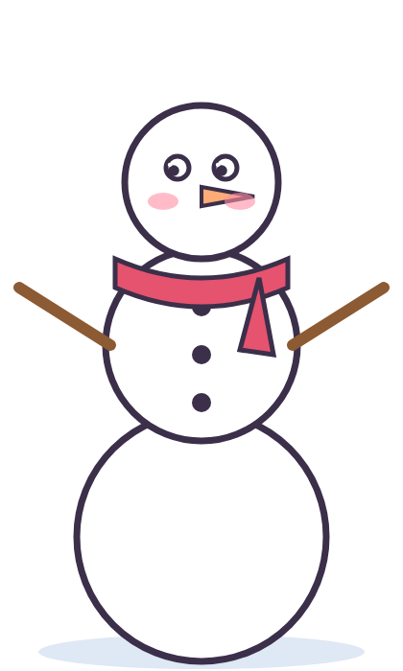
How do we read it?
عٓسٓقٓ
عَسَقۡ
عَيۡنۡ سِينۡ قَافۡ

Slide 8
Hello, snowman!

Slide 9
How do we read it?
الٓمٓ
أَلِفۡ لَآمۡ مِّيمۡ
أَلَمۡ
Try again!

Slide 10
What is its name?
ق
كَافۡ
قَافۡ
نُونۡ
Try again!

Slide 11
How many counts do we stretch it?
ر
0
2
6
Try again!

Slide 12
Find the letter we stretch 6 counts
ه
م
ي
Try again!

Slide 13
How do we read it?
عٓسٓقٓ
عَسَقۡ
عَيۡنۡ سِينۡ قَافۡ
Try again!

Slide 14

How to play: Treasure Dig
1. Read the question at the top.
2. Dig in the right sand.
3. Find the gems and the treasure!

Slide 15


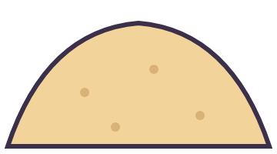
What is its name?
ن
نُونۡ
أَلِفۡ
صَادۡ

Slide 16

How many counts do we stretch it?
ن
6
2
0

Slide 17
Find the letter we stretch 2 counts
ع
ك
ط

Slide 18

How do we read it?
كٓهيعٓصٓ
كَافۡ هَا يَا عَيۡنۡ صَآدۡ
كَهَيۡعَصۡ

Slide 19
How do we read it?
كٓهيعٓصٓ
كَهَيۡعَصۡ
كَافۡ هَا يَا عَيۡنۡ صَآدۡ

Slide 20
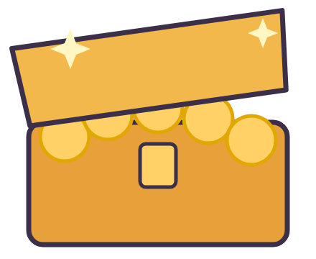
Treasure!

Slide 21
What is its name?
ن
Try again!
نُونۡ
أَلِفۡ
صَادۡ

Slide 22
How many counts do we stretch it?
ن
Try again!
6
2
0

Slide 23
Find the letter we stretch 2 counts
Try again!
ع
ك
ط

Slide 24
How do we read it?
كٓهيعٓصٓ
Try again!
كَافۡ هَا يَا عَيۡنۡ صَآدۡ
كَهَيۡعَصۡ

Slide 25
How do we read it?
كٓهيعٓصٓ
Try again!
كَهَيۡعَصۡ
كَافۡ هَا يَا عَيۡنۡ صَآدۡ

Slide 26
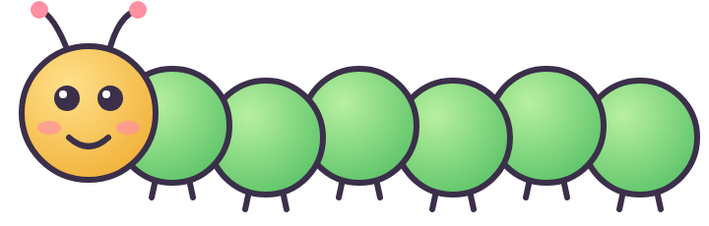
How to play: 2 or 6?
1. Read the letter and its name.
2. Short name (حَا): 2 counts.
3. Long name (نُونۡ): 6 counts.

Slide 27


2 counts or 6 counts?
ل لَامۡ
2 counts
6 counts

Slide 28
2 counts or 6 counts?
ي يَا
2 counts
6 counts

Slide 29
2 counts or 6 counts?
ي يَا
2 counts
6 counts

Slide 30
2 counts or 6 counts?
ص صَادۡ
2 counts
6 counts

Slide 31
2 counts or 6 counts?
س سِينۡ
2 counts
6 counts

Slide 32
Great sorting!

Slide 33
2 counts or 6 counts?
ل لَامۡ
Try again!
2 counts
6 counts

Slide 34
2 counts or 6 counts?
ي يَا
Try again!
2 counts
6 counts

Slide 35
2 counts or 6 counts?
ي يَا
Try again!
2 counts
6 counts

Slide 36
2 counts or 6 counts?
ص صَادۡ
Try again!
2 counts
6 counts

Slide 37
2 counts or 6 counts?
س سِينۡ
Try again!
2 counts
6 counts

Slide 38

How to play: Fireworks
1. Read the question at the top.
2. Light the right rocket.
3. Boom! A firework in the sky!

Slide 39


Find the letter we stretch 6 counts
ح
م
ر

Slide 40
How do we read it?
الٓمٓ
أَلِفۡ لَآمۡ مِّيمۡ
أَلَمۡ

Slide 41

How do we read it?
قٓ
قَافۡ
قَ

Slide 42

What is its name?
ر
نُونۡ
رَا
أَلِفۡ

Slide 43
How many counts do we stretch it?
م
6
2
0

Slide 44
Hooray!

Slide 45
Find the letter we stretch 6 counts
Try again!
ح
م
ر

Slide 46
How do we read it?
الٓمٓ
Try again!
أَلِفۡ لَآمۡ مِّيمۡ
أَلَمۡ

Slide 47
How do we read it?
قٓ
Try again!
قَافۡ
قَ

Slide 48
What is its name?
ر
Try again!
نُونۡ
رَا
أَلِفۡ

Slide 49
How many counts do we stretch it?
م
Try again!
6
2
0

Slide 50

How to play: Penalty Kick
1. Read the question at the top.
2. Tap the right card in the goal.
3. Score 5 goals!

Slide 51
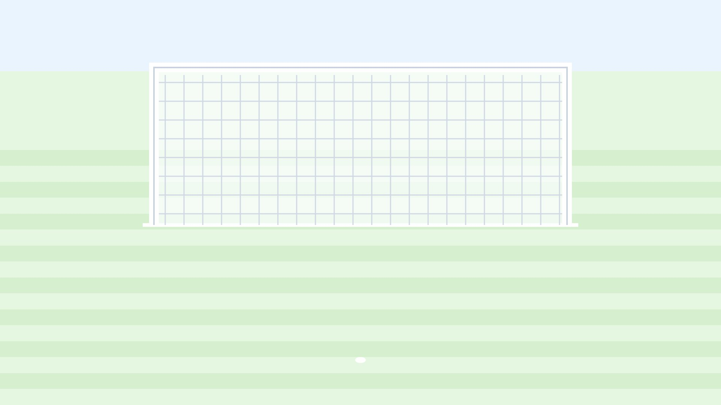
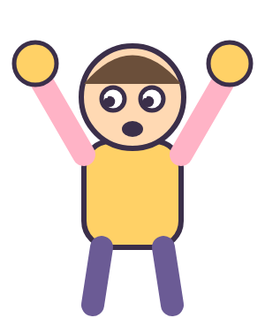
How do we read it?
الٓمٓر
أَلَمَرۡ
أَلِفۡ لَآمۡ مِّيمۡ رَا

Slide 52
How do we read it?
الٓمٓ
أَلَمۡ
أَلِفۡ لَآمۡ مِّيمۡ
GOAL!

Slide 53
What is its name?
ع
عَيۡنۡ
كَافۡ
هَا
GOAL!

Slide 54
How many counts do we stretch it?
م
6
2
0
GOAL!

Slide 55
Find the letter we stretch 2 counts
ن
م
ي
GOAL!

Slide 56
CHAMPION!

Slide 57
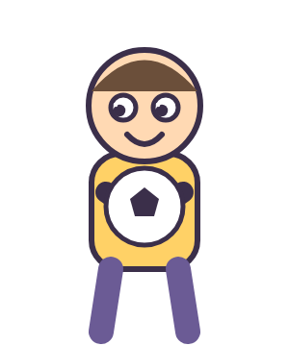
How do we read it?
الٓمٓر
أَلَمَرۡ
أَلِفۡ لَآمۡ مِّيمۡ رَا
Saved! Try again!

Slide 58
How do we read it?
الٓمٓ
أَلَمۡ
أَلِفۡ لَآمۡ مِّيمۡ
Saved! Try again!

Slide 59
What is its name?
ع
عَيۡنۡ
كَافۡ
هَا
Saved! Try again!

Slide 60
How many counts do we stretch it?
م
6
2
0
Saved! Try again!

Slide 61
Find the letter we stretch 2 counts
ن
م
ي
Saved! Try again!

Slide 62

How to play: Hot-Air Balloon
1. Read the question at the top.
2. Tap the right card.
3. Fly up to the clouds!

Slide 63

How do we read it?
عٓسٓقٓ
عَسَقۡ
عَيۡنۡ سِينۡ قَافۡ

Slide 64
What is its name?
ل
رَا
لَامۡ
مِيمۡ

Slide 65
How many counts do we stretch it?
ك
0
2
6

Slide 66
Find the letter we stretch 2 counts
ي
ع
ق

Slide 67
How do we read it?
الٓمٓ
أَلِفۡ لَآمۡ مِّيمۡ
أَلَمۡ

Slide 68
Up in the sky!

Slide 69
How do we read it?
عٓسٓقٓ
عَسَقۡ
عَيۡنۡ سِينۡ قَافۡ
Try again!

Slide 70
What is its name?
ل
رَا
لَامۡ
مِيمۡ
Try again!

Slide 71
How many counts do we stretch it?
ك
0
2
6
Try again!

Slide 72
Find the letter we stretch 2 counts
ي
ع
ق
Try again!

Slide 73
How do we read it?
الٓمٓ
أَلِفۡ لَآمۡ مِّيمۡ
أَلَمۡ
Try again!

Slide 74
2 counts or 6 counts?
ن نُونۡ
2 counts
6 counts

Slide 75
2 counts or 6 counts?
ح حَا
2 counts
6 counts

Slide 76
2 counts or 6 counts?
س سِينۡ
2 counts
6 counts

Slide 77
2 counts or 6 counts?
م مِيمۡ
2 counts
6 counts

Slide 78
2 counts or 6 counts?
ط طَا
2 counts
6 counts

Slide 79
Great sorting!

Slide 80
2 counts or 6 counts?
ن نُونۡ
Try again!
2 counts
6 counts

Slide 81
2 counts or 6 counts?
ح حَا
Try again!
2 counts
6 counts

Slide 82
2 counts or 6 counts?
س سِينۡ
Try again!
2 counts
6 counts

Slide 83
2 counts or 6 counts?
م مِيمۡ
Try again!
2 counts
6 counts

Slide 84
2 counts or 6 counts?
ط طَا
Try again!
2 counts
6 counts

Slide 85

How to play: Darts
1. Read the question at the top.
2. Throw at the right board.
3. Bullseye! You get a star.

Slide 86

How many counts do we stretch it?
ي
6
2
0

Slide 87
Find the letter we stretch 2 counts
م
س
ط
Bullseye!

Slide 88
How do we read it?
عٓسٓقٓ
عَسَقۡ
عَيۡنۡ سِينۡ قَافۡ
Bullseye!

Slide 89
How do we read it?
طه
طَهَ
طَا هَا
Bullseye!

Slide 90
What is its name?
ل
قَافۡ
مِيمۡ
لَامۡ
Bullseye!

Slide 91

Champion!

Slide 92
How many counts do we stretch it?
ي
6
2
0
Missed! Try again!

Slide 93
Find the letter we stretch 2 counts
م
س
ط
Missed! Try again!

Slide 94
How do we read it?
عٓسٓقٓ
عَسَقۡ
عَيۡنۡ سِينۡ قَافۡ
Missed! Try again!

Slide 95
How do we read it?
طه
طَهَ
طَا هَا
Missed! Try again!

Slide 96
What is its name?
ل
قَافۡ
مِيمۡ
لَامۡ
Missed! Try again!

Slide 97

How to play: Build a Robot
1. Read the question at the top.
2. Tap the right card.
3. Every right answer adds a part!

Slide 98

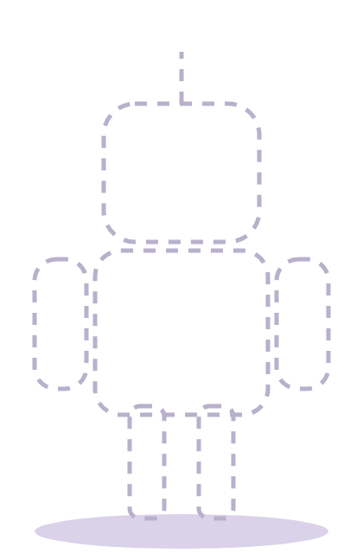
Find the letter we stretch 6 counts
س
ر
ه

Slide 99
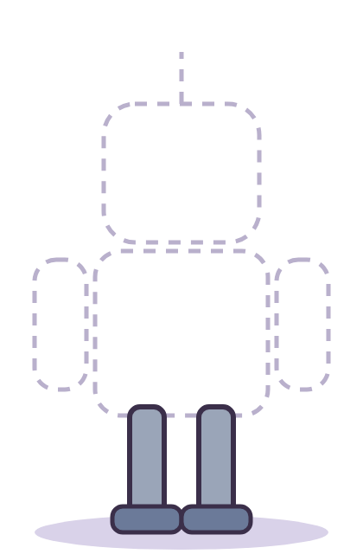
How do we read it?
الٓر
أَلَرۡ
أَلِفۡ لَآمۡ رَا

Slide 100
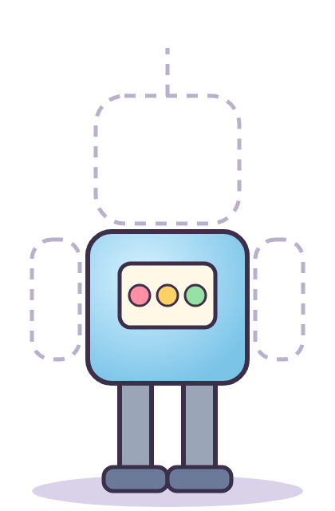
How do we read it?
طه
طَهَ
طَا هَا

Slide 101
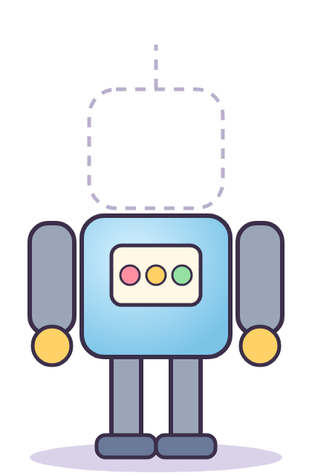
What is its name?
ق
سِينۡ
مِيمۡ
قَافۡ

Slide 102
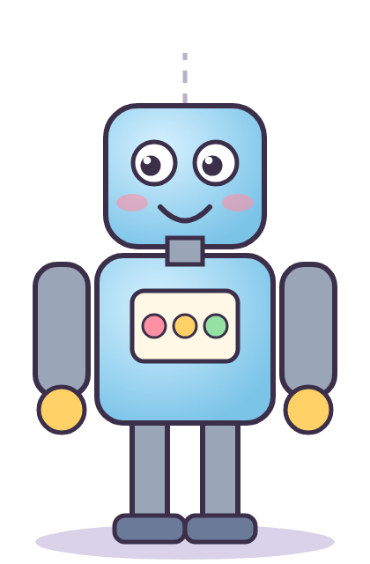
How many counts do we stretch it?
ع
0
2
6

Slide 103
Beep beep! Done!

Slide 104
Find the letter we stretch 6 counts
س
ر
ه
Try again!

Slide 105
How do we read it?
الٓر
أَلَرۡ
أَلِفۡ لَآمۡ رَا
Try again!

Slide 106
How do we read it?
طه
طَهَ
طَا هَا
Try again!

Slide 107
What is its name?
ق
سِينۡ
مِيمۡ
قَافۡ
Try again!

Slide 108
How many counts do we stretch it?
ع
0
2
6
Try again!

Slide 109

How to play: Butterfly Jar
1. Read the question at the top.
2. Catch the right butterfly.
3. Fill the jar!

Slide 110

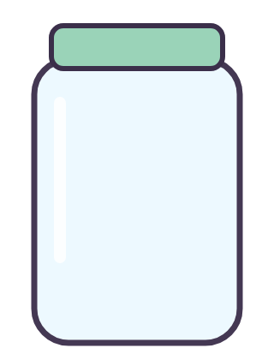
How do we read it?
كٓهيعٓصٓ
كَهَيۡعَصۡ
كَافۡ هَا يَا عَيۡنۡ صَآدۡ

Slide 111
How do we read it?
حمٓ
حَا مِيمۡ
حَمۡ

Slide 112

What is its name?
ي
عَيۡنۡ
يَا
طَا

Slide 113
How many counts do we stretch it?
ل
6
0
2

Slide 114
Find the letter we stretch 6 counts
ل
ا
ه

Slide 115
A jar full of butterflies!

Slide 116
How do we read it?
كٓهيعٓصٓ
كَهَيۡعَصۡ
كَافۡ هَا يَا عَيۡنۡ صَآدۡ
Try again!

Slide 117
How do we read it?
حمٓ
حَا مِيمۡ
حَمۡ
Try again!

Slide 118
What is its name?
ي
عَيۡنۡ
يَا
طَا
Try again!

Slide 119
How many counts do we stretch it?
ل
6
0
2
Try again!

Slide 120
Find the letter we stretch 6 counts
ل
ا
ه
Try again!

Slide 121
2 counts or 6 counts?
ق قَافۡ
2 counts
6 counts

Slide 122
2 counts or 6 counts?
م مِيمۡ
2 counts
6 counts

Slide 123
2 counts or 6 counts?
ه هَا
2 counts
6 counts

Slide 124
2 counts or 6 counts?
ر رَا
2 counts
6 counts

Slide 125
2 counts or 6 counts?
ح حَا
2 counts
6 counts

Slide 126
Great sorting!

Slide 127
2 counts or 6 counts?
ق قَافۡ
Try again!
2 counts
6 counts

Slide 128
2 counts or 6 counts?
م مِيمۡ
Try again!
2 counts
6 counts

Slide 129
2 counts or 6 counts?
ه هَا
Try again!
2 counts
6 counts

Slide 130
2 counts or 6 counts?
ر رَا
Try again!
2 counts
6 counts

Slide 131
2 counts or 6 counts?
ح حَا
Try again!
2 counts
6 counts

Slide 132

How to play: Monkey Climb
1. Read the question at the top.
2. Tap the right card.
3. Help the monkey reach the bananas!

Slide 133

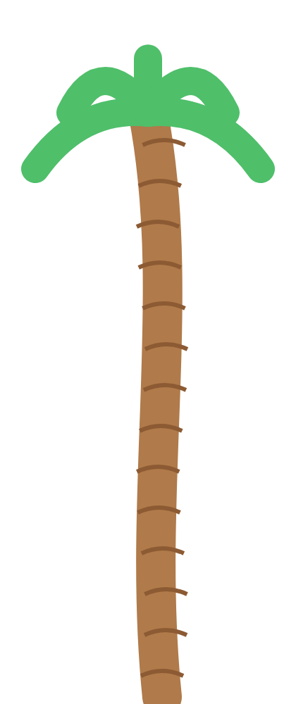

What is its name?
س
رَا
سِينۡ
عَيۡنۡ

Slide 134
How many counts do we stretch it?
ر
0
2
6

Slide 135
Find the letter we stretch 6 counts
ه
ي
س

Slide 136
How do we read it?
الٓمٓر
أَلَمَرۡ
أَلِفۡ لَآمۡ مِّيمۡ رَا

Slide 137
How do we read it?
قٓ
قَ
قَافۡ

Slide 138
Bananas! Yum!

Slide 139
What is its name?
س
رَا
سِينۡ
عَيۡنۡ
Try again!

Slide 140
How many counts do we stretch it?
ر
0
2
6
Try again!

Slide 141
Find the letter we stretch 6 counts
ه
ي
س
Try again!

Slide 142
How do we read it?
الٓمٓر
أَلَمَرۡ
أَلِفۡ لَآمۡ مِّيمۡ رَا
Try again!

Slide 143
How do we read it?
قٓ
قَ
قَافۡ
Try again!

Slide 144
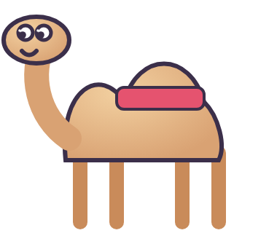
How to play: Camel Trip
1. Read the question at the top.
2. Tap the right card.
3. Walk the camel to the water!

Slide 145

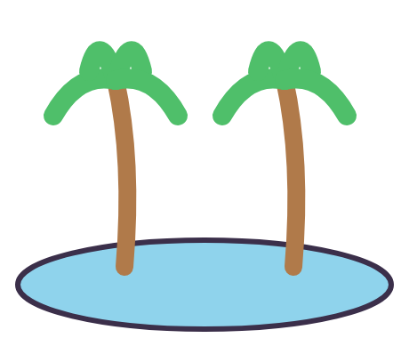
How many counts do we stretch it?
ح
6
2
0

Slide 146
Find the letter we stretch 2 counts
ر
ل
م

Slide 147
How do we read it?
الٓمٓر
أَلِفۡ لَآمۡ مِّيمۡ رَا
أَلَمَرۡ

Slide 148
How do we read it?
الٓر
أَلَرۡ
أَلِفۡ لَآمۡ رَا

Slide 149
What is its name?
ط
هَا
نُونۡ
طَا

Slide 150
Water at last!

Slide 151
How many counts do we stretch it?
ح
6
2
0
Try again!

Slide 152
Find the letter we stretch 2 counts
ر
ل
م
Try again!

Slide 153
How do we read it?
الٓمٓر
أَلِفۡ لَآمۡ مِّيمۡ رَا
أَلَمَرۡ
Try again!

Slide 154
How do we read it?
الٓر
أَلَرۡ
أَلِفۡ لَآمۡ رَا
Try again!

Slide 155
What is its name?
ط
هَا
نُونۡ
طَا
Try again!

Slide 156

How to play: Basketball
1. Read the question at the top.
2. Shoot the right ball.
3. Swish! You get a star.

Slide 157
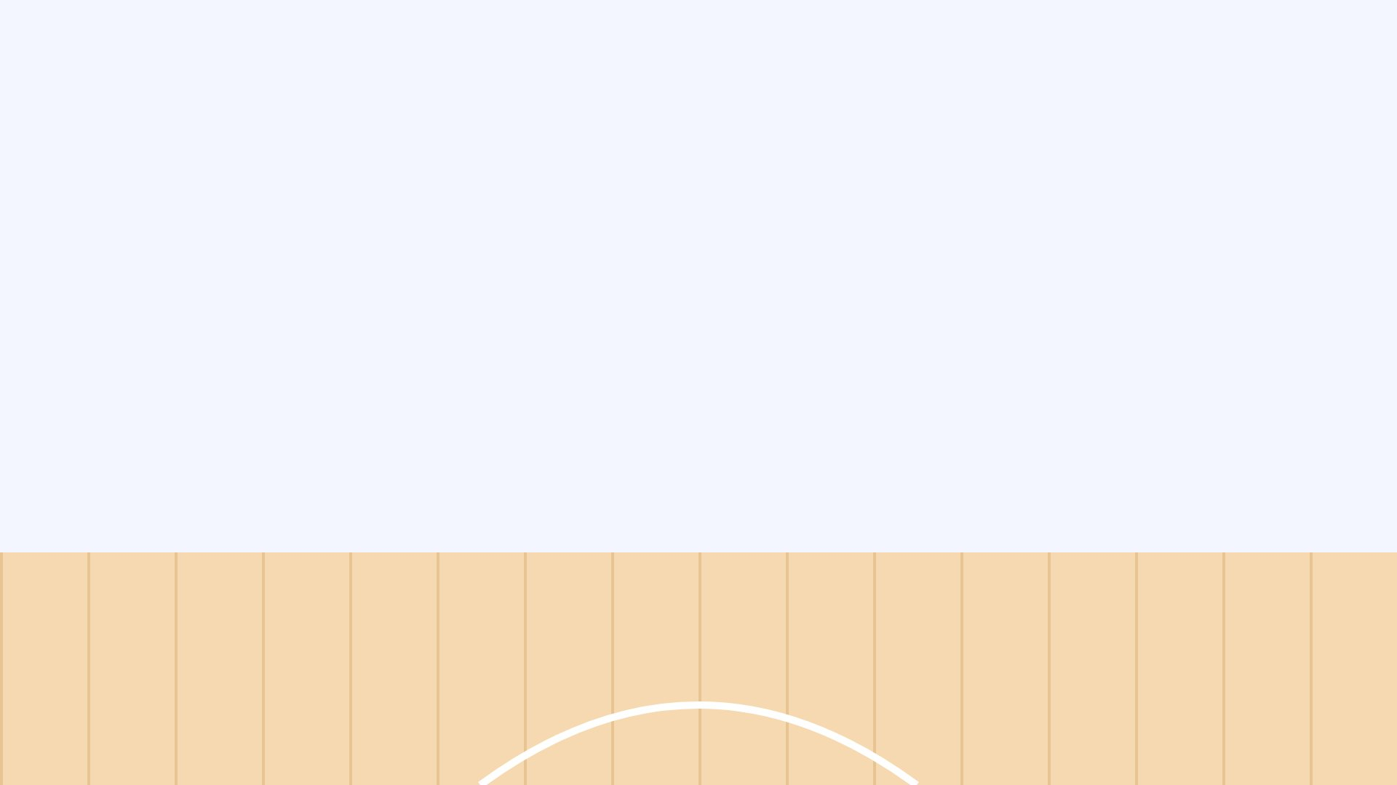

Find the letter we stretch 2 counts
ك
ص
ه

Slide 158
How do we read it?
حمٓ
Swish!
حَمۡ
حَا مِيمۡ

Slide 159
How do we read it?
طسٓ
Swish!
طَسۡ
طَا سِينۡ

Slide 160
What is its name?
ك
Swish!
حَا
كَافۡ
صَادۡ

Slide 161
How many counts do we stretch it?
ن
Swish!
6
2
0

Slide 162
What a player!

Slide 163
Find the letter we stretch 2 counts
Try again!
ك
ص
ه

Slide 164
How do we read it?
حمٓ
Try again!
حَمۡ
حَا مِيمۡ

Slide 165
How do we read it?
طسٓ
Try again!
طَسۡ
طَا سِينۡ

Slide 166
What is its name?
ك
Try again!
حَا
كَافۡ
صَادۡ

Slide 167
How many counts do we stretch it?
ن
Try again!
6
2
0

Slide 168
How do we read it?
قٓ
قَ
قَافۡ

Slide 169
How do we read it?
يسٓ
يَا سِينۡ
يَسۡ

Slide 170
What is its name?
ع
كَافۡ
عَيۡنۡ
لَامۡ

Slide 171
How many counts do we stretch it?
ر
0
2
6

Slide 172
Find the letter we stretch 6 counts
م
ا
ه

Slide 173
Hello, snowman!

Slide 174
How do we read it?
قٓ
قَ
قَافۡ
Try again!

Slide 175
How do we read it?
يسٓ
يَا سِينۡ
يَسۡ
Try again!

Slide 176
What is its name?
ع
كَافۡ
عَيۡنۡ
لَامۡ
Try again!

Slide 177
How many counts do we stretch it?
ر
0
2
6
Try again!

Slide 178
Find the letter we stretch 6 counts
م
ا
ه
Try again!

Slide 179
How do we read it?
عٓسٓقٓ
عَسَقۡ
عَيۡنۡ سِينۡ قَافۡ

Slide 180
What is its name?
ي
قَافۡ
حَا
يَا

Slide 181
How many counts do we stretch it?
س
6
2
0

Slide 182
Find the letter we stretch 2 counts
ل
ط
ق

Slide 183
How do we read it?
طسٓ
طَا سِينۡ
طَسۡ

Slide 184
Treasure!

Slide 185
How do we read it?
عٓسٓقٓ
Try again!
عَسَقۡ
عَيۡنۡ سِينۡ قَافۡ

Slide 186
What is its name?
ي
Try again!
قَافۡ
حَا
يَا

Slide 187
How many counts do we stretch it?
س
Try again!
6
2
0

Slide 188
Find the letter we stretch 2 counts
Try again!
ل
ط
ق

Slide 189
How do we read it?
طسٓ
Try again!
طَا سِينۡ
طَسۡ

Slide 190

How to play: Apple Tree (class game)
1. Two teams: Red and Blue.
2. Read the word, then tap your team.
3. First basket with 5 apples wins!

Slide 191
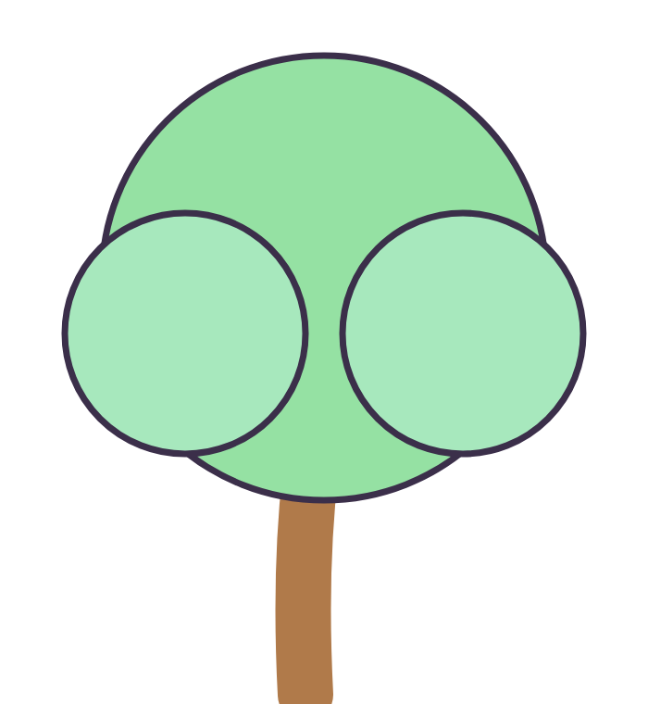

Apple Tree! Read the word, then tap your team.
عٓسٓقٓ
Red ✓
Blue ✓
Red: 0
Blue: 0

Slide 192
Apple Tree! Read the word, then tap your team.
الٓر
Red ✓
Blue ✓
Red: 0
Blue: 1

Slide 193
Apple Tree! Read the word, then tap your team.
الٓمٓصٓ
Red ✓
Blue ✓
Red: 0
Blue: 2

Slide 194
Apple Tree! Read the word, then tap your team.
كٓهيعٓصٓ
Red ✓
Blue ✓
Red: 0
Blue: 3

Slide 195
Apple Tree! Read the word, then tap your team.
صٓ
Red ✓
Blue ✓
Red: 0
Blue: 4

Slide 196
Blue team wins!
Red: 0
Blue: 5

Slide 197
Apple Tree! Read the word, then tap your team.
الٓر
Red ✓
Blue ✓
Red: 1
Blue: 0

Slide 198
Apple Tree! Read the word, then tap your team.
الٓمٓصٓ
Red ✓
Blue ✓
Red: 1
Blue: 1

Slide 199
Apple Tree! Read the word, then tap your team.
كٓهيعٓصٓ
Red ✓
Blue ✓
Red: 1
Blue: 2

Slide 200
Apple Tree! Read the word, then tap your team.
صٓ
Red ✓
Blue ✓
Red: 1
Blue: 3

Slide 201
Apple Tree! Read the word, then tap your team.
طه
Red ✓
Blue ✓
Red: 1
Blue: 4

Slide 202
Blue team wins!
Red: 1
Blue: 5

Slide 203
Apple Tree! Read the word, then tap your team.
الٓمٓصٓ
Red ✓
Blue ✓
Red: 2
Blue: 0

Slide 204
Apple Tree! Read the word, then tap your team.
كٓهيعٓصٓ
Red ✓
Blue ✓
Red: 2
Blue: 1

Slide 205
Apple Tree! Read the word, then tap your team.
صٓ
Red ✓
Blue ✓
Red: 2
Blue: 2

Slide 206
Apple Tree! Read the word, then tap your team.
طه
Red ✓
Blue ✓
Red: 2
Blue: 3

Slide 207
Apple Tree! Read the word, then tap your team.
قٓ
Red ✓
Blue ✓
Red: 2
Blue: 4

Slide 208
Blue team wins!
Red: 2
Blue: 5

Slide 209
Apple Tree! Read the word, then tap your team.
كٓهيعٓصٓ
Red ✓
Blue ✓
Red: 3
Blue: 0

Slide 210
Apple Tree! Read the word, then tap your team.
صٓ
Red ✓
Blue ✓
Red: 3
Blue: 1

Slide 211
Apple Tree! Read the word, then tap your team.
طه
Red ✓
Blue ✓
Red: 3
Blue: 2

Slide 212
Apple Tree! Read the word, then tap your team.
قٓ
Red ✓
Blue ✓
Red: 3
Blue: 3

Slide 213
Apple Tree! Read the word, then tap your team.
حمٓ
Red ✓
Blue ✓
Red: 3
Blue: 4

Slide 214
Blue team wins!
Red: 3
Blue: 5

Slide 215
Apple Tree! Read the word, then tap your team.
صٓ
Red ✓
Blue ✓
Red: 4
Blue: 0

Slide 216
Apple Tree! Read the word, then tap your team.
طه
Red ✓
Blue ✓
Red: 4
Blue: 1

Slide 217
Apple Tree! Read the word, then tap your team.
قٓ
Red ✓
Blue ✓
Red: 4
Blue: 2

Slide 218
Apple Tree! Read the word, then tap your team.
حمٓ
Red ✓
Blue ✓
Red: 4
Blue: 3

Slide 219
Apple Tree! Read the word, then tap your team.
طسٓمٓ
Red ✓
Blue ✓
Red: 4
Blue: 4

Slide 220
Blue team wins!
Red: 4
Blue: 5

Slide 221
Red team wins!
Red: 5
Blue: 0

Slide 222
Red team wins!
Red: 5
Blue: 1

Slide 223
Red team wins!
Red: 5
Blue: 2

Slide 224
Red team wins!
Red: 5
Blue: 3

Slide 225
Red team wins!
Red: 5
Blue: 4

Slide 226
2 counts or 6 counts?
ط طَا
2 counts
6 counts

Slide 227
2 counts or 6 counts?
م مِيمۡ
2 counts
6 counts

Slide 228
2 counts or 6 counts?
ك كَافۡ
2 counts
6 counts

Slide 229
2 counts or 6 counts?
ي يَا
2 counts
6 counts

Slide 230
2 counts or 6 counts?
ح حَا
2 counts
6 counts

Slide 231
Great sorting!

Slide 232
2 counts or 6 counts?
ط طَا
Try again!
2 counts
6 counts

Slide 233
2 counts or 6 counts?
م مِيمۡ
Try again!
2 counts
6 counts

Slide 234
2 counts or 6 counts?
ك كَافۡ
Try again!
2 counts
6 counts

Slide 235
2 counts or 6 counts?
ي يَا
Try again!
2 counts
6 counts

Slide 236
2 counts or 6 counts?
ح حَا
Try again!
2 counts
6 counts

Slide 237
How many counts do we stretch it?
ق
6
2
0

Slide 238
Find the letter we stretch 2 counts
ر
ا
ن

Slide 239
How do we read it?
حمٓ
حَمۡ
حَا مِيمۡ

Slide 240
How do we read it?
الٓر
أَلَرۡ
أَلِفۡ لَآمۡ رَا

Slide 241
What is its name?
ن
نُونۡ
سِينۡ
كَافۡ

Slide 242
Hooray!

Slide 243
How many counts do we stretch it?
ق
Try again!
6
2
0

Slide 244
Find the letter we stretch 2 counts
Try again!
ر
ا
ن

Slide 245
How do we read it?
حمٓ
Try again!
حَمۡ
حَا مِيمۡ

Slide 246
How do we read it?
الٓر
Try again!
أَلَرۡ
أَلِفۡ لَآمۡ رَا

Slide 247
What is its name?
ن
Try again!
نُونۡ
سِينۡ
كَافۡ

Slide 248
Find the letter we stretch 6 counts
م
ي
ح

Slide 249
How do we read it?
طه
طَا هَا
طَهَ
GOAL!

Slide 250
How do we read it?
حمٓ
حَمۡ
حَا مِيمۡ
GOAL!

Slide 251
What is its name?
ا
سِينۡ
أَلِفۡ
نُونۡ
GOAL!

Slide 252
How many counts do we stretch it?
ص
6
2
0
GOAL!

Slide 253
CHAMPION!

Slide 254
Find the letter we stretch 6 counts
م
ي
ح
Saved! Try again!

Slide 255
How do we read it?
طه
طَا هَا
طَهَ
Saved! Try again!

Slide 256
How do we read it?
حمٓ
حَمۡ
حَا مِيمۡ
Saved! Try again!

Slide 257
What is its name?
ا
سِينۡ
أَلِفۡ
نُونۡ
Saved! Try again!

Slide 258
How many counts do we stretch it?
ص
6
2
0
Saved! Try again!

Slide 259
How do we read it?
طسٓمٓ
طَسَمۡ
طَا سِينۡ مِّيمۡ

Slide 260
How do we read it?
طسٓ
طَسۡ
طَا سِينۡ

Slide 261
What is its name?
ه
نُونۡ
مِيمۡ
هَا

Slide 262
How many counts do we stretch it?
ط
0
2
6

Slide 263
Find the letter we stretch 2 counts
ا
ل
ه

Slide 264
Up in the sky!

Slide 265
How do we read it?
طسٓمٓ
طَسَمۡ
طَا سِينۡ مِّيمۡ
Try again!

Slide 266
How do we read it?
طسٓ
طَسۡ
طَا سِينۡ
Try again!

Slide 267
What is its name?
ه
نُونۡ
مِيمۡ
هَا
Try again!

Slide 268
How many counts do we stretch it?
ط
0
2
6
Try again!

Slide 269
Find the letter we stretch 2 counts
ا
ل
ه
Try again!

Slide 270
2 counts or 6 counts?
ن نُونۡ
2 counts
6 counts

Slide 271
2 counts or 6 counts?
ه هَا
2 counts
6 counts

Slide 272
2 counts or 6 counts?
ل لَامۡ
2 counts
6 counts

Slide 273
2 counts or 6 counts?
ص صَادۡ
2 counts
6 counts

Slide 274
2 counts or 6 counts?
ي يَا
2 counts
6 counts

Slide 275
Great sorting!

Slide 276
2 counts or 6 counts?
ن نُونۡ
Try again!
2 counts
6 counts

Slide 277
2 counts or 6 counts?
ه هَا
Try again!
2 counts
6 counts

Slide 278
2 counts or 6 counts?
ل لَامۡ
Try again!
2 counts
6 counts

Slide 279
2 counts or 6 counts?
ص صَادۡ
Try again!
2 counts
6 counts

Slide 280
2 counts or 6 counts?
ي يَا
Try again!
2 counts
6 counts

Slide 281
What is its name?
ط
عَيۡنۡ
طَا
أَلِفۡ

Slide 282
How many counts do we stretch it?
ص
6
2
0
Bullseye!

Slide 283
Find the letter we stretch 2 counts
ص
ط
ن
Bullseye!

Slide 284
How do we read it?
عٓسٓقٓ
عَيۡنۡ سِينۡ قَافۡ
عَسَقۡ
Bullseye!

Slide 285
How do we read it?
حمٓ
حَا مِيمۡ
حَمۡ
Bullseye!

Slide 286
Champion!

Slide 287
What is its name?
ط
عَيۡنۡ
طَا
أَلِفۡ
Missed! Try again!

Slide 288
How many counts do we stretch it?
ص
6
2
0
Missed! Try again!

Slide 289
Find the letter we stretch 2 counts
ص
ط
ن
Missed! Try again!

Slide 290
How do we read it?
عٓسٓقٓ
عَيۡنۡ سِينۡ قَافۡ
عَسَقۡ
Missed! Try again!

Slide 291
How do we read it?
حمٓ
حَا مِيمۡ
حَمۡ
Missed! Try again!

Slide 292
How many counts do we stretch it?
م
0
2
6

Slide 293
Find the letter we stretch 6 counts
ر
ا
ع

Slide 294
How do we read it?
طه
طَهَ
طَا هَا

Slide 295
How do we read it?
عٓسٓقٓ
عَسَقۡ
عَيۡنۡ سِينۡ قَافۡ

Slide 296
What is its name?
ه
يَا
هَا
رَا

Slide 297
Beep beep! Done!

Slide 298
How many counts do we stretch it?
م
0
2
6
Try again!

Slide 299
Find the letter we stretch 6 counts
ر
ا
ع
Try again!

Slide 300
How do we read it?
طه
طَهَ
طَا هَا
Try again!

Slide 301
How do we read it?
عٓسٓقٓ
عَسَقۡ
عَيۡنۡ سِينۡ قَافۡ
Try again!

Slide 302
What is its name?
ه
يَا
هَا
رَا
Try again!

Slide 303
Find the letter we stretch 6 counts
ر
ص
ه

Slide 304
How do we read it?
طسٓمٓ
طَسَمۡ
طَا سِينۡ مِّيمۡ

Slide 305
How do we read it?
طسٓ
طَسۡ
طَا سِينۡ

Slide 306
What is its name?
ق
قَافۡ
رَا
هَا

Slide 307
How many counts do we stretch it?
ص
6
0
2

Slide 308
A jar full of butterflies!

Slide 309
Find the letter we stretch 6 counts
ر
ص
ه
Try again!

Slide 310
How do we read it?
طسٓمٓ
طَسَمۡ
طَا سِينۡ مِّيمۡ
Try again!

Slide 311
How do we read it?
طسٓ
طَسۡ
طَا سِينۡ
Try again!

Slide 312
What is its name?
ق
قَافۡ
رَا
هَا
Try again!

Slide 313
How many counts do we stretch it?
ص
6
0
2
Try again!

Slide 314
2 counts or 6 counts?
ح حَا
2 counts
6 counts

Slide 315
2 counts or 6 counts?
ع عَيۡنۡ
2 counts
6 counts

Slide 316
2 counts or 6 counts?
ه هَا
2 counts
6 counts

Slide 317
2 counts or 6 counts?
ح حَا
2 counts
6 counts

Slide 318
2 counts or 6 counts?
س سِينۡ
2 counts
6 counts

Slide 319
Great sorting!

Slide 320
2 counts or 6 counts?
ح حَا
Try again!
2 counts
6 counts

Slide 321
2 counts or 6 counts?
ع عَيۡنۡ
Try again!
2 counts
6 counts

Slide 322
2 counts or 6 counts?
ه هَا
Try again!
2 counts
6 counts

Slide 323
2 counts or 6 counts?
ح حَا
Try again!
2 counts
6 counts

Slide 324
2 counts or 6 counts?
س سِينۡ
Try again!
2 counts
6 counts

Slide 325
How do we read it?
حمٓ
حَمۡ
حَا مِيمۡ

Slide 326
What is its name?
م
مِيمۡ
أَلِفۡ
لَامۡ

Slide 327
How many counts do we stretch it?
ع
0
2
6

Slide 328
Find the letter we stretch 6 counts
ا
م
ر

Slide 329
How do we read it?
الٓر
أَلِفۡ لَآمۡ رَا
أَلَرۡ

Slide 330
Bananas! Yum!

Slide 331
How do we read it?
حمٓ
حَمۡ
حَا مِيمۡ
Try again!

Slide 332
What is its name?
م
مِيمۡ
أَلِفۡ
لَامۡ
Try again!

Slide 333
How many counts do we stretch it?
ع
0
2
6
Try again!

Slide 334
Find the letter we stretch 6 counts
ا
م
ر
Try again!

Slide 335
How do we read it?
الٓر
أَلِفۡ لَآمۡ رَا
أَلَرۡ
Try again!

Slide 336
What is its name?
ه
هَا
نُونۡ
حَا

Slide 337
How many counts do we stretch it?
م
6
2
0

Slide 338
Find the letter we stretch 2 counts
ك
ن
ط

Slide 339
How do we read it?
كٓهيعٓصٓ
كَهَيۡعَصۡ
كَافۡ هَا يَا عَيۡنۡ صَآدۡ

Slide 340
How do we read it?
يسٓ
يَسۡ
يَا سِينۡ

Slide 341
Water at last!

Slide 342
What is its name?
ه
هَا
نُونۡ
حَا
Try again!

Slide 343
How many counts do we stretch it?
م
6
2
0
Try again!

Slide 344
Find the letter we stretch 2 counts
ك
ن
ط
Try again!

Slide 345
How do we read it?
كٓهيعٓصٓ
كَهَيۡعَصۡ
كَافۡ هَا يَا عَيۡنۡ صَآدۡ
Try again!

Slide 346
How do we read it?
يسٓ
يَسۡ
يَا سِينۡ
Try again!

Slide 347
How many counts do we stretch it?
ل
6
2
0

Slide 348
Find the letter we stretch 2 counts
Swish!
ق
ح
ع

Slide 349
How do we read it?
نٓ
Swish!
نُونۡ
نَ

Slide 350
How do we read it?
عٓسٓقٓ
Swish!
عَسَقۡ
عَيۡنۡ سِينۡ قَافۡ

Slide 351
What is its name?
ا
Swish!
هَا
طَا
أَلِفۡ

Slide 352
What a player!

Slide 353
How many counts do we stretch it?
ل
Try again!
6
2
0

Slide 354
Find the letter we stretch 2 counts
Try again!
ق
ح
ع

Slide 355
How do we read it?
نٓ
Try again!
نُونۡ
نَ

Slide 356
How do we read it?
عٓسٓقٓ
Try again!
عَسَقۡ
عَيۡنۡ سِينۡ قَافۡ

Slide 357
What is its name?
ا
Try again!
هَا
طَا
أَلِفۡ

Slide 358
Find the letter we stretch 6 counts
ه
ك
ح

Slide 359
How do we read it?
الٓمٓر
أَلِفۡ لَآمۡ مِّيمۡ رَا
أَلَمَرۡ

Slide 360
How do we read it?
حمٓ
حَا مِيمۡ
حَمۡ

Slide 361
What is its name?
ط
أَلِفۡ
طَا
قَافۡ

Slide 362
How many counts do we stretch it?
ر
0
2
6

Slide 363
Hello, snowman!

Slide 364
Find the letter we stretch 6 counts
ه
ك
ح
Try again!

Slide 365
How do we read it?
الٓمٓر
أَلِفۡ لَآمۡ مِّيمۡ رَا
أَلَمَرۡ
Try again!

Slide 366
How do we read it?
حمٓ
حَا مِيمۡ
حَمۡ
Try again!

Slide 367
What is its name?
ط
أَلِفۡ
طَا
قَافۡ
Try again!

Slide 368
How many counts do we stretch it?
ر
0
2
6
Try again!

Slide 369
How do we read it?
طسٓ
طَسۡ
طَا سِينۡ

Slide 370
How do we read it?
حمٓ
حَمۡ
حَا مِيمۡ

Slide 371
What is its name?
ن
نُونۡ
رَا
كَافۡ

Slide 372
How many counts do we stretch it?
ا
6
2
0

Slide 373
Find the letter we stretch 2 counts
ح
ص
ل

Slide 374
Treasure!

Slide 375
How do we read it?
طسٓ
Try again!
طَسۡ
طَا سِينۡ

Slide 376
How do we read it?
حمٓ
Try again!
حَمۡ
حَا مِيمۡ

Slide 377
What is its name?
ن
Try again!
نُونۡ
رَا
كَافۡ

Slide 378
How many counts do we stretch it?
ا
Try again!
6
2
0

Slide 379
Find the letter we stretch 2 counts
Try again!
ح
ص
ل

Slide 380
Apple Tree! Read the word, then tap your team.
نٓ
Red ✓
Blue ✓
Red: 0
Blue: 0

Slide 381
Apple Tree! Read the word, then tap your team.
طسٓ
Red ✓
Blue ✓
Red: 0
Blue: 1

Slide 382
Apple Tree! Read the word, then tap your team.
يسٓ
Red ✓
Blue ✓
Red: 0
Blue: 2

Slide 383
Apple Tree! Read the word, then tap your team.
كٓهيعٓصٓ
Red ✓
Blue ✓
Red: 0
Blue: 3

Slide 384
Apple Tree! Read the word, then tap your team.
عٓسٓقٓ
Red ✓
Blue ✓
Red: 0
Blue: 4

Slide 385
Blue team wins!
Red: 0
Blue: 5

Slide 386
Apple Tree! Read the word, then tap your team.
طسٓ
Red ✓
Blue ✓
Red: 1
Blue: 0

Slide 387
Apple Tree! Read the word, then tap your team.
يسٓ
Red ✓
Blue ✓
Red: 1
Blue: 1

Slide 388
Apple Tree! Read the word, then tap your team.
كٓهيعٓصٓ
Red ✓
Blue ✓
Red: 1
Blue: 2

Slide 389
Apple Tree! Read the word, then tap your team.
عٓسٓقٓ
Red ✓
Blue ✓
Red: 1
Blue: 3

Slide 390
Apple Tree! Read the word, then tap your team.
الٓر
Red ✓
Blue ✓
Red: 1
Blue: 4

Slide 391
Blue team wins!
Red: 1
Blue: 5

Slide 392
Apple Tree! Read the word, then tap your team.
يسٓ
Red ✓
Blue ✓
Red: 2
Blue: 0

Slide 393
Apple Tree! Read the word, then tap your team.
كٓهيعٓصٓ
Red ✓
Blue ✓
Red: 2
Blue: 1

Slide 394
Apple Tree! Read the word, then tap your team.
عٓسٓقٓ
Red ✓
Blue ✓
Red: 2
Blue: 2

Slide 395
Apple Tree! Read the word, then tap your team.
الٓر
Red ✓
Blue ✓
Red: 2
Blue: 3

Slide 396
Apple Tree! Read the word, then tap your team.
طه
Red ✓
Blue ✓
Red: 2
Blue: 4

Slide 397
Blue team wins!
Red: 2
Blue: 5

Slide 398
Apple Tree! Read the word, then tap your team.
كٓهيعٓصٓ
Red ✓
Blue ✓
Red: 3
Blue: 0

Slide 399
Apple Tree! Read the word, then tap your team.
عٓسٓقٓ
Red ✓
Blue ✓
Red: 3
Blue: 1

Slide 400
Apple Tree! Read the word, then tap your team.
الٓر
Red ✓
Blue ✓
Red: 3
Blue: 2

Slide 401
Apple Tree! Read the word, then tap your team.
طه
Red ✓
Blue ✓
Red: 3
Blue: 3

Slide 402
Apple Tree! Read the word, then tap your team.
قٓ
Red ✓
Blue ✓
Red: 3
Blue: 4

Slide 403
Blue team wins!
Red: 3
Blue: 5

Slide 404
Apple Tree! Read the word, then tap your team.
عٓسٓقٓ
Red ✓
Blue ✓
Red: 4
Blue: 0

Slide 405
Apple Tree! Read the word, then tap your team.
الٓر
Red ✓
Blue ✓
Red: 4
Blue: 1

Slide 406
Apple Tree! Read the word, then tap your team.
طه
Red ✓
Blue ✓
Red: 4
Blue: 2

Slide 407
Apple Tree! Read the word, then tap your team.
قٓ
Red ✓
Blue ✓
Red: 4
Blue: 3

Slide 408
Apple Tree! Read the word, then tap your team.
الٓمٓ
Red ✓
Blue ✓
Red: 4
Blue: 4

Slide 409
Blue team wins!
Red: 4
Blue: 5

Slide 410
Red team wins!
Red: 5
Blue: 0

Slide 411
Red team wins!
Red: 5
Blue: 1

Slide 412
Red team wins!
Red: 5
Blue: 2

Slide 413
Red team wins!
Red: 5
Blue: 3

Slide 414
Red team wins!
Red: 5
Blue: 4

Slide 415
Well done!
↺ Play again

