Slide 1

Silent Letters Games
قَالُوا۟ مِا۟ئَةَ أَنَا۠
Find the ghost letters: written, but not read!
Start ▶

Slide 2

How to play: Ghost Hunt
1. The word is split into its letters.
2. One letter is a ghost: we do not read it.
3. Tap the ghost letter!

Slide 3

Tap the letter we do NOT read
قَالُوا۟
ا۟
و
لُ
ا
قَ

Slide 4
Tap the letter we do NOT read
ءَامَنُوا۟
ا۟
و
نُ
مَ
ا
ءَ
Boo! Found it!

Slide 5
Tap the letter we do NOT read
قَالُوا۟
ا۟
و
لُ
ا
قَ
Boo! Found it!

Slide 6
Tap the letter we do NOT read
أُو۟لَـٰٓئِكَ
كَ
ئِ
لَٰٓ
و۟
أُ
Boo! Found it!

Slide 7
Tap the letter we do NOT read
ثَمُودَا۟
ا۟
دَ
و
مُ
ثَ
Boo! Found it!

Slide 8
You found all the ghosts!

Slide 9
Tap the letter we do NOT read
قَالُوا۟
ا۟
و
لُ
ا
قَ
Try again!

Slide 10
Tap the letter we do NOT read
ءَامَنُوا۟
ا۟
و
نُ
مَ
ا
ءَ
Try again!

Slide 11
Tap the letter we do NOT read
قَالُوا۟
ا۟
و
لُ
ا
قَ
Try again!

Slide 12
Tap the letter we do NOT read
أُو۟لَـٰٓئِكَ
كَ
ئِ
لَٰٓ
و۟
أُ
Try again!

Slide 13
Tap the letter we do NOT read
ثَمُودَا۟
ا۟
دَ
و
مُ
ثَ
Try again!

Slide 14

How to play: Build a Snowman
1. Read the question at the top.
2. Tap the right card.
3. Every right answer adds a piece!

Slide 15
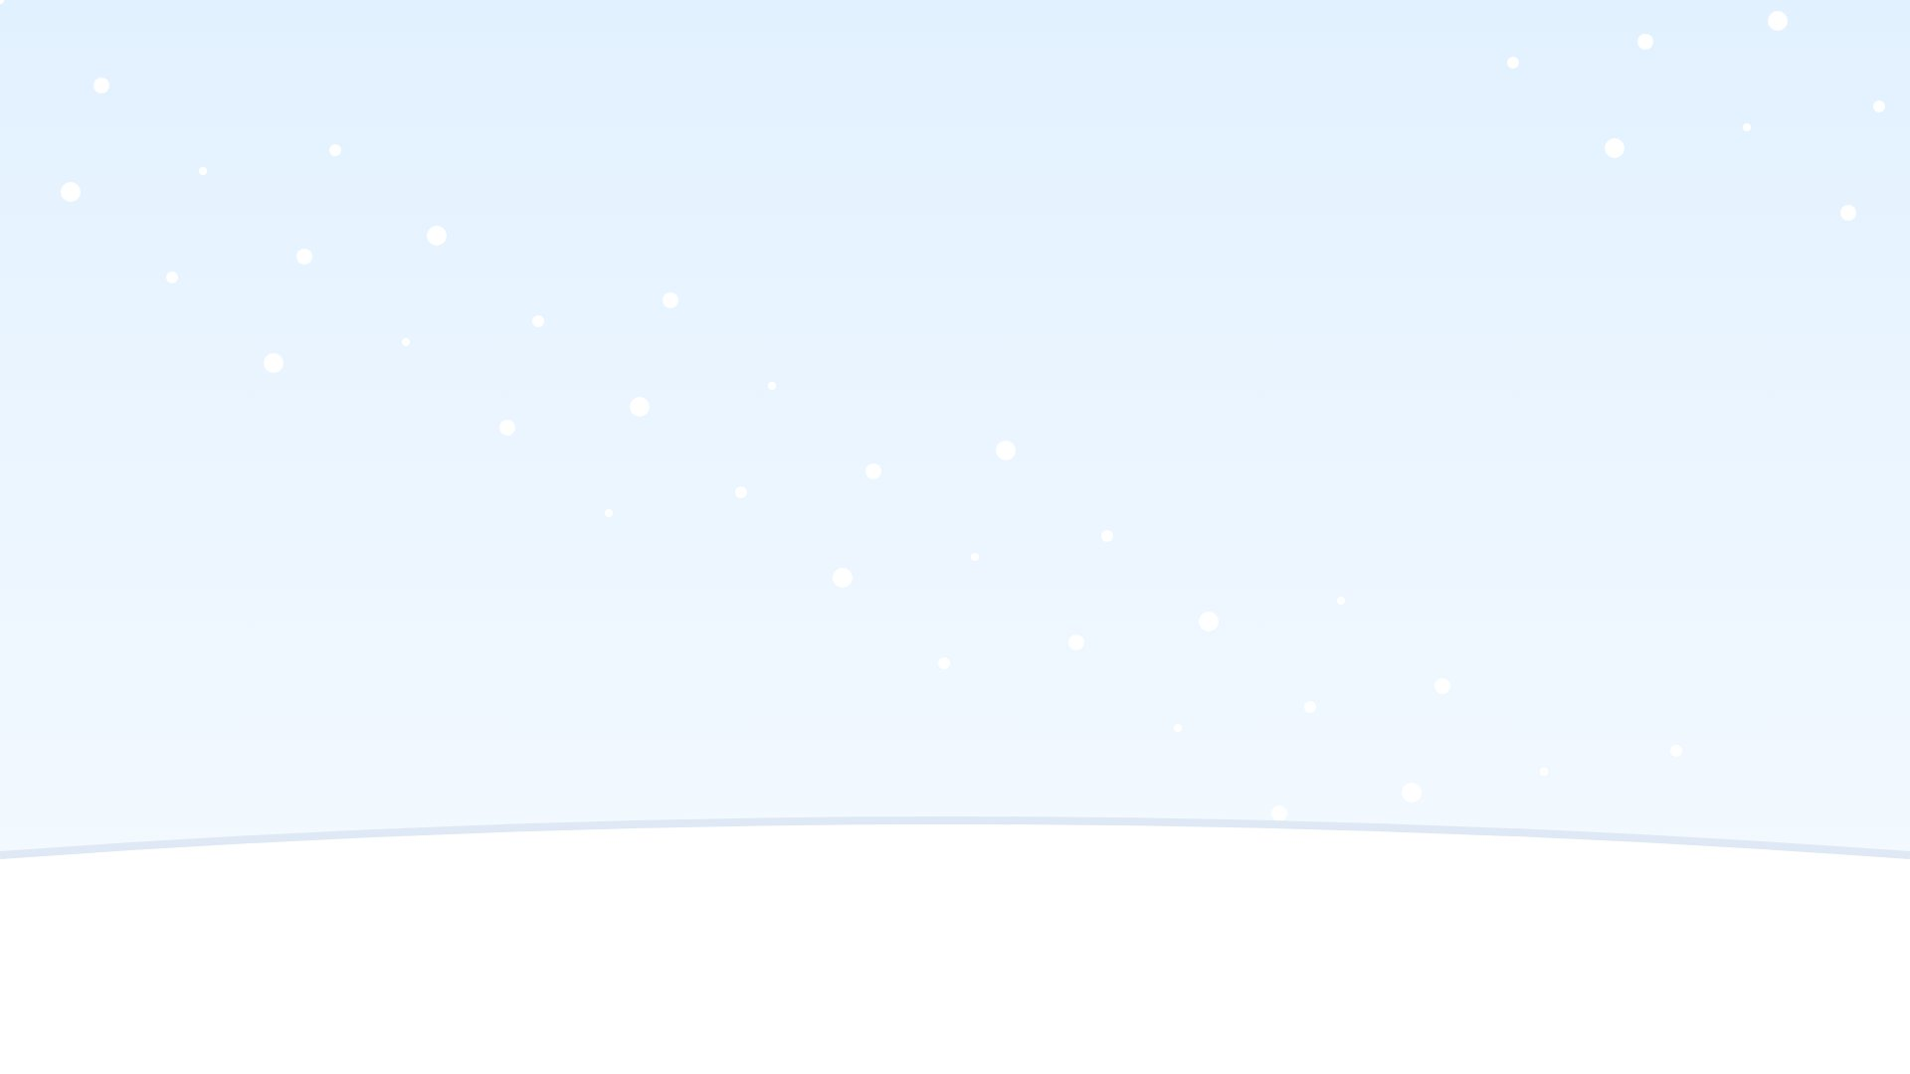

Stopping on this word:
ٱلرَّسُولَا۠
ٱلرَّسُولَ
ٱلرَّسُولَا

Slide 16
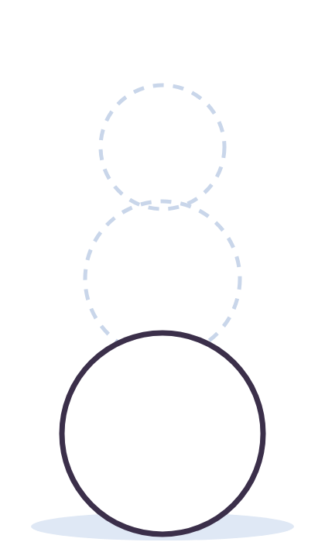
Find the word with a letter we never read
كِتَابٌ
ءَامَنُوا۟
ذَهَبَ

Slide 17
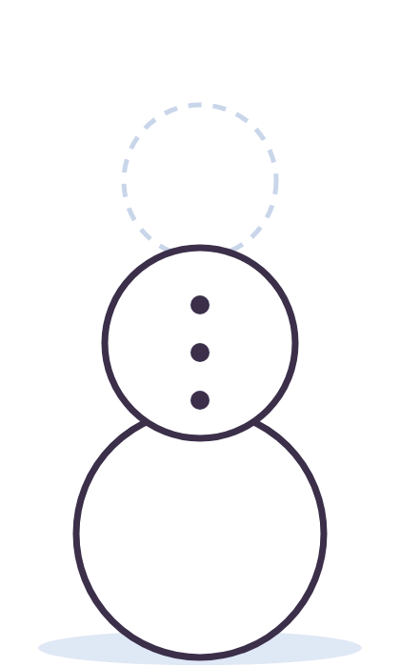
Reading on to the next word:
ٱلرَّسُولَا۠
ٱلرَّسُولَ
ٱلرَّسُولَا

Slide 18
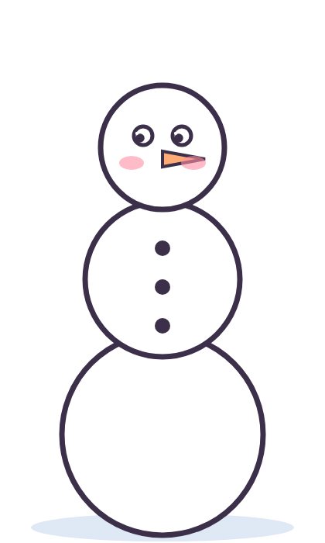
Find the word with a letter we never read
يَلۡعَبُ
كَفَرُوا۟
فِيلٌ

Slide 19
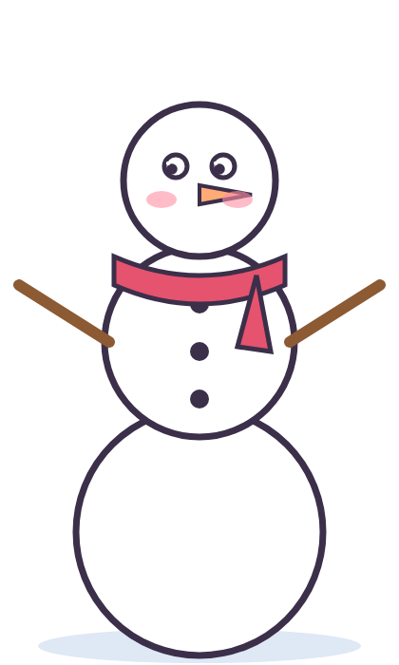
Find the word with a letter we never read
قَالَ
نَامَ
أُو۟لَـٰٓئِكَ

Slide 20
Hello, snowman!

Slide 21
Stopping on this word:
ٱلرَّسُولَا۠
ٱلرَّسُولَ
ٱلرَّسُولَا
Try again!

Slide 22
Find the word with a letter we never read
كِتَابٌ
ءَامَنُوا۟
ذَهَبَ
Try again!

Slide 23
Reading on to the next word:
ٱلرَّسُولَا۠
ٱلرَّسُولَ
ٱلرَّسُولَا
Try again!

Slide 24
Find the word with a letter we never read
يَلۡعَبُ
كَفَرُوا۟
فِيلٌ
Try again!

Slide 25
Find the word with a letter we never read
قَالَ
نَامَ
أُو۟لَـٰٓئِكَ
Try again!

Slide 26

How to play: Read It?
1. Look at the orange letter.
2. Read it, never read it,
3. or read it only when you stop?

Slide 27



The orange letter: read it?
تَابُوا۟
Read it
Never read
Only when I stop

Slide 28
The orange letter: read it?
ٱلسَّبِيلَا۠
Read it
Never read
Only when I stop

Slide 29
The orange letter: read it?
ٱلرَّسُولَا۠
Read it
Never read
Only when I stop

Slide 30
The orange letter: read it?
جَاهَدُوا۟
Read it
Never read
Only when I stop

Slide 31
The orange letter: read it?
تَابُوا۟
Read it
Never read
Only when I stop

Slide 32
Great sorting!

Slide 33
The orange letter: read it?
تَابُوا۟
Try again!
Read it
Never read
Only when I stop

Slide 34
The orange letter: read it?
ٱلسَّبِيلَا۠
Try again!
Read it
Never read
Only when I stop

Slide 35
The orange letter: read it?
ٱلرَّسُولَا۠
Try again!
Read it
Never read
Only when I stop

Slide 36
The orange letter: read it?
جَاهَدُوا۟
Try again!
Read it
Never read
Only when I stop

Slide 37
The orange letter: read it?
تَابُوا۟
Try again!
Read it
Never read
Only when I stop

Slide 38

How to play: Treasure Dig
1. Read the question at the top.
2. Dig in the right sand.
3. Find the gems and the treasure!

Slide 39


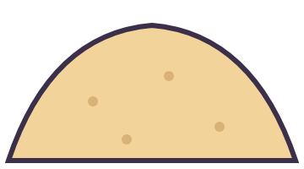
Reading on to the next word:
لَّـٰكِنَّا۠
لَـٰكِنَّا
لَـٰكِنَّ

Slide 40

Find the word with a letter we never read
يَلۡعَبُ
عَمِلُوا۟
سَمِعَ

Slide 41
Find the word with a letter we never read
كِتَابٌ
يَلۡعَبُ
جَاهَدُوا۟

Slide 42

Stopping on this word:
ٱلظُّنُونَا۠
ٱلظُّنُونَ
ٱلظُّنُونَا

Slide 43
Find the word with a letter we never read
ذَهَبَ
هَاجَرُوا۟
جَلَسَ

Slide 44
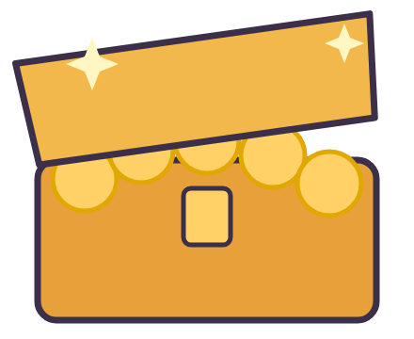
Treasure!

Slide 45
Reading on to the next word:
لَّـٰكِنَّا۠
Try again!
لَـٰكِنَّا
لَـٰكِنَّ

Slide 46
Find the word with a letter we never read
Try again!
يَلۡعَبُ
عَمِلُوا۟
سَمِعَ

Slide 47
Find the word with a letter we never read
Try again!
كِتَابٌ
يَلۡعَبُ
جَاهَدُوا۟

Slide 48
Stopping on this word:
ٱلظُّنُونَا۠
Try again!
ٱلظُّنُونَ
ٱلظُّنُونَا

Slide 49
Find the word with a letter we never read
Try again!
ذَهَبَ
هَاجَرُوا۟
جَلَسَ

Slide 50

How to play: Fireworks
1. Read the question at the top.
2. Light the right rocket.
3. Boom! A firework in the sky!

Slide 51


Find the word with a letter we never read
سَمِعَ
ءَامَنُوا۟
يَلۡعَبُ

Slide 52
Find the word with a letter we never read
قَالَ
كِتَابٌ
ثَمُودَا۟

Slide 53

Reading on to the next word:
لَّـٰكِنَّا۠
لَـٰكِنَّا
لَـٰكِنَّ

Slide 54

Find the word with a letter we never read
يَلۡعَبُ
فِيلٌ
ثَمُودَا۟

Slide 55
Reading on to the next word:
ٱلظُّنُونَا۠
ٱلظُّنُونَا
ٱلظُّنُونَ

Slide 56
Hooray!

Slide 57
Find the word with a letter we never read
Try again!
سَمِعَ
ءَامَنُوا۟
يَلۡعَبُ

Slide 58
Find the word with a letter we never read
Try again!
قَالَ
كِتَابٌ
ثَمُودَا۟

Slide 59
Reading on to the next word:
لَّـٰكِنَّا۠
Try again!
لَـٰكِنَّا
لَـٰكِنَّ

Slide 60
Find the word with a letter we never read
Try again!
يَلۡعَبُ
فِيلٌ
ثَمُودَا۟

Slide 61
Reading on to the next word:
ٱلظُّنُونَا۠
Try again!
ٱلظُّنُونَا
ٱلظُّنُونَ

Slide 62
Tap the letter we do NOT read
بِأَيۡي۟دٍ
دٍ
ي۟
يۡ
أَ
بِ

Slide 63
Tap the letter we do NOT read
مِا۟ئَةَ
ةَ
ئَ
ا۟
مِ
Boo! Found it!

Slide 64
Tap the letter we do NOT read
تَابُوا۟
ا۟
و
بُ
ا
تَ
Boo! Found it!

Slide 65
Tap the letter we do NOT read
جَاهَدُوا۟
ا۟
و
دُ
هَ
ا
جَ
Boo! Found it!

Slide 66
Tap the letter we do NOT read
عَمِلُوا۟
ا۟
و
لُ
مِ
عَ
Boo! Found it!

Slide 67
You found all the ghosts!

Slide 68
Tap the letter we do NOT read
بِأَيۡي۟دٍ
دٍ
ي۟
يۡ
أَ
بِ
Try again!

Slide 69
Tap the letter we do NOT read
مِا۟ئَةَ
ةَ
ئَ
ا۟
مِ
Try again!

Slide 70
Tap the letter we do NOT read
تَابُوا۟
ا۟
و
بُ
ا
تَ
Try again!

Slide 71
Tap the letter we do NOT read
جَاهَدُوا۟
ا۟
و
دُ
هَ
ا
جَ
Try again!

Slide 72
Tap the letter we do NOT read
عَمِلُوا۟
ا۟
و
لُ
مِ
عَ
Try again!

Slide 73

How to play: Frog Hop
1. Read the question at the top.
2. Tap the right lily pad.
3. Help the frog reach the island!

Slide 74

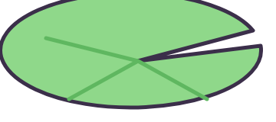

Stopping on this word:
قَوَارِيرَا۠
قَوَارِيرَا
قَوَارِيرَ

Slide 75
Find the word with a letter we never read
ذَهَبَ
هَاجَرُوا۟
سَمِعَ

Slide 76
Stopping on this word:
ٱلسَّبِيلَا۠
ٱلسَّبِيلَا
ٱلسَّبِيلَ

Slide 77
Find the word with a letter we never read
سَمِعَ
ذَهَبَ
جَاهَدُوا۟

Slide 78
Find the word with a letter we never read
نَامَ
جَلَسَ
أُو۟لَـٰٓئِكَ

Slide 79
You made it!

Slide 80
Stopping on this word:
قَوَارِيرَا۠
قَوَارِيرَا
قَوَارِيرَ
Splash! Try again!

Slide 81
Find the word with a letter we never read
ذَهَبَ
هَاجَرُوا۟
Splash! Try again!
سَمِعَ

Slide 82
Stopping on this word:
ٱلسَّبِيلَا۠
ٱلسَّبِيلَا
ٱلسَّبِيلَ
Splash! Try again!

Slide 83
Find the word with a letter we never read
سَمِعَ
ذَهَبَ
Splash! Try again!
جَاهَدُوا۟

Slide 84
Find the word with a letter we never read
نَامَ
جَلَسَ
Splash! Try again!
أُو۟لَـٰٓئِكَ

Slide 85
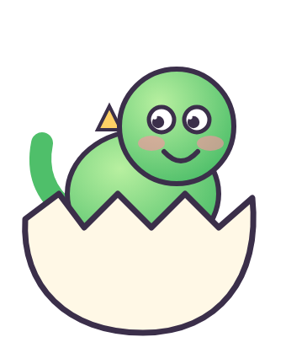
How to play: Dino Eggs
1. Read the question at the top.
2. Tap the right egg.
3. Hatch all the baby dinos!

Slide 86


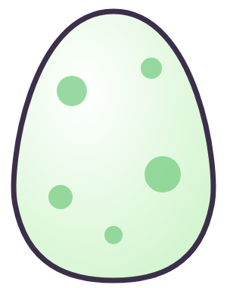
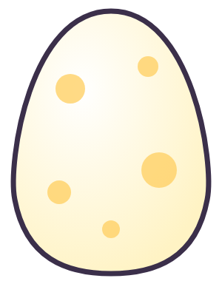
Find the word with a letter we never read
فِيلٌ
يَلۡعَبُ
لِشَا۟يۡءٍ

Slide 87

Stopping on this word:
لَّـٰكِنَّا۠
لَـٰكِنَّا
لَـٰكِنَّ

Slide 88
Find the word with a letter we never read
نُورٌ
هَاجَرُوا۟
ذَهَبَ

Slide 89
Find the word with a letter we never read
كِتَابٌ
نُورٌ
صَدَقُوا۟

Slide 90
Stopping on this word:
أَنَا۠
أَنَا
أَنَ

Slide 91
All the eggs hatched!

Slide 92
Find the word with a letter we never read
فِيلٌ
يَلۡعَبُ
لِشَا۟يۡءٍ
Try again!

Slide 93
Stopping on this word:
لَّـٰكِنَّا۠
لَـٰكِنَّا
لَـٰكِنَّ
Try again!

Slide 94
Find the word with a letter we never read
نُورٌ
هَاجَرُوا۟
ذَهَبَ
Try again!

Slide 95
Find the word with a letter we never read
كِتَابٌ
نُورٌ
صَدَقُوا۟
Try again!

Slide 96
Stopping on this word:
أَنَا۠
أَنَا
أَنَ
Try again!

Slide 97
The orange letter: read it?
أُو۟لَـٰٓئِكَ
Read it
Never read
Only when I stop

Slide 98
The orange letter: read it?
أَنَا۠
Read it
Never read
Only when I stop

Slide 99
The orange letter: read it?
ٱلرَّسُولَا۠
Read it
Never read
Only when I stop

Slide 100
The orange letter: read it?
لَّـٰكِنَّا۠
Read it
Never read
Only when I stop

Slide 101
The orange letter: read it?
أُو۟لَـٰٓئِكَ
Read it
Never read
Only when I stop

Slide 102
Great sorting!

Slide 103
The orange letter: read it?
أُو۟لَـٰٓئِكَ
Try again!
Read it
Never read
Only when I stop

Slide 104
The orange letter: read it?
أَنَا۠
Try again!
Read it
Never read
Only when I stop

Slide 105
The orange letter: read it?
ٱلرَّسُولَا۠
Try again!
Read it
Never read
Only when I stop

Slide 106
The orange letter: read it?
لَّـٰكِنَّا۠
Try again!
Read it
Never read
Only when I stop

Slide 107
The orange letter: read it?
أُو۟لَـٰٓئِكَ
Try again!
Read it
Never read
Only when I stop

Slide 108

How to play: Busy Bee
1. Read the question at the top.
2. Fly to the right flower.
3. Fill the honey jar!

Slide 109





Find the word with a letter we never read
سَمِعَ
يَقُولُ
أُو۟لَـٰٓئِكَ

Slide 110

Find the word with a letter we never read
جَاهَدُوا۟
فِيلٌ
يَلۡعَبُ

Slide 111

Stopping on this word:
ٱلسَّبِيلَا۠
ٱلسَّبِيلَا
ٱلسَّبِيلَ

Slide 112

Find the word with a letter we never read
يَقُولُ
جَاهَدُوا۟
نَامَ

Slide 113

Stopping on this word:
ٱلسَّبِيلَا۠
ٱلسَّبِيلَا
ٱلسَّبِيلَ

Slide 114

Yummy honey!

Slide 115
Find the word with a letter we never read
سَمِعَ
يَقُولُ
أُو۟لَـٰٓئِكَ
Try again!

Slide 116
Find the word with a letter we never read
جَاهَدُوا۟
فِيلٌ
يَلۡعَبُ
Try again!

Slide 117
Stopping on this word:
ٱلسَّبِيلَا۠
ٱلسَّبِيلَا
ٱلسَّبِيلَ
Try again!

Slide 118
Find the word with a letter we never read
يَقُولُ
جَاهَدُوا۟
نَامَ
Try again!

Slide 119
Stopping on this word:
ٱلسَّبِيلَا۠
ٱلسَّبِيلَا
ٱلسَّبِيلَ
Try again!

Slide 120
Tap the letter we do NOT read
كَفَرُوا۟
ا۟
و
رُ
فَ
كَ

Slide 121
Tap the letter we do NOT read
هَاجَرُوا۟
ا۟
و
رُ
جَ
ا
هَ
Boo! Found it!

Slide 122
Tap the letter we do NOT read
بِأَيۡي۟دٍ
دٍ
ي۟
يۡ
أَ
بِ
Boo! Found it!

Slide 123
Tap the letter we do NOT read
صَدَقُوا۟
ا۟
و
قُ
دَ
صَ
Boo! Found it!

Slide 124
Tap the letter we do NOT read
أُو۟لَـٰٓئِكَ
كَ
ئِ
لَٰٓ
و۟
أُ
Boo! Found it!

Slide 125
You found all the ghosts!

Slide 126
Tap the letter we do NOT read
كَفَرُوا۟
ا۟
و
رُ
فَ
كَ
Try again!

Slide 127
Tap the letter we do NOT read
هَاجَرُوا۟
ا۟
و
رُ
جَ
ا
هَ
Try again!

Slide 128
Tap the letter we do NOT read
بِأَيۡي۟دٍ
دٍ
ي۟
يۡ
أَ
بِ
Try again!

Slide 129
Tap the letter we do NOT read
صَدَقُوا۟
ا۟
و
قُ
دَ
صَ
Try again!

Slide 130
Tap the letter we do NOT read
أُو۟لَـٰٓئِكَ
كَ
ئِ
لَٰٓ
و۟
أُ
Try again!

Slide 131

How to play: Rocket Launch
1. Read the question at the top.
2. Tap the right card to add fuel.
3. Full tank? 3, 2, 1... go!

Slide 132

Stopping on this word:
قَوَارِيرَا۠
قَوَارِيرَ
قَوَارِيرَا
FUEL

Slide 133
Find the word with a letter we never read
قَالَ
يَلۡعَبُ
مِا۟ئَةَ
FUEL

Slide 134
Reading on to the next word:
ٱلسَّبِيلَا۠
ٱلسَّبِيلَا
ٱلسَّبِيلَ
FUEL

Slide 135
Find the word with a letter we never read
يَقُولُ
أُو۟لَـٰٓئِكَ
سَمِعَ
FUEL

Slide 136
Find the word with a letter we never read
ثَمُودَا۟
كِتَابٌ
قَالَ
FUEL

Slide 137

3, 2, 1... Blast off!
FUEL

Slide 138
Stopping on this word:
قَوَارِيرَا۠
قَوَارِيرَ
قَوَارِيرَا
Try again!
FUEL

Slide 139
Find the word with a letter we never read
قَالَ
يَلۡعَبُ
مِا۟ئَةَ
Try again!
FUEL

Slide 140
Reading on to the next word:
ٱلسَّبِيلَا۠
ٱلسَّبِيلَا
ٱلسَّبِيلَ
Try again!
FUEL

Slide 141
Find the word with a letter we never read
يَقُولُ
أُو۟لَـٰٓئِكَ
سَمِعَ
Try again!
FUEL

Slide 142
Find the word with a letter we never read
ثَمُودَا۟
كِتَابٌ
قَالَ
Try again!
FUEL

Slide 143

How to play: Claw Machine
1. Read the question at the top.
2. Grab the right toy.
3. Win all the prizes!

Slide 144
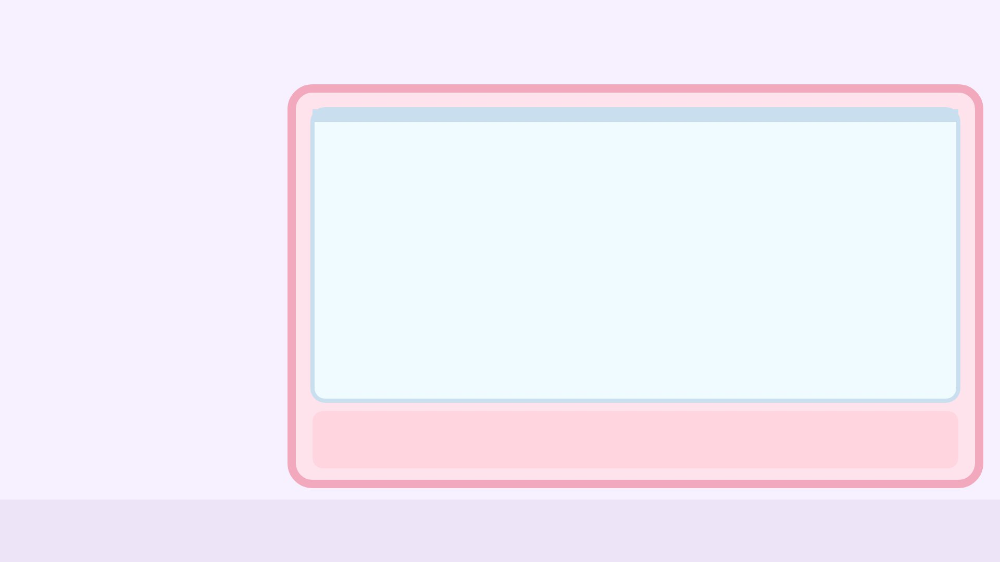



Find the word with a letter we never read
My prizes
مِا۟ئَةَ
يَلۡعَبُ
جَلَسَ

Slide 145
Stopping on this word:
لَّـٰكِنَّا۠
My prizes
لَـٰكِنَّ
لَـٰكِنَّا

Slide 146


Find the word with a letter we never read
My prizes
كَفَرُوا۟
يَقُولُ
نُورٌ

Slide 147
Find the word with a letter we never read
My prizes
لِشَا۟يۡءٍ
نُورٌ
قَالَ

Slide 148
Stopping on this word:
ٱلظُّنُونَا۠
My prizes
ٱلظُّنُونَا
ٱلظُّنُونَ

Slide 149
My prizes
You won all the toys!

Slide 150
Find the word with a letter we never read
My prizes
مِا۟ئَةَ
يَلۡعَبُ
جَلَسَ
Try again!

Slide 151
Stopping on this word:
لَّـٰكِنَّا۠
My prizes
لَـٰكِنَّ
لَـٰكِنَّا
Try again!

Slide 152
Find the word with a letter we never read
My prizes
كَفَرُوا۟
يَقُولُ
نُورٌ
Try again!

Slide 153
Find the word with a letter we never read
My prizes
لِشَا۟يۡءٍ
نُورٌ
قَالَ
Try again!

Slide 154
Stopping on this word:
ٱلظُّنُونَا۠
My prizes
ٱلظُّنُونَا
ٱلظُّنُونَ
Try again!

Slide 155
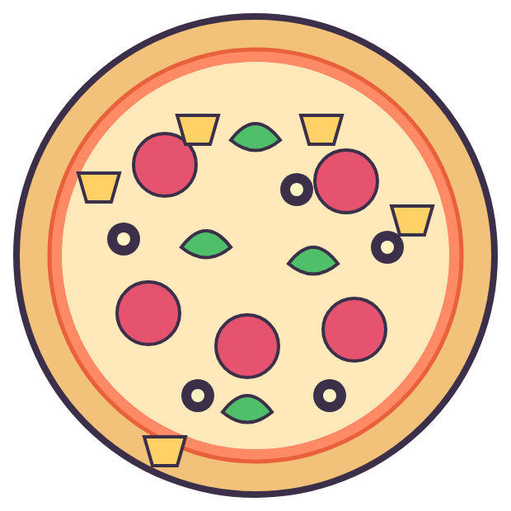
How to play: Pizza Party
1. Read the question at the top.
2. Tap the right card.
3. Every right answer adds a topping!

Slide 156


Reading on to the next word:
ٱلرَّسُولَا۠
ٱلرَّسُولَا
ٱلرَّسُولَ

Slide 157

Find the word with a letter we never read
قَالَ
مِا۟ئَةَ
سَمِعَ

Slide 158

Find the word with a letter we never read
كَفَرُوا۟
فِيلٌ
يَقُولُ

Slide 159

Stopping on this word:
لَّـٰكِنَّا۠
لَـٰكِنَّا
لَـٰكِنَّ

Slide 160

Find the word with a letter we never read
قَالَ
نَامَ
صَدَقُوا۟

Slide 161
Pizza is ready!

Slide 162
Reading on to the next word:
ٱلرَّسُولَا۠
ٱلرَّسُولَا
ٱلرَّسُولَ
Try again!

Slide 163
Find the word with a letter we never read
قَالَ
مِا۟ئَةَ
سَمِعَ
Try again!

Slide 164
Find the word with a letter we never read
كَفَرُوا۟
فِيلٌ
يَقُولُ
Try again!

Slide 165
Stopping on this word:
لَّـٰكِنَّا۠
لَـٰكِنَّا
لَـٰكِنَّ
Try again!

Slide 166
Find the word with a letter we never read
قَالَ
نَامَ
صَدَقُوا۟
Try again!

Slide 167
The orange letter: read it?
جَاهَدُوا۟
Read it
Never read
Only when I stop

Slide 168
The orange letter: read it?
أُو۟لَـٰٓئِكَ
Read it
Never read
Only when I stop

Slide 169
The orange letter: read it?
قَوَارِيرَا۠
Read it
Never read
Only when I stop

Slide 170
The orange letter: read it?
لَّـٰكِنَّا۠
Read it
Never read
Only when I stop

Slide 171
The orange letter: read it?
لَّٰكِنَّا۠
Read it
Never read
Only when I stop

Slide 172
Great sorting!

Slide 173
The orange letter: read it?
جَاهَدُوا۟
Try again!
Read it
Never read
Only when I stop

Slide 174
The orange letter: read it?
أُو۟لَـٰٓئِكَ
Try again!
Read it
Never read
Only when I stop

Slide 175
The orange letter: read it?
قَوَارِيرَا۠
Try again!
Read it
Never read
Only when I stop

Slide 176
The orange letter: read it?
لَّـٰكِنَّا۠
Try again!
Read it
Never read
Only when I stop

Slide 177
The orange letter: read it?
لَّٰكِنَّا۠
Try again!
Read it
Never read
Only when I stop

Slide 178
Tap the letter we do NOT read
كَفَرُوا۟
ا۟
و
رُ
فَ
كَ

Slide 179
Tap the letter we do NOT read
أُو۟لَـٰٓئِكَ
كَ
ئِ
لَٰٓ
و۟
أُ
Boo! Found it!

Slide 180
Tap the letter we do NOT read
صَدَقُوا۟
ا۟
و
قُ
دَ
صَ
Boo! Found it!

Slide 181
Tap the letter we do NOT read
صَدَقُوا۟
ا۟
و
قُ
دَ
صَ
Boo! Found it!

Slide 182
Tap the letter we do NOT read
قَالُوا۟
ا۟
و
لُ
ا
قَ
Boo! Found it!

Slide 183
You found all the ghosts!

Slide 184
Tap the letter we do NOT read
كَفَرُوا۟
ا۟
و
رُ
فَ
كَ
Try again!

Slide 185
Tap the letter we do NOT read
أُو۟لَـٰٓئِكَ
كَ
ئِ
لَٰٓ
و۟
أُ
Try again!

Slide 186
Tap the letter we do NOT read
صَدَقُوا۟
ا۟
و
قُ
دَ
صَ
Try again!

Slide 187
Tap the letter we do NOT read
صَدَقُوا۟
ا۟
و
قُ
دَ
صَ
Try again!

Slide 188
Tap the letter we do NOT read
قَالُوا۟
ا۟
و
لُ
ا
قَ
Try again!

Slide 189

How to play: Apple Tree (class game)
1. Two teams: Red and Blue.
2. Read the word, then tap your team.
3. First basket with 5 apples wins!

Slide 190



Apple Tree! Read the word, then tap your team.
هَاجَرُوا۟
Red ✓
Blue ✓
Red: 0
Blue: 0

Slide 191
Apple Tree! Read the word, then tap your team.
قَوَارِيرَا۠
Red ✓
Blue ✓
Red: 0
Blue: 1

Slide 192
Apple Tree! Read the word, then tap your team.
ٱلرَّسُولَا۠
Red ✓
Blue ✓
Red: 0
Blue: 2

Slide 193
Apple Tree! Read the word, then tap your team.
صَدَقُوا۟
Red ✓
Blue ✓
Red: 0
Blue: 3

Slide 194
Apple Tree! Read the word, then tap your team.
ٱلظُّنُونَا۠
Red ✓
Blue ✓
Red: 0
Blue: 4

Slide 195
Blue team wins!
Red: 0
Blue: 5

Slide 196
Apple Tree! Read the word, then tap your team.
قَوَارِيرَا۠
Red ✓
Blue ✓
Red: 1
Blue: 0

Slide 197
Apple Tree! Read the word, then tap your team.
ٱلرَّسُولَا۠
Red ✓
Blue ✓
Red: 1
Blue: 1

Slide 198
Apple Tree! Read the word, then tap your team.
صَدَقُوا۟
Red ✓
Blue ✓
Red: 1
Blue: 2

Slide 199
Apple Tree! Read the word, then tap your team.
ٱلظُّنُونَا۠
Red ✓
Blue ✓
Red: 1
Blue: 3

Slide 200
Apple Tree! Read the word, then tap your team.
أُو۟لَـٰٓئِكَ
Red ✓
Blue ✓
Red: 1
Blue: 4

Slide 201
Blue team wins!
Red: 1
Blue: 5

Slide 202
Apple Tree! Read the word, then tap your team.
ٱلرَّسُولَا۠
Red ✓
Blue ✓
Red: 2
Blue: 0

Slide 203
Apple Tree! Read the word, then tap your team.
صَدَقُوا۟
Red ✓
Blue ✓
Red: 2
Blue: 1

Slide 204
Apple Tree! Read the word, then tap your team.
ٱلظُّنُونَا۠
Red ✓
Blue ✓
Red: 2
Blue: 2

Slide 205
Apple Tree! Read the word, then tap your team.
أُو۟لَـٰٓئِكَ
Red ✓
Blue ✓
Red: 2
Blue: 3

Slide 206
Apple Tree! Read the word, then tap your team.
أَنَا۠
Red ✓
Blue ✓
Red: 2
Blue: 4

Slide 207
Blue team wins!
Red: 2
Blue: 5

Slide 208
Apple Tree! Read the word, then tap your team.
صَدَقُوا۟
Red ✓
Blue ✓
Red: 3
Blue: 0

Slide 209
Apple Tree! Read the word, then tap your team.
ٱلظُّنُونَا۠
Red ✓
Blue ✓
Red: 3
Blue: 1

Slide 210
Apple Tree! Read the word, then tap your team.
أُو۟لَـٰٓئِكَ
Red ✓
Blue ✓
Red: 3
Blue: 2

Slide 211
Apple Tree! Read the word, then tap your team.
أَنَا۠
Red ✓
Blue ✓
Red: 3
Blue: 3

Slide 212
Apple Tree! Read the word, then tap your team.
قَالُوا۟
Red ✓
Blue ✓
Red: 3
Blue: 4

Slide 213
Blue team wins!
Red: 3
Blue: 5

Slide 214
Apple Tree! Read the word, then tap your team.
ٱلظُّنُونَا۠
Red ✓
Blue ✓
Red: 4
Blue: 0

Slide 215
Apple Tree! Read the word, then tap your team.
أُو۟لَـٰٓئِكَ
Red ✓
Blue ✓
Red: 4
Blue: 1

Slide 216
Apple Tree! Read the word, then tap your team.
أَنَا۠
Red ✓
Blue ✓
Red: 4
Blue: 2

Slide 217
Apple Tree! Read the word, then tap your team.
قَالُوا۟
Red ✓
Blue ✓
Red: 4
Blue: 3

Slide 218
Apple Tree! Read the word, then tap your team.
ثَمُودَا۟
Red ✓
Blue ✓
Red: 4
Blue: 4

Slide 219
Blue team wins!
Red: 4
Blue: 5

Slide 220
Red team wins!
Red: 5
Blue: 0

Slide 221
Red team wins!
Red: 5
Blue: 1

Slide 222
Red team wins!
Red: 5
Blue: 2

Slide 223
Red team wins!
Red: 5
Blue: 3

Slide 224
Red team wins!
Red: 5
Blue: 4

Slide 225
Stopping on this word:
أَنَا۠
أَنَا
أَنَ

Slide 226
Find the word with a letter we never read
قَالَ
ءَامَنُوا۟
سَمِعَ

Slide 227
Stopping on this word:
قَوَارِيرَا۠
قَوَارِيرَا
قَوَارِيرَ

Slide 228
Find the word with a letter we never read
كَفَرُوا۟
فِيلٌ
ذَهَبَ

Slide 229
Find the word with a letter we never read
جَلَسَ
ثَمُودَا۟
قَالَ

Slide 230
Hello, snowman!

Slide 231
Stopping on this word:
أَنَا۠
أَنَا
أَنَ
Try again!

Slide 232
Find the word with a letter we never read
قَالَ
ءَامَنُوا۟
سَمِعَ
Try again!

Slide 233
Stopping on this word:
قَوَارِيرَا۠
قَوَارِيرَا
قَوَارِيرَ
Try again!

Slide 234
Find the word with a letter we never read
كَفَرُوا۟
فِيلٌ
ذَهَبَ
Try again!

Slide 235
Find the word with a letter we never read
جَلَسَ
ثَمُودَا۟
قَالَ
Try again!

Slide 236
The orange letter: read it?
ٱلسَّبِيلَا۠
Read it
Never read
Only when I stop

Slide 237
The orange letter: read it?
ثَمُودَا۟
Read it
Never read
Only when I stop

Slide 238
The orange letter: read it?
لَّـٰكِنَّا۠
Read it
Never read
Only when I stop

Slide 239
The orange letter: read it?
لَّـٰكِنَّا۠
Read it
Never read
Only when I stop

Slide 240
The orange letter: read it?
ٱلرَّسُولَا۠
Read it
Never read
Only when I stop

Slide 241
Great sorting!

Slide 242
The orange letter: read it?
ٱلسَّبِيلَا۠
Try again!
Read it
Never read
Only when I stop

Slide 243
The orange letter: read it?
ثَمُودَا۟
Try again!
Read it
Never read
Only when I stop

Slide 244
The orange letter: read it?
لَّـٰكِنَّا۠
Try again!
Read it
Never read
Only when I stop

Slide 245
The orange letter: read it?
لَّـٰكِنَّا۠
Try again!
Read it
Never read
Only when I stop

Slide 246
The orange letter: read it?
ٱلرَّسُولَا۠
Try again!
Read it
Never read
Only when I stop

Slide 247
Reading on to the next word:
ٱلرَّسُولَا۠
ٱلرَّسُولَا
ٱلرَّسُولَ

Slide 248
Find the word with a letter we never read
أُو۟لَـٰٓئِكَ
سَمِعَ
يَقُولُ

Slide 249
Find the word with a letter we never read
ذَهَبَ
فِيلٌ
أُو۟لَـٰٓئِكَ

Slide 250
Reading on to the next word:
ٱلظُّنُونَا۠
ٱلظُّنُونَ
ٱلظُّنُونَا

Slide 251
Find the word with a letter we never read
نُورٌ
هَاجَرُوا۟
جَلَسَ

Slide 252
Treasure!

Slide 253
Reading on to the next word:
ٱلرَّسُولَا۠
Try again!
ٱلرَّسُولَا
ٱلرَّسُولَ

Slide 254
Find the word with a letter we never read
Try again!
أُو۟لَـٰٓئِكَ
سَمِعَ
يَقُولُ

Slide 255
Find the word with a letter we never read
Try again!
ذَهَبَ
فِيلٌ
أُو۟لَـٰٓئِكَ

Slide 256
Reading on to the next word:
ٱلظُّنُونَا۠
Try again!
ٱلظُّنُونَ
ٱلظُّنُونَا

Slide 257
Find the word with a letter we never read
Try again!
نُورٌ
هَاجَرُوا۟
جَلَسَ

Slide 258
Find the word with a letter we never read
سَمِعَ
كَفَرُوا۟
فِيلٌ

Slide 259
Find the word with a letter we never read
صَدَقُوا۟
نُورٌ
يَقُولُ

Slide 260
Reading on to the next word:
ٱلظُّنُونَا۠
ٱلظُّنُونَ
ٱلظُّنُونَا

Slide 261
Find the word with a letter we never read
ءَامَنُوا۟
يَقُولُ
سَمِعَ

Slide 262
Reading on to the next word:
ٱلسَّبِيلَا۠
ٱلسَّبِيلَا
ٱلسَّبِيلَ

Slide 263
Hooray!

Slide 264
Find the word with a letter we never read
Try again!
سَمِعَ
كَفَرُوا۟
فِيلٌ

Slide 265
Find the word with a letter we never read
Try again!
صَدَقُوا۟
نُورٌ
يَقُولُ

Slide 266
Reading on to the next word:
ٱلظُّنُونَا۠
Try again!
ٱلظُّنُونَ
ٱلظُّنُونَا

Slide 267
Find the word with a letter we never read
Try again!
ءَامَنُوا۟
يَقُولُ
سَمِعَ

Slide 268
Reading on to the next word:
ٱلسَّبِيلَا۠
Try again!
ٱلسَّبِيلَا
ٱلسَّبِيلَ

Slide 269
Tap the letter we do NOT read
جَاهَدُوا۟
ا۟
و
دُ
هَ
ا
جَ

Slide 270
Tap the letter we do NOT read
بِأَيۡي۟دٍ
دٍ
ي۟
يۡ
أَ
بِ
Boo! Found it!

Slide 271
Tap the letter we do NOT read
قَالُوا۟
ا۟
و
لُ
ا
قَ
Boo! Found it!

Slide 272
Tap the letter we do NOT read
لِشَا۟يۡءٍ
ءٍ
يۡ
ا۟
شَ
لِ
Boo! Found it!

Slide 273
Tap the letter we do NOT read
ءَامَنُوا۟
ا۟
و
نُ
مَ
ا
ءَ
Boo! Found it!

Slide 274
You found all the ghosts!

Slide 275
Tap the letter we do NOT read
جَاهَدُوا۟
ا۟
و
دُ
هَ
ا
جَ
Try again!

Slide 276
Tap the letter we do NOT read
بِأَيۡي۟دٍ
دٍ
ي۟
يۡ
أَ
بِ
Try again!

Slide 277
Tap the letter we do NOT read
قَالُوا۟
ا۟
و
لُ
ا
قَ
Try again!

Slide 278
Tap the letter we do NOT read
لِشَا۟يۡءٍ
ءٍ
يۡ
ا۟
شَ
لِ
Try again!

Slide 279
Tap the letter we do NOT read
ءَامَنُوا۟
ا۟
و
نُ
مَ
ا
ءَ
Try again!

Slide 280
Reading on to the next word:
ٱلسَّبِيلَا۠
ٱلسَّبِيلَ
ٱلسَّبِيلَا

Slide 281
Find the word with a letter we never read
أُو۟لَـٰٓئِكَ
ذَهَبَ
جَلَسَ

Slide 282
Reading on to the next word:
ٱلرَّسُولَا۠
ٱلرَّسُولَا
ٱلرَّسُولَ

Slide 283
Find the word with a letter we never read
جَاهَدُوا۟
ذَهَبَ
يَلۡعَبُ

Slide 284
Find the word with a letter we never read
ذَهَبَ
فِيلٌ
ثَمُودَا۟

Slide 285
You made it!

Slide 286
Reading on to the next word:
ٱلسَّبِيلَا۠
ٱلسَّبِيلَ
ٱلسَّبِيلَا
Splash! Try again!

Slide 287
Find the word with a letter we never read
أُو۟لَـٰٓئِكَ
ذَهَبَ
Splash! Try again!
جَلَسَ

Slide 288
Reading on to the next word:
ٱلرَّسُولَا۠
ٱلرَّسُولَا
ٱلرَّسُولَ
Splash! Try again!

Slide 289
Find the word with a letter we never read
جَاهَدُوا۟
ذَهَبَ
Splash! Try again!
يَلۡعَبُ

Slide 290
Find the word with a letter we never read
ذَهَبَ
فِيلٌ
Splash! Try again!
ثَمُودَا۟

Slide 291
Find the word with a letter we never read
هَاجَرُوا۟
قَالَ
ذَهَبَ

Slide 292
Reading on to the next word:
ٱلظُّنُونَا۠
ٱلظُّنُونَ
ٱلظُّنُونَا

Slide 293
Find the word with a letter we never read
يَلۡعَبُ
كَفَرُوا۟
قَالَ

Slide 294
Find the word with a letter we never read
نَامَ
يَلۡعَبُ
ثَمُودَا۟

Slide 295
Stopping on this word:
ٱلرَّسُولَا۠
ٱلرَّسُولَا
ٱلرَّسُولَ

Slide 296
All the eggs hatched!

Slide 297
Find the word with a letter we never read
هَاجَرُوا۟
قَالَ
ذَهَبَ
Try again!

Slide 298
Reading on to the next word:
ٱلظُّنُونَا۠
ٱلظُّنُونَ
ٱلظُّنُونَا
Try again!

Slide 299
Find the word with a letter we never read
يَلۡعَبُ
كَفَرُوا۟
قَالَ
Try again!

Slide 300
Find the word with a letter we never read
نَامَ
يَلۡعَبُ
ثَمُودَا۟
Try again!

Slide 301
Stopping on this word:
ٱلرَّسُولَا۠
ٱلرَّسُولَا
ٱلرَّسُولَ
Try again!

Slide 302
The orange letter: read it?
أَنَا۠
Read it
Never read
Only when I stop

Slide 303
The orange letter: read it?
ٱلسَّبِيلَا۠
Read it
Never read
Only when I stop

Slide 304
The orange letter: read it?
قَوَارِيرَا۠
Read it
Never read
Only when I stop

Slide 305
The orange letter: read it?
أُو۟لَٰٓئِكَ
Read it
Never read
Only when I stop

Slide 306
The orange letter: read it?
قَوَارِيرَا۠
Read it
Never read
Only when I stop

Slide 307
Great sorting!

Slide 308
The orange letter: read it?
أَنَا۠
Try again!
Read it
Never read
Only when I stop

Slide 309
The orange letter: read it?
ٱلسَّبِيلَا۠
Try again!
Read it
Never read
Only when I stop

Slide 310
The orange letter: read it?
قَوَارِيرَا۠
Try again!
Read it
Never read
Only when I stop

Slide 311
The orange letter: read it?
أُو۟لَٰٓئِكَ
Try again!
Read it
Never read
Only when I stop

Slide 312
The orange letter: read it?
قَوَارِيرَا۠
Try again!
Read it
Never read
Only when I stop

Slide 313
Find the word with a letter we never read
صَدَقُوا۟
نَامَ
يَقُولُ

Slide 314
Find the word with a letter we never read
نُورٌ
قَالُوا۟
ذَهَبَ

Slide 315
Stopping on this word:
لَّـٰكِنَّا۠
لَـٰكِنَّا
لَـٰكِنَّ

Slide 316
Find the word with a letter we never read
قَالَ
صَدَقُوا۟
نُورٌ

Slide 317
Stopping on this word:
لَّـٰكِنَّا۠
لَـٰكِنَّا
لَـٰكِنَّ

Slide 318
Yummy honey!

Slide 319
Find the word with a letter we never read
صَدَقُوا۟
نَامَ
يَقُولُ
Try again!

Slide 320
Find the word with a letter we never read
نُورٌ
قَالُوا۟
ذَهَبَ
Try again!

Slide 321
Stopping on this word:
لَّـٰكِنَّا۠
لَـٰكِنَّا
لَـٰكِنَّ
Try again!

Slide 322
Find the word with a letter we never read
قَالَ
صَدَقُوا۟
نُورٌ
Try again!

Slide 323
Stopping on this word:
لَّـٰكِنَّا۠
لَـٰكِنَّا
لَـٰكِنَّ
Try again!

Slide 324
Tap the letter we do NOT read
كَفَرُوا۟
ا۟
و
رُ
فَ
كَ

Slide 325
Tap the letter we do NOT read
تَابُوا۟
ا۟
و
بُ
ا
تَ
Boo! Found it!

Slide 326
Tap the letter we do NOT read
مِا۟ئَةَ
ةَ
ئَ
ا۟
مِ
Boo! Found it!

Slide 327
Tap the letter we do NOT read
تَابُوا۟
ا۟
و
بُ
ا
تَ
Boo! Found it!

Slide 328
Tap the letter we do NOT read
أُو۟لَـٰٓئِكَ
كَ
ئِ
لَٰٓ
و۟
أُ
Boo! Found it!

Slide 329
You found all the ghosts!

Slide 330
Tap the letter we do NOT read
كَفَرُوا۟
ا۟
و
رُ
فَ
كَ
Try again!

Slide 331
Tap the letter we do NOT read
تَابُوا۟
ا۟
و
بُ
ا
تَ
Try again!

Slide 332
Tap the letter we do NOT read
مِا۟ئَةَ
ةَ
ئَ
ا۟
مِ
Try again!

Slide 333
Tap the letter we do NOT read
تَابُوا۟
ا۟
و
بُ
ا
تَ
Try again!

Slide 334
Tap the letter we do NOT read
أُو۟لَـٰٓئِكَ
كَ
ئِ
لَٰٓ
و۟
أُ
Try again!

Slide 335
Stopping on this word:
أَنَا۠
أَنَا
أَنَ
FUEL

Slide 336
Find the word with a letter we never read
تَابُوا۟
قَالَ
يَلۡعَبُ
FUEL

Slide 337
Reading on to the next word:
أَنَا۠
أَنَا
أَنَ
FUEL

Slide 338
Find the word with a letter we never read
مِا۟ئَةَ
فِيلٌ
قَالَ
FUEL

Slide 339
Find the word with a letter we never read
جَلَسَ
ثَمُودَا۟
فِيلٌ
FUEL

Slide 340
3, 2, 1... Blast off!
FUEL

Slide 341
Stopping on this word:
أَنَا۠
أَنَا
أَنَ
Try again!
FUEL

Slide 342
Find the word with a letter we never read
تَابُوا۟
قَالَ
يَلۡعَبُ
Try again!
FUEL

Slide 343
Reading on to the next word:
أَنَا۠
أَنَا
أَنَ
Try again!
FUEL

Slide 344
Find the word with a letter we never read
مِا۟ئَةَ
فِيلٌ
قَالَ
Try again!
FUEL

Slide 345
Find the word with a letter we never read
جَلَسَ
ثَمُودَا۟
فِيلٌ
Try again!
FUEL

Slide 346
Find the word with a letter we never read
My prizes
هَاجَرُوا۟
نُورٌ
نَامَ

Slide 347
Reading on to the next word:
لَّـٰكِنَّا۠
My prizes
لَـٰكِنَّا
لَـٰكِنَّ

Slide 348
Find the word with a letter we never read
My prizes
مِا۟ئَةَ
سَمِعَ
نُورٌ

Slide 349
Find the word with a letter we never read
My prizes
كِتَابٌ
لِشَا۟يۡءٍ
نُورٌ

Slide 350
Stopping on this word:
ٱلرَّسُولَا۠
My prizes
ٱلرَّسُولَا
ٱلرَّسُولَ

Slide 351
My prizes
You won all the toys!

Slide 352
Find the word with a letter we never read
My prizes
هَاجَرُوا۟
نُورٌ
نَامَ
Try again!

Slide 353
Reading on to the next word:
لَّـٰكِنَّا۠
My prizes
لَـٰكِنَّا
لَـٰكِنَّ
Try again!

Slide 354
Find the word with a letter we never read
My prizes
مِا۟ئَةَ
سَمِعَ
نُورٌ
Try again!

Slide 355
Find the word with a letter we never read
My prizes
كِتَابٌ
لِشَا۟يۡءٍ
نُورٌ
Try again!

Slide 356
Stopping on this word:
ٱلرَّسُولَا۠
My prizes
ٱلرَّسُولَا
ٱلرَّسُولَ
Try again!

Slide 357
Reading on to the next word:
ٱلسَّبِيلَا۠
ٱلسَّبِيلَا
ٱلسَّبِيلَ

Slide 358
Find the word with a letter we never read
كِتَابٌ
لِشَا۟يۡءٍ
نَامَ

Slide 359
Find the word with a letter we never read
جَلَسَ
كَفَرُوا۟
فِيلٌ

Slide 360
Stopping on this word:
ٱلسَّبِيلَا۠
ٱلسَّبِيلَا
ٱلسَّبِيلَ

Slide 361
Find the word with a letter we never read
كِتَابٌ
أُو۟لَـٰٓئِكَ
نَامَ

Slide 362
Pizza is ready!

Slide 363
Reading on to the next word:
ٱلسَّبِيلَا۠
ٱلسَّبِيلَا
ٱلسَّبِيلَ
Try again!

Slide 364
Find the word with a letter we never read
كِتَابٌ
لِشَا۟يۡءٍ
نَامَ
Try again!

Slide 365
Find the word with a letter we never read
جَلَسَ
كَفَرُوا۟
فِيلٌ
Try again!

Slide 366
Stopping on this word:
ٱلسَّبِيلَا۠
ٱلسَّبِيلَا
ٱلسَّبِيلَ
Try again!

Slide 367
Find the word with a letter we never read
كِتَابٌ
أُو۟لَـٰٓئِكَ
نَامَ
Try again!

Slide 368
The orange letter: read it?
كَفَرُوا۟
Read it
Never read
Only when I stop

Slide 369
The orange letter: read it?
قَالُوا۟
Read it
Never read
Only when I stop

Slide 370
The orange letter: read it?
هَاجَرُوا۟
Read it
Never read
Only when I stop

Slide 371
The orange letter: read it?
لِشَا۟يۡءٍ
Read it
Never read
Only when I stop

Slide 372
The orange letter: read it?
هَاجَرُوا۟
Read it
Never read
Only when I stop

Slide 373
Great sorting!

Slide 374
The orange letter: read it?
كَفَرُوا۟
Try again!
Read it
Never read
Only when I stop

Slide 375
The orange letter: read it?
قَالُوا۟
Try again!
Read it
Never read
Only when I stop

Slide 376
The orange letter: read it?
هَاجَرُوا۟
Try again!
Read it
Never read
Only when I stop

Slide 377
The orange letter: read it?
لِشَا۟يۡءٍ
Try again!
Read it
Never read
Only when I stop

Slide 378
The orange letter: read it?
هَاجَرُوا۟
Try again!
Read it
Never read
Only when I stop

Slide 379
Apple Tree! Read the word, then tap your team.
قَوَارِيرَا۠
Red ✓
Blue ✓
Red: 0
Blue: 0

Slide 380
Apple Tree! Read the word, then tap your team.
قَالُوا۟
Red ✓
Blue ✓
Red: 0
Blue: 1

Slide 381
Apple Tree! Read the word, then tap your team.
ٱلرَّسُولَا۠
Red ✓
Blue ✓
Red: 0
Blue: 2

Slide 382
Apple Tree! Read the word, then tap your team.
لِشَا۟يۡءٍ
Red ✓
Blue ✓
Red: 0
Blue: 3

Slide 383
Apple Tree! Read the word, then tap your team.
ٱلسَّبِيلَا۠
Red ✓
Blue ✓
Red: 0
Blue: 4

Slide 384
Blue team wins!
Red: 0
Blue: 5

Slide 385
Apple Tree! Read the word, then tap your team.
قَالُوا۟
Red ✓
Blue ✓
Red: 1
Blue: 0

Slide 386
Apple Tree! Read the word, then tap your team.
ٱلرَّسُولَا۠
Red ✓
Blue ✓
Red: 1
Blue: 1

Slide 387
Apple Tree! Read the word, then tap your team.
لِشَا۟يۡءٍ
Red ✓
Blue ✓
Red: 1
Blue: 2

Slide 388
Apple Tree! Read the word, then tap your team.
ٱلسَّبِيلَا۠
Red ✓
Blue ✓
Red: 1
Blue: 3

Slide 389
Apple Tree! Read the word, then tap your team.
جَاهَدُوا۟
Red ✓
Blue ✓
Red: 1
Blue: 4

Slide 390
Blue team wins!
Red: 1
Blue: 5

Slide 391
Apple Tree! Read the word, then tap your team.
ٱلرَّسُولَا۠
Red ✓
Blue ✓
Red: 2
Blue: 0

Slide 392
Apple Tree! Read the word, then tap your team.
لِشَا۟يۡءٍ
Red ✓
Blue ✓
Red: 2
Blue: 1

Slide 393
Apple Tree! Read the word, then tap your team.
ٱلسَّبِيلَا۠
Red ✓
Blue ✓
Red: 2
Blue: 2

Slide 394
Apple Tree! Read the word, then tap your team.
جَاهَدُوا۟
Red ✓
Blue ✓
Red: 2
Blue: 3

Slide 395
Apple Tree! Read the word, then tap your team.
أَنَا۠
Red ✓
Blue ✓
Red: 2
Blue: 4

Slide 396
Blue team wins!
Red: 2
Blue: 5

Slide 397
Apple Tree! Read the word, then tap your team.
لِشَا۟يۡءٍ
Red ✓
Blue ✓
Red: 3
Blue: 0

Slide 398
Apple Tree! Read the word, then tap your team.
ٱلسَّبِيلَا۠
Red ✓
Blue ✓
Red: 3
Blue: 1

Slide 399
Apple Tree! Read the word, then tap your team.
جَاهَدُوا۟
Red ✓
Blue ✓
Red: 3
Blue: 2

Slide 400
Apple Tree! Read the word, then tap your team.
أَنَا۠
Red ✓
Blue ✓
Red: 3
Blue: 3

Slide 401
Apple Tree! Read the word, then tap your team.
ءَامَنُوا۟
Red ✓
Blue ✓
Red: 3
Blue: 4

Slide 402
Blue team wins!
Red: 3
Blue: 5

Slide 403
Apple Tree! Read the word, then tap your team.
ٱلسَّبِيلَا۠
Red ✓
Blue ✓
Red: 4
Blue: 0

Slide 404
Apple Tree! Read the word, then tap your team.
جَاهَدُوا۟
Red ✓
Blue ✓
Red: 4
Blue: 1

Slide 405
Apple Tree! Read the word, then tap your team.
أَنَا۠
Red ✓
Blue ✓
Red: 4
Blue: 2

Slide 406
Apple Tree! Read the word, then tap your team.
ءَامَنُوا۟
Red ✓
Blue ✓
Red: 4
Blue: 3

Slide 407
Apple Tree! Read the word, then tap your team.
عَمِلُوا۟
Red ✓
Blue ✓
Red: 4
Blue: 4

Slide 408
Blue team wins!
Red: 4
Blue: 5

Slide 409
Red team wins!
Red: 5
Blue: 0

Slide 410
Red team wins!
Red: 5
Blue: 1

Slide 411
Red team wins!
Red: 5
Blue: 2

Slide 412
Red team wins!
Red: 5
Blue: 3

Slide 413
Red team wins!
Red: 5
Blue: 4

Slide 414
Well done!
↺ Play again

