Slide 1
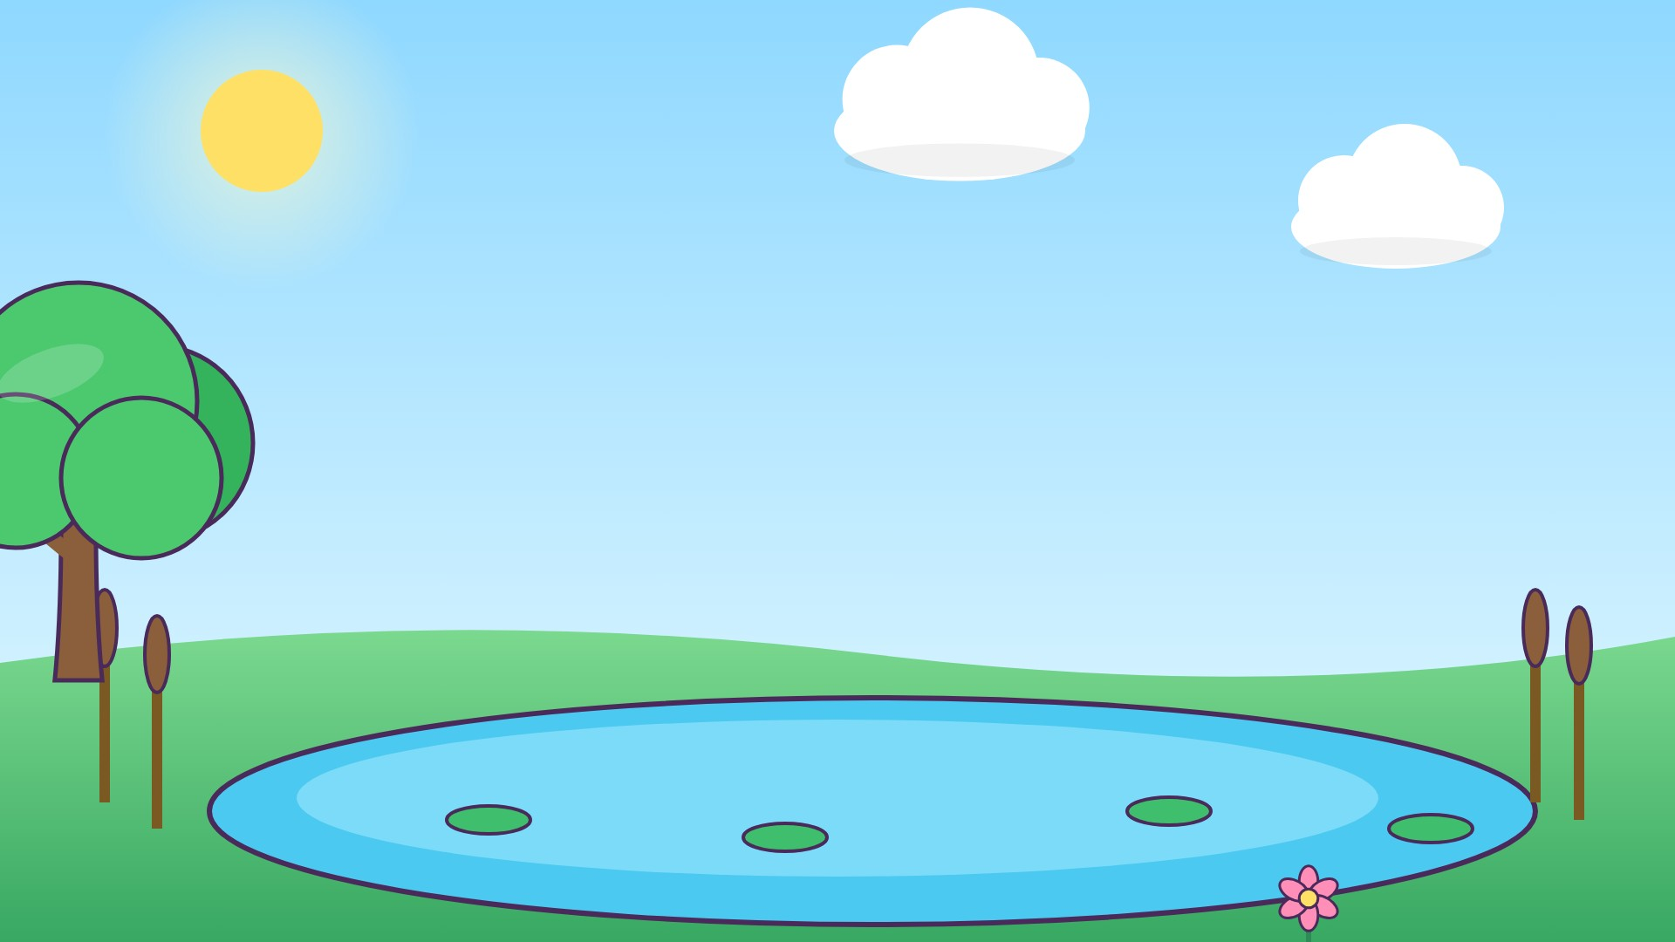


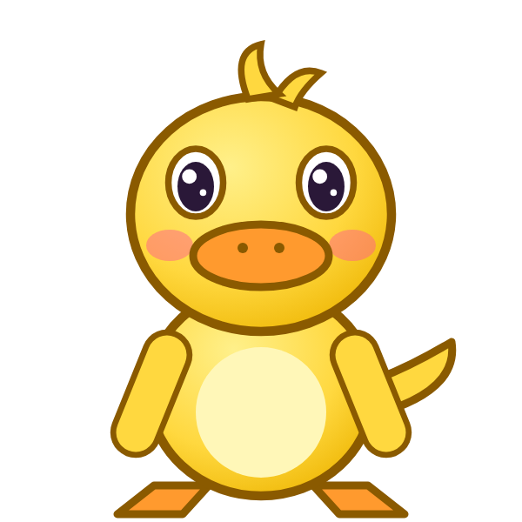

ب
بَ

Slide 2
بَأَ
أ
أَ
ب
بَ

Slide 3
بَتَ
ت
تَ
ب
بَ

Slide 4
بَثَ
ث
ثَ
ب
بَ

Slide 5
بَجَ
ج
جَ
ب
بَ

Slide 6
بَحَ
ح
حَ
ب
بَ

Slide 7
بَخَ
خ
خَ
ب
بَ

Slide 8
بَدَ
د
دَ
ب
بَ

Slide 9
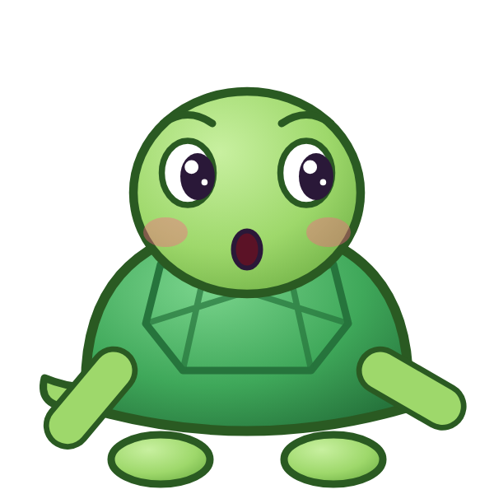

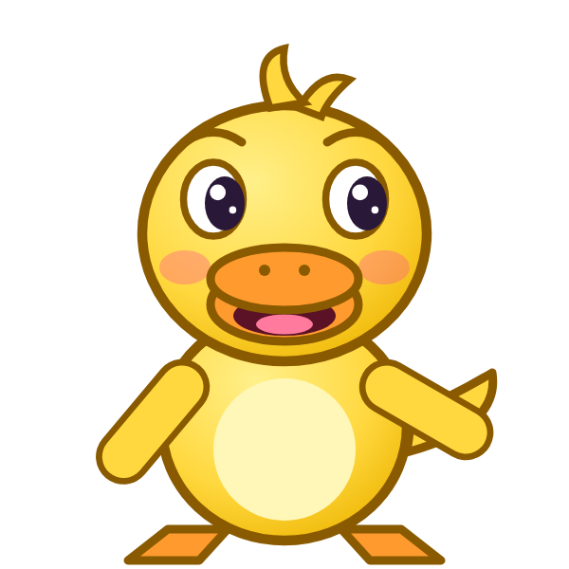
؟
دَ
بَ
بَذَ
بَدَ
دَبَ
Notes:
GAME TIME: ask the child to read the equation, then tap the animal holding the answer they think is right. Right answer = celebration slide. Wrong answer = a hidden try-again slide; tap the green button to try again.

Slide 10
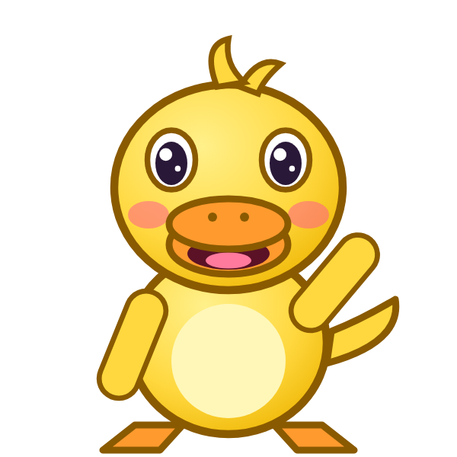

بَدَ

Slide 11
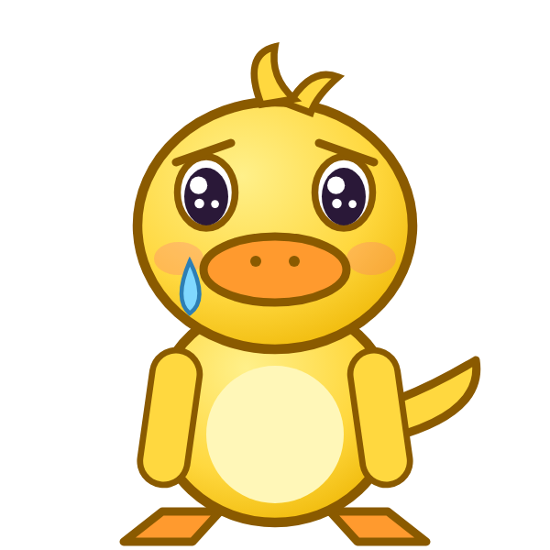
Notes:
Hidden try-again slide: only shown after a wrong answer. Tap the green button to go back to the question.

Slide 12
أَبَتَ
ت
تَ
ب
بَ
أ
أَ

Slide 13
تَبَثَ
ث
ثَ
ب
بَ
ت
تَ

Slide 14
ثَبَجَ
ج
جَ
ب
بَ
ث
ثَ

Slide 15
جَبَحَ
ح
حَ
ب
بَ
ج
جَ

Slide 16
حَبَخَ
خ
خَ
ب
بَ
ح
حَ

Slide 17
خَبَدَ
د
دَ
ب
بَ
خ
خَ

Slide 18
دَبَأَ
أ
أَ
ب
بَ
د
دَ

Slide 19
أَبَ
ب
بَ
أ
أَ

Slide 20
؟
بَ
أَ
أَبَ
بَبَ
بَأَ
Notes:
GAME TIME: ask the child to read the equation, then tap the animal holding the answer they think is right. Right answer = celebration slide. Wrong answer = a hidden try-again slide; tap the green button to try again.

Slide 21
أَبَ

Slide 22
Notes:
Hidden try-again slide: only shown after a wrong answer. Tap the green button to go back to the question.

Slide 23
تَبَ
ب
بَ
ت
تَ

Slide 24
ثَبَ
ب
بَ
ث
ثَ

Slide 25
جَبَ
ب
بَ
ج
جَ

Slide 26
حَبَ
ب
بَ
ح
حَ

Slide 27
خَبَ
ب
بَ
خ
خَ

Slide 28
دَبَ
ب
بَ
د
دَ

Slide 29
ت
تَ

Slide 30
تَأَ
أ
أَ
ت
تَ

Slide 31
؟
أَ
تَ
تَبَ
أَتَ
تَأَ
Notes:
GAME TIME: ask the child to read the equation, then tap the animal holding the answer they think is right. Right answer = celebration slide. Wrong answer = a hidden try-again slide; tap the green button to try again.

Slide 32
تَأَ

Slide 33
Notes:
Hidden try-again slide: only shown after a wrong answer. Tap the green button to go back to the question.

Slide 34
Notes:
Level up! Celebrate before the next set of letters.

Slide 35
تَبَ
ب
بَ
ت
تَ

Slide 36
تَثَ
ث
ثَ
ت
تَ

Slide 37
تَجَ
ج
جَ
ت
تَ

Slide 38
تَحَ
ح
حَ
ت
تَ

Slide 39
تَخَ
خ
خَ
ت
تَ

Slide 40
تَدَ
د
دَ
ت
تَ

Slide 41
أَتَبَ
ب
بَ
ت
تَ
أ
أَ

Slide 42
بَتَثَ
ث
ثَ
ت
تَ
ب
بَ

Slide 43
؟
ثَ
تَ
بَ
بَثَثَ
بَتَثَ
ثَتَبَ
Notes:
GAME TIME: ask the child to read the equation, then tap the animal holding the answer they think is right. Right answer = celebration slide. Wrong answer = a hidden try-again slide; tap the green button to try again.

Slide 44
بَتَثَ

Slide 45
Notes:
Hidden try-again slide: only shown after a wrong answer. Tap the green button to go back to the question.

Slide 46
ثَتَجَ
ج
جَ
ت
تَ
ث
ثَ

Slide 47
جَتَحَ
ح
حَ
ت
تَ
ج
جَ

Slide 48
حَتَخَ
خ
خَ
ت
تَ
ح
حَ

Slide 49
خَتَدَ
د
دَ
ت
تَ
خ
خَ

Slide 50
دَتَأَ
أ
أَ
ت
تَ
د
دَ

Slide 51
أَتَ
ت
تَ
أ
أَ

Slide 52
بَتَ
ت
تَ
ب
بَ

Slide 53
ثَتَ
ت
تَ
ث
ثَ

Slide 54
؟
تَ
ثَ
ثَتَ
ثَثَ
تَثَ
Notes:
GAME TIME: ask the child to read the equation, then tap the animal holding the answer they think is right. Right answer = celebration slide. Wrong answer = a hidden try-again slide; tap the green button to try again.

Slide 55
ثَتَ

Slide 56
Notes:
Hidden try-again slide: only shown after a wrong answer. Tap the green button to go back to the question.

Slide 57
جَتَ
ت
تَ
ج
جَ

Slide 58
حَتَ
ت
تَ
ح
حَ

Slide 59
خَتَ
ت
تَ
خ
خَ

Slide 60
دَتَ
ت
تَ
د
دَ

Slide 61
ث
ثَ

Slide 62
ثَأَ
أ
أَ
ث
ثَ

Slide 63
ثَبَ
ب
بَ
ث
ثَ

Slide 64
ثَتَ
ت
تَ
ث
ثَ

Slide 65
؟
تَ
ثَ
بَتَ
تَثَ
ثَتَ
Notes:
GAME TIME: ask the child to read the equation, then tap the animal holding the answer they think is right. Right answer = celebration slide. Wrong answer = a hidden try-again slide; tap the green button to try again.

Slide 66
ثَتَ

Slide 67
Notes:
Hidden try-again slide: only shown after a wrong answer. Tap the green button to go back to the question.

Slide 68
Notes:
Level up! Celebrate before the next set of letters.

Slide 69
ثَجَ
ج
جَ
ث
ثَ

Slide 70
ثَحَ
ح
حَ
ث
ثَ

Slide 71
ثَخَ
خ
خَ
ث
ثَ

Slide 72
ثَدَ
د
دَ
ث
ثَ

Slide 73
أَثَبَ
ب
بَ
ث
ثَ
أ
أَ

Slide 74
بَثَتَ
ت
تَ
ث
ثَ
ب
بَ

Slide 75
تَثَجَ
ج
جَ
ث
ثَ
ت
تَ

Slide 76
جَثَحَ
ح
حَ
ث
ثَ
ج
جَ

Slide 77
؟
حَ
ثَ
جَ
جَبَحَ
جَثَحَ
حَثَجَ
Notes:
GAME TIME: ask the child to read the equation, then tap the animal holding the answer they think is right. Right answer = celebration slide. Wrong answer = a hidden try-again slide; tap the green button to try again.

Slide 78
جَثَحَ

Slide 79
Notes:
Hidden try-again slide: only shown after a wrong answer. Tap the green button to go back to the question.

Slide 80
حَثَخَ
خ
خَ
ث
ثَ
ح
حَ

Slide 81
خَثَدَ
د
دَ
ث
ثَ
خ
خَ

Slide 82
دَثَأَ
أ
أَ
ث
ثَ
د
دَ

Slide 83
أَثَ
ث
ثَ
أ
أَ

Slide 84
بَثَ
ث
ثَ
ب
بَ

Slide 85
تَثَ
ث
ثَ
ت
تَ

Slide 86
جَثَ
ث
ثَ
ج
جَ

Slide 87
حَثَ
ث
ثَ
ح
حَ

Slide 88
؟
ثَ
حَ
حَثَ
خَثَ
ثَحَ
Notes:
GAME TIME: ask the child to read the equation, then tap the animal holding the answer they think is right. Right answer = celebration slide. Wrong answer = a hidden try-again slide; tap the green button to try again.

Slide 89
حَثَ

Slide 90
Notes:
Hidden try-again slide: only shown after a wrong answer. Tap the green button to go back to the question.

Slide 91
خَثَ
ث
ثَ
خ
خَ

Slide 92
دَثَ
ث
ثَ
د
دَ

Slide 93

Notes:
Finished! Give the child a big cheer.

