Slide 1
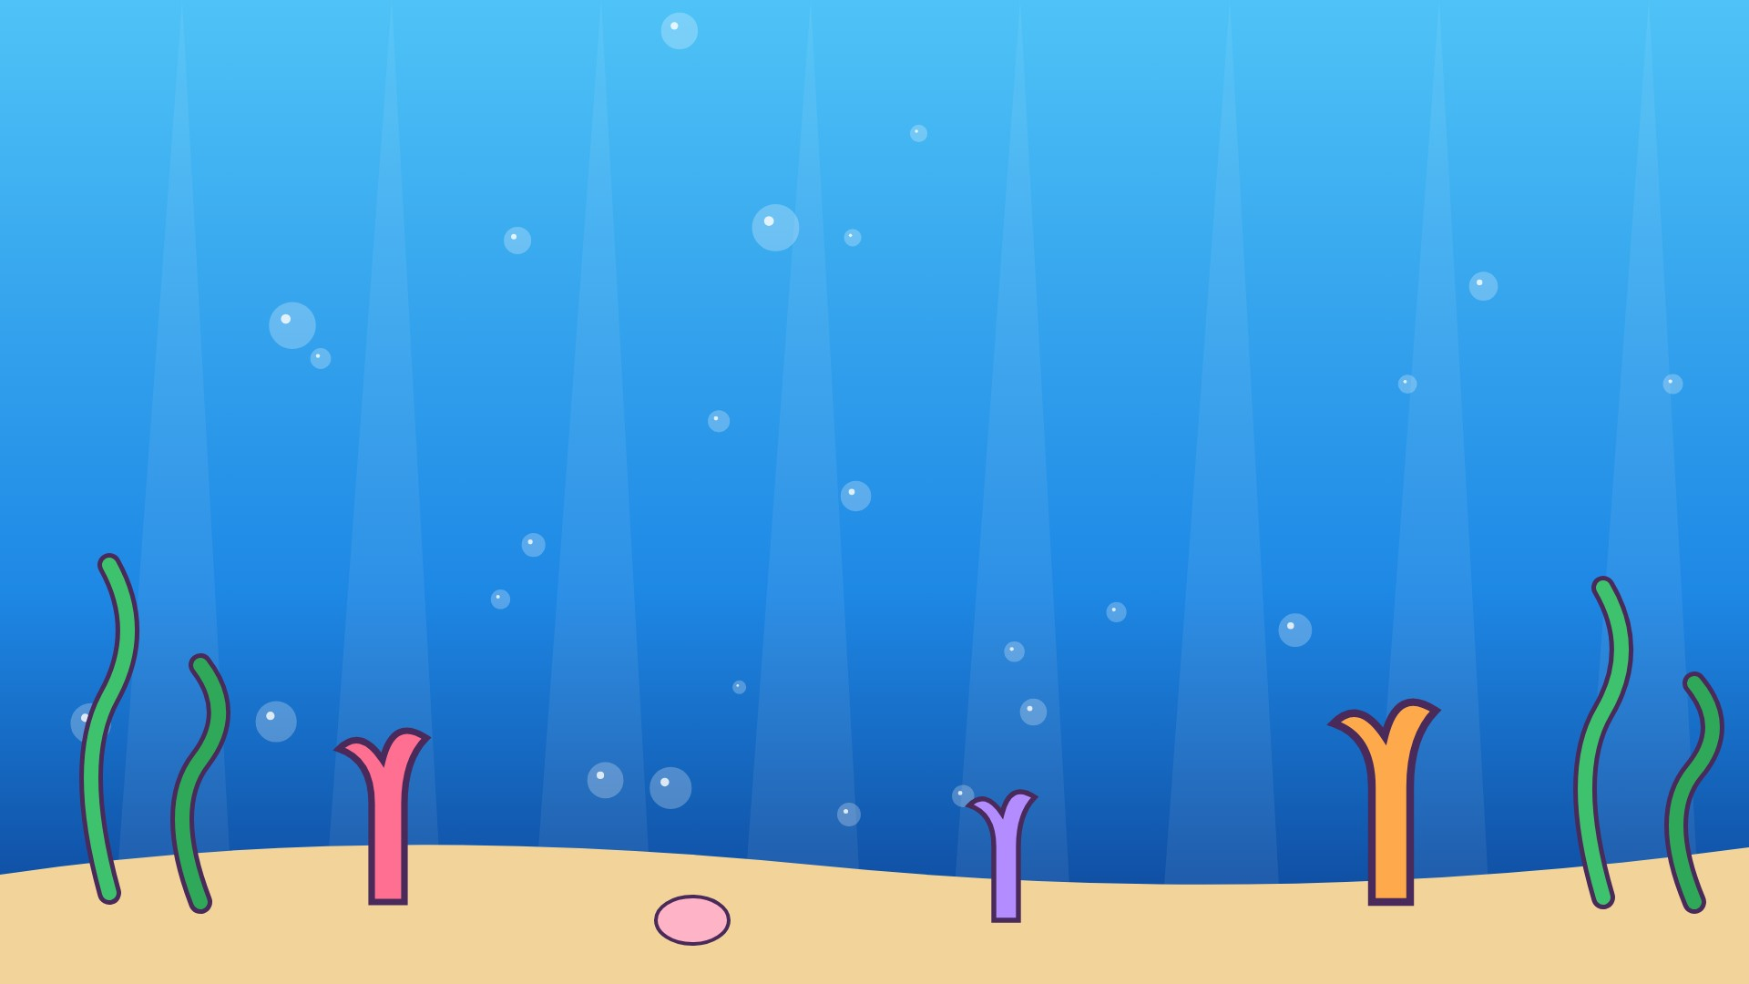
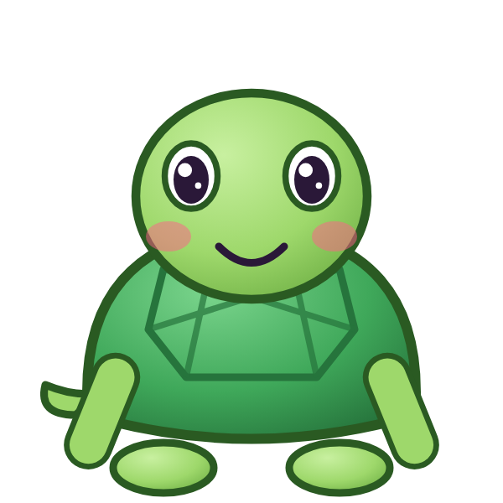



ن
نَ

Slide 2
نَأَ
أ
أَ
ن
نَ

Slide 3
نَبَ
ب
بَ
ن
نَ

Slide 4
نَتَ
ت
تَ
ن
نَ

Slide 5
نَثَ
ث
ثَ
ن
نَ

Slide 6
نَجَ
ج
جَ
ن
نَ

Slide 7
نَحَ
ح
حَ
ن
نَ

Slide 8
نَخَ
خ
خَ
ن
نَ

Slide 9

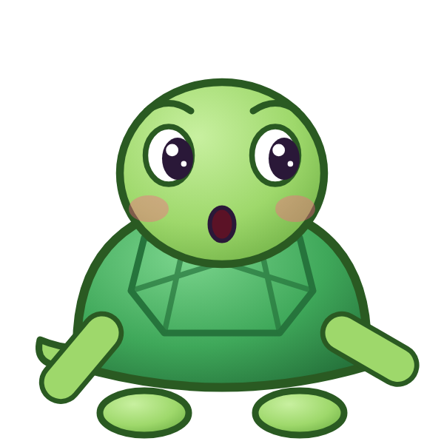

؟
خَ
نَ
نَجَ
نَخَ
خَنَ
Notes:
GAME TIME: ask the child to read the equation, then tap the animal holding the answer they think is right. Right answer = celebration slide. Wrong answer = a hidden try-again slide; tap the green button to try again.

Slide 10


نَخَ

Slide 11

Notes:
Hidden try-again slide: only shown after a wrong answer. Tap the green button to go back to the question.

Slide 12
نَدَ
د
دَ
ن
نَ

Slide 13
نَذَ
ذ
ذَ
ن
نَ

Slide 14
نَرَ
ر
رَ
ن
نَ

Slide 15
نَزَ
ز
زَ
ن
نَ

Slide 16
نَسَ
س
سَ
ن
نَ

Slide 17
نَشَ
ش
شَ
ن
نَ

Slide 18
نَصَ
ص
صَ
ن
نَ

Slide 19
نَضَ
ض
ضَ
ن
نَ

Slide 20
؟
ضَ
نَ
نَضَ
يَضَ
ضَنَ
Notes:
GAME TIME: ask the child to read the equation, then tap the animal holding the answer they think is right. Right answer = celebration slide. Wrong answer = a hidden try-again slide; tap the green button to try again.

Slide 21
نَضَ

Slide 22
Notes:
Hidden try-again slide: only shown after a wrong answer. Tap the green button to go back to the question.

Slide 23
نَطَ
ط
طَ
ن
نَ

Slide 24
نَظَ
ظ
ظَ
ن
نَ

Slide 25
نَعَ
ع
عَ
ن
نَ

Slide 26
نَغَ
غ
غَ
ن
نَ

Slide 27
نَفَ
ف
فَ
ن
نَ

Slide 28
نَقَ
ق
قَ
ن
نَ

Slide 29
نَكَ
ك
كَ
ن
نَ

Slide 30
نَلَ
ل
لَ
ن
نَ

Slide 31
؟
لَ
نَ
نَمَ
لَنَ
نَلَ
Notes:
GAME TIME: ask the child to read the equation, then tap the animal holding the answer they think is right. Right answer = celebration slide. Wrong answer = a hidden try-again slide; tap the green button to try again.

Slide 32
نَلَ

Slide 33
Notes:
Hidden try-again slide: only shown after a wrong answer. Tap the green button to go back to the question.

Slide 34
Notes:
Level up! Celebrate before the next set of letters.

Slide 35
نَمَ
م
مَ
ن
نَ

Slide 36
أَنَبَ
ب
بَ
ن
نَ
أ
أَ

Slide 37
بَنَتَ
ت
تَ
ن
نَ
ب
بَ

Slide 38
تَنَثَ
ث
ثَ
ن
نَ
ت
تَ

Slide 39
ثَنَجَ
ج
جَ
ن
نَ
ث
ثَ

Slide 40
جَنَحَ
ح
حَ
ن
نَ
ج
جَ

Slide 41
حَنَخَ
خ
خَ
ن
نَ
ح
حَ

Slide 42
خَنَدَ
د
دَ
ن
نَ
خ
خَ

Slide 43
؟
دَ
نَ
خَ
خَيَدَ
خَنَدَ
دَنَخَ
Notes:
GAME TIME: ask the child to read the equation, then tap the animal holding the answer they think is right. Right answer = celebration slide. Wrong answer = a hidden try-again slide; tap the green button to try again.

Slide 44
خَنَدَ

Slide 45
Notes:
Hidden try-again slide: only shown after a wrong answer. Tap the green button to go back to the question.

Slide 46
دَنَذَ
ذ
ذَ
ن
نَ
د
دَ

Slide 47
ذَنَرَ
ر
رَ
ن
نَ
ذ
ذَ

Slide 48
رَنَزَ
ز
زَ
ن
نَ
ر
رَ

Slide 49
زَنَسَ
س
سَ
ن
نَ
ز
زَ

Slide 50
سَنَشَ
ش
شَ
ن
نَ
س
سَ

Slide 51
شَنَصَ
ص
صَ
ن
نَ
ش
شَ

Slide 52
صَنَضَ
ض
ضَ
ن
نَ
ص
صَ

Slide 53
ضَنَطَ
ط
طَ
ن
نَ
ض
ضَ

Slide 54
؟
طَ
نَ
ضَ
ضَنَطَ
ضَنَظَ
طَنَضَ
Notes:
GAME TIME: ask the child to read the equation, then tap the animal holding the answer they think is right. Right answer = celebration slide. Wrong answer = a hidden try-again slide; tap the green button to try again.

Slide 55
ضَنَطَ

Slide 56
Notes:
Hidden try-again slide: only shown after a wrong answer. Tap the green button to go back to the question.

Slide 57
طَنَظَ
ظ
ظَ
ن
نَ
ط
طَ

Slide 58
ظَنَعَ
ع
عَ
ن
نَ
ظ
ظَ

Slide 59
عَنَغَ
غ
غَ
ن
نَ
ع
عَ

Slide 60
غَنَفَ
ف
فَ
ن
نَ
غ
غَ

Slide 61
فَنَقَ
ق
قَ
ن
نَ
ف
فَ

Slide 62
قَنَكَ
ك
كَ
ن
نَ
ق
قَ

Slide 63
كَنَلَ
ل
لَ
ن
نَ
ك
كَ

Slide 64
لَنَمَ
م
مَ
ن
نَ
ل
لَ

Slide 65
؟
مَ
نَ
لَ
مَنَمَ
مَنَلَ
لَنَمَ
Notes:
GAME TIME: ask the child to read the equation, then tap the animal holding the answer they think is right. Right answer = celebration slide. Wrong answer = a hidden try-again slide; tap the green button to try again.

Slide 66
لَنَمَ

Slide 67
Notes:
Hidden try-again slide: only shown after a wrong answer. Tap the green button to go back to the question.

Slide 68
Notes:
Level up! Celebrate before the next set of letters.

Slide 69
مَنَأَ
أ
أَ
ن
نَ
م
مَ

Slide 70
أَنَ
ن
نَ
أ
أَ

Slide 71
بَنَ
ن
نَ
ب
بَ

Slide 72
تَنَ
ن
نَ
ت
تَ

Slide 73
ثَنَ
ن
نَ
ث
ثَ

Slide 74
جَنَ
ن
نَ
ج
جَ

Slide 75
حَنَ
ن
نَ
ح
حَ

Slide 76
خَنَ
ن
نَ
خ
خَ

Slide 77
؟
نَ
خَ
خَيَ
خَنَ
نَخَ
Notes:
GAME TIME: ask the child to read the equation, then tap the animal holding the answer they think is right. Right answer = celebration slide. Wrong answer = a hidden try-again slide; tap the green button to try again.

Slide 78
خَنَ

Slide 79
Notes:
Hidden try-again slide: only shown after a wrong answer. Tap the green button to go back to the question.

Slide 80
دَنَ
ن
نَ
د
دَ

Slide 81
ذَنَ
ن
نَ
ذ
ذَ

Slide 82
رَنَ
ن
نَ
ر
رَ

Slide 83
زَنَ
ن
نَ
ز
زَ

Slide 84
سَنَ
ن
نَ
س
سَ

Slide 85
شَنَ
ن
نَ
ش
شَ

Slide 86
صَنَ
ن
نَ
ص
صَ

Slide 87
ضَنَ
ن
نَ
ض
ضَ

Slide 88
؟
نَ
ضَ
ضَنَ
صَنَ
نَضَ
Notes:
GAME TIME: ask the child to read the equation, then tap the animal holding the answer they think is right. Right answer = celebration slide. Wrong answer = a hidden try-again slide; tap the green button to try again.

Slide 89
ضَنَ

Slide 90
Notes:
Hidden try-again slide: only shown after a wrong answer. Tap the green button to go back to the question.

Slide 91
طَنَ
ن
نَ
ط
طَ

Slide 92
ظَنَ
ن
نَ
ظ
ظَ

Slide 93
عَنَ
ن
نَ
ع
عَ

Slide 94
غَنَ
ن
نَ
غ
غَ

Slide 95
فَنَ
ن
نَ
ف
فَ

Slide 96
قَنَ
ن
نَ
ق
قَ

Slide 97
كَنَ
ن
نَ
ك
كَ

Slide 98
لَنَ
ن
نَ
ل
لَ

Slide 99
؟
نَ
لَ
لَيَ
نَلَ
لَنَ
Notes:
GAME TIME: ask the child to read the equation, then tap the animal holding the answer they think is right. Right answer = celebration slide. Wrong answer = a hidden try-again slide; tap the green button to try again.

Slide 100
لَنَ

Slide 101
Notes:
Hidden try-again slide: only shown after a wrong answer. Tap the green button to go back to the question.

Slide 102
Notes:
Level up! Celebrate before the next set of letters.

Slide 103
مَنَ
ن
نَ
م
مَ

Slide 104
ي
يَ

Slide 105
يَأَ
أ
أَ
ي
يَ

Slide 106
يَبَ
ب
بَ
ي
يَ

Slide 107
يَتَ
ت
تَ
ي
يَ

Slide 108
يَثَ
ث
ثَ
ي
يَ

Slide 109
يَجَ
ج
جَ
ي
يَ

Slide 110
يَحَ
ح
حَ
ي
يَ

Slide 111
؟
حَ
يَ
نَحَ
يَحَ
حَيَ
Notes:
GAME TIME: ask the child to read the equation, then tap the animal holding the answer they think is right. Right answer = celebration slide. Wrong answer = a hidden try-again slide; tap the green button to try again.

Slide 112
يَحَ

Slide 113
Notes:
Hidden try-again slide: only shown after a wrong answer. Tap the green button to go back to the question.

Slide 114
يَخَ
خ
خَ
ي
يَ

Slide 115
يَدَ
د
دَ
ي
يَ

Slide 116
يَذَ
ذ
ذَ
ي
يَ

Slide 117
يَرَ
ر
رَ
ي
يَ

Slide 118
يَزَ
ز
زَ
ي
يَ

Slide 119
يَسَ
س
سَ
ي
يَ

Slide 120
يَشَ
ش
شَ
ي
يَ

Slide 121
يَصَ
ص
صَ
ي
يَ

Slide 122
؟
صَ
يَ
يَصَ
يَضَ
صَيَ
Notes:
GAME TIME: ask the child to read the equation, then tap the animal holding the answer they think is right. Right answer = celebration slide. Wrong answer = a hidden try-again slide; tap the green button to try again.

Slide 123
يَصَ

Slide 124
Notes:
Hidden try-again slide: only shown after a wrong answer. Tap the green button to go back to the question.

Slide 125
يَضَ
ض
ضَ
ي
يَ

Slide 126
يَطَ
ط
طَ
ي
يَ

Slide 127
يَظَ
ظ
ظَ
ي
يَ

Slide 128
يَعَ
ع
عَ
ي
يَ

Slide 129
يَغَ
غ
غَ
ي
يَ

Slide 130
يَفَ
ف
فَ
ي
يَ

Slide 131
يَقَ
ق
قَ
ي
يَ

Slide 132
يَكَ
ك
كَ
ي
يَ

Slide 133
؟
كَ
يَ
نَكَ
كَيَ
يَكَ
Notes:
GAME TIME: ask the child to read the equation, then tap the animal holding the answer they think is right. Right answer = celebration slide. Wrong answer = a hidden try-again slide; tap the green button to try again.

Slide 134
يَكَ

Slide 135
Notes:
Hidden try-again slide: only shown after a wrong answer. Tap the green button to go back to the question.

Slide 136
Notes:
Level up! Celebrate before the next set of letters.

Slide 137
يَلَ
ل
لَ
ي
يَ

Slide 138
يَمَ
م
مَ
ي
يَ

Slide 139
يَنَ
ن
نَ
ي
يَ

Slide 140
يَهَ
ه
هَ
ي
يَ

Slide 141
يَوَ
و
وَ
ي
يَ

Slide 142
أَيَبَ
ب
بَ
ي
يَ
أ
أَ

Slide 143
بَيَتَ
ت
تَ
ي
يَ
ب
بَ

Slide 144
تَيَثَ
ث
ثَ
ي
يَ
ت
تَ

Slide 145
؟
ثَ
يَ
تَ
تَنَثَ
تَيَثَ
ثَيَتَ
Notes:
GAME TIME: ask the child to read the equation, then tap the animal holding the answer they think is right. Right answer = celebration slide. Wrong answer = a hidden try-again slide; tap the green button to try again.

Slide 146
تَيَثَ

Slide 147
Notes:
Hidden try-again slide: only shown after a wrong answer. Tap the green button to go back to the question.

Slide 148
ثَيَجَ
ج
جَ
ي
يَ
ث
ثَ

Slide 149
جَيَحَ
ح
حَ
ي
يَ
ج
جَ

Slide 150
حَيَخَ
خ
خَ
ي
يَ
ح
حَ

Slide 151
خَيَدَ
د
دَ
ي
يَ
خ
خَ

Slide 152
دَيَذَ
ذ
ذَ
ي
يَ
د
دَ

Slide 153
ذَيَرَ
ر
رَ
ي
يَ
ذ
ذَ

Slide 154
رَيَزَ
ز
زَ
ي
يَ
ر
رَ

Slide 155
زَيَسَ
س
سَ
ي
يَ
ز
زَ

Slide 156
؟
سَ
يَ
زَ
زَيَسَ
زَيَشَ
سَيَزَ
Notes:
GAME TIME: ask the child to read the equation, then tap the animal holding the answer they think is right. Right answer = celebration slide. Wrong answer = a hidden try-again slide; tap the green button to try again.

Slide 157
زَيَسَ

Slide 158
Notes:
Hidden try-again slide: only shown after a wrong answer. Tap the green button to go back to the question.

Slide 159
سَيَشَ
ش
شَ
ي
يَ
س
سَ

Slide 160
شَيَصَ
ص
صَ
ي
يَ
ش
شَ

Slide 161
صَيَضَ
ض
ضَ
ي
يَ
ص
صَ

Slide 162
ضَيَطَ
ط
طَ
ي
يَ
ض
ضَ

Slide 163
طَيَظَ
ظ
ظَ
ي
يَ
ط
طَ

Slide 164
ظَيَعَ
ع
عَ
ي
يَ
ظ
ظَ

Slide 165
عَيَغَ
غ
غَ
ي
يَ
ع
عَ

Slide 166
غَيَفَ
ف
فَ
ي
يَ
غ
غَ

Slide 167
؟
فَ
يَ
غَ
عَيَفَ
فَيَغَ
غَيَفَ
Notes:
GAME TIME: ask the child to read the equation, then tap the animal holding the answer they think is right. Right answer = celebration slide. Wrong answer = a hidden try-again slide; tap the green button to try again.

Slide 168
غَيَفَ

Slide 169
Notes:
Hidden try-again slide: only shown after a wrong answer. Tap the green button to go back to the question.

Slide 170
Notes:
Level up! Celebrate before the next set of letters.

Slide 171
فَيَقَ
ق
قَ
ي
يَ
ف
فَ

Slide 172
قَيَكَ
ك
كَ
ي
يَ
ق
قَ

Slide 173
كَيَلَ
ل
لَ
ي
يَ
ك
كَ

Slide 174
لَيَمَ
م
مَ
ي
يَ
ل
لَ

Slide 175
مَيَنَ
ن
نَ
ي
يَ
م
مَ

Slide 176
نَيَهَ
ه
هَ
ي
يَ
ن
نَ

Slide 177
هَيَوَ
و
وَ
ي
يَ
ه
هَ

Slide 178
وَيَأَ
أ
أَ
ي
يَ
و
وَ

Slide 179
؟
أَ
يَ
وَ
وَنَأَ
وَيَأَ
أَيَوَ
Notes:
GAME TIME: ask the child to read the equation, then tap the animal holding the answer they think is right. Right answer = celebration slide. Wrong answer = a hidden try-again slide; tap the green button to try again.

Slide 180
وَيَأَ

Slide 181
Notes:
Hidden try-again slide: only shown after a wrong answer. Tap the green button to go back to the question.

Slide 182
أَيَ
ي
يَ
أ
أَ

Slide 183
بَيَ
ي
يَ
ب
بَ

Slide 184
تَيَ
ي
يَ
ت
تَ

Slide 185
ثَيَ
ي
يَ
ث
ثَ

Slide 186
جَيَ
ي
يَ
ج
جَ

Slide 187
حَيَ
ي
يَ
ح
حَ

Slide 188
خَيَ
ي
يَ
خ
خَ

Slide 189
دَيَ
ي
يَ
د
دَ

Slide 190
؟
يَ
دَ
دَيَ
دَنَ
يَدَ
Notes:
GAME TIME: ask the child to read the equation, then tap the animal holding the answer they think is right. Right answer = celebration slide. Wrong answer = a hidden try-again slide; tap the green button to try again.

Slide 191
دَيَ

Slide 192
Notes:
Hidden try-again slide: only shown after a wrong answer. Tap the green button to go back to the question.

Slide 193
ذَيَ
ي
يَ
ذ
ذَ

Slide 194
رَيَ
ي
يَ
ر
رَ

Slide 195
زَيَ
ي
يَ
ز
زَ

Slide 196
سَيَ
ي
يَ
س
سَ

Slide 197
شَيَ
ي
يَ
ش
شَ

Slide 198
صَيَ
ي
يَ
ص
صَ

Slide 199
ضَيَ
ي
يَ
ض
ضَ

Slide 200
طَيَ
ي
يَ
ط
طَ

Slide 201
؟
يَ
طَ
ظَيَ
يَطَ
طَيَ
Notes:
GAME TIME: ask the child to read the equation, then tap the animal holding the answer they think is right. Right answer = celebration slide. Wrong answer = a hidden try-again slide; tap the green button to try again.

Slide 202
طَيَ

Slide 203
Notes:
Hidden try-again slide: only shown after a wrong answer. Tap the green button to go back to the question.

Slide 204
Notes:
Level up! Celebrate before the next set of letters.

Slide 205
ظَيَ
ي
يَ
ظ
ظَ

Slide 206
عَيَ
ي
يَ
ع
عَ

Slide 207
غَيَ
ي
يَ
غ
غَ

Slide 208
فَيَ
ي
يَ
ف
فَ

Slide 209
قَيَ
ي
يَ
ق
قَ

Slide 210
كَيَ
ي
يَ
ك
كَ

Slide 211
لَيَ
ي
يَ
ل
لَ

Slide 212
مَيَ
ي
يَ
م
مَ

Slide 213
؟
يَ
مَ
مَنَ
مَيَ
يَمَ
Notes:
GAME TIME: ask the child to read the equation, then tap the animal holding the answer they think is right. Right answer = celebration slide. Wrong answer = a hidden try-again slide; tap the green button to try again.

Slide 214
مَيَ

Slide 215
Notes:
Hidden try-again slide: only shown after a wrong answer. Tap the green button to go back to the question.

Slide 216
نَيَ
ي
يَ
ن
نَ

Slide 217
هَيَ
ي
يَ
ه
هَ

Slide 218
وَيَ
ي
يَ
و
وَ

Slide 219

Notes:
Finished! Give the child a big cheer.

