Slide 1
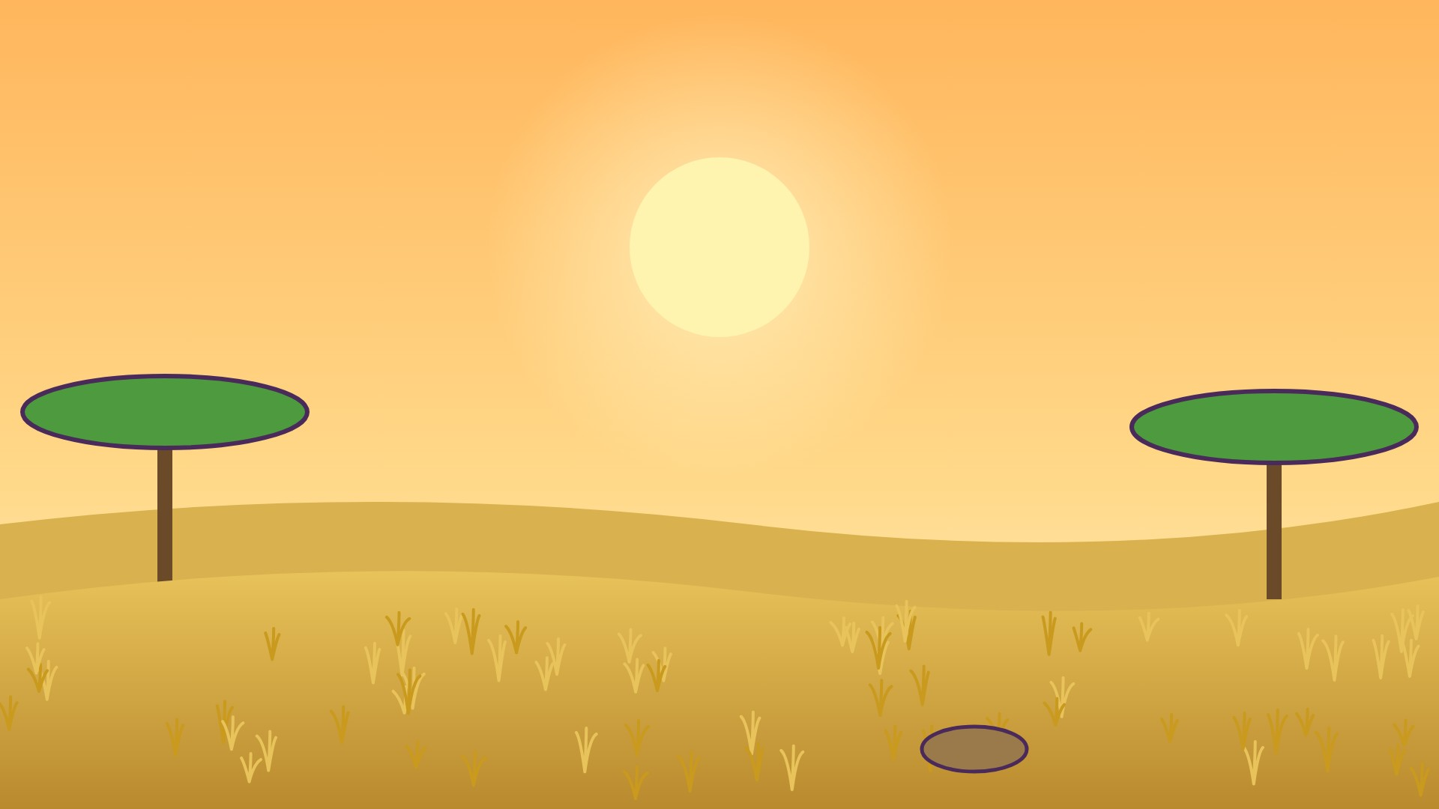



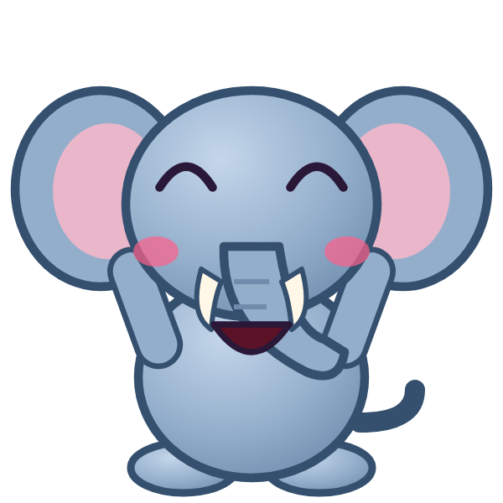
ج
جَ

Slide 2
جَأَ
أ
أَ
ج
جَ

Slide 3
جَبَ
ب
بَ
ج
جَ

Slide 4
جَتَ
ت
تَ
ج
جَ

Slide 5
جَثَ
ث
ثَ
ج
جَ

Slide 6
جَحَ
ح
حَ
ج
جَ

Slide 7
جَخَ
خ
خَ
ج
جَ

Slide 8
جَدَ
د
دَ
ج
جَ

Slide 9



؟
دَ
جَ
جَذَ
جَدَ
دَجَ
Notes:
GAME TIME: ask the child to read the equation, then tap the animal holding the answer they think is right. Right answer = celebration slide. Wrong answer = a hidden try-again slide; tap the green button to try again.

Slide 10


جَدَ

Slide 11
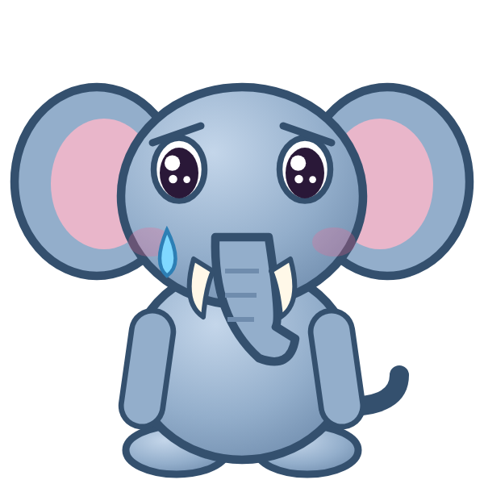
Notes:
Hidden try-again slide: only shown after a wrong answer. Tap the green button to go back to the question.

Slide 12
أَجَبَ
ب
بَ
ج
جَ
أ
أَ

Slide 13
بَجَتَ
ت
تَ
ج
جَ
ب
بَ

Slide 14
تَجَثَ
ث
ثَ
ج
جَ
ت
تَ

Slide 15
ثَجَحَ
ح
حَ
ج
جَ
ث
ثَ

Slide 16
حَجَخَ
خ
خَ
ج
جَ
ح
حَ

Slide 17
خَجَدَ
د
دَ
ج
جَ
خ
خَ

Slide 18
دَجَأَ
أ
أَ
ج
جَ
د
دَ

Slide 19
أَجَ
ج
جَ
أ
أَ

Slide 20
؟
جَ
أَ
أَجَ
بَجَ
جَأَ
Notes:
GAME TIME: ask the child to read the equation, then tap the animal holding the answer they think is right. Right answer = celebration slide. Wrong answer = a hidden try-again slide; tap the green button to try again.

Slide 21
أَجَ

Slide 22
Notes:
Hidden try-again slide: only shown after a wrong answer. Tap the green button to go back to the question.

Slide 23
بَجَ
ج
جَ
ب
بَ

Slide 24
تَجَ
ج
جَ
ت
تَ

Slide 25
ثَجَ
ج
جَ
ث
ثَ

Slide 26
حَجَ
ج
جَ
ح
حَ

Slide 27
خَجَ
ج
جَ
خ
خَ

Slide 28
دَجَ
ج
جَ
د
دَ

Slide 29
ح
حَ

Slide 30
حَأَ
أ
أَ
ح
حَ

Slide 31
؟
أَ
حَ
حَبَ
أَحَ
حَأَ
Notes:
GAME TIME: ask the child to read the equation, then tap the animal holding the answer they think is right. Right answer = celebration slide. Wrong answer = a hidden try-again slide; tap the green button to try again.

Slide 32
حَأَ

Slide 33
Notes:
Hidden try-again slide: only shown after a wrong answer. Tap the green button to go back to the question.

Slide 34
Notes:
Level up! Celebrate before the next set of letters.

Slide 35
حَبَ
ب
بَ
ح
حَ

Slide 36
حَتَ
ت
تَ
ح
حَ

Slide 37
حَثَ
ث
ثَ
ح
حَ

Slide 38
حَجَ
ج
جَ
ح
حَ

Slide 39
حَخَ
خ
خَ
ح
حَ

Slide 40
حَدَ
د
دَ
ح
حَ

Slide 41
أَحَبَ
ب
بَ
ح
حَ
أ
أَ

Slide 42
بَحَتَ
ت
تَ
ح
حَ
ب
بَ

Slide 43
؟
تَ
حَ
بَ
بَخَتَ
بَحَتَ
تَحَبَ
Notes:
GAME TIME: ask the child to read the equation, then tap the animal holding the answer they think is right. Right answer = celebration slide. Wrong answer = a hidden try-again slide; tap the green button to try again.

Slide 44
بَحَتَ

Slide 45
Notes:
Hidden try-again slide: only shown after a wrong answer. Tap the green button to go back to the question.

Slide 46
تَحَثَ
ث
ثَ
ح
حَ
ت
تَ

Slide 47
ثَحَجَ
ج
جَ
ح
حَ
ث
ثَ

Slide 48
جَحَخَ
خ
خَ
ح
حَ
ج
جَ

Slide 49
خَحَدَ
د
دَ
ح
حَ
خ
خَ

Slide 50
دَحَأَ
أ
أَ
ح
حَ
د
دَ

Slide 51
أَحَ
ح
حَ
أ
أَ

Slide 52
بَحَ
ح
حَ
ب
بَ

Slide 53
تَحَ
ح
حَ
ت
تَ

Slide 54
؟
حَ
تَ
تَحَ
تَخَ
حَتَ
Notes:
GAME TIME: ask the child to read the equation, then tap the animal holding the answer they think is right. Right answer = celebration slide. Wrong answer = a hidden try-again slide; tap the green button to try again.

Slide 55
تَحَ

Slide 56
Notes:
Hidden try-again slide: only shown after a wrong answer. Tap the green button to go back to the question.

Slide 57
ثَحَ
ح
حَ
ث
ثَ

Slide 58
جَحَ
ح
حَ
ج
جَ

Slide 59
خَحَ
ح
حَ
خ
خَ

Slide 60
دَحَ
ح
حَ
د
دَ

Slide 61
خ
خَ

Slide 62
خَأَ
أ
أَ
خ
خَ

Slide 63
خَبَ
ب
بَ
خ
خَ

Slide 64
خَتَ
ت
تَ
خ
خَ

Slide 65
؟
تَ
خَ
جَتَ
تَخَ
خَتَ
Notes:
GAME TIME: ask the child to read the equation, then tap the animal holding the answer they think is right. Right answer = celebration slide. Wrong answer = a hidden try-again slide; tap the green button to try again.

Slide 66
خَتَ

Slide 67
Notes:
Hidden try-again slide: only shown after a wrong answer. Tap the green button to go back to the question.

Slide 68
Notes:
Level up! Celebrate before the next set of letters.

Slide 69
خَثَ
ث
ثَ
خ
خَ

Slide 70
خَجَ
ج
جَ
خ
خَ

Slide 71
خَحَ
ح
حَ
خ
خَ

Slide 72
خَدَ
د
دَ
خ
خَ

Slide 73
أَخَبَ
ب
بَ
خ
خَ
أ
أَ

Slide 74
بَخَتَ
ت
تَ
خ
خَ
ب
بَ

Slide 75
تَخَثَ
ث
ثَ
خ
خَ
ت
تَ

Slide 76
ثَخَجَ
ج
جَ
خ
خَ
ث
ثَ

Slide 77
؟
جَ
خَ
ثَ
ثَجَجَ
ثَخَجَ
جَخَثَ
Notes:
GAME TIME: ask the child to read the equation, then tap the animal holding the answer they think is right. Right answer = celebration slide. Wrong answer = a hidden try-again slide; tap the green button to try again.

Slide 78
ثَخَجَ

Slide 79
Notes:
Hidden try-again slide: only shown after a wrong answer. Tap the green button to go back to the question.

Slide 80
جَخَحَ
ح
حَ
خ
خَ
ج
جَ

Slide 81
حَخَدَ
د
دَ
خ
خَ
ح
حَ

Slide 82
دَخَأَ
أ
أَ
خ
خَ
د
دَ

Slide 83
أَخَ
خ
خَ
أ
أَ

Slide 84
بَخَ
خ
خَ
ب
بَ

Slide 85
تَخَ
خ
خَ
ت
تَ

Slide 86
ثَخَ
خ
خَ
ث
ثَ

Slide 87
جَخَ
خ
خَ
ج
جَ

Slide 88
؟
خَ
جَ
جَخَ
حَخَ
خَجَ
Notes:
GAME TIME: ask the child to read the equation, then tap the animal holding the answer they think is right. Right answer = celebration slide. Wrong answer = a hidden try-again slide; tap the green button to try again.

Slide 89
جَخَ

Slide 90
Notes:
Hidden try-again slide: only shown after a wrong answer. Tap the green button to go back to the question.

Slide 91
حَخَ
خ
خَ
ح
حَ

Slide 92
دَخَ
خ
خَ
د
دَ

Slide 93

Notes:
Finished! Give the child a big cheer.

