Slide 1
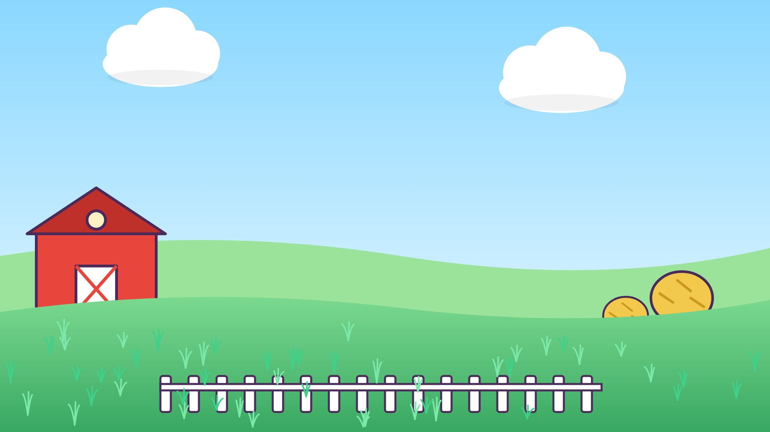




د
دَ

Slide 2
دَأَ
أ
أَ
د
دَ

Slide 3
دَبَ
ب
بَ
د
دَ

Slide 4
دَتَ
ت
تَ
د
دَ

Slide 5
دَثَ
ث
ثَ
د
دَ

Slide 6
دَجَ
ج
جَ
د
دَ

Slide 7
دَحَ
ح
حَ
د
دَ

Slide 8
دَخَ
خ
خَ
د
دَ

Slide 9
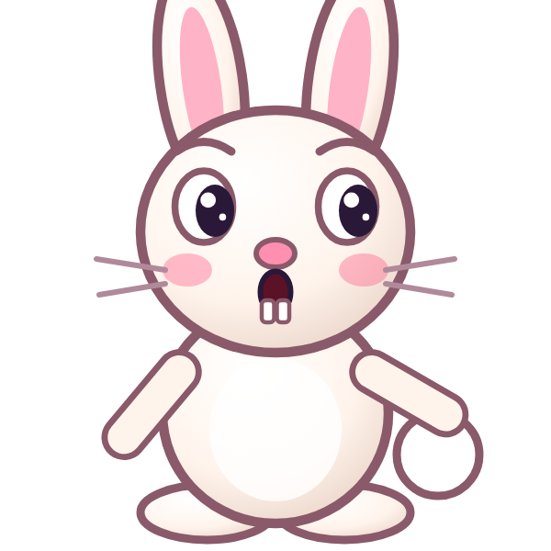


؟
خَ
دَ
دَجَ
دَخَ
خَدَ
Notes:
GAME TIME: ask the child to read the equation, then tap the animal holding the answer they think is right. Right answer = celebration slide. Wrong answer = a hidden try-again slide; tap the green button to try again.

Slide 10

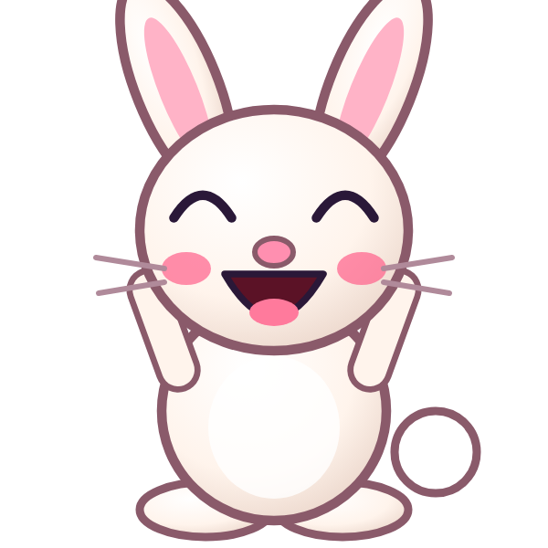
دَخَ

Slide 11

Notes:
Hidden try-again slide: only shown after a wrong answer. Tap the green button to go back to the question.

Slide 12
أَدَبَ
ب
بَ
د
دَ
أ
أَ

Slide 13
بَدَتَ
ت
تَ
د
دَ
ب
بَ

Slide 14
تَدَثَ
ث
ثَ
د
دَ
ت
تَ

Slide 15
ثَدَجَ
ج
جَ
د
دَ
ث
ثَ

Slide 16
جَدَحَ
ح
حَ
د
دَ
ج
جَ

Slide 17
حَدَخَ
خ
خَ
د
دَ
ح
حَ

Slide 18
خَدَأَ
أ
أَ
د
دَ
خ
خَ

Slide 19
أَدَ
د
دَ
أ
أَ

Slide 20
؟
دَ
أَ
أَدَ
بَدَ
دَأَ
Notes:
GAME TIME: ask the child to read the equation, then tap the animal holding the answer they think is right. Right answer = celebration slide. Wrong answer = a hidden try-again slide; tap the green button to try again.

Slide 21
أَدَ

Slide 22
Notes:
Hidden try-again slide: only shown after a wrong answer. Tap the green button to go back to the question.

Slide 23
بَدَ
د
دَ
ب
بَ

Slide 24
تَدَ
د
دَ
ت
تَ

Slide 25
ثَدَ
د
دَ
ث
ثَ

Slide 26
جَدَ
د
دَ
ج
جَ

Slide 27
حَدَ
د
دَ
ح
حَ

Slide 28
خَدَ
د
دَ
خ
خَ

Slide 29
ذ
ذَ

Slide 30
ذَأَ
أ
أَ
ذ
ذَ

Slide 31
؟
أَ
ذَ
ذَبَ
أَذَ
ذَأَ
Notes:
GAME TIME: ask the child to read the equation, then tap the animal holding the answer they think is right. Right answer = celebration slide. Wrong answer = a hidden try-again slide; tap the green button to try again.

Slide 32
ذَأَ

Slide 33
Notes:
Hidden try-again slide: only shown after a wrong answer. Tap the green button to go back to the question.

Slide 34
Notes:
Level up! Celebrate before the next set of letters.

Slide 35
ذَبَ
ب
بَ
ذ
ذَ

Slide 36
ذَتَ
ت
تَ
ذ
ذَ

Slide 37
ذَثَ
ث
ثَ
ذ
ذَ

Slide 38
ذَجَ
ج
جَ
ذ
ذَ

Slide 39
ذَحَ
ح
حَ
ذ
ذَ

Slide 40
ذَخَ
خ
خَ
ذ
ذَ

Slide 41
ذَدَ
د
دَ
ذ
ذَ

Slide 42
أَذَبَ
ب
بَ
ذ
ذَ
أ
أَ

Slide 43
؟
بَ
ذَ
أَ
أَدَبَ
أَذَبَ
بَذَأَ
Notes:
GAME TIME: ask the child to read the equation, then tap the animal holding the answer they think is right. Right answer = celebration slide. Wrong answer = a hidden try-again slide; tap the green button to try again.

Slide 44
أَذَبَ

Slide 45
Notes:
Hidden try-again slide: only shown after a wrong answer. Tap the green button to go back to the question.

Slide 46
بَذَتَ
ت
تَ
ذ
ذَ
ب
بَ

Slide 47
تَذَثَ
ث
ثَ
ذ
ذَ
ت
تَ

Slide 48
ثَذَجَ
ج
جَ
ذ
ذَ
ث
ثَ

Slide 49
جَذَحَ
ح
حَ
ذ
ذَ
ج
جَ

Slide 50
حَذَخَ
خ
خَ
ذ
ذَ
ح
حَ

Slide 51
خَذَدَ
د
دَ
ذ
ذَ
خ
خَ

Slide 52
دَذَأَ
أ
أَ
ذ
ذَ
د
دَ

Slide 53
أَذَ
ذ
ذَ
أ
أَ

Slide 54
؟
ذَ
أَ
أَذَ
أَدَ
ذَأَ
Notes:
GAME TIME: ask the child to read the equation, then tap the animal holding the answer they think is right. Right answer = celebration slide. Wrong answer = a hidden try-again slide; tap the green button to try again.

Slide 55
أَذَ

Slide 56
Notes:
Hidden try-again slide: only shown after a wrong answer. Tap the green button to go back to the question.

Slide 57
بَذَ
ذ
ذَ
ب
بَ

Slide 58
تَذَ
ذ
ذَ
ت
تَ

Slide 59
ثَذَ
ذ
ذَ
ث
ثَ

Slide 60
جَذَ
ذ
ذَ
ج
جَ

Slide 61
حَذَ
ذ
ذَ
ح
حَ

Slide 62
خَذَ
ذ
ذَ
خ
خَ

Slide 63
دَذَ
ذ
ذَ
د
دَ

Slide 64
Notes:
Finished! Give the child a big cheer.

