Slide 1
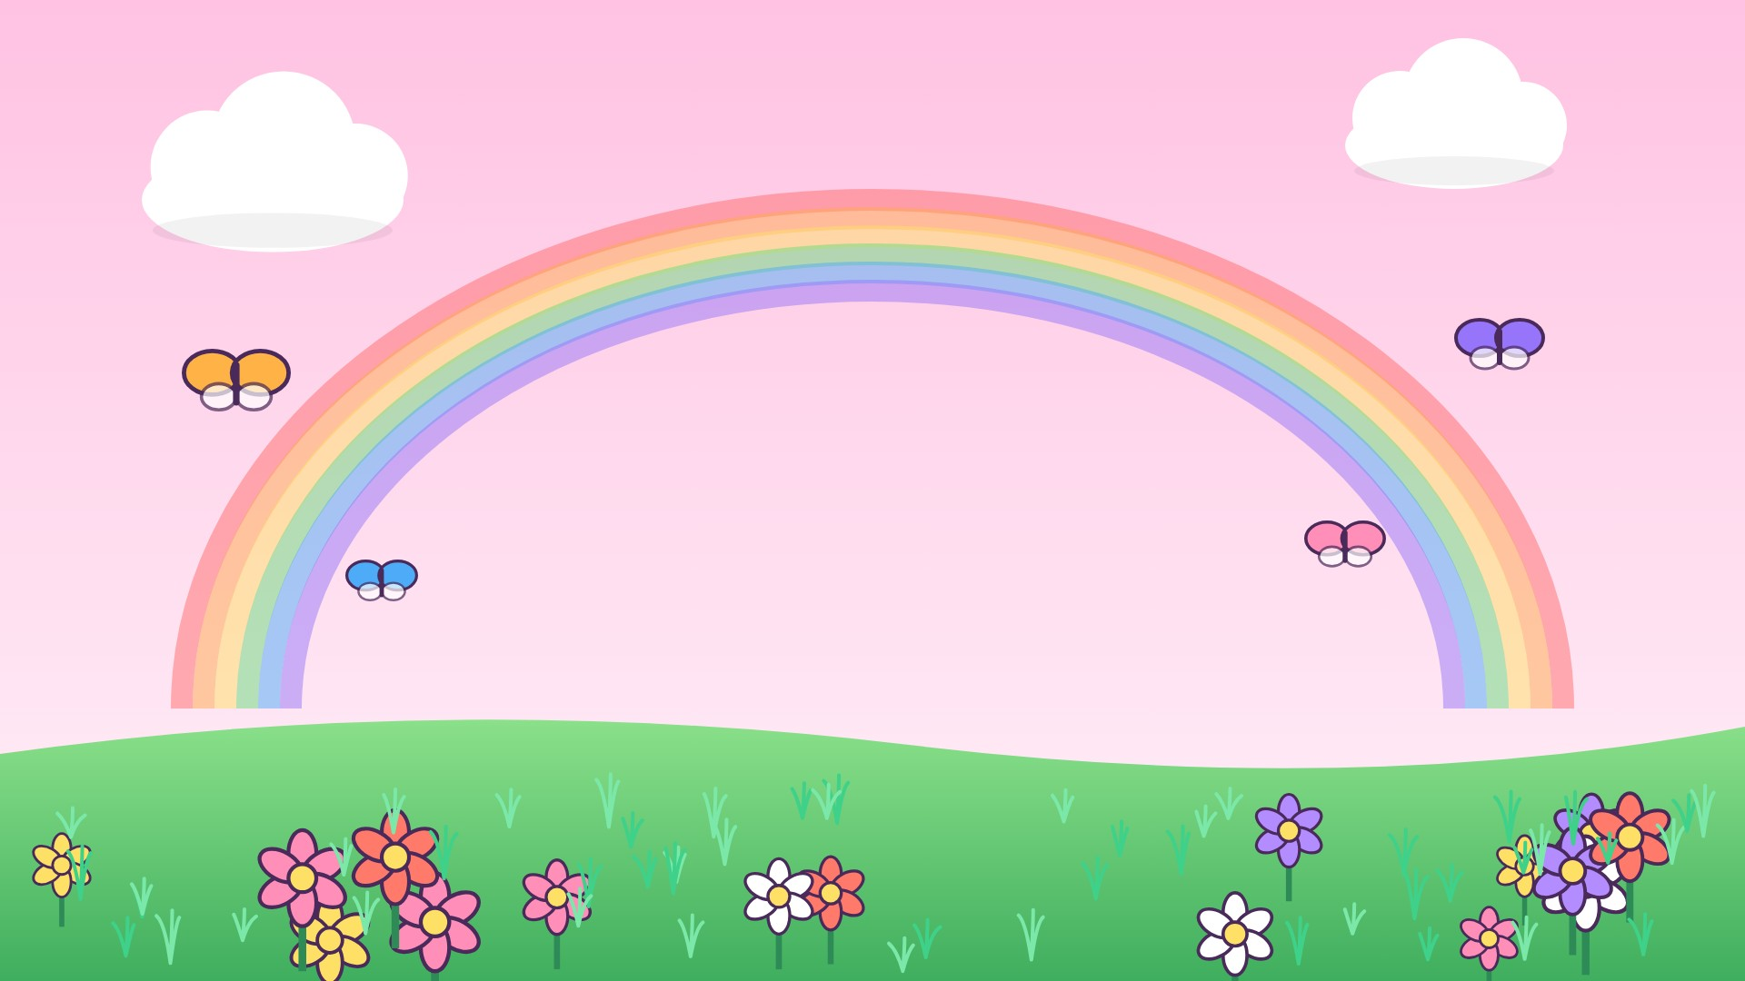
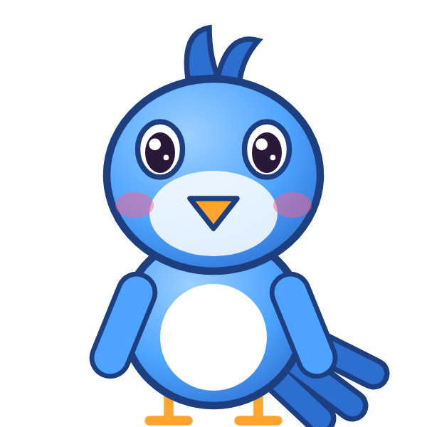

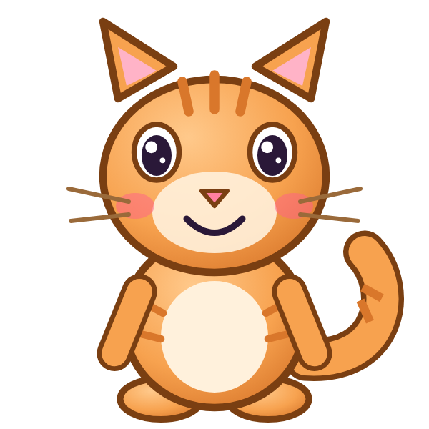
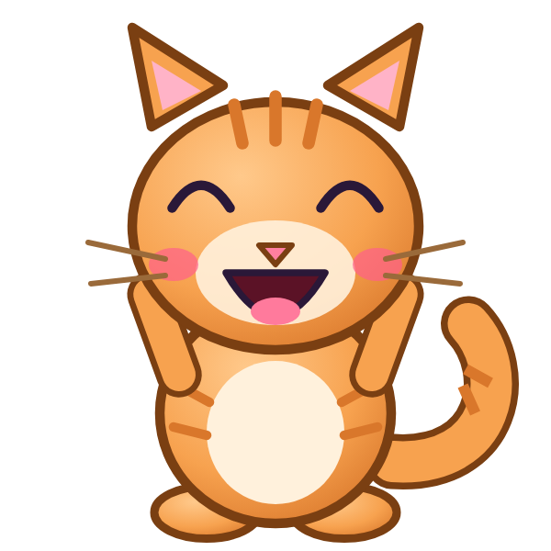
ر
رَ

Slide 2
رَأَ
أ
أَ
ر
رَ

Slide 3
رَبَ
ب
بَ
ر
رَ

Slide 4
رَتَ
ت
تَ
ر
رَ

Slide 5
رَثَ
ث
ثَ
ر
رَ

Slide 6
رَجَ
ج
جَ
ر
رَ

Slide 7
رَحَ
ح
حَ
ر
رَ

Slide 8
رَخَ
خ
خَ
ر
رَ

Slide 9

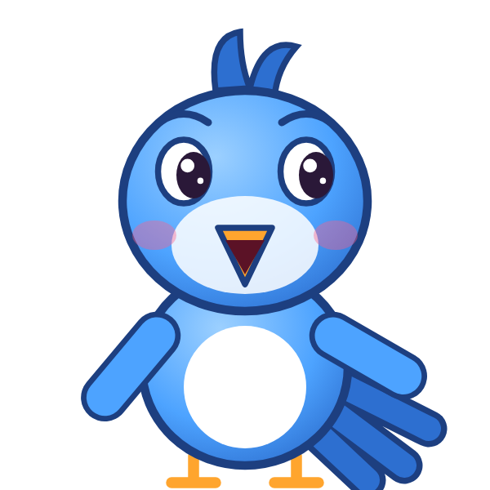
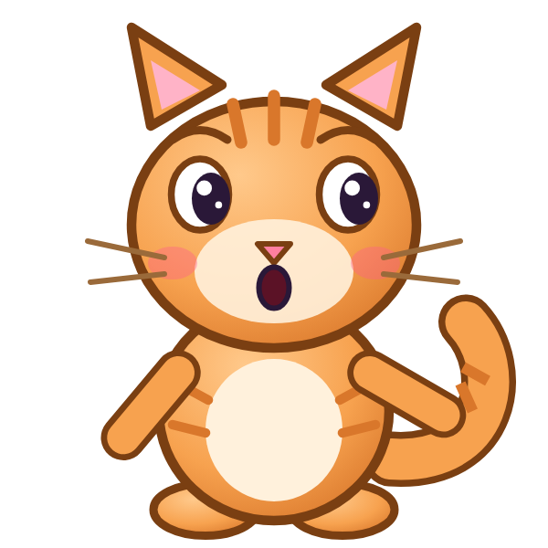
؟
خَ
رَ
رَجَ
رَخَ
خَرَ
Notes:
GAME TIME: ask the child to read the equation, then tap the animal holding the answer they think is right. Right answer = celebration slide. Wrong answer = a hidden try-again slide; tap the green button to try again.

Slide 10
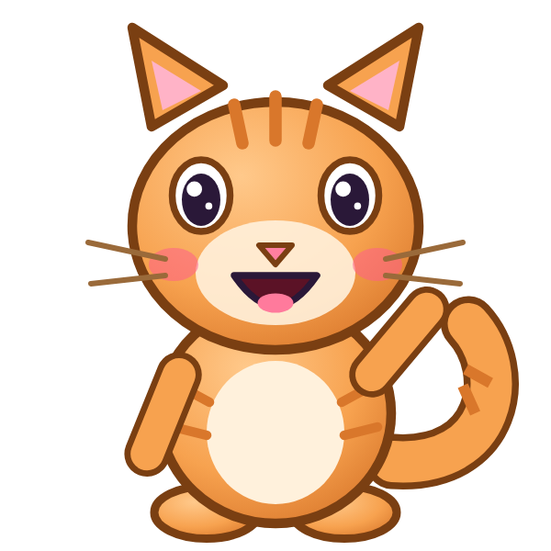

رَخَ

Slide 11

Notes:
Hidden try-again slide: only shown after a wrong answer. Tap the green button to go back to the question.

Slide 12
رَدَ
د
دَ
ر
رَ

Slide 13
رَذَ
ذ
ذَ
ر
رَ

Slide 14
أَرَبَ
ب
بَ
ر
رَ
أ
أَ

Slide 15
بَرَتَ
ت
تَ
ر
رَ
ب
بَ

Slide 16
تَرَثَ
ث
ثَ
ر
رَ
ت
تَ

Slide 17
ثَرَجَ
ج
جَ
ر
رَ
ث
ثَ

Slide 18
جَرَحَ
ح
حَ
ر
رَ
ج
جَ

Slide 19
حَرَخَ
خ
خَ
ر
رَ
ح
حَ

Slide 20
؟
خَ
رَ
حَ
حَرَخَ
حَرَجَ
خَرَحَ
Notes:
GAME TIME: ask the child to read the equation, then tap the animal holding the answer they think is right. Right answer = celebration slide. Wrong answer = a hidden try-again slide; tap the green button to try again.

Slide 21
حَرَخَ

Slide 22
Notes:
Hidden try-again slide: only shown after a wrong answer. Tap the green button to go back to the question.

Slide 23
خَرَدَ
د
دَ
ر
رَ
خ
خَ

Slide 24
دَرَذَ
ذ
ذَ
ر
رَ
د
دَ

Slide 25
ذَرَأَ
أ
أَ
ر
رَ
ذ
ذَ

Slide 26
أَرَ
ر
رَ
أ
أَ

Slide 27
بَرَ
ر
رَ
ب
بَ

Slide 28
تَرَ
ر
رَ
ت
تَ

Slide 29
ثَرَ
ر
رَ
ث
ثَ

Slide 30
جَرَ
ر
رَ
ج
جَ

Slide 31
؟
رَ
جَ
جَزَ
رَجَ
جَرَ
Notes:
GAME TIME: ask the child to read the equation, then tap the animal holding the answer they think is right. Right answer = celebration slide. Wrong answer = a hidden try-again slide; tap the green button to try again.

Slide 32
جَرَ

Slide 33
Notes:
Hidden try-again slide: only shown after a wrong answer. Tap the green button to go back to the question.

Slide 34
Notes:
Level up! Celebrate before the next set of letters.

Slide 35
حَرَ
ر
رَ
ح
حَ

Slide 36
خَرَ
ر
رَ
خ
خَ

Slide 37
دَرَ
ر
رَ
د
دَ

Slide 38
ذَرَ
ر
رَ
ذ
ذَ

Slide 39
ز
زَ

Slide 40
زَأَ
أ
أَ
ز
زَ

Slide 41
زَبَ
ب
بَ
ز
زَ

Slide 42
زَتَ
ت
تَ
ز
زَ

Slide 43
؟
تَ
زَ
رَتَ
زَتَ
تَزَ
Notes:
GAME TIME: ask the child to read the equation, then tap the animal holding the answer they think is right. Right answer = celebration slide. Wrong answer = a hidden try-again slide; tap the green button to try again.

Slide 44
زَتَ

Slide 45
Notes:
Hidden try-again slide: only shown after a wrong answer. Tap the green button to go back to the question.

Slide 46
زَثَ
ث
ثَ
ز
زَ

Slide 47
زَجَ
ج
جَ
ز
زَ

Slide 48
زَحَ
ح
حَ
ز
زَ

Slide 49
زَخَ
خ
خَ
ز
زَ

Slide 50
زَدَ
د
دَ
ز
زَ

Slide 51
زَذَ
ذ
ذَ
ز
زَ

Slide 52
زَرَ
ر
رَ
ز
زَ

Slide 53
أَزَبَ
ب
بَ
ز
زَ
أ
أَ

Slide 54
؟
بَ
زَ
أَ
أَزَبَ
أَزَتَ
بَزَأَ
Notes:
GAME TIME: ask the child to read the equation, then tap the animal holding the answer they think is right. Right answer = celebration slide. Wrong answer = a hidden try-again slide; tap the green button to try again.

Slide 55
أَزَبَ

Slide 56
Notes:
Hidden try-again slide: only shown after a wrong answer. Tap the green button to go back to the question.

Slide 57
بَزَتَ
ت
تَ
ز
زَ
ب
بَ

Slide 58
تَزَثَ
ث
ثَ
ز
زَ
ت
تَ

Slide 59
ثَزَجَ
ج
جَ
ز
زَ
ث
ثَ

Slide 60
جَزَحَ
ح
حَ
ز
زَ
ج
جَ

Slide 61
حَزَخَ
خ
خَ
ز
زَ
ح
حَ

Slide 62
خَزَدَ
د
دَ
ز
زَ
خ
خَ

Slide 63
دَزَذَ
ذ
ذَ
ز
زَ
د
دَ

Slide 64
ذَزَرَ
ر
رَ
ز
زَ
ذ
ذَ

Slide 65
؟
رَ
زَ
ذَ
دَزَرَ
رَزَذَ
ذَزَرَ
Notes:
GAME TIME: ask the child to read the equation, then tap the animal holding the answer they think is right. Right answer = celebration slide. Wrong answer = a hidden try-again slide; tap the green button to try again.

Slide 66
ذَزَرَ

Slide 67
Notes:
Hidden try-again slide: only shown after a wrong answer. Tap the green button to go back to the question.

Slide 68
Notes:
Level up! Celebrate before the next set of letters.

Slide 69
رَزَأَ
أ
أَ
ز
زَ
ر
رَ

Slide 70
أَزَ
ز
زَ
أ
أَ

Slide 71
بَزَ
ز
زَ
ب
بَ

Slide 72
تَزَ
ز
زَ
ت
تَ

Slide 73
ثَزَ
ز
زَ
ث
ثَ

Slide 74
جَزَ
ز
زَ
ج
جَ

Slide 75
حَزَ
ز
زَ
ح
حَ

Slide 76
خَزَ
ز
زَ
خ
خَ

Slide 77
؟
زَ
خَ
خَرَ
خَزَ
زَخَ
Notes:
GAME TIME: ask the child to read the equation, then tap the animal holding the answer they think is right. Right answer = celebration slide. Wrong answer = a hidden try-again slide; tap the green button to try again.

Slide 78
خَزَ

Slide 79
Notes:
Hidden try-again slide: only shown after a wrong answer. Tap the green button to go back to the question.

Slide 80
دَزَ
ز
زَ
د
دَ

Slide 81
ذَزَ
ز
زَ
ذ
ذَ

Slide 82
رَزَ
ز
زَ
ر
رَ

Slide 83
Notes:
Finished! Give the child a big cheer.

