Slide 1





س
سَ

Slide 2
سَأَ
أ
أَ
س
سَ

Slide 3
سَبَ
ب
بَ
س
سَ

Slide 4
سَتَ
ت
تَ
س
سَ

Slide 5
سَثَ
ث
ثَ
س
سَ

Slide 6
سَجَ
ج
جَ
س
سَ

Slide 7
سَحَ
ح
حَ
س
سَ

Slide 8
سَخَ
خ
خَ
س
سَ

Slide 9
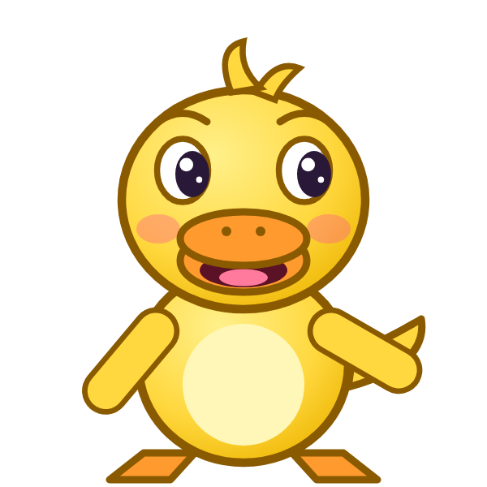


؟
خَ
سَ
سَجَ
سَخَ
خَسَ
Notes:
GAME TIME: ask the child to read the equation, then tap the animal holding the answer they think is right. Right answer = celebration slide. Wrong answer = a hidden try-again slide; tap the green button to try again.

Slide 10


سَخَ

Slide 11

Notes:
Hidden try-again slide: only shown after a wrong answer. Tap the green button to go back to the question.

Slide 12
سَدَ
د
دَ
س
سَ

Slide 13
سَذَ
ذ
ذَ
س
سَ

Slide 14
سَرَ
ر
رَ
س
سَ

Slide 15
سَزَ
ز
زَ
س
سَ

Slide 16
أَسَبَ
ب
بَ
س
سَ
أ
أَ

Slide 17
بَسَتَ
ت
تَ
س
سَ
ب
بَ

Slide 18
تَسَثَ
ث
ثَ
س
سَ
ت
تَ

Slide 19
ثَسَجَ
ج
جَ
س
سَ
ث
ثَ

Slide 20
؟
جَ
سَ
ثَ
ثَسَجَ
ثَسَحَ
جَسَثَ
Notes:
GAME TIME: ask the child to read the equation, then tap the animal holding the answer they think is right. Right answer = celebration slide. Wrong answer = a hidden try-again slide; tap the green button to try again.

Slide 21
ثَسَجَ

Slide 22
Notes:
Hidden try-again slide: only shown after a wrong answer. Tap the green button to go back to the question.

Slide 23
جَسَحَ
ح
حَ
س
سَ
ج
جَ

Slide 24
حَسَخَ
خ
خَ
س
سَ
ح
حَ

Slide 25
خَسَدَ
د
دَ
س
سَ
خ
خَ

Slide 26
دَسَذَ
ذ
ذَ
س
سَ
د
دَ

Slide 27
ذَسَرَ
ر
رَ
س
سَ
ذ
ذَ

Slide 28
رَسَزَ
ز
زَ
س
سَ
ر
رَ

Slide 29
زَسَأَ
أ
أَ
س
سَ
ز
زَ

Slide 30
أَسَ
س
سَ
أ
أَ

Slide 31
؟
سَ
أَ
أَشَ
سَأَ
أَسَ
Notes:
GAME TIME: ask the child to read the equation, then tap the animal holding the answer they think is right. Right answer = celebration slide. Wrong answer = a hidden try-again slide; tap the green button to try again.

Slide 32
أَسَ

Slide 33
Notes:
Hidden try-again slide: only shown after a wrong answer. Tap the green button to go back to the question.

Slide 34
Notes:
Level up! Celebrate before the next set of letters.

Slide 35
بَسَ
س
سَ
ب
بَ

Slide 36
تَسَ
س
سَ
ت
تَ

Slide 37
ثَسَ
س
سَ
ث
ثَ

Slide 38
جَسَ
س
سَ
ج
جَ

Slide 39
حَسَ
س
سَ
ح
حَ

Slide 40
خَسَ
س
سَ
خ
خَ

Slide 41
دَسَ
س
سَ
د
دَ

Slide 42
ذَسَ
س
سَ
ذ
ذَ

Slide 43
؟
سَ
ذَ
دَسَ
ذَسَ
سَذَ
Notes:
GAME TIME: ask the child to read the equation, then tap the animal holding the answer they think is right. Right answer = celebration slide. Wrong answer = a hidden try-again slide; tap the green button to try again.

Slide 44
ذَسَ

Slide 45
Notes:
Hidden try-again slide: only shown after a wrong answer. Tap the green button to go back to the question.

Slide 46
رَسَ
س
سَ
ر
رَ

Slide 47
زَسَ
س
سَ
ز
زَ

Slide 48
ش
شَ

Slide 49
شَأَ
أ
أَ
ش
شَ

Slide 50
شَبَ
ب
بَ
ش
شَ

Slide 51
شَتَ
ت
تَ
ش
شَ

Slide 52
شَثَ
ث
ثَ
ش
شَ

Slide 53
شَجَ
ج
جَ
ش
شَ

Slide 54
؟
جَ
شَ
شَجَ
شَحَ
جَشَ
Notes:
GAME TIME: ask the child to read the equation, then tap the animal holding the answer they think is right. Right answer = celebration slide. Wrong answer = a hidden try-again slide; tap the green button to try again.

Slide 55
شَجَ

Slide 56
Notes:
Hidden try-again slide: only shown after a wrong answer. Tap the green button to go back to the question.

Slide 57
شَحَ
ح
حَ
ش
شَ

Slide 58
شَخَ
خ
خَ
ش
شَ

Slide 59
شَدَ
د
دَ
ش
شَ

Slide 60
شَذَ
ذ
ذَ
ش
شَ

Slide 61
شَرَ
ر
رَ
ش
شَ

Slide 62
شَزَ
ز
زَ
ش
شَ

Slide 63
شَسَ
س
سَ
ش
شَ

Slide 64
أَشَبَ
ب
بَ
ش
شَ
أ
أَ

Slide 65
؟
بَ
شَ
أَ
بَشَبَ
بَشَأَ
أَشَبَ
Notes:
GAME TIME: ask the child to read the equation, then tap the animal holding the answer they think is right. Right answer = celebration slide. Wrong answer = a hidden try-again slide; tap the green button to try again.

Slide 66
أَشَبَ

Slide 67
Notes:
Hidden try-again slide: only shown after a wrong answer. Tap the green button to go back to the question.

Slide 68
Notes:
Level up! Celebrate before the next set of letters.

Slide 69
بَشَتَ
ت
تَ
ش
شَ
ب
بَ

Slide 70
تَشَثَ
ث
ثَ
ش
شَ
ت
تَ

Slide 71
ثَشَجَ
ج
جَ
ش
شَ
ث
ثَ

Slide 72
جَشَحَ
ح
حَ
ش
شَ
ج
جَ

Slide 73
حَشَخَ
خ
خَ
ش
شَ
ح
حَ

Slide 74
خَشَدَ
د
دَ
ش
شَ
خ
خَ

Slide 75
دَشَذَ
ذ
ذَ
ش
شَ
د
دَ

Slide 76
ذَشَرَ
ر
رَ
ش
شَ
ذ
ذَ

Slide 77
؟
رَ
شَ
ذَ
ذَسَرَ
ذَشَرَ
رَشَذَ
Notes:
GAME TIME: ask the child to read the equation, then tap the animal holding the answer they think is right. Right answer = celebration slide. Wrong answer = a hidden try-again slide; tap the green button to try again.

Slide 78
ذَشَرَ

Slide 79
Notes:
Hidden try-again slide: only shown after a wrong answer. Tap the green button to go back to the question.

Slide 80
رَشَزَ
ز
زَ
ش
شَ
ر
رَ

Slide 81
زَشَسَ
س
سَ
ش
شَ
ز
زَ

Slide 82
سَشَأَ
أ
أَ
ش
شَ
س
سَ

Slide 83
أَشَ
ش
شَ
أ
أَ

Slide 84
بَشَ
ش
شَ
ب
بَ

Slide 85
تَشَ
ش
شَ
ت
تَ

Slide 86
ثَشَ
ش
شَ
ث
ثَ

Slide 87
جَشَ
ش
شَ
ج
جَ

Slide 88
؟
شَ
جَ
جَشَ
حَشَ
شَجَ
Notes:
GAME TIME: ask the child to read the equation, then tap the animal holding the answer they think is right. Right answer = celebration slide. Wrong answer = a hidden try-again slide; tap the green button to try again.

Slide 89
جَشَ

Slide 90
Notes:
Hidden try-again slide: only shown after a wrong answer. Tap the green button to go back to the question.

Slide 91
حَشَ
ش
شَ
ح
حَ

Slide 92
خَشَ
ش
شَ
خ
خَ

Slide 93
دَشَ
ش
شَ
د
دَ

Slide 94
ذَشَ
ش
شَ
ذ
ذَ

Slide 95
رَشَ
ش
شَ
ر
رَ

Slide 96
زَشَ
ش
شَ
ز
زَ

Slide 97
سَشَ
ش
شَ
س
سَ

Slide 98

Notes:
Finished! Give the child a big cheer.

