Slide 1



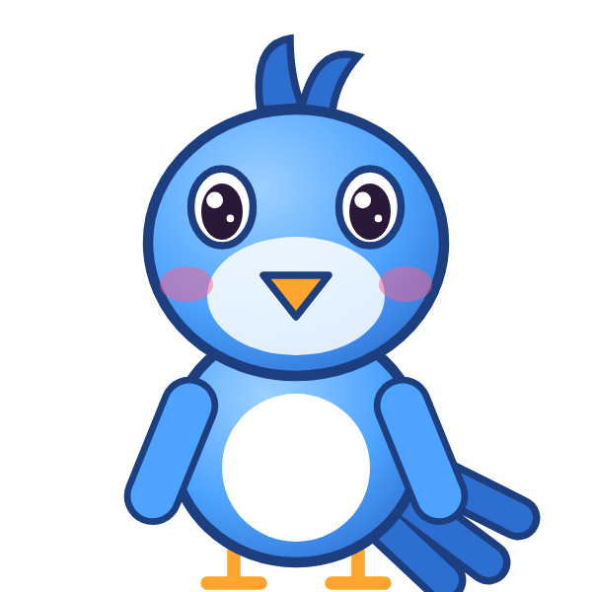

ص
صَ

Slide 2
صَأَ
أ
أَ
ص
صَ

Slide 3
صَبَ
ب
بَ
ص
صَ

Slide 4
صَتَ
ت
تَ
ص
صَ

Slide 5
صَثَ
ث
ثَ
ص
صَ

Slide 6
صَجَ
ج
جَ
ص
صَ

Slide 7
صَحَ
ح
حَ
ص
صَ

Slide 8
صَخَ
خ
خَ
ص
صَ

Slide 9
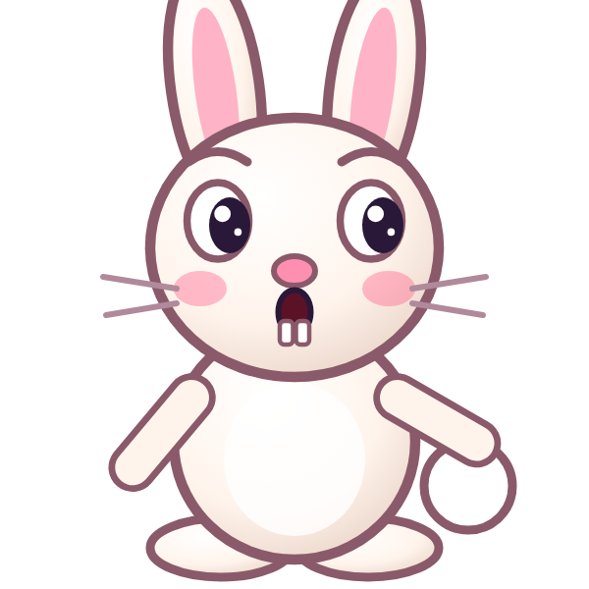

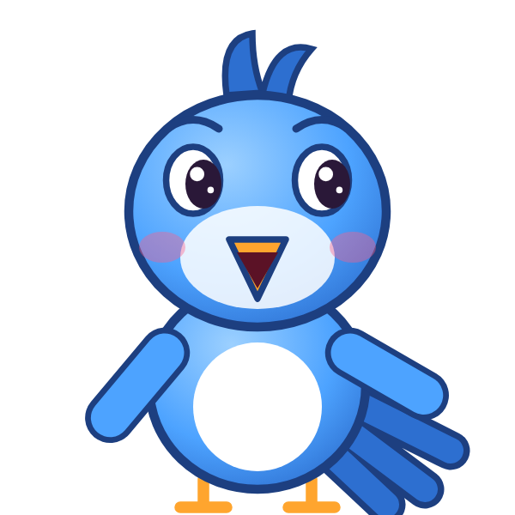
؟
خَ
صَ
صَجَ
صَخَ
خَصَ
Notes:
GAME TIME: ask the child to read the equation, then tap the animal holding the answer they think is right. Right answer = celebration slide. Wrong answer = a hidden try-again slide; tap the green button to try again.

Slide 10
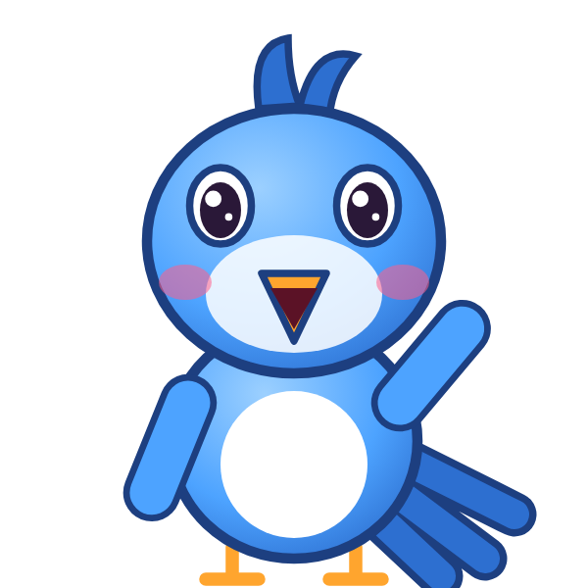
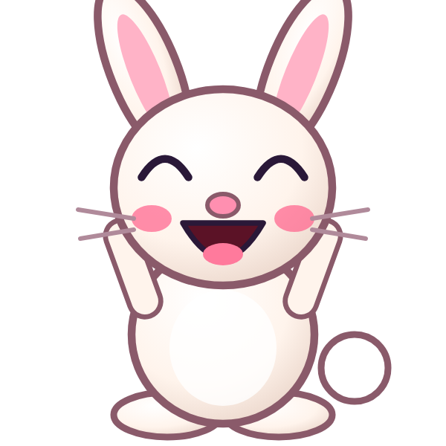
صَخَ

Slide 11
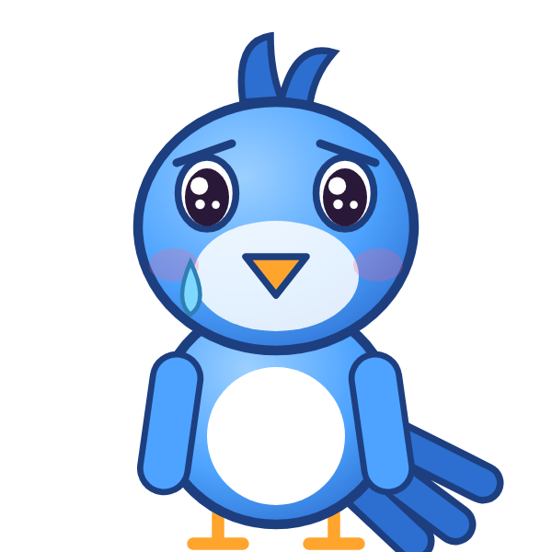
Notes:
Hidden try-again slide: only shown after a wrong answer. Tap the green button to go back to the question.

Slide 12
صَدَ
د
دَ
ص
صَ

Slide 13
صَذَ
ذ
ذَ
ص
صَ

Slide 14
صَرَ
ر
رَ
ص
صَ

Slide 15
صَزَ
ز
زَ
ص
صَ

Slide 16
صَسَ
س
سَ
ص
صَ

Slide 17
صَشَ
ش
شَ
ص
صَ

Slide 18
أَصَبَ
ب
بَ
ص
صَ
أ
أَ

Slide 19
بَصَتَ
ت
تَ
ص
صَ
ب
بَ

Slide 20
؟
تَ
صَ
بَ
بَصَتَ
بَصَثَ
تَصَبَ
Notes:
GAME TIME: ask the child to read the equation, then tap the animal holding the answer they think is right. Right answer = celebration slide. Wrong answer = a hidden try-again slide; tap the green button to try again.

Slide 21
بَصَتَ

Slide 22
Notes:
Hidden try-again slide: only shown after a wrong answer. Tap the green button to go back to the question.

Slide 23
تَصَثَ
ث
ثَ
ص
صَ
ت
تَ

Slide 24
ثَصَجَ
ج
جَ
ص
صَ
ث
ثَ

Slide 25
جَصَحَ
ح
حَ
ص
صَ
ج
جَ

Slide 26
حَصَخَ
خ
خَ
ص
صَ
ح
حَ

Slide 27
خَصَدَ
د
دَ
ص
صَ
خ
خَ

Slide 28
دَصَذَ
ذ
ذَ
ص
صَ
د
دَ

Slide 29
ذَصَرَ
ر
رَ
ص
صَ
ذ
ذَ

Slide 30
رَصَزَ
ز
زَ
ص
صَ
ر
رَ

Slide 31
؟
زَ
صَ
رَ
زَصَزَ
زَصَرَ
رَصَزَ
Notes:
GAME TIME: ask the child to read the equation, then tap the animal holding the answer they think is right. Right answer = celebration slide. Wrong answer = a hidden try-again slide; tap the green button to try again.

Slide 32
رَصَزَ

Slide 33
Notes:
Hidden try-again slide: only shown after a wrong answer. Tap the green button to go back to the question.

Slide 34
Notes:
Level up! Celebrate before the next set of letters.

Slide 35
زَصَسَ
س
سَ
ص
صَ
ز
زَ

Slide 36
سَصَشَ
ش
شَ
ص
صَ
س
سَ

Slide 37
شَصَأَ
أ
أَ
ص
صَ
ش
شَ

Slide 38
أَصَ
ص
صَ
أ
أَ

Slide 39
بَصَ
ص
صَ
ب
بَ

Slide 40
تَصَ
ص
صَ
ت
تَ

Slide 41
ثَصَ
ص
صَ
ث
ثَ

Slide 42
جَصَ
ص
صَ
ج
جَ

Slide 43
؟
صَ
جَ
حَصَ
جَصَ
صَجَ
Notes:
GAME TIME: ask the child to read the equation, then tap the animal holding the answer they think is right. Right answer = celebration slide. Wrong answer = a hidden try-again slide; tap the green button to try again.

Slide 44
جَصَ

Slide 45
Notes:
Hidden try-again slide: only shown after a wrong answer. Tap the green button to go back to the question.

Slide 46
حَصَ
ص
صَ
ح
حَ

Slide 47
خَصَ
ص
صَ
خ
خَ

Slide 48
دَصَ
ص
صَ
د
دَ

Slide 49
ذَصَ
ص
صَ
ذ
ذَ

Slide 50
رَصَ
ص
صَ
ر
رَ

Slide 51
زَصَ
ص
صَ
ز
زَ

Slide 52
سَصَ
ص
صَ
س
سَ

Slide 53
شَصَ
ص
صَ
ش
شَ

Slide 54
؟
صَ
شَ
شَصَ
شَضَ
صَشَ
Notes:
GAME TIME: ask the child to read the equation, then tap the animal holding the answer they think is right. Right answer = celebration slide. Wrong answer = a hidden try-again slide; tap the green button to try again.

Slide 55
شَصَ

Slide 56
Notes:
Hidden try-again slide: only shown after a wrong answer. Tap the green button to go back to the question.

Slide 57
ض
ضَ

Slide 58
ضَأَ
أ
أَ
ض
ضَ

Slide 59
ضَبَ
ب
بَ
ض
ضَ

Slide 60
ضَتَ
ت
تَ
ض
ضَ

Slide 61
ضَثَ
ث
ثَ
ض
ضَ

Slide 62
ضَجَ
ج
جَ
ض
ضَ

Slide 63
ضَحَ
ح
حَ
ض
ضَ

Slide 64
ضَخَ
خ
خَ
ض
ضَ

Slide 65
؟
خَ
ضَ
صَخَ
خَضَ
ضَخَ
Notes:
GAME TIME: ask the child to read the equation, then tap the animal holding the answer they think is right. Right answer = celebration slide. Wrong answer = a hidden try-again slide; tap the green button to try again.

Slide 66
ضَخَ

Slide 67
Notes:
Hidden try-again slide: only shown after a wrong answer. Tap the green button to go back to the question.

Slide 68
Notes:
Level up! Celebrate before the next set of letters.

Slide 69
ضَدَ
د
دَ
ض
ضَ

Slide 70
ضَذَ
ذ
ذَ
ض
ضَ

Slide 71
ضَرَ
ر
رَ
ض
ضَ

Slide 72
ضَزَ
ز
زَ
ض
ضَ

Slide 73
ضَسَ
س
سَ
ض
ضَ

Slide 74
ضَشَ
ش
شَ
ض
ضَ

Slide 75
ضَصَ
ص
صَ
ض
ضَ

Slide 76
أَضَبَ
ب
بَ
ض
ضَ
أ
أَ

Slide 77
؟
بَ
ضَ
أَ
أَصَبَ
أَضَبَ
بَضَأَ
Notes:
GAME TIME: ask the child to read the equation, then tap the animal holding the answer they think is right. Right answer = celebration slide. Wrong answer = a hidden try-again slide; tap the green button to try again.

Slide 78
أَضَبَ

Slide 79
Notes:
Hidden try-again slide: only shown after a wrong answer. Tap the green button to go back to the question.

Slide 80
بَضَتَ
ت
تَ
ض
ضَ
ب
بَ

Slide 81
تَضَثَ
ث
ثَ
ض
ضَ
ت
تَ

Slide 82
ثَضَجَ
ج
جَ
ض
ضَ
ث
ثَ

Slide 83
جَضَحَ
ح
حَ
ض
ضَ
ج
جَ

Slide 84
حَضَخَ
خ
خَ
ض
ضَ
ح
حَ

Slide 85
خَضَدَ
د
دَ
ض
ضَ
خ
خَ

Slide 86
دَضَذَ
ذ
ذَ
ض
ضَ
د
دَ

Slide 87
ذَضَرَ
ر
رَ
ض
ضَ
ذ
ذَ

Slide 88
؟
رَ
ضَ
ذَ
ذَضَرَ
ذَضَزَ
رَضَذَ
Notes:
GAME TIME: ask the child to read the equation, then tap the animal holding the answer they think is right. Right answer = celebration slide. Wrong answer = a hidden try-again slide; tap the green button to try again.

Slide 89
ذَضَرَ

Slide 90
Notes:
Hidden try-again slide: only shown after a wrong answer. Tap the green button to go back to the question.

Slide 91
رَضَزَ
ز
زَ
ض
ضَ
ر
رَ

Slide 92
زَضَسَ
س
سَ
ض
ضَ
ز
زَ

Slide 93
سَضَشَ
ش
شَ
ض
ضَ
س
سَ

Slide 94
شَضَصَ
ص
صَ
ض
ضَ
ش
شَ

Slide 95
صَضَأَ
أ
أَ
ض
ضَ
ص
صَ

Slide 96
أَضَ
ض
ضَ
أ
أَ

Slide 97
بَضَ
ض
ضَ
ب
بَ

Slide 98
تَضَ
ض
ضَ
ت
تَ

Slide 99
؟
ضَ
تَ
تَصَ
ضَتَ
تَضَ
Notes:
GAME TIME: ask the child to read the equation, then tap the animal holding the answer they think is right. Right answer = celebration slide. Wrong answer = a hidden try-again slide; tap the green button to try again.

Slide 100
تَضَ

Slide 101
Notes:
Hidden try-again slide: only shown after a wrong answer. Tap the green button to go back to the question.

Slide 102
Notes:
Level up! Celebrate before the next set of letters.

Slide 103
ثَضَ
ض
ضَ
ث
ثَ

Slide 104
جَضَ
ض
ضَ
ج
جَ

Slide 105
حَضَ
ض
ضَ
ح
حَ

Slide 106
خَضَ
ض
ضَ
خ
خَ

Slide 107
دَضَ
ض
ضَ
د
دَ

Slide 108
ذَضَ
ض
ضَ
ذ
ذَ

Slide 109
رَضَ
ض
ضَ
ر
رَ

Slide 110
زَضَ
ض
ضَ
ز
زَ

Slide 111
؟
ضَ
زَ
رَضَ
زَضَ
ضَزَ
Notes:
GAME TIME: ask the child to read the equation, then tap the animal holding the answer they think is right. Right answer = celebration slide. Wrong answer = a hidden try-again slide; tap the green button to try again.

Slide 112
زَضَ

Slide 113
Notes:
Hidden try-again slide: only shown after a wrong answer. Tap the green button to go back to the question.

Slide 114
سَضَ
ض
ضَ
س
سَ

Slide 115
شَضَ
ض
ضَ
ش
شَ

Slide 116
صَضَ
ض
ضَ
ص
صَ

Slide 117
Notes:
Finished! Give the child a big cheer.

