Slide 1
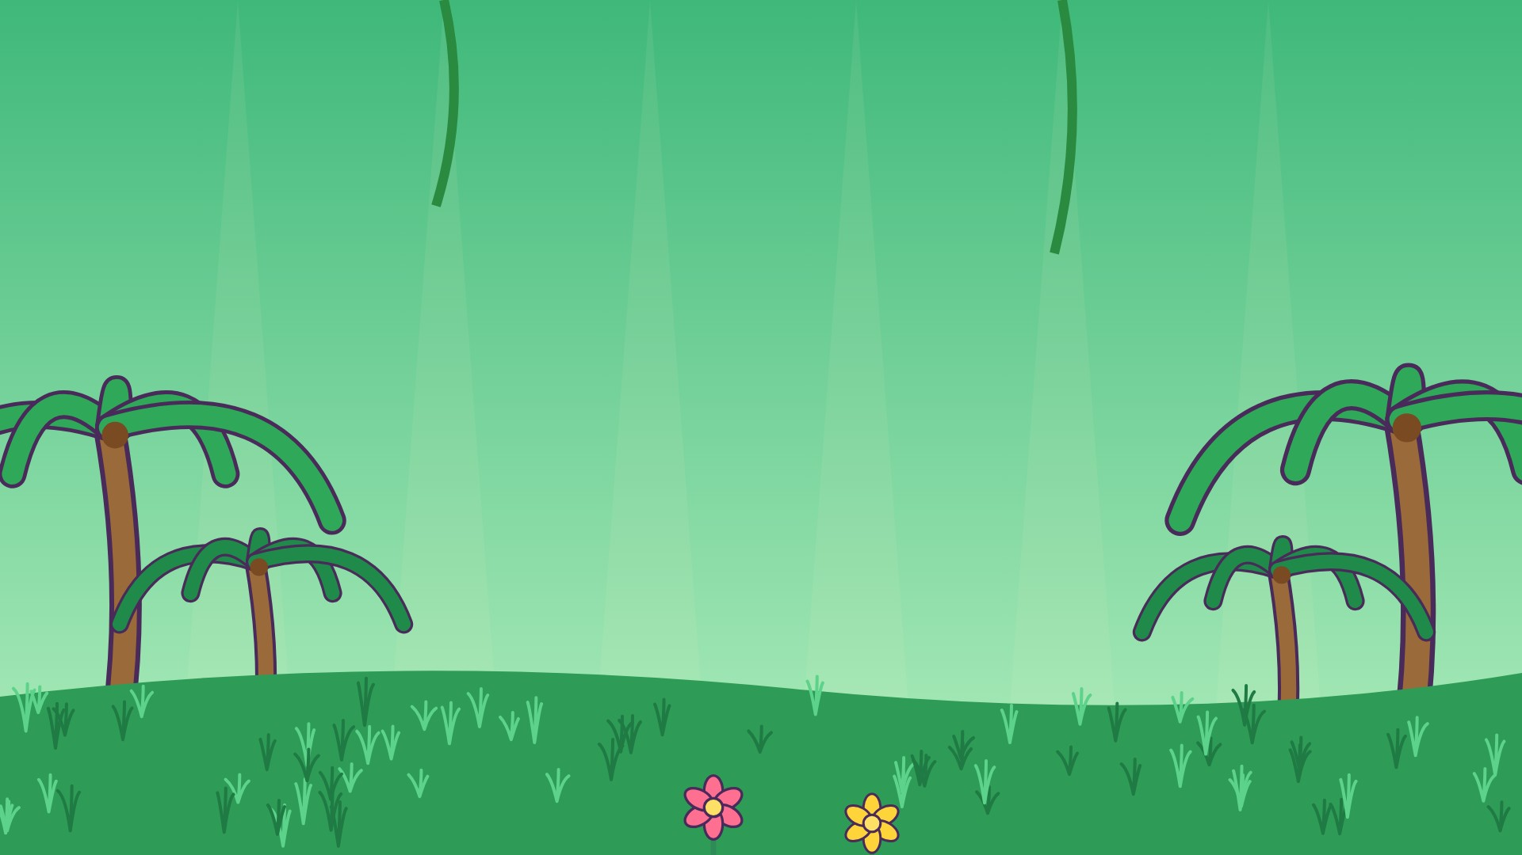
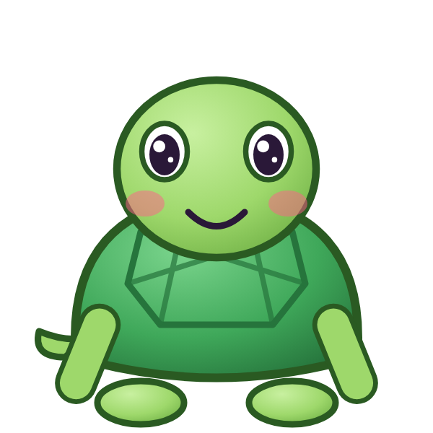



ط
طَ

Slide 2
طَأَ
أ
أَ
ط
طَ

Slide 3
طَبَ
ب
بَ
ط
طَ

Slide 4
طَتَ
ت
تَ
ط
طَ

Slide 5
طَثَ
ث
ثَ
ط
طَ

Slide 6
طَجَ
ج
جَ
ط
طَ

Slide 7
طَحَ
ح
حَ
ط
طَ

Slide 8
طَخَ
خ
خَ
ط
طَ

Slide 9

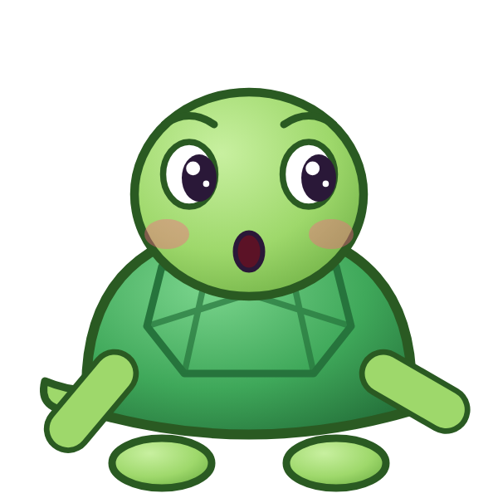

؟
خَ
طَ
طَجَ
طَخَ
خَطَ
Notes:
GAME TIME: ask the child to read the equation, then tap the animal holding the answer they think is right. Right answer = celebration slide. Wrong answer = a hidden try-again slide; tap the green button to try again.

Slide 10


طَخَ

Slide 11

Notes:
Hidden try-again slide: only shown after a wrong answer. Tap the green button to go back to the question.

Slide 12
طَدَ
د
دَ
ط
طَ

Slide 13
طَذَ
ذ
ذَ
ط
طَ

Slide 14
طَرَ
ر
رَ
ط
طَ

Slide 15
طَزَ
ز
زَ
ط
طَ

Slide 16
طَسَ
س
سَ
ط
طَ

Slide 17
طَشَ
ش
شَ
ط
طَ

Slide 18
طَصَ
ص
صَ
ط
طَ

Slide 19
طَضَ
ض
ضَ
ط
طَ

Slide 20
؟
ضَ
طَ
طَضَ
ظَضَ
ضَطَ
Notes:
GAME TIME: ask the child to read the equation, then tap the animal holding the answer they think is right. Right answer = celebration slide. Wrong answer = a hidden try-again slide; tap the green button to try again.

Slide 21
طَضَ

Slide 22
Notes:
Hidden try-again slide: only shown after a wrong answer. Tap the green button to go back to the question.

Slide 23
أَطَبَ
ب
بَ
ط
طَ
أ
أَ

Slide 24
بَطَتَ
ت
تَ
ط
طَ
ب
بَ

Slide 25
تَطَثَ
ث
ثَ
ط
طَ
ت
تَ

Slide 26
ثَطَجَ
ج
جَ
ط
طَ
ث
ثَ

Slide 27
جَطَحَ
ح
حَ
ط
طَ
ج
جَ

Slide 28
حَطَخَ
خ
خَ
ط
طَ
ح
حَ

Slide 29
خَطَدَ
د
دَ
ط
طَ
خ
خَ

Slide 30
دَطَذَ
ذ
ذَ
ط
طَ
د
دَ

Slide 31
؟
ذَ
طَ
دَ
ذَطَذَ
ذَطَدَ
دَطَذَ
Notes:
GAME TIME: ask the child to read the equation, then tap the animal holding the answer they think is right. Right answer = celebration slide. Wrong answer = a hidden try-again slide; tap the green button to try again.

Slide 32
دَطَذَ

Slide 33
Notes:
Hidden try-again slide: only shown after a wrong answer. Tap the green button to go back to the question.

Slide 34
Notes:
Level up! Celebrate before the next set of letters.

Slide 35
ذَطَرَ
ر
رَ
ط
طَ
ذ
ذَ

Slide 36
رَطَزَ
ز
زَ
ط
طَ
ر
رَ

Slide 37
زَطَسَ
س
سَ
ط
طَ
ز
زَ

Slide 38
سَطَشَ
ش
شَ
ط
طَ
س
سَ

Slide 39
شَطَصَ
ص
صَ
ط
طَ
ش
شَ

Slide 40
صَطَضَ
ض
ضَ
ط
طَ
ص
صَ

Slide 41
ضَطَأَ
أ
أَ
ط
طَ
ض
ضَ

Slide 42
أَطَ
ط
طَ
أ
أَ

Slide 43
؟
طَ
أَ
بَطَ
أَطَ
طَأَ
Notes:
GAME TIME: ask the child to read the equation, then tap the animal holding the answer they think is right. Right answer = celebration slide. Wrong answer = a hidden try-again slide; tap the green button to try again.

Slide 44
أَطَ

Slide 45
Notes:
Hidden try-again slide: only shown after a wrong answer. Tap the green button to go back to the question.

Slide 46
بَطَ
ط
طَ
ب
بَ

Slide 47
تَطَ
ط
طَ
ت
تَ

Slide 48
ثَطَ
ط
طَ
ث
ثَ

Slide 49
جَطَ
ط
طَ
ج
جَ

Slide 50
حَطَ
ط
طَ
ح
حَ

Slide 51
خَطَ
ط
طَ
خ
خَ

Slide 52
دَطَ
ط
طَ
د
دَ

Slide 53
ذَطَ
ط
طَ
ذ
ذَ

Slide 54
؟
طَ
ذَ
ذَطَ
ذَظَ
طَذَ
Notes:
GAME TIME: ask the child to read the equation, then tap the animal holding the answer they think is right. Right answer = celebration slide. Wrong answer = a hidden try-again slide; tap the green button to try again.

Slide 55
ذَطَ

Slide 56
Notes:
Hidden try-again slide: only shown after a wrong answer. Tap the green button to go back to the question.

Slide 57
رَطَ
ط
طَ
ر
رَ

Slide 58
زَطَ
ط
طَ
ز
زَ

Slide 59
سَطَ
ط
طَ
س
سَ

Slide 60
شَطَ
ط
طَ
ش
شَ

Slide 61
صَطَ
ط
طَ
ص
صَ

Slide 62
ضَطَ
ط
طَ
ض
ضَ

Slide 63
ظ
ظَ

Slide 64
ظَأَ
أ
أَ
ظ
ظَ

Slide 65
؟
أَ
ظَ
طَأَ
أَظَ
ظَأَ
Notes:
GAME TIME: ask the child to read the equation, then tap the animal holding the answer they think is right. Right answer = celebration slide. Wrong answer = a hidden try-again slide; tap the green button to try again.

Slide 66
ظَأَ

Slide 67
Notes:
Hidden try-again slide: only shown after a wrong answer. Tap the green button to go back to the question.

Slide 68
Notes:
Level up! Celebrate before the next set of letters.

Slide 69
ظَبَ
ب
بَ
ظ
ظَ

Slide 70
ظَتَ
ت
تَ
ظ
ظَ

Slide 71
ظَثَ
ث
ثَ
ظ
ظَ

Slide 72
ظَجَ
ج
جَ
ظ
ظَ

Slide 73
ظَحَ
ح
حَ
ظ
ظَ

Slide 74
ظَخَ
خ
خَ
ظ
ظَ

Slide 75
ظَدَ
د
دَ
ظ
ظَ

Slide 76
ظَذَ
ذ
ذَ
ظ
ظَ

Slide 77
؟
ذَ
ظَ
ظَدَ
ظَذَ
ذَظَ
Notes:
GAME TIME: ask the child to read the equation, then tap the animal holding the answer they think is right. Right answer = celebration slide. Wrong answer = a hidden try-again slide; tap the green button to try again.

Slide 78
ظَذَ

Slide 79
Notes:
Hidden try-again slide: only shown after a wrong answer. Tap the green button to go back to the question.

Slide 80
ظَرَ
ر
رَ
ظ
ظَ

Slide 81
ظَزَ
ز
زَ
ظ
ظَ

Slide 82
ظَسَ
س
سَ
ظ
ظَ

Slide 83
ظَشَ
ش
شَ
ظ
ظَ

Slide 84
ظَصَ
ص
صَ
ظ
ظَ

Slide 85
ظَضَ
ض
ضَ
ظ
ظَ

Slide 86
ظَطَ
ط
طَ
ظ
ظَ

Slide 87
أَظَبَ
ب
بَ
ظ
ظَ
أ
أَ

Slide 88
؟
بَ
ظَ
أَ
أَظَبَ
أَظَتَ
بَظَأَ
Notes:
GAME TIME: ask the child to read the equation, then tap the animal holding the answer they think is right. Right answer = celebration slide. Wrong answer = a hidden try-again slide; tap the green button to try again.

Slide 89
أَظَبَ

Slide 90
Notes:
Hidden try-again slide: only shown after a wrong answer. Tap the green button to go back to the question.

Slide 91
بَظَتَ
ت
تَ
ظ
ظَ
ب
بَ

Slide 92
تَظَثَ
ث
ثَ
ظ
ظَ
ت
تَ

Slide 93
ثَظَجَ
ج
جَ
ظ
ظَ
ث
ثَ

Slide 94
جَظَحَ
ح
حَ
ظ
ظَ
ج
جَ

Slide 95
حَظَخَ
خ
خَ
ظ
ظَ
ح
حَ

Slide 96
خَظَدَ
د
دَ
ظ
ظَ
خ
خَ

Slide 97
دَظَذَ
ذ
ذَ
ظ
ظَ
د
دَ

Slide 98
ذَظَرَ
ر
رَ
ظ
ظَ
ذ
ذَ

Slide 99
؟
رَ
ظَ
ذَ
دَظَرَ
رَظَذَ
ذَظَرَ
Notes:
GAME TIME: ask the child to read the equation, then tap the animal holding the answer they think is right. Right answer = celebration slide. Wrong answer = a hidden try-again slide; tap the green button to try again.

Slide 100
ذَظَرَ

Slide 101
Notes:
Hidden try-again slide: only shown after a wrong answer. Tap the green button to go back to the question.

Slide 102
Notes:
Level up! Celebrate before the next set of letters.

Slide 103
رَظَزَ
ز
زَ
ظ
ظَ
ر
رَ

Slide 104
زَظَسَ
س
سَ
ظ
ظَ
ز
زَ

Slide 105
سَظَشَ
ش
شَ
ظ
ظَ
س
سَ

Slide 106
شَظَصَ
ص
صَ
ظ
ظَ
ش
شَ

Slide 107
صَظَضَ
ض
ضَ
ظ
ظَ
ص
صَ

Slide 108
ضَظَطَ
ط
طَ
ظ
ظَ
ض
ضَ

Slide 109
طَظَأَ
أ
أَ
ظ
ظَ
ط
طَ

Slide 110
أَظَ
ظ
ظَ
أ
أَ

Slide 111
؟
ظَ
أَ
بَظَ
أَظَ
ظَأَ
Notes:
GAME TIME: ask the child to read the equation, then tap the animal holding the answer they think is right. Right answer = celebration slide. Wrong answer = a hidden try-again slide; tap the green button to try again.

Slide 112
أَظَ

Slide 113
Notes:
Hidden try-again slide: only shown after a wrong answer. Tap the green button to go back to the question.

Slide 114
بَظَ
ظ
ظَ
ب
بَ

Slide 115
تَظَ
ظ
ظَ
ت
تَ

Slide 116
ثَظَ
ظ
ظَ
ث
ثَ

Slide 117
جَظَ
ظ
ظَ
ج
جَ

Slide 118
حَظَ
ظ
ظَ
ح
حَ

Slide 119
خَظَ
ظ
ظَ
خ
خَ

Slide 120
دَظَ
ظ
ظَ
د
دَ

Slide 121
ذَظَ
ظ
ظَ
ذ
ذَ

Slide 122
؟
ظَ
ذَ
ذَظَ
ذَطَ
ظَذَ
Notes:
GAME TIME: ask the child to read the equation, then tap the animal holding the answer they think is right. Right answer = celebration slide. Wrong answer = a hidden try-again slide; tap the green button to try again.

Slide 123
ذَظَ

Slide 124
Notes:
Hidden try-again slide: only shown after a wrong answer. Tap the green button to go back to the question.

Slide 125
رَظَ
ظ
ظَ
ر
رَ

Slide 126
زَظَ
ظ
ظَ
ز
زَ

Slide 127
سَظَ
ظ
ظَ
س
سَ

Slide 128
شَظَ
ظ
ظَ
ش
شَ

Slide 129
صَظَ
ظ
ظَ
ص
صَ

Slide 130
ضَظَ
ظ
ظَ
ض
ضَ

Slide 131
طَظَ
ظ
ظَ
ط
طَ

Slide 132

Notes:
Finished! Give the child a big cheer.

