Slide 1
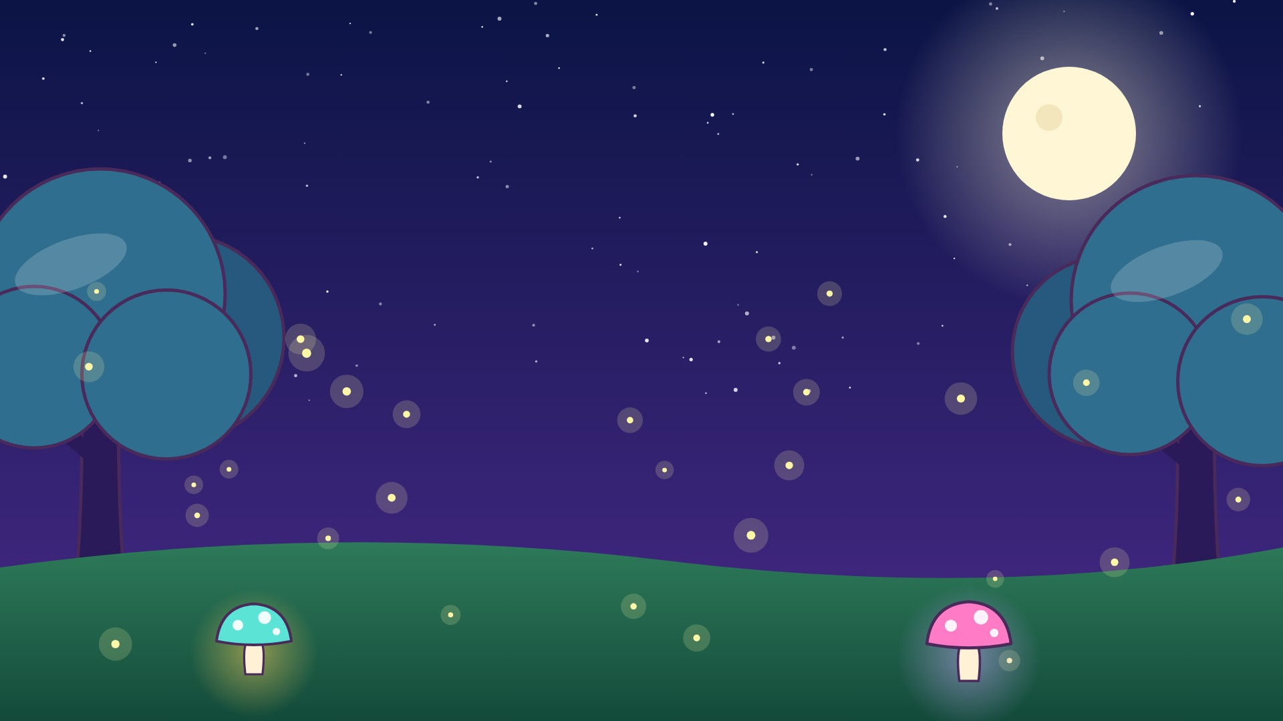
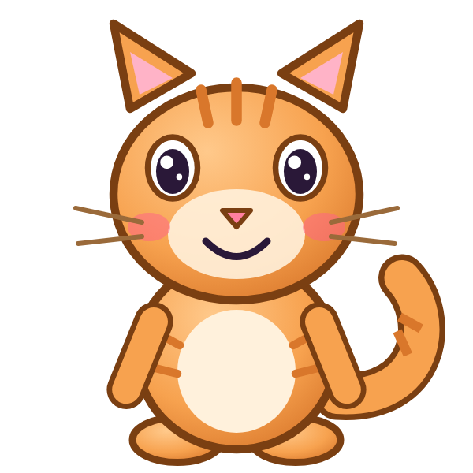
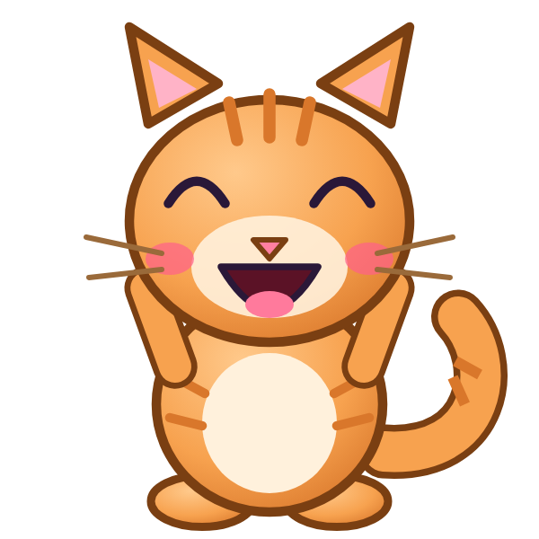
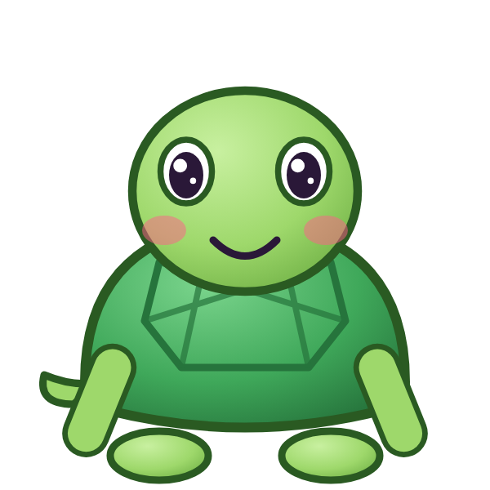

ع
عَ

Slide 2
عَأَ
أ
أَ
ع
عَ

Slide 3
عَبَ
ب
بَ
ع
عَ

Slide 4
عَتَ
ت
تَ
ع
عَ

Slide 5
عَثَ
ث
ثَ
ع
عَ

Slide 6
عَجَ
ج
جَ
ع
عَ

Slide 7
عَحَ
ح
حَ
ع
عَ

Slide 8
عَخَ
خ
خَ
ع
عَ

Slide 9
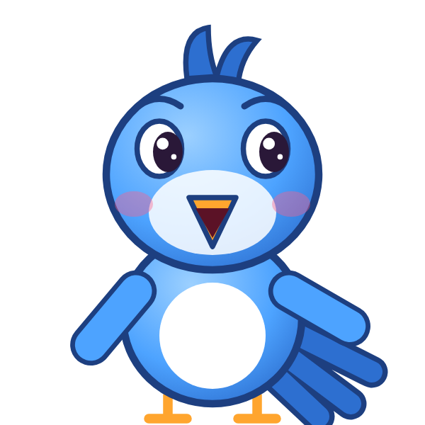
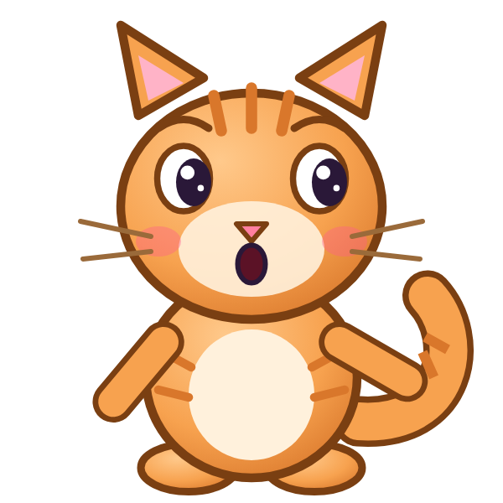
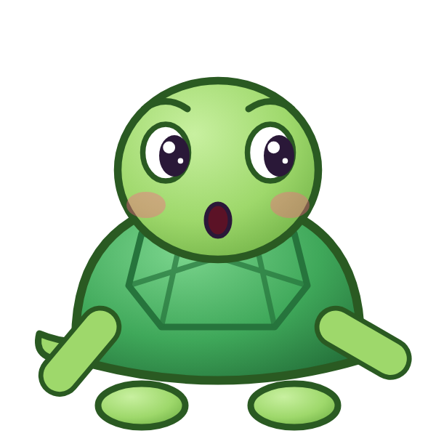
؟
خَ
عَ
عَجَ
عَخَ
خَعَ
Notes:
GAME TIME: ask the child to read the equation, then tap the animal holding the answer they think is right. Right answer = celebration slide. Wrong answer = a hidden try-again slide; tap the green button to try again.

Slide 10


عَخَ

Slide 11
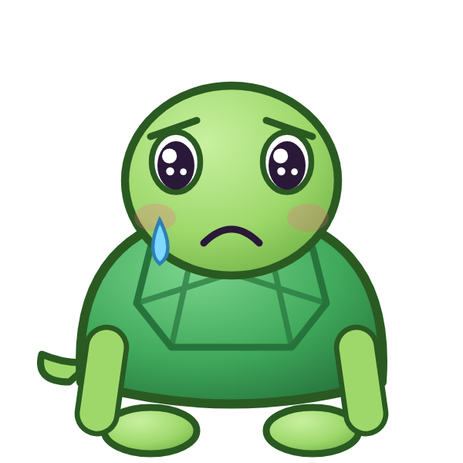
Notes:
Hidden try-again slide: only shown after a wrong answer. Tap the green button to go back to the question.

Slide 12
عَدَ
د
دَ
ع
عَ

Slide 13
عَذَ
ذ
ذَ
ع
عَ

Slide 14
عَرَ
ر
رَ
ع
عَ

Slide 15
عَزَ
ز
زَ
ع
عَ

Slide 16
عَسَ
س
سَ
ع
عَ

Slide 17
عَشَ
ش
شَ
ع
عَ

Slide 18
عَصَ
ص
صَ
ع
عَ

Slide 19
عَضَ
ض
ضَ
ع
عَ

Slide 20
؟
ضَ
عَ
عَضَ
غَضَ
ضَعَ
Notes:
GAME TIME: ask the child to read the equation, then tap the animal holding the answer they think is right. Right answer = celebration slide. Wrong answer = a hidden try-again slide; tap the green button to try again.

Slide 21
عَضَ

Slide 22
Notes:
Hidden try-again slide: only shown after a wrong answer. Tap the green button to go back to the question.

Slide 23
عَطَ
ط
طَ
ع
عَ

Slide 24
عَظَ
ظ
ظَ
ع
عَ

Slide 25
أَعَبَ
ب
بَ
ع
عَ
أ
أَ

Slide 26
بَعَتَ
ت
تَ
ع
عَ
ب
بَ

Slide 27
تَعَثَ
ث
ثَ
ع
عَ
ت
تَ

Slide 28
ثَعَجَ
ج
جَ
ع
عَ
ث
ثَ

Slide 29
جَعَحَ
ح
حَ
ع
عَ
ج
جَ

Slide 30
حَعَخَ
خ
خَ
ع
عَ
ح
حَ

Slide 31
؟
خَ
عَ
حَ
خَعَخَ
خَعَحَ
حَعَخَ
Notes:
GAME TIME: ask the child to read the equation, then tap the animal holding the answer they think is right. Right answer = celebration slide. Wrong answer = a hidden try-again slide; tap the green button to try again.

Slide 32
حَعَخَ

Slide 33
Notes:
Hidden try-again slide: only shown after a wrong answer. Tap the green button to go back to the question.

Slide 34
Notes:
Level up! Celebrate before the next set of letters.

Slide 35
خَعَدَ
د
دَ
ع
عَ
خ
خَ

Slide 36
دَعَذَ
ذ
ذَ
ع
عَ
د
دَ

Slide 37
ذَعَرَ
ر
رَ
ع
عَ
ذ
ذَ

Slide 38
رَعَزَ
ز
زَ
ع
عَ
ر
رَ

Slide 39
زَعَسَ
س
سَ
ع
عَ
ز
زَ

Slide 40
سَعَشَ
ش
شَ
ع
عَ
س
سَ

Slide 41
شَعَصَ
ص
صَ
ع
عَ
ش
شَ

Slide 42
صَعَضَ
ض
ضَ
ع
عَ
ص
صَ

Slide 43
؟
ضَ
عَ
صَ
صَغَضَ
صَعَضَ
ضَعَصَ
Notes:
GAME TIME: ask the child to read the equation, then tap the animal holding the answer they think is right. Right answer = celebration slide. Wrong answer = a hidden try-again slide; tap the green button to try again.

Slide 44
صَعَضَ

Slide 45
Notes:
Hidden try-again slide: only shown after a wrong answer. Tap the green button to go back to the question.

Slide 46
ضَعَطَ
ط
طَ
ع
عَ
ض
ضَ

Slide 47
طَعَظَ
ظ
ظَ
ع
عَ
ط
طَ

Slide 48
ظَعَأَ
أ
أَ
ع
عَ
ظ
ظَ

Slide 49
أَعَ
ع
عَ
أ
أَ

Slide 50
بَعَ
ع
عَ
ب
بَ

Slide 51
تَعَ
ع
عَ
ت
تَ

Slide 52
ثَعَ
ع
عَ
ث
ثَ

Slide 53
جَعَ
ع
عَ
ج
جَ

Slide 54
؟
عَ
جَ
جَعَ
جَغَ
عَجَ
Notes:
GAME TIME: ask the child to read the equation, then tap the animal holding the answer they think is right. Right answer = celebration slide. Wrong answer = a hidden try-again slide; tap the green button to try again.

Slide 55
جَعَ

Slide 56
Notes:
Hidden try-again slide: only shown after a wrong answer. Tap the green button to go back to the question.

Slide 57
حَعَ
ع
عَ
ح
حَ

Slide 58
خَعَ
ع
عَ
خ
خَ

Slide 59
دَعَ
ع
عَ
د
دَ

Slide 60
ذَعَ
ع
عَ
ذ
ذَ

Slide 61
رَعَ
ع
عَ
ر
رَ

Slide 62
زَعَ
ع
عَ
ز
زَ

Slide 63
سَعَ
ع
عَ
س
سَ

Slide 64
شَعَ
ع
عَ
ش
شَ

Slide 65
؟
عَ
شَ
سَعَ
عَشَ
شَعَ
Notes:
GAME TIME: ask the child to read the equation, then tap the animal holding the answer they think is right. Right answer = celebration slide. Wrong answer = a hidden try-again slide; tap the green button to try again.

Slide 66
شَعَ

Slide 67
Notes:
Hidden try-again slide: only shown after a wrong answer. Tap the green button to go back to the question.

Slide 68
Notes:
Level up! Celebrate before the next set of letters.

Slide 69
صَعَ
ع
عَ
ص
صَ

Slide 70
ضَعَ
ع
عَ
ض
ضَ

Slide 71
طَعَ
ع
عَ
ط
طَ

Slide 72
ظَعَ
ع
عَ
ظ
ظَ

Slide 73
غ
غَ

Slide 74
غَأَ
أ
أَ
غ
غَ

Slide 75
غَبَ
ب
بَ
غ
غَ

Slide 76
غَتَ
ت
تَ
غ
غَ

Slide 77
؟
تَ
غَ
غَثَ
غَتَ
تَغَ
Notes:
GAME TIME: ask the child to read the equation, then tap the animal holding the answer they think is right. Right answer = celebration slide. Wrong answer = a hidden try-again slide; tap the green button to try again.

Slide 78
غَتَ

Slide 79
Notes:
Hidden try-again slide: only shown after a wrong answer. Tap the green button to go back to the question.

Slide 80
غَثَ
ث
ثَ
غ
غَ

Slide 81
غَجَ
ج
جَ
غ
غَ

Slide 82
غَحَ
ح
حَ
غ
غَ

Slide 83
غَخَ
خ
خَ
غ
غَ

Slide 84
غَدَ
د
دَ
غ
غَ

Slide 85
غَذَ
ذ
ذَ
غ
غَ

Slide 86
غَرَ
ر
رَ
غ
غَ

Slide 87
غَزَ
ز
زَ
غ
غَ

Slide 88
؟
زَ
غَ
غَزَ
عَزَ
زَغَ
Notes:
GAME TIME: ask the child to read the equation, then tap the animal holding the answer they think is right. Right answer = celebration slide. Wrong answer = a hidden try-again slide; tap the green button to try again.

Slide 89
غَزَ

Slide 90
Notes:
Hidden try-again slide: only shown after a wrong answer. Tap the green button to go back to the question.

Slide 91
غَسَ
س
سَ
غ
غَ

Slide 92
غَشَ
ش
شَ
غ
غَ

Slide 93
غَصَ
ص
صَ
غ
غَ

Slide 94
غَضَ
ض
ضَ
غ
غَ

Slide 95
غَطَ
ط
طَ
غ
غَ

Slide 96
غَظَ
ظ
ظَ
غ
غَ

Slide 97
غَعَ
ع
عَ
غ
غَ

Slide 98
أَغَبَ
ب
بَ
غ
غَ
أ
أَ

Slide 99
؟
بَ
غَ
أَ
بَغَبَ
بَغَأَ
أَغَبَ
Notes:
GAME TIME: ask the child to read the equation, then tap the animal holding the answer they think is right. Right answer = celebration slide. Wrong answer = a hidden try-again slide; tap the green button to try again.

Slide 100
أَغَبَ

Slide 101
Notes:
Hidden try-again slide: only shown after a wrong answer. Tap the green button to go back to the question.

Slide 102
Notes:
Level up! Celebrate before the next set of letters.

Slide 103
بَغَتَ
ت
تَ
غ
غَ
ب
بَ

Slide 104
تَغَثَ
ث
ثَ
غ
غَ
ت
تَ

Slide 105
ثَغَجَ
ج
جَ
غ
غَ
ث
ثَ

Slide 106
جَغَحَ
ح
حَ
غ
غَ
ج
جَ

Slide 107
حَغَخَ
خ
خَ
غ
غَ
ح
حَ

Slide 108
خَغَدَ
د
دَ
غ
غَ
خ
خَ

Slide 109
دَغَذَ
ذ
ذَ
غ
غَ
د
دَ

Slide 110
ذَغَرَ
ر
رَ
غ
غَ
ذ
ذَ

Slide 111
؟
رَ
غَ
ذَ
ذَعَرَ
ذَغَرَ
رَغَذَ
Notes:
GAME TIME: ask the child to read the equation, then tap the animal holding the answer they think is right. Right answer = celebration slide. Wrong answer = a hidden try-again slide; tap the green button to try again.

Slide 112
ذَغَرَ

Slide 113
Notes:
Hidden try-again slide: only shown after a wrong answer. Tap the green button to go back to the question.

Slide 114
رَغَزَ
ز
زَ
غ
غَ
ر
رَ

Slide 115
زَغَسَ
س
سَ
غ
غَ
ز
زَ

Slide 116
سَغَشَ
ش
شَ
غ
غَ
س
سَ

Slide 117
شَغَصَ
ص
صَ
غ
غَ
ش
شَ

Slide 118
صَغَضَ
ض
ضَ
غ
غَ
ص
صَ

Slide 119
ضَغَطَ
ط
طَ
غ
غَ
ض
ضَ

Slide 120
طَغَظَ
ظ
ظَ
غ
غَ
ط
طَ

Slide 121
ظَغَعَ
ع
عَ
غ
غَ
ظ
ظَ

Slide 122
؟
عَ
غَ
ظَ
ظَغَعَ
ظَغَغَ
عَغَظَ
Notes:
GAME TIME: ask the child to read the equation, then tap the animal holding the answer they think is right. Right answer = celebration slide. Wrong answer = a hidden try-again slide; tap the green button to try again.

Slide 123
ظَغَعَ

Slide 124
Notes:
Hidden try-again slide: only shown after a wrong answer. Tap the green button to go back to the question.

Slide 125
عَغَأَ
أ
أَ
غ
غَ
ع
عَ

Slide 126
أَغَ
غ
غَ
أ
أَ

Slide 127
بَغَ
غ
غَ
ب
بَ

Slide 128
تَغَ
غ
غَ
ت
تَ

Slide 129
ثَغَ
غ
غَ
ث
ثَ

Slide 130
جَغَ
غ
غَ
ج
جَ

Slide 131
حَغَ
غ
غَ
ح
حَ

Slide 132
خَغَ
غ
غَ
خ
خَ

Slide 133
؟
غَ
خَ
جَغَ
غَخَ
خَغَ
Notes:
GAME TIME: ask the child to read the equation, then tap the animal holding the answer they think is right. Right answer = celebration slide. Wrong answer = a hidden try-again slide; tap the green button to try again.

Slide 134
خَغَ

Slide 135
Notes:
Hidden try-again slide: only shown after a wrong answer. Tap the green button to go back to the question.

Slide 136
Notes:
Level up! Celebrate before the next set of letters.

Slide 137
دَغَ
غ
غَ
د
دَ

Slide 138
ذَغَ
غ
غَ
ذ
ذَ

Slide 139
رَغَ
غ
غَ
ر
رَ

Slide 140
زَغَ
غ
غَ
ز
زَ

Slide 141
سَغَ
غ
غَ
س
سَ

Slide 142
شَغَ
غ
غَ
ش
شَ

Slide 143
صَغَ
غ
غَ
ص
صَ

Slide 144
ضَغَ
غ
غَ
ض
ضَ

Slide 145
؟
غَ
ضَ
ضَعَ
ضَغَ
غَضَ
Notes:
GAME TIME: ask the child to read the equation, then tap the animal holding the answer they think is right. Right answer = celebration slide. Wrong answer = a hidden try-again slide; tap the green button to try again.

Slide 146
ضَغَ

Slide 147
Notes:
Hidden try-again slide: only shown after a wrong answer. Tap the green button to go back to the question.

Slide 148
طَغَ
غ
غَ
ط
طَ

Slide 149
ظَغَ
غ
غَ
ظ
ظَ

Slide 150
عَغَ
غ
غَ
ع
عَ

Slide 151

Notes:
Finished! Give the child a big cheer.

