Slide 1



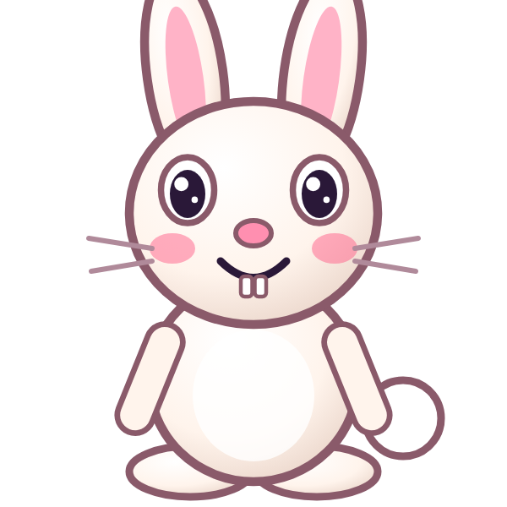
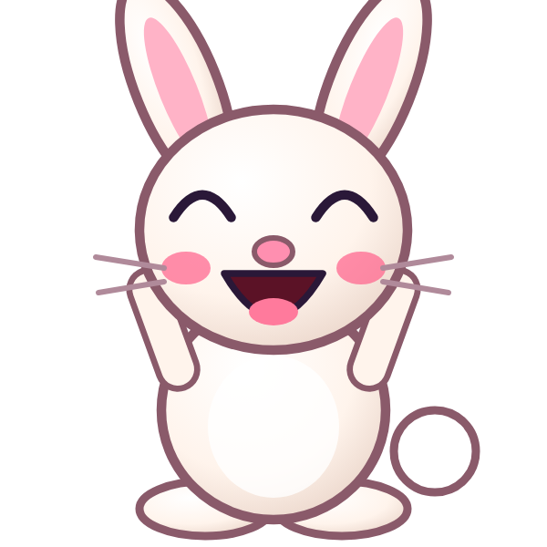
ف
فَ

Slide 2
فَأَ
أ
أَ
ف
فَ

Slide 3
فَبَ
ب
بَ
ف
فَ

Slide 4
فَتَ
ت
تَ
ف
فَ

Slide 5
فَثَ
ث
ثَ
ف
فَ

Slide 6
فَجَ
ج
جَ
ف
فَ

Slide 7
فَحَ
ح
حَ
ف
فَ

Slide 8
فَخَ
خ
خَ
ف
فَ

Slide 9


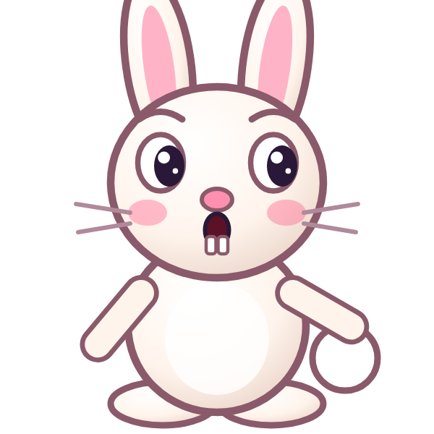
؟
خَ
فَ
فَجَ
فَخَ
خَفَ
Notes:
GAME TIME: ask the child to read the equation, then tap the animal holding the answer they think is right. Right answer = celebration slide. Wrong answer = a hidden try-again slide; tap the green button to try again.

Slide 10
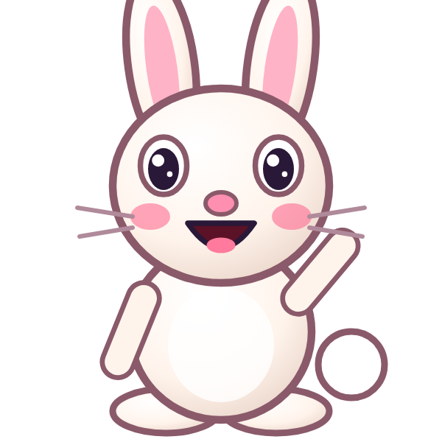

فَخَ

Slide 11
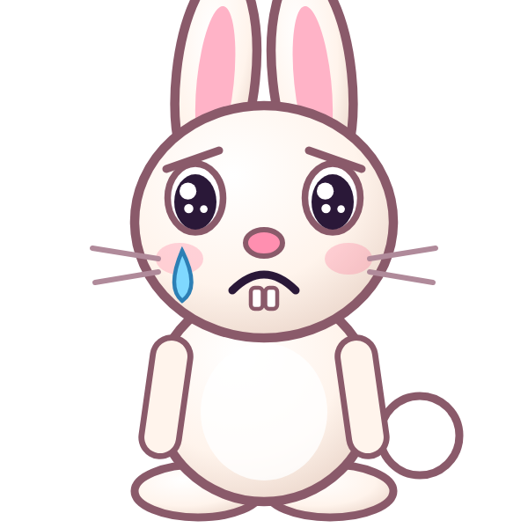
Notes:
Hidden try-again slide: only shown after a wrong answer. Tap the green button to go back to the question.

Slide 12
فَدَ
د
دَ
ف
فَ

Slide 13
فَذَ
ذ
ذَ
ف
فَ

Slide 14
فَرَ
ر
رَ
ف
فَ

Slide 15
فَزَ
ز
زَ
ف
فَ

Slide 16
فَسَ
س
سَ
ف
فَ

Slide 17
فَشَ
ش
شَ
ف
فَ

Slide 18
فَصَ
ص
صَ
ف
فَ

Slide 19
فَضَ
ض
ضَ
ف
فَ

Slide 20
؟
ضَ
فَ
فَضَ
قَضَ
ضَفَ
Notes:
GAME TIME: ask the child to read the equation, then tap the animal holding the answer they think is right. Right answer = celebration slide. Wrong answer = a hidden try-again slide; tap the green button to try again.

Slide 21
فَضَ

Slide 22
Notes:
Hidden try-again slide: only shown after a wrong answer. Tap the green button to go back to the question.

Slide 23
فَطَ
ط
طَ
ف
فَ

Slide 24
فَظَ
ظ
ظَ
ف
فَ

Slide 25
فَعَ
ع
عَ
ف
فَ

Slide 26
فَغَ
غ
غَ
ف
فَ

Slide 27
أَفَبَ
ب
بَ
ف
فَ
أ
أَ

Slide 28
بَفَتَ
ت
تَ
ف
فَ
ب
بَ

Slide 29
تَفَثَ
ث
ثَ
ف
فَ
ت
تَ

Slide 30
ثَفَجَ
ج
جَ
ف
فَ
ث
ثَ

Slide 31
؟
جَ
فَ
ثَ
بَفَجَ
جَفَثَ
ثَفَجَ
Notes:
GAME TIME: ask the child to read the equation, then tap the animal holding the answer they think is right. Right answer = celebration slide. Wrong answer = a hidden try-again slide; tap the green button to try again.

Slide 32
ثَفَجَ

Slide 33
Notes:
Hidden try-again slide: only shown after a wrong answer. Tap the green button to go back to the question.

Slide 34
Notes:
Level up! Celebrate before the next set of letters.

Slide 35
جَفَحَ
ح
حَ
ف
فَ
ج
جَ

Slide 36
حَفَخَ
خ
خَ
ف
فَ
ح
حَ

Slide 37
خَفَدَ
د
دَ
ف
فَ
خ
خَ

Slide 38
دَفَذَ
ذ
ذَ
ف
فَ
د
دَ

Slide 39
ذَفَرَ
ر
رَ
ف
فَ
ذ
ذَ

Slide 40
رَفَزَ
ز
زَ
ف
فَ
ر
رَ

Slide 41
زَفَسَ
س
سَ
ف
فَ
ز
زَ

Slide 42
سَفَشَ
ش
شَ
ف
فَ
س
سَ

Slide 43
؟
شَ
فَ
سَ
سَقَشَ
سَفَشَ
شَفَسَ
Notes:
GAME TIME: ask the child to read the equation, then tap the animal holding the answer they think is right. Right answer = celebration slide. Wrong answer = a hidden try-again slide; tap the green button to try again.

Slide 44
سَفَشَ

Slide 45
Notes:
Hidden try-again slide: only shown after a wrong answer. Tap the green button to go back to the question.

Slide 46
شَفَصَ
ص
صَ
ف
فَ
ش
شَ

Slide 47
صَفَضَ
ض
ضَ
ف
فَ
ص
صَ

Slide 48
ضَفَطَ
ط
طَ
ف
فَ
ض
ضَ

Slide 49
طَفَظَ
ظ
ظَ
ف
فَ
ط
طَ

Slide 50
ظَفَعَ
ع
عَ
ف
فَ
ظ
ظَ

Slide 51
عَفَغَ
غ
غَ
ف
فَ
ع
عَ

Slide 52
غَفَأَ
أ
أَ
ف
فَ
غ
غَ

Slide 53
أَفَ
ف
فَ
أ
أَ

Slide 54
؟
فَ
أَ
أَفَ
أَقَ
فَأَ
Notes:
GAME TIME: ask the child to read the equation, then tap the animal holding the answer they think is right. Right answer = celebration slide. Wrong answer = a hidden try-again slide; tap the green button to try again.

Slide 55
أَفَ

Slide 56
Notes:
Hidden try-again slide: only shown after a wrong answer. Tap the green button to go back to the question.

Slide 57
بَفَ
ف
فَ
ب
بَ

Slide 58
تَفَ
ف
فَ
ت
تَ

Slide 59
ثَفَ
ف
فَ
ث
ثَ

Slide 60
جَفَ
ف
فَ
ج
جَ

Slide 61
حَفَ
ف
فَ
ح
حَ

Slide 62
خَفَ
ف
فَ
خ
خَ

Slide 63
دَفَ
ف
فَ
د
دَ

Slide 64
ذَفَ
ف
فَ
ذ
ذَ

Slide 65
؟
فَ
ذَ
دَفَ
فَذَ
ذَفَ
Notes:
GAME TIME: ask the child to read the equation, then tap the animal holding the answer they think is right. Right answer = celebration slide. Wrong answer = a hidden try-again slide; tap the green button to try again.

Slide 66
ذَفَ

Slide 67
Notes:
Hidden try-again slide: only shown after a wrong answer. Tap the green button to go back to the question.

Slide 68
Notes:
Level up! Celebrate before the next set of letters.

Slide 69
رَفَ
ف
فَ
ر
رَ

Slide 70
زَفَ
ف
فَ
ز
زَ

Slide 71
سَفَ
ف
فَ
س
سَ

Slide 72
شَفَ
ف
فَ
ش
شَ

Slide 73
صَفَ
ف
فَ
ص
صَ

Slide 74
ضَفَ
ف
فَ
ض
ضَ

Slide 75
طَفَ
ف
فَ
ط
طَ

Slide 76
ظَفَ
ف
فَ
ظ
ظَ

Slide 77
؟
فَ
ظَ
ظَقَ
ظَفَ
فَظَ
Notes:
GAME TIME: ask the child to read the equation, then tap the animal holding the answer they think is right. Right answer = celebration slide. Wrong answer = a hidden try-again slide; tap the green button to try again.

Slide 78
ظَفَ

Slide 79
Notes:
Hidden try-again slide: only shown after a wrong answer. Tap the green button to go back to the question.

Slide 80
عَفَ
ف
فَ
ع
عَ

Slide 81
غَفَ
ف
فَ
غ
غَ

Slide 82
ق
قَ

Slide 83
قَأَ
أ
أَ
ق
قَ

Slide 84
قَبَ
ب
بَ
ق
قَ

Slide 85
قَتَ
ت
تَ
ق
قَ

Slide 86
قَثَ
ث
ثَ
ق
قَ

Slide 87
قَجَ
ج
جَ
ق
قَ

Slide 88
؟
جَ
قَ
قَجَ
فَجَ
جَقَ
Notes:
GAME TIME: ask the child to read the equation, then tap the animal holding the answer they think is right. Right answer = celebration slide. Wrong answer = a hidden try-again slide; tap the green button to try again.

Slide 89
قَجَ

Slide 90
Notes:
Hidden try-again slide: only shown after a wrong answer. Tap the green button to go back to the question.

Slide 91
قَحَ
ح
حَ
ق
قَ

Slide 92
قَخَ
خ
خَ
ق
قَ

Slide 93
قَدَ
د
دَ
ق
قَ

Slide 94
قَذَ
ذ
ذَ
ق
قَ

Slide 95
قَرَ
ر
رَ
ق
قَ

Slide 96
قَزَ
ز
زَ
ق
قَ

Slide 97
قَسَ
س
سَ
ق
قَ

Slide 98
قَشَ
ش
شَ
ق
قَ

Slide 99
؟
شَ
قَ
قَسَ
شَقَ
قَشَ
Notes:
GAME TIME: ask the child to read the equation, then tap the animal holding the answer they think is right. Right answer = celebration slide. Wrong answer = a hidden try-again slide; tap the green button to try again.

Slide 100
قَشَ

Slide 101
Notes:
Hidden try-again slide: only shown after a wrong answer. Tap the green button to go back to the question.

Slide 102
Notes:
Level up! Celebrate before the next set of letters.

Slide 103
قَصَ
ص
صَ
ق
قَ

Slide 104
قَضَ
ض
ضَ
ق
قَ

Slide 105
قَطَ
ط
طَ
ق
قَ

Slide 106
قَظَ
ظ
ظَ
ق
قَ

Slide 107
قَعَ
ع
عَ
ق
قَ

Slide 108
قَغَ
غ
غَ
ق
قَ

Slide 109
قَفَ
ف
فَ
ق
قَ

Slide 110
أَقَبَ
ب
بَ
ق
قَ
أ
أَ

Slide 111
؟
بَ
قَ
أَ
أَفَبَ
أَقَبَ
بَقَأَ
Notes:
GAME TIME: ask the child to read the equation, then tap the animal holding the answer they think is right. Right answer = celebration slide. Wrong answer = a hidden try-again slide; tap the green button to try again.

Slide 112
أَقَبَ

Slide 113
Notes:
Hidden try-again slide: only shown after a wrong answer. Tap the green button to go back to the question.

Slide 114
بَقَتَ
ت
تَ
ق
قَ
ب
بَ

Slide 115
تَقَثَ
ث
ثَ
ق
قَ
ت
تَ

Slide 116
ثَقَجَ
ج
جَ
ق
قَ
ث
ثَ

Slide 117
جَقَحَ
ح
حَ
ق
قَ
ج
جَ

Slide 118
حَقَخَ
خ
خَ
ق
قَ
ح
حَ

Slide 119
خَقَدَ
د
دَ
ق
قَ
خ
خَ

Slide 120
دَقَذَ
ذ
ذَ
ق
قَ
د
دَ

Slide 121
ذَقَرَ
ر
رَ
ق
قَ
ذ
ذَ

Slide 122
؟
رَ
قَ
ذَ
ذَقَرَ
ذَقَزَ
رَقَذَ
Notes:
GAME TIME: ask the child to read the equation, then tap the animal holding the answer they think is right. Right answer = celebration slide. Wrong answer = a hidden try-again slide; tap the green button to try again.

Slide 123
ذَقَرَ

Slide 124
Notes:
Hidden try-again slide: only shown after a wrong answer. Tap the green button to go back to the question.

Slide 125
رَقَزَ
ز
زَ
ق
قَ
ر
رَ

Slide 126
زَقَسَ
س
سَ
ق
قَ
ز
زَ

Slide 127
سَقَشَ
ش
شَ
ق
قَ
س
سَ

Slide 128
شَقَصَ
ص
صَ
ق
قَ
ش
شَ

Slide 129
صَقَضَ
ض
ضَ
ق
قَ
ص
صَ

Slide 130
ضَقَطَ
ط
طَ
ق
قَ
ض
ضَ

Slide 131
طَقَظَ
ظ
ظَ
ق
قَ
ط
طَ

Slide 132
ظَقَعَ
ع
عَ
ق
قَ
ظ
ظَ

Slide 133
؟
عَ
قَ
ظَ
طَقَعَ
عَقَظَ
ظَقَعَ
Notes:
GAME TIME: ask the child to read the equation, then tap the animal holding the answer they think is right. Right answer = celebration slide. Wrong answer = a hidden try-again slide; tap the green button to try again.

Slide 134
ظَقَعَ

Slide 135
Notes:
Hidden try-again slide: only shown after a wrong answer. Tap the green button to go back to the question.

Slide 136
Notes:
Level up! Celebrate before the next set of letters.

Slide 137
عَقَغَ
غ
غَ
ق
قَ
ع
عَ

Slide 138
غَقَفَ
ف
فَ
ق
قَ
غ
غَ

Slide 139
فَقَأَ
أ
أَ
ق
قَ
ف
فَ

Slide 140
أَقَ
ق
قَ
أ
أَ

Slide 141
بَقَ
ق
قَ
ب
بَ

Slide 142
تَقَ
ق
قَ
ت
تَ

Slide 143
ثَقَ
ق
قَ
ث
ثَ

Slide 144
جَقَ
ق
قَ
ج
جَ

Slide 145
؟
قَ
جَ
جَفَ
جَقَ
قَجَ
Notes:
GAME TIME: ask the child to read the equation, then tap the animal holding the answer they think is right. Right answer = celebration slide. Wrong answer = a hidden try-again slide; tap the green button to try again.

Slide 146
جَقَ

Slide 147
Notes:
Hidden try-again slide: only shown after a wrong answer. Tap the green button to go back to the question.

Slide 148
حَقَ
ق
قَ
ح
حَ

Slide 149
خَقَ
ق
قَ
خ
خَ

Slide 150
دَقَ
ق
قَ
د
دَ

Slide 151
ذَقَ
ق
قَ
ذ
ذَ

Slide 152
رَقَ
ق
قَ
ر
رَ

Slide 153
زَقَ
ق
قَ
ز
زَ

Slide 154
سَقَ
ق
قَ
س
سَ

Slide 155
شَقَ
ق
قَ
ش
شَ

Slide 156
؟
قَ
شَ
شَقَ
سَقَ
قَشَ
Notes:
GAME TIME: ask the child to read the equation, then tap the animal holding the answer they think is right. Right answer = celebration slide. Wrong answer = a hidden try-again slide; tap the green button to try again.

Slide 157
شَقَ

Slide 158
Notes:
Hidden try-again slide: only shown after a wrong answer. Tap the green button to go back to the question.

Slide 159
صَقَ
ق
قَ
ص
صَ

Slide 160
ضَقَ
ق
قَ
ض
ضَ

Slide 161
طَقَ
ق
قَ
ط
طَ

Slide 162
ظَقَ
ق
قَ
ظ
ظَ

Slide 163
عَقَ
ق
قَ
ع
عَ

Slide 164
غَقَ
ق
قَ
غ
غَ

Slide 165
فَقَ
ق
قَ
ف
فَ

Slide 166

Notes:
Finished! Give the child a big cheer.

