Slide 1
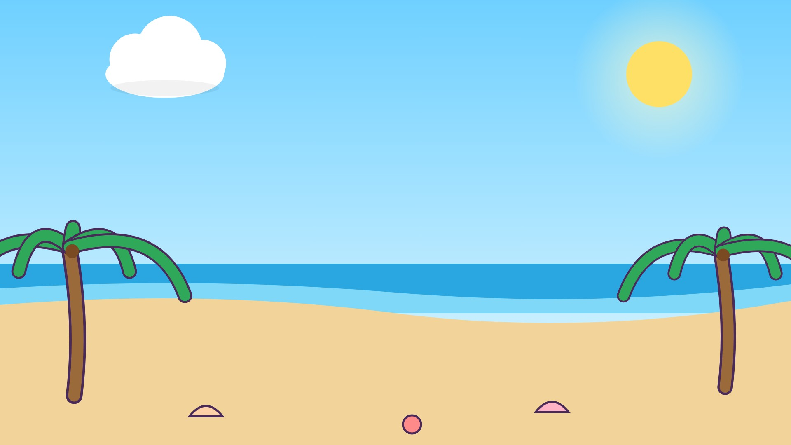




ك
كَ

Slide 2
كَأَ
أ
أَ
ك
كَ

Slide 3
كَبَ
ب
بَ
ك
كَ

Slide 4
كَتَ
ت
تَ
ك
كَ

Slide 5
كَثَ
ث
ثَ
ك
كَ

Slide 6
كَجَ
ج
جَ
ك
كَ

Slide 7
كَحَ
ح
حَ
ك
كَ

Slide 8
كَخَ
خ
خَ
ك
كَ

Slide 9


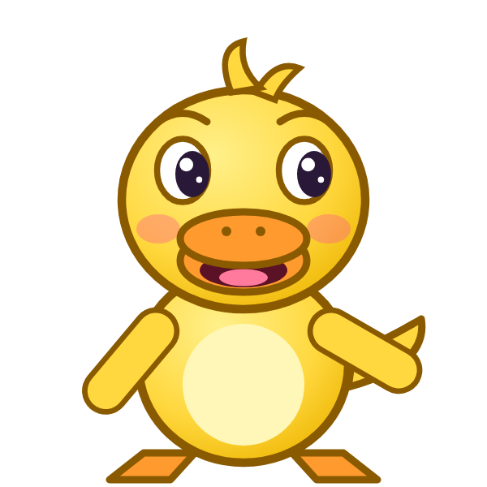
؟
خَ
كَ
كَجَ
كَخَ
خَكَ
Notes:
GAME TIME: ask the child to read the equation, then tap the animal holding the answer they think is right. Right answer = celebration slide. Wrong answer = a hidden try-again slide; tap the green button to try again.

Slide 10


كَخَ

Slide 11

Notes:
Hidden try-again slide: only shown after a wrong answer. Tap the green button to go back to the question.

Slide 12
كَدَ
د
دَ
ك
كَ

Slide 13
كَذَ
ذ
ذَ
ك
كَ

Slide 14
كَرَ
ر
رَ
ك
كَ

Slide 15
كَزَ
ز
زَ
ك
كَ

Slide 16
كَسَ
س
سَ
ك
كَ

Slide 17
كَشَ
ش
شَ
ك
كَ

Slide 18
كَصَ
ص
صَ
ك
كَ

Slide 19
كَضَ
ض
ضَ
ك
كَ

Slide 20
؟
ضَ
كَ
كَضَ
لَضَ
ضَكَ
Notes:
GAME TIME: ask the child to read the equation, then tap the animal holding the answer they think is right. Right answer = celebration slide. Wrong answer = a hidden try-again slide; tap the green button to try again.

Slide 21
كَضَ

Slide 22
Notes:
Hidden try-again slide: only shown after a wrong answer. Tap the green button to go back to the question.

Slide 23
كَطَ
ط
طَ
ك
كَ

Slide 24
كَظَ
ظ
ظَ
ك
كَ

Slide 25
كَعَ
ع
عَ
ك
كَ

Slide 26
كَغَ
غ
غَ
ك
كَ

Slide 27
كَفَ
ف
فَ
ك
كَ

Slide 28
كَقَ
ق
قَ
ك
كَ

Slide 29
أَكَبَ
ب
بَ
ك
كَ
أ
أَ

Slide 30
بَكَتَ
ت
تَ
ك
كَ
ب
بَ

Slide 31
؟
تَ
كَ
بَ
تَكَتَ
تَكَبَ
بَكَتَ
Notes:
GAME TIME: ask the child to read the equation, then tap the animal holding the answer they think is right. Right answer = celebration slide. Wrong answer = a hidden try-again slide; tap the green button to try again.

Slide 32
بَكَتَ

Slide 33
Notes:
Hidden try-again slide: only shown after a wrong answer. Tap the green button to go back to the question.

Slide 34
Notes:
Level up! Celebrate before the next set of letters.

Slide 35
تَكَثَ
ث
ثَ
ك
كَ
ت
تَ

Slide 36
ثَكَجَ
ج
جَ
ك
كَ
ث
ثَ

Slide 37
جَكَحَ
ح
حَ
ك
كَ
ج
جَ

Slide 38
حَكَخَ
خ
خَ
ك
كَ
ح
حَ

Slide 39
خَكَدَ
د
دَ
ك
كَ
خ
خَ

Slide 40
دَكَذَ
ذ
ذَ
ك
كَ
د
دَ

Slide 41
ذَكَرَ
ر
رَ
ك
كَ
ذ
ذَ

Slide 42
رَكَزَ
ز
زَ
ك
كَ
ر
رَ

Slide 43
؟
زَ
كَ
رَ
رَلَزَ
رَكَزَ
زَكَرَ
Notes:
GAME TIME: ask the child to read the equation, then tap the animal holding the answer they think is right. Right answer = celebration slide. Wrong answer = a hidden try-again slide; tap the green button to try again.

Slide 44
رَكَزَ

Slide 45
Notes:
Hidden try-again slide: only shown after a wrong answer. Tap the green button to go back to the question.

Slide 46
زَكَسَ
س
سَ
ك
كَ
ز
زَ

Slide 47
سَكَشَ
ش
شَ
ك
كَ
س
سَ

Slide 48
شَكَصَ
ص
صَ
ك
كَ
ش
شَ

Slide 49
صَكَضَ
ض
ضَ
ك
كَ
ص
صَ

Slide 50
ضَكَطَ
ط
طَ
ك
كَ
ض
ضَ

Slide 51
طَكَظَ
ظ
ظَ
ك
كَ
ط
طَ

Slide 52
ظَكَعَ
ع
عَ
ك
كَ
ظ
ظَ

Slide 53
عَكَغَ
غ
غَ
ك
كَ
ع
عَ

Slide 54
؟
غَ
كَ
عَ
عَكَغَ
عَكَعَ
غَكَعَ
Notes:
GAME TIME: ask the child to read the equation, then tap the animal holding the answer they think is right. Right answer = celebration slide. Wrong answer = a hidden try-again slide; tap the green button to try again.

Slide 55
عَكَغَ

Slide 56
Notes:
Hidden try-again slide: only shown after a wrong answer. Tap the green button to go back to the question.

Slide 57
غَكَفَ
ف
فَ
ك
كَ
غ
غَ

Slide 58
فَكَقَ
ق
قَ
ك
كَ
ف
فَ

Slide 59
قَكَأَ
أ
أَ
ك
كَ
ق
قَ

Slide 60
أَكَ
ك
كَ
أ
أَ

Slide 61
بَكَ
ك
كَ
ب
بَ

Slide 62
تَكَ
ك
كَ
ت
تَ

Slide 63
ثَكَ
ك
كَ
ث
ثَ

Slide 64
جَكَ
ك
كَ
ج
جَ

Slide 65
؟
كَ
جَ
حَكَ
كَجَ
جَكَ
Notes:
GAME TIME: ask the child to read the equation, then tap the animal holding the answer they think is right. Right answer = celebration slide. Wrong answer = a hidden try-again slide; tap the green button to try again.

Slide 66
جَكَ

Slide 67
Notes:
Hidden try-again slide: only shown after a wrong answer. Tap the green button to go back to the question.

Slide 68
Notes:
Level up! Celebrate before the next set of letters.

Slide 69
حَكَ
ك
كَ
ح
حَ

Slide 70
خَكَ
ك
كَ
خ
خَ

Slide 71
دَكَ
ك
كَ
د
دَ

Slide 72
ذَكَ
ك
كَ
ذ
ذَ

Slide 73
رَكَ
ك
كَ
ر
رَ

Slide 74
زَكَ
ك
كَ
ز
زَ

Slide 75
سَكَ
ك
كَ
س
سَ

Slide 76
شَكَ
ك
كَ
ش
شَ

Slide 77
؟
كَ
شَ
شَلَ
شَكَ
كَشَ
Notes:
GAME TIME: ask the child to read the equation, then tap the animal holding the answer they think is right. Right answer = celebration slide. Wrong answer = a hidden try-again slide; tap the green button to try again.

Slide 78
شَكَ

Slide 79
Notes:
Hidden try-again slide: only shown after a wrong answer. Tap the green button to go back to the question.

Slide 80
صَكَ
ك
كَ
ص
صَ

Slide 81
ضَكَ
ك
كَ
ض
ضَ

Slide 82
طَكَ
ك
كَ
ط
طَ

Slide 83
ظَكَ
ك
كَ
ظ
ظَ

Slide 84
عَكَ
ك
كَ
ع
عَ

Slide 85
غَكَ
ك
كَ
غ
غَ

Slide 86
فَكَ
ك
كَ
ف
فَ

Slide 87
قَكَ
ك
كَ
ق
قَ

Slide 88
Notes:
Finished! Give the child a big cheer.

