Slide 1
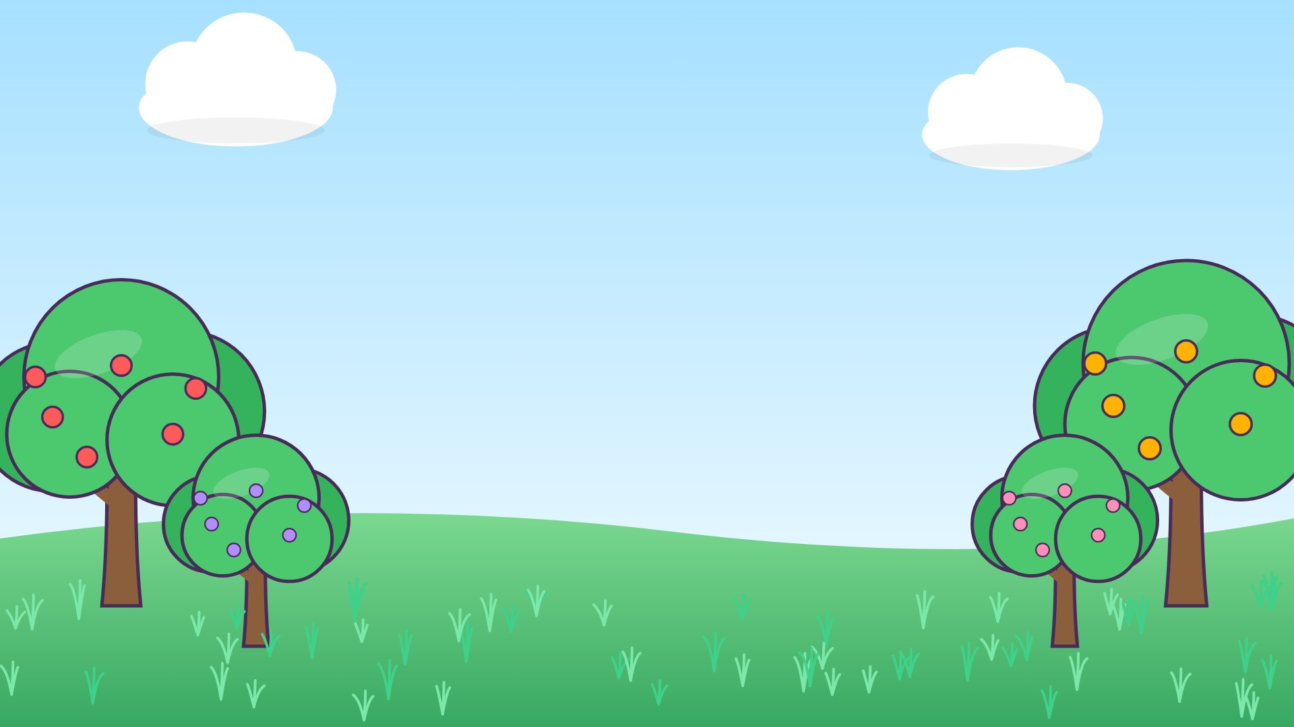
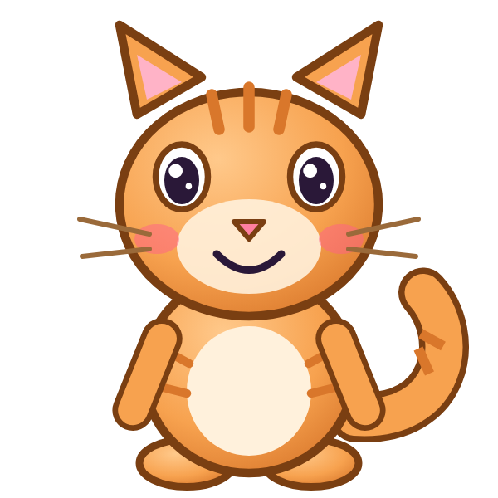



ل
لَ

Slide 2
لَأَ
أ
أَ
ل
لَ

Slide 3
لَبَ
ب
بَ
ل
لَ

Slide 4
لَتَ
ت
تَ
ل
لَ

Slide 5
لَثَ
ث
ثَ
ل
لَ

Slide 6
لَجَ
ج
جَ
ل
لَ

Slide 7
لَحَ
ح
حَ
ل
لَ

Slide 8
لَخَ
خ
خَ
ل
لَ

Slide 9

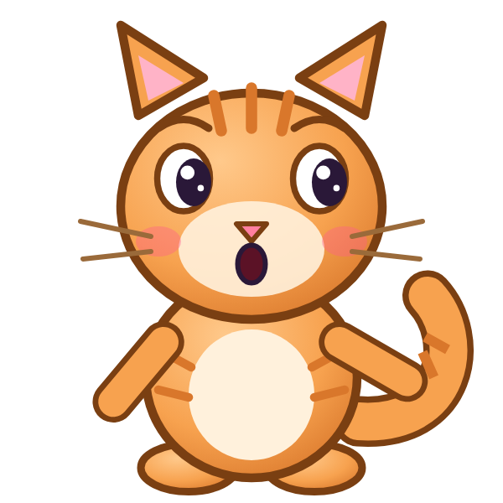

؟
خَ
لَ
لَجَ
لَخَ
خَلَ
Notes:
GAME TIME: ask the child to read the equation, then tap the animal holding the answer they think is right. Right answer = celebration slide. Wrong answer = a hidden try-again slide; tap the green button to try again.

Slide 10


لَخَ

Slide 11

Notes:
Hidden try-again slide: only shown after a wrong answer. Tap the green button to go back to the question.

Slide 12
لَدَ
د
دَ
ل
لَ

Slide 13
لَذَ
ذ
ذَ
ل
لَ

Slide 14
لَرَ
ر
رَ
ل
لَ

Slide 15
لَزَ
ز
زَ
ل
لَ

Slide 16
لَسَ
س
سَ
ل
لَ

Slide 17
لَشَ
ش
شَ
ل
لَ

Slide 18
لَصَ
ص
صَ
ل
لَ

Slide 19
لَضَ
ض
ضَ
ل
لَ

Slide 20
؟
ضَ
لَ
لَضَ
مَضَ
ضَلَ
Notes:
GAME TIME: ask the child to read the equation, then tap the animal holding the answer they think is right. Right answer = celebration slide. Wrong answer = a hidden try-again slide; tap the green button to try again.

Slide 21
لَضَ

Slide 22
Notes:
Hidden try-again slide: only shown after a wrong answer. Tap the green button to go back to the question.

Slide 23
لَطَ
ط
طَ
ل
لَ

Slide 24
لَظَ
ظ
ظَ
ل
لَ

Slide 25
لَعَ
ع
عَ
ل
لَ

Slide 26
لَغَ
غ
غَ
ل
لَ

Slide 27
لَفَ
ف
فَ
ل
لَ

Slide 28
لَقَ
ق
قَ
ل
لَ

Slide 29
لَكَ
ك
كَ
ل
لَ

Slide 30
أَلَبَ
ب
بَ
ل
لَ
أ
أَ

Slide 31
؟
بَ
لَ
أَ
بَلَبَ
بَلَأَ
أَلَبَ
Notes:
GAME TIME: ask the child to read the equation, then tap the animal holding the answer they think is right. Right answer = celebration slide. Wrong answer = a hidden try-again slide; tap the green button to try again.

Slide 32
أَلَبَ

Slide 33
Notes:
Hidden try-again slide: only shown after a wrong answer. Tap the green button to go back to the question.

Slide 34
Notes:
Level up! Celebrate before the next set of letters.

Slide 35
بَلَتَ
ت
تَ
ل
لَ
ب
بَ

Slide 36
تَلَثَ
ث
ثَ
ل
لَ
ت
تَ

Slide 37
ثَلَجَ
ج
جَ
ل
لَ
ث
ثَ

Slide 38
جَلَحَ
ح
حَ
ل
لَ
ج
جَ

Slide 39
حَلَخَ
خ
خَ
ل
لَ
ح
حَ

Slide 40
خَلَدَ
د
دَ
ل
لَ
خ
خَ

Slide 41
دَلَذَ
ذ
ذَ
ل
لَ
د
دَ

Slide 42
ذَلَرَ
ر
رَ
ل
لَ
ذ
ذَ

Slide 43
؟
رَ
لَ
ذَ
ذَمَرَ
ذَلَرَ
رَلَذَ
Notes:
GAME TIME: ask the child to read the equation, then tap the animal holding the answer they think is right. Right answer = celebration slide. Wrong answer = a hidden try-again slide; tap the green button to try again.

Slide 44
ذَلَرَ

Slide 45
Notes:
Hidden try-again slide: only shown after a wrong answer. Tap the green button to go back to the question.

Slide 46
رَلَزَ
ز
زَ
ل
لَ
ر
رَ

Slide 47
زَلَسَ
س
سَ
ل
لَ
ز
زَ

Slide 48
سَلَشَ
ش
شَ
ل
لَ
س
سَ

Slide 49
شَلَصَ
ص
صَ
ل
لَ
ش
شَ

Slide 50
صَلَضَ
ض
ضَ
ل
لَ
ص
صَ

Slide 51
ضَلَطَ
ط
طَ
ل
لَ
ض
ضَ

Slide 52
طَلَظَ
ظ
ظَ
ل
لَ
ط
طَ

Slide 53
ظَلَعَ
ع
عَ
ل
لَ
ظ
ظَ

Slide 54
؟
عَ
لَ
ظَ
ظَلَعَ
ظَلَغَ
عَلَظَ
Notes:
GAME TIME: ask the child to read the equation, then tap the animal holding the answer they think is right. Right answer = celebration slide. Wrong answer = a hidden try-again slide; tap the green button to try again.

Slide 55
ظَلَعَ

Slide 56
Notes:
Hidden try-again slide: only shown after a wrong answer. Tap the green button to go back to the question.

Slide 57
عَلَغَ
غ
غَ
ل
لَ
ع
عَ

Slide 58
غَلَفَ
ف
فَ
ل
لَ
غ
غَ

Slide 59
فَلَقَ
ق
قَ
ل
لَ
ف
فَ

Slide 60
قَلَكَ
ك
كَ
ل
لَ
ق
قَ

Slide 61
كَلَأَ
أ
أَ
ل
لَ
ك
كَ

Slide 62
أَلَ
ل
لَ
أ
أَ

Slide 63
بَلَ
ل
لَ
ب
بَ

Slide 64
تَلَ
ل
لَ
ت
تَ

Slide 65
؟
لَ
تَ
ثَلَ
لَتَ
تَلَ
Notes:
GAME TIME: ask the child to read the equation, then tap the animal holding the answer they think is right. Right answer = celebration slide. Wrong answer = a hidden try-again slide; tap the green button to try again.

Slide 66
تَلَ

Slide 67
Notes:
Hidden try-again slide: only shown after a wrong answer. Tap the green button to go back to the question.

Slide 68
Notes:
Level up! Celebrate before the next set of letters.

Slide 69
ثَلَ
ل
لَ
ث
ثَ

Slide 70
جَلَ
ل
لَ
ج
جَ

Slide 71
حَلَ
ل
لَ
ح
حَ

Slide 72
خَلَ
ل
لَ
خ
خَ

Slide 73
دَلَ
ل
لَ
د
دَ

Slide 74
ذَلَ
ل
لَ
ذ
ذَ

Slide 75
رَلَ
ل
لَ
ر
رَ

Slide 76
زَلَ
ل
لَ
ز
زَ

Slide 77
؟
لَ
زَ
زَمَ
زَلَ
لَزَ
Notes:
GAME TIME: ask the child to read the equation, then tap the animal holding the answer they think is right. Right answer = celebration slide. Wrong answer = a hidden try-again slide; tap the green button to try again.

Slide 78
زَلَ

Slide 79
Notes:
Hidden try-again slide: only shown after a wrong answer. Tap the green button to go back to the question.

Slide 80
سَلَ
ل
لَ
س
سَ

Slide 81
شَلَ
ل
لَ
ش
شَ

Slide 82
صَلَ
ل
لَ
ص
صَ

Slide 83
ضَلَ
ل
لَ
ض
ضَ

Slide 84
طَلَ
ل
لَ
ط
طَ

Slide 85
ظَلَ
ل
لَ
ظ
ظَ

Slide 86
عَلَ
ل
لَ
ع
عَ

Slide 87
غَلَ
ل
لَ
غ
غَ

Slide 88
؟
لَ
غَ
غَلَ
عَلَ
لَغَ
Notes:
GAME TIME: ask the child to read the equation, then tap the animal holding the answer they think is right. Right answer = celebration slide. Wrong answer = a hidden try-again slide; tap the green button to try again.

Slide 89
غَلَ

Slide 90
Notes:
Hidden try-again slide: only shown after a wrong answer. Tap the green button to go back to the question.

Slide 91
فَلَ
ل
لَ
ف
فَ

Slide 92
قَلَ
ل
لَ
ق
قَ

Slide 93
كَلَ
ل
لَ
ك
كَ

Slide 94
Notes:
Finished! Give the child a big cheer.

