Slide 1
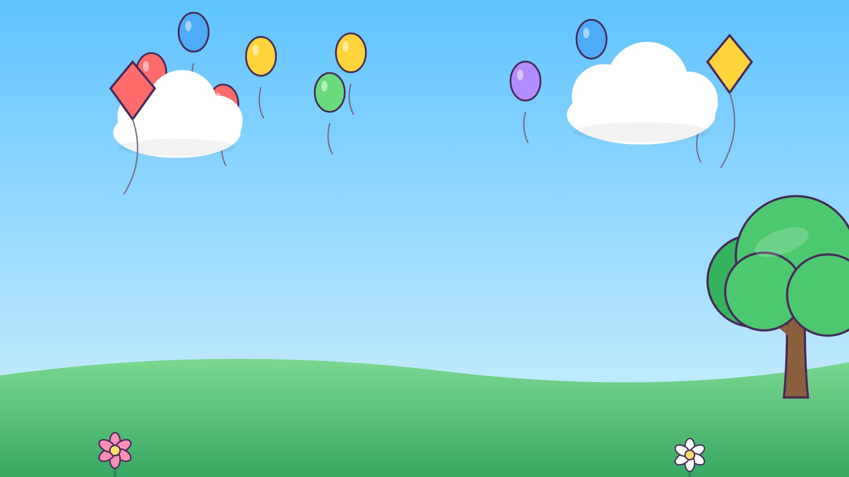


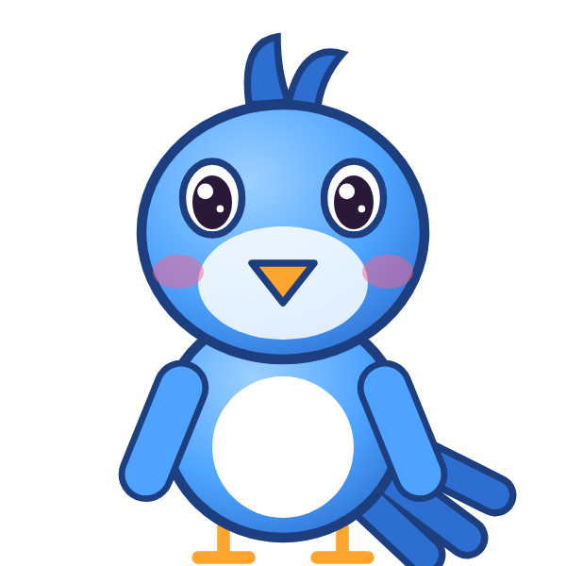

م
مَ

Slide 2
مَأَ
أ
أَ
م
مَ

Slide 3
مَبَ
ب
بَ
م
مَ

Slide 4
مَتَ
ت
تَ
م
مَ

Slide 5
مَثَ
ث
ثَ
م
مَ

Slide 6
مَجَ
ج
جَ
م
مَ

Slide 7
مَحَ
ح
حَ
م
مَ

Slide 8
مَخَ
خ
خَ
م
مَ

Slide 9


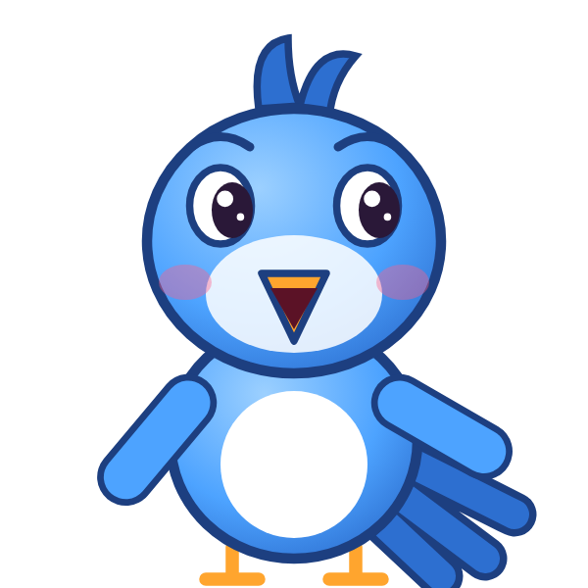
؟
خَ
مَ
مَجَ
مَخَ
خَمَ
Notes:
GAME TIME: ask the child to read the equation, then tap the animal holding the answer they think is right. Right answer = celebration slide. Wrong answer = a hidden try-again slide; tap the green button to try again.

Slide 10
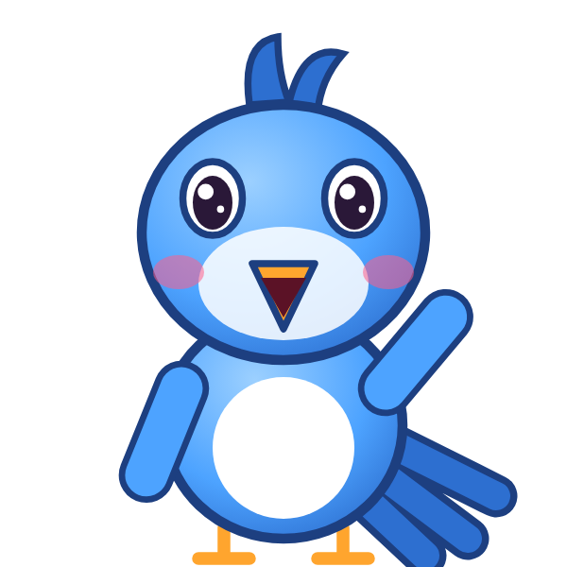

مَخَ

Slide 11
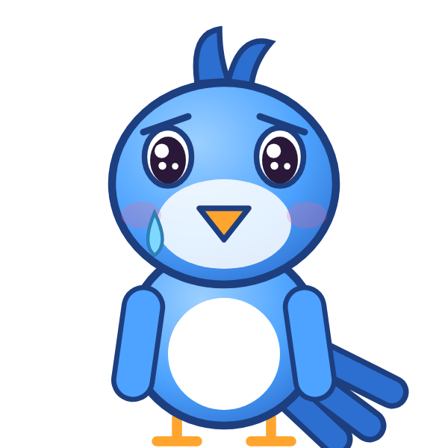
Notes:
Hidden try-again slide: only shown after a wrong answer. Tap the green button to go back to the question.

Slide 12
مَدَ
د
دَ
م
مَ

Slide 13
مَذَ
ذ
ذَ
م
مَ

Slide 14
مَرَ
ر
رَ
م
مَ

Slide 15
مَزَ
ز
زَ
م
مَ

Slide 16
مَسَ
س
سَ
م
مَ

Slide 17
مَشَ
ش
شَ
م
مَ

Slide 18
مَصَ
ص
صَ
م
مَ

Slide 19
مَضَ
ض
ضَ
م
مَ

Slide 20
؟
ضَ
مَ
مَضَ
نَضَ
ضَمَ
Notes:
GAME TIME: ask the child to read the equation, then tap the animal holding the answer they think is right. Right answer = celebration slide. Wrong answer = a hidden try-again slide; tap the green button to try again.

Slide 21
مَضَ

Slide 22
Notes:
Hidden try-again slide: only shown after a wrong answer. Tap the green button to go back to the question.

Slide 23
مَطَ
ط
طَ
م
مَ

Slide 24
مَظَ
ظ
ظَ
م
مَ

Slide 25
مَعَ
ع
عَ
م
مَ

Slide 26
مَغَ
غ
غَ
م
مَ

Slide 27
مَفَ
ف
فَ
م
مَ

Slide 28
مَقَ
ق
قَ
م
مَ

Slide 29
مَكَ
ك
كَ
م
مَ

Slide 30
مَلَ
ل
لَ
م
مَ

Slide 31
؟
لَ
مَ
مَمَ
لَمَ
مَلَ
Notes:
GAME TIME: ask the child to read the equation, then tap the animal holding the answer they think is right. Right answer = celebration slide. Wrong answer = a hidden try-again slide; tap the green button to try again.

Slide 32
مَلَ

Slide 33
Notes:
Hidden try-again slide: only shown after a wrong answer. Tap the green button to go back to the question.

Slide 34
Notes:
Level up! Celebrate before the next set of letters.

Slide 35
أَمَبَ
ب
بَ
م
مَ
أ
أَ

Slide 36
بَمَتَ
ت
تَ
م
مَ
ب
بَ

Slide 37
تَمَثَ
ث
ثَ
م
مَ
ت
تَ

Slide 38
ثَمَجَ
ج
جَ
م
مَ
ث
ثَ

Slide 39
جَمَحَ
ح
حَ
م
مَ
ج
جَ

Slide 40
حَمَخَ
خ
خَ
م
مَ
ح
حَ

Slide 41
خَمَدَ
د
دَ
م
مَ
خ
خَ

Slide 42
دَمَذَ
ذ
ذَ
م
مَ
د
دَ

Slide 43
؟
ذَ
مَ
دَ
دَنَذَ
دَمَذَ
ذَمَدَ
Notes:
GAME TIME: ask the child to read the equation, then tap the animal holding the answer they think is right. Right answer = celebration slide. Wrong answer = a hidden try-again slide; tap the green button to try again.

Slide 44
دَمَذَ

Slide 45
Notes:
Hidden try-again slide: only shown after a wrong answer. Tap the green button to go back to the question.

Slide 46
ذَمَرَ
ر
رَ
م
مَ
ذ
ذَ

Slide 47
رَمَزَ
ز
زَ
م
مَ
ر
رَ

Slide 48
زَمَسَ
س
سَ
م
مَ
ز
زَ

Slide 49
سَمَشَ
ش
شَ
م
مَ
س
سَ

Slide 50
شَمَصَ
ص
صَ
م
مَ
ش
شَ

Slide 51
صَمَضَ
ض
ضَ
م
مَ
ص
صَ

Slide 52
ضَمَطَ
ط
طَ
م
مَ
ض
ضَ

Slide 53
طَمَظَ
ظ
ظَ
م
مَ
ط
طَ

Slide 54
؟
ظَ
مَ
طَ
طَمَظَ
طَمَطَ
ظَمَطَ
Notes:
GAME TIME: ask the child to read the equation, then tap the animal holding the answer they think is right. Right answer = celebration slide. Wrong answer = a hidden try-again slide; tap the green button to try again.

Slide 55
طَمَظَ

Slide 56
Notes:
Hidden try-again slide: only shown after a wrong answer. Tap the green button to go back to the question.

Slide 57
ظَمَعَ
ع
عَ
م
مَ
ظ
ظَ

Slide 58
عَمَغَ
غ
غَ
م
مَ
ع
عَ

Slide 59
غَمَفَ
ف
فَ
م
مَ
غ
غَ

Slide 60
فَمَقَ
ق
قَ
م
مَ
ف
فَ

Slide 61
قَمَكَ
ك
كَ
م
مَ
ق
قَ

Slide 62
كَمَلَ
ل
لَ
م
مَ
ك
كَ

Slide 63
لَمَأَ
أ
أَ
م
مَ
ل
لَ

Slide 64
أَمَ
م
مَ
أ
أَ

Slide 65
؟
مَ
أَ
بَمَ
مَأَ
أَمَ
Notes:
GAME TIME: ask the child to read the equation, then tap the animal holding the answer they think is right. Right answer = celebration slide. Wrong answer = a hidden try-again slide; tap the green button to try again.

Slide 66
أَمَ

Slide 67
Notes:
Hidden try-again slide: only shown after a wrong answer. Tap the green button to go back to the question.

Slide 68
Notes:
Level up! Celebrate before the next set of letters.

Slide 69
بَمَ
م
مَ
ب
بَ

Slide 70
تَمَ
م
مَ
ت
تَ

Slide 71
ثَمَ
م
مَ
ث
ثَ

Slide 72
جَمَ
م
مَ
ج
جَ

Slide 73
حَمَ
م
مَ
ح
حَ

Slide 74
خَمَ
م
مَ
خ
خَ

Slide 75
دَمَ
م
مَ
د
دَ

Slide 76
ذَمَ
م
مَ
ذ
ذَ

Slide 77
؟
مَ
ذَ
ذَنَ
ذَمَ
مَذَ
Notes:
GAME TIME: ask the child to read the equation, then tap the animal holding the answer they think is right. Right answer = celebration slide. Wrong answer = a hidden try-again slide; tap the green button to try again.

Slide 78
ذَمَ

Slide 79
Notes:
Hidden try-again slide: only shown after a wrong answer. Tap the green button to go back to the question.

Slide 80
رَمَ
م
مَ
ر
رَ

Slide 81
زَمَ
م
مَ
ز
زَ

Slide 82
سَمَ
م
مَ
س
سَ

Slide 83
شَمَ
م
مَ
ش
شَ

Slide 84
صَمَ
م
مَ
ص
صَ

Slide 85
ضَمَ
م
مَ
ض
ضَ

Slide 86
طَمَ
م
مَ
ط
طَ

Slide 87
ظَمَ
م
مَ
ظ
ظَ

Slide 88
؟
مَ
ظَ
ظَمَ
طَمَ
مَظَ
Notes:
GAME TIME: ask the child to read the equation, then tap the animal holding the answer they think is right. Right answer = celebration slide. Wrong answer = a hidden try-again slide; tap the green button to try again.

Slide 89
ظَمَ

Slide 90
Notes:
Hidden try-again slide: only shown after a wrong answer. Tap the green button to go back to the question.

Slide 91
عَمَ
م
مَ
ع
عَ

Slide 92
غَمَ
م
مَ
غ
غَ

Slide 93
فَمَ
م
مَ
ف
فَ

Slide 94
قَمَ
م
مَ
ق
قَ

Slide 95
كَمَ
م
مَ
ك
كَ

Slide 96
لَمَ
م
مَ
ل
لَ

Slide 97

Notes:
Finished! Give the child a big cheer.

