Slide 1



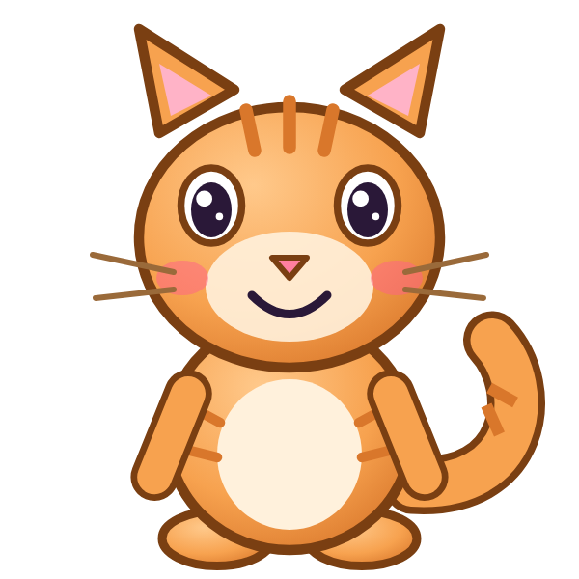

ه
هَ

Slide 2
هَأَ
أ
أَ
ه
هَ

Slide 3
هَبَ
ب
بَ
ه
هَ

Slide 4
هَتَ
ت
تَ
ه
هَ

Slide 5
هَثَ
ث
ثَ
ه
هَ

Slide 6
هَجَ
ج
جَ
ه
هَ

Slide 7
هَحَ
ح
حَ
ه
هَ

Slide 8
هَخَ
خ
خَ
ه
هَ

Slide 9
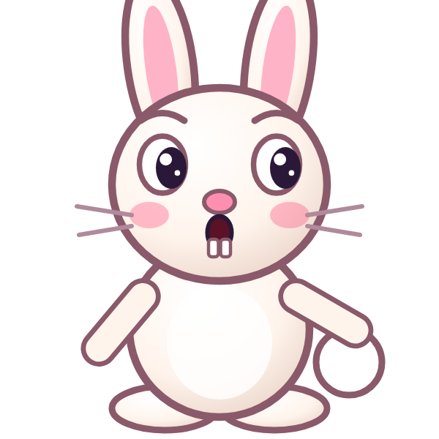

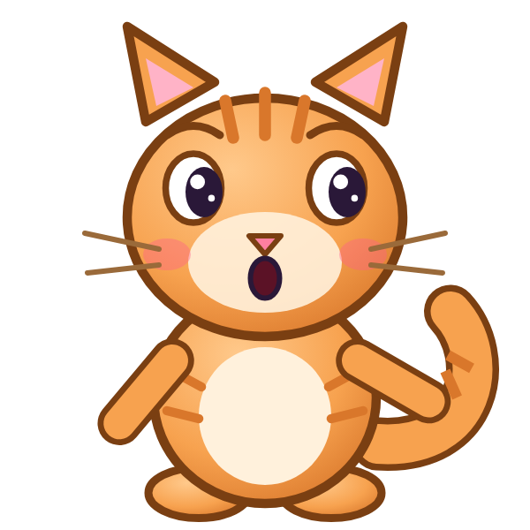
؟
خَ
هَ
هَجَ
هَخَ
خَهَ
Notes:
GAME TIME: ask the child to read the equation, then tap the animal holding the answer they think is right. Right answer = celebration slide. Wrong answer = a hidden try-again slide; tap the green button to try again.

Slide 10
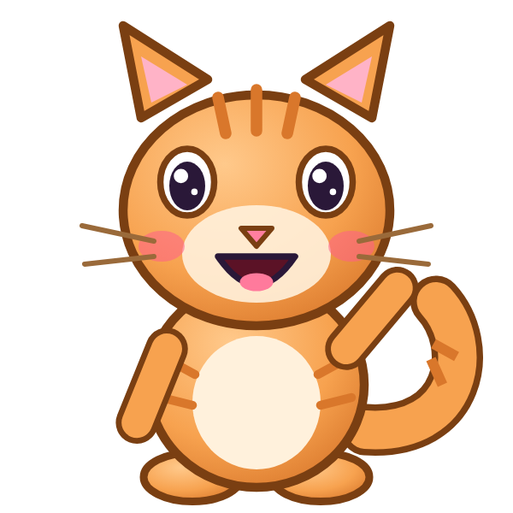

هَخَ

Slide 11

Notes:
Hidden try-again slide: only shown after a wrong answer. Tap the green button to go back to the question.

Slide 12
هَدَ
د
دَ
ه
هَ

Slide 13
هَذَ
ذ
ذَ
ه
هَ

Slide 14
هَرَ
ر
رَ
ه
هَ

Slide 15
هَزَ
ز
زَ
ه
هَ

Slide 16
هَسَ
س
سَ
ه
هَ

Slide 17
هَشَ
ش
شَ
ه
هَ

Slide 18
هَصَ
ص
صَ
ه
هَ

Slide 19
هَضَ
ض
ضَ
ه
هَ

Slide 20
؟
ضَ
هَ
هَضَ
وَضَ
ضَهَ
Notes:
GAME TIME: ask the child to read the equation, then tap the animal holding the answer they think is right. Right answer = celebration slide. Wrong answer = a hidden try-again slide; tap the green button to try again.

Slide 21
هَضَ

Slide 22
Notes:
Hidden try-again slide: only shown after a wrong answer. Tap the green button to go back to the question.

Slide 23
هَطَ
ط
طَ
ه
هَ

Slide 24
هَظَ
ظ
ظَ
ه
هَ

Slide 25
هَعَ
ع
عَ
ه
هَ

Slide 26
هَغَ
غ
غَ
ه
هَ

Slide 27
هَفَ
ف
فَ
ه
هَ

Slide 28
هَقَ
ق
قَ
ه
هَ

Slide 29
هَكَ
ك
كَ
ه
هَ

Slide 30
هَلَ
ل
لَ
ه
هَ

Slide 31
؟
لَ
هَ
هَمَ
لَهَ
هَلَ
Notes:
GAME TIME: ask the child to read the equation, then tap the animal holding the answer they think is right. Right answer = celebration slide. Wrong answer = a hidden try-again slide; tap the green button to try again.

Slide 32
هَلَ

Slide 33
Notes:
Hidden try-again slide: only shown after a wrong answer. Tap the green button to go back to the question.

Slide 34
Notes:
Level up! Celebrate before the next set of letters.

Slide 35
هَمَ
م
مَ
ه
هَ

Slide 36
هَنَ
ن
نَ
ه
هَ

Slide 37
أَهَبَ
ب
بَ
ه
هَ
أ
أَ

Slide 38
بَهَتَ
ت
تَ
ه
هَ
ب
بَ

Slide 39
تَهَثَ
ث
ثَ
ه
هَ
ت
تَ

Slide 40
ثَهَجَ
ج
جَ
ه
هَ
ث
ثَ

Slide 41
جَهَحَ
ح
حَ
ه
هَ
ج
جَ

Slide 42
حَهَخَ
خ
خَ
ه
هَ
ح
حَ

Slide 43
؟
خَ
هَ
حَ
حَوَخَ
حَهَخَ
خَهَحَ
Notes:
GAME TIME: ask the child to read the equation, then tap the animal holding the answer they think is right. Right answer = celebration slide. Wrong answer = a hidden try-again slide; tap the green button to try again.

Slide 44
حَهَخَ

Slide 45
Notes:
Hidden try-again slide: only shown after a wrong answer. Tap the green button to go back to the question.

Slide 46
خَهَدَ
د
دَ
ه
هَ
خ
خَ

Slide 47
دَهَذَ
ذ
ذَ
ه
هَ
د
دَ

Slide 48
ذَهَرَ
ر
رَ
ه
هَ
ذ
ذَ

Slide 49
رَهَزَ
ز
زَ
ه
هَ
ر
رَ

Slide 50
زَهَسَ
س
سَ
ه
هَ
ز
زَ

Slide 51
سَهَشَ
ش
شَ
ه
هَ
س
سَ

Slide 52
شَهَصَ
ص
صَ
ه
هَ
ش
شَ

Slide 53
صَهَضَ
ض
ضَ
ه
هَ
ص
صَ

Slide 54
؟
ضَ
هَ
صَ
صَهَضَ
صَهَصَ
ضَهَصَ
Notes:
GAME TIME: ask the child to read the equation, then tap the animal holding the answer they think is right. Right answer = celebration slide. Wrong answer = a hidden try-again slide; tap the green button to try again.

Slide 55
صَهَضَ

Slide 56
Notes:
Hidden try-again slide: only shown after a wrong answer. Tap the green button to go back to the question.

Slide 57
ضَهَطَ
ط
طَ
ه
هَ
ض
ضَ

Slide 58
طَهَظَ
ظ
ظَ
ه
هَ
ط
طَ

Slide 59
ظَهَعَ
ع
عَ
ه
هَ
ظ
ظَ

Slide 60
عَهَغَ
غ
غَ
ه
هَ
ع
عَ

Slide 61
غَهَفَ
ف
فَ
ه
هَ
غ
غَ

Slide 62
فَهَقَ
ق
قَ
ه
هَ
ف
فَ

Slide 63
قَهَكَ
ك
كَ
ه
هَ
ق
قَ

Slide 64
كَهَلَ
ل
لَ
ه
هَ
ك
كَ

Slide 65
؟
لَ
هَ
كَ
لَهَلَ
لَهَكَ
كَهَلَ
Notes:
GAME TIME: ask the child to read the equation, then tap the animal holding the answer they think is right. Right answer = celebration slide. Wrong answer = a hidden try-again slide; tap the green button to try again.

Slide 66
كَهَلَ

Slide 67
Notes:
Hidden try-again slide: only shown after a wrong answer. Tap the green button to go back to the question.

Slide 68
Notes:
Level up! Celebrate before the next set of letters.

Slide 69
لَهَمَ
م
مَ
ه
هَ
ل
لَ

Slide 70
مَهَنَ
ن
نَ
ه
هَ
م
مَ

Slide 71
نَهَأَ
أ
أَ
ه
هَ
ن
نَ

Slide 72
أَهَ
ه
هَ
أ
أَ

Slide 73
بَهَ
ه
هَ
ب
بَ

Slide 74
تَهَ
ه
هَ
ت
تَ

Slide 75
ثَهَ
ه
هَ
ث
ثَ

Slide 76
جَهَ
ه
هَ
ج
جَ

Slide 77
؟
هَ
جَ
جَوَ
جَهَ
هَجَ
Notes:
GAME TIME: ask the child to read the equation, then tap the animal holding the answer they think is right. Right answer = celebration slide. Wrong answer = a hidden try-again slide; tap the green button to try again.

Slide 78
جَهَ

Slide 79
Notes:
Hidden try-again slide: only shown after a wrong answer. Tap the green button to go back to the question.

Slide 80
حَهَ
ه
هَ
ح
حَ

Slide 81
خَهَ
ه
هَ
خ
خَ

Slide 82
دَهَ
ه
هَ
د
دَ

Slide 83
ذَهَ
ه
هَ
ذ
ذَ

Slide 84
رَهَ
ه
هَ
ر
رَ

Slide 85
زَهَ
ه
هَ
ز
زَ

Slide 86
سَهَ
ه
هَ
س
سَ

Slide 87
شَهَ
ه
هَ
ش
شَ

Slide 88
؟
هَ
شَ
شَهَ
سَهَ
هَشَ
Notes:
GAME TIME: ask the child to read the equation, then tap the animal holding the answer they think is right. Right answer = celebration slide. Wrong answer = a hidden try-again slide; tap the green button to try again.

Slide 89
شَهَ

Slide 90
Notes:
Hidden try-again slide: only shown after a wrong answer. Tap the green button to go back to the question.

Slide 91
صَهَ
ه
هَ
ص
صَ

Slide 92
ضَهَ
ه
هَ
ض
ضَ

Slide 93
طَهَ
ه
هَ
ط
طَ

Slide 94
ظَهَ
ه
هَ
ظ
ظَ

Slide 95
عَهَ
ه
هَ
ع
عَ

Slide 96
غَهَ
ه
هَ
غ
غَ

Slide 97
فَهَ
ه
هَ
ف
فَ

Slide 98
قَهَ
ه
هَ
ق
قَ

Slide 99
؟
هَ
قَ
قَوَ
هَقَ
قَهَ
Notes:
GAME TIME: ask the child to read the equation, then tap the animal holding the answer they think is right. Right answer = celebration slide. Wrong answer = a hidden try-again slide; tap the green button to try again.

Slide 100
قَهَ

Slide 101
Notes:
Hidden try-again slide: only shown after a wrong answer. Tap the green button to go back to the question.

Slide 102
Notes:
Level up! Celebrate before the next set of letters.

Slide 103
كَهَ
ه
هَ
ك
كَ

Slide 104
لَهَ
ه
هَ
ل
لَ

Slide 105
مَهَ
ه
هَ
م
مَ

Slide 106
نَهَ
ه
هَ
ن
نَ

Slide 107

Notes:
Finished! Give the child a big cheer.

