Slide 1
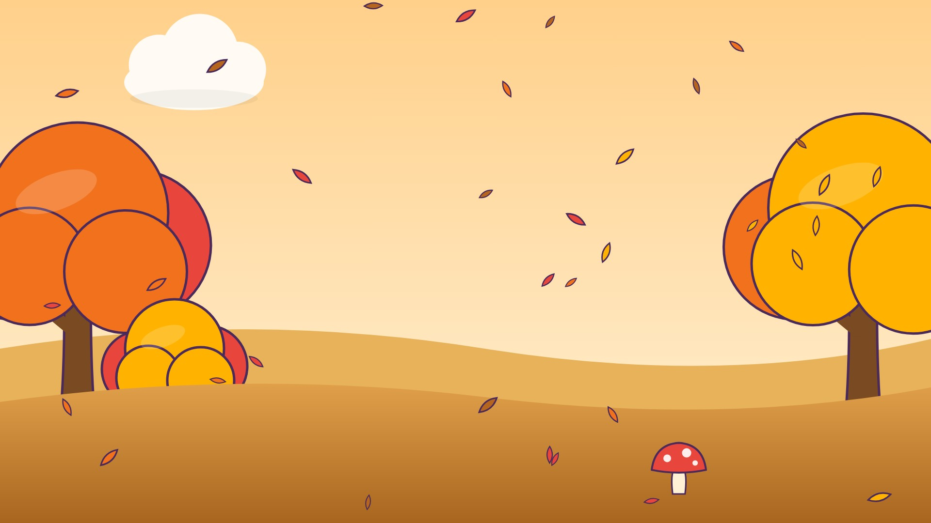




و
وَ

Slide 2
وَأَ
أ
أَ
و
وَ

Slide 3
وَبَ
ب
بَ
و
وَ

Slide 4
وَتَ
ت
تَ
و
وَ

Slide 5
وَثَ
ث
ثَ
و
وَ

Slide 6
وَجَ
ج
جَ
و
وَ

Slide 7
وَحَ
ح
حَ
و
وَ

Slide 8
وَخَ
خ
خَ
و
وَ

Slide 9



؟
خَ
وَ
وَجَ
وَخَ
خَوَ
Notes:
GAME TIME: ask the child to read the equation, then tap the animal holding the answer they think is right. Right answer = celebration slide. Wrong answer = a hidden try-again slide; tap the green button to try again.

Slide 10


وَخَ

Slide 11

Notes:
Hidden try-again slide: only shown after a wrong answer. Tap the green button to go back to the question.

Slide 12
وَدَ
د
دَ
و
وَ

Slide 13
وَذَ
ذ
ذَ
و
وَ

Slide 14
وَرَ
ر
رَ
و
وَ

Slide 15
وَزَ
ز
زَ
و
وَ

Slide 16
وَسَ
س
سَ
و
وَ

Slide 17
وَشَ
ش
شَ
و
وَ

Slide 18
وَصَ
ص
صَ
و
وَ

Slide 19
وَضَ
ض
ضَ
و
وَ

Slide 20
؟
ضَ
وَ
وَضَ
يَضَ
ضَوَ
Notes:
GAME TIME: ask the child to read the equation, then tap the animal holding the answer they think is right. Right answer = celebration slide. Wrong answer = a hidden try-again slide; tap the green button to try again.

Slide 21
وَضَ

Slide 22
Notes:
Hidden try-again slide: only shown after a wrong answer. Tap the green button to go back to the question.

Slide 23
وَطَ
ط
طَ
و
وَ

Slide 24
وَظَ
ظ
ظَ
و
وَ

Slide 25
وَعَ
ع
عَ
و
وَ

Slide 26
وَغَ
غ
غَ
و
وَ

Slide 27
وَفَ
ف
فَ
و
وَ

Slide 28
وَقَ
ق
قَ
و
وَ

Slide 29
وَكَ
ك
كَ
و
وَ

Slide 30
وَلَ
ل
لَ
و
وَ

Slide 31
؟
لَ
وَ
وَمَ
لَوَ
وَلَ
Notes:
GAME TIME: ask the child to read the equation, then tap the animal holding the answer they think is right. Right answer = celebration slide. Wrong answer = a hidden try-again slide; tap the green button to try again.

Slide 32
وَلَ

Slide 33
Notes:
Hidden try-again slide: only shown after a wrong answer. Tap the green button to go back to the question.

Slide 34
Notes:
Level up! Celebrate before the next set of letters.

Slide 35
وَمَ
م
مَ
و
وَ

Slide 36
وَنَ
ن
نَ
و
وَ

Slide 37
وَهَ
ه
هَ
و
وَ

Slide 38
أَوَبَ
ب
بَ
و
وَ
أ
أَ

Slide 39
بَوَتَ
ت
تَ
و
وَ
ب
بَ

Slide 40
تَوَثَ
ث
ثَ
و
وَ
ت
تَ

Slide 41
ثَوَجَ
ج
جَ
و
وَ
ث
ثَ

Slide 42
جَوَحَ
ح
حَ
و
وَ
ج
جَ

Slide 43
؟
حَ
وَ
جَ
جَيَحَ
جَوَحَ
حَوَجَ
Notes:
GAME TIME: ask the child to read the equation, then tap the animal holding the answer they think is right. Right answer = celebration slide. Wrong answer = a hidden try-again slide; tap the green button to try again.

Slide 44
جَوَحَ

Slide 45
Notes:
Hidden try-again slide: only shown after a wrong answer. Tap the green button to go back to the question.

Slide 46
حَوَخَ
خ
خَ
و
وَ
ح
حَ

Slide 47
خَوَدَ
د
دَ
و
وَ
خ
خَ

Slide 48
دَوَذَ
ذ
ذَ
و
وَ
د
دَ

Slide 49
ذَوَرَ
ر
رَ
و
وَ
ذ
ذَ

Slide 50
رَوَزَ
ز
زَ
و
وَ
ر
رَ

Slide 51
زَوَسَ
س
سَ
و
وَ
ز
زَ

Slide 52
سَوَشَ
ش
شَ
و
وَ
س
سَ

Slide 53
شَوَصَ
ص
صَ
و
وَ
ش
شَ

Slide 54
؟
صَ
وَ
شَ
شَوَصَ
شَوَضَ
صَوَشَ
Notes:
GAME TIME: ask the child to read the equation, then tap the animal holding the answer they think is right. Right answer = celebration slide. Wrong answer = a hidden try-again slide; tap the green button to try again.

Slide 55
شَوَصَ

Slide 56
Notes:
Hidden try-again slide: only shown after a wrong answer. Tap the green button to go back to the question.

Slide 57
صَوَضَ
ض
ضَ
و
وَ
ص
صَ

Slide 58
ضَوَطَ
ط
طَ
و
وَ
ض
ضَ

Slide 59
طَوَظَ
ظ
ظَ
و
وَ
ط
طَ

Slide 60
ظَوَعَ
ع
عَ
و
وَ
ظ
ظَ

Slide 61
عَوَغَ
غ
غَ
و
وَ
ع
عَ

Slide 62
غَوَفَ
ف
فَ
و
وَ
غ
غَ

Slide 63
فَوَقَ
ق
قَ
و
وَ
ف
فَ

Slide 64
قَوَكَ
ك
كَ
و
وَ
ق
قَ

Slide 65
؟
كَ
وَ
قَ
فَوَكَ
كَوَقَ
قَوَكَ
Notes:
GAME TIME: ask the child to read the equation, then tap the animal holding the answer they think is right. Right answer = celebration slide. Wrong answer = a hidden try-again slide; tap the green button to try again.

Slide 66
قَوَكَ

Slide 67
Notes:
Hidden try-again slide: only shown after a wrong answer. Tap the green button to go back to the question.

Slide 68
Notes:
Level up! Celebrate before the next set of letters.

Slide 69
كَوَلَ
ل
لَ
و
وَ
ك
كَ

Slide 70
لَوَمَ
م
مَ
و
وَ
ل
لَ

Slide 71
مَوَنَ
ن
نَ
و
وَ
م
مَ

Slide 72
نَوَهَ
ه
هَ
و
وَ
ن
نَ

Slide 73
هَوَأَ
أ
أَ
و
وَ
ه
هَ

Slide 74
أَوَ
و
وَ
أ
أَ

Slide 75
بَوَ
و
وَ
ب
بَ

Slide 76
تَوَ
و
وَ
ت
تَ

Slide 77
؟
وَ
تَ
تَيَ
تَوَ
وَتَ
Notes:
GAME TIME: ask the child to read the equation, then tap the animal holding the answer they think is right. Right answer = celebration slide. Wrong answer = a hidden try-again slide; tap the green button to try again.

Slide 78
تَوَ

Slide 79
Notes:
Hidden try-again slide: only shown after a wrong answer. Tap the green button to go back to the question.

Slide 80
ثَوَ
و
وَ
ث
ثَ

Slide 81
جَوَ
و
وَ
ج
جَ

Slide 82
حَوَ
و
وَ
ح
حَ

Slide 83
خَوَ
و
وَ
خ
خَ

Slide 84
دَوَ
و
وَ
د
دَ

Slide 85
ذَوَ
و
وَ
ذ
ذَ

Slide 86
رَوَ
و
وَ
ر
رَ

Slide 87
زَوَ
و
وَ
ز
زَ

Slide 88
؟
وَ
زَ
زَوَ
رَوَ
وَزَ
Notes:
GAME TIME: ask the child to read the equation, then tap the animal holding the answer they think is right. Right answer = celebration slide. Wrong answer = a hidden try-again slide; tap the green button to try again.

Slide 89
زَوَ

Slide 90
Notes:
Hidden try-again slide: only shown after a wrong answer. Tap the green button to go back to the question.

Slide 91
سَوَ
و
وَ
س
سَ

Slide 92
شَوَ
و
وَ
ش
شَ

Slide 93
صَوَ
و
وَ
ص
صَ

Slide 94
ضَوَ
و
وَ
ض
ضَ

Slide 95
طَوَ
و
وَ
ط
طَ

Slide 96
ظَوَ
و
وَ
ظ
ظَ

Slide 97
عَوَ
و
وَ
ع
عَ

Slide 98
غَوَ
و
وَ
غ
غَ

Slide 99
؟
وَ
غَ
غَيَ
وَغَ
غَوَ
Notes:
GAME TIME: ask the child to read the equation, then tap the animal holding the answer they think is right. Right answer = celebration slide. Wrong answer = a hidden try-again slide; tap the green button to try again.

Slide 100
غَوَ

Slide 101
Notes:
Hidden try-again slide: only shown after a wrong answer. Tap the green button to go back to the question.

Slide 102
Notes:
Level up! Celebrate before the next set of letters.

Slide 103
فَوَ
و
وَ
ف
فَ

Slide 104
قَوَ
و
وَ
ق
قَ

Slide 105
كَوَ
و
وَ
ك
كَ

Slide 106
لَوَ
و
وَ
ل
لَ

Slide 107
مَوَ
و
وَ
م
مَ

Slide 108
نَوَ
و
وَ
ن
نَ

Slide 109
هَوَ
و
وَ
ه
هَ

Slide 110
Notes:
Finished! Give the child a big cheer.

