Slide 1

Review Games
بَ بٌ بَا أَبۡ بَّ
Everything so far: harakat, tanween, madd, sukun, shaddah
Start ▶

Slide 2

How to play: Frog Hop
1. Read the question at the top.
2. Tap the right lily pad.
3. Help the frog reach the island!

Slide 3

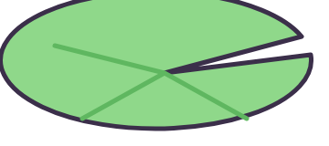

Find
بِ
بَ
بُ
بِ

Slide 4
Find
تٍ
تٍ
تٌ
تًا

Slide 5
Find
ثَا
ثَا
ثِي
ثُو

Slide 6
Find
قَنۡ
قَنۡ
قَنِ
قَنَ

Slide 7
Find
يَّ
يَّ
يَ
يِّ

Slide 8
You made it!

Slide 9
Find
بِ
بَ
بُ
Splash! Try again!
بِ

Slide 10
Find
تٍ
تٍ
تٌ
Splash! Try again!
تًا

Slide 11
Find
ثَا
ثَا
ثِي
Splash! Try again!
ثُو

Slide 12
Find
قَنۡ
قَنۡ
قَنِ
Splash! Try again!
قَنَ

Slide 13
Find
يَّ
يَّ
يَ
Splash! Try again!
يِّ

Slide 14

How to play: Penalty Kick
1. Read the question at the top.
2. Tap the right card in the goal.
3. Score 5 goals!

Slide 15
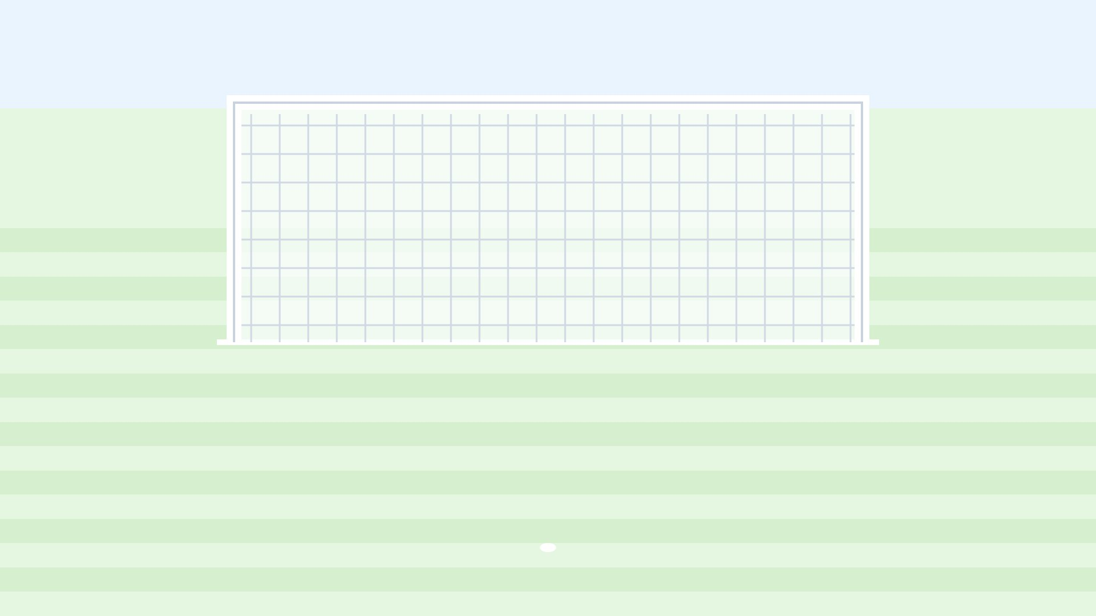

Find
نِي
نَا
نُو
نِي

Slide 16
Find
تَيۡ
تَيۡ
تَيَ
تَيِ
GOAL!

Slide 17
Find
جَّ
جَّ
جَ
جِّ
GOAL!

Slide 18
What is it called?
حُ
ضَمَّةٌ
مَدٌّ
تَنۡوِينٌ
GOAL!

Slide 19
Tap the word where we SAY the lam
السَّمَكُ
الۡوَلَدُ
الرَّجُلُ
GOAL!

Slide 20
CHAMPION!

Slide 21

Find
نِي
نَا
نُو
نِي
Saved! Try again!

Slide 22
Find
تَيۡ
تَيۡ
تَيَ
تَيِ
Saved! Try again!

Slide 23
Find
جَّ
جَّ
جَ
جِّ
Saved! Try again!

Slide 24
What is it called?
حُ
ضَمَّةٌ
مَدٌّ
تَنۡوِينٌ
Saved! Try again!

Slide 25
Tap the word where we SAY the lam
السَّمَكُ
الۡوَلَدُ
الرَّجُلُ
Saved! Try again!

Slide 26

How to play: Build a Robot
1. Read the question at the top.
2. Tap the right card.
3. Every right answer adds a part!

Slide 27

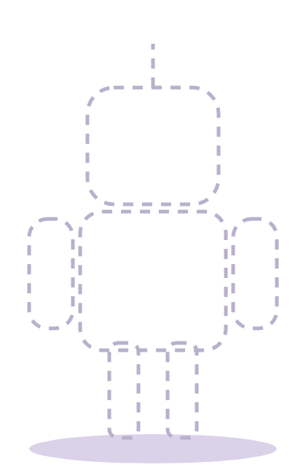
Find
حِّ
حَّ
حِّ
حِ

Slide 28
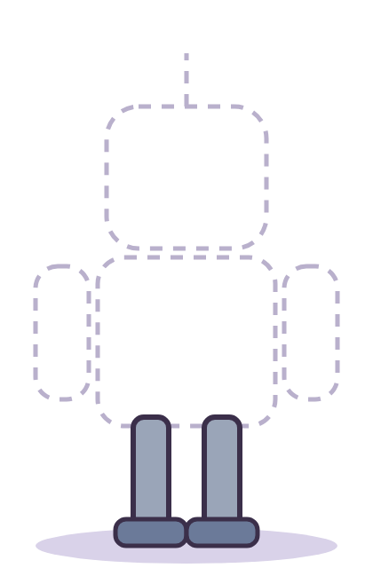
What is it called?
خُو
سُكُونٌ
فَتۡحَةٌ
مَدٌّ

Slide 29

Tap the word where we SAY the lam
الزَّهۡرُ
الصَّبۡرُ
الۡعِلۡمُ

Slide 30

Find
إِنَّ
إِنَّ
إِنُّ
إِنَ

Slide 31

What is it called?
رِ
كَسۡرَةٌ
شَدَّةٌ
تَنۡوِينٌ

Slide 32
Beep beep! Done!

Slide 33
Find
حِّ
حَّ
حِّ
حِ
Try again!

Slide 34
What is it called?
خُو
سُكُونٌ
فَتۡحَةٌ
مَدٌّ
Try again!

Slide 35
Tap the word where we SAY the lam
الزَّهۡرُ
الصَّبۡرُ
الۡعِلۡمُ
Try again!

Slide 36
Find
إِنَّ
إِنَّ
إِنُّ
إِنَ
Try again!

Slide 37
What is it called?
رِ
كَسۡرَةٌ
شَدَّةٌ
تَنۡوِينٌ
Try again!

Slide 38

How to play: Ice-Cream Tower
1. Read the question at the top.
2. Tap the right card.
3. Every right answer adds a scoop!

Slide 39


Tap the word where we SAY the lam
السَّمَكُ
الۡعِلۡمُ
التِّينُ

Slide 40

Find
مُعَلِّمٌ
مُعَلِمٌ
مُعَلِّمٌ
مُعُلِّمٌ

Slide 41

What is it called?
زٌ
تَنۡوِينٌ
شَدَّةٌ
كَسۡرَةٌ

Slide 42

Find
سِ
سُ
سِ
سَ

Slide 43

Find
شٌ
شٌ
شٍ
شًا

Slide 44
Yummy! Done!

Slide 45
Tap the word where we SAY the lam
السَّمَكُ
الۡعِلۡمُ
التِّينُ
Try again!

Slide 46
Find
مُعَلِّمٌ
مُعَلِمٌ
مُعَلِّمٌ
مُعُلِّمٌ
Try again!

Slide 47
What is it called?
زٌ
تَنۡوِينٌ
شَدَّةٌ
كَسۡرَةٌ
Try again!

Slide 48
Find
سِ
سُ
سِ
سَ
Try again!

Slide 49
Find
شٌ
شٌ
شٍ
شًا
Try again!

Slide 50

How to play: Rocket Launch
1. Read the question at the top.
2. Tap the right card to add fuel.
3. Full tank? 3, 2, 1... go!

Slide 51

What is it called?
سَّ
ضَمَّةٌ
شَدَّةٌ
فَتۡحَةٌ
FUEL

Slide 52
Find
شَ
شَ
شُ
شِ
FUEL

Slide 53
Find
صًا
صٍ
صًا
صٌ
FUEL

Slide 54
Find
ضَا
ضِي
ضَا
ضُو
FUEL

Slide 55
Find
شِطۡ
شِطَ
شِطِ
شِطۡ
FUEL

Slide 56

3, 2, 1... Blast off!
FUEL

Slide 57
What is it called?
سَّ
ضَمَّةٌ
شَدَّةٌ
فَتۡحَةٌ
Try again!
FUEL

Slide 58
Find
شَ
شَ
شُ
شِ
Try again!
FUEL

Slide 59
Find
صًا
صٍ
صًا
صٌ
Try again!
FUEL

Slide 60
Find
ضَا
ضِي
ضَا
ضُو
Try again!
FUEL

Slide 61
Find
شِطۡ
شِطَ
شِطِ
شِطۡ
Try again!
FUEL

Slide 62

How to play: Castle Doors
1. Read the question at the top.
2. Open the right door.
3. Find the treasure!

Slide 63

Room 1 of 5
Find
ضٍ
ضٍ
ضٌ
ضًا

Slide 64
Room 2 of 5
Find
طَا
طَا
طُو
طِي

Slide 65
Room 3 of 5
Find
فِظۡ
فِظۡ
فِظِ
فِظَ

Slide 66
Room 4 of 5
Find
عُّ
عُ
عُّ
عَّ

Slide 67
Room 5 of 5
What is it called?
غٌ
ضَمَّةٌ
فَتۡحَةٌ
تَنۡوِينٌ

Slide 68

Room 5 of 5
You found the treasure!

Slide 69
Room 1 of 5
Find
ضٍ
ضٍ
ضٌ
ضًا
Locked! Try again!

Slide 70
Room 2 of 5
Find
طَا
طَا
طُو
طِي
Locked! Try again!

Slide 71
Room 3 of 5
Find
فِظۡ
فِظۡ
فِظِ
فِظَ
Locked! Try again!

Slide 72
Room 4 of 5
Find
عُّ
عُ
عُّ
عَّ
Locked! Try again!

Slide 73
Room 5 of 5
What is it called?
غٌ
ضَمَّةٌ
فَتۡحَةٌ
تَنۡوِينٌ
Locked! Try again!

Slide 74

How to play: Mystery Picture
1. Read the question at the top.
2. Tap the right card.
3. A piece of the picture opens!

Slide 75
Find
سَعۡ
?
?
?
سَعۡ
سَعَ
?
?
?
سَعِ

Slide 76
Find
غَّ
?
?
غَ
غِّ
?
?
?
غَّ

Slide 77
What is it called?
أَفۡ
?
شَدَّةٌ
سُكُونٌ
?
?
?
كَسۡرَةٌ

Slide 78
Tap the word where we SAY the lam
السَّمَكُ
الۡكِتَابُ
?
?
?
النَّجۡمُ

Slide 79
Find
شَدَّ
شَدَ
شُدَّ
?
?
شَدَّ

Slide 80
What is it called?
لُ
ضَمَّةٌ
سُكُونٌ
?
شَدَّةٌ

Slide 81
It's a lion!

Slide 82
Find
سَعۡ
?
?
?
سَعۡ
سَعَ
?
?
?
سَعِ
Try again!

Slide 83
Find
غَّ
?
?
غَ
غِّ
?
?
?
غَّ
Try again!

Slide 84
What is it called?
أَفۡ
?
شَدَّةٌ
سُكُونٌ
?
?
?
كَسۡرَةٌ
Try again!

Slide 85
Tap the word where we SAY the lam
السَّمَكُ
الۡكِتَابُ
?
?
?
النَّجۡمُ
Try again!

Slide 86
Find
شَدَّ
شَدَ
شُدَّ
?
?
شَدَّ
Try again!

Slide 87
What is it called?
لُ
ضَمَّةٌ
سُكُونٌ
?
شَدَّةٌ
Try again!

Slide 88
What is it called?
قٌ
فَتۡحَةٌ
تَنۡوِينٌ
كَسۡرَةٌ

Slide 89
Tap the word where we SAY the lam
الشَّمۡسُ
الۡفِيلُ
السَّمَكُ

Slide 90
Find
مُدَرِّسٌ
مُدُرِّسٌ
مُدَرِسٌ
مُدَرِّسٌ

Slide 91
What is it called?
مُ
شَدَّةٌ
كَسۡرَةٌ
ضَمَّةٌ

Slide 92
Find
هِ
هِ
هَ
هُ

Slide 93
You made it!

Slide 94
What is it called?
قٌ
فَتۡحَةٌ
تَنۡوِينٌ
Splash! Try again!
كَسۡرَةٌ

Slide 95
Tap the word where we SAY the lam
الشَّمۡسُ
الۡفِيلُ
Splash! Try again!
السَّمَكُ

Slide 96
Find
مُدَرِّسٌ
مُدُرِّسٌ
مُدَرِسٌ
Splash! Try again!
مُدَرِّسٌ

Slide 97
What is it called?
مُ
شَدَّةٌ
كَسۡرَةٌ
Splash! Try again!
ضَمَّةٌ

Slide 98
Find
هِ
هِ
هَ
Splash! Try again!
هُ

Slide 99
Find
سَلَّمَ
سَلَّمَ
سَلَمَ
سُلَّمَ

Slide 100
What is it called?
هَّ
شَدَّةٌ
فَتۡحَةٌ
كَسۡرَةٌ
GOAL!

Slide 101
Find
وُ
وُ
وَ
وِ
GOAL!

Slide 102
Find
بًا
بًا
بٍ
بٌ
GOAL!

Slide 103
Find
تُو
تَا
تُو
تِي
GOAL!

Slide 104
CHAMPION!

Slide 105
Find
سَلَّمَ
سَلَّمَ
سَلَمَ
سُلَّمَ
Saved! Try again!

Slide 106
What is it called?
هَّ
شَدَّةٌ
فَتۡحَةٌ
كَسۡرَةٌ
Saved! Try again!

Slide 107
Find
وُ
وُ
وَ
وِ
Saved! Try again!

Slide 108
Find
بًا
بًا
بٍ
بٌ
Saved! Try again!

Slide 109
Find
تُو
تَا
تُو
تِي
Saved! Try again!

Slide 110
Find
بَ
بُ
بِ
بَ

Slide 111
Find
تٌ
تٍ
تًا
تٌ

Slide 112
Find
ثُو
ثُو
ثَا
ثِي

Slide 113
Find
زُنۡ
زُنۡ
زُنَ
زُنِ

Slide 114
Find
يِّ
يَّ
يِّ
يِ

Slide 115
Beep beep! Done!

Slide 116
Find
بَ
بُ
بِ
بَ
Try again!

Slide 117
Find
تٌ
تٍ
تًا
تٌ
Try again!

Slide 118
Find
ثُو
ثُو
ثَا
ثِي
Try again!

Slide 119
Find
زُنۡ
زُنۡ
زُنَ
زُنِ
Try again!

Slide 120
Find
يِّ
يَّ
يِّ
يِ
Try again!

Slide 121
Find
نُو
نِي
نُو
نَا

Slide 122
Find
ذَيۡ
ذَيِ
ذَيَ
ذَيۡ

Slide 123
Find
جُّ
جُّ
جُ
جَّ

Slide 124
What is it called?
حِ
كَسۡرَةٌ
ضَمَّةٌ
مَدٌّ

Slide 125
Tap the word where we SAY the lam
الصَّبۡرُ
الۡفِيلُ
الشَّمۡسُ

Slide 126
Yummy! Done!

Slide 127
Find
نُو
نِي
نُو
نَا
Try again!

Slide 128
Find
ذَيۡ
ذَيِ
ذَيَ
ذَيۡ
Try again!

Slide 129
Find
جُّ
جُّ
جُ
جَّ
Try again!

Slide 130
What is it called?
حِ
كَسۡرَةٌ
ضَمَّةٌ
مَدٌّ
Try again!

Slide 131
Tap the word where we SAY the lam
الصَّبۡرُ
الۡفِيلُ
الشَّمۡسُ
Try again!

Slide 132
Find
حَّ
حَ
حِّ
حَّ
FUEL

Slide 133
What is it called?
خَ
سُكُونٌ
ضَمَّةٌ
فَتۡحَةٌ
FUEL

Slide 134
Tap the word where we SAY the lam
الشَّمۡسُ
الدَّرۡسُ
الۡقَمَرُ
FUEL

Slide 135
Find
سَلَّمَ
سَلَمَ
سَلَّمَ
سُلَّمَ
FUEL

Slide 136
What is it called?
رُ
فَتۡحَةٌ
ضَمَّةٌ
كَسۡرَةٌ
FUEL

Slide 137
3, 2, 1... Blast off!
FUEL

Slide 138
Find
حَّ
حَ
حِّ
حَّ
Try again!
FUEL

Slide 139
What is it called?
خَ
سُكُونٌ
ضَمَّةٌ
فَتۡحَةٌ
Try again!
FUEL

Slide 140
Tap the word where we SAY the lam
الشَّمۡسُ
الدَّرۡسُ
الۡقَمَرُ
Try again!
FUEL

Slide 141
Find
سَلَّمَ
سَلَمَ
سَلَّمَ
سُلَّمَ
Try again!
FUEL

Slide 142
What is it called?
رُ
فَتۡحَةٌ
ضَمَّةٌ
كَسۡرَةٌ
Try again!
FUEL

Slide 143
Room 1 of 5
Tap the word where we SAY the lam
السَّمَكُ
الۡقَمَرُ
الرَّجُلُ

Slide 144
Room 2 of 5
Find
سُكَّرٌ
سُكُّرٌ
سُكَرٌ
سُكَّرٌ

Slide 145
Room 3 of 5
What is it called?
زَ
ضَمَّةٌ
فَتۡحَةٌ
مَدٌّ

Slide 146
Room 4 of 5
Find
سُ
سُ
سَ
سِ

Slide 147
Room 5 of 5
Find
شٍ
شًا
شٍ
شٌ

Slide 148
Room 5 of 5
You found the treasure!

Slide 149
Room 1 of 5
Tap the word where we SAY the lam
السَّمَكُ
الۡقَمَرُ
الرَّجُلُ
Locked! Try again!

Slide 150
Room 2 of 5
Find
سُكَّرٌ
سُكُّرٌ
سُكَرٌ
سُكَّرٌ
Locked! Try again!

Slide 151
Room 3 of 5
What is it called?
زَ
ضَمَّةٌ
فَتۡحَةٌ
مَدٌّ
Locked! Try again!

Slide 152
Room 4 of 5
Find
سُ
سُ
سَ
سِ
Locked! Try again!

Slide 153
Room 5 of 5
Find
شٍ
شًا
شٍ
شٌ
Locked! Try again!

Slide 154
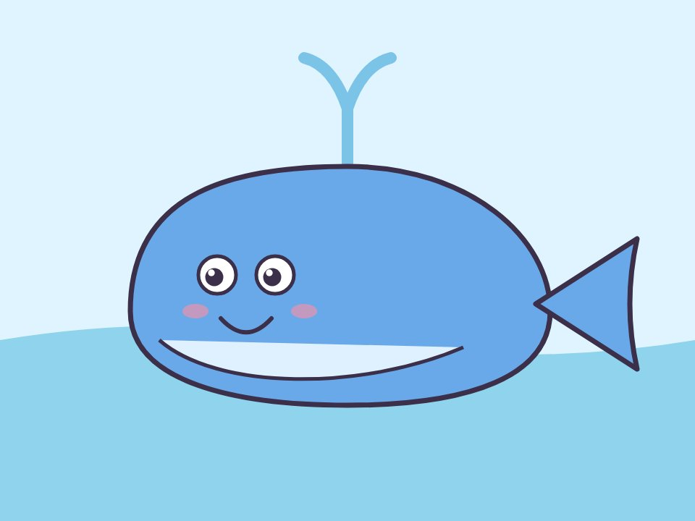
What is it called?
سِ
?
?
?
كَسۡرَةٌ
مَدٌّ
?
?
?
فَتۡحَةٌ

Slide 155
Find
شِ
?
?
شِ
شَ
?
?
?
شُ

Slide 156
Find
صٌ
?
صٍ
صًا
?
?
?
صٌ

Slide 157
Find
ضُو
ضِي
ضَا
?
?
?
ضُو

Slide 158
Find
شُطۡ
شُطِ
شُطۡ
?
?
شُطَ

Slide 159
Find
ظَّ
ظَ
ظَّ
?
ظِّ

Slide 160
It's a whale!

Slide 161
What is it called?
سِ
?
?
?
كَسۡرَةٌ
مَدٌّ
?
?
?
فَتۡحَةٌ
Try again!

Slide 162
Find
شِ
?
?
شِ
شَ
?
?
?
شُ
Try again!

Slide 163
Find
صٌ
?
صٍ
صًا
?
?
?
صٌ
Try again!

Slide 164
Find
ضُو
ضِي
ضَا
?
?
?
ضُو
Try again!

Slide 165
Find
شُطۡ
شُطِ
شُطۡ
?
?
شُطَ
Try again!

Slide 166
Find
ظَّ
ظَ
ظَّ
?
ظِّ
Try again!

Slide 167
Find
ضٌ
ضًا
ضٍ
ضٌ

Slide 168
Find
طَا
طِي
طُو
طَا

Slide 169
Find
قُظۡ
قُظۡ
قُظَ
قُظِ

Slide 170
Find
عُّ
عُ
عَّ
عُّ

Slide 171
What is it called?
غُ
شَدَّةٌ
ضَمَّةٌ
مَدٌّ

Slide 172
You made it!

Slide 173
Find
ضٌ
ضًا
ضٍ
Splash! Try again!
ضٌ

Slide 174
Find
طَا
طِي
طُو
Splash! Try again!
طَا

Slide 175
Find
قُظۡ
قُظۡ
قُظَ
Splash! Try again!
قُظِ

Slide 176
Find
عُّ
عُ
عَّ
Splash! Try again!
عُّ

Slide 177
What is it called?
غُ
شَدَّةٌ
ضَمَّةٌ
Splash! Try again!
مَدٌّ

Slide 178
Find
طُعۡ
طُعۡ
طُعَ
طُعِ

Slide 179
Find
غُّ
غَّ
غُّ
غُ
GOAL!

Slide 180
What is it called?
فُ
ضَمَّةٌ
كَسۡرَةٌ
مَدٌّ
GOAL!

Slide 181
Tap the word where we SAY the lam
التِّينُ
الۡقَمَرُ
الدَّرۡسُ
GOAL!

Slide 182
Find
شَدَّ
شَدَّ
شَدَ
شُدَّ
GOAL!

Slide 183
CHAMPION!

Slide 184
Find
طُعۡ
طُعۡ
طُعَ
طُعِ
Saved! Try again!

Slide 185
Find
غُّ
غَّ
غُّ
غُ
Saved! Try again!

Slide 186
What is it called?
فُ
ضَمَّةٌ
كَسۡرَةٌ
مَدٌّ
Saved! Try again!

Slide 187
Tap the word where we SAY the lam
التِّينُ
الۡقَمَرُ
الدَّرۡسُ
Saved! Try again!

Slide 188
Find
شَدَّ
شَدَّ
شَدَ
شُدَّ
Saved! Try again!

Slide 189
What is it called?
قُ
كَسۡرَةٌ
ضَمَّةٌ
فَتۡحَةٌ

Slide 190
Tap the word where we SAY the lam
الۡعِلۡمُ
الدَّرۡسُ
التِّينُ

Slide 191
Find
بَطَّةٌ
بَطَةٌ
بُطَّةٌ
بَطَّةٌ

Slide 192
What is it called?
مٌ
تَنۡوِينٌ
فَتۡحَةٌ
مَدٌّ

Slide 193
Find
هِ
هِ
هُ
هَ

Slide 194
Beep beep! Done!

Slide 195
What is it called?
قُ
كَسۡرَةٌ
ضَمَّةٌ
فَتۡحَةٌ
Try again!

Slide 196
Tap the word where we SAY the lam
الۡعِلۡمُ
الدَّرۡسُ
التِّينُ
Try again!

Slide 197
Find
بَطَّةٌ
بَطَةٌ
بُطَّةٌ
بَطَّةٌ
Try again!

Slide 198
What is it called?
مٌ
تَنۡوِينٌ
فَتۡحَةٌ
مَدٌّ
Try again!

Slide 199
Find
هِ
هِ
هُ
هَ
Try again!

Slide 200
Find
تُفَّاحٌ
تُفُّاحٌ
تُفَاحٌ
تُفَّاحٌ

Slide 201
What is it called?
هٌ
فَتۡحَةٌ
شَدَّةٌ
تَنۡوِينٌ

Slide 202
Find
وِ
وُ
وَ
وِ

Slide 203
Find
بٌ
بٍ
بًا
بٌ

Slide 204
Find
تِي
تَا
تِي
تُو

Slide 205
Yummy! Done!

Slide 206
Find
تُفَّاحٌ
تُفُّاحٌ
تُفَاحٌ
تُفَّاحٌ
Try again!

Slide 207
What is it called?
هٌ
فَتۡحَةٌ
شَدَّةٌ
تَنۡوِينٌ
Try again!

Slide 208
Find
وِ
وُ
وَ
وِ
Try again!

Slide 209
Find
بٌ
بٍ
بًا
بٌ
Try again!

Slide 210
Find
تِي
تَا
تِي
تُو
Try again!

Slide 211
Find
بُ
بَ
بِ
بُ
FUEL

Slide 212
Find
تًا
تٍ
تًا
تٌ
FUEL

Slide 213
Find
ثَا
ثَا
ثُو
ثِي
FUEL

Slide 214
Find
تِنۡ
تِنِ
تِنۡ
تِنَ
FUEL

Slide 215
Find
يُّ
يُّ
يُ
يَّ
FUEL

Slide 216
3, 2, 1... Blast off!
FUEL

Slide 217
Find
بُ
بَ
بِ
بُ
Try again!
FUEL

Slide 218
Find
تًا
تٍ
تًا
تٌ
Try again!
FUEL

Slide 219
Find
ثَا
ثَا
ثُو
ثِي
Try again!
FUEL

Slide 220
Find
تِنۡ
تِنِ
تِنۡ
تِنَ
Try again!
FUEL

Slide 221
Find
يُّ
يُّ
يُ
يَّ
Try again!
FUEL

Slide 222

How to play: Tug of War (class game)
1. Two teams: Red and Blue.
2. Read the word, then tap your team.
3. Pull the flag 3 steps to win!

Slide 223



Tug of War! Read the word, then tap your team.
مِنۡ
Red ✓
Blue ✓
Red: 0
Blue: 0

Slide 224
Tug of War! Read the word, then tap your team.
الۡعِلۡمُ
Red ✓
Blue ✓
Red: 0
Blue: 1

Slide 225
Tug of War! Read the word, then tap your team.
رَدَّ
Red ✓
Blue ✓
Red: 0
Blue: 2

Slide 226
Blue team wins!
Red: 0
Blue: 3

Slide 227
Tug of War! Read the word, then tap your team.
الۡعِلۡمُ
Red ✓
Blue ✓
Red: 1
Blue: 0

Slide 228
Tug of War! Read the word, then tap your team.
رَدَّ
Red ✓
Blue ✓
Red: 1
Blue: 1

Slide 229
Tug of War! Read the word, then tap your team.
جَمَلٌ
Red ✓
Blue ✓
Red: 1
Blue: 2

Slide 230
Tug of War! Read the word, then tap your team.
حَقٌّ
Red ✓
Blue ✓
Red: 1
Blue: 3

Slide 231
Tug of War! Read the word, then tap your team.
رَدَّ
Red ✓
Blue ✓
Red: 2
Blue: 0

Slide 232
Tug of War! Read the word, then tap your team.
جَمَلٌ
Red ✓
Blue ✓
Red: 2
Blue: 1

Slide 233
Tug of War! Read the word, then tap your team.
حَقٌّ
Red ✓
Blue ✓
Red: 2
Blue: 2

Slide 234
Tug of War! Read the word, then tap your team.
كَتَبَ
Red ✓
Blue ✓
Red: 2
Blue: 3

Slide 235
Tug of War! Read the word, then tap your team.
ذِئۡبٌ
Red ✓
Blue ✓
Red: 2
Blue: 4

Slide 236
Red team wins!
Red: 3
Blue: 0

Slide 237
Tug of War! Read the word, then tap your team.
حَقٌّ
Red ✓
Blue ✓
Red: 3
Blue: 1

Slide 238
Tug of War! Read the word, then tap your team.
كَتَبَ
Red ✓
Blue ✓
Red: 3
Blue: 2

Slide 239
Tug of War! Read the word, then tap your team.
ذِئۡبٌ
Red ✓
Blue ✓
Red: 3
Blue: 3

Slide 240
Tug of War! Read the word, then tap your team.
شُكۡرٌ
Red ✓
Blue ✓
Red: 3
Blue: 4

Slide 241
Tug of War! Read the word, then tap your team.
بَطَّةٌ
Red ✓
Blue ✓
Red: 3
Blue: 5

Slide 242
Tug of War! Read the word, then tap your team.
ذِئۡبٌ
Red ✓
Blue ✓
Red: 4
Blue: 2

Slide 243
Tug of War! Read the word, then tap your team.
شُكۡرٌ
Red ✓
Blue ✓
Red: 4
Blue: 3

Slide 244
Tug of War! Read the word, then tap your team.
بَطَّةٌ
Red ✓
Blue ✓
Red: 4
Blue: 4

Slide 245
Tug of War! Read the word, then tap your team.
بَطَّةٌ
Red ✓
Blue ✓
Red: 5
Blue: 3

Slide 246
Room 1 of 5
Find
نُو
نُو
نِي
نَا

Slide 247
Room 2 of 5
Find
شَيۡ
شَيۡ
شَيَ
شَيِ

Slide 248
Room 3 of 5
Find
جِّ
جِ
جَّ
جِّ

Slide 249
Room 4 of 5
What is it called?
صَحۡ
تَنۡوِينٌ
سُكُونٌ
كَسۡرَةٌ

Slide 250
Room 5 of 5
Tap the word where we SAY the lam
التِّينُ
النَّجۡمُ
الۡعِلۡمُ

Slide 251
Room 5 of 5
You found the treasure!

Slide 252
Room 1 of 5
Find
نُو
نُو
نِي
نَا
Locked! Try again!

Slide 253
Room 2 of 5
Find
شَيۡ
شَيۡ
شَيَ
شَيِ
Locked! Try again!

Slide 254
Room 3 of 5
Find
جِّ
جِ
جَّ
جِّ
Locked! Try again!

Slide 255
Room 4 of 5
What is it called?
صَحۡ
تَنۡوِينٌ
سُكُونٌ
كَسۡرَةٌ
Locked! Try again!

Slide 256
Room 5 of 5
Tap the word where we SAY the lam
التِّينُ
النَّجۡمُ
الۡعِلۡمُ
Locked! Try again!

Slide 257

Find
حِّ
?
?
?
حِ
حَّ
?
?
?
حِّ

Slide 258
What is it called?
غَخۡ
?
?
سُكُونٌ
فَتۡحَةٌ
?
?
?
تَنۡوِينٌ

Slide 259
Tap the word where we SAY the lam
?
الصَّبۡرُ
السَّمَكُ
?
?
?
الۡقَمَرُ

Slide 260
Find
سَلَّمَ
سُلَّمَ
سَلَّمَ
?
?
?
سَلَمَ

Slide 261
What is it called?
رَّ
شَدَّةٌ
تَنۡوِينٌ
?
?
مَدٌّ

Slide 262
Find
زِ
زَ
زُ
?
زِ

Slide 263
A hot-air balloon!

Slide 264
Find
حِّ
?
?
?
حِ
حَّ
?
?
?
حِّ
Try again!

Slide 265
What is it called?
غَخۡ
?
?
سُكُونٌ
فَتۡحَةٌ
?
?
?
تَنۡوِينٌ
Try again!

Slide 266
Tap the word where we SAY the lam
?
الصَّبۡرُ
السَّمَكُ
?
?
?
الۡقَمَرُ
Try again!

Slide 267
Find
سَلَّمَ
سُلَّمَ
سَلَّمَ
?
?
?
سَلَمَ
Try again!

Slide 268
What is it called?
رَّ
شَدَّةٌ
تَنۡوِينٌ
?
?
مَدٌّ
Try again!

Slide 269
Find
زِ
زَ
زُ
?
زِ
Try again!

Slide 270
Tap the word where we SAY the lam
الۡكِتَابُ
الرَّجُلُ
التِّينُ

Slide 271
Find
جَنَّةٌ
جَنَّةٌ
جَنَةٌ
جُنَّةٌ

Slide 272
What is it called?
زٌ
تَنۡوِينٌ
سُكُونٌ
ضَمَّةٌ

Slide 273
Find
سَ
سَ
سُ
سِ

Slide 274
Find
شًا
شٌ
شٍ
شًا

Slide 275
You made it!

Slide 276
Tap the word where we SAY the lam
الۡكِتَابُ
الرَّجُلُ
Splash! Try again!
التِّينُ

Slide 277
Find
جَنَّةٌ
جَنَّةٌ
جَنَةٌ
Splash! Try again!
جُنَّةٌ

Slide 278
What is it called?
زٌ
تَنۡوِينٌ
سُكُونٌ
Splash! Try again!
ضَمَّةٌ

Slide 279
Find
سَ
سَ
سُ
Splash! Try again!
سِ

Slide 280
Find
شًا
شٌ
شٍ
Splash! Try again!
شًا

Slide 281
What is it called?
سَ
فَتۡحَةٌ
ضَمَّةٌ
سُكُونٌ

Slide 282
Find
شُ
شُ
شَ
شِ
GOAL!

Slide 283
Find
صٍ
صًا
صٍ
صٌ
GOAL!

Slide 284
Find
ضِي
ضَا
ضِي
ضُو
GOAL!

Slide 285
Find
سُطۡ
سُطَ
سُطۡ
سُطِ
GOAL!

Slide 286
CHAMPION!

Slide 287
What is it called?
سَ
فَتۡحَةٌ
ضَمَّةٌ
سُكُونٌ
Saved! Try again!

Slide 288
Find
شُ
شُ
شَ
شِ
Saved! Try again!

Slide 289
Find
صٍ
صًا
صٍ
صٌ
Saved! Try again!

Slide 290
Find
ضِي
ضَا
ضِي
ضُو
Saved! Try again!

Slide 291
Find
سُطۡ
سُطَ
سُطۡ
سُطِ
Saved! Try again!

Slide 292
Find
ضًا
ضًا
ضٍ
ضٌ

Slide 293
Find
طِي
طِي
طُو
طَا

Slide 294
Find
غَظۡ
غَظِ
غَظَ
غَظۡ

Slide 295
Find
عَّ
عَ
عَّ
عِّ

Slide 296
What is it called?
غَّ
سُكُونٌ
شَدَّةٌ
كَسۡرَةٌ

Slide 297
Beep beep! Done!

Slide 298
Find
ضًا
ضًا
ضٍ
ضٌ
Try again!

Slide 299
Find
طِي
طِي
طُو
طَا
Try again!

Slide 300
Find
غَظۡ
غَظِ
غَظَ
غَظۡ
Try again!

Slide 301
Find
عَّ
عَ
عَّ
عِّ
Try again!

Slide 302
What is it called?
غَّ
سُكُونٌ
شَدَّةٌ
كَسۡرَةٌ
Try again!

Slide 303
Find
ذَعۡ
ذَعِ
ذَعَ
ذَعۡ

Slide 304
Find
غِّ
غَّ
غِّ
غِ

Slide 305
What is it called?
فٌ
شَدَّةٌ
كَسۡرَةٌ
تَنۡوِينٌ

Slide 306
Tap the word where we SAY the lam
الۡكِتَابُ
الرَّجُلُ
الشَّمۡسُ

Slide 307
Find
تُفَّاحٌ
تُفُّاحٌ
تُفَاحٌ
تُفَّاحٌ

Slide 308
Yummy! Done!

Slide 309
Find
ذَعۡ
ذَعِ
ذَعَ
ذَعۡ
Try again!

Slide 310
Find
غِّ
غَّ
غِّ
غِ
Try again!

Slide 311
What is it called?
فٌ
شَدَّةٌ
كَسۡرَةٌ
تَنۡوِينٌ
Try again!

Slide 312
Tap the word where we SAY the lam
الۡكِتَابُ
الرَّجُلُ
الشَّمۡسُ
Try again!

Slide 313
Find
تُفَّاحٌ
تُفُّاحٌ
تُفَاحٌ
تُفَّاحٌ
Try again!

Slide 314
What is it called?
شَقۡ
شَدَّةٌ
فَتۡحَةٌ
سُكُونٌ
FUEL

Slide 315
Tap the word where we SAY the lam
الۡعِلۡمُ
الشَّمۡسُ
السَّمَكُ
FUEL

Slide 316
Find
كَسَّرَ
كَسَّرَ
كَسَرَ
كُسَّرَ
FUEL

Slide 317
What is it called?
مَّ
تَنۡوِينٌ
ضَمَّةٌ
شَدَّةٌ
FUEL

Slide 318
Find
هِ
هَ
هِ
هُ
FUEL

Slide 319
3, 2, 1... Blast off!
FUEL

Slide 320
What is it called?
شَقۡ
شَدَّةٌ
فَتۡحَةٌ
سُكُونٌ
Try again!
FUEL

Slide 321
Tap the word where we SAY the lam
الۡعِلۡمُ
الشَّمۡسُ
السَّمَكُ
Try again!
FUEL

Slide 322
Find
كَسَّرَ
كَسَّرَ
كَسَرَ
كُسَّرَ
Try again!
FUEL

Slide 323
What is it called?
مَّ
تَنۡوِينٌ
ضَمَّةٌ
شَدَّةٌ
Try again!
FUEL

Slide 324
Find
هِ
هَ
هِ
هُ
Try again!
FUEL

Slide 325
Room 1 of 5
Find
مُحَمَّدٌ
مُحُمَّدٌ
مُحَمَّدٌ
مُحَمَدٌ

Slide 326
Room 2 of 5
What is it called?
هَّ
مَدٌّ
شَدَّةٌ
ضَمَّةٌ

Slide 327
Room 3 of 5
Find
وِ
وَ
وُ
وِ

Slide 328
Room 4 of 5
Find
بٌ
بٍ
بٌ
بًا

Slide 329
Room 5 of 5
Find
تِي
تُو
تِي
تَا

Slide 330
Room 5 of 5
You found the treasure!

Slide 331
Room 1 of 5
Find
مُحَمَّدٌ
مُحُمَّدٌ
مُحَمَّدٌ
مُحَمَدٌ
Locked! Try again!

Slide 332
Room 2 of 5
What is it called?
هَّ
مَدٌّ
شَدَّةٌ
ضَمَّةٌ
Locked! Try again!

Slide 333
Room 3 of 5
Find
وِ
وَ
وُ
وِ
Locked! Try again!

Slide 334
Room 4 of 5
Find
بٌ
بٍ
بٌ
بًا
Locked! Try again!

Slide 335
Room 5 of 5
Find
تِي
تُو
تِي
تَا
Locked! Try again!

Slide 336
Find
بَ
?
?
?
بَ
بِ
?
?
?
بُ

Slide 337
Find
تًا
?
?
تٌ
تًا
?
?
?
تٍ

Slide 338
Find
ثَا
?
ثَا
ثُو
?
?
?
ثِي

Slide 339
Find
خُنۡ
خُنِ
خُنَ
?
?
?
خُنۡ

Slide 340
Find
يِّ
يَّ
يِ
?
?
يِّ

Slide 341
What is it called?
جٌ
تَنۡوِينٌ
سُكُونٌ
?
ضَمَّةٌ

Slide 342
It's a lion!

Slide 343
Find
بَ
?
?
?
بَ
بِ
?
?
?
بُ
Try again!

Slide 344
Find
تًا
?
?
تٌ
تًا
?
?
?
تٍ
Try again!

Slide 345
Find
ثَا
?
ثَا
ثُو
?
?
?
ثِي
Try again!

Slide 346
Find
خُنۡ
خُنِ
خُنَ
?
?
?
خُنۡ
Try again!

Slide 347
Find
يِّ
يَّ
يِ
?
?
يِّ
Try again!

Slide 348
What is it called?
جٌ
تَنۡوِينٌ
سُكُونٌ
?
ضَمَّةٌ
Try again!

Slide 349
Find
نِي
نَا
نُو
نِي

Slide 350
Find
هَيۡ
هَيِ
هَيۡ
هَيَ

Slide 351
Find
جِّ
جِ
جَّ
جِّ

Slide 352
What is it called?
حٌ
فَتۡحَةٌ
تَنۡوِينٌ
كَسۡرَةٌ

Slide 353
Tap the word where we SAY the lam
الزَّهۡرُ
الۡوَلَدُ
التِّينُ

Slide 354
You made it!

Slide 355
Find
نِي
نَا
نُو
Splash! Try again!
نِي

Slide 356
Find
هَيۡ
هَيِ
هَيۡ
Splash! Try again!
هَيَ

Slide 357
Find
جِّ
جِ
جَّ
Splash! Try again!
جِّ

Slide 358
What is it called?
حٌ
فَتۡحَةٌ
تَنۡوِينٌ
Splash! Try again!
كَسۡرَةٌ

Slide 359
Tap the word where we SAY the lam
الزَّهۡرُ
الۡوَلَدُ
Splash! Try again!
التِّينُ

Slide 360
Find
حَّ
حَ
حِّ
حَّ

Slide 361
What is it called?
خُ
ضَمَّةٌ
شَدَّةٌ
فَتۡحَةٌ
GOAL!

Slide 362
Tap the word where we SAY the lam
الۡجَمَلُ
السَّمَكُ
الزَّهۡرُ
GOAL!

Slide 363
Find
كَسَّرَ
كَسَّرَ
كُسَّرَ
كَسَرَ
GOAL!

Slide 364
What is it called?
ذَرۡ
شَدَّةٌ
سُكُونٌ
مَدٌّ
GOAL!

Slide 365
CHAMPION!

Slide 366
Find
حَّ
حَ
حِّ
حَّ
Saved! Try again!

Slide 367
What is it called?
خُ
ضَمَّةٌ
شَدَّةٌ
فَتۡحَةٌ
Saved! Try again!

Slide 368
Tap the word where we SAY the lam
الۡجَمَلُ
السَّمَكُ
الزَّهۡرُ
Saved! Try again!

Slide 369
Find
كَسَّرَ
كَسَّرَ
كُسَّرَ
كَسَرَ
Saved! Try again!

Slide 370
What is it called?
ذَرۡ
شَدَّةٌ
سُكُونٌ
مَدٌّ
Saved! Try again!

Slide 371
Tap the word where we SAY the lam
الشَّمۡسُ
التِّينُ
الۡعِلۡمُ

Slide 372
Find
سَلَّمَ
سَلَّمَ
سُلَّمَ
سَلَمَ

Slide 373
What is it called?
زِ
ضَمَّةٌ
فَتۡحَةٌ
كَسۡرَةٌ

Slide 374
Find
سُ
سِ
سَ
سُ

Slide 375
Find
شٌ
شًا
شٍ
شٌ

Slide 376
Beep beep! Done!

Slide 377
Tap the word where we SAY the lam
الشَّمۡسُ
التِّينُ
الۡعِلۡمُ
Try again!

Slide 378
Find
سَلَّمَ
سَلَّمَ
سُلَّمَ
سَلَمَ
Try again!

Slide 379
What is it called?
زِ
ضَمَّةٌ
فَتۡحَةٌ
كَسۡرَةٌ
Try again!

Slide 380
Find
سُ
سِ
سَ
سُ
Try again!

Slide 381
Find
شٌ
شًا
شٍ
شٌ
Try again!

Slide 382
What is it called?
سُو
مَدٌّ
سُكُونٌ
ضَمَّةٌ

Slide 383
Find
شَ
شِ
شَ
شُ

Slide 384
Find
صٍ
صٍ
صٌ
صًا

Slide 385
Find
ضِي
ضُو
ضَا
ضِي

Slide 386
Find
سَطۡ
سَطۡ
سَطِ
سَطَ

Slide 387
Yummy! Done!

Slide 388
What is it called?
سُو
مَدٌّ
سُكُونٌ
ضَمَّةٌ
Try again!

Slide 389
Find
شَ
شِ
شَ
شُ
Try again!

Slide 390
Find
صٍ
صٍ
صٌ
صًا
Try again!

Slide 391
Find
ضِي
ضُو
ضَا
ضِي
Try again!

Slide 392
Find
سَطۡ
سَطۡ
سَطِ
سَطَ
Try again!

Slide 393
Find
ضًا
ضًا
ضٍ
ضٌ
FUEL

Slide 394
Find
طَا
طَا
طِي
طُو
FUEL

Slide 395
Find
هُظۡ
هُظۡ
هُظَ
هُظِ
FUEL

Slide 396
Find
عَّ
عَ
عِّ
عَّ
FUEL

Slide 397
What is it called?
غَ
تَنۡوِينٌ
فَتۡحَةٌ
مَدٌّ
FUEL

Slide 398
3, 2, 1... Blast off!
FUEL

Slide 399
Find
ضًا
ضًا
ضٍ
ضٌ
Try again!
FUEL

Slide 400
Find
طَا
طَا
طِي
طُو
Try again!
FUEL

Slide 401
Find
هُظۡ
هُظۡ
هُظَ
هُظِ
Try again!
FUEL

Slide 402
Find
عَّ
عَ
عِّ
عَّ
Try again!
FUEL

Slide 403
What is it called?
غَ
تَنۡوِينٌ
فَتۡحَةٌ
مَدٌّ
Try again!
FUEL

Slide 404
Room 1 of 5
Find
غَعۡ
غَعۡ
غَعَ
غَعِ

Slide 405
Room 2 of 5
Find
غَّ
غَّ
غَ
غِّ

Slide 406
Room 3 of 5
What is it called?
فُ
ضَمَّةٌ
سُكُونٌ
مَدٌّ

Slide 407
Room 4 of 5
Tap the word where we SAY the lam
السَّمَكُ
الۡجَمَلُ
النَّجۡمُ

Slide 408
Room 5 of 5
Find
تُفَّاحٌ
تُفُّاحٌ
تُفَّاحٌ
تُفَاحٌ

Slide 409
Room 5 of 5
You found the treasure!

Slide 410
Room 1 of 5
Find
غَعۡ
غَعۡ
غَعَ
غَعِ
Locked! Try again!

Slide 411
Room 2 of 5
Find
غَّ
غَّ
غَ
غِّ
Locked! Try again!

Slide 412
Room 3 of 5
What is it called?
فُ
ضَمَّةٌ
سُكُونٌ
مَدٌّ
Locked! Try again!

Slide 413
Room 4 of 5
Tap the word where we SAY the lam
السَّمَكُ
الۡجَمَلُ
النَّجۡمُ
Locked! Try again!

Slide 414
Room 5 of 5
Find
تُفَّاحٌ
تُفُّاحٌ
تُفَّاحٌ
تُفَاحٌ
Locked! Try again!

Slide 415
What is it called?
قَّ
?
?
?
كَسۡرَةٌ
سُكُونٌ
?
?
?
شَدَّةٌ

Slide 416
Tap the word where we SAY the lam
?
?
النَّجۡمُ
الۡبَابُ
?
?
?
الصَّبۡرُ

Slide 417
Find
مُعَلِّمٌ
?
مُعَلِّمٌ
مُعُلِّمٌ
?
?
?
مُعَلِمٌ

Slide 418
What is it called?
مِ
شَدَّةٌ
كَسۡرَةٌ
?
?
?
مَدٌّ

Slide 419
Find
هُ
هَ
هِ
?
?
هُ

Slide 420
Find
وًا
وًا
وٌ
?
وٍ

Slide 421
It's a whale!

Slide 422
What is it called?
قَّ
?
?
?
كَسۡرَةٌ
سُكُونٌ
?
?
?
شَدَّةٌ
Try again!

Slide 423
Tap the word where we SAY the lam
?
?
النَّجۡمُ
الۡبَابُ
?
?
?
الصَّبۡرُ
Try again!

Slide 424
Find
مُعَلِّمٌ
?
مُعَلِّمٌ
مُعُلِّمٌ
?
?
?
مُعَلِمٌ
Try again!

Slide 425
What is it called?
مِ
شَدَّةٌ
كَسۡرَةٌ
?
?
?
مَدٌّ
Try again!

Slide 426
Find
هُ
هَ
هِ
?
?
هُ
Try again!

Slide 427
Find
وًا
وًا
وٌ
?
وٍ
Try again!

Slide 428
Find
ثُمَّ
ثُمَّ
ثُمَ
ثُمُّ

Slide 429
What is it called?
هٌ
مَدٌّ
ضَمَّةٌ
تَنۡوِينٌ

Slide 430
Find
وَ
وُ
وِ
وَ

Slide 431
Find
بٌ
بٍ
بٌ
بًا

Slide 432
Find
تَا
تَا
تُو
تِي

Slide 433
You made it!

Slide 434
Find
ثُمَّ
ثُمَّ
ثُمَ
Splash! Try again!
ثُمُّ

Slide 435
What is it called?
هٌ
مَدٌّ
ضَمَّةٌ
Splash! Try again!
تَنۡوِينٌ

Slide 436
Find
وَ
وُ
وِ
Splash! Try again!
وَ

Slide 437
Find
بٌ
بٍ
بٌ
Splash! Try again!
بًا

Slide 438
Find
تَا
تَا
تُو
Splash! Try again!
تِي

Slide 439
Tug of War! Read the word, then tap your team.
بَقَرٌ
Red ✓
Blue ✓
Red: 0
Blue: 0

Slide 440
Tug of War! Read the word, then tap your team.
كَسَّرَ
Red ✓
Blue ✓
Red: 0
Blue: 1

Slide 441
Tug of War! Read the word, then tap your team.
يَكۡتُبُ
Red ✓
Blue ✓
Red: 0
Blue: 2

Slide 442
Blue team wins!
Red: 0
Blue: 3

Slide 443
Tug of War! Read the word, then tap your team.
كَسَّرَ
Red ✓
Blue ✓
Red: 1
Blue: 0

Slide 444
Tug of War! Read the word, then tap your team.
يَكۡتُبُ
Red ✓
Blue ✓
Red: 1
Blue: 1

Slide 445
Tug of War! Read the word, then tap your team.
سَلَّمَ
Red ✓
Blue ✓
Red: 1
Blue: 2

Slide 446
Tug of War! Read the word, then tap your team.
حَجَرٌ
Red ✓
Blue ✓
Red: 1
Blue: 3

Slide 447
Tug of War! Read the word, then tap your team.
يَكۡتُبُ
Red ✓
Blue ✓
Red: 2
Blue: 0

Slide 448
Tug of War! Read the word, then tap your team.
سَلَّمَ
Red ✓
Blue ✓
Red: 2
Blue: 1

Slide 449
Tug of War! Read the word, then tap your team.
حَجَرٌ
Red ✓
Blue ✓
Red: 2
Blue: 2

Slide 450
Tug of War! Read the word, then tap your team.
جَمَلٌ
Red ✓
Blue ✓
Red: 2
Blue: 3

Slide 451
Tug of War! Read the word, then tap your team.
حَقٌّ
Red ✓
Blue ✓
Red: 2
Blue: 4

Slide 452
Red team wins!
Red: 3
Blue: 0

Slide 453
Tug of War! Read the word, then tap your team.
حَجَرٌ
Red ✓
Blue ✓
Red: 3
Blue: 1

Slide 454
Tug of War! Read the word, then tap your team.
جَمَلٌ
Red ✓
Blue ✓
Red: 3
Blue: 2

Slide 455
Tug of War! Read the word, then tap your team.
حَقٌّ
Red ✓
Blue ✓
Red: 3
Blue: 3

Slide 456
Tug of War! Read the word, then tap your team.
دَرَّسَ
Red ✓
Blue ✓
Red: 3
Blue: 4

Slide 457
Tug of War! Read the word, then tap your team.
ثُمَّ
Red ✓
Blue ✓
Red: 3
Blue: 5

Slide 458
Tug of War! Read the word, then tap your team.
حَقٌّ
Red ✓
Blue ✓
Red: 4
Blue: 2

Slide 459
Tug of War! Read the word, then tap your team.
دَرَّسَ
Red ✓
Blue ✓
Red: 4
Blue: 3

Slide 460
Tug of War! Read the word, then tap your team.
ثُمَّ
Red ✓
Blue ✓
Red: 4
Blue: 4

Slide 461
Tug of War! Read the word, then tap your team.
ثُمَّ
Red ✓
Blue ✓
Red: 5
Blue: 3

Slide 462
Well done!
↺ Play again

