Slide 1


Slide 2

Clothes Management System

Slide 3
Group Members Introduction
Sawaira Mumtaz BC220408093

Slide 4

INTRODUCTION OF PROJECT
The Clothes Management System is a desktop-based application designed to streamline the management of clothing inventory. Its core objective is to store, organize, and manage detailed information about clothing items efficiently. The application categorizes inventory by target groups (Men, Women, Kids) and seasons (Summer, Winter), allowing for fast, structured searches. This categorization helps users quickly retrieve item specifications, including pricing and availability, enhancing customer service

Slide 5
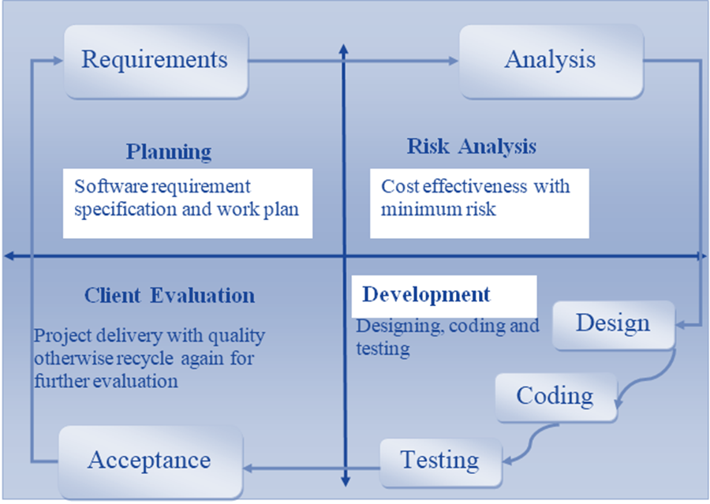
VU process Model

Slide 6
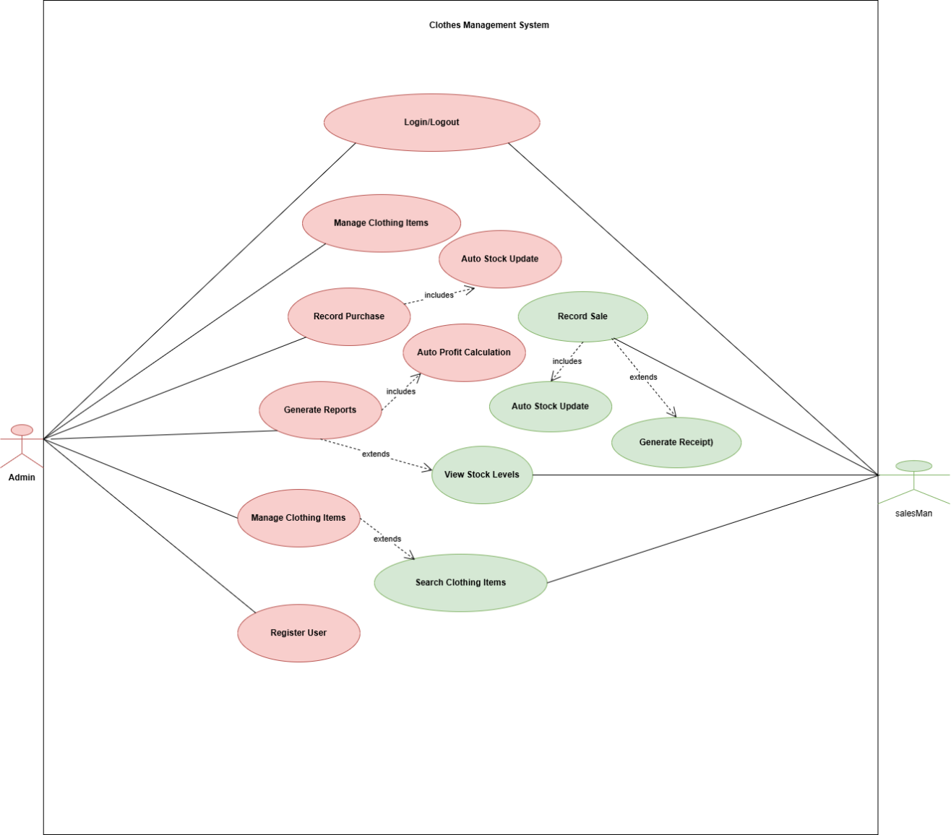
Use Case Diagram

Slide 7
Business Rules Catalog
User Registration and Authentication
  The system must allow the admin to register new users by storing their credentials securely in the database. All users, including admins and sales staff, must be able to log in and log out using valid credentials. The system must validate usernames and passwords before granting access. Incorrect login attempts should display an error message and deny access.

Slide 8
Business Rules Catalog
Clothing Item Management
  The admin must be able to add new clothing items by entering details such as name, category, season, purchase price, sale price, quantity, and unique item ID. The system must allow the admin to update item information when needed and delete items that are no longer available. Every modification should immediately reflect in the inventory database.

Slide 9
Business Rules Catalog
Item Search
  The system must allow users and admins to search for clothing items using various filters such as item name, ID, category, season, or price. Search results should display all relevant details including availability, price, and stock count. The system must return accurate and fast results to support customer queries.

Slide 10
Business Rules Catalog
Sales Management
The system must record each sale made at the counter. Whenever an item is sold, the system should automatically reduce its stock quantity in the database. Users should be able to view the remaining quantity after each sale. The system must also prevent sales if an item is out of stock

Slide 11
Business Rules Catalog
Purchase Management
  The admin must be able to record purchases of new stock. Whenever new stock arrives, the system should add the purchased quantity to the existing inventory. The purchase process must update the database instantly to ensure accurate stock tracking.

Slide 12
Business Rules Catalog
Stock Updates
The system must dynamically update stock levels after each sale or purchase. Users must be able to view updated stock information at any time. Low stock items should be highlighted or indicated for restocking
Report Generation
  The admin must be able to generate report summaries for daily, weekly, monthly, and yearly sales and purchases. Reports should include total available stock, total sold items, total purchased items, and profit calculations. Reports must be printable and saved digitally for recordkeeping.

Slide 13
Business Rules Catalog
Automated Profit Calculation
  The system must automatically calculate profit based on predefined purchase and sale prices stored in the database. Manual entry of profit values should not be allowed. Profit values must update instantly after every sale.
Centralized Data Management
  All modules should use a single centralized database. Any data entered in one module must automatically update in all relevant modules without requiring repeated entry.

Slide 14
Business Rules Catalog
Non Functional Requirements
Performance Requirements
  The system must respond quickly to user actions. Search results should appear within a few seconds. Stock updates and report generation should be processed without noticeable lag. The system must handle large inventories without slowing down.
Usability Requirements
  The interface must be simple and easy to use for non technical staff. All buttons, menus, and input fields must be clearly labeled. The system must support keyboard and mouse navigation and provide clear error or confirmation messages.

Slide 15
Business Rules Catalog
Reliability Requirements
  The system must run without crashes and must protect data against loss or corruption. All updates to the database must be reliable and consistent. System errors should not affect stored data.
Security Requirements
  User credentials must be stored securely. Only authenticated users should access the application. Admin only functions must be protected so that normal users cannot modify sensitive data like clothing items, purchases, or user accounts.

Slide 16
Business Rules Catalog
Maintainability Requirements
  The system should be easy to maintain, update, and debug. The codebase must follow a modular structure where inventory, sales, login, and reporting are clearly separated for easier modification.
Portability Requirements
  The system must run on Windows based computers. It should not depend on external web based technologies. The system must be fully functional on desktops and laptops using Python and Tinker.

Slide 17
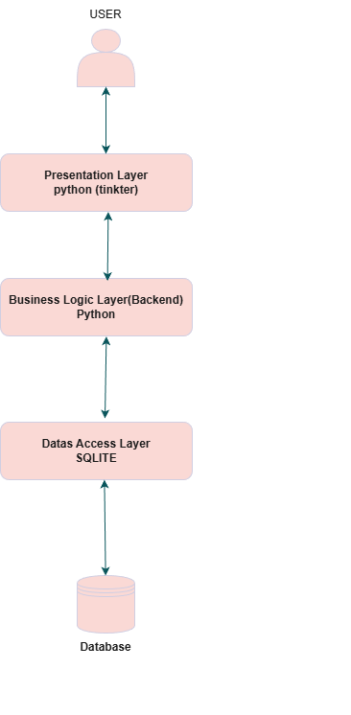
Architectural Design

Slide 18

Team Structure

Slide 19
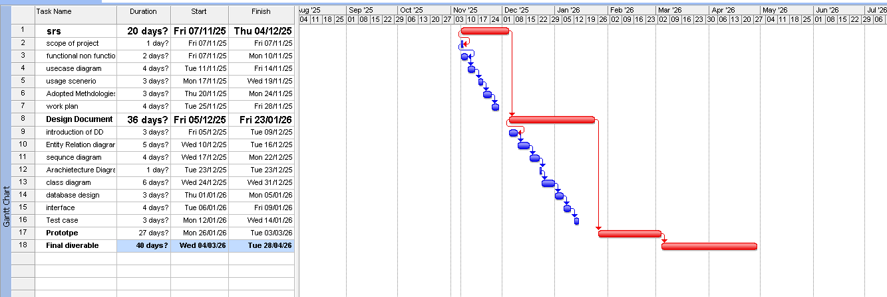
Project Schedule

Slide 20
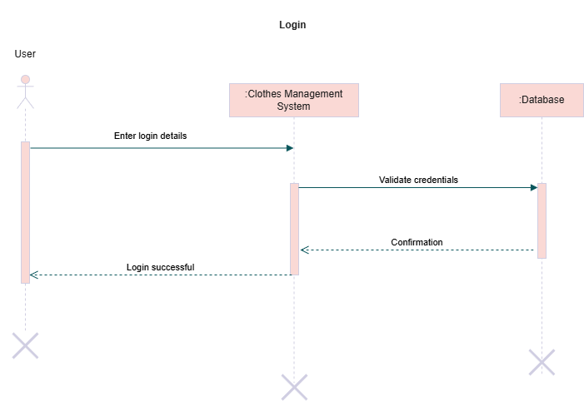
Sequence Diagrams

Slide 21
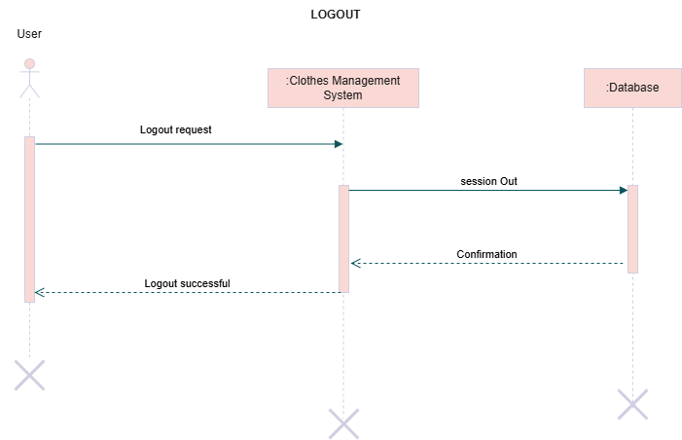
Sequence Diagrams

Slide 22
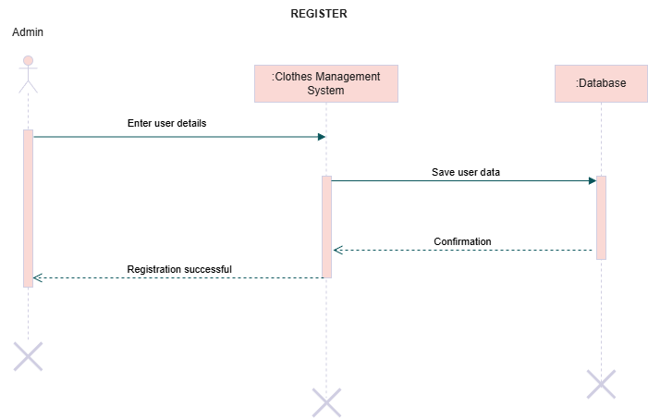
Sequence Diagrams

Slide 23
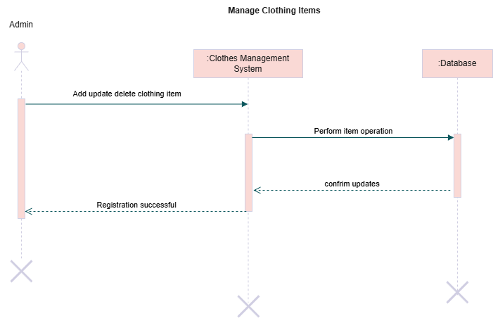
Sequence Diagrams

Slide 24
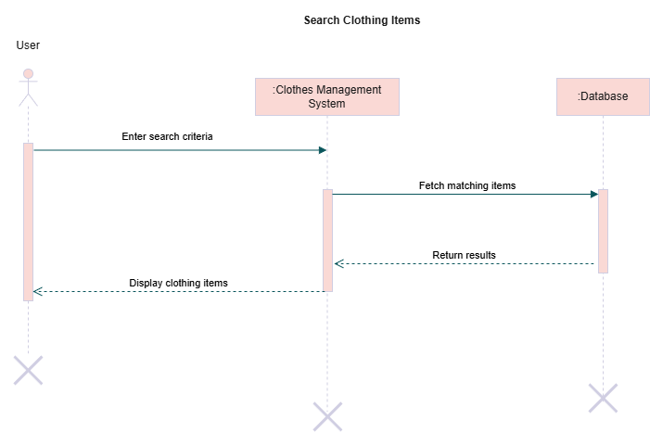
Sequence Diagrams

Slide 25
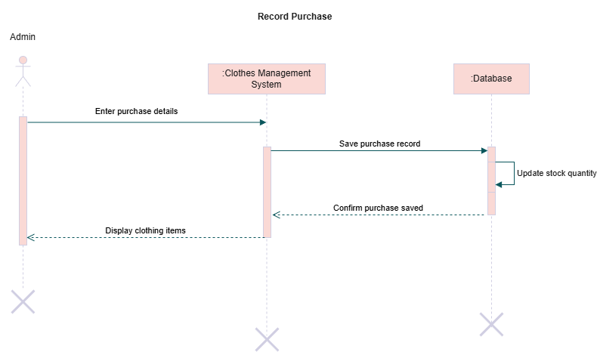
Sequence Diagrams

Slide 26
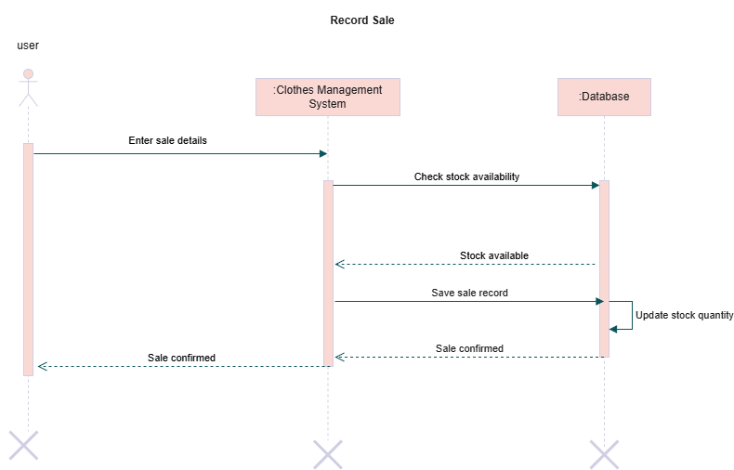
Sequence Diagrams

Slide 27
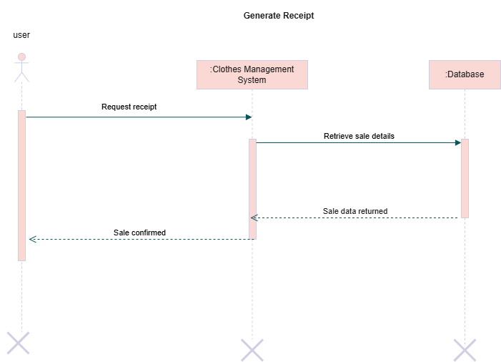
Sequence Diagrams

Slide 28
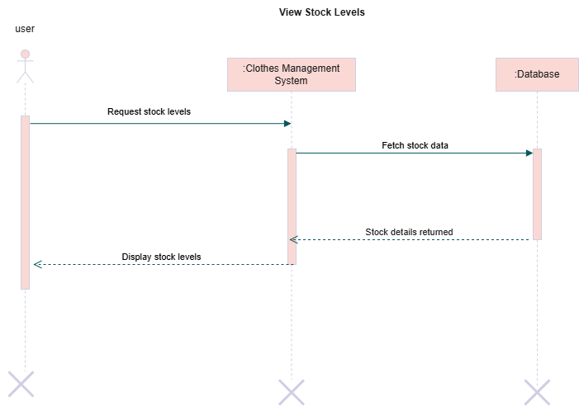
Sequence Diagrams

Slide 29

Sequence Diagrams

Slide 30
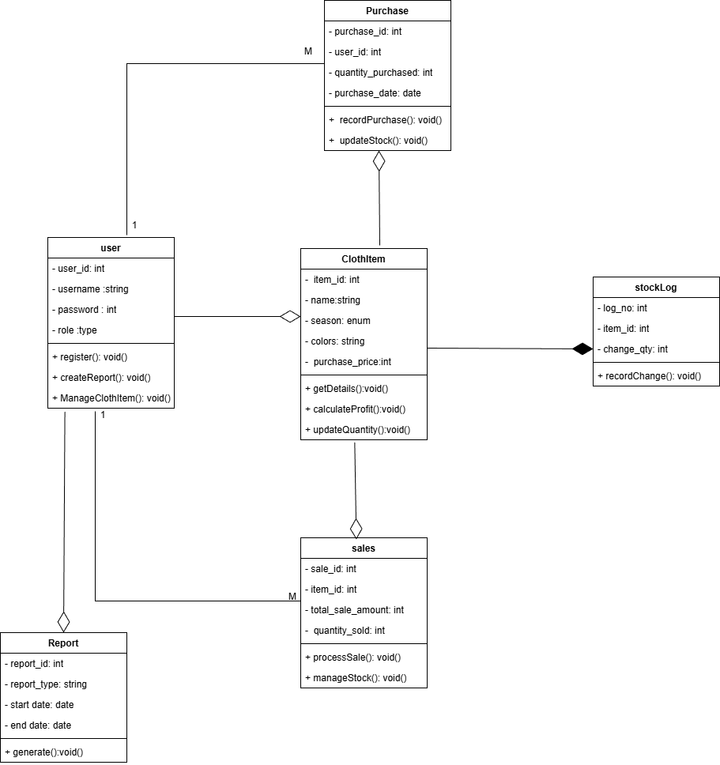
Logical Model/Class Diagram

Slide 31
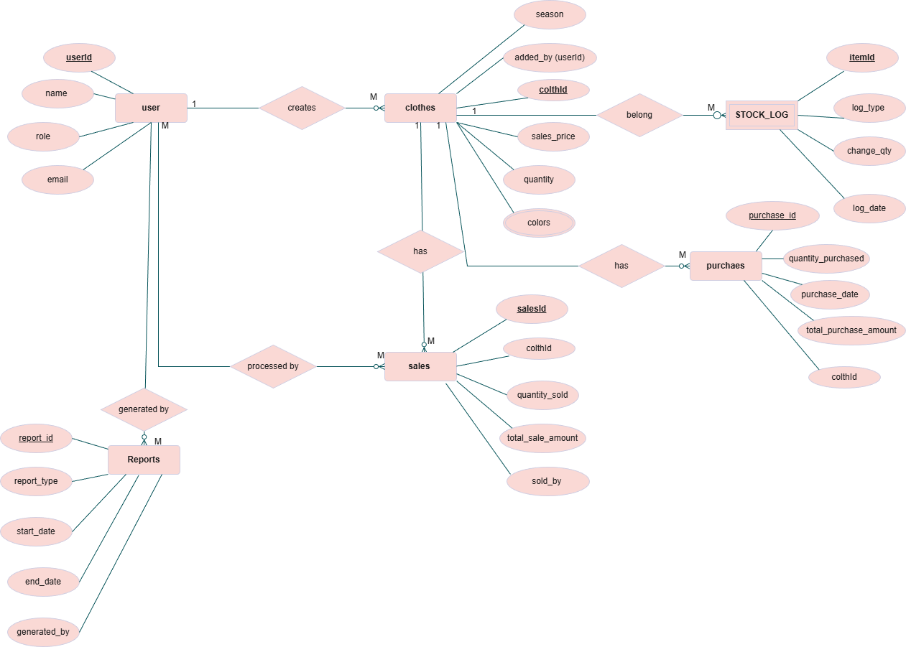
Entity-Relationship Diagram

Slide 32
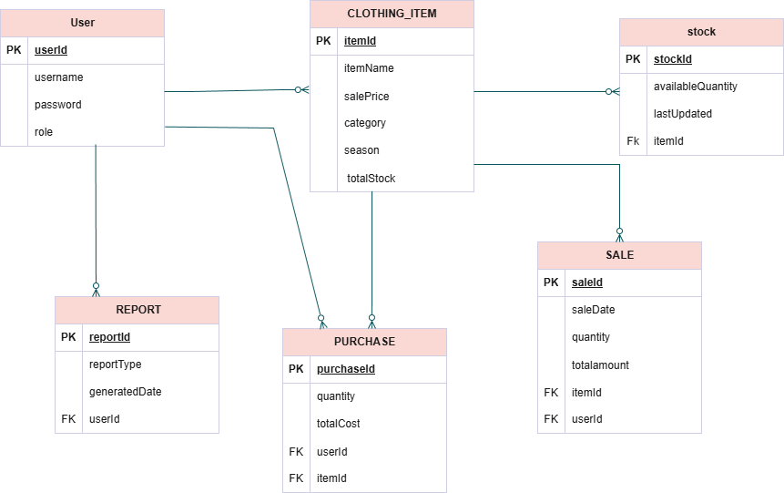
Database Diagram

Slide 33
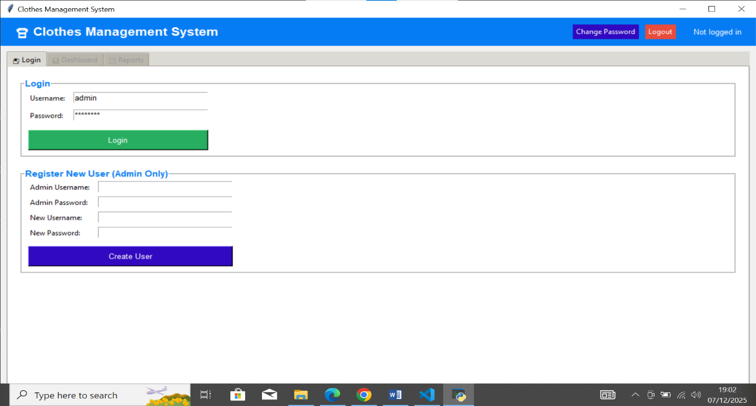
User Interfaces

Slide 34
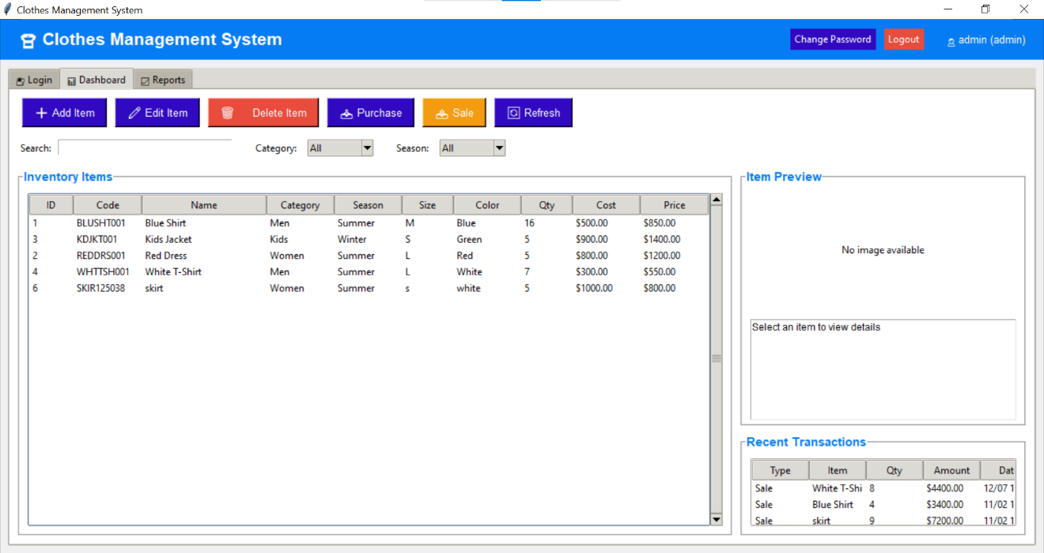
User Interfaces

Slide 35

Tools

