Slide 1
LLM-Driven Verilog Testbench Generation
with Pyverilog-Based Early Error Localization
Muhammad Sawaiz Naveed
280 runs
215 injected faults
4 sweeps
Supervisor: Bing Wen · TU Ilmenau · Research Project S6.ReKI.1
Notes:
SAY: Good morning. This project is about testing circuits — specifically, getting an AI to write the test programme, and then catching its mistakes before we run anything.
PLAN: I will show you the problem, then walk the pipeline node by node, then the results. About twenty minutes.
TIMING: if you are past 3 minutes when you leave slide 3, speed up the node slides.

Slide 2
BACKGROUND
What is a testbench?
The thing this project gets an AI to write
The circuit — the DUT
The testbench
A design written in Verilog, a hardware description language. Not a programme that runs line by line: a description of wires and gates that all operate at once, and eventually becomes silicon.
Engineers call it the DUT — the device under test.
A second piece of Verilog whose only job is to test the first. It feeds inputs in, watches what comes out, compares that against what should have come out, and prints PASS or FAIL.
Writing these by hand is most of the work in verification — which is why people want an AI to do it.
A testbench is itself a test — and a test can be written badly. It can run, report success, and have checked almost nothing.
Notes:
SAY: Two words I will use throughout, before anything else.
A circuit — the DUT, device under test — is a hardware design in Verilog. Verilog is not a programming language in the usual sense. It does not run line by line; it describes wires and gates operating simultaneously, and it eventually becomes actual silicon.
A testbench is a second piece of Verilog whose only job is to test the first. Feed inputs in, watch the outputs, compare against what should have happened, print PASS or FAIL.
Writing these by hand is most of the work in verification. That is why people want an AI to do it — and this project is about the mistakes it makes when it does.
THE BOX: a testbench is itself a test, and a test can be written badly. It can run happily, report success, and have checked almost nothing. Hold onto that one.

Slide 3
THE PROBLEM
Most of the effort is testing — and the loop is slow
~60%
valid
slow
of chip design effort goes into verification, not design
AI testbenches compile cleanly and still test the wrong thing
the only way to find out is to run a full simulation
Foster 2022, industry survey
syntactically right, functionally wrong
minutes per attempt, every attempt
A testbench that stops checking an output PASSES — because it is no longer looking. Running it can never find that.
Notes:
SAY: Verification is about sixty percent of the effort in chip design. AI can write these test programmes now, but they are often valid code that tests the wrong thing — and the only way to find out is to run a full simulation.
THEN THE BOX, SLOWLY: if a testbench stops checking one of the outputs, running it PASSES. It is not looking any more. So simulation can never find that particular mistake. That is the gap this project goes after.
This one sentence is the reason the whole project exists. Pause after it.

Slide 4
WHAT WE SET OUT TO ANSWER
Four questions
RQ1
What kinds of mistake does an AI actually make when it writes a testbench — and which of them can be found without running anything?
RQ2
How much can reading the code, rather than running it, narrow those mistakes down?
RQ3
Can the AI use that diagnosis to fix its own testbench — and is that better than just letting the compiler tell it?
RQ4
What does it cost, and is it worth it?
Notes:
SAY: Four questions drive the project.
One — what kinds of mistake does an AI actually make, and which can you find without running anything?
Two — how far can reading the code narrow a mistake down?
Three — can the AI use that diagnosis to fix itself, and is it better than just letting the compiler tell it?
Four — what does it cost, and is it worth it?
I come back to all four at the end with the answers. Do not answer them now — just plant them. Thirty seconds.

Slide 5
WHERE WE START FROM
AutoBench — the paper we build on
Qiu et al., MLCAD 2024 · 156 benchmark circuits · GPT-4-turbo
What they built
What it does not do
A six-stage AI pipeline that writes testbenches
It retries when the compiler complains
Eval0 95.7% · Eval1 51.5% · Eval2 44.8%
It never reads the Verilog it produces
It has nothing to compare against — no control group
Those two gaps are what we add.
We keep most of their design, add a layer that reads the Verilog before anything runs, and add a control group so we can tell whether it helped.
Notes:
SAY: This builds directly on a 2024 paper called AutoBench. They built a six-stage AI pipeline that writes testbenches, and it works reasonably well.
Two things they do not do. First, they never actually read the Verilog they produce — their error detection is text search and compiler messages. Second, they have no control group, and I will come back to why that matters.
Those two gaps are exactly what this project adds.
IF ASKED why build on AutoBench: it is the closest prior work on this exact task and it uses the standard benchmark, so our numbers sit on the same ground as theirs.

Slide 6
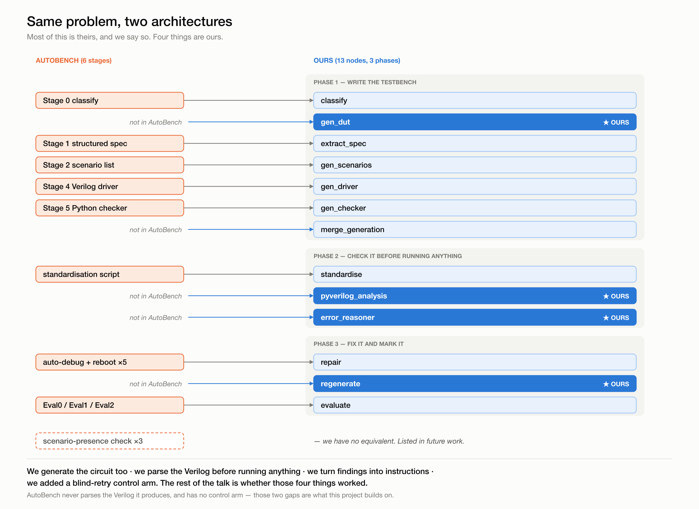
THE PIPELINE
Thirteen steps, three phases
What is ours
we write the circuit as well
we read the Verilog before running it
we turn what we find into instructions
we added a control group
The next slides walk through each step: what it does, why it is there, and what came out of it.
Notes:
SAY: Here is the whole thing. On the left is AutoBench's design; on the right is ours. Most of it is theirs and I want to be clear about that — the four highlighted boxes are what we added.
Do not read the boxes out. Point at the four blue ones, then move on. The next thirteen slides cover them one at a time.
TIMING: leave this slide by 4:30.

Slide 7
PIPELINE · STEP 1 OF 13
classify
Is this circuit one that remembers?
What it does
Why we need it
Reads the description and answers one question: does this circuit have memory, or does its output depend only on its inputs right now?
Everything after this branches on the answer. A circuit with memory needs a clock generated, needs its outputs watched over time, and gets an extra cleanup step that the others skip.
Example
What came out of it
counter_4bit — the description in, the verdict out
188 / 92
“a synchronous 4-bit up counter
with synchronous reset”
→ SEQ
sequential vs combinational,
across 280 runs
It was never the problem. We never traced a single failure back to a wrong answer here.
Notes:
SAY: The first step just sorts the circuit into one of two kinds. Does it remember anything, or not? A calculator does not — two plus three is five, always. A counter does — the answer depends on how many times you pressed the button.
This matters because everything downstream changes depending on the answer.
We use the cheap model here — it is a yes-or-no question from a paragraph of English, so paying for the expensive one would be waste.
IF ASKED how AutoBench does it: they get the AI to write a sample of the circuit and then text-search it for a clock. We just ask the model directly.

Slide 8
PIPELINE · STEP 2 OF 13
gen_dut
Write the circuit itself ★ ours
What it does
Why we need it
Takes the same description and writes the circuit — not the test, the actual design under test.
It is the realistic order of work: you have a description, you build a design, then you test it. And it keeps the marking honest — the known-correct circuit is locked away and only used at the very end, so the AI can never copy the answers out of it.
Example
What came out of it
what it wrote for counter_4bit — identical interface to the reference
273 / 280
module counter_4bit(
input clk,
input rst,
output [3:0] out
);
of the circuits it wrote match
the reference exactly
The seven that differ are all the same circuit, where the AI invented a clock pin that the real design does not have.
Notes:
SAY: This is the first thing that is ours — AutoBench never generates the design, only the test.
Why do it? Two reasons. It is the realistic flow. And it keeps marking honest: if the AI could see the correct circuit while writing the test, it could just copy the answers. So the correct circuit stays locked away until the very end.
THE ISSUE, SAY IT HERE: there is a consequence. For most of the pipeline we are working with the AI's own version of the circuit, and only at marking do we swap in the real one. So two versions are in play. We measured how far apart they get — 273 of 280 match exactly. The seven that do not are all one circuit, where the AI added a clock and reset pin that the real design does not have.
IF PUSHED: that comparison is on the pin interface, not on behaviour — we did not run an equivalence check. And the one circuit where it went wrong is the same one that shows up later in the repair story, so it is a single known case, not a pattern.

Slide 9
PIPELINE · STEP 3 OF 13
extract_spec
Turn the English into a checklist
What it does
Why we need it
Reads the description and the circuit and produces a tidy structured list: what the pins are called, how wide each one is, what the circuit should do.
Later steps need to know what pins exist, dozens of times. Re-reading a paragraph of English every time is unreliable — the AI might read it slightly differently each time. Extracting it once means every later step works from the same facts.
Example
What came out of it
the structured spec it produced
same as theirs
field | value
inputs | clk (1 bit), rst (1 bit)
outputs | out (4 bits)
clock | clk
reset | rst
timing | synchronous, posedge
we copied this step from
AutoBench directly
Plumbing that worked. Not a contribution, but the pipeline would be much flakier without it.
Notes:
SAY: This one turns the English description into a structured checklist — the pin names, the widths, the timing.
Why bother? Because later steps ask what pins exist dozens of times, and if you re-read English prose every time, the AI can answer slightly differently each time. Pin it down once and everything downstream agrees.
This one is straight out of AutoBench. Keep it quick — nothing interesting happened here and that is worth saying plainly.

Slide 10
PIPELINE · STEP 4 OF 13
gen_scenarios
Decide what to test
What it does
Why we need it
Produces a list of named situations to test — reset clears the counter, it wraps around at the maximum, it holds when disabled.
It makes the AI plan before it writes. And the names end up printed in the output, so when something fails we know which behaviour failed, not just that something did.
Example
What came out of it
the scenarios it chose for counter_4bit, and how each one did
~8
scenario | result
normal_increment | FAIL
reset_to_zero | PASS
wrap_around | PASS
increment_from_zero_to_five | FAIL
hold_value_on_reset | PASS
increment_to_fourteen | FAIL
test cases generated per run
That number comes back later — eight test cases is a thin sample of a big circuit.
Notes:
SAY: Here the AI plans what to test, as a list of named situations. Reset clears the counter. It wraps at the maximum. And so on.
The names matter more than they look. They get printed in the output as PASS or FAIL next to the name, so when a run fails we know which behaviour broke — not just that something did. All our failure analysis depends on that.
We get about eight of these per run. Remember that number — it comes back.
IF ASKED about the eight: on a circuit with ten input bits there are over a thousand input combinations, so eight test cases is a thin sample. That is the honest explanation for why our mutant-detection score drops on the bigger benchmark circuits. It is in the report as future work.

Slide 11
PIPELINE · STEP 5 OF 13
gen_driver
Write the testbench
What it does
Why we need it
Writes the actual Verilog testbench — the thing this whole project is about. It drives inputs into the circuit, watches the outputs, and prints PASS or FAIL.
This is the deliverable. Everything before it is preparation; everything after it is checking.
Example
What came out of it
how it wires the circuit up inside the testbench
92.5%
counter_4bit dut (
.clk(clk),
.rst(rst),
.out(out)
);
of the testbenches it wrote
compiled successfully
Compiling is the easy part. Only 31% of them actually worked against the real circuit.
Notes:
SAY: This is the main event — the actual test programme, in Verilog. It feeds inputs in, watches what comes out, and prints PASS or FAIL for each of the scenarios from the previous step.
Nearly everything it writes compiles — 92.5%. But compiling is the easy part. Only about a third of them actually pass against the real circuit, and that gap is where the interesting part of this project lives.
We use the strong model here. Writing correct hardware code is genuinely hard.

Slide 12
PIPELINE · STEP 6 OF 13
gen_checker
A second opinion, in Python
What it does
Why we need it
Writes a small Python programme that can read the testbench's output and decide pass or fail independently.
It separates deciding the verdict from producing the output — a second, independent way to judge the same run.
Example
What came out of it
the output it reads — one line per scenario
runs in parallel
FAIL: normal_increment
PASS: reset_to_zero
PASS: wrap_around
FAIL: increment_from_zero_to_five
alongside the testbench —
neither waits for the other
Ours does less work than AutoBench's, because our testbench already judges itself.
Notes:
SAY: Alongside the testbench we also generate a small Python checker. These two run at the same time, in parallel, because neither needs the other's output — it saves wall-clock time.
IF ASKED how this differs from AutoBench: theirs is a bigger split. Their Verilog only drives the circuit and dumps everything into a text file, and their Python does all the judging. Ours is a self-checking testbench — the Verilog decides PASS or FAIL itself. Ours is simpler and closer to what engineers actually write. Theirs separates the stimulus from the checking, which in principle lets the checking be more thorough. We did not test which is better.

Slide 13
PIPELINE · STEP 7 OF 13
merge_generation
Wait for both
What it does
Why we need it
Nothing at all. It is a waiting point.
The two previous steps run at the same time. Something has to wait for both before the pipeline moves on, otherwise the next step could start while one is still running.
Example
What came out of it
the two branches rejoin here
0
gen_driver ┐
├─→ merge → next step
gen_checker ┘
AI calls — it is pure
control flow
Not a research contribution. It is there so the parallel branches are safe.
Notes:
SAY: This one does nothing — it is a waiting point. The two previous steps run in parallel, so something has to wait for both before we continue.
Move fast here. Fifteen seconds. It is on its own slide for completeness, not because it is interesting.

Slide 14
PIPELINE · STEP 8 OF 13
standardise
Mechanical cleanup, no AI
What it does
Why we need it
Plain Python. If an output is never printed anywhere, it inserts the line that prints it. If a clock is declared but never made to tick, it inserts the few lines that make it tick.
There is exactly one correct answer to both of those, so a script is better than a model: faster, free, and it does the same thing every time.
Example
What came out of it
what it inserts, and how it marks its own work
6 / 188
// [standardised]
$monitor("out = %b", out);
// it skips anything already marked
sequential runs where it had
anything to fix
AutoBench's version of this step was their single biggest win — worth 42 points. Ours does almost nothing.
Notes:
SAY: This step is plain Python, no AI at all. It inserts a missing print statement, or starts a clock that was declared but never ticks. There is one correct answer to both, so a script beats a model — it is faster, free, and predictable.
THE INTERESTING BIT: AutoBench has the same idea, and for them it was the single biggest improvement in the whole paper — it took their sequential compile rate from 55 percent to 97. Forty-two points.
Ours fired six times in a hundred and eighty-eight runs. Almost nothing.
That is not because our version is worse. It is because the mistake it fixes has stopped happening — current models do not forget to print their outputs any more. I will show you the number that proves that later.
IF ASKED for the proof now: the 182 runs where our script never fired at all still compile at 90.7 percent, against AutoBench's 55.5 without theirs.

Slide 15
PIPELINE · STEP 9 OF 13
pyverilog_analysis
Read the code without running it ★ ours
What it does
Why we need it
Parses the testbench and the circuit into a structure — not text — and runs six checks looking for mistakes. No simulation.
Two of the six catch faults that nothing else can see: an output nobody checks, and a sequential output that is never printed. If the testbench stops looking, running it passes.
Example
What came out of it
a real finding — Prob150, where the AI invented a clock pin
100%
field | value
error_type | port_binding_mismatch
affected_signal | clk
severity | ERROR
found by | reading the code, before running
detection on every fault class
it was built for
Zero false alarms on clean testbenches. This is the core contribution.
Notes:
SAY: This is the heart of the project. It reads the testbench and the circuit as structure rather than as text, and runs six checks — without running anything.
The six are things like: is a pin wired to the wrong name, does a signal width match the pin, is an input never given a value. Two of them are the important ones: is there an output nobody ever checks, and for clocked circuits, is there an output that is never printed.
Those two are the argument for the whole project, because nothing else can catch them. If the testbench stops checking an output, running it passes.
The next slide shows how well it works. Do not give the number here — save it.
IF ASKED about coverage: the parser could only read about 60 percent of the files. The rest use newer SystemVerilog syntax it does not support, and fall back to a second parser that only checks whether the file is valid. That is a real limitation and it is in the report.
IF ASKED whether we tuned the checks: we built seven and deleted one. It caught none of the faults it was built for and raised a false alarm on a correct testbench, so we removed it rather than patch it.

Slide 16
PIPELINE · STEP 10 OF 13
error_reasoner
Turn findings into instructions
What it does
Why we need it
Takes the machine-generated report from the previous step and turns it into something the AI can act on: which signal, what is wrong, what to do about it.
A raw report says “unobserved output: q”. That is not an instruction. This turns it into “the output q is never printed — add a display statement after each check”.
Example
What came out of it
machine report in, instruction out
skipped when clean
unobserved_output: q
↓
“the output q is never printed —
add a display after each check”
no AI call is made if the
report found nothing
Since the reports were almost always clean, this made the static-only configuration cheaper than doing nothing at all.
Notes:
SAY: The checker produces a machine report. This step turns it into an instruction the AI can actually act on — which signal, what is wrong, what to do.
One small design point worth mentioning: it skips the AI call entirely when the report is clean. Since our reports were almost always clean, that made the static-analysis-only setting cheaper to run than doing nothing at all.
Quick slide. Thirty seconds.

Slide 17
PIPELINE · STEP 11 OF 13
repair
Try again, knowing what went wrong
What it does
Why we need it
Rewrites the testbench given an error report. Three things can trigger it: our checker found something, the compiler refused the file, or it ran and got the wrong answers. Capped at three attempts.
A diagnosis is only worth having if something acts on it.
Example
What came out of it
the one repair our checker ever triggered, iteration by iteration
26 / 102
attempt | what the checker saw
0 | clean
1 | clk and reset not connected
2 | clean — the repair worked
3 | the problem came back
repair attempts that ended
in a working testbench
About one in four. Repairing a testbench from an error message is harder than it sounds.
Notes:
SAY: When something is wrong, this step rewrites the testbench — and it is told what was wrong. Three things can trigger it: our checker, the compiler, or a failed run.
A hundred and two runs tried a repair. Twenty-six of them ended up working. About one in four.
TWO SAFEGUARDS worth naming: if the same error comes back twice we stop, because a fourth identical attempt will not suddenly work. And we keep the best version, not the last one — repair rewrites the whole file, so attempt three can be worse than attempt one. Without that, a setting that repairs more could score worse, which is not something an experiment can allow.
IF ASKED why three quarters fail: two patterns. Some regenerate a testbench that fails the exact same scenarios — the diagnosis was not acted on. Others produce a different error every single time until the budget runs out. Across fourteen multi-attempt runs, no error ever repeated. Prior work does not report this.

Slide 18
PIPELINE · STEP 12 OF 13
regenerate
Try again, told nothing — the control ★ ours
What it does
Why we need it
Rewrites the testbench from the original description, with no error report, no findings, and no compiler output. Deliberately blind.
If our version beats the plain one, there are two explanations: the feedback worked, or the AI simply got a second try. This step isolates the second try, so we can tell them apart.
Example
What came out of it
the control against the plain version, over 44 circuits
worth nothing
setting | worked
baseline — one attempt | 12 of 44
retry_only — a blind second attempt | 13 of 44
difference | 1 circuit · p = 1.000
a blind second attempt did not
beat doing nothing at all
Which means any real improvement has to come from the diagnosis, not from the extra attempt.
Notes:
SAY: This one looks strange — it rewrites the testbench and is told nothing at all about what was wrong.
Here is why it exists. Suppose our full version beats the plain one. Two explanations fit equally well: the feedback found the problem, or the AI just got a second roll of the dice. You cannot tell those apart, because the plain version never gets a second try.
So we added one that gets the second try with no information. That isolates the dice roll.
And the result: a blind second attempt is worth nothing at all. Which is useful — it means any real improvement has to be coming from the diagnosis.
AutoBench has nothing like this, so their reported improvements cannot separate those two explanations. This is the clearest methodological thing we add.

Slide 19
PIPELINE · STEP 13 OF 13
evaluate
Mark it
What it does
Why we need it
Three tests in order. Does it compile? Does it pass against the known-correct circuit? And does it catch five deliberately broken copies of that circuit?
Ground truth. Everything reported in this talk comes out of this step, along with the cost and timing of every AI call.
Example
What came out of it
one run's scorecard — counter_4bit
92.5 / 31.4 / 95
test | result
Eval0 — compiles? | pass
Eval1 — works on the real circuit? | 8 of 11 scenarios
Eval2 — catches broken copies? | not reached
compiles · works · catches
broken copies (%)
The last number is flattering and we treat it as a limitation, not a result.
Notes:
SAY: Finally, marking. Three levels. Does it compile — 92.5 percent. Does it pass against the real circuit — 31 percent. And does it catch deliberately broken copies of the circuit — 95 percent.
BE UP FRONT ABOUT THE LAST ONE: that 95 looks great and we report it as a limitation rather than a result. Our own test circuits are small — a one-bit flip-flop has nowhere for a bug to hide, so almost any testbench catches everything. We checked this properly rather than assuming: we regenerated the broken copies with a better model and the score moved one point. We swapped in the bigger benchmark circuits and it moved forty-four. So it is the circuits, not the test.
IF ASKED how 31 percent compares: AutoBench report 37 percent on sequential circuits, and ours are mostly sequential and the hardest quintile of their benchmark. Same range.
IF ASKED whether our 95 beats their 44.8: it does not — they measure something different. Theirs counts a problem as passed only if the testbench agrees with a reference testbench on 80 percent of the broken copies. Under their rule we get 20 percent against their 26 on sequential circuits. No ranking either way at this sample size.

Slide 20
RESULTS · 1 OF 6
Does the checker actually work?
We broke 215 testbenches in known ways and scored three things against them
The mistake we injected | How many | Our checker | The compiler | Running it
a pin renamed so it does not exist | 62 | finds all | finds all | finds none
a pin left unconnected | 62 | finds all | finds none | finds 98%
an input never given a value | 30 | finds all | finds none | finds 97%
a signal of the wrong width | 22 | finds all | finds none | finds 82%
an output nobody ever checks | 19 | finds all | FINDS NONE | FINDS NONE
a clock that never ticks | 6 | finds all | finds none | finds 17%
two same-width signals swapped (control) | 9 | finds none | finds none | finds 78%
broken clock synchronisation (control) | 5 | finds none | finds none | finds 80%
The bold row is the one that matters: if the testbench stops checking an output, running it PASSES — nothing else can see that. The last two rows are controls, built to be impossible to spot from structure.
Notes:
SAY: To test the checker we deliberately broke 215 testbenches in known ways and scored three things against them: our checker, the compiler, and actually running it.
Our checker finds all of every kind it was built for. No false alarms on clean testbenches.
POINT AT THE BOLD ROW: this is the one that matters. Nineteen cases where the testbench stops checking an output. We find all of them. The compiler finds none. Running it finds none — because the test passes. It is not looking any more.
The last two rows are controls. We built those faults to be impossible to spot from structure — swapping two signals of the same width, for instance. Our checker scores zero on them, exactly as predicted. We put them in so nobody has to take our word that the fault set was fair.
This is the strongest slide in the talk. Take your time on it.

Slide 21
RESULTS · 2 OF 6
The three scores, and how they compare
Ours across 280 runs, against AutoBench's published figures
 | What it asks | Ours | AutoBench | Read it as
Eval0 | does the testbench compile? | 92.5% | 95.7% | level — 98.7% on our strong model
Eval1 | does it pass against the real circuit? | 31.4% | 51.5% · 37.1% clocked | comparable — ours are mostly clocked
Eval2 | does it catch deliberately broken copies? | 95% | 44.8% | NOT comparable — different rule
Eval2 | …scored under AutoBench's own rule | 20% | 26.0% clocked | comparable — no ranking at n=20
Why our Eval2 is not a win
Why the rest is a fair comparison
95% is a ceiling — our own test circuits are too small for a bug to hide in. We checked: better broken copies moved the score one point, bigger circuits moved it forty-four. So it measures our choice of circuits, not our testbenches.
Our 20 benchmark circuits are the hardest fifth of theirs, and three quarters are clocked — the hard case. Where the measures line up we are in the same range, with a newer model, on harder circuits.
Notes:
SAY: All three scores side by side with theirs.
Eval0, does it compile — level. 92.5 against their 95.7, and our strong model alone reaches 98.7.
Eval1, does it actually work — 31 against their 51. But their 51 is across all circuits; on clocked circuits, which is what ours mostly are, they report 37. Comparable.
Eval2 — careful with this row. Ours says 95, theirs says 44.8, and that looks like we win by miles. We do not. They measure something different: a problem only counts as passed if the testbench agrees with a reference testbench on 80 percent of the broken copies. Apply their rule to us and we get 20 percent against their 26 on clocked circuits. At twenty circuits that establishes no ranking either way.
IF ASKED why our 95 is so high: our own circuits are too small for a bug to hide in, and we tested that rather than assuming it.

Slide 22
RESULTS · 3 OF 6
Five settings, compared
Same pipeline every time — the only thing that changes is when it may try again
Setting | What it is allowed to do | Circuits that worked
pyverilog_only | try again if our checker complained | 9 of 44
baseline | nothing — one attempt only | 12 of 44
retry_only | try again, told nothing at all ← the control | 13 of 44
compiler_only | try again if it did not compile | 15 of 44
hybrid | try again for any of those reasons ← ours | 18 of 44
The three comparisons
What that means
ours 18 vs baseline 12 +6 — looks like a clear win
ours 18 vs the control 13 +5 — the fair test
pyverilog_only 9 vs baseline 12 −3 — and these two ran the same logic
The bottom pair never actually repaired anything, so they ran the same logic — and still landed three circuits apart. Three circuits of difference happens by luck alone.
So a five-circuit lead is not a result. We report it as not significant.
Notes:
SAY: We ran the same pipeline five ways. The only thing that changes is when it is allowed to try again.
Our full version gets 18 circuits out of 44. The plain one gets 12. Six better, looks like a clear win.
But the fair comparison is against the blind retry — the control — which gets 13. So five, not six.
AND NOW THE IMPORTANT BIT: look at the bottom pair of that comparison list. Those two settings never actually repaired anything, because our checker never fired. So they ran effectively identical logic. They still came out three circuits apart.
That means three circuits of difference happens by pure luck. A five-circuit lead against a three-circuit noise floor is not a result, and we report it as not significant rather than claiming the win.
Building that control is what caught our own overclaim. It is the part of this project I am most confident about.

Slide 23
RESULTS · 4 OF 6
What actually triggered every repair
Every rewrite the pipeline performed, across all 280 runs
What caused the rewrite | Times
Simulation — it ran and got the wrong answers | 79
Blind retry — no information at all (the control) | 64
Compiler errors | 10
Our static checker | 1
Not a broken tool
The last slide showed it catches everything it was built for.
The mistakes it looks for have become rare.
Almost all the failures we see now are about meaning, not structure — the wiring is perfect and the expected answer is wrong.
And the setting that isolates our checker on its own repaired zero times in 44 runs. It never found anything to act on.
Notes:
SAY: This is the central finding, and I want to state it plainly.
Across 280 runs, our layer triggered exactly one repair. Simulation triggered 79. The compiler triggered 10. And the setting that isolates our checker on its own repaired zero times in 44 runs.
DO NOT APOLOGISE HERE. Deliver it as a discovery:
This is not a broken tool. The previous slide showed it catches everything it was built for, with no false alarms. The mistakes it looks for have simply become rare in what current models produce.
We could only establish that because we measured the tool separately from the pipeline. Without that, this would just look like something that did not work.
IF ASKED whether our full version's lead proves the checker helps: no, and I would not claim it. That setting is also the only one that gets simulation feedback, which drove almost all the repairs. We cannot separate the two, and that is in the report.

Slide 24
RESULTS · 5 OF 6
Why the mistakes we look for disappeared
Structural mistakes — mostly gone
Meaning mistakes — still there
A pin wired to the wrong name. A three-bit signal in a four-bit port. These are local, repetitive patterns — the same shapes appear in millions of code examples. Getting them right is pattern matching.
Expecting the counter to read 7 when it should read 8. To get that right you have to work out what the circuit does over several clock cycles. That is reasoning about behaviour, not recall of a pattern.
Model progress solved the pattern half and left the reasoning half.
Sequential compile rate
AutoBench, without their cleanup script (2024) | 55.5%
AutoBench, with it — their single biggest win | 97.3%
Ours, on the 182 runs where our script never fired | 90.7%
Ours, strong model | 98.7%
A pipeline whose cleanup step does nothing compiles 35 points better than a 2024 pipeline without one. It is the models, not us.
Notes:
SAY: So why did the mistakes disappear? I want to separate what we measured from what we think explains it.
WHAT WE MEASURED: 87 percent of the failures we see are about meaning, not structure. And our checker fired once in 280 runs.
WHAT WE THINK EXPLAINS IT — interpretation, not measurement: structural correctness is local and repetitive. A port list, a signal width, wiring up an instance — those exact shapes appear in millions of code examples, so getting them right is pattern matching, and that is what these models became very good at.
Meaning is different. To know a counter should read 8 rather than 7 you have to work out what the circuit does over several clock cycles. That is reasoning about behaviour over time, and it is much harder.
So model progress solved the pattern half and left the reasoning half — and our tool was built for the pattern half.
THE EVIDENCE IT IS THE MODELS AND NOT US — point at the table: AutoBench had the same kind of cleanup step and it was their biggest single win, worth 42 points. On the 182 runs where ours never fired at all we still compile at 90.7 percent, against their 55.5 without theirs.
BE HONEST IF PUSHED: the measurements are solid. The explanation is a reasonable reading of them, not something we ran an experiment on.

Slide 25
RESULTS · 6 OF 6
What it costs, and whether it is worth it
RQ4 — mean per run, pooled over 220 runs
Setting | Cost vs baseline | Time | Worked | Verdict
pyverilog_only | −2% | 40 s | 20.5% | costs nothing, gains nothing
baseline | — | 42 s | 27.3% | the floor
compiler_only | +6% | 43 s | 34.1% | best value — 7 points for 6%
retry_only | +29% | 55 s | 29.5% | the control
hybrid (ours) | +50% | 61 s | 40.9% | best score, worst cost, not significant
~$16.50
~$0.10
~4 h
every experiment in the
project, end to end
per generated testbench
at the strong tier
total compute across
all 280 runs
Notes:
SAY: Question four was cost. This is the answer.
Our full version buys the best score, at fifty percent more tokens and fifty percent more time — and as we saw, not significantly better than the control.
The value winner is compiler feedback: seven points for six percent more tokens. If you only do one thing, do that.
And our own layer costs essentially nothing — it is deterministic, milliseconds, no model call. It is actually slightly cheaper than doing nothing, because we skip the reasoning step when the report comes back clean.
So the cost answer is nuanced: our layer is nearly free and nearly useless against current models. Those are not in tension — free means there is little reason to remove it, in case a weaker or older model is the one generating.
The whole project cost about sixteen dollars fifty.

Slide 26
THE ANSWERS
Back to the four questions
RQ1
What mistakes, and which are findable without running?
Six kinds. 87% of real failures are about meaning, not structure.
answered
RQ2
How far can reading the code narrow them down?
Completely, for what it targets — every class, no false alarms.
answered
RQ3
Can the AI repair itself from that diagnosis?
Rarely — the diagnosis almost never fires. Simulation does the work.
answered, negative
RQ4
What does it cost, and is it worth it?
Our layer is nearly free. Compiler feedback is the best value.
answered
All four answered. One of them negatively — and that is the one worth reporting.
Notes:
SAY: Back to the four questions.
One — what mistakes, and which are findable without running. Six kinds, and we now know 87 percent of real failures are about meaning rather than structure.
Two — how far can reading the code narrow them down. Completely, for what it targets. Every class it was built for, no false alarms.
Three — can the AI repair itself from that diagnosis. Rarely, because the diagnosis almost never fires. Simulation feedback does essentially all the repair work. That is a negative answer and it is the most interesting thing in the project.
Four — cost. Our layer is nearly free; compiler feedback is the best value.
All four answered. One negatively — and a negative answer with a validated instrument behind it is worth more than a positive one without.

Slide 27
CONCLUSION
What this project contributes
1
A working pipeline
2
A checker we measured
Thirteen steps, five configurations, 280 runs, every call recorded. Open source.
100% on every fault class in scope, no false alarms, and 30 faults nothing else could see.
3
A control group the prior work has not got
4
A finding about the field
Which changed our own conclusion — it caught us claiming more than we could show.
The mistake behind prior work's biggest win has largely stopped happening.
We built the tool, showed that it works, and showed that it is not needed much any more. Only the second half of that was a surprise.
Notes:
SAY: Four things this project contributes.
A working pipeline, open source, with every AI call recorded. A checker we actually measured rather than asserted. A control group the prior work does not have — which changed our own conclusion. And a finding about the field: the mistake behind prior work's biggest win has largely stopped happening.
READ THE BOTTOM LINE OUT: we built the tool, showed that it works, and showed that it is not needed much any more. Only the second half of that was a surprise.
IF ASKED whether the project succeeded: yes, and I would put it precisely. We set out to find whether you can localise testbench errors before simulation. You can — completely, for the faults it targets, including ones nothing else sees. But against current models there is not much left to find. We can say that with confidence rather than as a guess, because we validated the tool separately and ran a control group. A measured negative is worth more than an unmeasured positive.

Slide 28
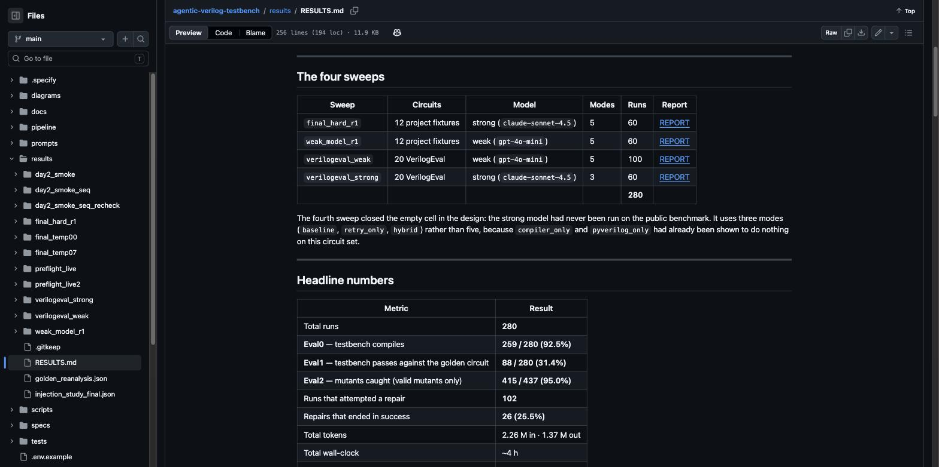
Thank you
Happy to take questions.
280
215
~$16.50
48
runs, 4 sweeps
injected faults
total compute
pages of report
github.com/Sawaiz-zip/agentic-verilog-testbench
Every number in this talk traces back to the raw run records.
Notes:
The screenshot is the published results page — point at it if someone asks whether the numbers are reproducible.
QUESTIONS YOU ARE LIKELY TO GET, and where the answer lives:
· “Did you beat AutoBench?” — no, and we do not claim to. Different model, different sample, and their Eval2 measures something else. See the evaluate slide.
· “Is static analysis useless then?” — not in general. It costs almost nothing, both findings we did get were real, and smaller or older models are untested. What we rule out is treating it as the primary defence against current frontier models.
· “Why is your sample so small?” — budget. 280 runs at about sixteen dollars. We chose the hardest fifth of the benchmark deliberately so the checks could fire.
· “What would you do next?” — three things: enforce that every planned scenario reaches the testbench, which AutoBench does and we do not; bigger circuits so the mutant score discriminates; and a fuller Verilog parser so the checker can read every file.

