Slide 1
THE FUN THEY HAD by ISAAC ASIMOV
SUBJECT:- ENGLISH CLASS:- IX

Slide 2

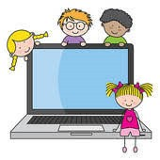



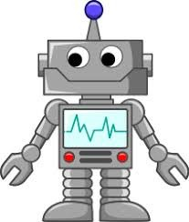
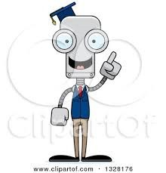
THE FUN THEY HAD by ISAAC ASIMOV
LEARNING THROUGH COMPUTERS
VIRTUAL CLASSROOM
SCHOOLS OF FUTURE
MOVING E-TEXT
ROBOTIC TEACHER

Slide 3
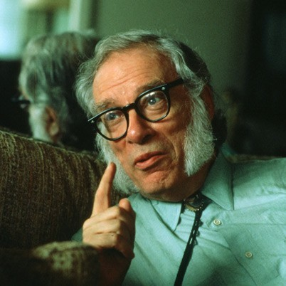
ABOUT THE AUTHOR
AA
Isaac Asimov was born on 02 January 1920 in Petrovichi (Russia). He immigrated with his family to the United States and became a bio-chemistry professor while pursuing writing. He published his first novel, Pebble in the Sky, in 1950. An immensely prolific author who penned nearly 500 books, he published influential sci-fi works like I, Robot and the Foundation trilogy, as well as books in a variety of other genres. He died in New York city on 06 April 1992.

Slide 4
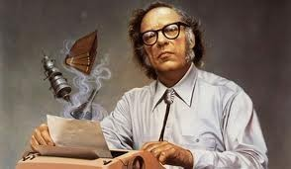
AUTHOR:- A BRIEF
N
INTRODUCTION
AUTHOR:- ISAAC ASIMOV ( 02-01-1920—06-04-1992 )
♣
♣
♣
♣
♣
♣
♣
♣
NAME:- Isaac Asimov OCCUPATION:- Writer
BIRTH DATE:- 02 January 1920
DEATH DATE: - 06 April 1992
EDUCATION:- Columbia University, Boston University of Medicine PLACE OF BIRTH:- Petrovichi (Russia)
PLACE OF DEATH:- New York, New York Originally:- Isaak Yudovick Ozimov

Slide 5
PROLIFIC AND VARIED
WRITER
♣ Issac Asimov was also known for writing books on a wide variety of subjects outside of science fiction, taking on topics like astronomy, biology, math, religion and literary biography. A small sample of notable titles include The Human Body (1963), Asimov's Guide to the Bible (1969), the mystery Murder at the ABA (1976) and his 1979 autobiography, In Memory Yet Green.

Slide 6
QUESTIONS TO PONDER UPON….
What kind of school would you want
to have in the future?
How much will the computer be involved in the future education ?
Will you feel more happy in a more developed, high-tech society? Why or why not ?

Slide 7
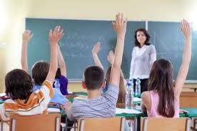
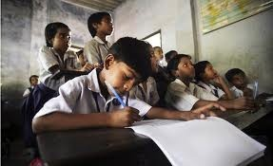
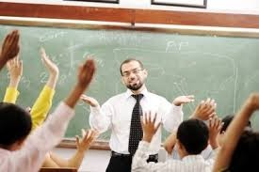
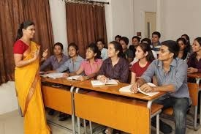
PRESENT (OLD) SCHOOL CLASSROOMS

Slide 8
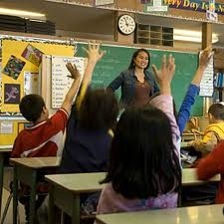
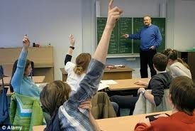
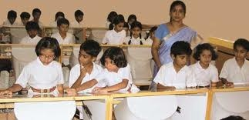
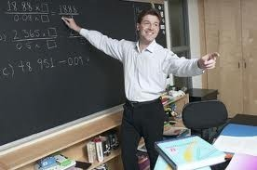
PRESENT (OLD) SCHOOL CLASSROOMS

Slide 9
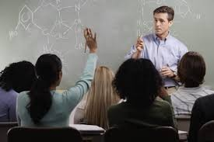
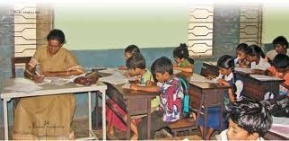
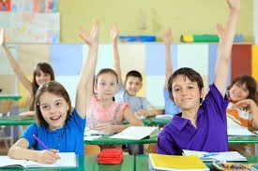
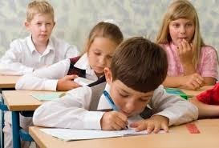
PRESENT (OLD) SCHOOL CLASSROOMS

Slide 10
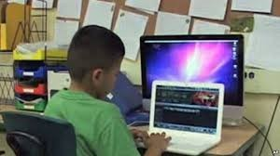
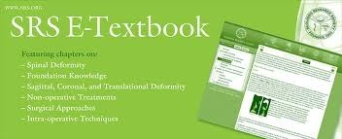

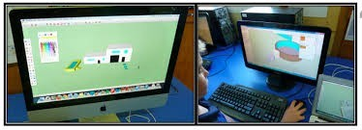
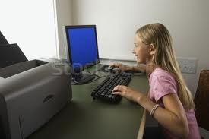
FUTURE SCHOOL CLASSROOMS

Slide 11
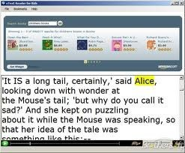
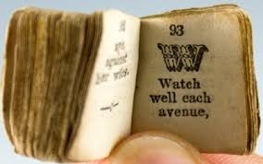
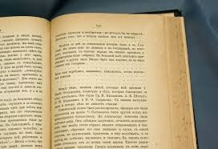
DIFFERENCE BETWEEN THE PRESENT
(OLD) SCHOOL AND THE FUTURE
SCHOOL
♣
The basic difference between the Present
(Old) and the future Schools as follows:-
1. MATERIALS:-
PRESENT SCHOOL:- Real book:-Printed on papers; yellow; crinkly.
♣ FUTURE SCHOOL:- Tele-book:-E-book; on the screen ; can be changed.

Slide 12
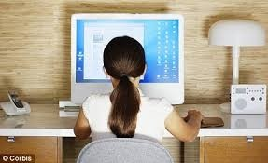
3. CLASSROOMS:-
♣ PRESENT SCHOOL:-Teaching in a building; many students are taught the same thing
togtogeeththerer..
♣ FUTURE SCHOOL:- In his or her own house; needless to leave home; each kid could be taught differently; the classes are always on at the same time every day.

Slide 13
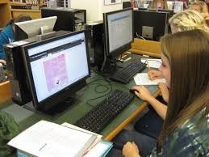
4. HOMEWORK & TEST:-
♣ PRESENT SCHOOL:- Exam; Test; Paper Writing; Essay Writing.
♣ FUTURE SCHOOL:- Write them out in a computer by pressing the keys; them put them on the slot.

Slide 14
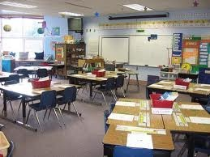
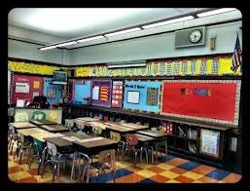
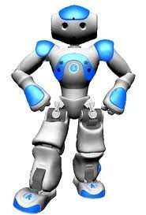
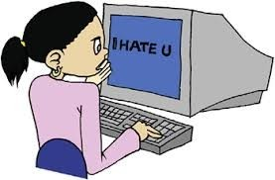
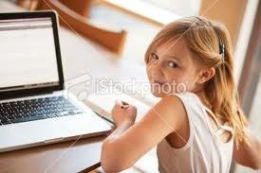
FUTURE SCHOOL CLASSROOMS

Slide 15
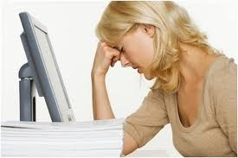
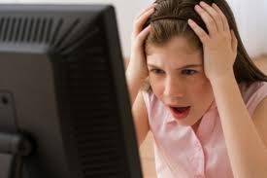
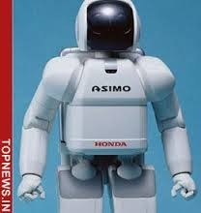

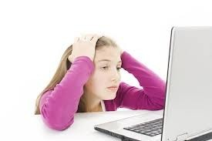
FUTURE SCHOOL CLASSROOMS

Slide 16

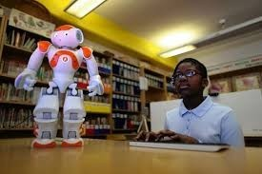
FUTURE SCHOOL CLASSROOMS

Slide 17
2. TEACHERS:-
♣ PRESENT SCHOOL:- Teacher:-a real man; communication; emotional; not perfectly
ccorreorrecctt..
♣ FUTURE SCHOOL:- Robotic or mechanical teacher; giving test after test; no communication; large; cold; black; ugly; more

Slide 18
INTRODUCTION
♣
Set in the year 2157, when children learn individually at home using a mechanical teacher (robotic teacher), the story tells of an eleven-year-old Margie Jones, whose neighbour Tommy finds a real book in the attic of his house. Isaac Asimov depicts a school system which is independent of human teacher and based on technical advance. In this system there are no human mistakes and it is a perfect way to give every child the same knowledge and information as per his level. But there are some disadvantages too. Human pupils do not learn like a computer. I think learning has to be a kind of fun, otherwise the probability of forgetting is higher. Studies have come to the result that you can learn things better if you have fun while you are learning.

Slide 19
INTRODUCTION….
♣ Another disadvantage is that there is no social , moral and emotional development like at schools in past. Learning with friends at school can be a motivation. At schools today, the pupils improve their communication and their behavior in a group. In Asimov´s future vision, there are no human teachers who can give moral values to the children. Giving moral values is the duty of their parents and teachers because a mechanical teacher cannot give moral values.

Slide 20
CONTINUES…..
♣ I think the story "The Fun They Had" is very interesting. It shows how the world could be in 2157 when everybody owns a machine teacher. Isaac Asimov´s representation of a non-desirable school of the future gives you "food for thought" how school should be and how much computers determine our lives. So in my opinion it is an excellent story.

Slide 21
SUMMARY
The story takes us to the world of future where computers will play a major role in the field of education. Books and schools as we know now will perhaps not exist.
The story opens with Margie writing in her diary about an old book that Tommy had found. Margie was reminded of her grandfather who had once talked about his grandfather who went to an actual school where the students were taught by human teachers. Tommy was thirteen years old and Margie was of eleven. They found many strange things in the book. One of the strangest things was that after reading the
However, Margie and Tommy lived in the future world, in the year 2157 where education was completely computerized. They did not go to schools. Instead, they had a special study room where a computer taught them. The computer teacher was programmed and adjusted according to the needs of each child.
The pages of the book they found were yellow and crinkly. Margie and Tommy found it funny to read the words that didn’t move like they moved on the screen. When they turned back to the page before, it still had the same words on it.

Slide 22
SUMMARY……
Margie hated school. She was having problems with learning Geography from her 'mechanical teacher’. It was black, large and ugly with a big screen on which all the lessons were shown and questions were asked, all in a special room in their own house. It could also calculate the marks in no time. Margie hated the slot where she had to insert her homework or test papers. Once the geography sector of her mechanical teacher was graded too quick so that her marks got worse and worse. The county inspector rebuilt it in one hour.
Both Tommy and Margie wondered at the book found. Margie also wondered how much fun it would be studying in a school. Studying in a fun way, with other children and that too from a human teacher who gave them homework and asked questions. They had a special building, where the children went to study and they learned the same thing if they were the same age.
The author’s message is one of warning against the dangers of computerized homeschooling which will deprive children of the benefits of the personal interactions between students and teachers, which help them develop social skills.

Slide 23
WORD MEANINGS:-
fiction = books and stories about imaginary people and events.
crinkly = having many thin folds
Be supposed to = should
Be through with= to have finished doing.
slot = Place your coin in the slot before getting on the bus.
punch = a quick strong heat with your fist .
superior = having a higher position or rank than someone else.

Slide 24
WORD MEANINGS:-
loftily = lofty: a. seeming to think you are better than other people.
dispute = serious disagreement between two countries or two group of people
argue = to disagree with someone in words, often in an angry way.
tuck = to push the edge of a cloth or a paper into sth so that it looks tidier or stays in place.

Slide 25
Now a few questions…
1. How old are Margie and Tommy?
2. What did Margie write in her diary?
3. Had Margie ever seen a book before?
4. What are 3 things about the book did she find strange?
5. What do you think a telebook is?
6. Where was Margie’s school? Did she have any classmates?
7. What subjects did Margie and Tommy learn?

