Slide 1

Non-Linear Dynamics of an Articulated Loading Platform attached to an FPSO
Name: Sawan Chakraborty
Roll No: OE22M019
M.Tech Thesis PROJECT
Subject Code: OE6902
PROJECT GUIDE: Dr. Deepak Kumar
Dept. Of Ocean Engineering

Slide 2
Introduction & Context to the Problem
Compliant Structures in Ocean Engineering.
Presence of Hydrodynamic Force.
High Non-linear behaviour.
High Instability.
Safe and Accurate design of the structure.
Thesis Problem Definition.

Slide 3
Literature Review
ALP modeled without a tanker:
S.No | Author | Timeline | Remarks
1 | A.K. Banik and T.K Datta | 2008 | Incremental Harmonic Balance to solve the equation of motion and is able to find stable and unstable responses for a varied range of frequencies.
2 | Mohd Monees Zaheer and Nazrul Islam | 2012 | Modeled ALP as a double-hinged structure. The problem is then solved by the Newmark Beta method, and the forces on the hinge are analyzed for fatigue considerations.
3 | Bar-Avi and Benaroya | 1995 | Derived the equation of motion of an ALP using Lagrange’s equation. Additionally, the hinge of the ALP is assumed to have Coulomb friction.

Slide 4
Literature Review
ALP modeled with a tanker:
S.No | Author | Timeline | Remarks
1 | A.K. Jain | 1995 | The effect of the surge motion of the tanker transferred to the tower is taken into consideration as well. The analysis is carried out by an iterative frequency domain method.
2 | Gernon and Lou | 1987 | Tanker system was modeled as a two DOF system where the ALP is allowed to pitch and the tanker is allowed to surge.
3 | Kirk and Jain | 1977 | Both ALP and tanker are treated as rigid bodies. Lagrange’s equation to formulate the problem

Slide 5
Objective and Scope of the Thesis
Based on the above literature review, the objective and scope of the thesis have been finalized as follows.
Objective:
To study the nonlinear dynamic behavior of ALP attached to large ships and obtain the instability conditions.
Scope:
Mathematical modelling of an SDOF ALP under regular and irregular ocean waves and to study its dynamic behaviour.
Connecting a large ship with the ALP platform and developing its mathematical model under the irregular and regular ocean.
Studying its dynamic behaviour, mainly nonlinear phenomena like instability and Lyapunov exponents.
Understanding the various responses of the system by varying different parameters and initial conditions.

Slide 6
Methodology
Non-linear behavior of ALP
Without a Ship
With a ship
Derivation of EoM of SDOF ALP.
Wave loads are calculated using the Morisson equation, and PM Spectra are used to calculate the respective values of the external force.
Responses of all the cases will be obtained using the Newmark β method.
Responses will be studied by varying different parameters of the equation of motion.
Phase plot, joint pdf, and maximum Lyapunov constant will be calculated to analyze the system.

Slide 7
Work Done till now……….
Literature Review.
Derivation of Equation of Motion of ALP.
Formulation of ALP Structure and Moment of Buoyancy(Ro), Mass Moment of Inertia(Io) and frequency Calculation.
Calculating load on ALP based on random ocean waves presented by PM Spectra.
Solution of Equation of Motion using Newmark β method.
Analysis of the Responses using Phase plot, joint PDF, and Lyapunov constant.
Analysis of the Responses in Ship attached condition.
,

Slide 8
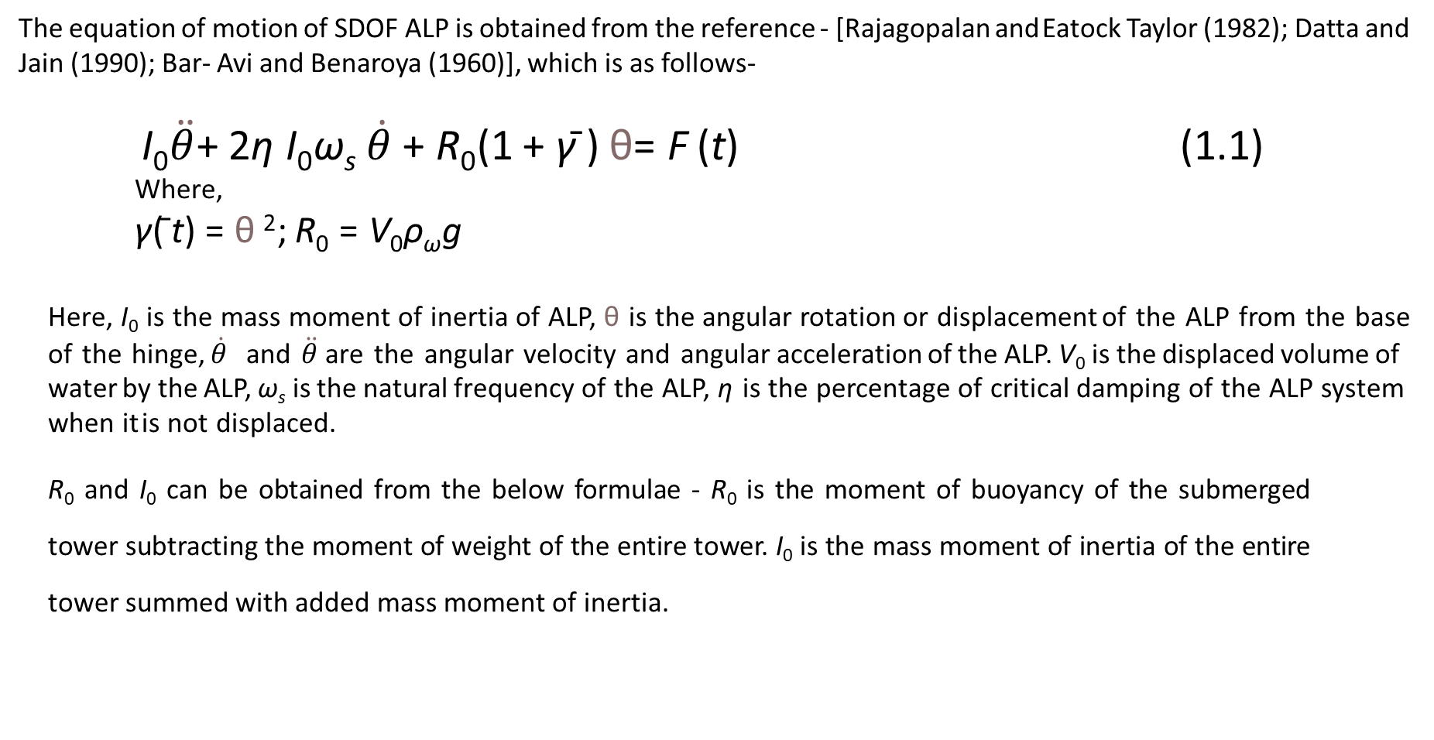
Equation of Motion of ALP
The equation of motion of SDOF ALP is obtained from the reference - [Rajagopalan and Eatock Taylor (1982); Datta and Jain (1990); Bar- Avi and Benaroya (1960)], which is as follows-
I₀$\ddot{θ}$+ 2η I₀ω_{s} $\dot{θ}$+ R₀(1 + γ¯) θ= F (t) (1.1)
Where,
γ(¯t) = θ ²; R₀ = V₀ρ_{ω}g
Here, I₀ is the mass moment of inertia of ALP, θ is the angular rotation or displacement of the ALP from the base of the hinge, $\dot{θ}$ and $\ddot{θ}$are the angular velocity and angular acceleration of the ALP. V₀ is the displaced volume of water by the ALP, ω_{s} is the natural frequency of the ALP, η is the percentage of critical damping of the ALP system when it is not displaced.
R₀ and I₀ can be obtained from the below formulae - R₀ is the moment of buoyancy of the submerged tower subtracting the moment of weight of the entire tower. I₀ is the mass moment of inertia of the entire tower summed with added mass moment of inertia.

Slide 9
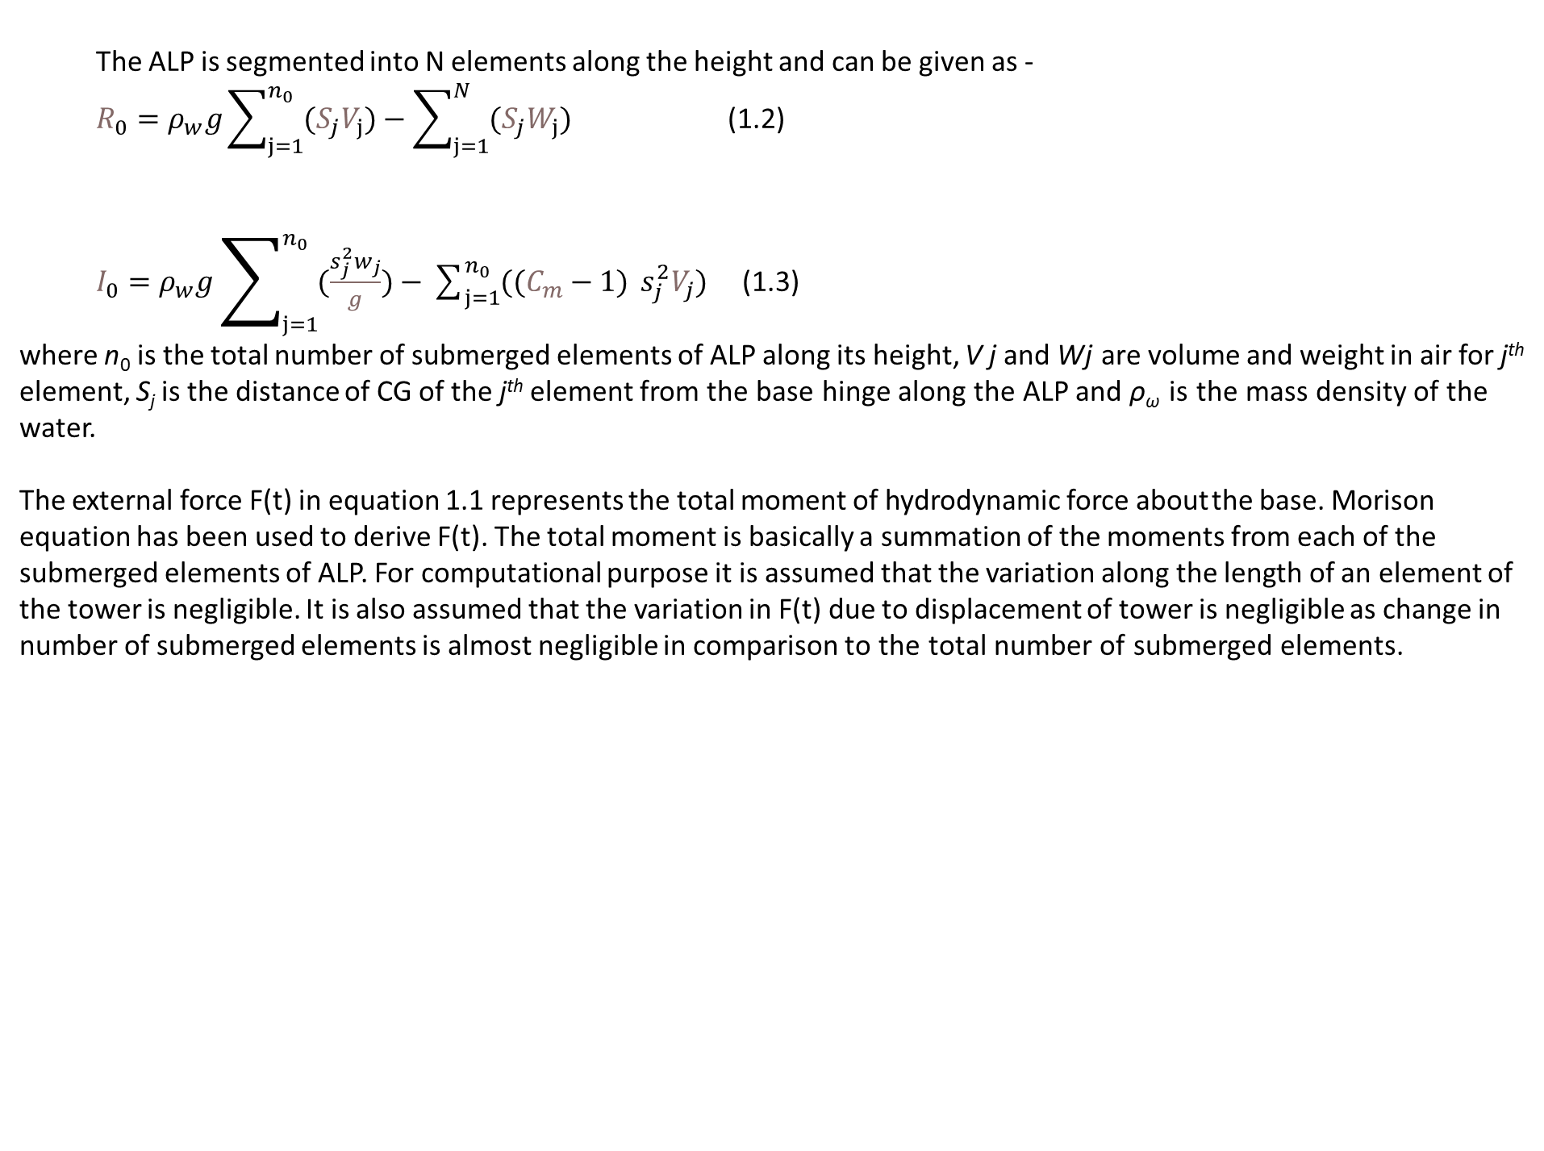
The ALP is segmented into N elements along the height and can be given as -
$R_{0}=ρ_{w}g\sum_{j=1}^{n_{0}}{(S_{j}V_{j})}−$ $\sum_{j=1}^{N_{}}{(S_{j}W_{j})}$ (1.2)
$I_{0}=ρ_{w}g\sum_{j=1}^{n_{0}}{(\frac{s_{j}^{2}w_{j}}{g})}−$ $\sum_{j=1}^{n_{0}}{((C_{m}−1)} s_{j}^{2}V_{j})$ (1.3)
where n₀ is the total number of submerged elements of ALP along its height, V j and Wj are volume and weight in air for j^{th} element, S_{j} is the distance of CG of the j^{th} element from the base hinge along the ALP and ρ_{ω} is the mass density of the water.
The external force F(t) in equation 1.1 represents the total moment of hydrodynamic force about the base. Morison equation has been used to derive F(t). The total moment is basically a summation of the moments from each of the submerged elements of ALP. For computational purpose it is assumed that the variation along the length of an element of the tower is negligible. It is also assumed that the variation in F(t) due to displacement of tower is negligible as change in number of submerged elements is almost negligible in comparison to the total number of submerged elements.

Slide 10
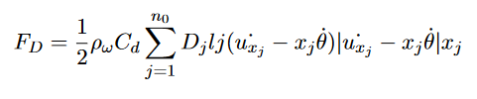

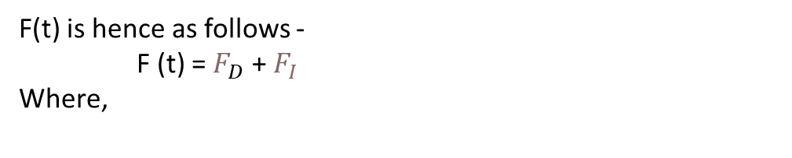
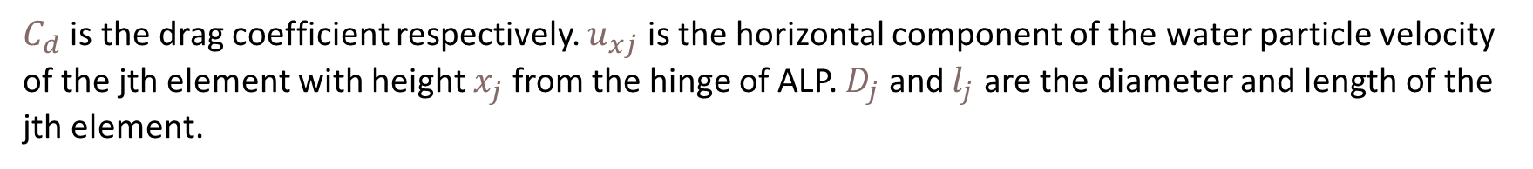
F(t) is hence as follows -
F (t) = $F_{D}$ + $F_{I}$
Where,
$C_{d}$ is the drag coefficient respectively. $u_{xj}$ is the horizontal component of the water particle velocity of the jth element with height $x_{j}$ from the hinge of ALP. $D_{j}$ and $l_{j}$ are the diameter and length of the jth element.
C_{m} is the inertia coefficient , V_{j} is the volume of the j_{th} element and u¨_{x}j is the horizontal component of the water particle acceleration of j_{th} the element with height x_{j} from the hinge of ALP.

Slide 11

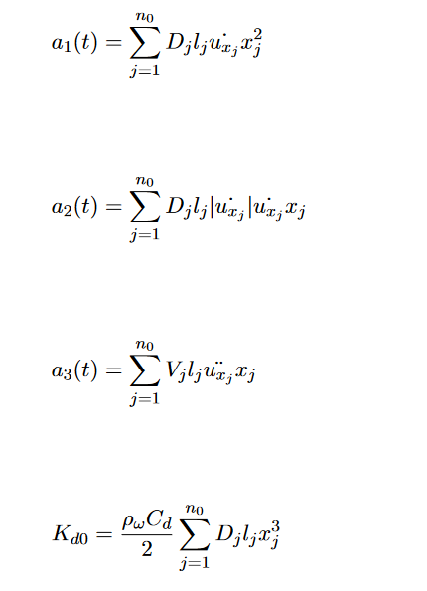
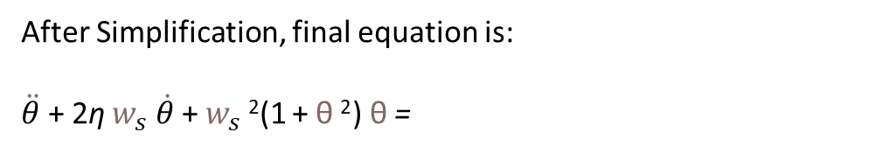
After Simplification, final equation is:
$\ddot{θ}$+ 2η $w_{s} \dot{θ}$ + $w_{s}$²(1 + θ ²) θ =
(1.4)
Where,
(1.5)
(1.6)
(1.7)
(1.8)
a1, a2 and a3 are the time-varying load components.

Slide 12
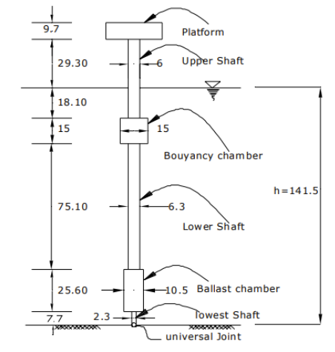
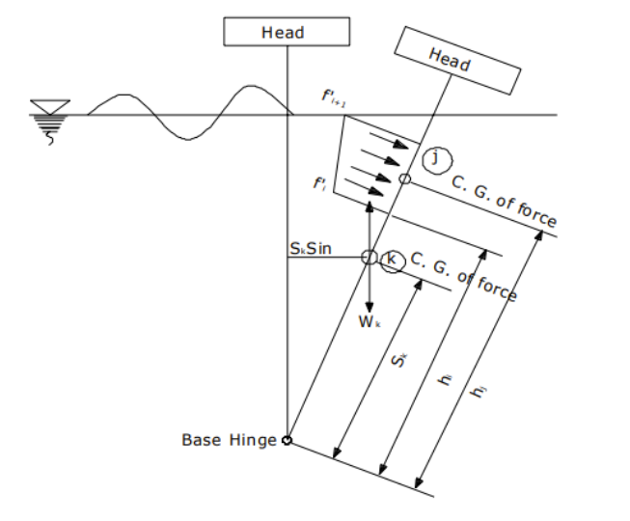
Formulation of ALP Structure
The total height of the ALP is 141.5 m which is further divided into smaller segments of length 1 m each.
The dimensions for the ALP has been obtained from [Rajagopalan and Eatock Taylor (1982); Datta and Jain (1990); Bar- Avi and Benaroya (1960)] and it has been showed in the figure below.
Fig 01: Dimensions of ALP
Fig 02: Mathematical Model of ALP [Ref:04]
[Ref: 04]

Slide 13
Part of ALP | Weight(kN) | Buoyancy(kN)
Head | 3730 | -
Upper Shaft(above msl) | 2810 | -
Upper Shaft(below msl) | 1740 | 5220
Buoyancy Chamber | 7210 | 27170
Lower Shaft | 22580 | 23390
Ballast Chamber | 40140 | 24700
Lowest Shaft | 840.4 | 320.06
Total | 79050.4 | 80800.06
Table 01: Physical Properties of ALP
According to the eq 1.2 & 1.3, the parameters S_{j}, W_{j} and V_{j} are calculated. These parameters are then summed up for the required number of elements to obtain R₀ and I₀.

Slide 14
The value of R₀ for the ALP considered is 1.0773e+08 N-m.
The value of I₀ for the ALP considered is 1.0570e+10 N- m ²
Based on the above values, the natural frequency of the ALP is calculated. The value of ω₀ for the ALP considered is 0.11 rad/sec.

Slide 15
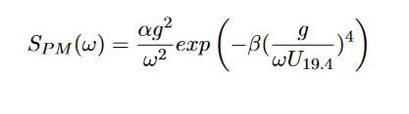
PM Spectra
where,
α is a numerical constant =0.0081
β is a numerical constant =0.74
U_{19.4} is the wind speed at 19.4m above the sea surface
S_{P} _{M} is sea spectral density function

Slide 16
Procedure for Load Calculation
From PM Spectra calculated the Amplitude, Spectral Density, and Wave number for the frequency range of 0 to 2 rad/sec.
2.Find the PSDF for a1,a2,and a3 using Transfer function and PM spectra.
3. Get the Time series of load components from PSDF.
4. Use those time series in the equation of motion as external load.

Slide 17

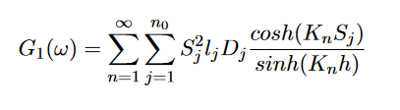
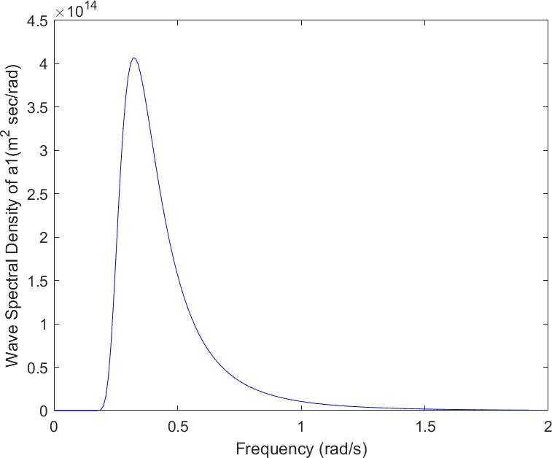
The PSDFs of a₁(t), a₂(t), and a₃(t) can be obtained by multiplying the square of the transfer function with the PSDF of the sea spectra.
PSDF of a1(t) can be written as,
Where,
we integrate it for all submerged elements for a frequency range of 0 to 2 rad/s, with an interval of 0.01 rad/s, leading to 200 values of S_{a1}(w)
Fig 03: PSDF Values of a₁(t)

Slide 18

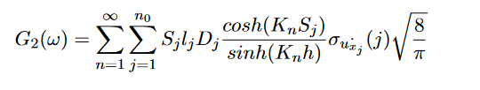
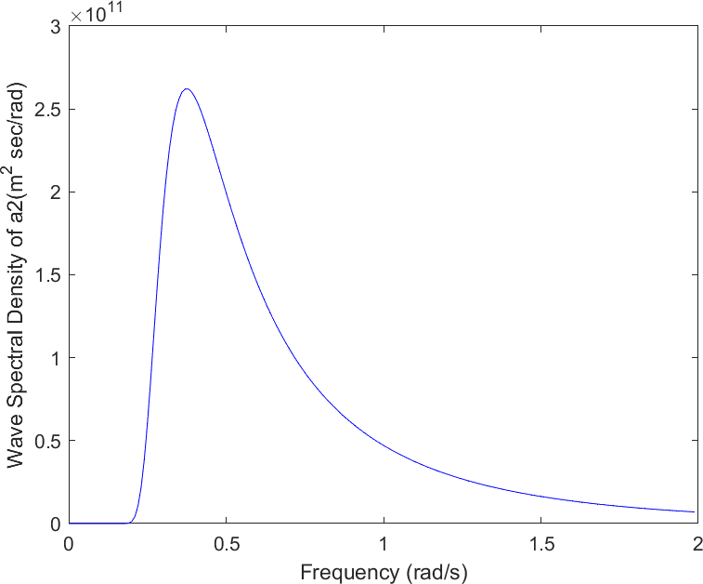
PSDF of a2(t) can be written as,
Where,
We integrate it for all submerged elements for a frequency range of 0 to 2 rad/s, with an interval of 0.01 rad/s, leading to 200 values of S_{a2}(w)
Fig 04: PSDF Values of a₂(t) for 16m significant wave height of sea spectrum

Slide 19

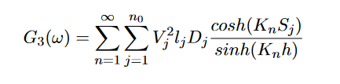
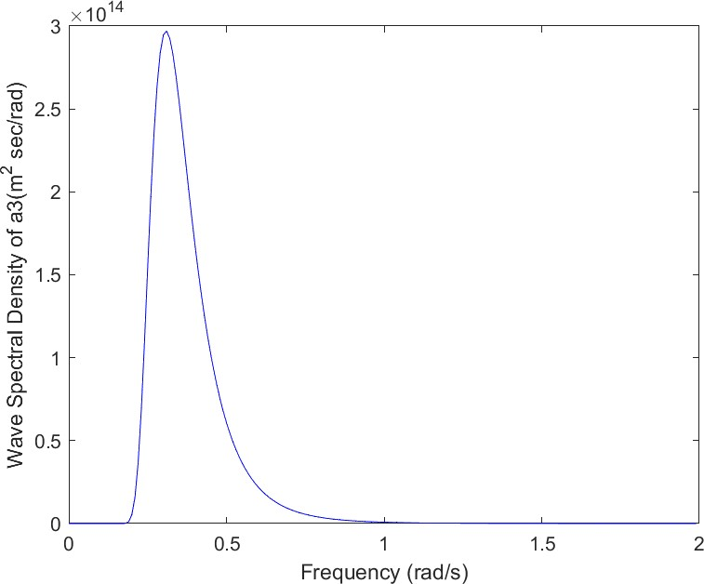
PSDF of a3(t) can be written as,
Where,
We integrate it for all submerged elements for a frequency range of 0 to 2 rad/s, with an interval of 0.01 rad/s, leading to 200 values of S_{a3}(w)
Fig 05: PSDF Values of a₃(t) for 16m significant wave height of sea spectrum

Slide 20
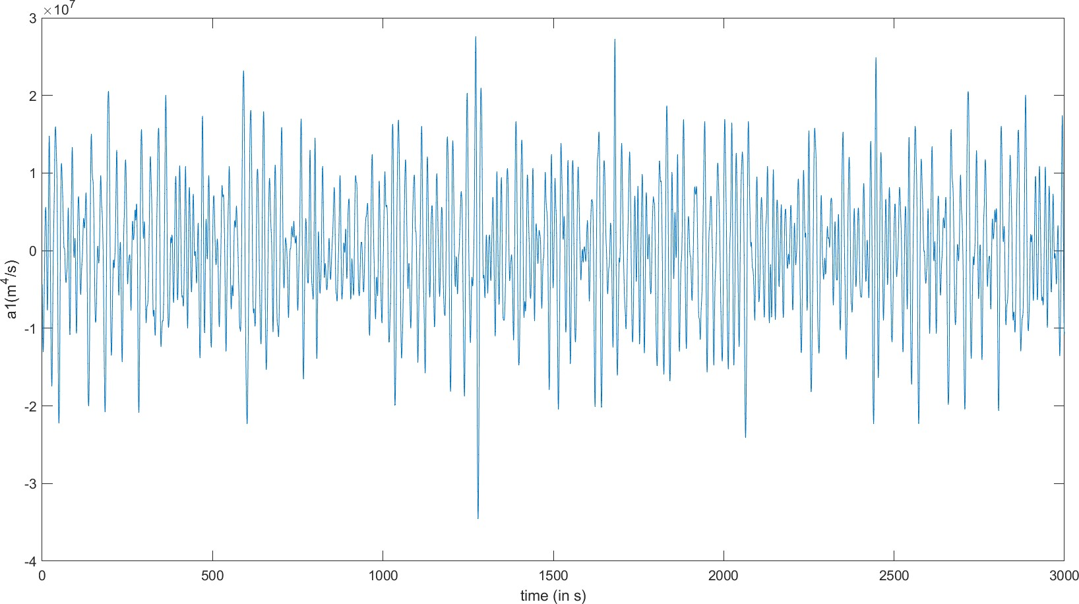
a₁(t) = A₁cos((ω_{n})t + ϕ_{n})
Fig:06-Time Series of a₁(t)

Slide 21
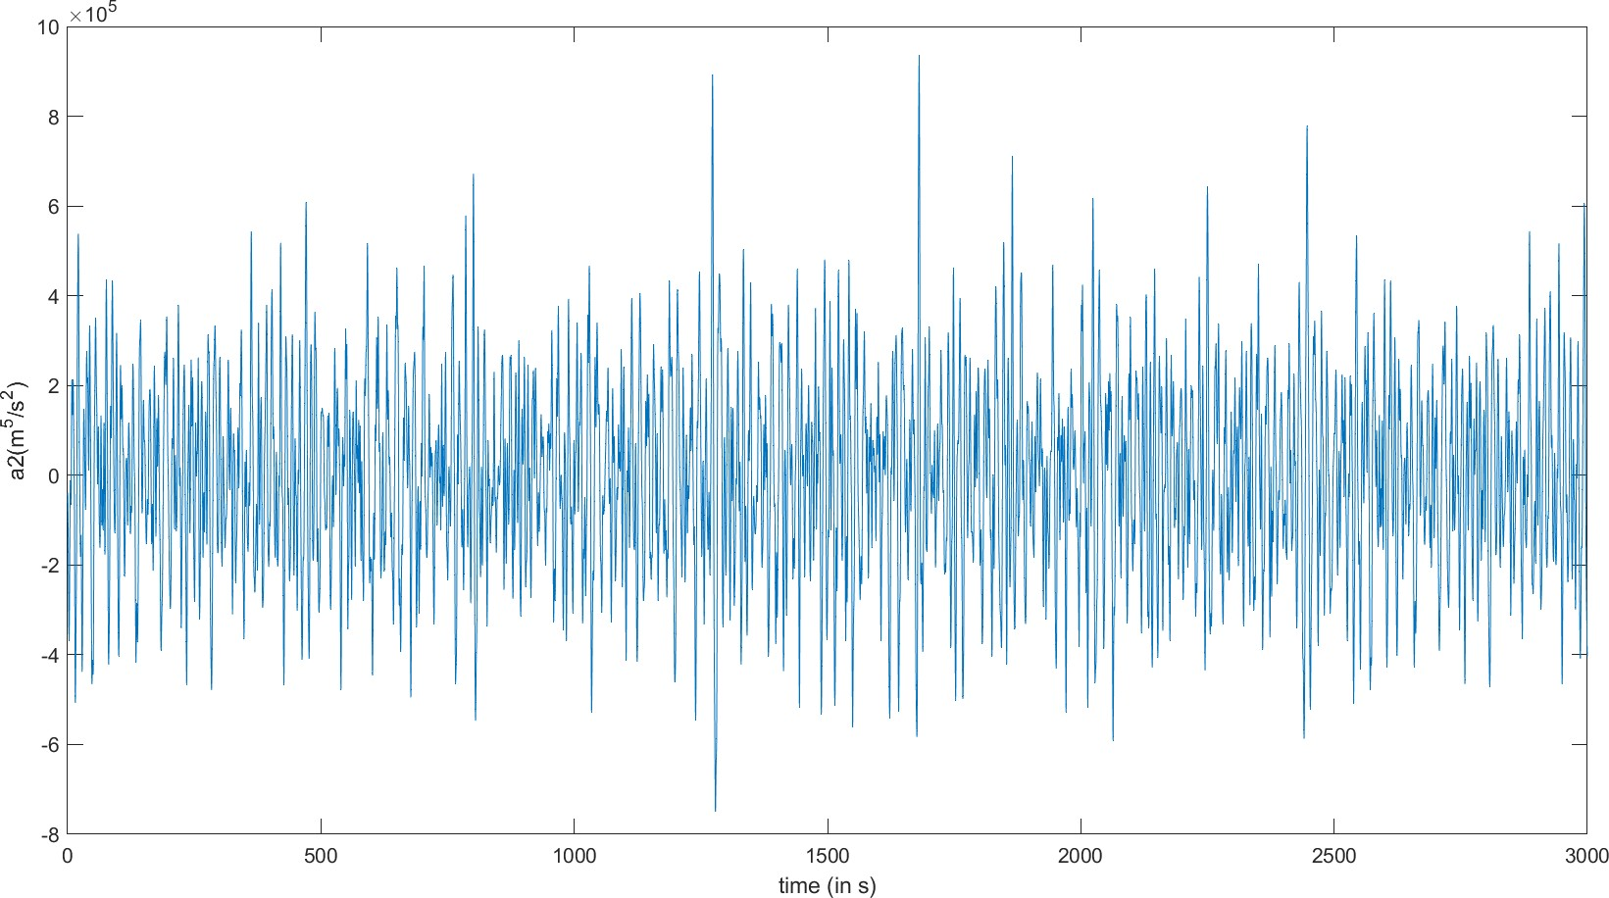
a₂(t) = A₂cos((ω_{n})t + ϕ_{n})
Fig:07-Time Series of a₂(t)

Slide 22
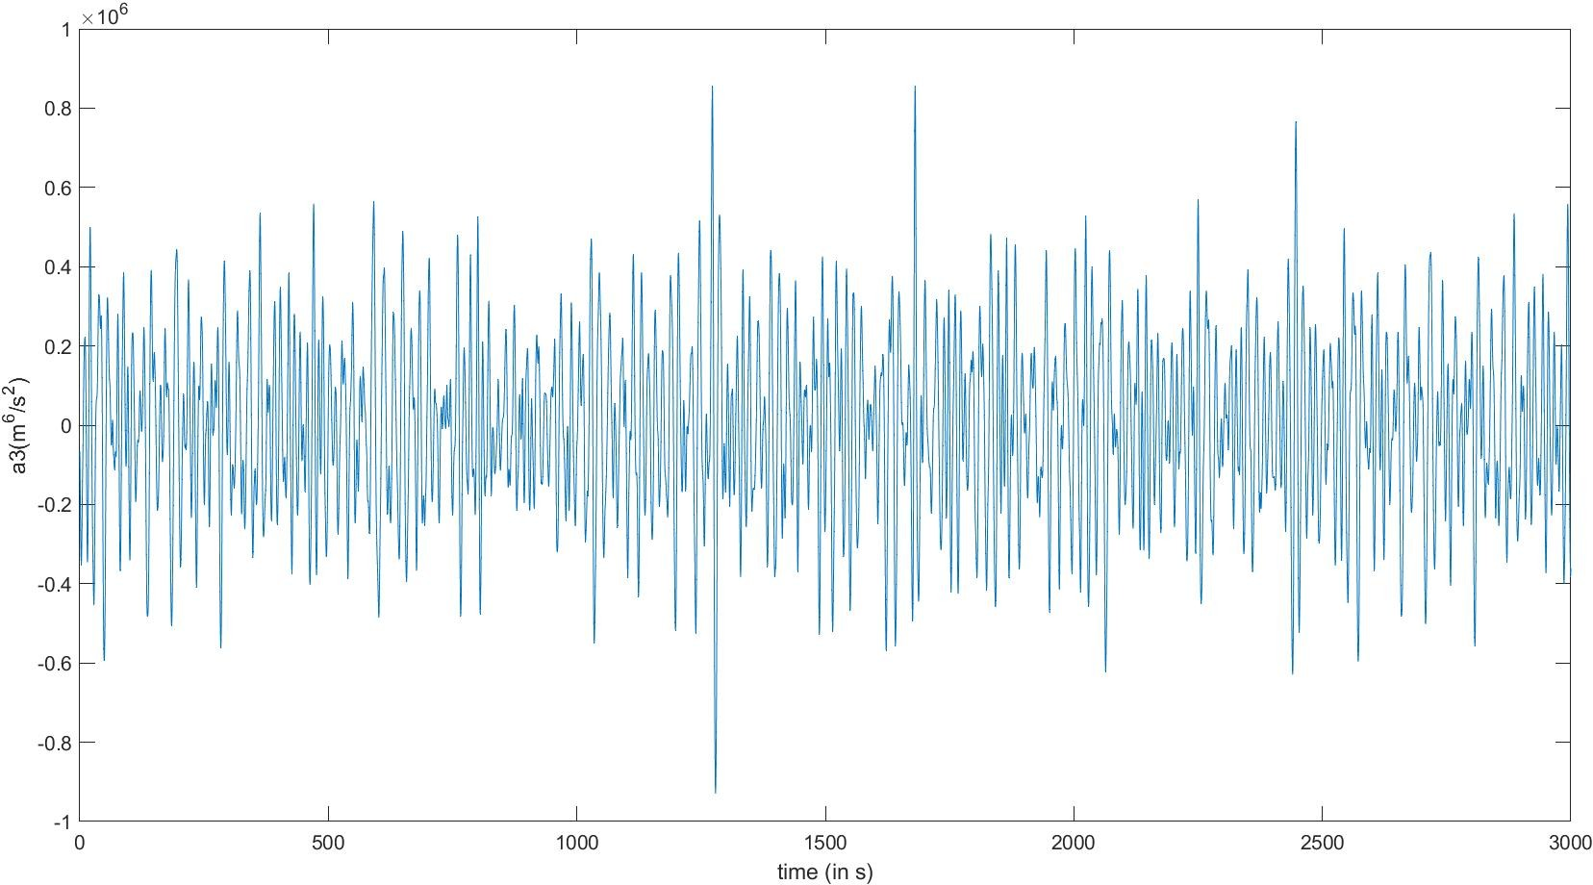
a₃(t) = A₃cos((ω_{n})t + ϕ_{n})
Fig:08-Time Series of a₃(t)

Slide 23
Algorithm of Newmark beta method
Calculated the initial conditions
Calculated dp using linear force term
For Every Timestep
Calculated dp using non-linear force term
Till converged
Final Response

Slide 24
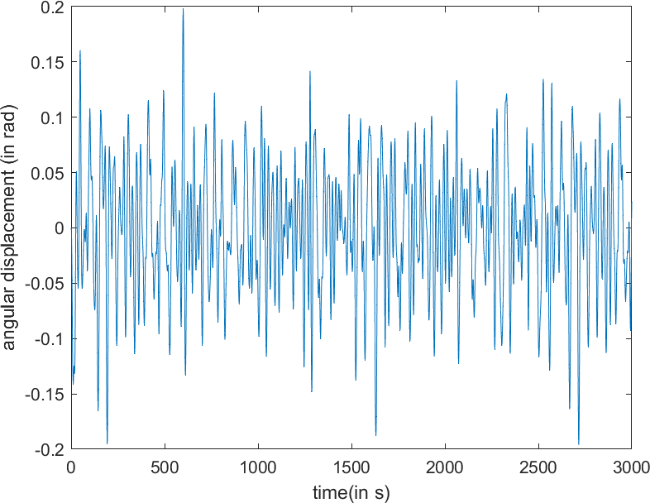
Solutions from Newmark beta method
Angular displacement of ALP:
Fig 09: Angular Displacement of SDOF ALP for time simulation of 3000s

Slide 25
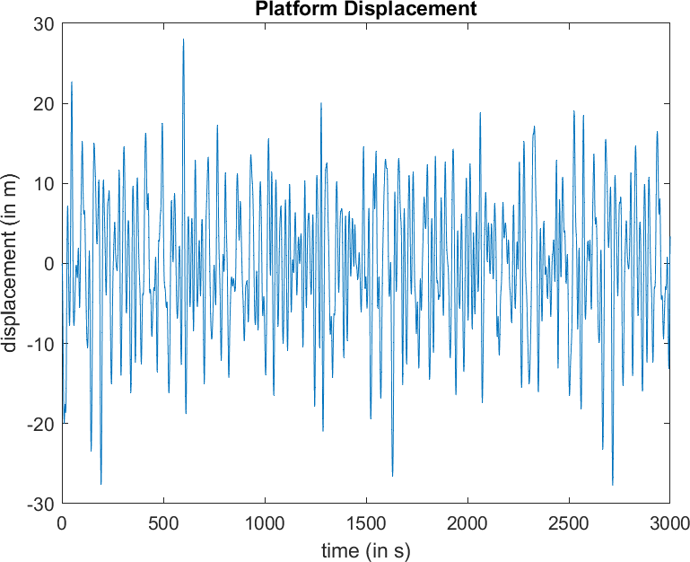
Platform displacement of ALP:
Fig 10: Platform Displacement of SDOF ALP for time simulation of 3000s

Slide 26
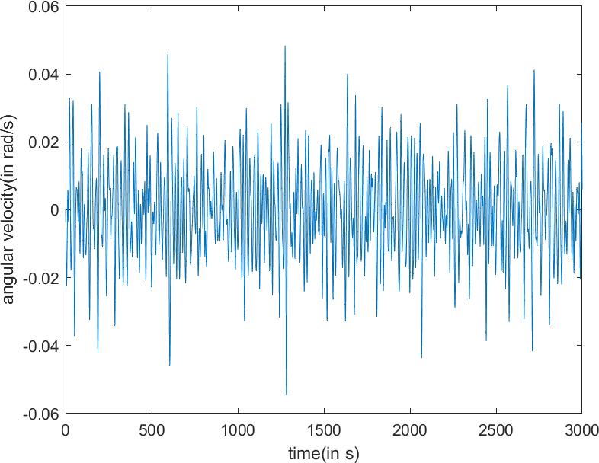
Angular Velocity of ALP:
Fig11: Angular Velocity of SDOF ALP for time simulation of 3000s

Slide 27
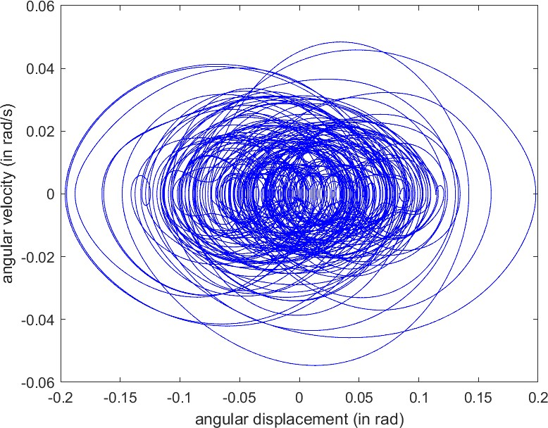
Analysis of the Responses
Phase Plot:
Fig 12: Phase Plot for a time simulation of 3000s

Slide 28
References
[1] A. K. Banik and T. K. Dutta, “Stability Analysis of an Articulated Loading Platform in Regular Sea,” Journal of Computational and Nonlinear Dynamics, vol. 3, 12 2007. 011013.
[2] C. Kirk and R. Jain, “Response of Articulated Towers to Waves and Current,” Society of Petroleum Engineers Journal, vol. 18, pp. 283–290, 10 1978.
[3] P. Bar-Avi and H. Benaroya, “Non-linear dynamics of an articulated tower in the ocean,” Journal of Sound and Vibration, vol. 190, no. 1, pp. 77–103, 1996.
[4] Deepak Kumar and T. K. Datta, “Stochastic response of articulated leg platform in probability domain”.

Slide 29
Timeline
Topic | June | July | August | September | October | November | Dec-Mar24
Topic Selection & Literature Review
Derivation of EoM & Simplification
Formulation of ALP Structure and Calculation of Ro,Io
Load Calculation & Time Series
Solution of EoM using Newmark Beta Method
Analysis of Responses
Response in Ship attached condition

Slide 30
Thank You

