Slide 1


PRESENTATION
By Sawan Kumar

Slide 2

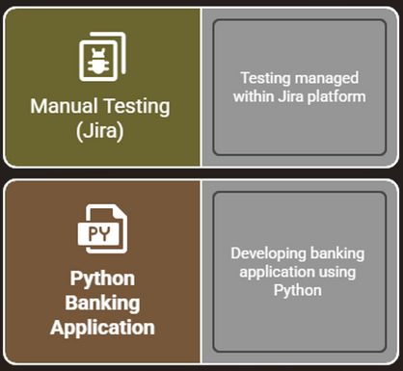
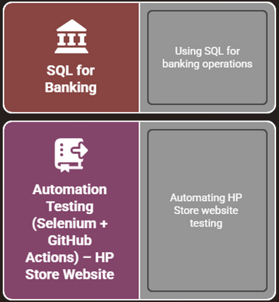
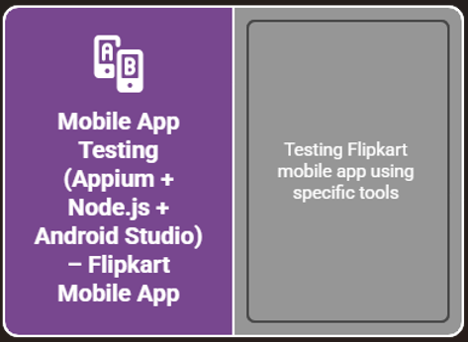
CAPSTONE PROJECT
Subtasks Overview:

Slide 3
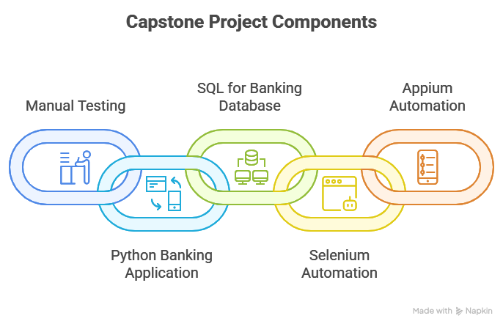
PROJECT GOALS
  Aim:
  To test & automate a complete application ecosystem (web + mobile + backend) using multiple tools.
  Tools Used:
  Jira, pycharm, MySQL, Pytest for Selenium (HP Store), GitHub Actions, node js. , Appium server (Flipkart App), Android Studio

Slide 4

1. MANUAL TESTING WITH JIRA
🔹 What we created in Jira
  Epics
  User Stories
  Test Cases
  Test Executions
🔹 Purpose
  To manually test key e-commerce features such as Login, Search, Cart, Payment, Order Tracking.

Slide 5

EPICS & USER STORIES (JIRA BACKLOG)
📌 Epic 1 – User Login
  Story: Customer logs in using email/password.
📌 Epic 2 – Product Search
  Story: Search by product name.
  Story: View search suggestions.
📌 Epic 3 – Add to Cart
  Story: Add product to cart.
  Story: Remove product from cart.
📌 Epic 4 – Checkout & Payment
  Story: Proceed to checkout.
  Story: Payment confirmation.
📌 Epic 5 – Order Tracking
  Story: View order history.
  Story: Track delivery status.

Slide 6
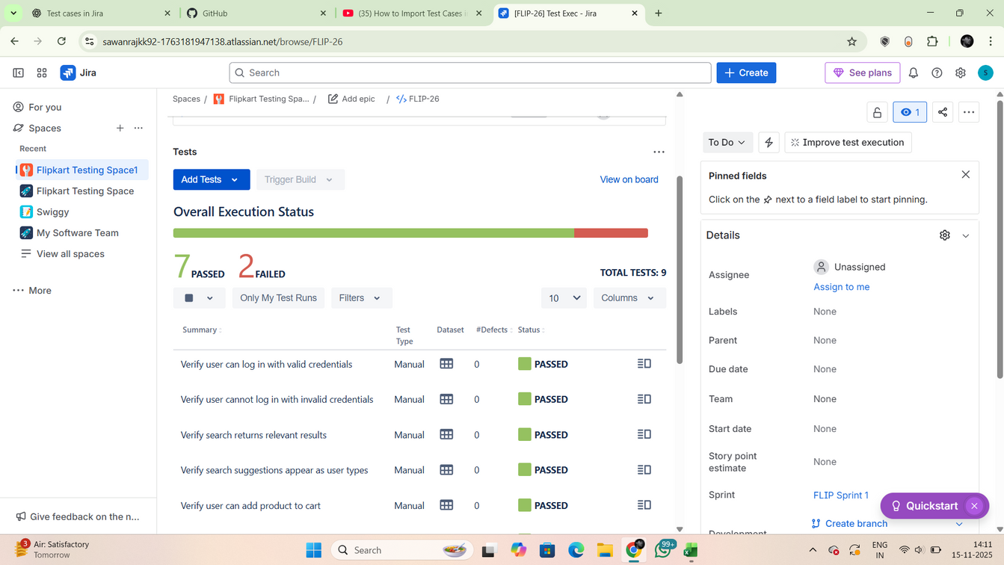
Example Testcase (TC_LOGIN_001):
Precondition: Registered user
Steps: Open browser → Go to Flipkart → Enter credentials → Login
Test Data: Email + Password
Expected Result: Homepage opens

Slide 7

2. PYTHON BANKING APPLICATION
OOP Concepts Implemented
1. Classes & Objects
  Created multiple classes like: BankAccount, SavingsAccount, Customer, BankingSystem
  Objects are created dynamically when adding customers, accounts, or performing transactions.
2. Inheritance
  SavingsAccount inherits from BankAccount
  Reuses deposit/withdraw logic
class SavingsAccount(BankAccount):
def __init__(...):
super().__init__(...)

Slide 8
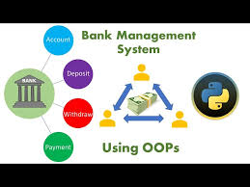
Encapsulation: Encapsulation means keeping data safe inside a class.
In our project:
  Account balance, account number, and customer ID are stored inside the BankAccount class.
  We cannot change them directly.
  We use methods like deposit(), withdraw(), add_interest() to update them.
  This protects the data from incorrect modification and keeps it controlled.
Abstraction: Abstraction hides complex code and shows only the important functions.
In the project:
  CSV reading/writing
  Logging transactions
  Interest calculation
are hidden behind method like:
account.deposit(amount)
system.log_transaction(...)
The user does not see how it works internally.
now here
  Both BankAccount and SavingsAccount use deposit() and withdraw()
  But SavingsAccount adds new behavior with add_interest()
Same method name → different behavior depending on the class. this is the Polymorphism concept

Slide 9
3. SQL FOR BANKING
In this application, I have used all the concepts of CRUD operations while building the banking system.
CRUD stands for Create, Read, Update, and Delete, and these four operations are the foundation of any database-based application.
In my project:
  CREATE is used whenever a new customer, account, or transaction is added to the system.
  READ is used to view customer details, check account balances, and display the full transaction history.
  UPDATE is used for real banking actions like deposit, withdraw, and adding interest to an account.
  DELETE is used to safely remove a customer, their accounts, and all related transactions from the system.
Together, these CRUD operations allow the banking application to behave like a real bank where data is continuously added, viewed, modified, and removed.

Slide 10
3. SQL FOR BANKING
I have also used SQL JOIN operations to connect information across tables.
JOINs help combine Customers, Accounts, and Transactions into one meaningful view.
  INNER JOIN shows customers along with their account details.
  MULTI-TABLE JOIN brings Customers + Accounts + Transactions together to display complete transaction history.
  LEFT JOIN shows all customers, even if they don’t have an account yet.
JOINs make the banking system more powerful by showing complete, connected information instead of data from single tables.

Slide 11
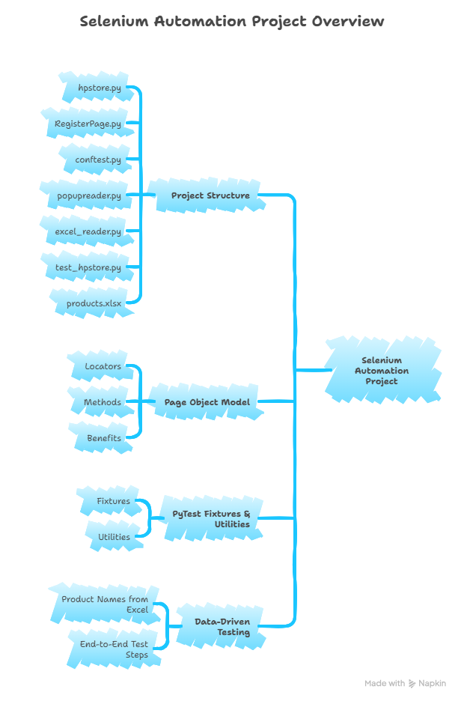
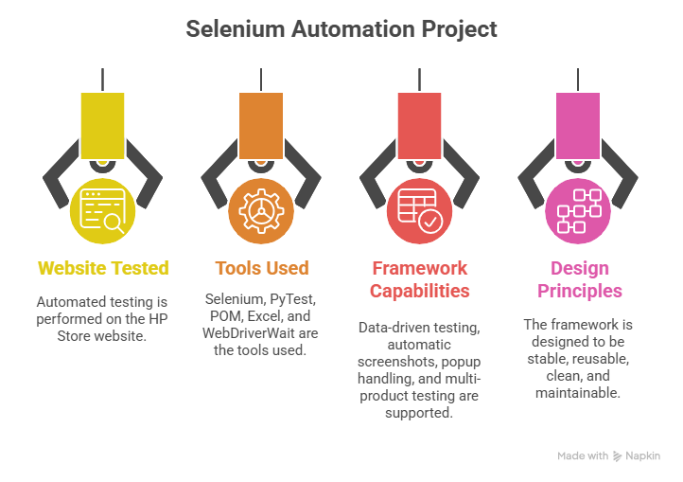
4. AUTOMATION TESTING (SELENIUM + GITHUB ACTIONS) – HP STORE WEBSITE

Slide 12

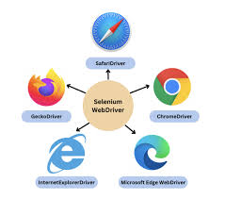
  hpstore.py – Main Page Object Model file (locators + actions)
  RegisterPage.py – POM for URL validation/registration page
  conftest.py – PyTest fixtures for browser setup & screenshots
  popupreader.py – Handles alerts, modals, cookie popups, iframes
  excel_reader.py – Reads product names from Excel file
  test_hpstore.py – Main automation script (end-to-end flow)
  products.xlsx – Test data for product names

Slide 13
POM
Page Object Model is a design pattern in Selenium where each webpage is represented as a separate class, and all the elements and actions related to that page are stored inside that class.
How i applied Pom in MY project?
  All web locators (XPath, ID, CSS selectors) are stored inside the POM file instead of the test script.
  All actions that the user performs (clicking, typing, searching) are created as separate methods.
  The test script only calls these methods, it never interacts with the webpage directly.
in my project POM uses By.ID , By.XPATH , By.CSS_SELECTOR
These locators help Selenium to find UI elements on the website.

Slide 14



5. MOBILE APP TESTING (APPIUM + NODE.JS + ANDROID STUDIO)
Page Object Model (POM)
  home_page.py → handles search, permissions
  search_results_page.py → filters, results, scrolling
  Cleaner code
  Easy to maintain
Popup Handling
  Permissions
  Language screen
  Login popup
  Notification popup
  Random overlays
Test Data From Excel
  Product name read dynamically
  Supports multiple test inputs
Allure Reporting
  Step-by-step logs
  Screenshots
  Filter actions
  Test status

Slide 15
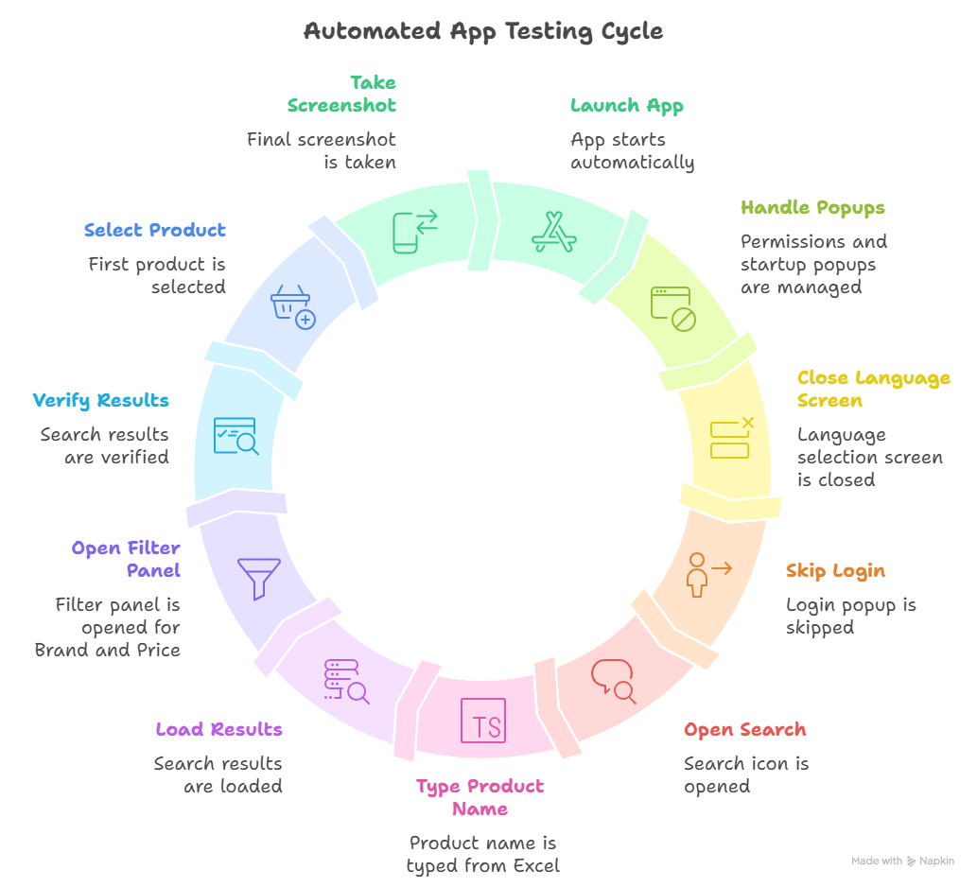
TESTCASES

Slide 16
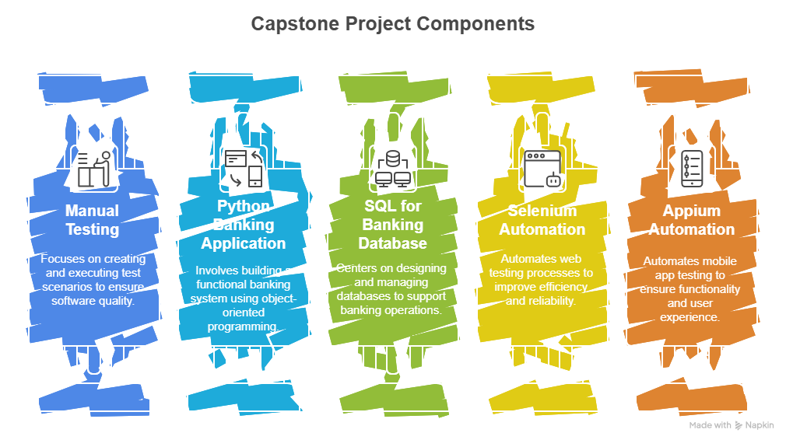
CONCLUSION
We successfully completed all five parts of the capstone project—Jira, Python, SQL, Selenium, and Appium—showing complete end-to-end testing and development skills. Jira was used to design organized epics, stories, and test cases. Python was used to build a banking application with OOP concepts, while SQL handled all backend CRUD operations and reporting. Selenium automated key web flows on the HP Store website using POM and data-driven testing. Appium automated the Flipkart Android app, covering onboarding, search, filters, and product validation with screenshots and Allure reports. Overall, the project demonstrates strong practical experience in manual, web, mobile, and backend testing.

Slide 17
THANK YOU

