Slide 1

NobleGPT
AI-BASED
MEDICAL ASSISTANT

Slide 2
NobleGPT
Introducing NobleGPT, the latest breakthrough in natural language processing technology. It is a state-of-the-art language model based on the GPT-2 architecture, capable of providing patient care and diagnosis with just a few symptoms.
It makes healthcare more accurate, efficient and accessible for patients worldwide.

Slide 3
Problem
Statement
It is an AI-based medical assistant that can assist medical professionals in patient care, diagnosis, and treatment planning. It develops algorithms that can accurately analyze patient data and provide real-time decision-making support.
It ensures data privacy and security for both patients and medical professionals. It develops personalized treatment plans based on patient data, medical history, and other relevant information.

Slide 4
Scope of
Scalability
We can scale it to make some other problem statements with vast number of solutions.
As we increase the amount of data input, it functions more smoothly.

Slide 5
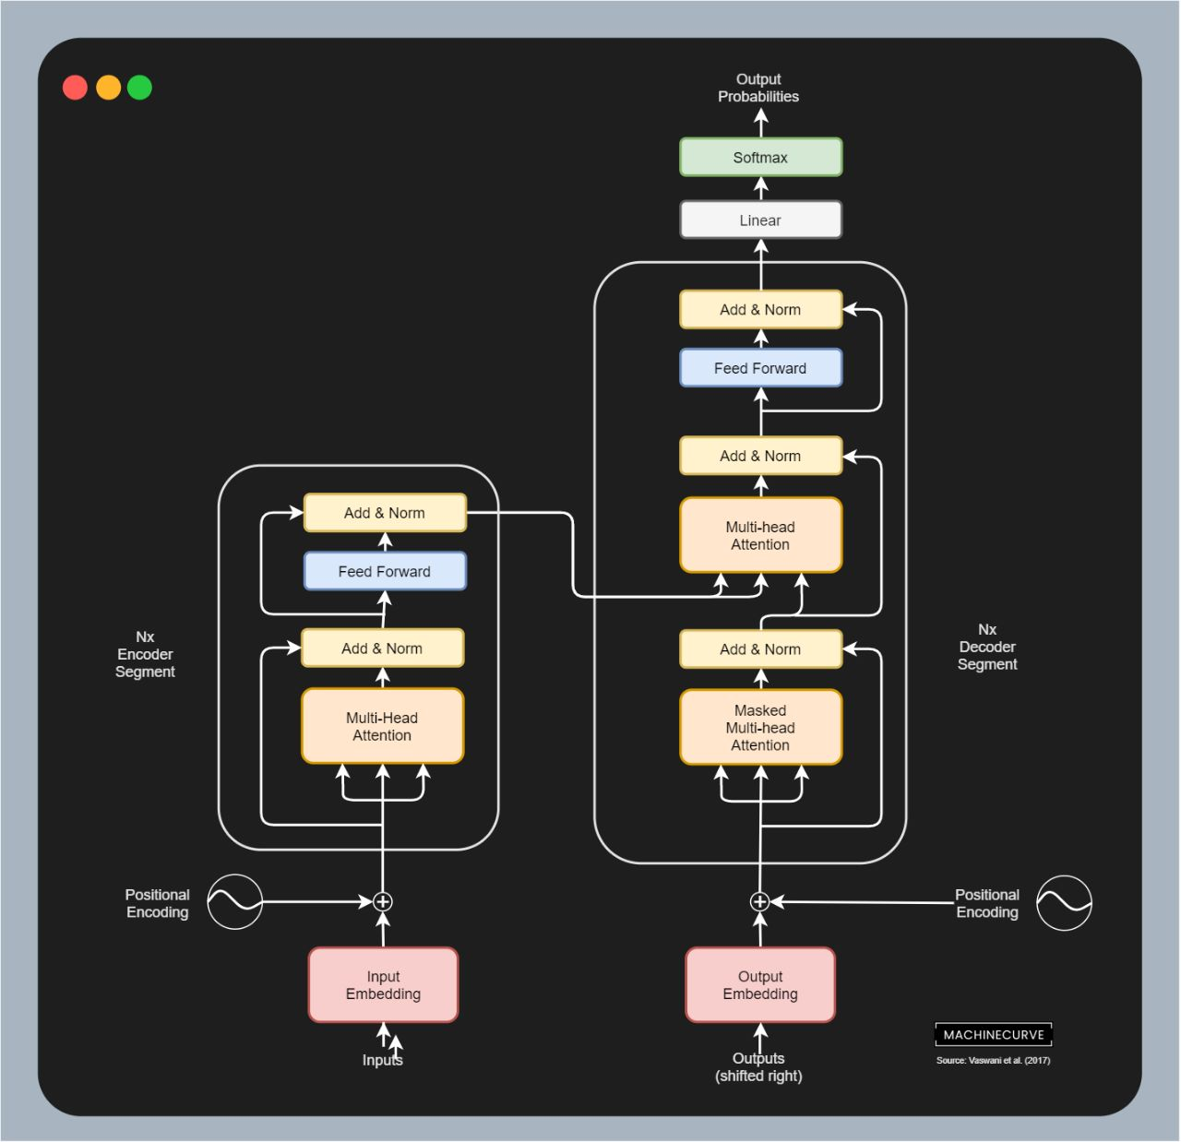

Slide 6
Platform
used
Back end: Python (Pytorch, Tensorflow, Pyscript, Tensor)
Front end: HTML, CSS, Bootstrap
Code Editor used: Virtual Studio Code

Slide 7
Members
Satvik Sawhney – RA2211026010212
Hetarsh Patel – RA2211051010045
Ishita Goel – RA2211026010247
Gunjan Mishra – RA2211026010214

Slide 8
THANK
YOU!!

