Slide 1

iSociety
SOCIETY MANAGEMENT SYSTEM

Slide 2
iSociety
iSociety is an Object Oriented Design and Programming Project on a housing society management system. It is one of a kind project made using C++ programming language.
It is a systemised way of putting everything together from managing your apartment/houses to payment of various bills, etc.

Slide 3
Problem
Statement
In today’s modern world, people have a lot on their plate, so we are trying to take off some load off their plates. Housing problems are common to all and managing them is an even bigger job.
Our project combines all the management and billing systems of an apartment/house in a society and provide the residents with the desirable output.

Slide 4
Scope of Scalability
We can write our program in newer programming languages like python and make a nice GUI so that users can have a better experience.
We can make a website on our project using languages like HTML, CSS, JS, React Js.
Upon successful implementation of our website, we can turn it into a financial model by renting subscriptions out to big societies.

Slide 5
Concepts
used
Concept of different data types
If… else if… Else… statements
Switch
Loops
Classes
Inheritance of Classes
File handling

Slide 6
Modules
Admin Module
An admin is provided with a unique password with which he/she can login. The admin has the right to access, add, modify and delete residents. They also has access to all the bills.
Resident Module
The residents enters personal details along with a password. They can choose the apartments and amenities as per their requirements and also pay the bills. They can also view all their details.

Slide 7
UML DIAGRAMS

Slide 8
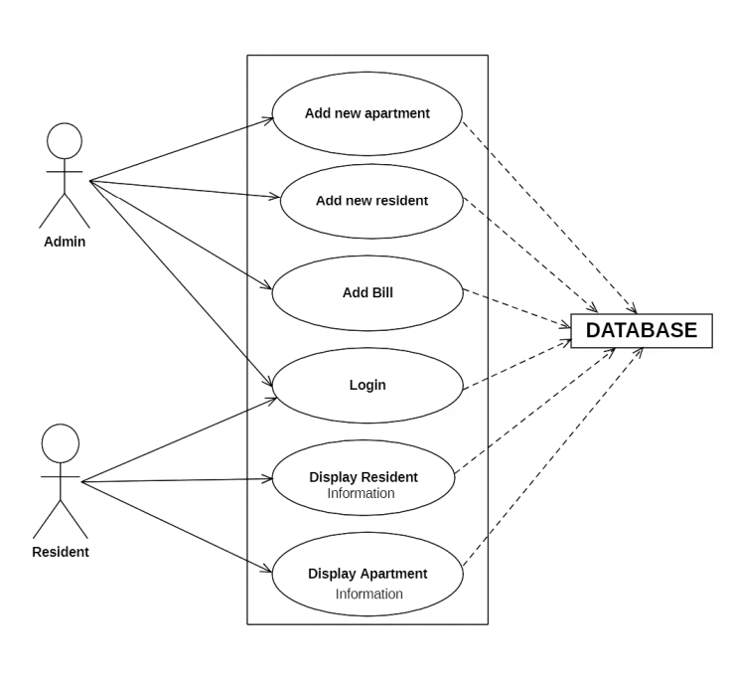
USE
CASE
DIAGRAM

Slide 9
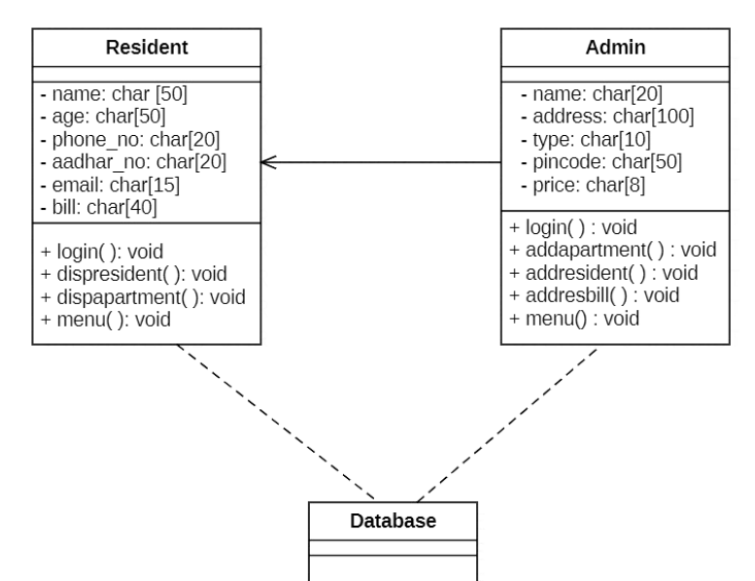
DIAGRAM
CLASS
+ storesinfo()
+retrieveinfo()

Slide 10
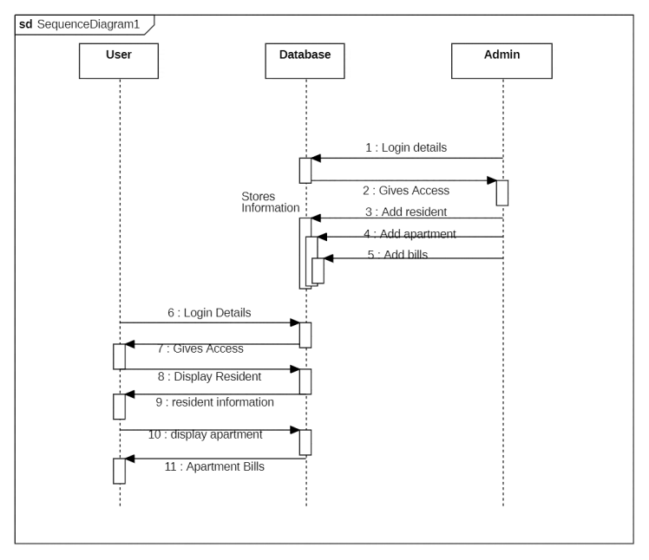
SEQUENCE
DIAGRAM

Slide 11
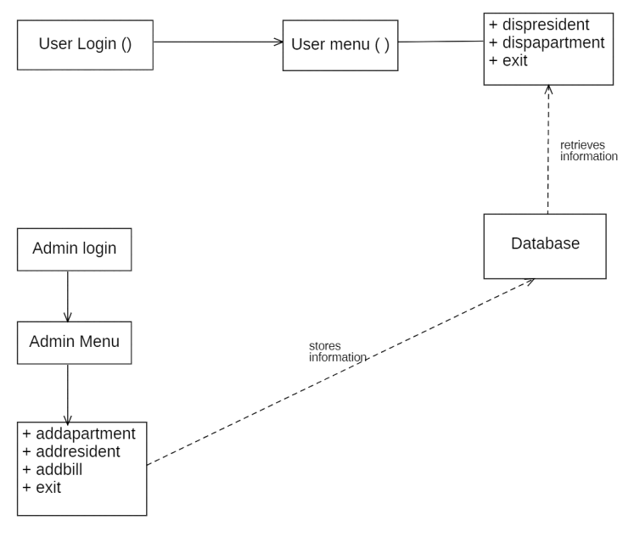
COLLABORATION
DIAGRAM

Slide 12
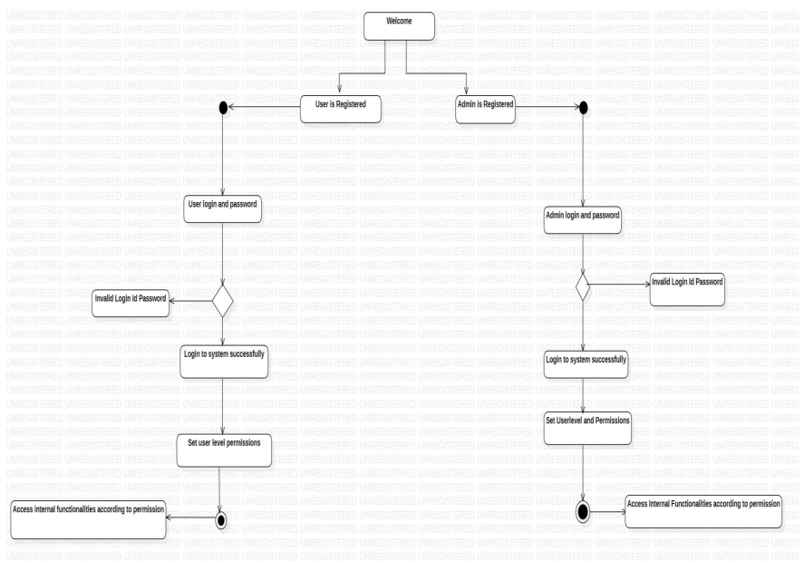
STATE
CHART
DIAGRAM

Slide 13
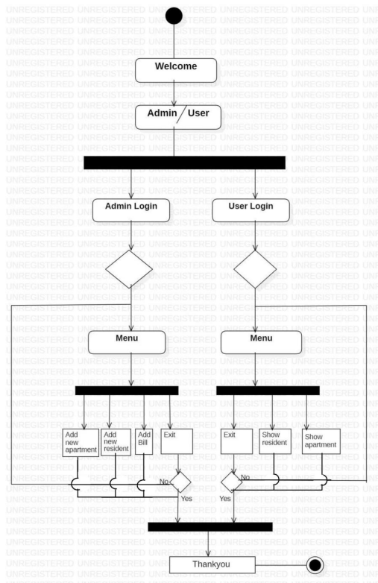
ACTIVITY
DIAGRAM

Slide 14
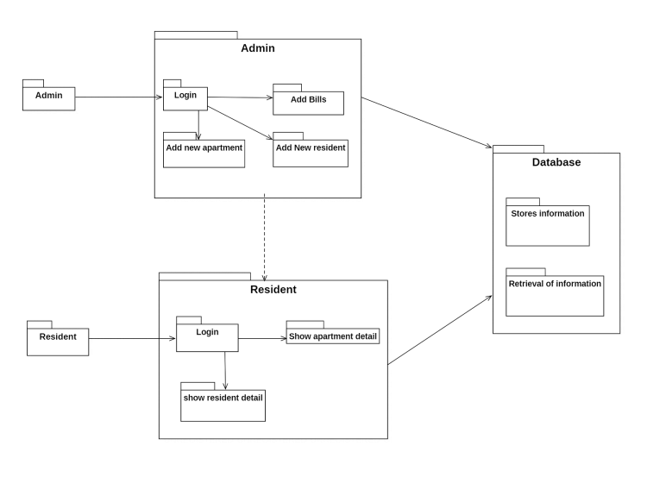
PACKAGE
DIAGRAM

Slide 15
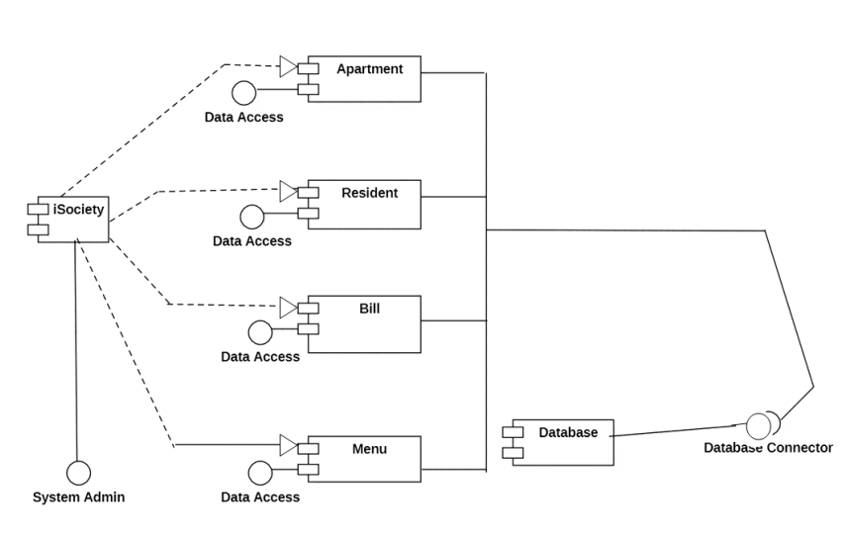
COMPONENT
DIAGRAM

Slide 16
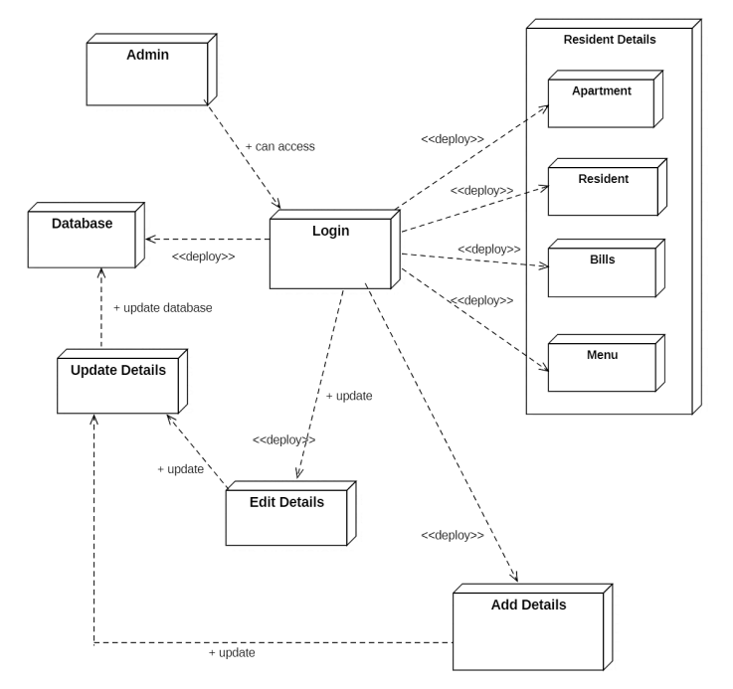
DEPLOYMENT
DIAGRAM

Slide 17
Result
iSociety is a solution to all the problems we deal with while managing their apartments and houses. It is a systemized way of putting everything together from managing your apartments for the payment of various bills.
Therefore, our projects makes management of houses easier for existing users, new uses as well as for the admins for putting everything in a more systemized manner.

Slide 18
Members
Satvik Sawhney – RA2211026010212
Ishita Goel – RA2211026010247
Saanvi Kumar – RA2211026010215
Gunjan Mishra – RA2211026010214
Reva Mahesh Kudchadkar – RA2211026010209

Slide 19
THANK
YOU!!

