Slide 1
EE-390(a) TP de conception de systèmes numériques
Hardware Clusters for Secure Hash Algorithm 1:
Profiling Performance for Different Clusters Configurations
Saverio Nasturzio, Gianluca Radi

Slide 2
Project in a nutshell
Hardware modules (hashers) that compute the hashes of an array of 512-bit blocks according to the SHA-1 algorithm.
The hashers are organized in different clusters. Each hasher within the same cluster computes the hash for the same block. Different clusters compute the hashes for different blocks.
Proof-of-work. The computed hashes must start with a certain number of ‘0’s (difficulty) that is specified by the application. Otherwise, the least significant 32 bits (nonce) of the input blocks are changed and a new hash is computed.
The input blocks are read one by one from the memory, and the resulting hashes are then written back.

Slide 3
Design Features: Checklist (1/2)
ARM Processors
The ARM Core computes hashes and is used as a baseline when benchmarking different cluster configurations.
DRAM memory
DRAM is used to store all the input blocks and the computed hashes.
Memory coherence
All allocated memory is non-cacheable. Every input block is saved internally by each cluster to avoid redundant read transactions.
AXI slave
AXI4 Lite slave is used to allow the user to program the following features of the accelerator: block address, number of blocks, difficulty, result address, start, stop

Slide 4
Design Features: Checklist (2/2)
AXI master
AXI4 Lite master is used by the accelerator to access the DRAM to read the input blocks and write back the resulting hashes.
Interrupts
An interrupt is asserted by the accelerator when all the blocks have been successfully hashed.
Linux device driver
The driver is used to abstract away the details of the configuration of the hardware and notify of the completion of the task.

Slide 5
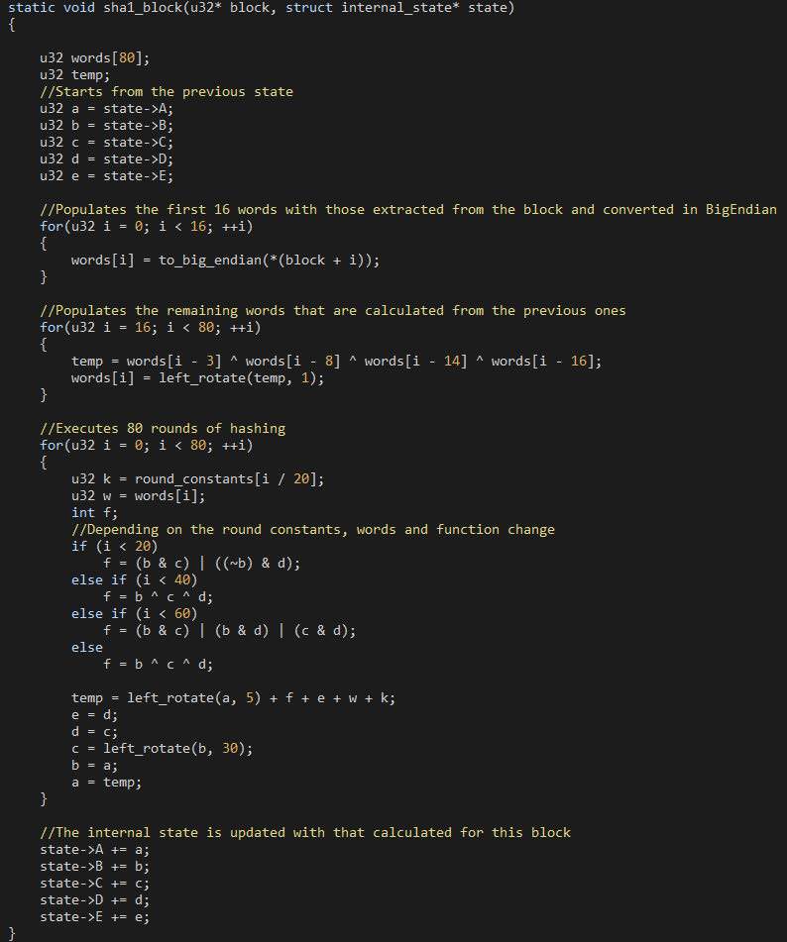
SHA-1 Overview
Two main phases of the algorithm:
80 32-bit words are computed from the input block.
80 iterations in which the internal state (5 32-bit words) is updated according to pre-defined constants and functions that depend on the iteration number.
The resulting hash is the final state.

Slide 6
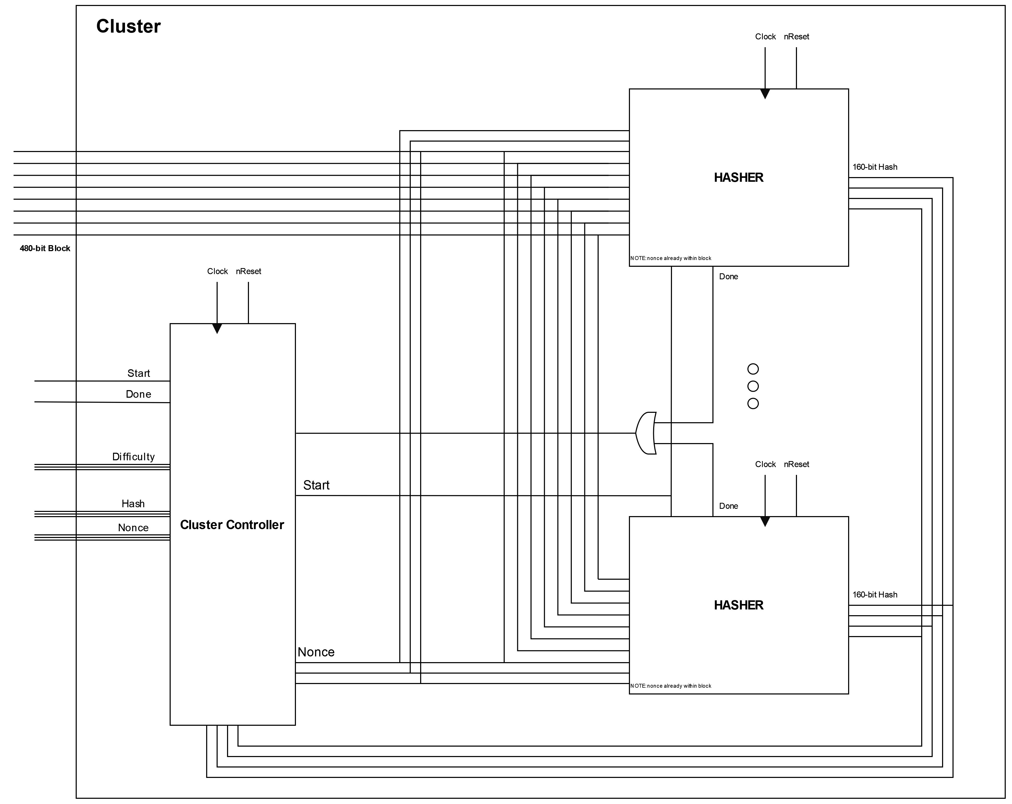
Cluster Overview
Cluster controller coordinates the different hashers and assigns them increasing nonces.
The most significant 480 bits of the input block are shared among hashers to avoid unnecessary registers.
All hashers execute in lockstep and yield back their result to the controller, which checks the compliance of the computed hashes with the difficulty.

Slide 7
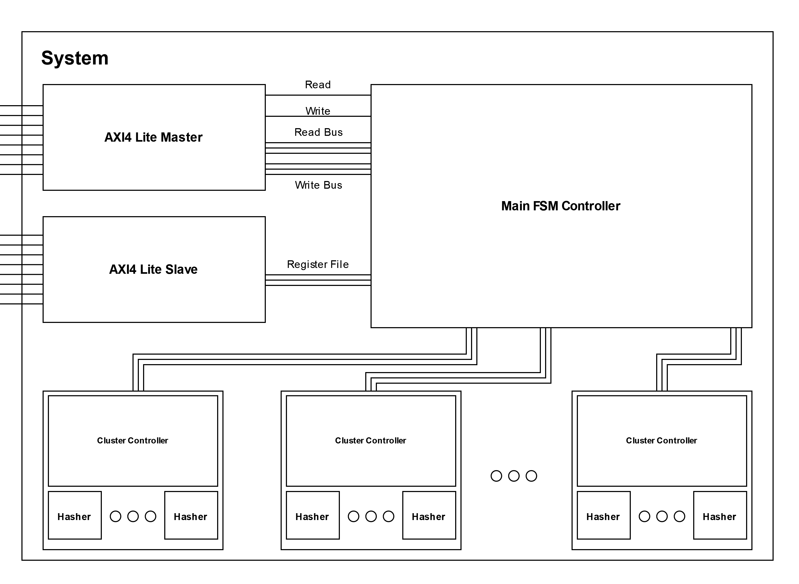
System Overview
Main controller is programmed via the AXI slave.
Main controller orchestrates the functioning of each cluster by assigning different input blocks to different clusters.
Main controller checks whether a cluster has finished and writes back the result to DRAM.

Slide 8
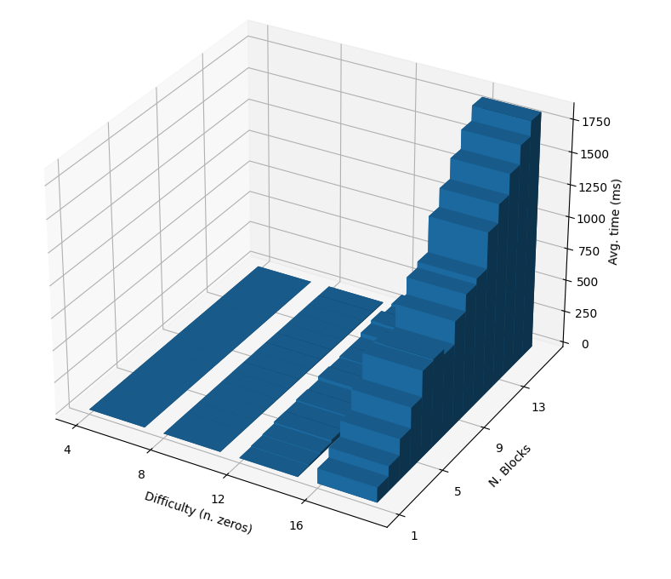

Why 76 MHz?
76 Mhz
100 Mhz

Slide 9
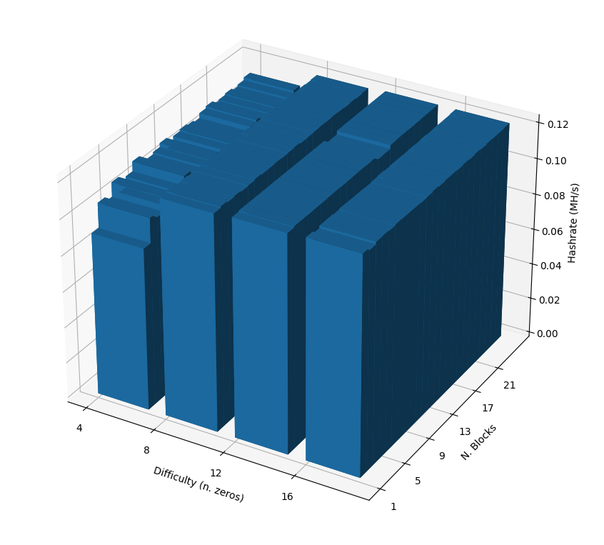
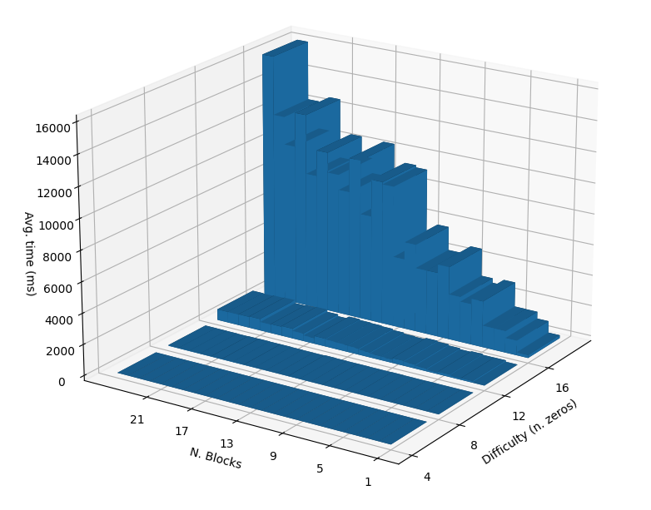
Baseline CPU Only

Slide 10
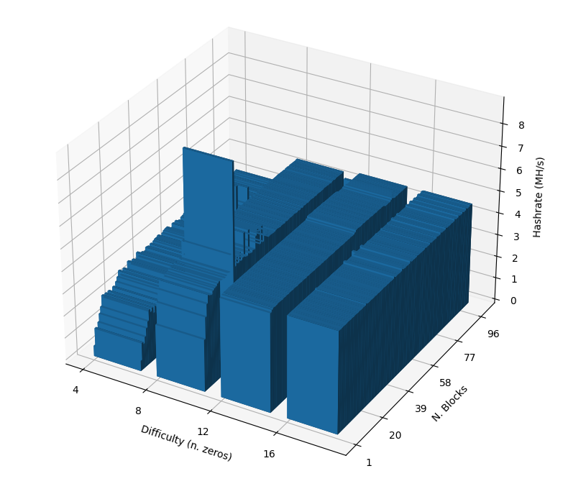
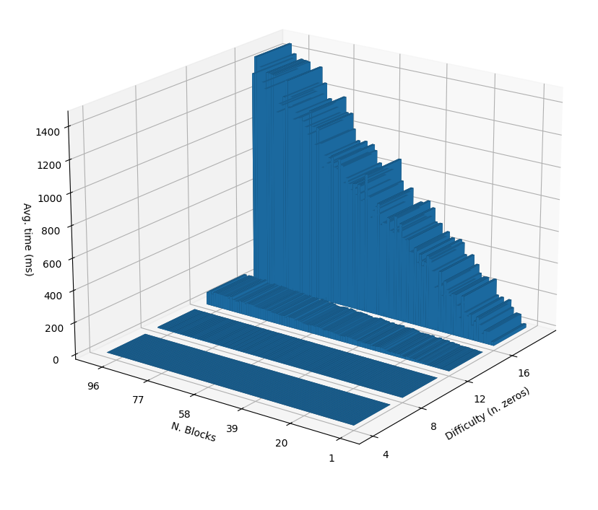
1 Cluster – 8 Hashers

Slide 11
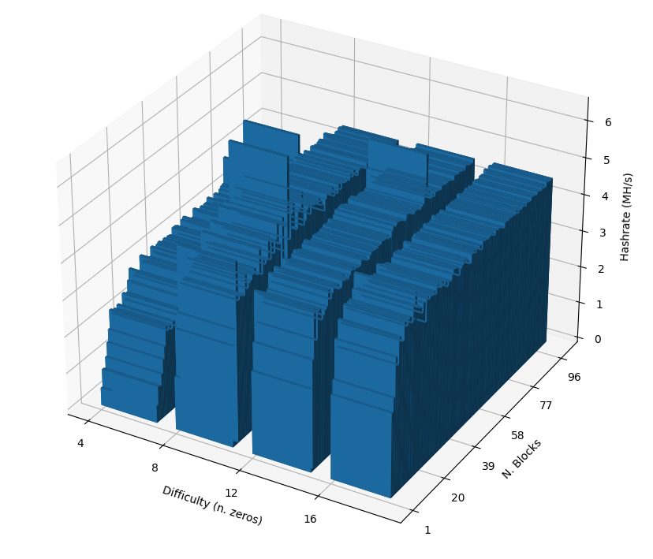
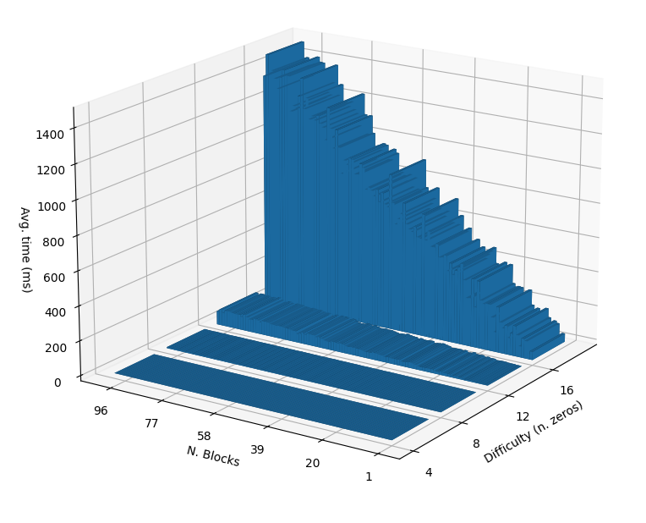
2 Cluster – 4 Hashers

Slide 12
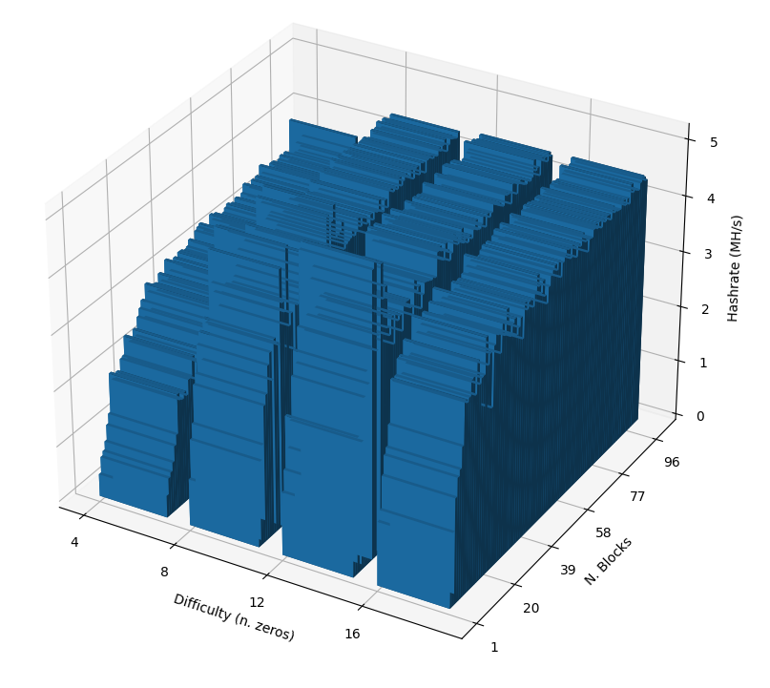
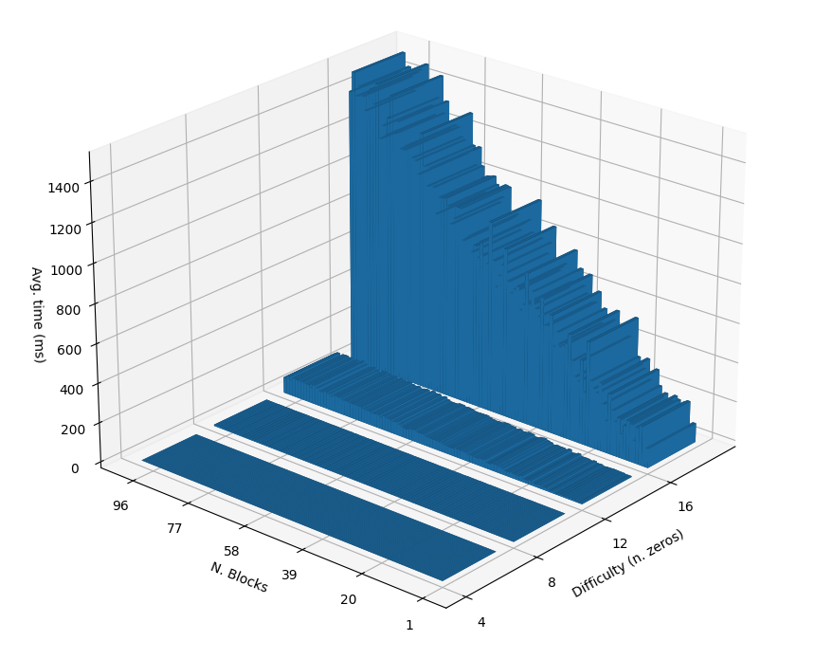
4 Cluster – 2 Hashers

Slide 13
Considerations
1 cluster – 8 hashers outperforms 4 clusters – 2 hashers for a small block number because in the first configuration all hashers are working, whereas in the second only 2 hashers are carrying out useful work.
Complexity: 0xFFFF0000
Average Time (ms) | Average Hash Rate (Hash / s)
13.449660 | 4556103.980000
53.870260 | 1140909.480000
1 block:
Solution?
FIFO + separate controller
Average Time (ms) | Average Hash Rate (Hash / s)
137.490333 | 4573730.666667
212.668667 | 3173293.666667
9 blocks:

Slide 14
Thank you for your attention.

