Slide 1

CSE 404
Artificial intelligence and Experts Systems Lab
Implementation
of a small map using
A* search algorithm
Submitted By:
Md. Abdur Rashid
Reg id: 19101008
Sec: A1

Slide 2
Introduction
Objective
Designed map
Outline
Search tree of the map
Implementation
Result analysis
Conclusion

Slide 3
Introduction
A* algorithm is a searching algorithm that searches for the shortest path between the initial state to the final state. Here, I will find the most optimal path from my home (Mugdapara) to my university (UAP) using A* search algorithm.

Slide 4
Objective
The objective of this project is to find an optimal path from my home (Mugdapara) to my university (UAP).

Slide 5
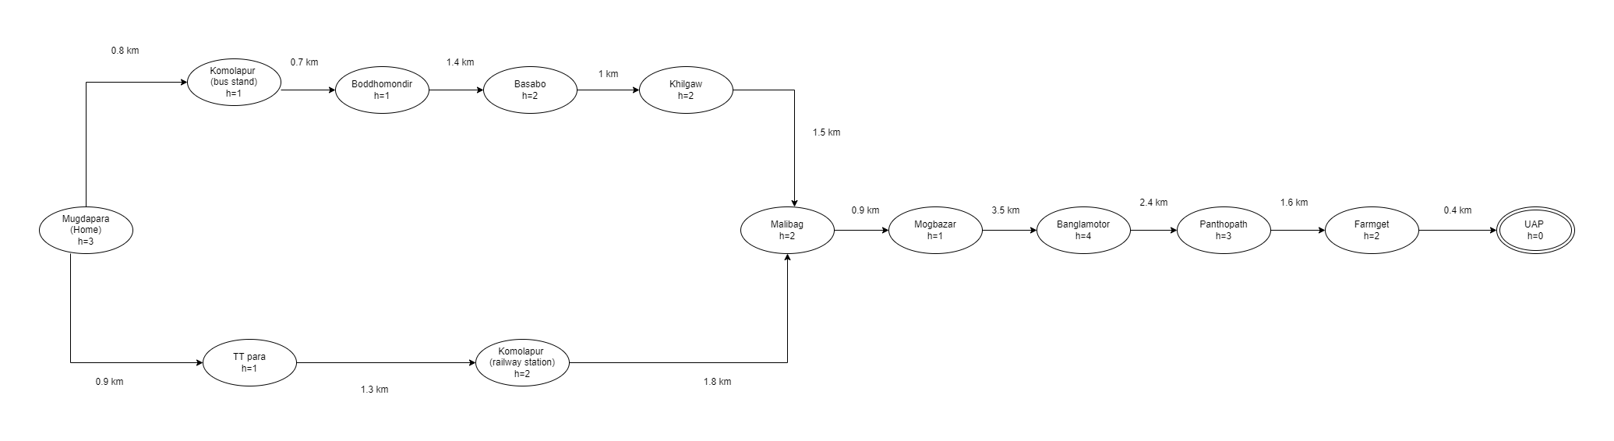
Designed Map

Slide 6
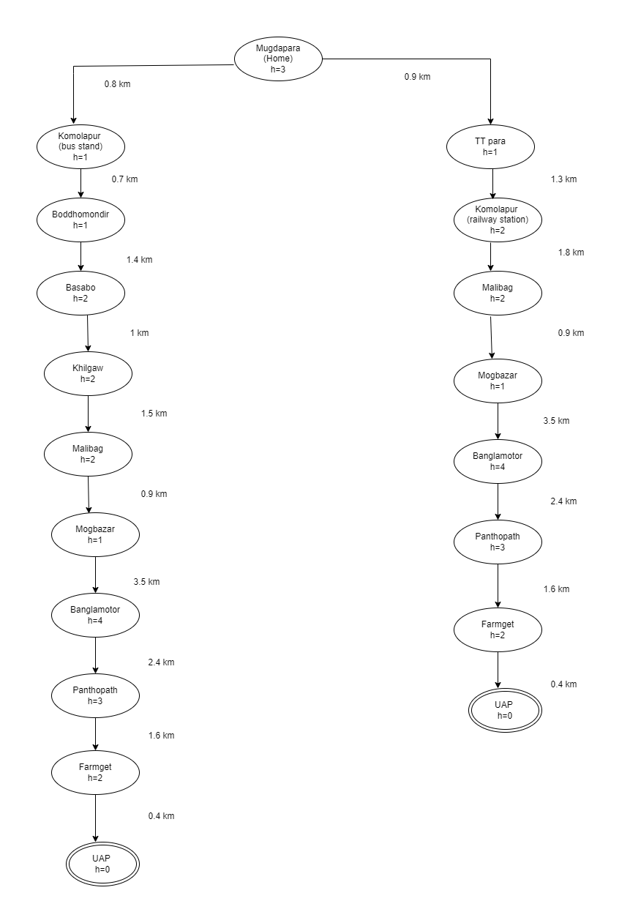
Search Tree

Slide 7
Implementation
Now I will explain implementation part of this project.
I have used python for the programming language and implement it in Pycharm IDE.

Slide 8
Result Analysis
After Using A* Search Algorithm on this designed map, on output we can find the shortest path:
Mugdapara (Home) --> TT para --> Komolapur Railway station --> Malibag --> Mogbazar --> Banglamotor --> Panthopath --> Farmget --> UAP.
Path cost: (0.9+1.3+1.8+0.9+3.5+2.4+1.6+0.4) km = 12.80 km

Slide 9
Conclusion
In this project, after successful implementation, A* search algorithm gives the most optimal path as output. So we can use this algorithm for approximate the shortest path in real-life situation, like - in maps, games etc.

Slide 10
THANK YOU !!

