Slide 1

CSE 403 Lab
Topic: Family Tree
Name: Md. abdur rashid
Id: 19101008

Slide 2
Problem Statement
Implement a basic family relationship tree structure of your own family using Prolog. Write rules against degree and removal for up to 3rd degree and twice removed situation for cousin relationship. You have to use recursion in your rules for different family relations.

Slide 3
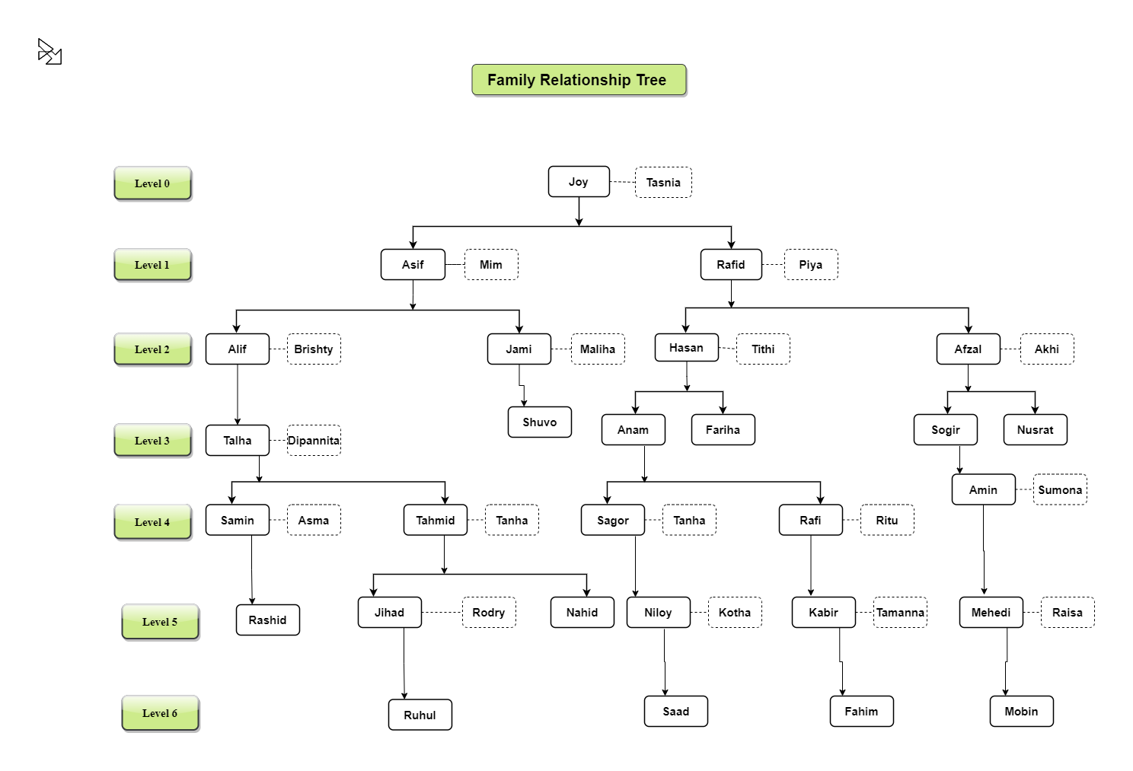
Family Tree Diagram

Slide 4
Technical Report
At first write code in note pad.
Then save it as .pl file. PL means Prolog.
Open pl file with prolog.
Then run pl file.

Slide 5
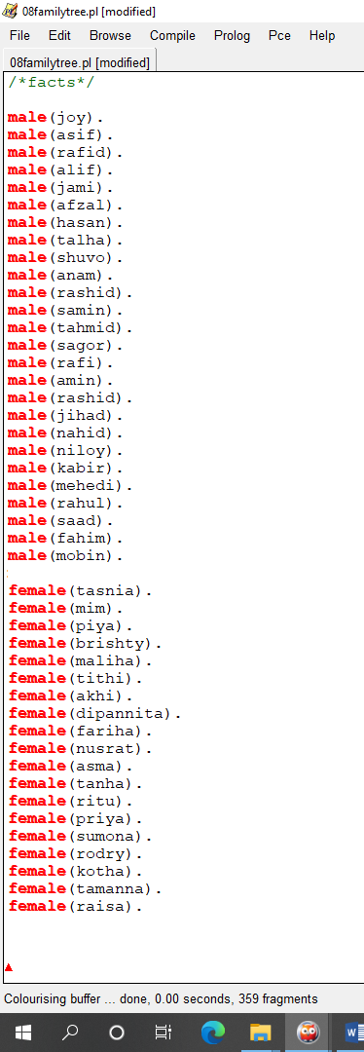
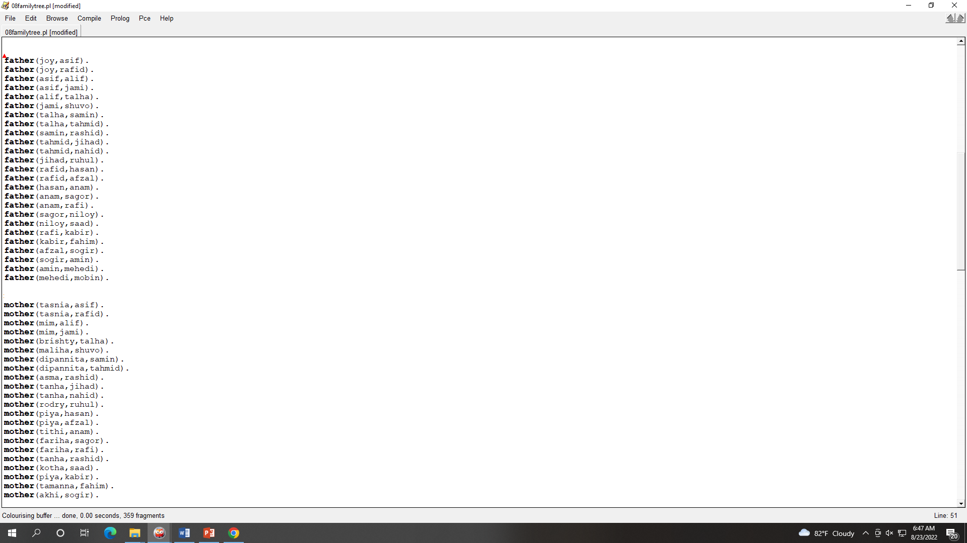
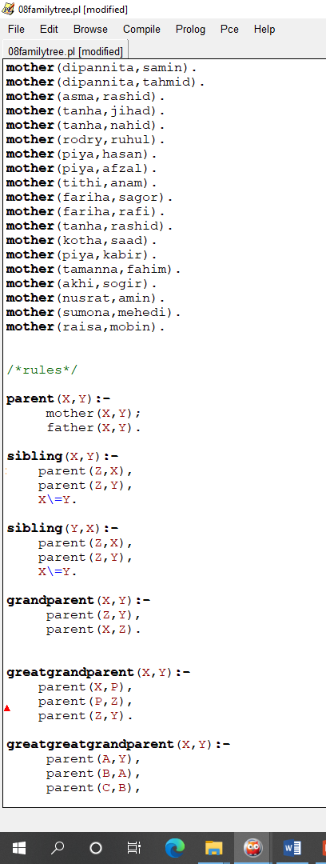
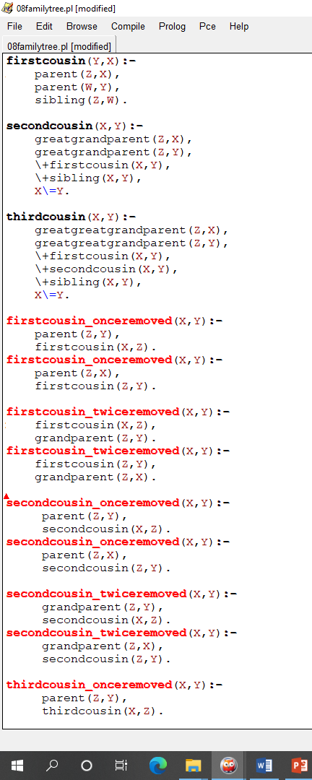
Source code

Slide 6
Conclusion
I had faced some minor problems during completing the assignment like code error, also could not find the desire output. I have also fix all the errors of SWI-prolog.

