Slide 1

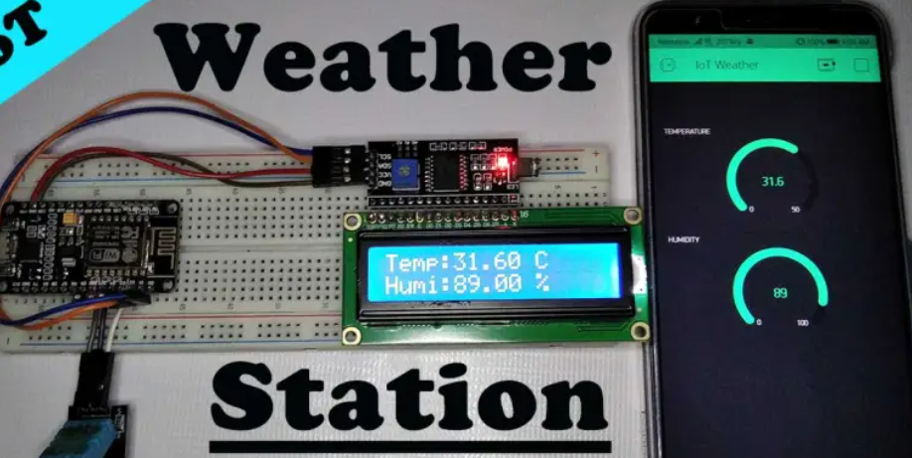
IoT Weather Station
CSE 316- Peripheral and Interfacing Lab
Presented by
Nor Mohammad Nasim
Reg: 19101010
Md. Abdur Rashid
Reg: 19101008

Slide 2
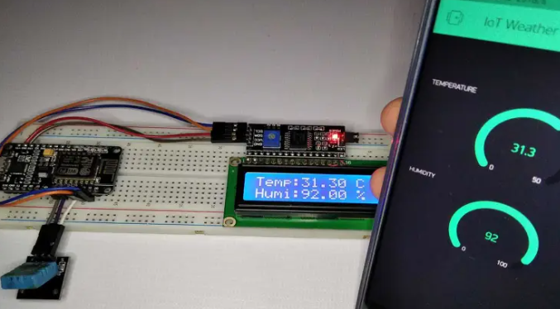
Content
Abstract
Motivation
Components Required
Budget
Circuit Diagram
Configure Blynk App for IoT Weather Station
Some related work
Where is our project unique

Slide 3
Abstract
A weather station can be described as an instrument or device, which provides us with the information of the weather in our neighbouring environment. For example it can provide us with details about the surrounding temperature, barometric pressure, humidity, etc.

Slide 4
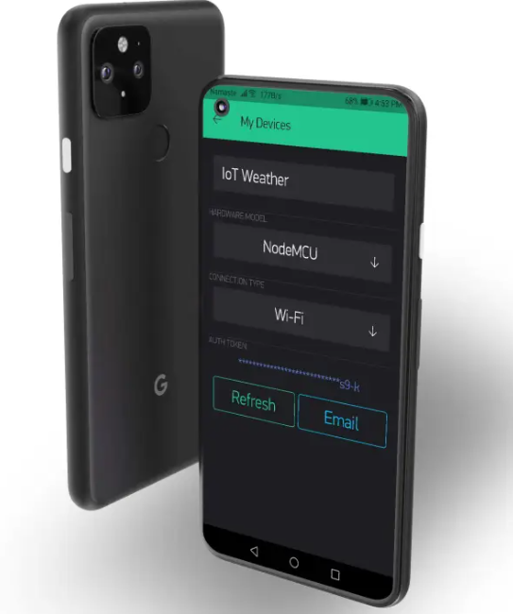
Motivation
Weather stations are the closest source of information about the weather in real-time to us. When forecasting the weather, they should be used together with different weather models.
On an everyday basis, many use weather forecasts to determine what to wear on a given day.

Slide 5
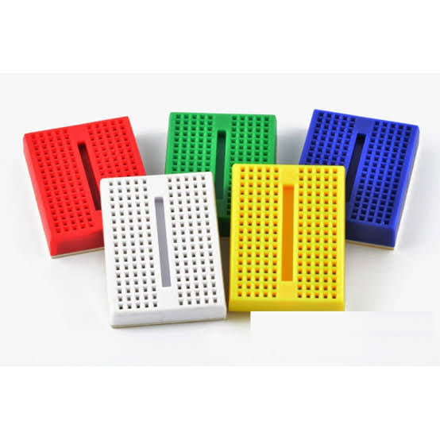
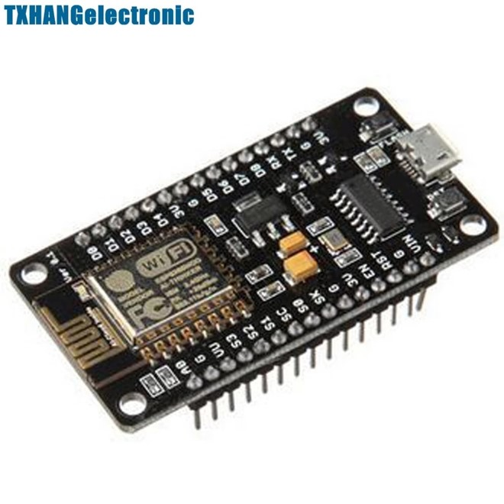
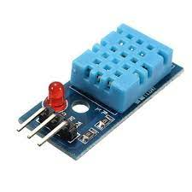
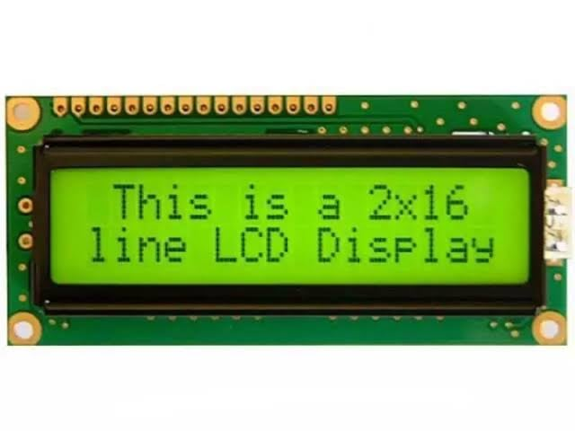
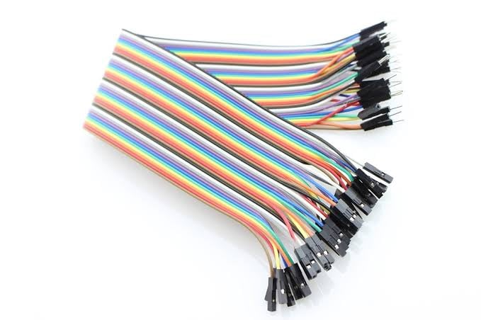
Components Required
NodeMCU ESP8266 12E
development Module
DHT11 Temperature and
Humidity Sensor
Breadboard
16×2 LCD Display with
I2C interface
Jumper wires

Slide 6
Budget
Component | Price (taka)
Breadboard | 65
LCD monitor (16*2) | 220
Jumper Wire 40pcs set | 90
NodeMCU ESP8266 12E development Module | 520
DHT11 Temperature and Humidity Sensor | 190

Slide 7

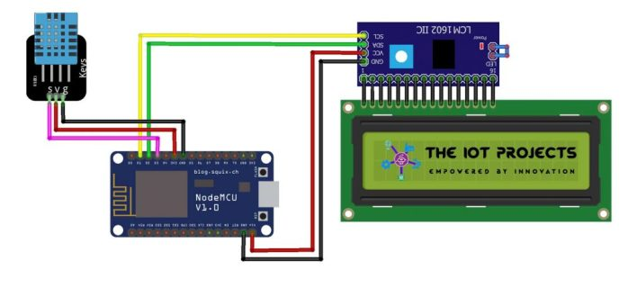
Circuit Diagram
The wiring connections are made as follows : Pin 1 of the DHT11 goes into +3v of the NodeMCU. Pin 2 of the DHT11 goes into Digital Pin D4 of the NodeMCU. Pin 3 of the DHT11 goes into Ground Pin (GND) of the NodeMCU.

Slide 8
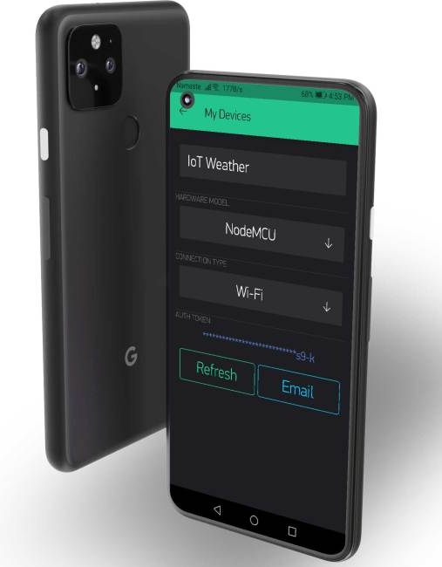
Configure Blynk App for IoT Weather Station
Go to App Store/Play Store on your smartphone. Download and login to the blynk app using our email address.
Now, create a new project.
Select connection type as WiFi.
we will see a popup that says an authentication token was sent to our email address.
Now, select (+) plus icon and add two “Gauges”.
After you add two gauges tap on it and name it as Humidity and you can even change the level.
Now select the input pin no as V5. Then choose a refresh rate of 1second for each gauge.

Slide 9
Some related work
Simple Weather station using Arduino & BME280 Barometric Pressure Sensor
BME280 Based Mini Weather Station using ESP8266/ESP32
NodeMCU ESP8266 Monitoring DHT11/DHT22 Temperature and Humidity with Local Web Server

Slide 10
Where is our project unique
In previous project there are many complex Circuit are made. For access the weather situation there are not any user-friendly interface.
Here first Arduino project using barometric pressure. and in last Arduino project use local web server.
Our project can calculate temperature, humidity. The results shown good accuracy and stability compared to other budget friendly weather stations. It has a user-friendly interface with a very low maintenance charge

Slide 11

Thank You!

