Slide 1
DISCRIMINATION OF SWERTIA CHIRAYITA USING NIR SPECTROSCOPY TECHNIQUE
SAWON BHOWMIK
CLASS ROLL NO- 001911103010
EXAMINATION ROLL NO- M4IEE21010

Slide 2
INTRODUCTION TO MEDICINAL PLANTS
Nature has always played a key role in the lives of people by supplying fresh water and oxygen. Not only that from nature people collected a diversity of valuable forest products for food and medicine. Historically plants have played an important role in medicine. Through observation and experimentation, human beings have learned that plants promote health and well-being.
According to the WHO, over 80% of the world's population relies on traditional forms of medicine. Largely different parts of plants meet primary health care needs.
These medicinal plants are used in numerous applications in the Indian society and used to make medicines in traditional medical practices such as Ayurveda, Unani, Siddha, Sowa-Rigpa and homeopathy, also used in plant-based pharmaceutical companies.
Allopathic medicine also owes a tremendous debt to medicinal plants; one in four prescriptions filled in a country like the U.S is either synthesized from or derived from plant materials.

Slide 3
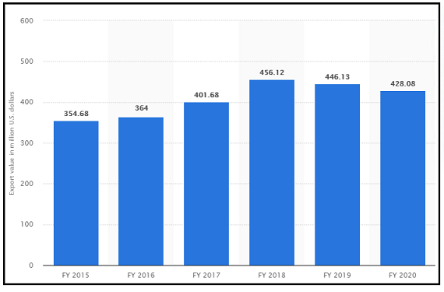
ECONOMIC IMPLICATIONS OF MEDICINAL PLANTS
WHO also estimated that the present demand for medicinal plants stands approximately at 14 billion US$. The demand for medicinal plant and plant-based products and raw extracts is growing at a steady rate of 15 to 25 percent per year.
This figure the year wise export of medicinal plant from India is shown.
In India there are approximately 7500 plant species that have medicinal qualities.

Slide 4
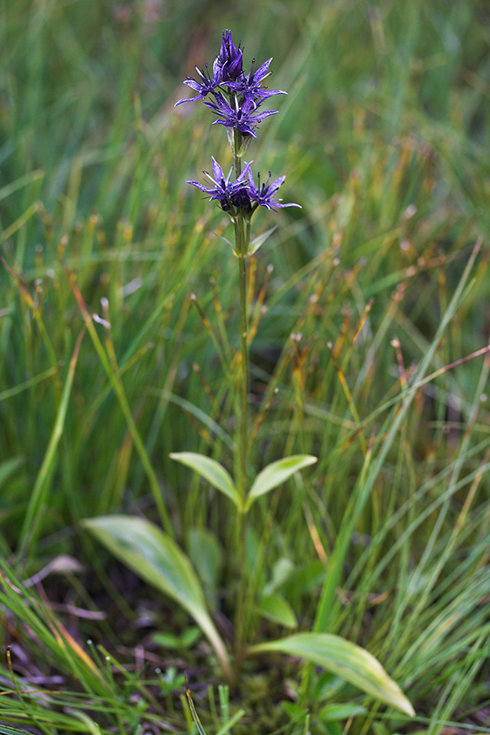
SWERTIA CHIRAYITA
Swertia chirayita a plant of gentian family and order of gentianales.
In India, 40 species of Swertia are recorded. One of those recorded species Swertia chirayita is a well-known and widely used species for its medicinal qualities.
Swertia chirayita commonly known as 'Chiretta' is an indigenous plant that grows in the region of the Himalayas at an altitude roughly about 1200 to 2100m mostly on the shady and moist slopes of the mountain.
Mostly 30 to 40 cm in high the plant has a unique green and purple coloured flower.
This particular herb is mostly known for its bitter taste.

Slide 5
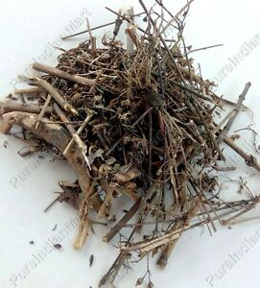
USES OF SWERTIA CHIRAYITA
Mostly used as a treatment of hepatitis, inflammation, and digestive diseases.
Its medicinal uses can be found in the treatment of chronic fever, malaria, anaemia, bronchial asthma, hepatotoxic disorders, liver disorders, hepatitis, gastritis, constipation, dyspepsia and diabetes.
The roots are used in treating feature, cough, general weakness .
The roots serve as a treatment of asthma and common cold.
Leaves and stems if soaked overnight in water and filtered with water if this preparation taken once in 2 or 3 days can cure headache.
A paste made out of the herb can be sued for the treatment of skin disease like eczema.
For tremor fever the stems and leaves of Swertia chirayita are taken and chopped into small pieces. Boiled with water then depending upon the age of the patient if the required amount of that preparation is consumed.
Recently it is found that Swertia chirayita have anti-hepatitis qualities along with its anti-fungal and anti-bacterial qualities.

Slide 6
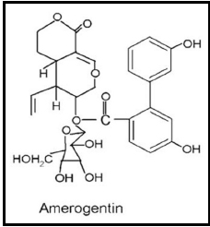
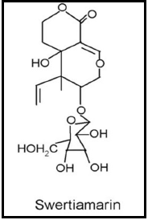
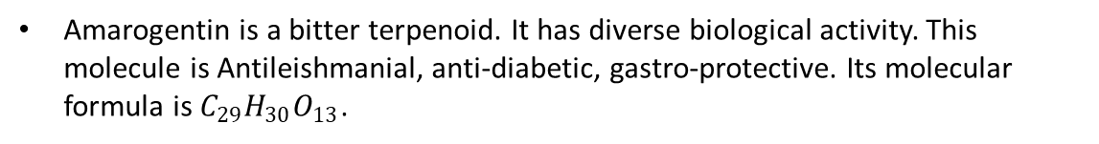
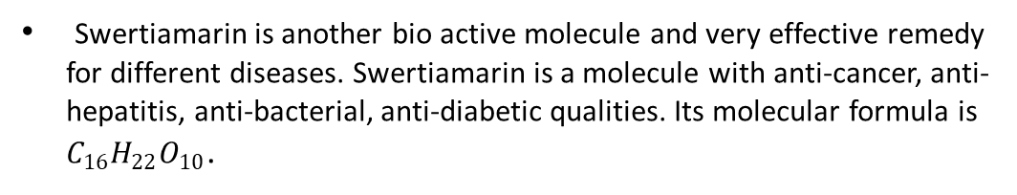
PHYTOCHEMISTRY OF SWERTIA CHIRAYITA
There are different bioactive chemical or molecule present in Swertia chirayita. Amarogentin, Swertiamarin, Mangiferin, Swerchirin, Sweroside, Amaroswerin, and Gentiopicrin are present in Swertia chirayita.
Amarogentin is a bitter terpenoid. It has diverse biological activity. This molecule is Antileishmanial, anti-diabetic, gastro-protective. Its molecular formula is $C_{29}H_{30}O_{13}$.
Swertiamarin is another bio active molecule and very effective remedy for different diseases. Swertiamarin is a molecule with anti-cancer, anti-hepatitis, anti-bacterial, anti-diabetic qualities. Its molecular formula is $C_{16}H_{22}O_{10}$.

Slide 7
CHALLENGES
The economic implications of Swertia chirayita is undeniably huge. This is the reason that the molecule now been over exploited and it is on the verge of extinction.
Cultivation of this herb is still an issue for the government because this herb can grow at a specific temperature and at a certain altitude. So proper planning in cultivation is not present right now.
Despite Swertia chirayita is been used traditionally but the safety of its use is still not been established. If there is any harmful toxic element present in the herb is still unknown, so more and more research is necessary in this context.
As there is a huge demand for Swertia chirayita, there is a rise in adulteration and misidentification as far as this plant is concerned. The use of this plant is wide spread so there must be a measure for quality control but sadly so far there is no such measures in place.
The presence of previously mentioned molecules is proven but the quantitative measure for those molecules can vary depending upon the place where the plant is cultivated. So a region wise discrimination for the herb is necessary. Depending upon that a quality control can be specified.

Slide 8
RESEARCH WORK ALREADY DONE ON SWERTIA CHIRAYITA
Swertia mussotii and Swertia chirayita are two species of Swertia family they both have uses in traditional Tibetan medicines for treatment of lever and gall bladder disease. Those two were characterized and classified by using H NMR based metabolomics and well known PCA and PLSR.
Twelve bioactive chemical components were identified and isolated while studying the chemical components of different extracts of Swertia chirayita. Mostly H NMR or photon nuclear magnetic resonance was used other than that IR and C NMR or carbon-13 nuclear magnetic resonance was used for isolating different molecules.
This study is based on standardization of the phytochemicals present in Swertia chirayita and upon that distinguish the possibility of adulteration or substitution for the plant. For that in this literature UPLC (Ultra performance liquid chromatography) and PDA (Photodiode array detector) was used, then for chemo-metric data analysis PCA and hierarchical clustering analysis was used for discrimination.
A total of forty samples from three different districts of Nepal was analysed by using Polymerase Chain Reaction (PCR)-based Random amplified polymorphic technique. Genetic diversity between samples were found out by using cluster analysis.

Slide 9
WORK DONE IN THIS STUDY
In this research study of Swertia chirata is undertaken. Samples from six different geographical locations (Nepal, Sikkim) was collected and prepared for NIR analysis.
After NIR data collection in absorbance mode the data is structured and prepared for further analysis.
25 pre-processing plots were generated and their separability index values were studied and further among them six pre-processing techniques were taken considering their separability index values.
Comparative study was done for those pre-processing techniques in terms of PCA and their separability index values.
Then for each pre-processing techniques prediction analysis was done using PCR and then a comparison was made on their prediction error values.

Slide 10
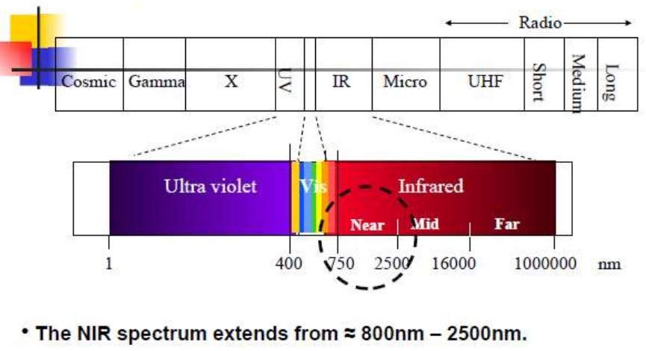
NEAR INFRARED SPECTROMETER
Near Infrared Spectroscopy is a kind of vibration spectroscopy. NIR usually employs photon energy more specifically electromagnetic radiation having energy ranges between 2.65 x 10-19 to 7.96 x 10-20 J, the corresponding wavelength range is 750 to 2,500 nm (wavenumbers: 13,300 to 4,000 cm-1). The main objective for the study of Near Infrared Spectrometry is to target those molecules which are showing molecular vibrations. The energy level specified for near infrared radiation is enough for changing the vibration states of those molecules and from that valuable insights as well as a good quantitative analysis can be generated.

Slide 11
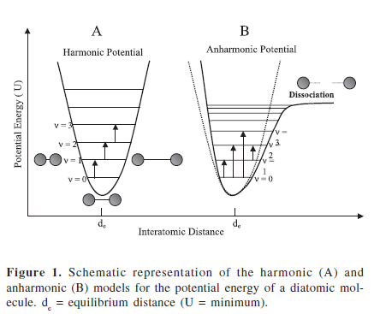
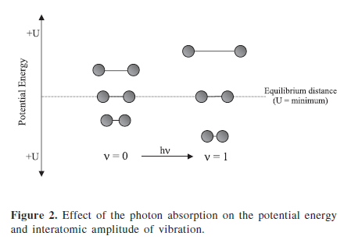
VIBRATION SPECTROSCOPY
At ambient temperature most of the molecules are in their fundamental vibrational energy levels.
Evib = (v + ½) * h * ν, Equation for harmonic oscillator
Evib = h*ν(v + ½) – x*(v + ½)^2*h*ν, equation for anharmonic oscillator

Slide 12
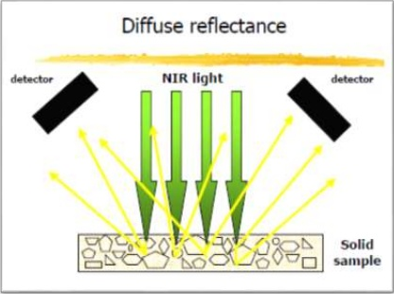
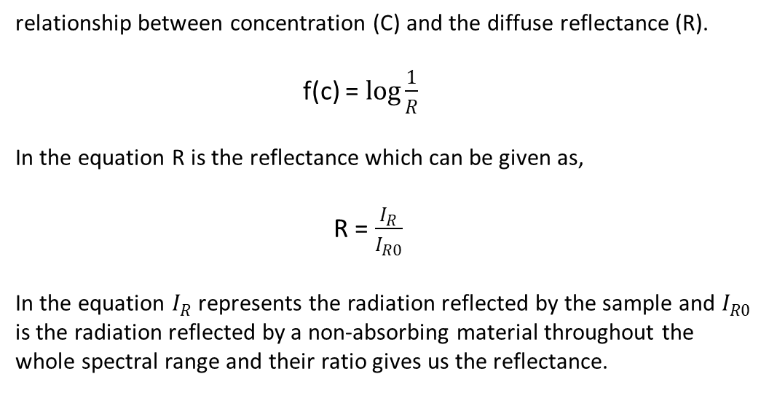
DIFFUSE REFLECTANCE MODE
Solid sample can be used directly in this mode
Minimal sample preparation is the advantage of this mode.
Scattering and absorbance by solid granules contribute to change the signal intensity
relationship between concentration (C) and the diffuse reflectance (R).
f(c) = $\log{\frac{1}{R}}$
In the equation R is the reflectance which can be given as,
R = $\frac{I_{R}}{I_{R0}}$
In the equation $I_{R}$ represents the radiation reflected by the sample and $I_{R0}$ is the radiation reflected by a non-absorbing material throughout the whole spectral range and their ratio gives us the reflectance.

Slide 13
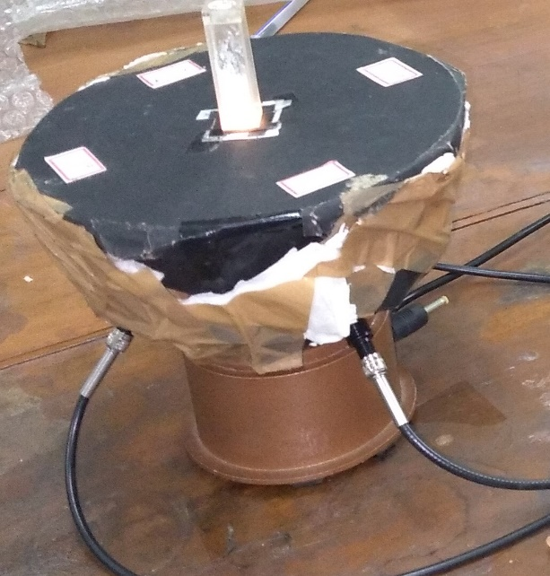
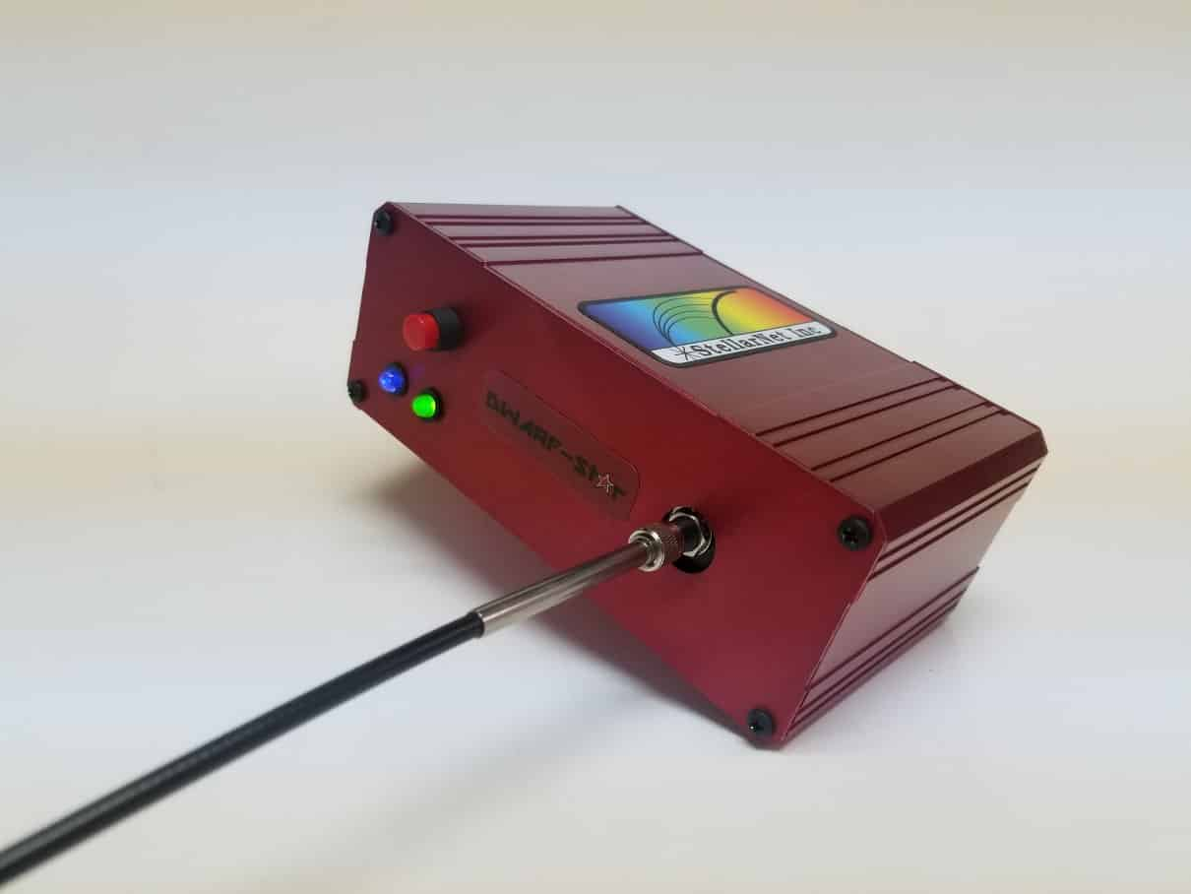
NIR INSTRUMENT USED IN THIS STUDY
SOURCE:
SL1 Tungsten Halogen light source has tungsten halogen lamp field with Krypton gas.
12V DC supply.
Spectral range 350 to 2200 nm.
Three optical fiber probe making 45° angle with the sample surface and making 120º angle among each other.
DETECTOR:
In GaAs detector array
900-1700nm wavelength range
512 pixel Resolving resolutions to 1.25nm.
Integrated thermoelectric cooler.

Slide 14
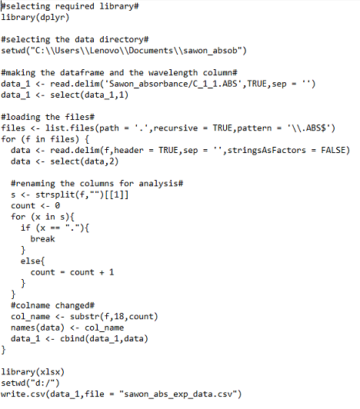
SAMPLE PREPARATION DATA COLLECTION
Six sample from six different places were collected. Then the samples were dried. After that the sample with stem and leaves cut into small pieces. A grinder machine is used for making dust from the sample. With butter paper and sieve fine sample powder was collected and ready to put into the cuvette.
Spectrawiz software was used for the data collection. 20 repetitive measurements were taken form one sample while the angular position of the cuvette was changed after 5 consecutive data collection.
The data stored in txt or abs format was arranged in a ‘CSV’ by using a R- program.

Slide 15
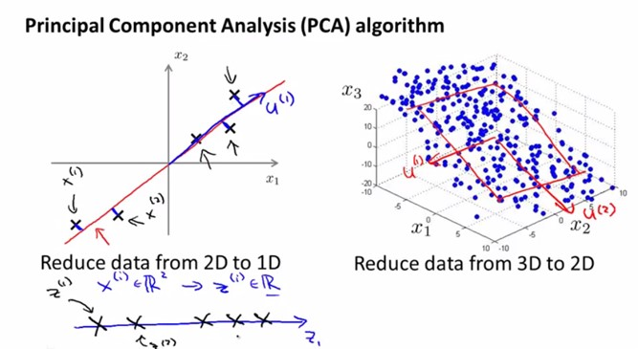
PRINCIPAL COMPONENT ANALYSIS
Principal component analysis (PCA) is a statistical procedure that uses an orthogonal transformation to convert a set of observations of possibly correlated variables into a set of values of linearly uncorrelated variables called principal components.

Slide 16
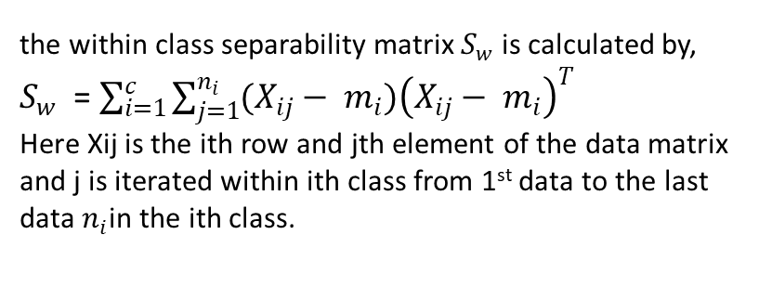
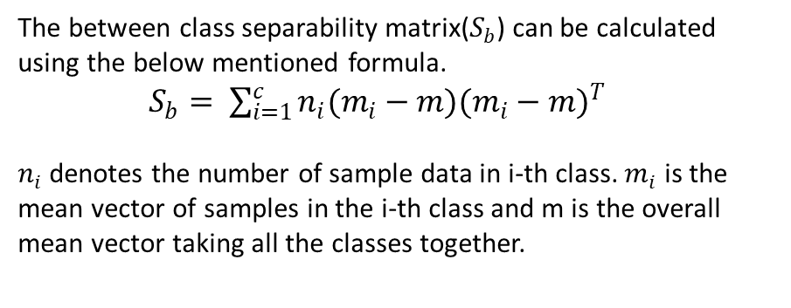
SEPARABILITY INDEX
This thesis is based on separability of Swertia chirayita of different geographical location after PCA in this thesis there is a need for quantification of separability of different classes. For this purpose, separability index calculation is most common and frequently used technique.
Calculating separability index involves two scatter matrices one is within class scatter matrix and another is between class scatter matrix. After calculating both of them if the trace of those matrix is divided that would give the separability index.
The between class separability matrix($S_{b}$) can be calculated using the below mentioned formula.
$S_{b}= \sum_{i=1}^{c}{n_{i}(m_{i}−m){(m_{i}−m)}^{T}}$
$n_{i}$denotes the number of sample data in i-th class. $m_{i}$ is the mean vector of samples in the i-th class and m is the overall mean vector taking all the classes together.
the within class separability matrix $S_{w}$ is calculated by,
$S_{w}$ = $\sum_{i=1}^{c}{\sum_{j=1}^{n_{i}}{(X_{ij}− m_{i}){\left(X_{ij}− m_{i}\right)}^{T}}}$
Here Xij is the ith row and jth element of the data matrix and j is iterated within ith class from 1st data to the last data $n_{i}$in the ith class.

Slide 17
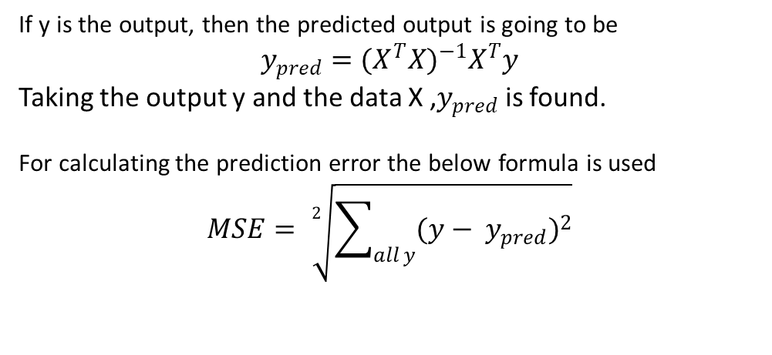
PRINCIPAL COMPONENT REGRESSION
PCR is a regression method were despite using the feature (wavelengths for NIR absorption mode) the principal components after doing PCA is used.
In this study four principal components were taken for PCR.
Reducing correlation is the main objective for PCR.
Least square solution is used here for finding the best fit line that linearly describes the samples.
If y is the output, then the predicted output is going to be
$$y_{pred}={(X^{T}X)}^{−1}X^{T}y$$
Taking the output y and the data X ,$y_{pred}$ is found.
For calculating the prediction error the below formula is used
$$MSE= \sqrt[2]{\sum_{all y}{{(y− y_{pred})}^{2}}}$$

Slide 18
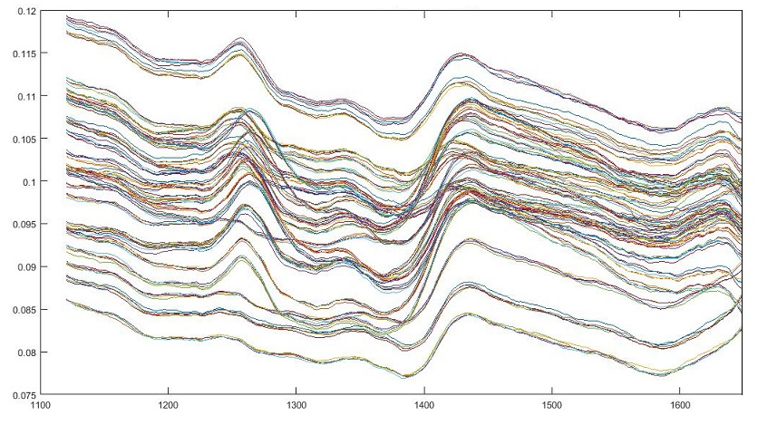
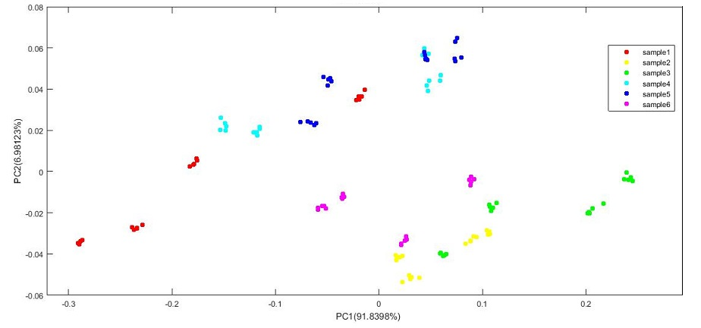
RAW DATA PLOT
Using MATLAB a line plot of raw data was done to analyse the peaks and trends present in the data. In the X-axis the wavelengths were plotted and in the y-axis the absorption values were plotted given if figure. The peaks at 1280nm and 1440nm can be seen for all the data.
It can be seen in the plot that PC1 can explain 91.8 percent of variance and PC2 can explain 6.9 percent variance.

Slide 19
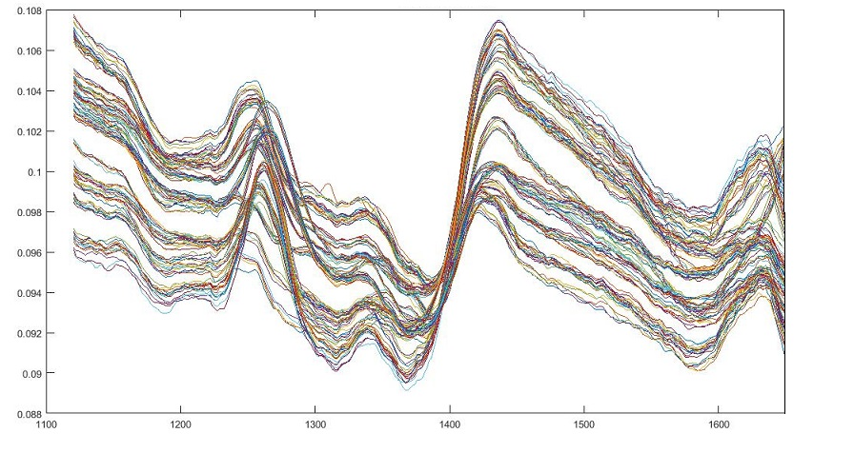
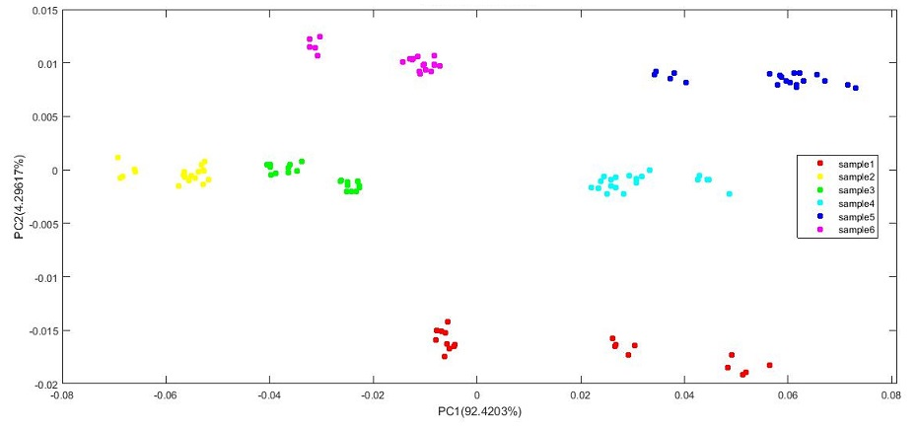
MULTIPLICATIVE SCATTER CORRECTION
For MSC first the mean of all the data vector were calculated then a least square solution was found out by taking Xi as the output then the regression coefficients used for calculating MSC.
For the line plot x-axis is the wavelength and y-axis is the MSC absorbance values

Slide 20
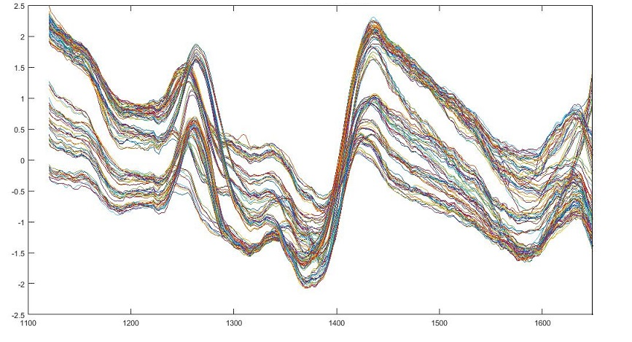
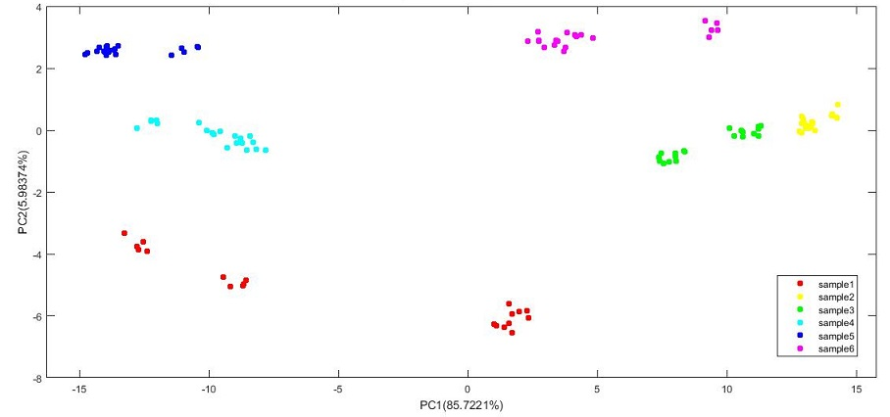
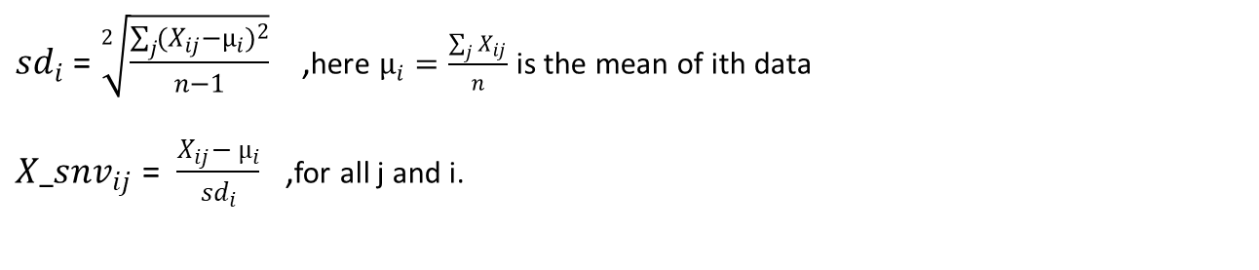
SNV NORMALIZATION
Mathematically it can be done by calculating the mean and standard deviation of every data separately then subtracting the mean from the respective data vector after that data vector is divided by its respective standard deviation.
${sd}_{i}$ = $\sqrt[2]{\frac{\sum_{j}{{{(X}_{ij}−µ_{i})}^{2}}}{n−1}}$ ,here $µ_{i}=\frac{\sum_{j}{X_{ij}}}{n}$ is the mean of ith data
${X_snv}_{ij }$= $\frac{X_{ij}− µ_{i}}{{sd}_{i}}$ ,for all j and i.

Slide 21
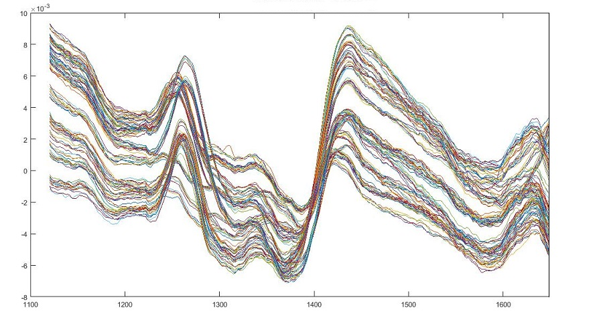
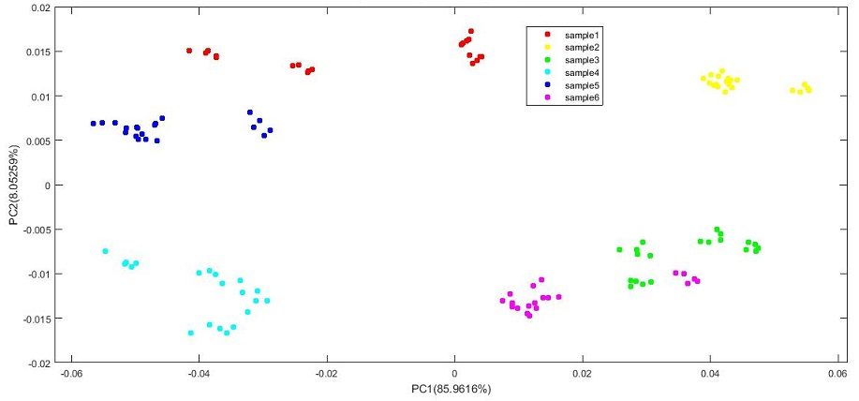
MEAN CENTERING TECHNIQUE
This technique is used to reduce the multicollinearity in the data features. Mean from each of the data column and then that mean is subtracted from the respective column to get the mean centered data.
X-axis represents wavelength and y- axis represents the mean-centered wavelength values
PC1(var = 85.96) and PC2(var = 8.052)

Slide 22
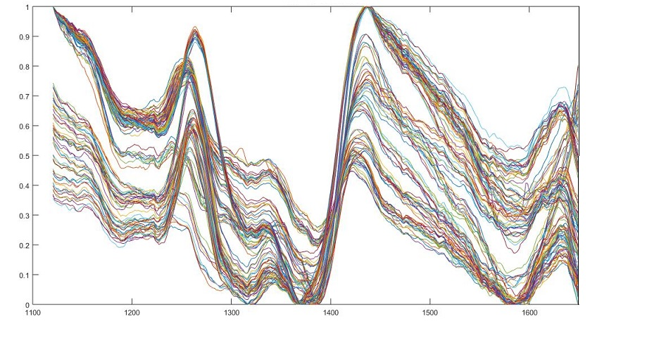
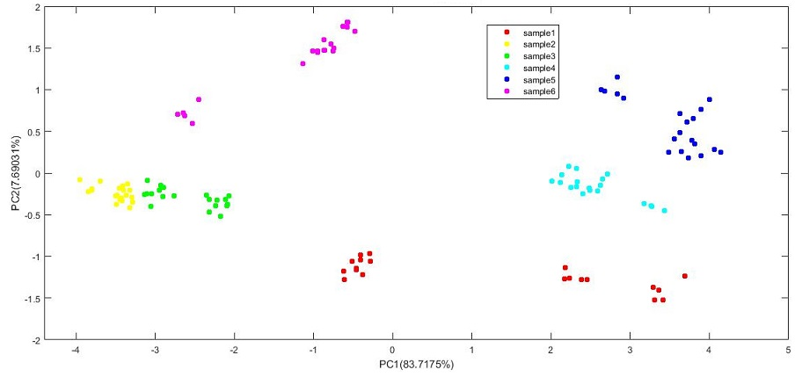
MAXMIN STANDARDIZATION
For this particular standardization first max and min values for all data vector throughout all wavelengths is calculated and then the min value is subtracted and the result is divided by the max values to get max min standardization.
The data values scaled with in [0,1] closed interval.
Wavelength range remains same.
PC1 explains 83.7 percent and PC2 explains 7.6 percent variation in the data.

Slide 23
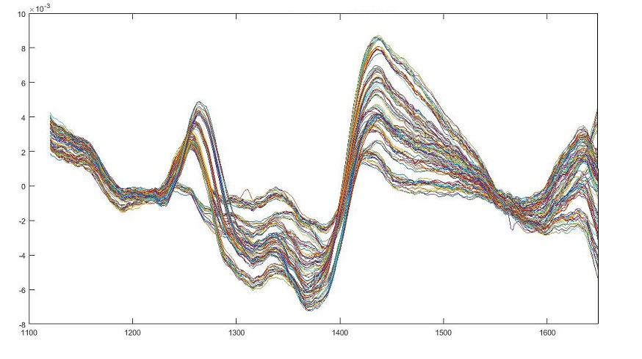
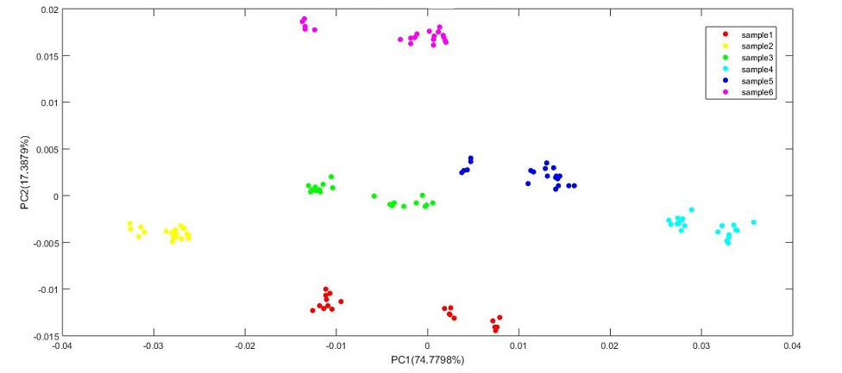
DETRENDING
First a linear trend was generated for each of the data vectors then the trend values were subtracted from the respective data to get the detrended data vector.
PC1 explains 74 percent and PC2 explains 17 percent variation in data.

Slide 24
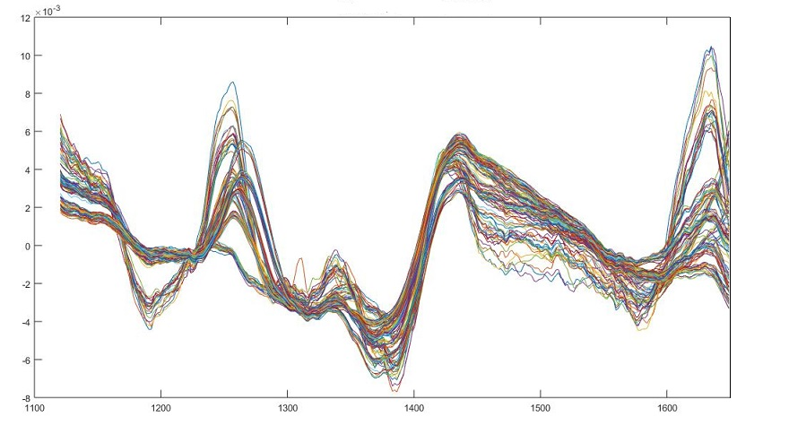
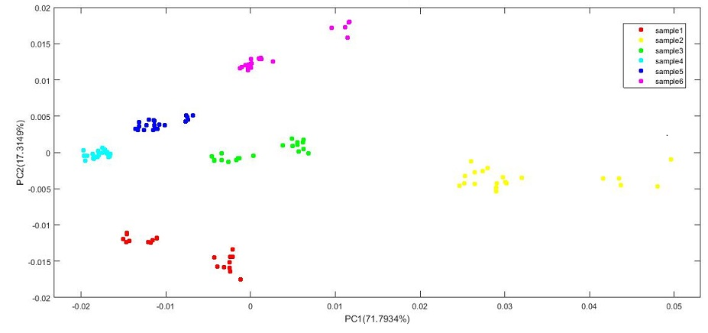
MSC ON DETRENDED DATA
This kind of compound techniques are also implemented often in NIRS data analysis. In this technique first the raw data was taken and detrending of the data was done. Then scatter correction technique was also implemented on that pre-processed data.
PC1 represents 71.7 percent variation in data and PC2 represents 17.3 percent data.

Slide 25
SEPARABILITY ANALYSIS
Taking four principal components for each of the pre-processed data separability index was calculated then a table is given for comparison.
Pre-Processing techniques | PC1 variance explained | PC2 variance explained | Separability index
Raw data | 91.84 | 6.9812 | 2.0217
Multiplicative scatter correction | 92.42 | 4.2962 | 9.8198
Z-Score/ SNV normalization | 85.722 | 5.9837 | 10.393
Mean Centered data | 85.962 | 8.0526 | 12.411
Max min standardization | 83.717 | 7.6903 | 9.6309
Detrended data | 74.78 | 17.388 | 14.516
MSC on Detrended data | 71.793 | 17.315 | 12.229
Detrending gives the maximum separability index value. Then mean centered data. MSC also gives relatively good separability.

Slide 26
PREDICTION ANALYSIS
Principal component regression was used for prediction analysis.
Four principal components were taken as the features.
70 percent data(84) after randomly separating was used for training.
30 percent data(36) taken for testing.
Pre-Processing techniques | Residual Standard Error | R squared | Prediction error test data
Raw data | 0.3615 | 0.9579 | 1.72024
Multiplicative scatter correction | 0.1877 | 0.9886 | 1.231996
Z-Score/ SNV normalization | 0.2938 | 0.9722 | 1.460319
Mean Centered data | 0.1543 | 0.9923 | 0.7348995
Max min standardization | 0.4793 | 0.9259 | 2.56541
Detrended data | 0.13 | 0.9945 | 0.6279176
MSC on Detrended data | 0.3053 | 0.9699 | 1.453096
Residual standard error calculated for the training data.
The prediction error calculated for the testing data using mean squared error formula.

Slide 27
CONCLUSION
Considering the impact of Swertia chirayita on human health and medicines as well as the economic implications of this herb in India and throughout the world there is an immediate need of research based quantification of this particular plant. This study takes up the opportunity. Simple and cost effective quantification through Near Infrared Spectroscopy was the aim of this study.
This study reveals that detrending the sample data collected from NIR spectroscopy has more unique sample information and can be separable.
The scatter correction and standardization techniques extract information from the sample data of different origin and based on that information a discrimination of samples can be performed.
Principal component analysis in this work for feature transformation and reduction provides number of uncorrelated data features that can be used for separability study and prediction analysis.
The separability index values calculated from different pre-processing techniques indicates that any simple clustering technique like k means clustering can discriminate the samples easily.
The prediction analysis using Principal component regression suggest that a liner discrimination and prediction model can be formed with the NIRS data with good accuracy and relatively minimal prediction error. Here also detrending is the most effective technique with minimum prediction error among all the pre-processing techniques.

Slide 28
QUESTIONS ?

