Slide 1





Medical Supply Chain Viability
During Pandemics
Integrating Machine Learning & Unified Robust
Stochastic Programming
Authors
Journal
Yılmaz et al.
Omega 133 (2025)
January 2026
Presented by: Group A1

Slide 2






The Challenge
COVID-19 Impact on MSC
Demand Surge
Radical increase in medical supplies
Patient Crisis
Sharp rise in patient numbers
Capacity Issues
Fluctuations in medical center capacity
Distribution Gaps
Inefficiencies in supply distribution

Slide 3





Research Questions
1
Optimization Method
2
Risk Aversion
Which approach achieves MSC viability?
How do risk approaches affect performance?
Stochastic
Robust
Combined
Sustainability
Resilience
3
Government Policies
4
Uncertainty Structure
Which implementations are most effective?
How does uncertainty affect overall cost?
Legislation
Healthcare
Known
Unknown

Slide 4





Demand Uncertainty
Capacity Constraints
Unpredictable surge in medical supplies needs
Limited production and storage capabilities
Key MSC
Challenges
Critical obstacles in medical supply chain management during pandemics
Distribution Issues
Risk Mitigation
Inefficient logistics and delivery networks
Inadequate strategies for disruption response

Slide 5









Viability vs Resilience
Viability
Resilience
Long-term Survival
Short-term Recovery
Sustain and adapt over extended periods
Withstand and recover from disruptions
Structural Reconfiguration
Adapt to Changes
Strategic restructuring and replanning
Absorb shocks and bounce back quickly
Unknown-Unknown
Known-Unknown
Address unprecedented black swan events
Manage predictable uncertainty scenarios

Slide 6








Uncertainty Types
Unknown-Unknown
Known-Unknown
Historical Data
Novel Pathogens
Past patterns available
Previously unknown threats
Probability Distributions
No Historical Precedent
Statistical modeling possible
Zero prior experience
Predictable Patterns
Black Swan Events
Seasonal fluctuations
Unprecedented disruptions

Slide 7





Methodology Overview
1
Machine Learning
2
URSP
Contagion Prediction
Kit Allocation
Predict disease contagion levels
Optimize medical kit distribution
Estimate demand adjustments
Minimize total operational cost
Calculate Contagion Index (CI)
Control shortage levels
Stage 1
Stage 2
Optimal Allocation

Slide 8









Machine Learning Component
Purpose
Predict Contagion Levels
Random Forest
Gradient Boosting
K-Nearest Neighbors
Estimate disease spread patterns
Adjust Demand Forecasts
Ensemble learning
Sequential improvement
Distance-based
Multiple decision trees
Non-parametric
Dynamic demand adjustments
Error correction
Calculate Contagion Index
Regional impact quantification
All algorithms used for regression prediction
Normalized CI values

Slide 9










Unified Robust Stochastic Programming
SP
Stochastic Programming
Known-Unknown uncertainty
URSP Integration
Expected cost minimization
Probability distributions
Adjustable weights (Γ)
Shared decision variables
Balance cost and robustness
Coordinated allocation
Dual objective
MSC viability
Cost + Robustness
Operational perspective
RO
Robust Optimization
Advantages
Less conservative than pure RO
More robust than pure SP
Unknown-Unknown uncertainty
Worst-case protection
Uncertainty sets

Slide 10













URSP Model Formulation
Key Constraints
Objective Function
Inventory Balance
Allocation + Production = Demand ± Surplus/Shortage
min Z = Costtransport + Costproduction + Costbackorder + Costholding
Production Capacity
Total production ≤ Maximum capacity
Transportation
Production
Backorder
Holding
CVaR Shortage Limits
Restrict shortage levels under confidence level α
Robustness Parameter (Γ)
Γ = 0
Pure Stochastic
Γ = 1
Pure Robust
Non-negativity
All variables ≥ 0

Slide 11











CVaR Approach
CVaR vs VaR
Risk Management
Value at Risk (VaR)
Single point estimate at confidence level
Restrict Shortages
Adjustable α
Conditional VaR (CVaR)
Control shortage levels
Confidence level
Average of losses exceeding VaR
CVaR Formula
α = 0
α = 1
Risk Neutral
Worst Case
CVaRα = η + (1 / (1-α)) × Σ ps × ws
Key Benefit
Realistic shortage control for MSC resilience

Slide 12








Taguchi Design of Experiments
Government Policies
Orthogonal Array
Legislation
Factor 1
Factor 2
Factor 3
Legislation
Education
Healthcare
Higher Education
Low
Medium
High
Healthcare
1
Case 1
5
Case 5
9
Case 9
L-L-L
M-M-M
H-H-H
Contagion Factor
Varying contagion levels across regions
9 Experimental Cases
Comprehensive policy combinations

Slide 13



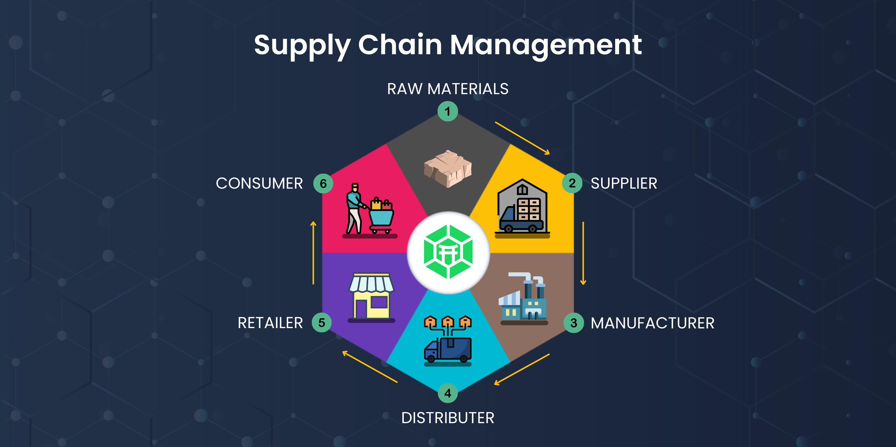








Case Study: Turkey Medical Supply Chain
Network Components
Supply Chain Network
Hospitals
Multiple hospitals across regions
Medical Warehouse
Central distribution hub
Supplier
Kit production and delivery
Hospitals
Warehouse
Supplier
Real-World Application
Demand points
Storage & distribution
Kit production
Actual demand patterns
Real constraints

Slide 14


















Comparative Methods
SP-CVaR
SP-noCVaR
RO-CVaR
Known-Unknown
Known-Unknown
Unknown-Unknown
Modeling Approaches
Risk Averse
Risk Neutral
Risk Averse
Shortage Control
No Shortage Control
Worst-Case
SP
RO
Stochastic Programming
Robust Optimization
URSP
CVaR
Unified Approach
Risk Measure
RO-noCVaR
URSP-CVaR
URSP-noCVaR
Unknown-Unknown
Both Uncertainties
Variations
Risk Neutral
Risk Averse
Both Uncertainties
Most Conservative
Balanced Approach
Risk Neutral
With CVaR constraints
Optimized Cost
Without CVaR constraints

Slide 15



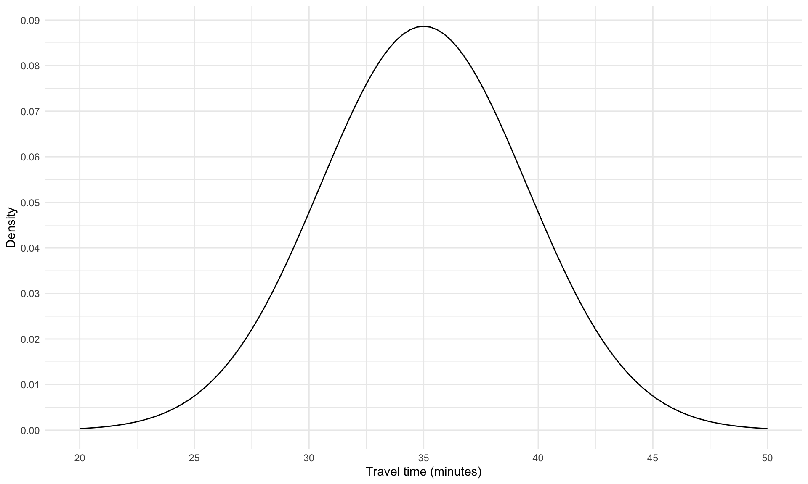


Cost Performance Results
Total Cost Comparison
Lower is Better
URSP Advantages
Stochastic
Robust
URSP
+18% More Robust than SP
$2.8M
$4.2M
$3.4M
Better uncertainty protection
-19% Cheaper than RO
SP-CVaR
RO-CVaR
URSP-CVaR
Cost-effective allocation
Key Findings
Optimal balance achieved
Adjustable robustness (Γ)
Superior MSC viability

Slide 16



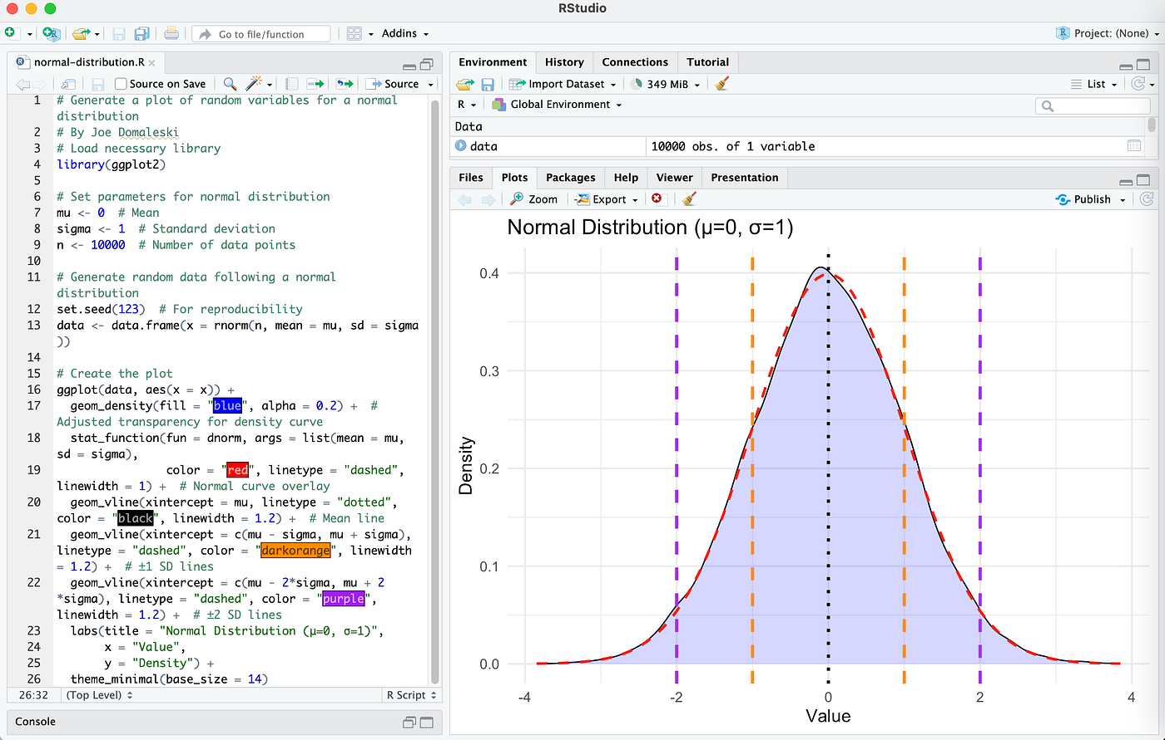








Shortage Analysis & CVaR Impact
Shortage Distribution
CVaR Control Mechanism
Restrict Shortage Levels
Control maximum allowable shortage
Confidence Level α
Adjustable risk parameter
MSC Resilience
Ensures supply chain viability
High α
Low α
More Risk-Averse
More Risk-Neutral
Lower shortage levels
Higher shortage levels
Managerial Insight
CVaR enables balanced risk management while maintaining cost-effectiveness

Slide 17

















Managerial Insights
Optimal Balance
Risk Management
URSP outperforms pure methods
CVaR controls shortage levels
Better cost-robustness trade-off
Enhanced MSC resilience
Policy Impact
ML Integration
Government policies matter
Contagion prediction improves
Taguchi design effective
Demand adjustment accuracy
Policy Recommendations
Adopt URSP approach
Integrate ML predictions
Use CVaR for risk control
Adjust Γ per priorities
Monitor contagion levels
Implement Taguchi design
Cost-Effective
Robust
Viable
19% cheaper than RO
18% more robust than SP
Survives pandemics

Slide 18










Key Contributions
1
2
3
Novel Integration
Comprehensive Methodology
Managerial Value
URSP approach for MSC
Taguchi design experiments
Medical kit allocation
ML contagion prediction
Policy effectiveness analysis
Both uncertainties handled
CVaR risk control
Actionable recommendations
URSP optimization
Enhances MSC viability during pandemics
Evidence-based decision support
Holistic MSC viability framework
Novelty
Practicality
Impact
First study combining ML, CVaR, and URSP for MSC viability
Real-world case study with comprehensive managerial insights
Demonstrated improvements in cost, robustness, and resilience
Research Impact
|
Published in Omega (2025)
|
Advances MSC viability research

