Slide 1
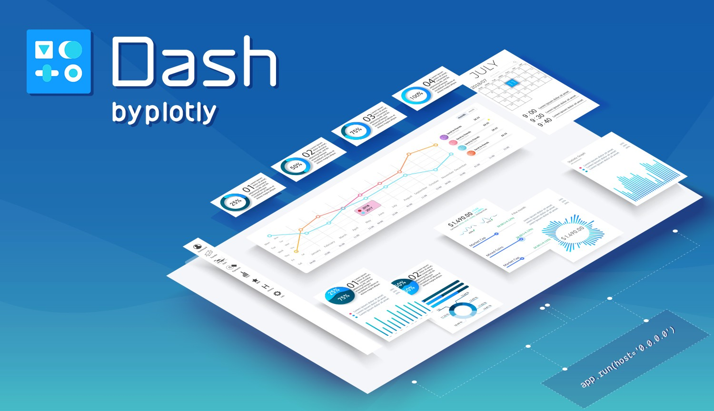
Data Visualization with Dash & Plotly
Sawon Bhattacharya

Slide 2
Contents
Data Visualization
Dashboard
Plotly
Dash
References

Slide 3
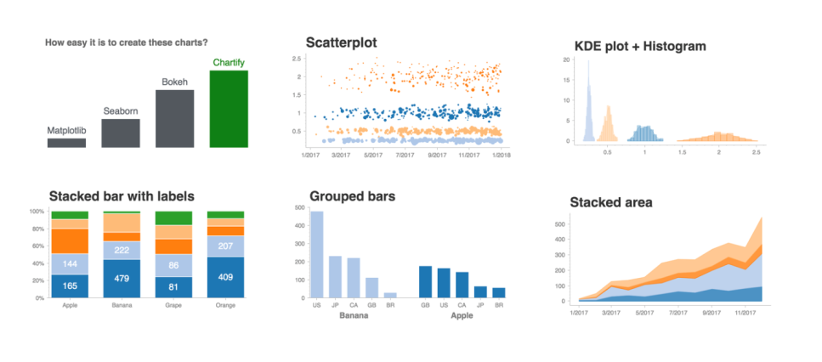
Data Visualization
Data visualization is especially important when it comes to big data and data analyzation projects.
Companies who can gather and quickly act on their data will be more competitive in the marketplace because they can make informed decisions sooner than the competition.
Notes:
We are an inherently visual world, where images speak louder than words. As we have more information at our fingertips than ever before, the importance of data visualization has never been greater than it is right now.
Nowadays more and more companies are using machine learning to collect mass amounts of data. While it’s great that they’re able to do this so quickly and effectively, it also calls for a way to sort through, comprehend, and explain this data in a way that makes sense to both the business owners and stakeholders.
The same concept applies to advanced data analyzation projects. When data scientists are in the midst of a complex project, they need a way to understand the data that’s being collected so that they can monitor and tweak their process to ensure it’s performing the way it should.
Speed is key, and data visualization aides in the understanding of vast quantities of data by applying visual representations to the data.

Slide 4
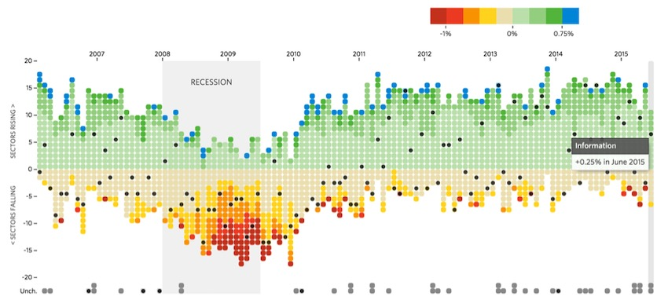
Data visualization with python
Python offers multiple great graphing libraries that come packed with lots of different features. No matter if you want to create interactive, live or highly customized plots python has an excellent library for you.

Slide 5
Cont.
To get a little overview here are a few popular plotting libraries:
Matplotlib: low level, provides lots of freedom
Pandas Visualization: easy to use interface, built on Matplotlib
Seaborn: high-level interface, great default styles
ggplot: based on R’s ggplot2, uses Grammar of Graphics
Plotly: can create interactive plots

Slide 6
Plotly-intro
What is Plotly?
Plotly Python is a library which helps in data visualisation in an interactive manner.
Apart from Python , Plotly is also used in R, MATLAB, JULIA.
The fact that we could visualise data online removed a lot of hurdles which are associated with the offline usage of a library.
Notes:
But you might be wondering why do we need Plotly when we already have Matplotlib which does the same thing. Plotly was created to make data more meaningful by having interactive charts and plots which could be created online as well.
However, Plotly can be used as both, an offline as well as online tool, thus giving us the best of both worlds.

Slide 7
PLOTLy-features
Plotly the python library
Plotly is another great Python visualization tool that’s capable of handling geographical, scientific, statistical, and financial data.
Plotly has three different Python APIs
1. Object-oriented API
2. Data-driven API
3. Plotly Express API
Installation of Plotly in anaconda(windows):
pip install plotly
Notes:
Plotly is a plotting ecosystem that allows you to make plots in Python, as well as JavaScript and R.
But you might be wondering why do we need Plotly when we already have matplotlib which does the same thing. Plotly was created to make data more meaningful by having interactive charts and plots which could be created online as well. The fact that we could visualise data online removed a lot of hurdles which are associated with the offline usage of a library. However, Plotly can be used as both, an offline as well as online tool, thus giving us the best of both worlds.
Plotly has three different Python APIs, giving you a choice of how to drive it:
An object-oriented API that feels similar to Matplotlib
A data-driven API that specifies plots by constructing dictionaries of JSON-like data
A "Plotly Express" API that gives you high-level plotting functions similar to Seaborn

Slide 8
Plotly-benefits
Why Plotly is better than other libraries?
1. Produce more meaningful data.
2. Charts and plots could be created online as well.
3. Fewer lines of codes generate aesthetically pleasing and interactive graphs.
Notes:
1. But you might be wondering why do we need Plotly when we already have matplotlib which does the same thing.
2. The interactivity also offers a number of advantages over static matplotlib plots:
Saves time when initially exploring your dataset
Makes it easy to modify and export your plot
Offers a more ornate visualization, which is well-suited for conveying the important insights hidden within your dataset.
3. Plotly was created to make data more meaningful by having interactive charts and plots which could be created online as well. The fact that we could visualise data online removed a lot of hurdles which are associated with the offline usage of a library. However, Plotly can be used as both, an offline as well as online tool, thus giving us the best of both worlds.

Slide 9
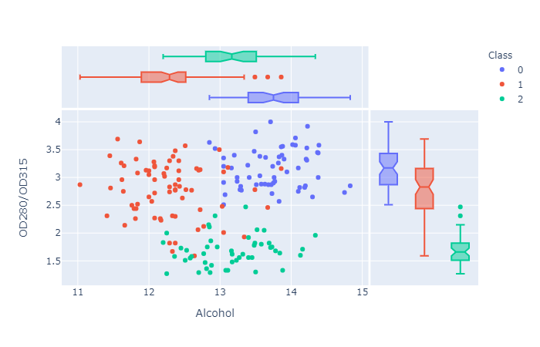
Basics of plotly-1
Scatterplot
Syntax: plotly.express.scatter(data_frame=None, x=None, y=None, color=None, symbol=None, size=None, hover_name=None, hover_data=None, title=None, template=None, width=None, height=None)
Notes:
Plotly Express is a great option for exploring pandas dataframes. It is a high-level wrapper included in the most recent version of plotly.

Slide 10
Cont.
Parameters:
data_frame: DataFrame or array-like or dict needs to be passed for column names.
x, y: This parameters is either a name of a column in data_frame, or a pandas Series or array_like object. Values from this column or array_like are used to position marks along the x and y axis in cartesian coordinates respectively.
color: This parameters assign color to marks.
symbol: This parameter is used to assign symbols to marks. It is either a name of a column in data_frame, or a pandas Series or array_like object.
size: This parameter is used to assign mark sizes. It is either a name of a column in data_frame, or a pandas Series or array_like object.
hover_name: Values from this column or array_like appear in bold in the hover tooltip.
hover_data: This parameter is used to appear in the hover tooltip or tuples with a bool or formatting string as first element, and list-like data to appear in hover as second element Values from these columns appear as extra data in the hover tooltip.
custom_data: This parameter is either names of columns in data_frame, or pandas Series, or array_like objects

Slide 11
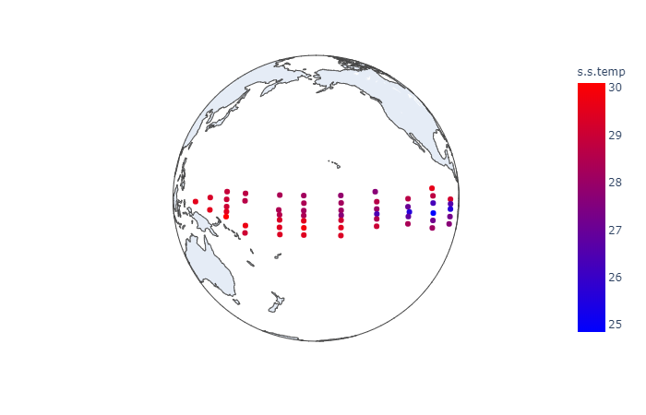
Basics of plotly-2
plotly.express.scatter_geo() function
Syntax: plotly.express.scatter_geo(data_frame=None, lat=None, lon=None, locations=None, locationmode=None, color=None, text=None, hover_name=None, hover_data=None, custom_data=None, size=None, title=None, template=None, width=None, height=None)

Slide 12
Cont.
Parameters:
data_frame: DataFrame or array-like or dict needs to be passed for column names.
lat: This parameter is used to position marks according to latitude on a map.
lon: This parameter is used to position marks according to longitude on a map.
locations: This parameter is interpreted according to locationmode and mapped to longitude/latitude.
locationmode: This parameter determines the set of locations used to match entries in locations to regions on the map.
color: This parameters assign color to marks.
size: This parameter is used to assign mark sizes. It is either a name of a column in data_frame, or a pandas Series or array_like object.
title: This parameter sets the title of the figure.
width: This parameter sets the width of the figure
Notes:
Notice that when you move your cursor over each buoy, the buoy number, temperature value, and location information are displayed. This is all done by default with plotly, and this is barely scratching the surface of what it can do.

Slide 13
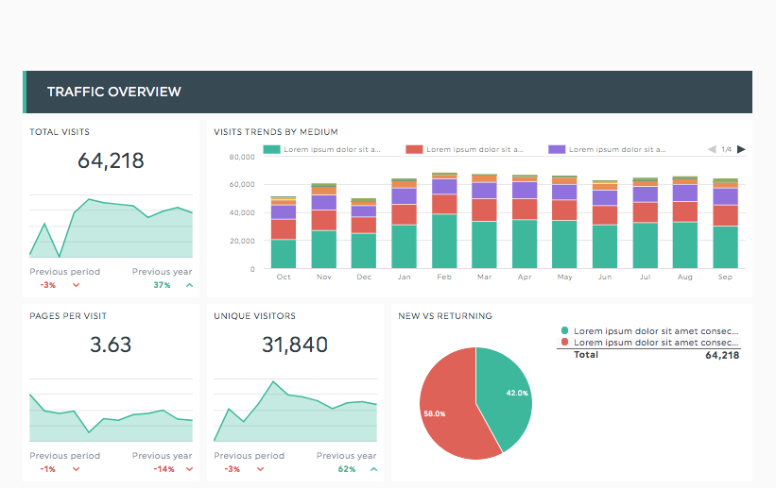
Dashboard
What is Dashboard?
A data dashboard is an information management tool that visually tracks, analyzes and displays key performance indicators (KPI), metrics and key data points to monitor the health of a business, department or specific process.
Notes:
They are customizable to meet the specific needs of a department and company. Data is visualized on a dashboard as tables, line charts, bar charts and gauges so that users can track the health of their business against benchmarks and goals.
A data dashboard is the most efficient way to track multiple data sources because it provides a central location for businesses to monitor and analyze performance. Real-time monitoring reduces the hours of analyzing and long line of communication that previously challenged businesses.

Slide 14
DASH
What is Dash?
Dash is a productive Python framework for building web applications.
Created and maintained by Plotly. https://plot.ly/products/dash/.
Written on top of Flask, Plotly.js, and React.js.
Dashboard is implemented in pure Python.
Dash is an open source library, released under the permissive MIT license.
Notes:
Dash is an open source Python framework for building web applications, created and maintained by the people at Plotly. Dash’s web graphics are completely interactive because the framework is built on top of Ploty.js, a JavaScript library written and maintained by Ploty. This means that after importing the Dash framework into a Python file you can build a web application writing strictly in Python with no other languages necessary.

Slide 15
Dash installation
In order to start using Dash, we have to install several packages.
The core dash backend.
pip install dash
Dash front-end
pip install dash-renderer
Dash HTML components
pip install dash-html-components
Dash core components
pip install dash-core-components

Slide 16
Features of Dash
Frontend generated in Python
Reactive computations abstraction
Component class for every HTML tag as well as keyword arguments for all of the HTML arguments implemented in Dash_html_components package
Interactive user interfaces are implemented in dash-core-components
Plotly python API implemented in dash-core-components available through Graph class

Slide 17
Dash architecture
A Dash application is usually composed of two parts.
1.Layout: This part basically describes how the dashboard will look like. Dash_core_componentes and Dash_html_components are basically used to design the dashboard.
2.Interactivity: Interactivity basically depends upon the callbacks. Each callback in the program takes input from dashboard and pass it into the function defined in the later and returns the output to the dashboard.
Notes:
The first part is the layout and describes how the app will look like and the second part describes the interactivity of the application.

Slide 18
Dash core components
Dropdown
Slider
RangeSlider
Input
TextArea
Checkboxes
RadioItems
Button
DatePickerSingle
DatePickerRange
Markdown
Upload component
Tabs
Graph - component shares the same syntax as the open-source plotly.py library. See https://plot.ly/python/ for reference
Interactive Table - under development in https://github.com/plotly/dash-table-experiments repository

Slide 19
Dash limitations
We still explore how it scales for many concurrent users
At some point, you will need more sophisticated components than Dash provides by default
You’ll have to write your own components in React.js
Or you’ll have to port already existing components from React.js to Dash

Slide 20
CONT.
There are no intermediate values in the reactive graph.
You have to add hidden div with intermediate data (as suggested by plotly)
You have to write separate function for every Output which forces you to restructure the code
There may be still some issues with Dash that we don’t know about – we have to add a margin to our work

Slide 21
References
https://www.datacamp.com/community/tutorials/learn-build-dash-python
https://www.geeksforgeeks.org/plotly-express-scatter-function-in-python/
https://www.geeksforgeeks.org/plotly-express-scatter_geo-function-in-python/#:~:text=locationmode%3A%20This%20parameter%20determines%20the,pandas%20Series%20or%20array_like%20object.
https://appsilon.com/overview-of-dash-python-framework-from-plotly-for-building-dashboards/
https://dash.plotly.com/
https://plotly.com/python/
https://www.activestate.com/blog/plotting-data-in-python-matplotlib-vs-plotly/#:~:text=Matplotlib%20is%20also%20a%20great,creating%20elaborate%20plots%20more%20efficiently.
https://medium.com/analytics-vidhya/plot-with-plotly-114ac106e25f

Slide 22
THANK YOU

