Slide 1

Sprocket Central Pty Ltd
Data analytics approach by
Sawon Bhattacharya

Slide 2
AGENDA
1. Introduction
2. Data Exploration
3. Model Development
4. Interpretation

Slide 3
Introduction
Customers Analysis
Age distributions
Number of bike purchases in 3 years / percentages purchases
Job industry category.
Wealth segments
Number of cars own on each states

Slide 4
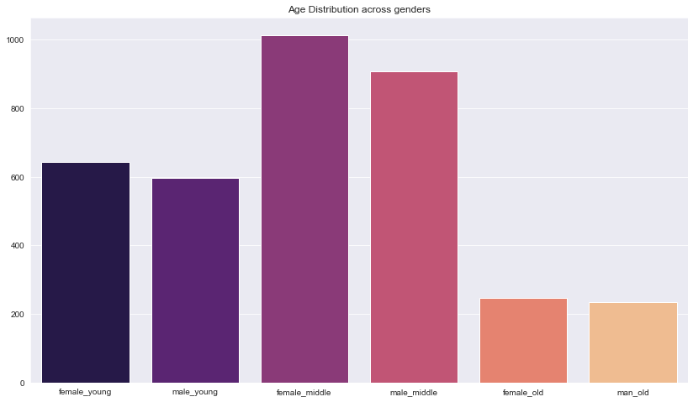
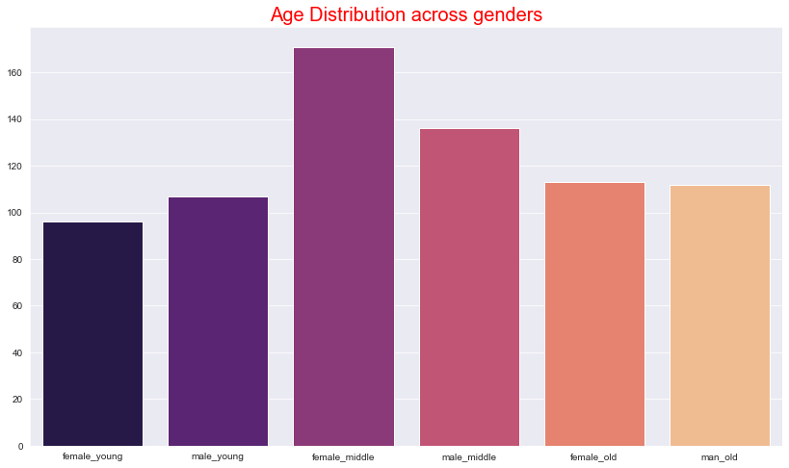
Data Exploration
Customers’ age distribution
As we can see, mostly our new customers are between 39 to 58 years old.
Number of customers from 58 to 89 years old has big drops on percentages.
There is a slightly increase in number of customers over 49 years old in term of percentages
It looks like the percentages of under 38 years old not really change.

Slide 5
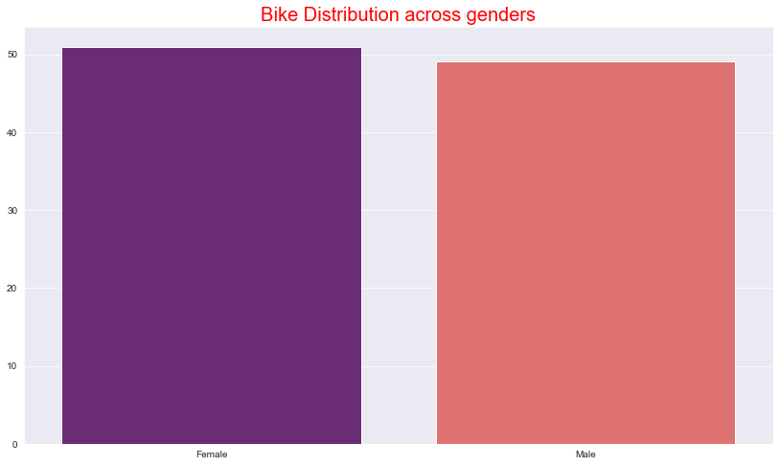
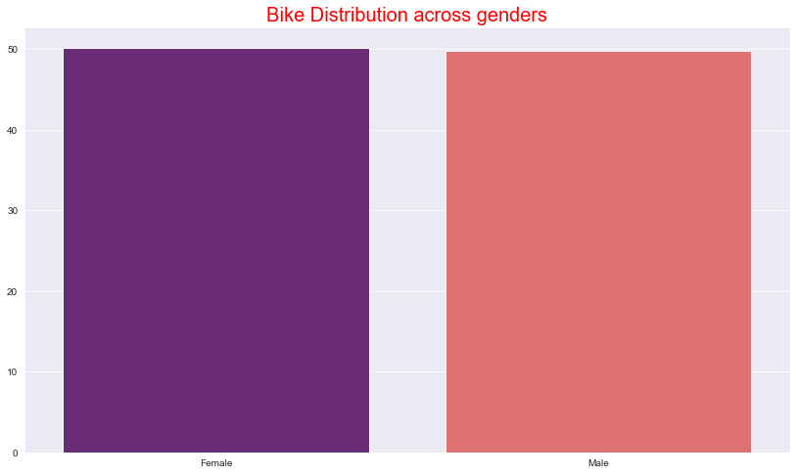
Model Development
Bike purchases last 3 years
As we can see, our new customers mostly Female with 50.19% purchases with total of 18,325 bikes
Male contributed to 49.80% purchases with 18,179 bikes
So we should focus on advertises on Female customers than Male customers

Slide 6
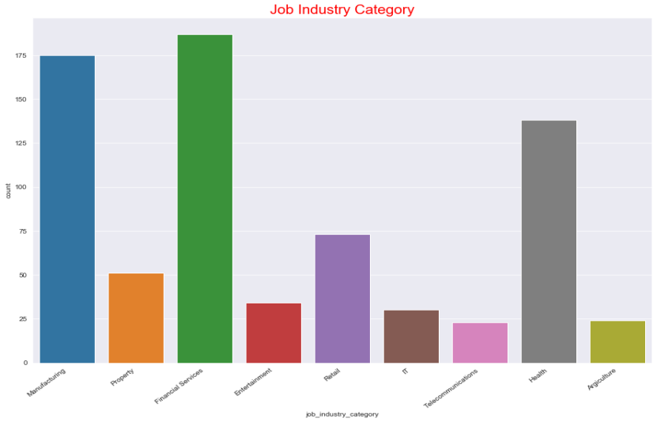
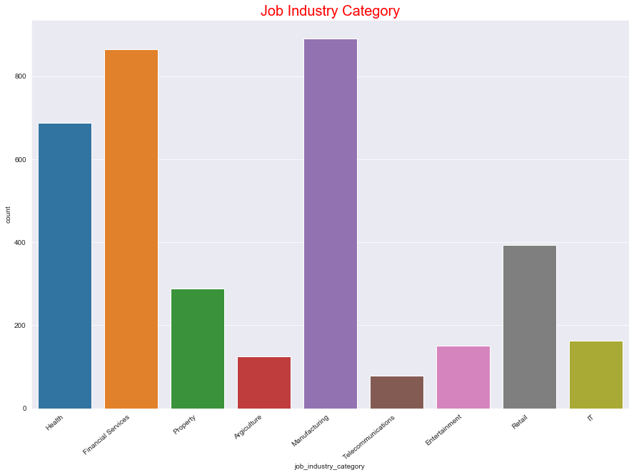
INTERPRETATION
Job industry category
Mostly our new customers are on Finance industry and our Manufacturing customers are still on top 2.
The rest industries is still same

Slide 7
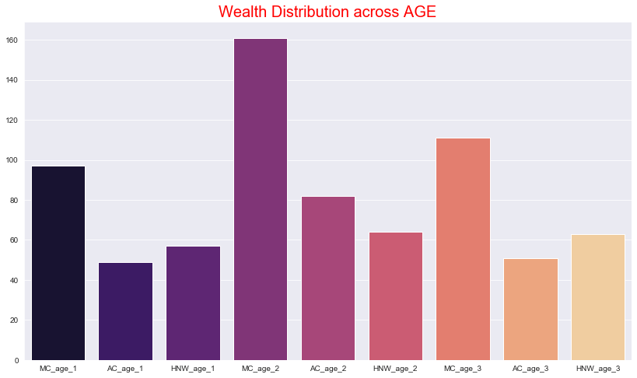
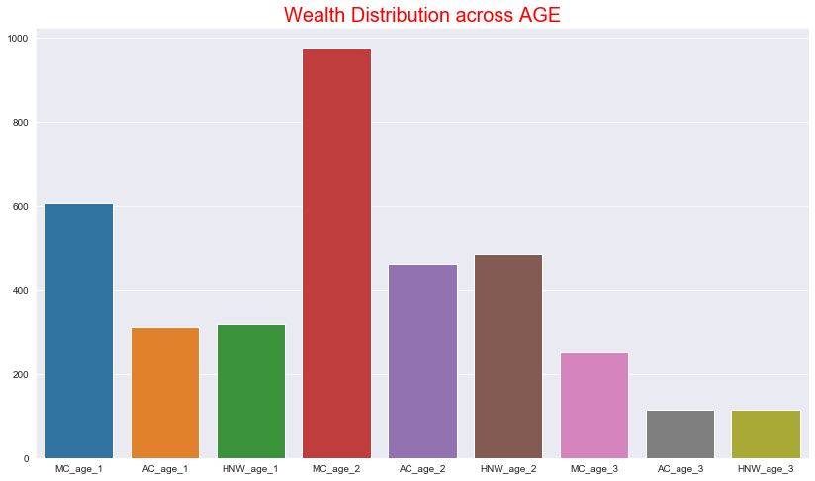
Interpretation
Wealth Segments
In all ages, the number of Mass Customers is the highest so we should focus on this social class.
After that, we should focus on High Net Customer.
Then Affluent Customers but mostly second and third quadrant

Slide 8
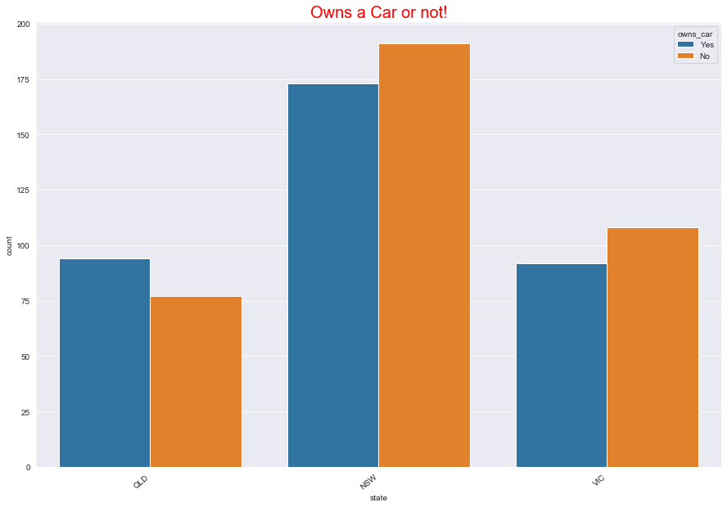
Interpretation
Numbers of cars owned
NSW should be considered the most since numbers of customers don’t own cars is significantly larger than that own.
VIC and QLD has more customers that own car that who don’t but we can try to have something so that those owns car will buy bikes.

Slide 9
THANK YOU

