Slide 1

ù
What is a Database ?
First of all, we need to know What is a Database?
A database is a system in which we can store our data , retrieve the data from it ,manipulate the data as well. Servers mainly maintain these systems in the database. Each application has its own database.
0

Slide 2
ù
What is
MYSQL?
What is a Database ?
MySQL is a Relational Database Management System (RDBMS) developed and operated by Oracle. It is currently one of the most widely used databases in the Big Data ecosystem.
Some features of this system make it especially attractive for companies and organizations, which has led to its widespread use nowadays.
MySQL uses the so-called client-server architecture, in which the data is stored on the server and one or more clients can query it.
MySQL differs from SQL in that it offers additional features, such as a graphical interface.

Slide 3

ù
Advantages of
MYSQL?
Open Source:
Any person or company can use, view and modify the source code free of charge.
High compatibility:
MySQL is compatible with all operating systems Unix-based (e.g. Mac OS) or Windows.
What is a Database ?
Relational databases:
MySQL stores only relational data. information that can be organized in tables with rows and columns.
Easy to use:
Relational data is widely used and easy to understand even for users with little experience.

Slide 4
ù
Client Server Architecture
What is a Database ?
When using MySQL, there are two components of the architecture, the client and the server. Clients are all the computers that have the RDBMS installed and access the database. The server, in turn, is the instance that has the actual data stored. There are several reasons why it makes sense to physically separate the server and client as well and not run both on the same computer:

Slide 5

ù
Client Server Architecture
Centralization: All data is stored centrally on one server and not distributed across different machines. If problems should arise, this one server can be focused on and different systems do not need to be investigated.
Scalability: The scaling of the server is done centrally by better equipping the computer on which the data is located, for example with more memory. These configurations can be carried out easily, since no new machines have to be integrated, which could then lead to network problems, for example.
Security aspects: Data access permissions can be implemented very easily, as only access to the data server needs to be restricted. This can be implemented, for example, by assigning users and corresponding passwords.

Slide 6
ù
What is
PostgreSQL ?
What is a Database ?
PostgreSQL is the open-source relational database software that runs on the Linux platform and functions with objects as a relational component in the database management system. It uses Structured Query Language (SQL) for accessing the data in the tables of the database, and hence it is also called Postgres.

Slide 7
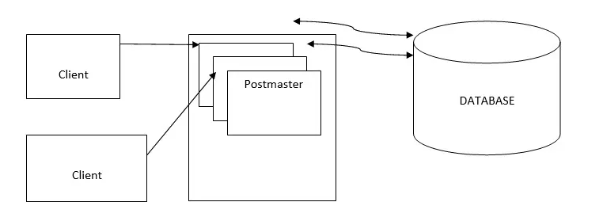
ù
Architecture of
PostgreSQL
What is a Database ?
In the following diagram, we see more than one client is requesting a database at the time. And the database is serving these clients efficiently. This helps PostgreSQL to maintain integrity.
The Architecture is based on Client-Server Model:

Slide 8
ù
What is
is the Use of PostgreSQL?
MVCC (Multiple version concurrency control)..
User-defined types.
What is a Database ?
View.
Sophisticated locking.
Foreign key referential integrity.
Subselects.

Slide 9
ù
Advantages and
Disadvantages
What is a Database ?
Advantages
Disadvantages
Easy to use.
Has a user-defined data type.
Open-source.
A lot of community support.
Make use of Stored procedures.
It supports Atomicity, Consistency, Isolation, Durability.
This also has a lack of skilled professionals.
When it comes to speed, it is not worthy as compared to other tools.
Making replication is more complex.
Installation is not easy for the beginner.

Slide 10
ù
What is
SQL Server ?
What is a Database ?
SQL Server is a relational database management system (RDBMS) developed by Microsoft. It is primarily designed and developed to compete with MySQL and Oracle database. SQL Server supports ANSI SQL, which is the standard SQL (Structured Query Language) language. However, SQL Server comes with its own implementation of the SQL language, T-SQL (Transact-SQL).
T-SQL is a Microsoft propriety Language known as Transact-SQL. It provides further capabilities of declaring variable, exception

Slide 11
ù
advantages of SQL
Server
The following are the advantages of SQL Server instances:
For installation of different versions on one machine
You can have different versions of SQL Server on a single machine. Each
installation works independently from the other installations.
2. For cost reduction
Instances can help us reduce the costs of operating SQL Server, especially in purchasing the SQL Server license. You can get different services from different instances, hence no need for purchasing one license for all services.
3. For maintenance of development, production and test environments separately
This is the main benefit of having many SQL Server instances on a single machine. You can use different instances for development, production and test purposes.
4. For reducing temporary database problems
When you have all services running on a single SQL Server instance, there are high chances of having problems with the problems, especially problems that keep on recurring. When such services are run on different instances, you can avoid having such problems.
What is a Database ?

Slide 12
MS SQL Server as Client-Server Architecture
A CLIENT is an application that sends requests to the MS SQL SERVER installed on a given machine. The SERVER is capable of processing input data as requested. Finally, respond with PROCESSED OUTPUT DATA as a result.

Slide 13
 | Microsoft SQL Server | MySQL | PostgreSQL
Description | Microsofts flagship relational DBMS | Widely used open source RDBMS | Widely used open source RDBMS
Primary Database mode | Document store Graph DBMS Spatial DBMS | Document store Spatial DBMS | Document store Spatial DBMS
Developer | Microsoft | Oracle | PostgreSQL Global Development Group
Consistency concepts | Immediate Consistency | Immediate Consistency | Immediate Consistency
Durability | yes | yes | yes
In-memory capabilities | yes | yes | no
User concepts | fine grained access rights according to SQL-standard | Users with fine-grained authorization concept | fine grained access rights according to SQL-standard

