Slide 1
Analysis of algorithms
Issues:
  correctness
  time efficiency
  space efficiency
  optimality
Approaches:
  empirical analysis – less useful
  theoretical analysis – most important
A. Levitin “Introduction to the Design & Analysis of Algorithms,” 3rd ed., Ch. 2 ©2012 Pearson Education, Inc. Upper Saddle River, NJ. All Rights Reserved.

Slide 2
Empirical analysis of time efficiency
Select a specific sample of inputs
Use physical unit of time (e.g., milliseconds) or
Count actual number of basic operation’s executions
Analyze the empirical data
Problems:
A. Levitin “Introduction to the Design & Analysis of Algorithms,” 3rd ed., Ch. 2 ©2012 Pearson Education, Inc. Upper Saddle River, NJ. All Rights Reserved.

Slide 3
Empirical analysis of time efficiency
Select a specific sample of inputs
Use physical unit of time (e.g., milliseconds) or
Count actual number of basic operation’s executions
Analyze the empirical data
Problem - Inefficient:
  Must implement algorithm
  Must run on many data sets to see effects of scaling
  Hard to see patterns in actual data
A. Levitin “Introduction to the Design & Analysis of Algorithms,” 3rd ed., Ch. 2 ©2012 Pearson Education, Inc. Upper Saddle River, NJ. All Rights Reserved.

Slide 4
Theoretical analysis of time efficiency
Time efficiency is analyzed by determining the number of repetitions of the basic operation as a function of input size
Basic operation: the operation that contributes most towards the running time of the algorithm
T(n) ≈ c_{op}C(n)
input size
running time
execution time
for basic operation
Number of times basic operation is executed
A. Levitin “Introduction to the Design & Analysis of Algorithms,” 3rd ed., Ch. 2 ©2012 Pearson Education, Inc. Upper Saddle River, NJ. All Rights Reserved.

Slide 5
Input size and basic operation examples
Problem | Input size measure | Basic operation
Searching for key in a list of n items | Number of list’s items, i.e. n | Key comparison
Multiplication of two matrices | Matrix dimensions or total number of elements | Multiplication of two numbers
Checking primality of a given integer n | n’size = number of digits (in binary representation) | Division
Typical graph problem | #vertices and/or edges | Visiting a vertex or traversing an edge
A. Levitin “Introduction to the Design & Analysis of Algorithms,” 3rd ed., Ch. 2 ©2012 Pearson Education, Inc. Upper Saddle River, NJ. All Rights Reserved.

Slide 6
Counting Operations
Consider counting steps in FindMax
Problems:
  Hard to analyze
  May not need precise information
    Precise details less relevant than order growth
    May not know times (or relative times) of steps
    Only gives results within constants (constants relevant later)
      aC(n) < T(n) < bC(n)
More interested in growth rates (ie Big O), but
Careful analysis can compare algs with same growth rate
  If needed
  Knuth examples
A. Levitin “Introduction to the Design & Analysis of Algorithms,” 3rd ed., Ch. 2 ©2012 Pearson Education, Inc. Upper Saddle River, NJ. All Rights Reserved.

Slide 7
Best-case, average-case, worst-case
For a given input size, how does algorithm perform
on different datasets of that size
For datasets of size n identify different datasets that give:
Worst case: C_{worst}(n) – maximum over all inputs of size n
Best case: C_{best}(n) – minimum over all inputs of size n
Average case: C_{avg}(n) – “average” over inputs of size n
  Typical input, NOT the average of worst and best case
  Aanalysis requires knowing distribution of all possible inputs of size n
  Can consider ALL POSSIBLE input sets of size n, average over all sets
Some algs are same for all three (eg all case performance)
A. Levitin “Introduction to the Design & Analysis of Algorithms,” 3rd ed., Ch. 2 ©2012 Pearson Education, Inc. Upper Saddle River, NJ. All Rights Reserved.

Slide 8
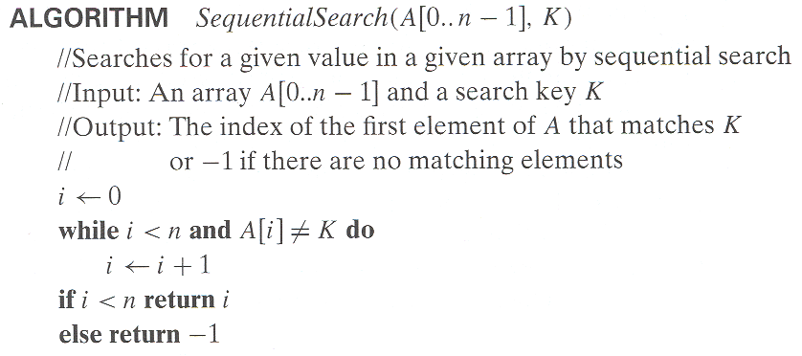
Example: Sequential search
Worst case
Best case
Average case: depends on assumputions about input: ?
A. Levitin “Introduction to the Design & Analysis of Algorithms,” 3rd ed., Ch. 2 ©2012 Pearson Education, Inc. Upper Saddle River, NJ. All Rights Reserved.

Slide 9
Example: Sequential search
Worst case
Best case
Average case: depends on assumputions about input: proportion of found vs not-found keys
A. Levitin “Introduction to the Design & Analysis of Algorithms,” 3rd ed., Ch. 2 ©2012 Pearson Education, Inc. Upper Saddle River, NJ. All Rights Reserved.

Slide 10
Example: Find maximum
Worst case:
Best case:
Average case:
All case:
A. Levitin “Introduction to the Design & Analysis of Algorithms,” 3rd ed., Ch. 2 ©2012 Pearson Education, Inc. Upper Saddle River, NJ. All Rights Reserved.

Slide 11
Critical factor for analysis: Growth rate
Most important: Order of growth as n→∞
  What is the growth rate of time as input size increases
  How does time increase as input size increases
A. Levitin “Introduction to the Design & Analysis of Algorithms,” 3rd ed., Ch. 2 ©2012 Pearson Education, Inc. Upper Saddle River, NJ. All Rights Reserved.
Notes:
Example: cn²
how much faster on twice as fast computer? (2)
how much longer for 2n? (4)

Slide 12
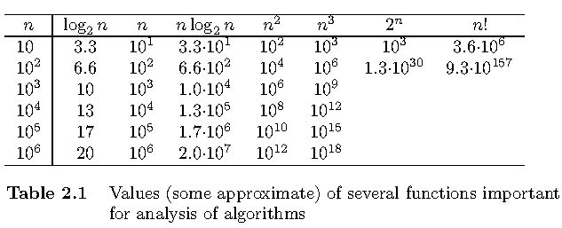
Growth rate: critical for performance performance
Focus: asymptotic order of growth:
Main concern: which function describes behavior.
Less concerned with constants
A. Levitin “Introduction to the Design & Analysis of Algorithms,” 3rd ed., Ch. 2 ©2012 Pearson Education, Inc. Upper Saddle River, NJ. All Rights Reserved.

Slide 13
Asymptotic order of growth
Critical factor for problem size n:
- IS NOT the exact number of basic ops executed for given n
- IS how number of basic ops GROWS as n increases
- Constant factors and constants do not change growth RATE
- Rate most relevant for large input sizes, so ignore small sizes
- Informally: 5n^2 and 100n^2 +1000 are both n^2
- Define formally later
Call this: Asymptotic Order of Growth
A. Levitin “Introduction to the Design & Analysis of Algorithms,” 3rd ed., Ch. 2 ©2012 Pearson Education, Inc. Upper Saddle River, NJ. All Rights Reserved.

Slide 14
Basic asymptotic efficiency classes
1 | constant | Best case
log n | logarithmic | Divide Ignore part
n | linear | Examine each Online/Stream Algs
n log n | n-log-n or linearithmic | Divide Use all parts
n² | quadratic | Nested loops
n³ n^{k} | cubic | Nested loops Examine all k-tuples
2^{n} | exponential | All subsets
n! | factorial | All permutations
A. Levitin “Introduction to the Design & Analysis of Algorithms,” 3rd ed., Ch. 2 ©2012 Pearson Education, Inc. Upper Saddle River, NJ. All Rights Reserved.

Slide 15
Order of growth: Sets of functions
Approach: Group functions based on their growth rates
Example: Θ(n^2) is set of functions whose growth rate is n^2
(ie group all functions with n^2 growth rate)
These are all in Θ(n^2):
f(n) = 100n^2 + 1000
f(n) = n^2 + 1
f(n) = 0.001n^2 + 1000000
They are also Θ(10n^2), but we rarely say that
A. Levitin “Introduction to the Design & Analysis of Algorithms,” 3rd ed., Ch. 2 ©2012 Pearson Education, Inc. Upper Saddle River, NJ. All Rights Reserved.

Slide 16
Order of growth: Upper, tight, lower bounds
More formally:
- Θ(g(n)): class of functions f(n) that grow at same rate as g(n)
Upper, tight, and lower bounds on performance:
O(g(n)): class of functions f(n) that grow no faster than g(n)
  [ie f ’s speed is same as or faster than g, f bounded above by g]
Θ(g(n)): class of functions f(n) that grow at same rate as g(n)
Ω(g(n)): class of functions f(n) that grow at least as fast as g(n)
  [ie f ’s speed is same as or slower than g, f bounded below by g]
A. Levitin “Introduction to the Design & Analysis of Algorithms,” 3rd ed., Ch. 2 ©2012 Pearson Education, Inc. Upper Saddle River, NJ. All Rights Reserved.

Slide 17
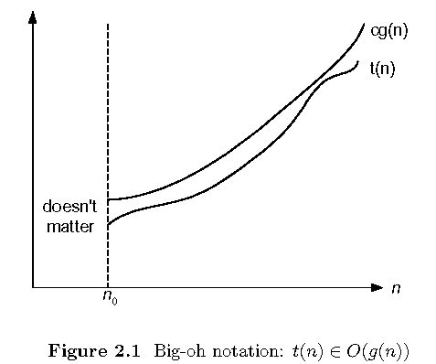
t(n) ∈ O(g(n)) iff t(n) <=cg(n) for n > n₀
t(n) = 10n³ in O(n³) and in O(n⁵). What c and n0? More later.
A. Levitin “Introduction to the Design & Analysis of Algorithms,” 3rd ed., Ch. 2 ©2012 Pearson Education, Inc. Upper Saddle River, NJ. All Rights Reserved.

Slide 18
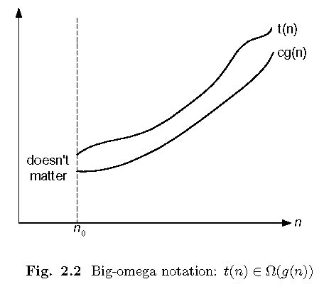
t(n) ∈ Ω(g(n)) iff t(n) >=cg(n) for n > n₀
t(n) = 10n³ in Ω(n²) and in Ω(n³)
A. Levitin “Introduction to the Design & Analysis of Algorithms,” 3rd ed., Ch. 2 ©2012 Pearson Education, Inc. Upper Saddle River, NJ. All Rights Reserved.

Slide 19
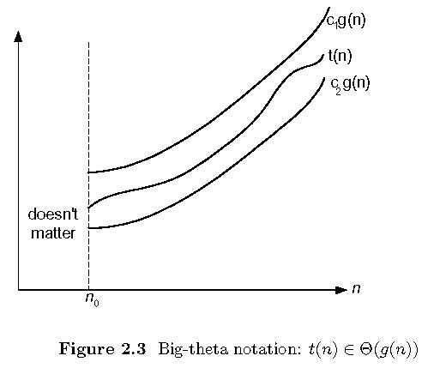
t(n)∈ Θ(g(n)) iff t(n)∈O(g(n)) and ∈Ω(g(n))
t(n) = 10n³ in Θ(n³) but NOT in Θ(n²) or Θ(n⁴)
A. Levitin “Introduction to the Design & Analysis of Algorithms,” 3rd ed., Ch. 2 ©2012 Pearson Education, Inc. Upper Saddle River, NJ. All Rights Reserved.

Slide 20
Terminology
Informally: f(n) is O(g) means f(n) ∈ O(g)
Example: 10n is O(n²)
Informally: f(n) = O(g) means f(n) ∈ O(g)
Example: 10n = O(n²)
Use similar terms for Big Omega and Big Theta
A. Levitin “Introduction to the Design & Analysis of Algorithms,” 3rd ed., Ch. 2 ©2012 Pearson Education, Inc. Upper Saddle River, NJ. All Rights Reserved.
Notes:
Examples:
10n is O(n²)
since 10n ≤ 10n² for n ≥ 1 or 10n ≤ n² for n ≥ 10
c n₀
5n+20 is O(10n)
since 5n+20 ≤ 10 n for n ≥ 4
c n₀

Slide 21
Big O, Ω, Θ : Informal Definitions
f(n) is in O(g(n)) if order of growth of f(n) ≤ order of growth of g(n) (within constant multiple and for large n).
f(n) is in Ω(g(n)) if order of growth of f(n) ≥ order of growth of g(n) (within constant multiple and for large n).
f(n) is in Θ(g(n)) if order of growth of f(n) = order of growth of g(n) (within constant multiples and for large n).
A. Levitin “Introduction to the Design & Analysis of Algorithms,” 3rd ed., Ch. 2 ©2012 Pearson Education, Inc. Upper Saddle River, NJ. All Rights Reserved.
Notes:
Examples:
10n is O(n²)
since 10n ≤ 10n² for n ≥ 1 or 10n ≤ n² for n ≥ 10
c n₀
5n+20 is O(10n)
since 5n+20 ≤ 10 n for n ≥ 4
c n₀

Slide 22
Big O, Ω, Θ : Formal Definitions
f(n) ∈ O(g(n)) iff there exist positive constant c and non-negative integer n₀ such that
f(n) ≤ c g(n) for every n ≥ n₀
f(n) ∈ Ω(g(n)) iff there exist positive constant c and non-negative integer n₀ such that
f(n) ≥ c g(n) for every n ≥ n₀
f(n) ∈ Θ(g(n)) iff there exist positive constants c₁ and c₂ and non-negative integer n₀ such that
c₁ g(n) ≤ f(n) ≤ c₂ g(n) for every n ≥ n₀
A. Levitin “Introduction to the Design & Analysis of Algorithms,” 3rd ed., Ch. 2 ©2012 Pearson Education, Inc. Upper Saddle River, NJ. All Rights Reserved.
Notes:
Examples:
10n is O(n²)
since 10n ≤ 10n² for n ≥ 1 or 10n ≤ n² for n ≥ 10
c n₀
5n+20 is O(10n)
since 5n+20 ≤ 10 n for n ≥ 4
c n₀

Slide 23
Big O, Ω, Θ: Why Constant c
What is gained by the constant c:
f(n) ≤ c g(n) for every n ≥ n₀
What do you think?
A. Levitin “Introduction to the Design & Analysis of Algorithms,” 3rd ed., Ch. 2 ©2012 Pearson Education, Inc. Upper Saddle River, NJ. All Rights Reserved.
Notes:
Examples:
10n is O(n²)
since 10n ≤ 10n² for n ≥ 1 or 10n ≤ n² for n ≥ 10
c n₀
5n+20 is O(10n)
since 5n+20 ≤ 10 n for n ≥ 4
c n₀

Slide 24
Big O, Ω, Θ: Why Constant c
What is gained by the constant c:
f(n) ≤ c g(n) for every n ≥ n₀
What do you think?
Allows c g(n) to exceed f(n)
Allows us to ignore leading constants in f(n)
For example, 0.1n^2, n^2, and 10n^2
All have same growth rate: n^2
Meaning what: as input size doubles, time is 4x increase
A. Levitin “Introduction to the Design & Analysis of Algorithms,” 3rd ed., Ch. 2 ©2012 Pearson Education, Inc. Upper Saddle River, NJ. All Rights Reserved.
Notes:
Examples:
10n is O(n²)
since 10n ≤ 10n² for n ≥ 1 or 10n ≤ n² for n ≥ 10
c n₀
5n+20 is O(10n)
since 5n+20 ≤ 10 n for n ≥ 4
c n₀

Slide 25
Using the Definition: Big O
Informal Definition: f(n) is in O(g(n)) if order of growth of f(n) ≤ order of growth of g(n) (within constant multiple),
Definition: f(n) ∈ O(g(n)) iff there exist positive constant c and non-negative integer n₀ such that
f(n) ≤ c g(n) for every n ≥ n₀
Examples:
10n is O(n²)
  [Can choose c and n₀. Solve for 2 different c’s]
5n + 20 is O(n) [Solve for c and n₀]
A. Levitin “Introduction to the Design & Analysis of Algorithms,” 3rd ed., Ch. 2 ©2012 Pearson Education, Inc. Upper Saddle River, NJ. All Rights Reserved.
Notes:
Examples:
10n is O(n²)
since 10n ≤ 10n² for n ≥ 1 or 10n ≤ n² for n ≥ 10
c n₀
5n+20 is O(10n)
since 5n+20 ≤ 10 n for n ≥ 4
c n₀

Slide 26
Using the Definition: Big Omega
Informal Definition: f(n) is in Ω (g(n)) iff order of growth of f(n) ≥ order of growth of g(n) (within constant multiple),
Definition: f(n) ∈ Ω(g(n)) iff there exist positive constant c and non-negative integer n₀ such that
f(n) ≥ c g(n) for every n ≥ n₀
Examples:
10n² is Ω(n)
5n + 20 is Ω(n)
A. Levitin “Introduction to the Design & Analysis of Algorithms,” 3rd ed., Ch. 2 ©2012 Pearson Education, Inc. Upper Saddle River, NJ. All Rights Reserved.
Notes:
Examples:
10n is O(n²)
since 10n ≤ 10n² for n ≥ 1 or 10n ≤ n² for n ≥ 10
c n₀
5n+20 is O(10n)
since 5n+20 ≤ 10 n for n ≥ 4
c n₀

Slide 27
Using the Definition: Theta
Informal Definition: f(n) is in Θ(g(n)) if order of growth of f(n) = order of growth of g(n) (within constant multiple),
Definition: f(n) ∈ Θ(g(n)) iff there exist positive constants c₁ and c₂ and non-negative integer n₀ such that
c₁ g(n) ≤ f(n) ≤ c₂ g(n) for every n ≥ n₀
Examples:
10n² is Θ(n²)
5n + 20 is Θ(n)
A. Levitin “Introduction to the Design & Analysis of Algorithms,” 3rd ed., Ch. 2 ©2012 Pearson Education, Inc. Upper Saddle River, NJ. All Rights Reserved.
Notes:
Examples:
10n is O(n²)
since 10n ≤ 10n² for n ≥ 1 or 10n ≤ n² for n ≥ 10
c n₀
5n+20 is O(10n)
since 5n+20 ≤ 10 n for n ≥ 4
c n₀

Slide 28
Some properties of asymptotic order of growth
f(n) ∈ O(f(n))
f(n) ∈ O(g(n)) iff g(n) ∈Ω(f(n))
If f (n) ∈ O(g (n)) and g(n) ∈ O(h(n)) , then f(n) ∈ O(h(n))
Note similarity with a ≤ b
If f₁(n) ∈ O(g₁(n)) and f₂(n) ∈ O(g₂(n)) , then
f₁(n) + f₂(n) ∈ O(max{g₁(n), g₂(n)})
O(g₁(n) + g₂(n))?
A. Levitin “Introduction to the Design & Analysis of Algorithms,” 3rd ed., Ch. 2 ©2012 Pearson Education, Inc. Upper Saddle River, NJ. All Rights Reserved.

Slide 29
Establishing order of growth using limits
0 order of growth of T(n) < order of growth of g(n)
lim T(n)/g(n) =
c > 0 order of growth of T(n) = order of growth of g(n)
n→∞
∞ order of growth of T(n) > order of growth of g(n)
Examples:
10n vs. n²
n(n+1)/2 vs. n²
A. Levitin “Introduction to the Design & Analysis of Algorithms,” 3rd ed., Ch. 2 ©2012 Pearson Education, Inc. Upper Saddle River, NJ. All Rights Reserved.

Slide 30
Big O, Little o. Big and little Omega
0 order of growth of T(n) < order of growth of g(n)
lim T(n)/g(n) =
c > 0 order of growth of T(n) = order of growth of g(n)
n→∞
∞ order of growth of T(n) > order of growth of g(n)
Examples:
10n vs. n²
10n is O(n^2) and o(n^2)
10n is O(n) but not o(n)
Big O: upper bound or the same
Little o: upper bound and not the same
A. Levitin “Introduction to the Design & Analysis of Algorithms,” 3rd ed., Ch. 2 ©2012 Pearson Education, Inc. Upper Saddle River, NJ. All Rights Reserved.

Slide 31
L’Hôpital’s rule and Stirling’s formula
L’Hôpital’s rule: If lim_{n→∞} f(n) = lim_{n→∞} g(n) = ∞ and
the derivatives f´, g´ exist, then
Stirling’s formula: n! ≈ (2πn)^{1/2} (n/e)^{n}
f(n)
g(n)
f ´(n)
g ´(n)
lim
n→∞
=
lim
n→∞
Example: log n vs. n
Example: 2^{n} vs. n!
A. Levitin “Introduction to the Design & Analysis of Algorithms,” 3rd ed., Ch. 2 ©2012 Pearson Education, Inc. Upper Saddle River, NJ. All Rights Reserved.

Slide 32
Orders of growth of some important functions
All polynomials of the same degree k belong to the same class: a_{k}n^{k} + a_{k-1}n^{k-1} + … + a₀ ∈ Θ(n^{k}) [Why?]
All logarithmic functions log_{a} n belong to the same class
Θ(log n) no matter what the logarithm’s base a > 1 is [Why?]
Exponential functions a^{n} have different orders of growth for different a’s
  Frequently just say Exponential time, ignoring exponent
order log n < order n^{α} (α>0) < order a^{n} < order n! < order n
  Order n log n ?
A. Levitin “Introduction to the Design & Analysis of Algorithms,” 3rd ed., Ch. 2 ©2012 Pearson Education, Inc. Upper Saddle River, NJ. All Rights Reserved.

Slide 33
Basic asymptotic efficiency classes
1 | constant | Best case
log n | logarithmic | Divide Ignore part
n | linear | Examine each Online/Stream Algs
n log n | n-log-n or linearithmic | Divide Use all parts
n² | quadratic | Nested loops
n³ n^{k} | cubic | Nested loops Examine all k-tuples
2^{n} | exponential | All subsets
n! | factorial | All permutations
A. Levitin “Introduction to the Design & Analysis of Algorithms,” 3rd ed., Ch. 2 ©2012 Pearson Education, Inc. Upper Saddle River, NJ. All Rights Reserved.

Slide 34
Polynomial=Efficient. Exponential=Not Efficient
In general, we say that
  Functions with polynomial growth are efficient
  Functions with exponential growth are NOT efficient
But, what about n^100 vs 2^{0.2 log n}
  Yes, exponential is faster for all reasonable n
  But, such algorithms don’t happen in practice
In practice, polynomials are faster than exponential
A. Levitin “Introduction to the Design & Analysis of Algorithms,” 3rd ed., Ch. 2 ©2012 Pearson Education, Inc. Upper Saddle River, NJ. All Rights Reserved.

Slide 35
Time efficiency of nonrecursive algorithms
General Plan for Analysis
Decide on parameter n indicating input size
Identify algorithm’s basic operation
Determine worst, average, and best cases for input of size n
Set up a sum for the number of times the basic operation is executed
Simplify the sum using standard formulas and rules (see Appendix A)
A. Levitin “Introduction to the Design & Analysis of Algorithms,” 3rd ed., Ch. 2 ©2012 Pearson Education, Inc. Upper Saddle River, NJ. All Rights Reserved.

Slide 36
Useful summation formulas and rules
Σ_{l≤i≤u}1 = 1+1+ ⋯ +1 = u - l + 1
In particular, Σ_{l≤i≤u}1 = n - 1 + 1 = n ∈ Θ(n)
Σ_{1≤i≤n} i = 1+2+ ⋯ +n = n(n+1)/2 ≈ n²/2 ∈ Θ(n²)
Σ_{1≤i≤n} i² = 1²+2²+ ⋯ +n² = n(n+1)(2n+1)/6 ≈ n³/3 ∈ Θ(n³)
Σ_{0≤i≤n} a^{i} = 1 + a + ⋯ + a^{n} = (a^{n+1} - 1)/(a - 1) for any a ≠ 1
In particular, Σ_{0≤i≤n} 2^{i} = 2⁰ + 2¹ + ⋯ + 2^{n} = 2^{n+1} - 1 ∈ Θ(2^{n} )
Σ(a_{i} ± b_{i} ) = Σa_{i} ± Σb_{i} Σca_{i} = cΣa_{i} Σ_{l≤i≤u}a_{i} = Σ_{l≤i≤m}a_{i} + Σ_{m+1≤i≤u}a_{i}
A. Levitin “Introduction to the Design & Analysis of Algorithms,” 3rd ed., Ch. 2 ©2012 Pearson Education, Inc. Upper Saddle River, NJ. All Rights Reserved.

Slide 37
Example: Sequential search
Worst case: Omega, Theta, O?
Best case: Omega, Theta, O?
Average case: Omega, Theta, O?
A. Levitin “Introduction to the Design & Analysis of Algorithms,” 3rd ed., Ch. 2 ©2012 Pearson Education, Inc. Upper Saddle River, NJ. All Rights Reserved.

Slide 38
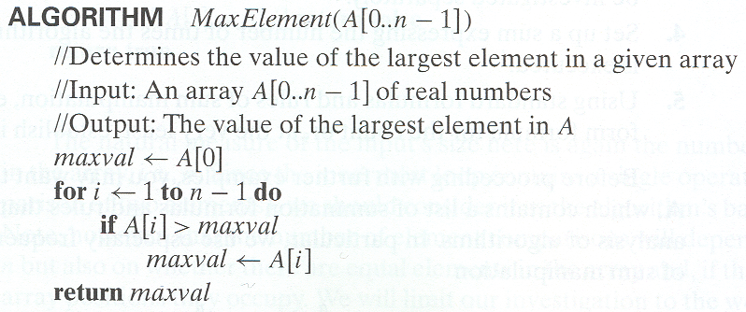
Example 1: Maximum element
A. Levitin “Introduction to the Design & Analysis of Algorithms,” 3rd ed., Ch. 2 ©2012 Pearson Education, Inc. Upper Saddle River, NJ. All Rights Reserved.

Slide 39
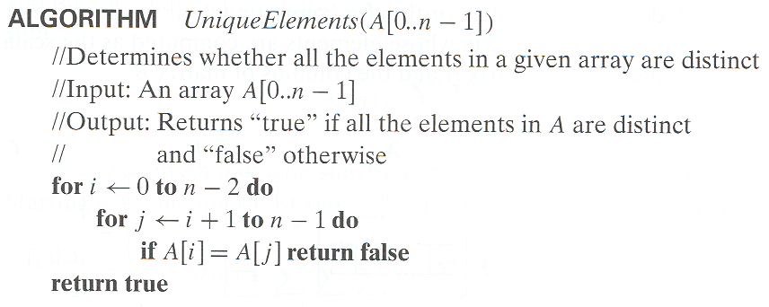
Example 2: Element uniqueness problem
A. Levitin “Introduction to the Design & Analysis of Algorithms,” 3rd ed., Ch. 2 ©2012 Pearson Education, Inc. Upper Saddle River, NJ. All Rights Reserved.

Slide 40
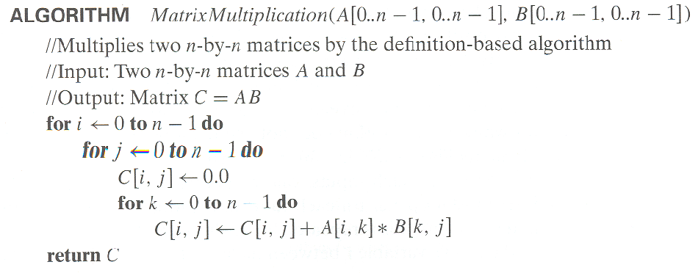
Example 3: Matrix multiplication
A. Levitin “Introduction to the Design & Analysis of Algorithms,” 3rd ed., Ch. 2 ©2012 Pearson Education, Inc. Upper Saddle River, NJ. All Rights Reserved.

Slide 41
Example 4: Gaussian elimination
Algorithm GaussianElimination(A[0..n-1,0..n])
//Implements Gaussian elimination of an n-by-(n+1) matrix A
for i ← 0 to n - 2 do
for j ← i + 1 to n - 1 do
for k ← i to n do
A[j,k] ← A[j,k] - A[i,k] ∗ A[j,i] / A[i,i]
Find the efficiency class and a constant factor improvement.
A. Levitin “Introduction to the Design & Analysis of Algorithms,” 3rd ed., Ch. 2 ©2012 Pearson Education, Inc. Upper Saddle River, NJ. All Rights Reserved.

Slide 42
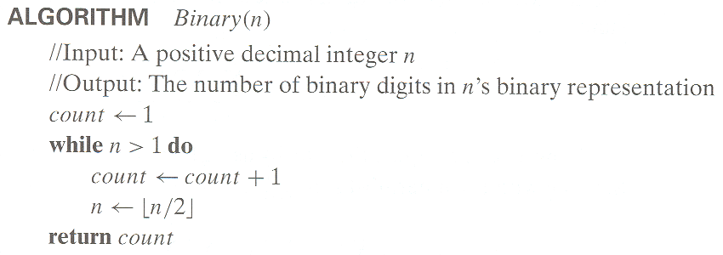
Example 5: Counting binary digits
?
A. Levitin “Introduction to the Design & Analysis of Algorithms,” 3rd ed., Ch. 2 ©2012 Pearson Education, Inc. Upper Saddle River, NJ. All Rights Reserved.

Slide 43
Plan for Analysis of Recursive Algorithms
Decide on a parameter indicating an input’s size.
Identify the algorithm’s basic operation.
Check whether the number of times the basic op. is executed may vary on different inputs of the same size. (If it may, the worst, average, and best cases must be investigated separately.)
Set up a recurrence relation with an appropriate initial condition expressing the number of times the basic op. is executed.
Solve the recurrence (ie find a closed form or, at the very least, establish its solution’s order of growth) by backward substitutions or another method.
A. Levitin “Introduction to the Design & Analysis of Algorithms,” 3rd ed., Ch. 2 ©2012 Pearson Education, Inc. Upper Saddle River, NJ. All Rights Reserved.

Slide 44
Recurrences
Terminology (used interchangably):
- Recurrence
- Recurrence Relation
- Recurrence Equation
Express T(n) in terms of T(smaller n)
- Example: M(n) = M(n-1) + 1, M(0) = 0
Solve: find a closed form:
- ie T(n) in terms of n, alone (ie not T)
Learn: 1. how to describe an alg w/ a recurrence
2. how to solve a recurrence (ie find a closed form)
A. Levitin “Introduction to the Design & Analysis of Algorithms,” 3rd ed., Ch. 2 ©2012 Pearson Education, Inc. Upper Saddle River, NJ. All Rights Reserved.

Slide 45
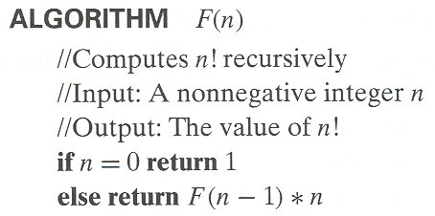
Example 1: Recursive evaluation of n!
Definition: n ! = 1 ⋅ 2 ⋅ … ⋅ (n-1) ⋅ n for n ≥ 1 and 0! = 1
Recursive definition of n!: F(n) = F(n-1) ⋅ n for n ≥ 1 and
F(0) = 1
Size:
Basic operation:
Recurrence relation:
A. Levitin “Introduction to the Design & Analysis of Algorithms,” 3rd ed., Ch. 2 ©2012 Pearson Education, Inc. Upper Saddle River, NJ. All Rights Reserved.
Notes:
Note the difference between the two recurrences. Students often confuse these!
F(n) = F(n-1) n
F(0) = 1
for the values of n!
------------
M(n) =M(n-1) + 1
M(0) = 0
for the number of multiplications made by this algorithm

Slide 46
Solving the recurrence for M(n)
Recurrence: M(n) = M(n-1) + 1,
Initial Condition: M(0) = 0
Solution Methods:
- Guess?
- Forward Substitution?
- Backward Substitution?
- General Methods?
Guess closed form: ?
How to check a possible solution?
A. Levitin “Introduction to the Design & Analysis of Algorithms,” 3rd ed., Ch. 2 ©2012 Pearson Education, Inc. Upper Saddle River, NJ. All Rights Reserved.

Slide 47
Check a possible solution with Substitution
Recurrence: M(n) = M(n-1) + 1
Initial Condition: M(0) = 0
Possible solution: M(n) = n. Substitute:
n=0: M(0) = n = 0
n = k > 0: M(k) = M(k-1) + 1
k = (k-1) + 1
= k (Correct)
Or: M(k) = M(k-1) + 1 = (k-1) + 1 = k. (Correct)
N.B. This is actually a hand-wavy proof by induction
A. Levitin “Introduction to the Design & Analysis of Algorithms,” 3rd ed., Ch. 2 ©2012 Pearson Education, Inc. Upper Saddle River, NJ. All Rights Reserved.

Slide 48
Recurrences, Initial Conditions, Solutions
M(n) = M(n-1) + 1, M(0) = 1
M(n) = ??
A Recurrence has an infinite number of solutions
- Initial conditions eliminate all but 1
(Anyone know what other kind of equation is similar?)
(Sort of similar to y = x + 1, then add x=3)
A. Levitin “Introduction to the Design & Analysis of Algorithms,” 3rd ed., Ch. 2 ©2012 Pearson Education, Inc. Upper Saddle River, NJ. All Rights Reserved.

Slide 49
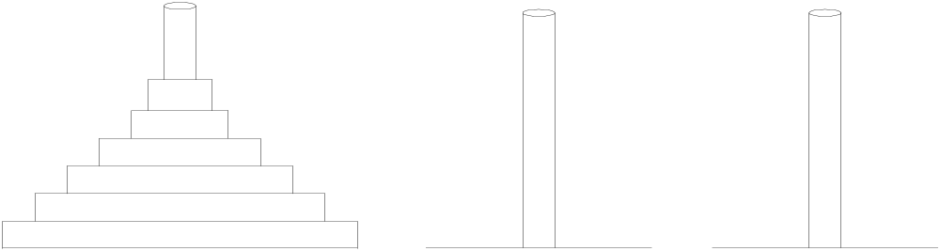
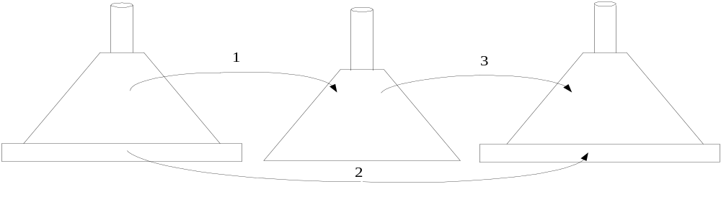
Example 2: The Tower of Hanoi Puzzle
Recurrence for number of moves:
A. Levitin “Introduction to the Design & Analysis of Algorithms,” 3rd ed., Ch. 2 ©2012 Pearson Education, Inc. Upper Saddle River, NJ. All Rights Reserved.

Slide 50
Solving recurrence for number of moves
M(n) = 2M(n-1) + 1, M(1) = 1
Guess closed form?
(What happens to number of moves when …)
A. Levitin “Introduction to the Design & Analysis of Algorithms,” 3rd ed., Ch. 2 ©2012 Pearson Education, Inc. Upper Saddle River, NJ. All Rights Reserved.

Slide 51
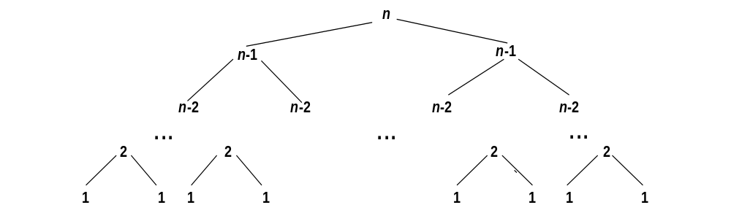
Tree of calls for the Tower of Hanoi Puzzle
M(n) = 2M(n-1) + 1, M(1) = 1
What happens when we add another disk?
Another level of the tree?
What proportion of the nodes are leaves?
A. Levitin “Introduction to the Design & Analysis of Algorithms,” 3rd ed., Ch. 2 ©2012 Pearson Education, Inc. Upper Saddle River, NJ. All Rights Reserved.

Slide 52
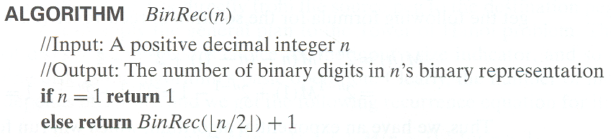
Example 3: Counting #bits
M(n) = M(?) ?,
M(?) = ?
Guess closed form?
A. Levitin “Introduction to the Design & Analysis of Algorithms,” 3rd ed., Ch. 2 ©2012 Pearson Education, Inc. Upper Saddle River, NJ. All Rights Reserved.

Slide 53
General Methods
Forward and Backward Substitution problems:
solution must be proved
solution may be difficult to find
General Methods:
Apply to certain classes of recurrences
Solution always possible within the class
Two Common General Methods:
1. Master Method
2. Create and solve Characteristic Equation
A. Levitin “Introduction to the Design & Analysis of Algorithms,” 3rd ed., Ch. 2 ©2012 Pearson Education, Inc. Upper Saddle River, NJ. All Rights Reserved.

Slide 54
Fibonacci numbers
The Fibonacci numbers: 0, 1, 1, 2, 3, 5, 8, 13, 21, …
The Fibonacci recurrence:
  F(n) = F(n-1) + F(n-2)
  F(0) = 0
  F(1) = 1
General 2nd order linear homogeneous recurrence with
constant coefficients:
  aX(n) + bX(n-1) + cX(n-2) = 0
  Key idea: Assume X(n) = r^{n} for some value r.
  Steps: Change recurrence to equation. Solve for r.
A. Levitin “Introduction to the Design & Analysis of Algorithms,” 3rd ed., Ch. 2 ©2012 Pearson Education, Inc. Upper Saddle River, NJ. All Rights Reserved.

Slide 55
Solving aX(n) + bX(n-1) + cX(n-2) = 0
Set up the characteristic equation (quadratic)
ar² + br + c = 0
Solve to obtain roots r₁ and r₂
General solution to the recurrence
  if r₁ and r₂ are two distinct real roots: X(n) = αr₁^{n} + βr₂^{n}
  if r₁ = r₂ = r are two equal real roots: X(n) = αr^{n} + βnr ^{n}
Particular solution can be found by using initial conditions
A. Levitin “Introduction to the Design & Analysis of Algorithms,” 3rd ed., Ch. 2 ©2012 Pearson Education, Inc. Upper Saddle River, NJ. All Rights Reserved.

Slide 56
Application to the Fibonacci numbers
F(n) = F(n-1) + F(n-2) or F(n) - F(n-1) - F(n-2) = 0
Characteristic equation:
Roots of the characteristic equation:
General solution to the recurrence:
Particular solution for F(0) =0, F(1)=1:
A. Levitin “Introduction to the Design & Analysis of Algorithms,” 3rd ed., Ch. 2 ©2012 Pearson Education, Inc. Upper Saddle River, NJ. All Rights Reserved.

Slide 57
Computing Fibonacci numbers
Definition-based recursive algorithm
Nonrecursive definition-based algorithm
Explicit formula algorithm
Logarithmic algorithm based on formula:
n
F(n-1) F(n)
0 1
=
F(n) F(n+1)
1 1
for n≥1, assuming an efficient way of computing matrix powers.
A. Levitin “Introduction to the Design & Analysis of Algorithms,” 3rd ed., Ch. 2 ©2012 Pearson Education, Inc. Upper Saddle River, NJ. All Rights Reserved.

